Slide 1
The Data Link Layer
Chapter 3

Slide 2
Data Link Layer
Algorithms for achieving:
Reliable data transfer
Efficient communication of a whole units – frames (as opposed to bits – Physical Layer) between two machines.
Two machines are connected by a communication channel that acts conceptually like a wire (e.g., telephone line, coaxial cable) or wireless channel.
Essential property of a channel that makes it “wire-like” connection is that the bits are delivered in exactly the same order in which they are sent.
For ideal channel (no distortion, unlimited bandwidth and no delay) the job of data link layer would be trivial.
However, limited bandwidth, distortions and delay makes this job very difficult.

Slide 3
Data Link Layer Design Issues
Physical layer delivers bits of information to and from data link layer. The functions of Data Link Layer are:
Providing a well-defined service interface to the network layer.
Dealing with transmission errors.
Regulating the flow of data so that slow receivers are not swamped by fast senders.
Data Link layer
Takes the packets from Physical layer, and
Encapsulates them into frames .
Each frame has a
frame header
Payload- a field for holding the packet.
frame trailer.
Frame Management is what Data Link Layer does.

Slide 4
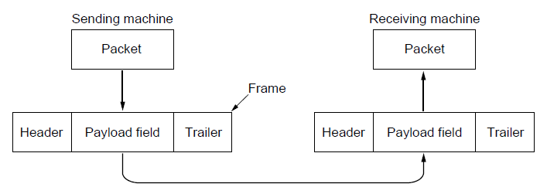
Packets and Frames
Relationship between packets and frames.

Slide 5
Data Link Layer Design Issues
Network layer services
Framing
Error control
Flow control

Slide 6
Services Provided to the Network Layer
Principal Service Function of the data link layer is to transfer the data from the network layer on the source machine to the network layer on the destination machine.
Process in the network layer that hands some bits to the data link layer for transmission.
Job of data link layer is to transmit the bits to the destination machine so they can be handed over to the network layer there (see figure in the next slide).
The data link layer can be designed to offer various services.
Three reasonable possibilities that we will consider in turn are:
1. Unacknowledged connectionless service.
2. Acknowledged connectionless service.
3. Acknowledged connection-oriented service.

Slide 7
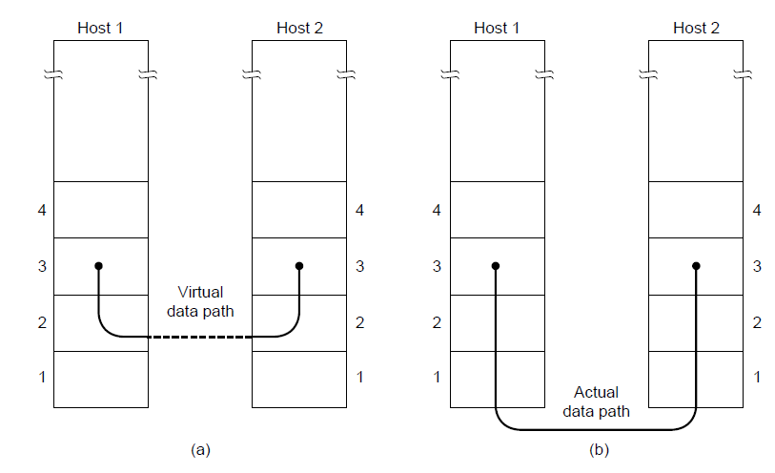
Network Layer Services
(a) Virtual communication. (b) Actual communication.

Slide 8
Unacknowledged Connectionless Service
It consists of having the source machine send independent frames to the destination machine without having the destination machine acknowledge them.
Example: Ethernet, Voice over IP, etc. in all the communication channel were real time operation is more important that quality of transmission.
No logical connection is established beforehand or released afterward.
If a frame is lost due to noise on the line, no attempt is made to detect the loss or recover from it in the data link layer.
This class of service is appropriate when the error rate is very low, so recovery is left to higher layers.

Slide 9
Acknowledged Connectionless Service
There are still no logical connections used..
Each frame send by the Data Link layer is acknowledged and the sender knows if a specific frame has been received or lost.
Typically the protocol uses a specific time period that if has passed without getting acknowledgment it will re-send the frame.
This service is useful for commutation when an unreliable channel is being utilized (e.g., 802.11 WiFi).
Network layer does not know frame size of the packets and other restriction of the data link layer.
Example:Large packet is broken into 10 frames and on average 2 might lost.
Hence it becomes necessary for data link layer to have some mechanism to optimize the transmission.

Slide 10
Acknowledged Connection Oriented Service
Source and Destination establish a connection first.
Each frame sent is numbered
Data link layer guarantees that each frame sent is indeed received.
It guarantees that each frame is received only once and that all frames are received in the correct order.
Examples:
Satellite channel communication,
Long-distance telephone communication, etc.
Phases of transfer
Connection is established and initialize variables and counters to keep track of which frames have been received and which ones have not.
one or more frames are actually transmitted.
The connection is released, freeing up the variables, buffers, and other resources used to maintain the connection.

Slide 11
Framing
To provide service to the network layer the data link layer must use the service provided to it by physical layer.
Stream of data bits provided to data link layer is not guaranteed to be without errors.
Errors could be:
Number of received bits does not match number of transmitted bits (deletion or insertion)
Bit Value
It is up to data link layer to correct the errors if necessary.
Transmission of the data link layer starts with breaking up the bit stream
into discrete frames
Computation of a checksum for each frame, and
Include the checksum into the frame before it is transmitted.

Slide 12
Framing
Receiver computes its checksum error for a receiving frame and if it is different from the checksum that is being transmitted will have to deal with the error.
Framing is more difficult than one could think!
Framing methods
1.Byte count.
2. Flag bytes with byte stuffing.
3. Flag bits with bit stuffing.
4. Physical layer coding violations.

Slide 13
Byte Count Framing Method
It uses a field in the header to specify the number of bytes in the frame.
Once the header information is being received it will be used to determine end of the frame.
See figure in the next slide:
Trouble with this algorithm is that when the count is incorrectly received the destination will get out of synch with transmission.
Destination may be able to detect that the frame is in error but it does not have a means (in this algorithm) how to correct it.
Example:In the second frame instead of 5 the byte count was 7(i bit flip).Unable to locate correct start of next frame.

Slide 14
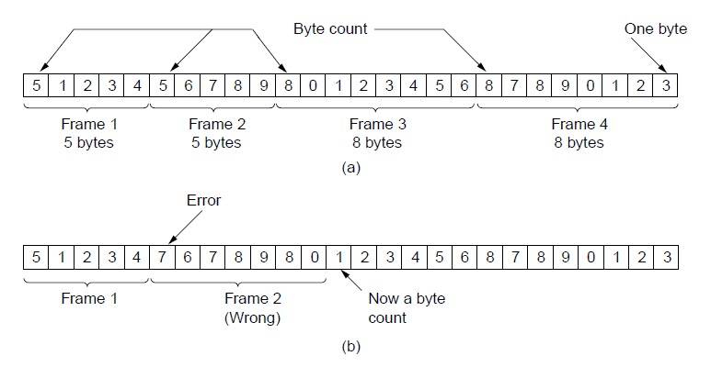
Framing (1)
A byte stream. (a) Without errors. (b) With one error.

Slide 15
Flag Bytes with Byte Stuffing Framing Method
This methods gets around the boundary detection of the frame by having each appended by the frame start and frame end special bytes.
If they are the same (beginning and ending byte in the frame) they are called flag byte.
In the next slide figure this byte is shown as FLAG.
If the actual data contains a byte that is identical to the FLAG byte (e.g., picture, data stream, etc.) the convention that can be used is to have escape character inserted just before the “FLAG” character.
The data link layer on the receiving end removes the escape bytes before giving the data to the network layer.
This technique is called byte stuffing.

Slide 16
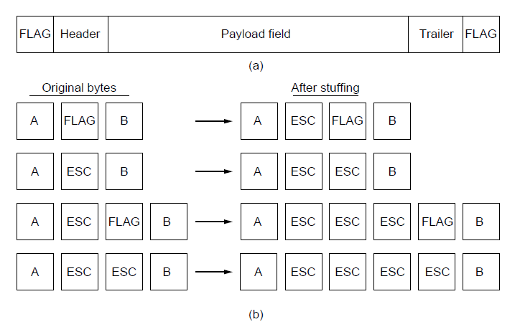
Framing (2)
A frame delimited by flag bytes.
Four examples of byte sequences before and after byte stuffing.

Slide 17
Flag Bits with Bit Stuffing Framing Method
This methods achieves the same thing as Byte Stuffing method by using Bits (1) instead of Bytes (8 Bits).
It was developed for High-level Data Link Control (HDLC) protocol.
Each frames begins and ends with a special bit pattern:
01111110 or 0x7E <- Flag Byte
Whenever the sender’s data link layer encounters five consecutive 1s in the data it automatically stuffs a 0 bit into the outgoing bit stream.
USB uses bit stuffing.
When the receiver sees five consecutive incoming 1 bits, followed by a 0 bit, it automatically destuffs (i.e., deletes) the 0 bit.
If the user data contain the flag pattern, 01111110, this flag is transmitted as 011111010 but stored in the receiver’s memory as 01111110.
With bit stuffing, the boundary between two frames can be unambiguously recognized by the flag pattern

Slide 18
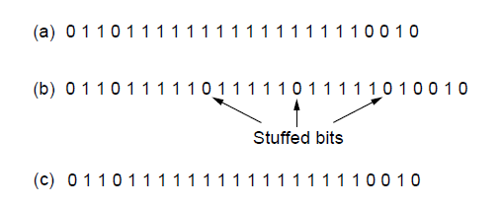
Framing (3)
Bit stuffing. (a) The original data. (b) The data as they appear on
the line. (c) The data as they are stored in the receiver’s memory after destuffing.

Slide 19
Framing
With both bit and byte stuffing, a side effect is that the length of a frame now depends on the contents of the data it carries.
Example:100 bytes of the data then the frame size is 100 bytes if no flag bytes otherwise 200 bytes.
Physical layer coding violations:
Example:In the 4B/5B line code 4 data bits are mapped to 5 signal bits to ensure sufficient bit transitions.
This means that 16 out of the 32 signal possibilities are not used.
We can use some reserved signals to indicate the start and end of frames.
In effect, we are using ‘‘coding violations’’ to delimit frames.
The beauty of this scheme is that, because they are reserved signals, it is easy to find the start and end of frames and there is no need to stuff the data.

Slide 20
Framing
Ethernet and 802.11:
Frame begin with a well-defined pattern called a preamble.
This pattern might be quite long (72 bits is typical for 802.11) to allow the receiver to prepare for an incoming packet.
The preamble is then followed by a length (i.e., count) field in the header that is used to locate the end of the frame.

Slide 21
Error Control
After solving the marking of the frame with start and end the data link layer has to handle eventual errors in transmission or detection.
Ensuring that all frames are delivered to the network layer at the destination and in proper order.
Unacknowledged connectionless service: It is OK for the sender to output frames regardless of its reception.
Reliable connection-oriented service: It is NOT OK.
Reliable connection-oriented service usually will provide a sender with some feedback about what is happening at the other end of the line.
Receiver Sends Back Special Control Frames.
If the Sender receives positive Acknowledgment it will know that the frame has arrived safely.
A negative acknowledgement means that something has gone wrong and the frame must be transmitted again.
Hardware troubles may cause a frame to vanish completely.

Slide 22
Error Control
So introduce timers into the data link layer.
Sender transmits a frame and generally starts a timer.
The timer is set to expire after an interval long enough for the frame to reach the destination, be processed there, and have the acknowledgement propagate back to the sender.
If either the frame or the acknowledgement is lost, the timer will go off, alerting the sender to a potential problem.
The obvious solution is to just transmit the frame again.
Sometimes receiver accept the same frame two or more times and may pass it to the network layer more than once.
Assign sequence numbers to outgoing frames, so that the receiver can distinguish retransmissions from originals.
Managing the timers and sequence numbers so as to ensure that each frame is ultimately passed to the network layer at the destination exactly once is the duty of data link layer.

Slide 23
Flow Control
Important Design issue for the cases when the sender is running on a fast powerful computer and receiver is running on a slow low-end machine.
Example:Mobile phone requests a web page from powerful server.
Two approaches:
Feedback-based flow control:
Receiver sends back information to the sender giving it permission to send more data, or
Telling sender how receiver is doing.
Rate-based Flow Control
Built in mechanism that limits the rate at which sender may transmit data, without the need for feedback from the receiver.

Slide 24
Error Detection and Correction
Two basic strategies to deal with errors:
Include enough redundant information to enable the receiver to deduce what the transmitted data must have been. Error correcting codes also called Forward Error Correction
Include only enough redundancy to allow the receiver to deduce that an error has occurred (but not which error). Error detecting codes.

Slide 25
Error Detection and Correction
Highly reliable, such as fiber, it is cheaper to use an error-detecting code and just retransmit the occasional block found to be faulty.
FEC is used on noisy channels because retransmissions are just as likely to be in error as the first transmission.
Example:Wireless Links.
Neither error-correcting codes nor error-detecting codes can handle all possible errors since the redundant bits that offer protection are as likely to be received in error as the data bits

Slide 26
Error Detection and Correction
Types of errors:
Thermal Noise: Overwhelm the signal briefly and occasionally, giving rise to isolated single-bit errors.
Deep fade on a wireless channel or transient electrical interference on a wired channel causes more bit errors.
The disadvantage of burst errors is that when they do occur they are much harder to correct than isolated errors
Erasure channel:The physical layer received an analog signal that was far from the expected value for a 0 or 1 and declared the bit to be lost

Slide 27
Error Detection and Correction
Error codes are examined in Link Layer because this is the first place that we have run up against the problem of reliability transmitting groups of bits.
Codes are reused because reliability is an overall concern.
The error correcting code are also seen in the physical layer for noise channels.
Commonly they are used in link, network and transport layer.
Error codes have been developed after long fundamental research conducted in mathematics.
Many protocol standards get codes from the large field in mathematics.

Slide 28
Error Detection & Correction Code
All the codes presented in previous slide add redundancy to the information that is being sent.
A frame consists of
m data bits (message) and
r redundant bits (check).
Block code - the r check bits are computed solely as function of the m data bits with which they are associated.
Systemic code – the m data bits are send directly along with the check bits.
Linear code – the r check bits are computed as a linear function of the m data bits.

Slide 29
Error Detection & Correction Code
n – total length of a block (i.e., n = m + r)
(n, m) – code
n – bit codeword containing n bits.
m/n – code rate (range ½ for noisy channel and close to 1 for high-quality channel).
Example
Transmitted: 10001001
Received: 10110001
XOR operation gives number of bits that are different.
XOR: 00111000
Number of bit positions in which two codewords differ is called Hamming Distance. It shows that two codes are d distance apart, and it will require d errors to convert one into the other.

Slide 30
Error Detection & Correction Code
All 2^{m} possible data messages are legal, but due to the way the check bits are computers not all 2^{n} possible code words are used.
Only small fraction of 2^{m}/2^{n}=1/2^{r} are possible will be legal codewords.
The error-detecting and error-correcting codes of the block code depend on this Hamming distance.
To reliably detect d error, one would need a distance d+1 code.
To correct d error, one would need a distance 2d+1 code.

Slide 31
Error Detection & Correction Code
All 2^{m} possible data messages are legal, but due to the way the check bits are computers not all 2^{n} possible code words are used.
Only small fraction of 2^{m}/2^{n}=1/2^{r} are possible will be legal codewords.
The error-detecting and error-correcting codes of the block code depend on this Hamming distance.
To reliably detect d error, one would need a distance d+1 code.
To correct d error, one would need a distance 2d+1 code.

Slide 32
Error Detection & Correction Code
Example:
4 valid codes:
0000000000
0000011111
1111100000
1111111111
Minimal Distance of this code is 5 => can correct double errors and it detect quadruple errors.
0000000111 => single or double – bit error. Hence the receiving end must assume the original transmission was 0000011111.
0000000000 => had triple error that was received as 0000000111
They would be detected in error.

Slide 33
Error Detection & Correction Code
One cannot perform double errors and at the same time detect quadruple errors.
Error correction requires evaluation of each candidate codeword which may be time consuming search.
Through design this search time can be minimized.
In theory if n = m + r, this requirement becomes:
(m + r + 1) ≤ 2^{r}

Slide 34
Error Correction Codes (1)
Hamming codes.
Binary convolutional codes.
Reed-Solomon codes.
Low-Density Parity Check codes.

Slide 35
Hamming Code
Codeword: b1 b2 b3 b4 ….
Check bits: The bits that are powers of 2 (p1, p2, p4, p8, p16, …).
The rest of bits (m3, m5, m6, m7, m9, …) are filled with m data bits.
Example of the Hamming code(11,7) with m = 7 data bits and r = 4 check bits is given in the next slide.

Slide 36
The Hamming Code
Consider a message having four data bits (D) which is to be transmitted as a 7-bit codeword by adding three error control bits. This would be called a (7,4) code. The three bits to be added are three EVEN Parity bits (P), where the parity of each is computed on different subsets of the message bits as shown below.
7 | 6 | 5 | 4 | 3 | 2 | 1
D | D | D | P | D | P | P | 7-BIT CODEWORD
D | - | D | - | D | - | P | (EVEN PARITY)
D | D | - | - | D | P | - | (EVEN PARITY)
D | D | D | P | - | - | - | (EVEN PARITY)

Slide 37
Hamming Code
Why Those Bits? - The three parity bits (1,2,4) are related to the data bits (3,5,6,7) as shown at right.
In this diagram, each overlapping circle corresponds to one parity bit and defines the four bits contributing to that parity computation.
For example, data bit 3 contributes to parity bits 1 and 2.
Each circle (parity bit) encompasses a total of four bits, and each circle must have EVEN parity.
Given four data bits, the three parity bits can easily be chosen to ensure this condition.
It can be observed that changing any one bit numbered 1..7 uniquely affects the three parity bits.
Changing bit 7 affects all three parity bits, while an error in bit 6 affects only parity bits 2 and 4, and an error in a parity bit affects only that bit.
The location of any single bit error is determined directly upon checking the three parity circles.

Slide 38
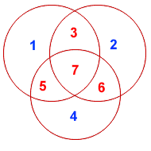
Hamming Code

Slide 39
Hamming Code
For example, the message 1101 would be sent as 1100110, since:
7 | 6 | 5 | 4 | 3 | 2 | 1
1 | 1 | 0 | 0 | 1 | 1 | 0 | 7-BIT CODEWORD
1 | - | 0 | - | 1 | - | 0 | (EVEN PARITY)
1 | 1 | - | - | 1 | 1 | - | (EVEN PARITY)
1 | 1 | 0 | 0 | - | - | - | (EVEN PARITY)

Slide 40
Hamming Code
It may now be observed that if an error occurs in any of the seven bits, that error will affect different combinations of the three parity bits depending on the bit position.
For example, suppose the above message 1100110 is sent and a single bit error occurs such that the codeword 1110110 is received:
transmitted message received message
1 1 0 0 1 1 0 ------------> 1 1 1 0 1 1 0
BIT: 7 6 5 4 3 2 1 BIT: 7 6 5 4 3 2 1
m The above error (in bit 5) can be corrected by examining which of the three parity bits was affected by the bad bit:

Slide 41
Hamming Code
1-3,5,7 bits
2-3,7,6
4-5,7,6
7 | 6 | 5 | 4 | 3 | 2 | 1
1 | 1 | 1 | 0 | 1 | 1 | 0 | 7-BIT CODEWORD
1 | - | 1 | - | 1 | - | 0 | (EVEN PARITY) | NOT! | 1
1 | 1 | - | - | 1 | 1 | - | (EVEN PARITY) | OK! | 0
1 | 1 | 1 | 0 | - | - | - | (EVEN PARITY) | NOT! | 1

Slide 42
Hamming Code
In fact, the bad parity bits labeled 101 point directly to the bad bit since 101 binary equals 5. Examination of the 'parity circles' confirms that any single bit error could be corrected in this way.
The value of the Hamming code can be summarized:
Detection of 2 bit errors (assuming no correction is attempted);
Correction of single bit errors;
Cost of 3 bits added to a 4-bit message.
The ability to correct single bit errors comes at a cost which is less than sending the entire message twice. (Recall that simply sending a message twice accomplishes no error correction.)

Slide 43

Error correction code
Example 2:(11,7) Hamming code.
11 = 1 + 2 + 8
So check bits are 1,2,8 and the hamming distance is 3.
It can correct single bit errors.
For filling the check bits use even parity according to the following figure
Input is to send a character A(1000001)

Slide 44
Hamming code(2)
Sender side
Check bits are 1,2,4,8
The Hamming code is 00100001001(11-bit code).
1 | 2 | 3 | 4 | 5 | 6 | 7 | 8 | 9 | 10 | 11
 |  | 1 |  | 0 | 0 | 0 |  | 0 | 0 | 1
0 |  | 1 |  | 0 | 0 | 0 |  | 0 | 0 | 1
0 | 0 | 1 | 0 | 0 | 0 | 0 |  | 0 | 0 | 1
0 | 0 | 1 | 0 | 0 | 0 | 0 | 1 | 0 | 0 | 1

Slide 45
Hamming code(2)
At receiver side:
The received message is 00101001001.Single bit error occurred.
Apply the same procedure to find out the error.
The position can be find by the observing the value of the parity bits .
1 | 2 | 3 | 4 | 5 | 6 | 7 | 8 | 9 | 10 | 11
0 | 0 | 1 | 0 | 1 | 0 | 0 | 1 | 0 | 0 | 1 | 1
0 | 0 | 1 | 0 | 1 | 0 | 0 | 1 | 0 | 0 | 1 | 0
0 | 0 | 1 | 0 | 1 | 0 | 0 | 1 | 0 | 0 | 1 | 1
0 | 0 | 1 | 0 | 1 | 0 | 0 | 1 | 0 | 0 | 1 | 0

Slide 46
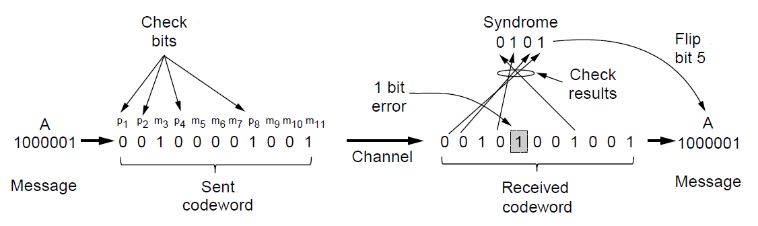
Error Correction Codes (2)
Example of an (11, 7) Hamming code correcting a single-bit error.

Slide 47
Convolutional Codes
Not a block code.
There is no natural message size or encoding boundary as in a block code.
The output depends on the current and previous input bits. Encoder has memory.
The number of previous bits on which the output depends is called the constraint length of the code.
They are deployed as part of the
GSM mobile phone system
Satellite Communications, and
802.11 (see example in the previous slide).

Slide 48
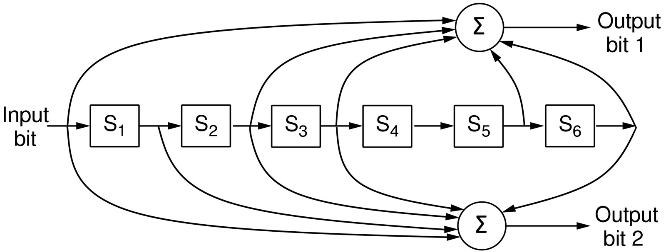
Error Correction Codes (3)
The NASA binary convolutional code used in 802.11.

Slide 49
Convolution codes
each input bit on the left-hand side produces two output bits on the right-hand side that are XOR sums of the input and internal state.
Since it deals with bits and performs linear operations, this is a binary, linear convolutional code.
1 input bit produces 2 output bits, the code rate is 1/2.
It is not systematic since none of the output bits is simply the input bit.
The internal state is kept in six memory registers.
Each time another bit is input the values in the registers are shifted to the right.
For example, if 111 is input and the initial state is all zeros.
The internal state, written left to right, will become
100000, 110000, and 111000 after the first, second, and third bits have been input.

Slide 50
Convolution codes
The output bits will be 11, followed by 10, and then 01. It takes seven shifts to flush an input completely so that it does not affect the output.
The constraint length of this code is thus k = 7.
A convolutional code is decoded by finding the sequence of input bits that is most likely to have produced the observed sequence of output bits (which includes any errors).
For small values of k, this is done with a widely used algorithm developed by Viterbi

Slide 51
Reed-solomon code
Reed-Solomon codes are based on the fact that every n degree polynomial is uniquely determined by n + 1 points.
Extra points on the same line are redundant, which is helpful for error correction.
Imagine that we have two data points that represent a line and we send those two data points plus two check points chosen to lie on the same line.
If one of the points is received in error, we can still recover the data points by fitting a line to the received points.
A popular choice is to make m = 8 so that symbols are bytes.
A code word is then 255 bytes long. The (255, 233) code is widely used.
It adds 32 redundant symbols to 233 data symbols.
Decoding with error correction is done with an algorithm developed by Berlekamp and Masse

Slide 52
Reed-solomon code
They are used for DSL, data over cable, satellite communications, and perhaps most ubiquitously on CDs,
DVDs, and Blu-ray discs.
Widely used in practice because of their strong error-correction properties, particularly for burst errors.
Convolutional codes are effective at handling isolated bit errors, but they will fail, likely with a burst of errors.
By adding a Reed-Solomon code within the convolutional code, the Reed-Solomon decoding can mop up the error bursts, a task at which it is very good.

Slide 53
LDPC codes
Low-Density Parity Check codes are linear block codes that were invented by Robert Gallagher in his doctoral thesis.
Each output bit is formed from only a fraction of the input
bits.
This leads to a matrix representation of the code that has a low density of 1s, hence the name for the code.
The received code words are decoded with an approximation algorithm that iteratively improves on a best fit of the received
data to a legal code word.
This corrects errors.
LDPC codes are practical for large block sizes and have excellent error-correction abilities that outperform many other codes.
They are part of the standard for digital video broadcasting, 10 Gbps
Ethernet, power-line networks, and the latest version of 802.11

Slide 54
Error-Detecting Codes (1)
Linear, systematic block codes
Parity.
Checksums.
Cyclic Redundancy Checks (CRCs).

Slide 55
Error-Detecting Codes
Error-correcting codes are widely used on wireless links, which are notoriously noisy and error prone when compared to optical fibers.
Over fiber or high-quality copper, the error rate is much lower, so error detection and retransmission is usually more efficient there for dealing with the occasional error.
Parity:
A single parity bit is appended to the data. The parity bit is chosen so that the number of 1 bits in the codeword is even (or odd).
Example:
1011010 is sent in even parity, a
Even parity: 10110100.
With odd parity it becomes 10110101.
It can detect single-bit errors.

Slide 56
Error-Detecting Codes
If the block is badly garbled by a long burst error, the probability that the error will be detected is only 0.5.
A burst error does not imply that all the bits are wrong; it just
implies that at least the first and last are wrong
We can compute the parity bits over the data in a different
order than the order in which the data bits are transmitted. Doing so is called interleaving.
We will compute a parity bit for each of the n columns and send all the data bits as k rows
At the last row, we send the n parity bits.
4 bits were flipped over a range of 7 bits.
At most 1 bit in each of the n columns will be affected, so
the parity bits on those columns will detect the error.
This method uses n parity bits on blocks of kn data bits to detect a single burst error of length n or less.

Slide 57
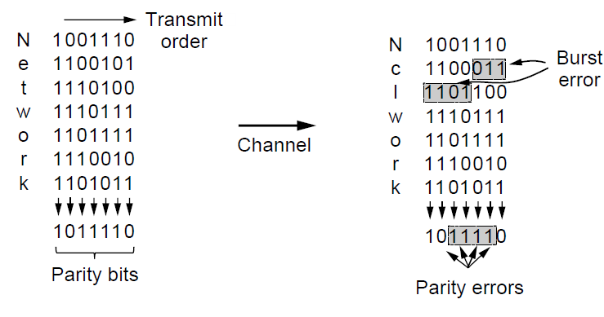
Error-Detecting Codes (2)
Interleaving of parity bits to detect a burst error.

Slide 58
Error-Detecting Codes
Check sum: It is used to mean a group of check bits associated with a message.
The checksum is usually placed at the end of the message, as the complement of the sum function.
This way, errors may be detected by summing the entire received codeword, both data bits and checksum.
If the result comes out to be zero, no error has been detected.
Example:16-bit Internet checksum used on all Internet
packets as part of the IP protocol.
This checksum is a sum of the message bits divided into 16-bit words.
The Internet checksum in particular is efficient and simple but provides weak protection.
Fletcher’s checksum:It includes a positional component, adding the product of the data and its position to the running sum.
This provides stronger detection of changes in the position of data.

Slide 59
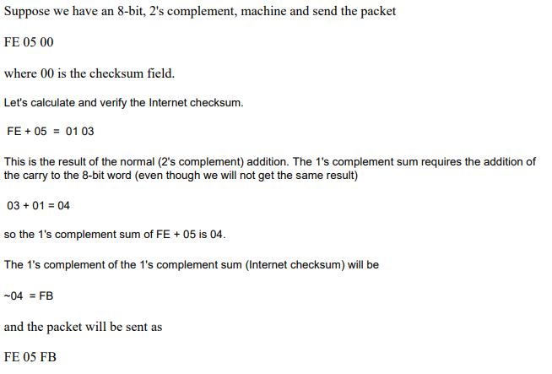
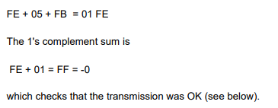
Internet checksum example
At sender side At receiver side

Slide 60
Error-Detecting Codes
CRC (Cyclic Redundancy Check), also known as a polynomial codes is tronger kind of error-detecting code and is in widespread use at the link layer
A k-bit frame is regarded as the coefficient list for a polynomial with k terms, ranging from x to the power of k − 1 to x to the power of 0.
Such a polynomial is said to be of degree k − 1.
The high-order (leftmost) bit is the coefficient of x to the power of k − 1, the next bit is the coefficient of x to the power of k − 2, and so on.
Example :110001
The polynomial is

Slide 61
Error-Detecting Codes
the sender and receiver must agree upon a generator polynomial, G(x), in advance.
Both the high- and low order bits of the generator must be 1.
To compute the CRC for some frame with m bits corresponding to the polynomial M(x), the frame must be longer than the
generator polynomial
The algorithm for computing the CRC is as follows:
1. Let r be the degree of G(x). Append r zero bits to the
low-order end of the frame so it now contains m + r bits and
corresponds to the polynomial x to the power of r.M(x).
2. Divide the bit string corresponding to G(x) into the bit string
corresponding to x to the power of r.M(x), using modulo 2
division.

Slide 62
Error-Detecting Codes
3.Subtract the remainder (which is always r or fewer bits) from
the bit string corresponding to x rM(x) using modulo 2
subtraction. The result is the checksummed frame to be
transmitted. Call its polynomial T(x).
At receiver side:
Upon receiving the checksummed frame, the receiver divides it by G(x); that is, it computes [T(x) + E(x)]/G(x).
Example:
Among other desirable properties, it has the property that it detects all bursts of length 32 or less and all bursts affecting an odd number of bits.
It has been used widely since the 1980s.

Slide 63
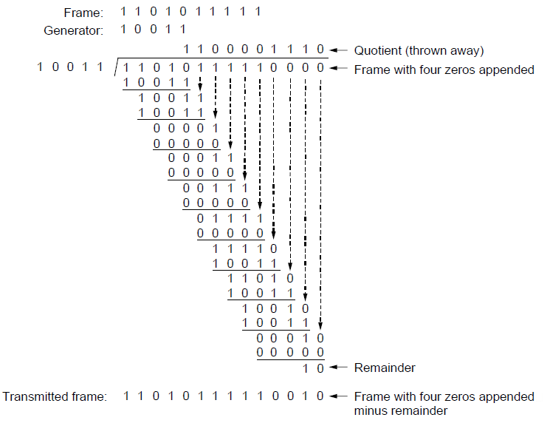
Error-Detecting Codes (3)
Example calculation of the CRC

Slide 64
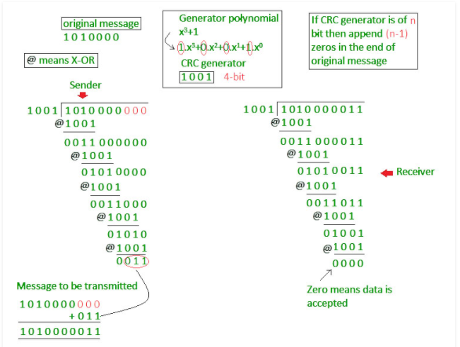
Example

Slide 65
Elementary Data Link Prototocls
The physical layer process and some of the data link layer process run on dedicated hardware called a NIC
(Network Interface Card).
The rest of the link layer process and the network layer process run on the main CPU as part of the operating system, with the software for the link layer process often taking the form of a device driver.
Assumptions:
A is assumed to have an infinite supply of data ready to send and never has to wait for data to be produced.
We also assume that machines do not crash.
the packet passed across the interface to it from the network layer is pure data, whose every bit is to be delivered to the destination’s network layer.
A frame consists of an embedded packet, some control information (in the header), and a checksum (in the trailer).

Slide 66
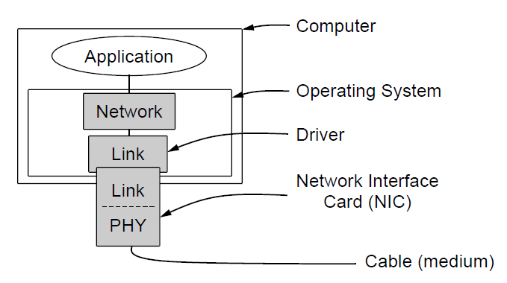
Elementary Data Link Protocols (2)
Implementation of the physical, data link, and network layers.

Slide 67
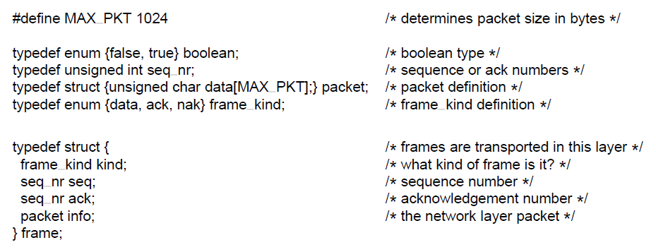
Elementary Data Link Protocols (3)
. . .
Some definitions needed in the protocols to follow. These definitions are located in the file protocol.h.

Slide 68
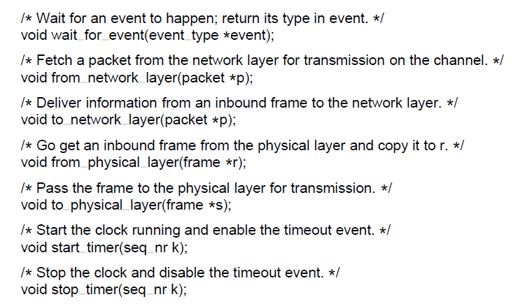
Elementary Data Link Protocols (4)
. . .
Some definitions needed in the protocols to follow. These definitions are located in the file protocol.h.

Slide 69
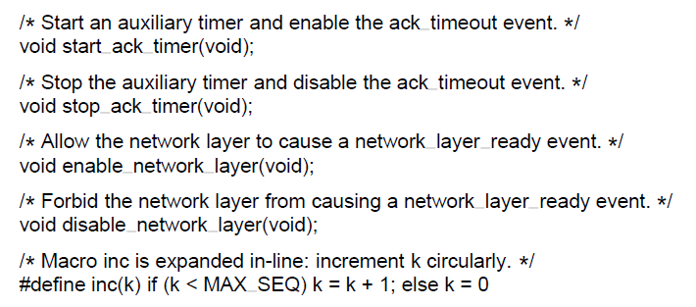
Elementary Data Link Protocols (5)
Some definitions needed in the protocols to follow. These definitions are located in the file protocol.h.

Slide 70
Elementary Data Link Protocols (1)
Utopian Simplex Protocol
Simplex Stop-and-Wait Protocol
Error-Free Channel
Simplex Stop-and-Wait Protocol
Noisy Channel

Slide 71
Utopian Simplex Protocol
Data are transmitted in one direction only.
Both the transmitting and receiving network layers are always ready.
Processing time can be ignored. Infinite buffer space is available.
The sender runs in the data link layer of the source machine, and the receiver runs in the data link layer of the destination machine.
No sequence numbers or acknowledgements are used here
The only event type possible is frame arrival (i.e., the arrival of an undamaged frame).
It does not handle either flow control or error correction.
Its processing is close to that of an unacknowledged connectionless service that relies on higher layers to solve these problems

Slide 72
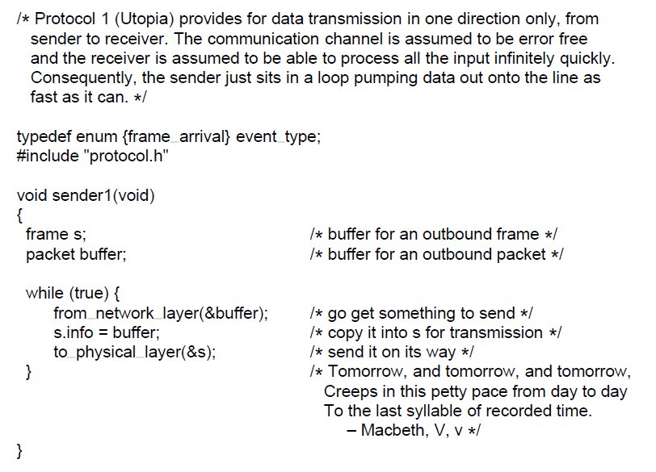
Utopian Simplex Protocol (1)
. . .
A utopian simplex protocol.

Slide 73
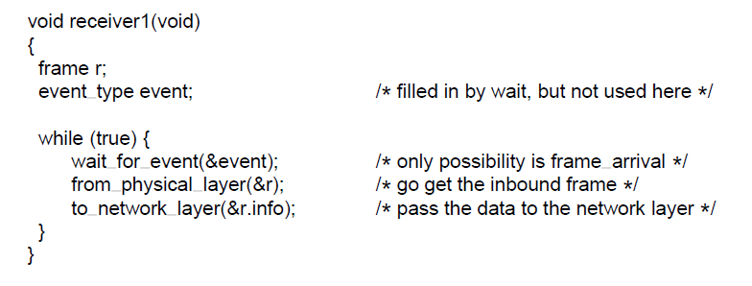
Utopian Simplex Protocol (2)
A utopian simplex protocol.

Slide 74
Simplex Stop-and-Wait Protocol for a Error-Free Channel
The communication channel is still assumed to be error free, however, and the data traffic is still simplex.
After having passed a packet to its network layer, the receiver sends a little dummy frame back to the sender which, in effect, gives the sender permission to transmit the next frame.
After having sent a frame, the sender is required by the protocol to bide its time until the little dummy (i.e., acknowledgement) frame arrives.
This delay is a simple example of a flow control protocol.
Protocols in which the sender sends one frame and then waits for an acknowledgement before proceeding are called stop-and-wait.
A hal-fduplex physical channel would suffice here.

Slide 75
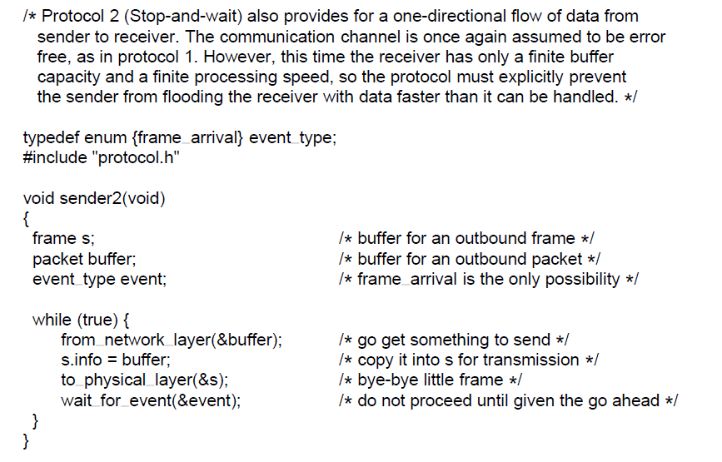
Simplex Stop-and-Wait Protocol for a Error-free Channel (1)
. . .
A simplex stop-and-wait protocol.

Slide 76
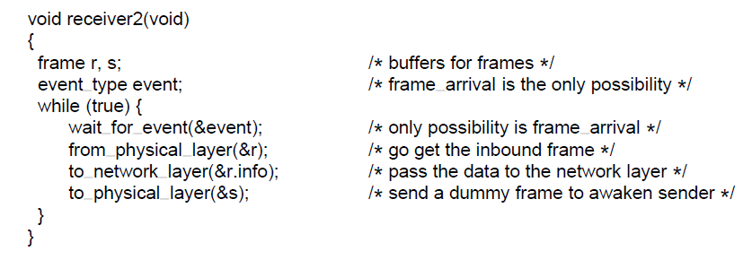
Simplex Stop-and-Wait Protocol for a Error free Channel (2)
A simplex stop-and-wait protocol.

Slide 77
Simplex Stop-and-Wait Protocol for a Noise Channel
Frames may be either damaged or lost completely.
The sender could send a frame, but the receiver would only send an acknowledgement frame if the data were correctly received.
If a damaged frame arrived at the receiver, it would be discarded.
After a while the sender would time out and send the frame again.
This process would be repeated until the frame finally arrived intact.
Flaw:If the ack frame lost then receiver might accapt the duplicate frame and send to the network layer.

Slide 78
Simplex Stop-and-Wait Protocol for a Noise Channel
To distinguish the retransmitted frame sender put a sequence number in the header of each frame it sends.
Then the receiver can check the sequence number of each arriving frame to see if it is a new frame or a duplicate to be discarded.
The header might provide 1 bit, a few bits, 1 byte, or multiple bytes for a sequence number depending on the protocol.
Example:1-bit sequence number.
At each instant of time, the receiver expects a particular sequence number next.
When a frame containing the correct sequence number arrives, it is accepted and passed to the network
layer, then acknowledged.

Slide 79
Simplex Stop-and-Wait Protocol for a Noise Channel
Any arriving frame containing the wrong sequence number is rejected as a duplicate.
However, the last valid acknowledgement is repeated so that the sender can eventually discover that the frame has been received.
Protocols in which the sender waits for a positive acknowledgement before advancing to the next
data item are often called ARQ (Automatic Repeat reQuest) or PAR (Positive Acknowledgement with Retransmission).

Slide 80
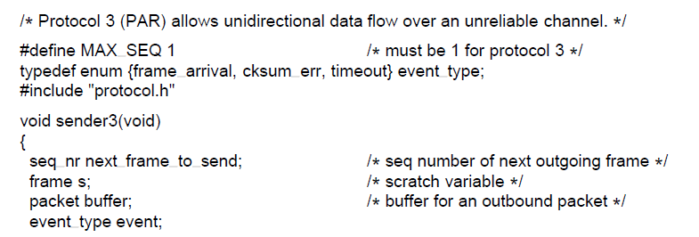
Simplex Stop-and-Wait Protocol for a Noise Channel (3)
. . .
A positive acknowledgement with retransmission protocol.

Slide 81
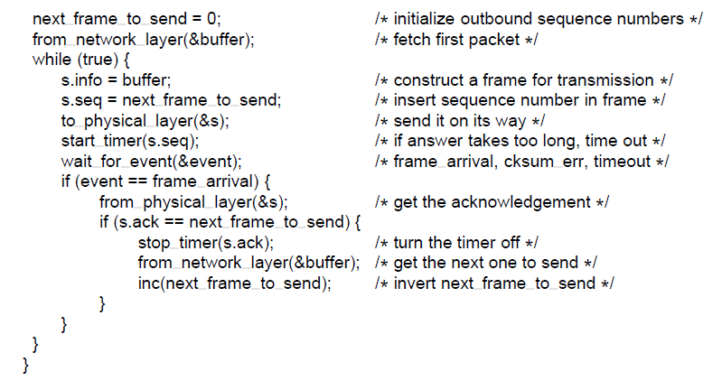
Simplex Stop-and-Wait Protocol for a Noise Channel (3)
. . .
A positive acknowledgement with retransmission protocol.

Slide 82
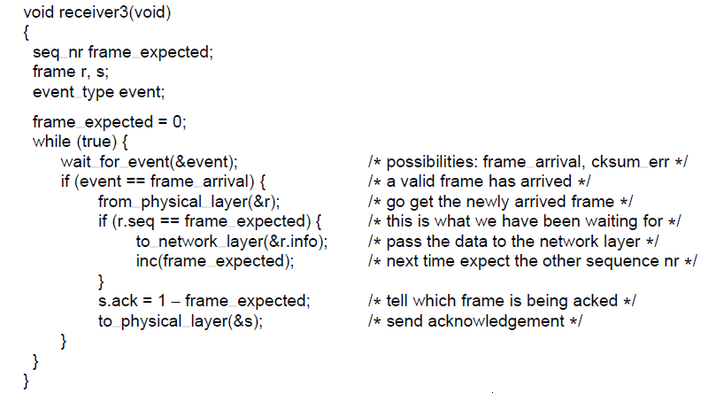
Simplex Stop-and-Wait Protocol for a Noise Channel (3)
A positive acknowledgement with retransmission protocol.

Slide 83
Sliding Window Protocols
In most practical situations, there is a need to transmit data in both directions.
Use the same link for data in both directions.
In this model the data frames from A to B are intermixed with the acknowledgement frames from A to B.
By looking at the kind field in the header of an incoming
frame, the receiver can tell whether the frame is data or an acknowledgement.
Instead of immediately sending a separate control frame after receiving a data frame the acknowledgement is attached to the outgoing data frame from the receiver.
This is called piggybacking.
If the new packet arrived from network layer within the time then ok, otherwise the ack frame will be sent separately.

Slide 84
Sliding Window Protocols
The following three protocols are bidirectional protocols that belong to a class called sliding window protocols.
One-bit sliding window.
Go-back-n
Selective-Repeat.
Each outbound frame contains a sequence number,ranging from 0 up to (2 to the power of n) -1.
The stop-and-wait sliding window protocol uses n = 1, restricting the sequence numbers to 0 and 1
At any instant of time, the sender maintains a set of sequence numbers corresponding to frames it is permitted
to send.
These frames are said to fall within the sending window.

Slide 85
Sliding Window Protocols
The receiver also maintains a receiving window corresponding to the set of frames it is permitted to accept.
The sender’s window and the receiver’s window need not have the same lower and upper limits or even have the same size.
Whenever a new packet arrives from the network layer, it is given the next highest sequence number, and the upper edge of the window is advanced by one.
When an acknowledgement comes in, the lower edge is advanced by one.
In this way the window continuously maintains a list of unacknowledged frames.
The sender must keep all of these frames in its memory for
possible retransmission.
If the maximum window size is n, the sender needs n buffers to hold the unacknowledged frames.

Slide 86
Sliding Window Protocols
When a frame whose sequence number is equal to the lower edge of the window is received, it is passed to the network layer and the window is rotated by one.
Any frame falling outside the window is discarded.

Slide 87
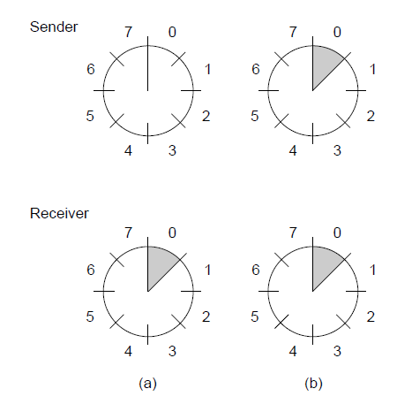
Sliding Window Protocols (4)
A sliding window of size 1, with a 3-bit sequence number. (a) Initially. (b) After the first frame has been sent.

Slide 88
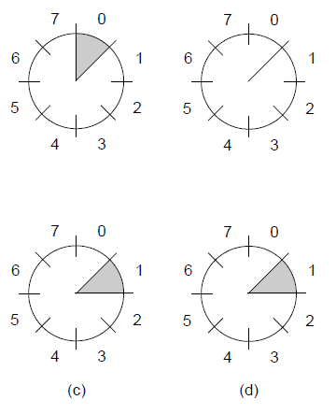


Sliding Window Protocols (5)
A sliding window of size 1, with a 3-bit sequence number
(c) After the first frame has been received. (d) After the first acknowledgement has been received.

Slide 89
One-Bit Sliding Window Protocol
Such a protocol uses stop-and-wait since the sender transmits a frame and waits for its acknowledgement before sending the next one.
Under normal circumstances, one of the two data link layers goes first and transmits the first frame.
The starting machine fetches the first packet from its network layer, builds a frame from it, and sends it.
The receiving data link layer checks to see if it is a duplicate, otherwise the frame is the one expected, it is passed to the network layer and the receiver’s window is slid up.
The acknowledgement field contains the number of the last frame received without error.
If this number agrees with the sequence number of the frame the sender is trying to send, the sender knows it is done and can fetch the next packet from its network layer.
If the sequence number disagrees, it must continue trying to send the same frame.

Slide 90
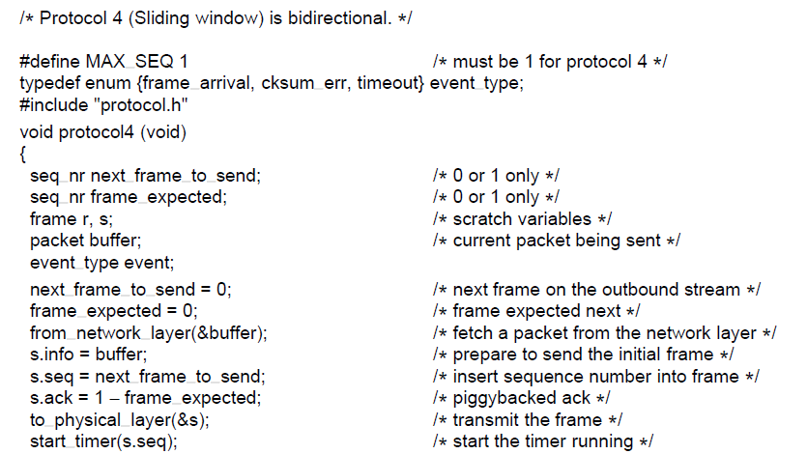
One-Bit Sliding Window Protocol (1)
. . .
A 1-bit sliding window protocol.

Slide 91
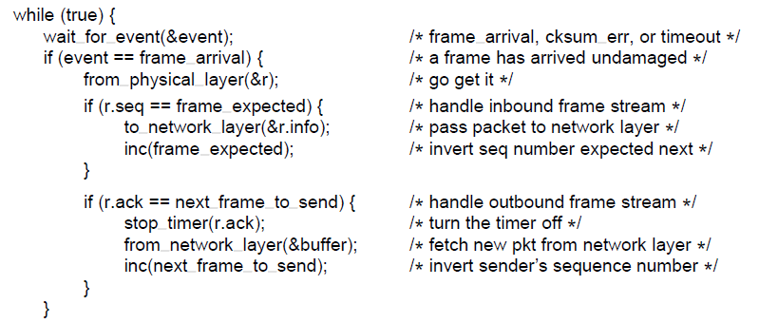
One-Bit Sliding Window Protocol (2)
. . .
A 1-bit sliding window protocol.

Slide 92
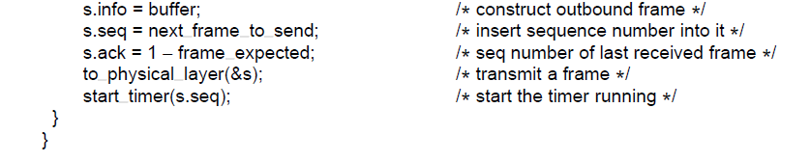
One-Bit Sliding Window Protocol (3)
A 1-bit sliding window protocol.

Slide 93
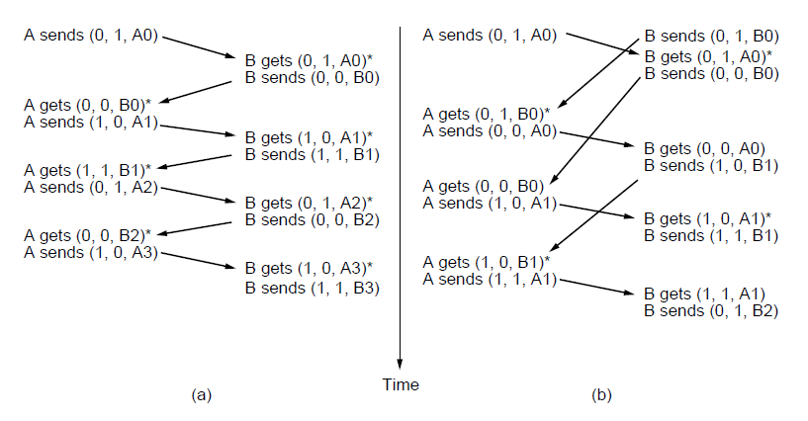
One-Bit Sliding Window Protocol (4)
Two scenarios for protocol 4. (a) Normal case. (b) Abnormal
case. The notation is (seq, ack, packet number). An asterisk indicates where a network layer accepts a packet

Slide 94
One-Bit Sliding Window Protocol
If A and B simultaneously initiate communication, their first frames cross, and the data link layers then get into situation (b)
Half of the frames contain duplicates, even though there are no transmission errors.
Similar situations can occur as a result of premature timeouts, even when one side clearly starts first.
In fact, if multiple premature timeouts occur, frames may be
sent three or more times, wasting valuable bandwidth.

Slide 95
Go-Back-N
The long round-trip time can have important implications
for the efficiency of the bandwidth utilization.
Example:Satellite channels of 500 msec round trip delay.
So allow the sender to transmit up to w frames before blocking, instead of just 1.
w should be set to 2BD+1.where BD is the bandwidth delay no.of frames and 1 as ack frame will be sent only after arriving the first frame.
Ex:For a 50 kbps channel and a delay of 250 msec the no.of frames are 26 frames of 1000 bits.
This technique of keeping multiple frames in flight is an example of pipelining.

Slide 96
Go-Back-N
What happens if a frame in the middle of a long stream is
damaged or lost?
Two approaches
Go-back-N: The receiver simply to discard all subsequent
frames, sending no acknowledgements for the discarded frames. The sender will time out and retransmit all unacknowledged frames in order, starting with the damaged or lost one. This approach can waste a lot of bandwidth if the error rate is high.
For the for the case in which the receiver’s window is large
the sender, continues to send frames until the timer for frame 2 expires. Then it backs up to frame 2 and
starts over with it, sending 2, 3, 4, etc. all over again.

Slide 97
Selective Repeat
A bad frame that is received is discarded, but any good frames received after it are accepted and buffered.
When the sender times out, only the oldest unacknowledged frame is retransmitted.
If the damaged frame arrives correctly the receiver can deliver to the network layer, in sequence, all the frames it has buffered.
Selective repeat corresponds to a receiver window larger than 1.
The receiver send a negative acknowledgement (NAK) when it detects an error then this stimulate retransmission before
the corresponding timer expires and thus improve performance.
When an acknowledgement comes in for frame n, frames n − 1, n − 2, and so on are also automatically acknowledged. This type of acknowledgement is called a cumulative acknowledgement.

Slide 98
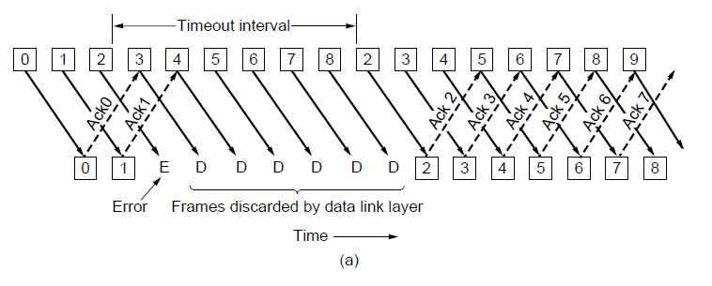
Protocol Using Go-Back-N (1)
Pipelining and error recovery. Effect of an error when
(a) receiver’s window size is 1

Slide 99
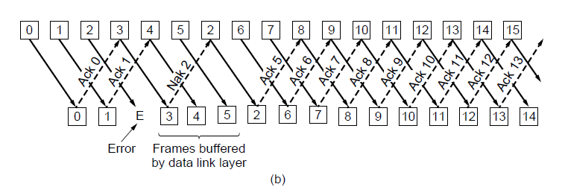
Protocol Using Go-Back-N (2)
Pipelining and error recovery. Effect of an error when
(b) receiver’s window size is large.

Slide 100
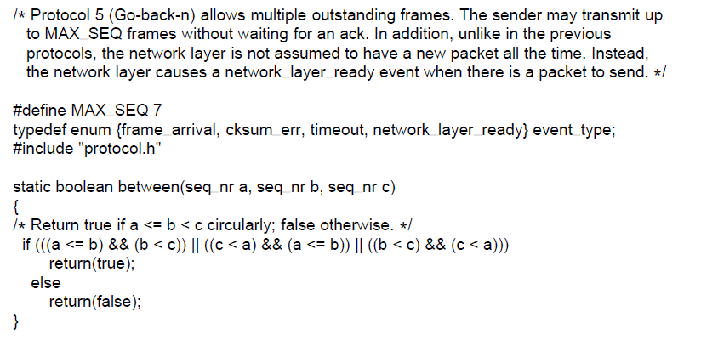
Protocol Using Go-Back-N (3)
. . .
A sliding window protocol using go-back-n.

Slide 101
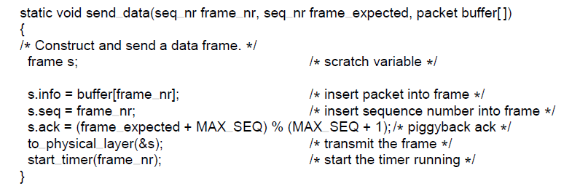
Protocol Using Go-Back-N (4)
. . .
A sliding window protocol using go-back-n.

Slide 102
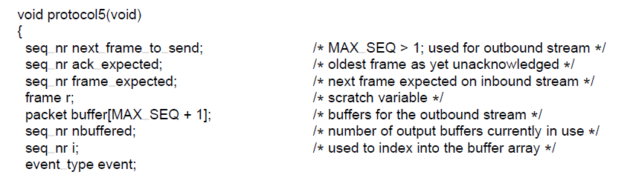
Protocol Using Go-Back-N (5)
. . .
A sliding window protocol using go-back-n.

Slide 103
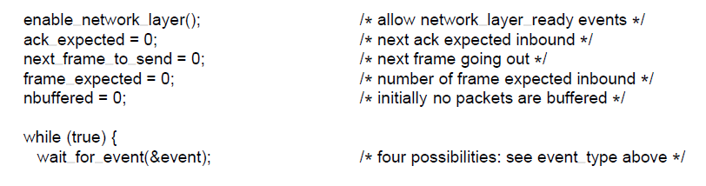
Protocol Using Go-Back-N (6)
. . .
A sliding window protocol using go-back-n.

Slide 104
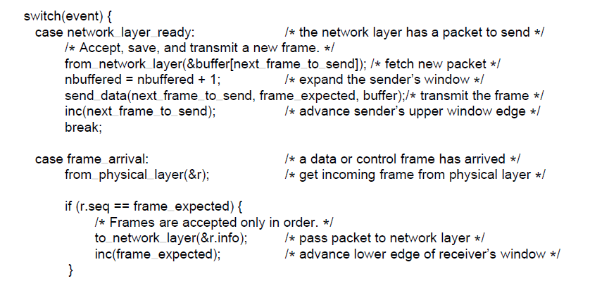
Protocol Using Go-Back-N (7)
. . .
A sliding window protocol using go-back-n.

Slide 105
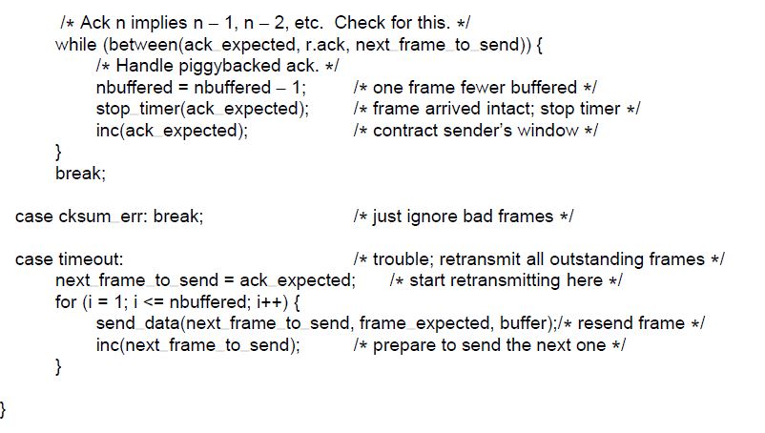
Protocol Using Go-Back-N (8)
. . .
A sliding window protocol using go-back-n.

Slide 106
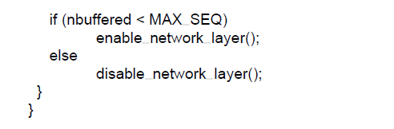
Protocol Using Go-Back-N (9)
A sliding window protocol using go-back-n.

Slide 107
Protocol Using Go-Back-N
Protocol 5 has multiple outstanding frames, it logically needs multiple timers, one per outstanding frame.
These timers can easily be simulated in software using a single hardware clock that causes interrupts periodically.
The pending timeouts form a linked list, with each node of the list containing the number of clock ticks until the timer expires, the frame being timed, and a pointer to the next node.
Example: The real time is 10:00:00.000; three timeouts are pending, at 10:00:00.005, 10:00:00.013, and 10:00:00.019.
Every time the hardware clock ticks, the real time is updated and the tick counter at the head of the list is decremented.
When the tick counter becomes zero, a timeout is caused and the node is removed from the list.

Slide 108
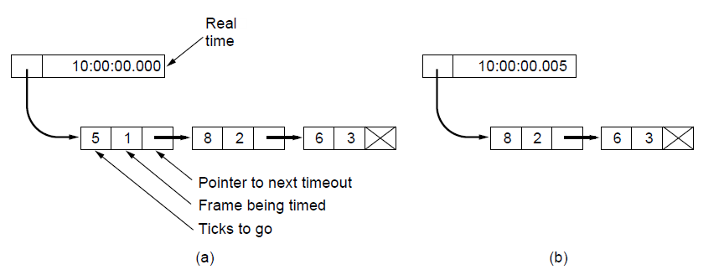
Protocol Using Go-Back-N (10)
Simulation of multiple timers in software. (a) The queued timeouts (b) The situation after the first timeout has expired.

Slide 109
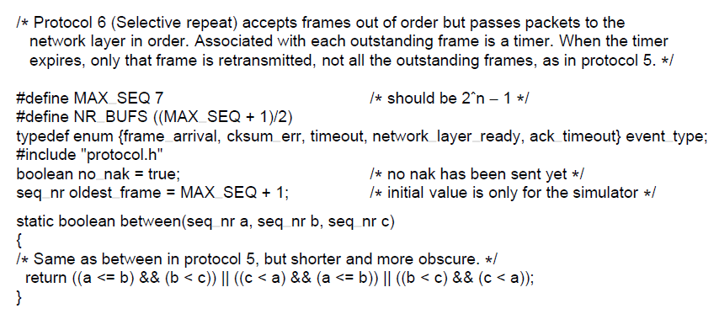
Protocol Using Selective Repeat (1)
. . .
A sliding window protocol using selective repeat.

Slide 110
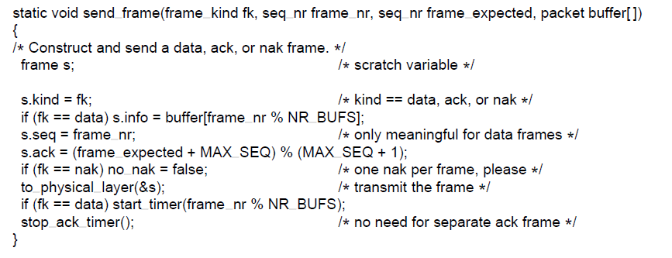
Protocol Using Selective Repeat (2)
. . .
A sliding window protocol using selective repeat.

Slide 111
Selective Repeat
The go-back-n protocol works well if errors are rare, but if the line is poor it wastes a lot of bandwidth on retransmitted frames.
The sender’s window size starts out at 0 and grows to some predefined maximum.
The receiver’s window, in contrast, is always fixed in size and equal to the predetermined maximum.
The receiver has a buffer reserved for each sequence number within its fixed window.
Associated with each buffer is a bit (arrived ) telling whether the buffer is full or empty.
Whenever a frame arrives, its sequence number is checked by the function between to see if it falls within the window. If so and if it has not already been received, it is accepted and stored.

Slide 112
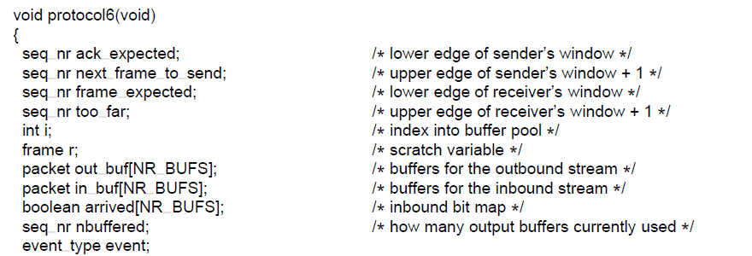
Protocol Using Selective Repeat (3)
. . .
A sliding window protocol using selective repeat.

Slide 113
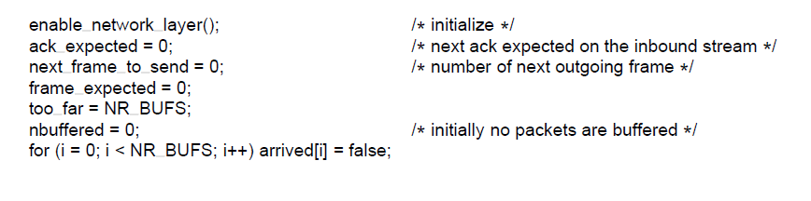
Protocol Using Selective Repeat (4)
. . .
A sliding window protocol using selective repeat.

Slide 114
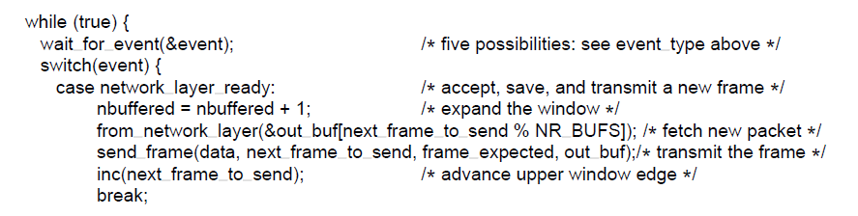
Protocol Using Selective Repeat (5)
. . .
A sliding window protocol using selective repeat.

Slide 115
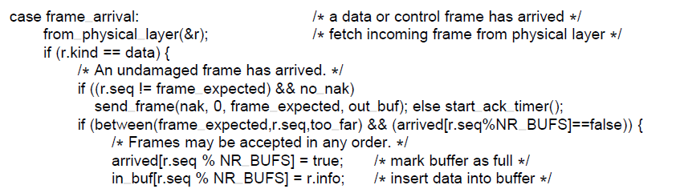
Protocol Using Selective Repeat (6)
. . .
A sliding window protocol using selective repeat.

Slide 116
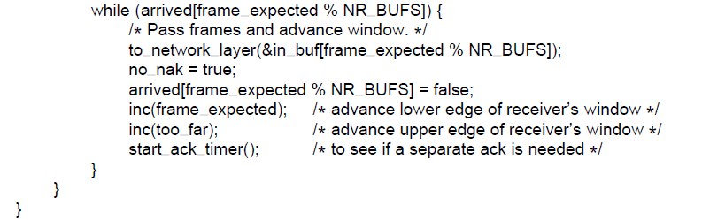
Protocol Using Selective Repeat (7)
. . .
A sliding window protocol using selective repeat.

Slide 117
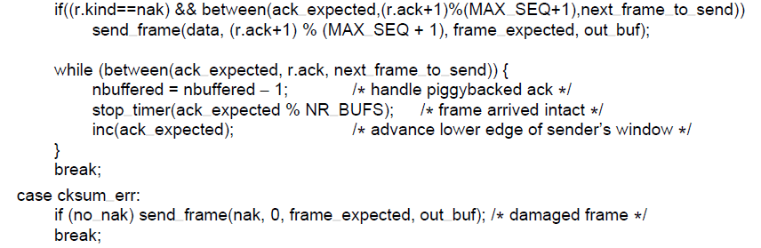
Protocol Using Selective Repeat (8)
. . .
A sliding window protocol using selective repeat.

Slide 118
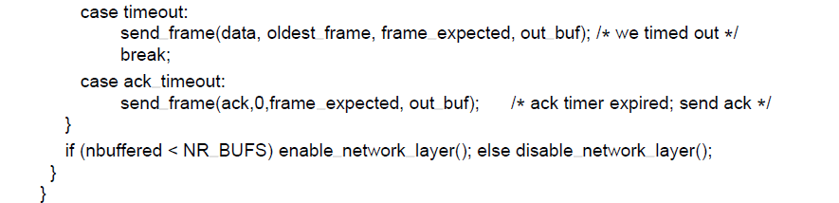
Protocol Using Selective Repeat (9)
A sliding window protocol using selective repeat.

Slide 119
Selective repeat
Trouble with sequence numbers:
Example: Suppose that we have a 3-bit sequence number, so that the sender is permitted to transmit up to seven frames.
The sender now transmits frames 0 through 6.
The receiver’s window allows it to accept any frame with a
sequence number between 0 and 6 inclusive.
All seven frames arrive correctly, so the receiver acknowledges them and advances its window to allow receipt of 7, 0,
1, 2, 3, 4, or 5,
The ack frame was lost .
The sender eventually times out and retransmits frame 0.
When this frame arrives at the receiver as it falls within the new window, so it is accepted as a new frame.
The receiver then sends a (piggybacked) acknowledgement
for frame 6.

Slide 120
Selective repeat
The sender now learnt that all its transmitted frames arrived
correctly, so it advances its window and immediately sends frames 7, 0, 1, 2, 3, 4, and 5.
Frame 7 will be accepted by the receiver and its packet will be passed directly to the network layer.
Immediately thereafter, the receiving data link layer checks to see if it has a valid frame 0 already, discovers that it does, and passes the old buffered packet to the network layer.
Consequently, the network layer gets an incorrect packet, and the protocol fails.
Solution:make sure that after the receiver has advanced
its window there is no overlap with the original window.
The maximum window size should be at most half the range of
the sequence numbers.

Slide 121
Selective Repeat
The number of buffers needed is equal to the window size, not to the range of sequence numbers.
The number of timers needed is equal to the number of
buffers, not to the size of the sequence space.
An auxiliary timer is started by start ack timer after
an in-sequence data frame arrives.
If no reverse traffic has presented itself before this timer expires, a separate acknowledgement frame is sent.
An interrupt due to the auxiliary timer is called an ack timeout event.
The receiver has reason to suspect that an error has occurred, it sends a negative acknowledgement (NAK) frame back to the sender.

Slide 122
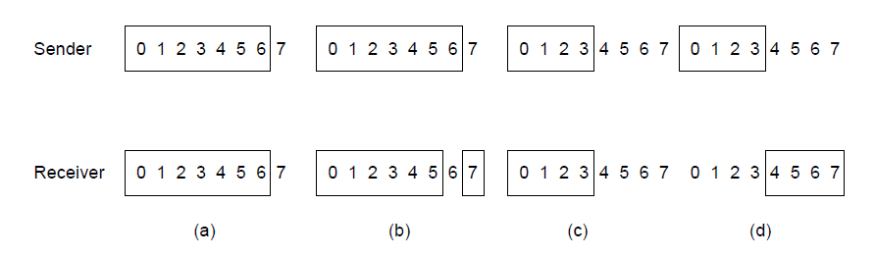
Protocol Using Selective Repeat (10)
Initial situation with a window of size 7
After 7 frames sent and received but not acknowledged.
Initial situation with a window size of 4.
After 4 frames sent and received but not acknowledged.

Slide 123
End
Chapter 3

