Slide 1
The Medium Access Control Sublayer
Chapter 4

Slide 2
MAC Sublayer
In any broadcast network, the key issue is how to determine who gets to use the channel when there is competition for it.
Example:Conference call.
The Broadcast channels are sometimes referred to as multiaccess channels or random access channels.
The protocols used to determine who goes next on a multiaccess channel belong to a sublayer of the data link layer called the MAC (Medium Access Control) sublayer.
Ex:Wireless LAN.
Channel allocation problem:how to allocate a single broadcast channel among competing users?
Two types
Static allocation
Dynamic allocation

Slide 3
Static allocation:The traditional way of allocating a single channel among multiple competing users is to chop up its capacity by using one of the multiplexing schemes such as FDM (Frequency Division Multiplexing).
If there are N users, the bandwidth is divided into N equal-sized portions, with each user being assigned one portion.
Since each user has a private frequency band, there is now no interference among users.
When the number of senders is large and varying or the traffic is bursty, FDM presents some problems.
Example:Bandwidth wastage,users>N then some of them will be denied.

Slide 4
Assumptions for Dynamic Channel Allocation
Independent traffic:The model consists of N independent stations that generates frames for transmission.
Single channel:All stations can transmit on it and all can receive from it.
Observable Collisions:All stations can detect that a collision(two frames transmitted simultaneously) has occurred.
Continuous or slotted time:frame transmission can begin at any instant or must begin at the start of a slot.
Carrier sense or no carrier sense:stations can tell if the channel is in use before trying to use it.

Slide 5
Multiple Access Protocols
ALOHA
Carrier Sense Multiple Access
Collision-free protocols
Limited-contention protocols
Wireless LAN protocols

Slide 6
Aloha
Let users transmit whenever they have data to be sent.
After each station has sent its frame to the central computer,
this computer rebroadcasts the frame to all of the stations.
A sending station can thus listen for the broadcast from the hub to see if its frame has gotten through.
If the frame was destroyed, the sender just waits a random amount of time and sends it again.
The waiting time must be random or the same frames will collide over and over, in lockstep.
Systems in which multiple users share a common channel in a
way that can lead to conflicts are known as contention systems.
Wehave made the frames all the same length because the throughput of ALOHA systems is maximized by having a uniform frame size.

Slide 7
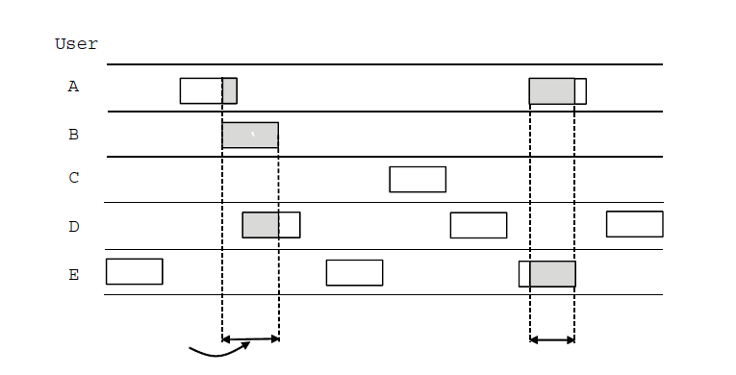
ALOHA (1)
User
A
B
C
D
E
Collision
Collision
Time
In pure ALOHA, frames are transmitted at completely arbitrary times

Slide 8
ALOHA
The new frames generated by the stations are well modeled
by a Poisson distribution with a mean of N frames per frame time.
If N > 1, the user community is generating frames at a higher
rate than the channel can handle, and nearly every frame will suffer a collision.
For reasonable throughput, we would expect 0 < N < 1.
The stations also generate retransmissions of frames that previously suffered collisions.
Let us further assume that the old and new frames combined are well modeled by a Poisson distribution, with mean of G
frames per frame time.
At low load (i.e., N ∼∼0), there will be few collisions, hence few retransmissions, so G ∼∼ N.

Slide 9
ALOHA
At high load, there will be many collisions, so G > N.
Under all loads, the throughput, S, is just the offered load, G, times the probability, P0, of a transmission succeeding.
The maximum throughput occurs at G = 0.5, with S = 1/2e, which is about 0.184.
In other words, the best we can hope for is a channel utilization of 18%.
This result is not very encouraging, but with everyone transmitting at will, we could hardly have expected a 100% success rate.

Slide 10
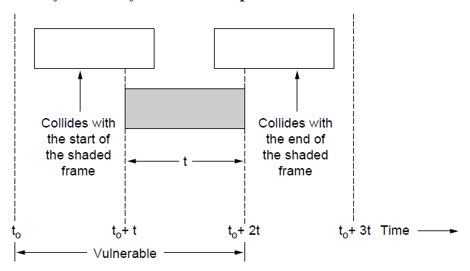
ALOHA (2)
Vulnerable period for the shaded frame.

Slide 11
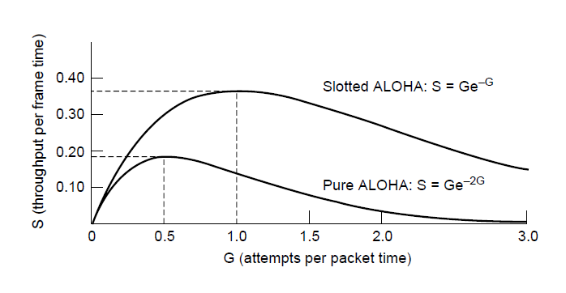
ALOHA (3)
Throughput versus offered traffic for ALOHA systems.

Slide 12
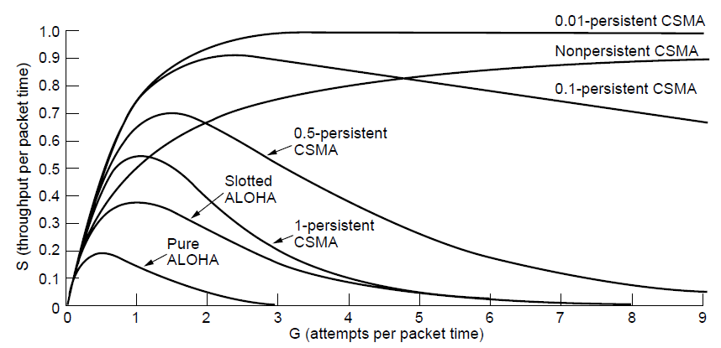
Persistent and Nonpersistent CSMA
Comparison of the channel utilization versus load for various random access protocols.

Slide 13
Slotted ALOHA
Divide time into discrete intervals called slots, each interval corresponding to one frame.
A station is not permitted to send whenever the user types a line.
It is required to wait for the beginning of the next slot.
The probability of no other traffic during thesame slot as our test frame is then e to the power of −G, which leads to
S = Ge−G
Slotted ALOHA peaks at G = 1, with a throughput of S = 1/e or about 0.368, twice that of pure ALOHA.
The best we can hope for using slotted ALOHA is 37% of the slots empty, 37% successes, and 26% collisions.

Slide 14
CSMA
In LANs, however, it is often possible for stations to detect what other stations are doing, and thus adapt their behavior accordingly.
These networks can achieve a much better utilization than 1/e.
Protocols in which stations listen for a carrier (i.e., a transmission) and act accordingly are called carrier sense protocols.
1-persistent CSMA
When a station has data to send, it first listens to the channel to see if anyone else is transmitting at that moment.
If the channel is idle, the stations sends its data.
Otherwise, if the channel is busy, the station just waits until it becomes idle.
Then the station transmits a frame.
If a collision occurs, the station waits a random amount of time and starts all over again.

Slide 15
CSMA
The propagation delay has an important effect on collisions.
If the first station’s signal has not yet reached the second one, the latter will sense an idle channel and will also begin
sending, resulting in a collision.
The larger the bandwidth-delay product, the more important this effect becomes, and the worse the performance of the protocol.
Nonpersistent CSMA:
Station senses the channel when it wants to send a frame, and if no one else is sending, the station begins doing so itself.
If the channel is already in use, the station does not continually sense it
and wait a random period of time and then repeats the algorithm.
p-persistent CSMA:
When a station becomes ready to send, it senses the channel. If it is idle, it transmits with a probability p.

Slide 16
CSMA
With a probability q = 1 − p, it defers until the next slot.
If that slot is also idle, it either transmits or defers again, with probabilities p and q.
If the station initially senses that the channel is busy, it waits until the next slot and applies the above algorithm.
Disadvantage:
If two stations sense the channel to be idle and begin
transmitting simultaneously, their signals will still collide.
CSMA/CD
Quickly detect the collision and abruptly stop transmitting.This
strategy saves time and bandwidth.
The station’s hardware must listen to the channel while it is transmitting. If the signal it reads back is different from the signal it is putting out, it knows that a collision is occurring.

Slide 17
CSMA
Example:
At the point marked t0, a station has finished transmitting its frame.
Any other station having a frame to send may now attempt to do so.
If two or more stations decide to transmit simultaneously, there will be a collision.
If a station detects a collision, it aborts its transmission, waits a random period of time, and then tries again.
CSMA/CD will consist of alternating contention and transmission periods, with idle periods occurring when all stations are quiet.
The minimum time to detect the collision is just the time it takes the signal to propagate from one station to the other.
If a station has not heard a collision for a time equal to the full cable
propagation time after starting its transmission can be sure it has seized the cable.
In the worst case a station cannot be sure that it has seized the channel until it has transmitted for 2τ(propagation delay) without hearing a collision.

Slide 18
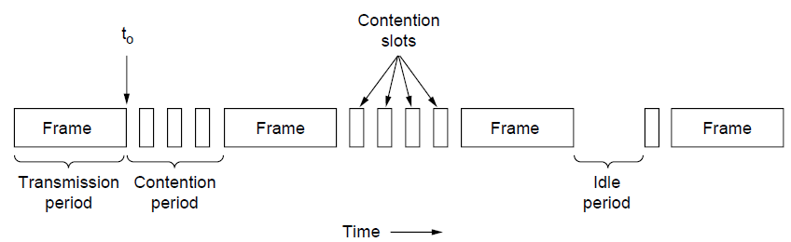
CSMA with Collision Detection
CSMA/CD can be in one of three states: contention, transmission, or idle.

Slide 19
Collision-Free Protocols
In CSMA/CD collisions can still occur during the contention period.
Collisions reduce bandwidth and they make the time to send a frame variable, which is not a good fit for real-time traffic such as voice over IP.
Require protocols that resolve the contention for the channel without any collisions at all, not even during the contention period.
A Bit-Map Protocol
Each contention period consists of exactly N slots.
If station 0 has a frame to send, it transmits a 1 bit during the slot 0. No other station is allowed to transmit during this slot.
After all N slots have passed by, each station has complete knowledge of which stations wish to transmit.
At that point, they begin transmitting frames in numerical order
Since everyone agrees on who goes next, there will never be any collisions.

Slide 20
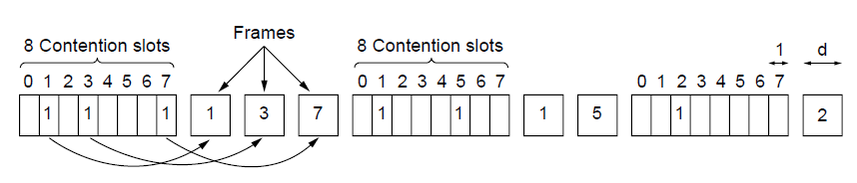
Collision-Free Protocols (1)
The basic bit-map protocol.

Slide 21
Collision-Free Protocols
Since low-numbered stations must wait on average 1.5N slots and high-numbered stations must wait on average 0.5N slots, the mean for all stations is N slots.
For low load the overhead is d /(d + N).(d:data bits).
At high load,the Nbit contention period is prorated over N frames, yielding an overhead of only 1 bit per frame, or an efficiency of d /(d + 1).
Token Passing
Pass a small message called a token from one station to the next in the same predefined order.
The token represents permission to send.
If a station has a frame queued for transmission when it receives the token, it can send that frame before it passes the token to the next station.
If it has no queued frame, it simply passes the token.

Slide 22
Collision-Free Protocols
Frames are also transmitted in the direction of the token.
This way they will circulate around the ring and reach whichever station is the destination
However, to stop the frame circulating indefinitely (like the token), either sender or receiver needs to remove it from the ring.
A subtle difference with bit-map protocol is that, since all positions in the cycle are equivalent, there is no bias for low- or high-numbered stations.
Ex:Token Ring,FDDI(Fiber Distributed Data Interface),RPR (Resilient Packet Ring)

Slide 23
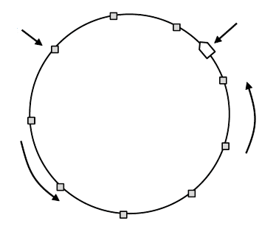
Collision-Free Protocols (2)
Token
Station
Direction of
transmission
Token ring.

Slide 24
Collision-Free Protocols
Binary Countdown
Bit-map protocol,token ring does not scale well to networks with thousands of stations.
A station wanting to use the channel now broadcasts its address as a binary bit string, starting with the high order
bit.
All addresses are assumed to be the same length.
The bits in each address position from different stations are BOOLEAN ORed together by the channel when they are sent at the same time.
We will call this protocol binary countdown.
Arbitration Rule: As soon as a station sees that a high-order bit position that is 0 in its address has been overwritten with
a 1, it gives up.

Slide 25
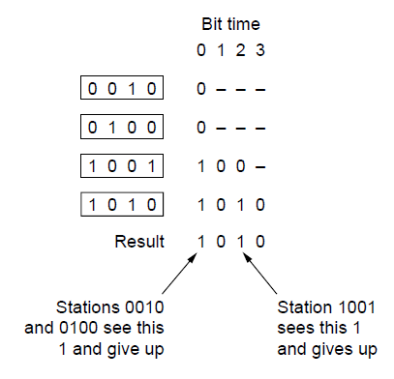
Binary Countdown
The binary countdown protocol. A dash indicates silence.

Slide 26
Collision-Free Protocols
The channel efficiency of this method is d /(d + log2 N).
The frame format has been cleverly chosen so that the sender’s address is the first field in the frame, even these log2 N bits are not wasted, and the efficiency is 100%.

Slide 27
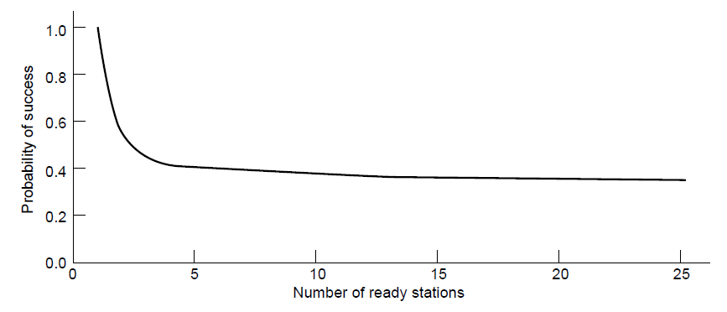
Limited-Contention Protocols
Acquisition probability for a symmetric contention channel.

Slide 28
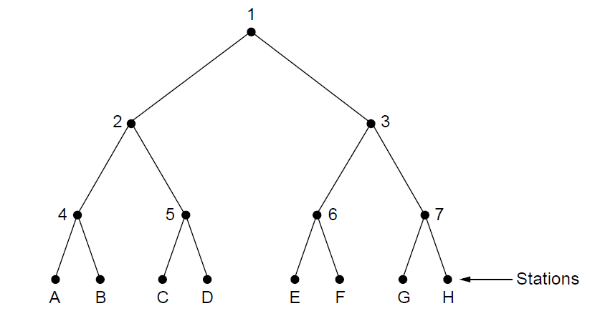
The Adaptive Tree Walk Protocol
The tree for eight stations

Slide 29
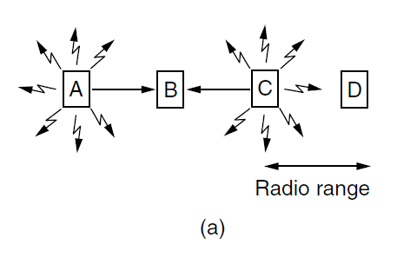
Wireless LAN Protocols (1)
A wireless LAN. (a) A and C are hidden terminals when transmitting to B.

Slide 30
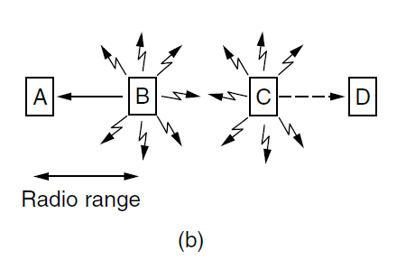
Wireless LAN Protocols (2)
A wireless LAN. (b) B and C are exposed terminals when transmitting to A and D.

Slide 31
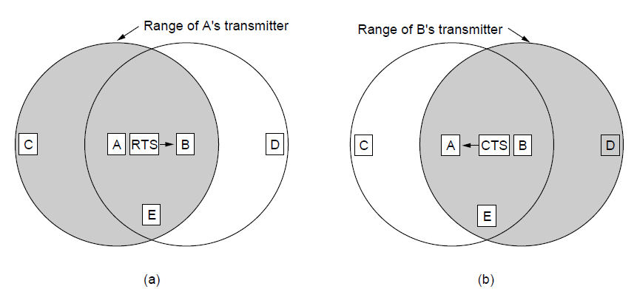
Wireless LAN Protocols (3)
The MACA protocol. (a) A sending an RTS to B. (b) B responding with a CTS to A.

Slide 32
Ethernet
Many of the designs for personal, local, and metropolitan area networks have been standardized under the name of IEEE 802
We will begin our study of real systems with Ethernet, probably the most ubiquitous kind of computer network in the world.
Two kinds
classic Ethernet:ran at rates from 3 to 10 Mbps
switched Ethernet:runs at 100, 1000, and 10,000 Mbps
Many people use the terms ‘‘Ethernet’’ and ‘‘IEEE 802.3’’ interchangeably.

Slide 33
Ethernet
Physical layer
MAC sublayer protocol
Ethernet performance
Switched Ethernet
Fast Ethernet
Gigabit Ethernet
10 Gigabit Ethernet
IEEE 802.2: Logical Link Control
Retrospective on Ethernet

Slide 34
Classic Ethernet Physical Layer
Bob Metcalfe together with his colleague David Boggs, designed and implemented the first local area network using
a single long, thick coaxial cable and ran at 3 Mbps.
They called the system Ethernet after the luminiferous ether through which electromagnetic radiation was once thought to propagate.
DEC, Intel, and Xerox drew up a standard in 1978 for a 10-Mbps Ethernet, called the DIX standard. With a minor
change, the DIX standard became the IEEE 802.3 standard in 1983.
The first variety, popularly called thick Ethernet, with
markings every 2.5 meters to show where to attach computers.
It was succeeded by thin Ethernet, which bent more easily and made connections using industry-standard BNC connectors.

Slide 35
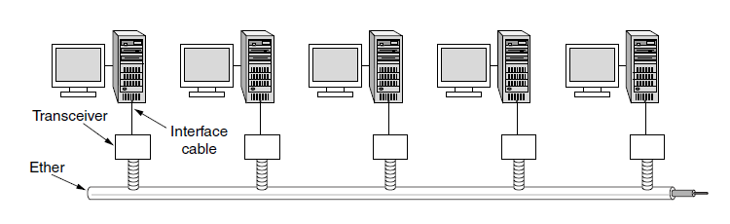
Classic Ethernet Physical Layer
Architecture of classic Ethernet

Slide 36
Classic Ethernet Physical Layer
Each version of Ethernet has a maximum cable length per segment over which the signal will propagate.
To allow larger networks, multiple cables can be connected by repeaters.
A repeater is a physical layer device that receives, amplifies (i.e., regenerates), and retransmits signals in both directions.
Over each of these cables, information was sent using the Manchester encoding.
No two transceivers could be more than 2.5 km apart and
no path between any two transceivers could traverse more than four repeaters.

Slide 37
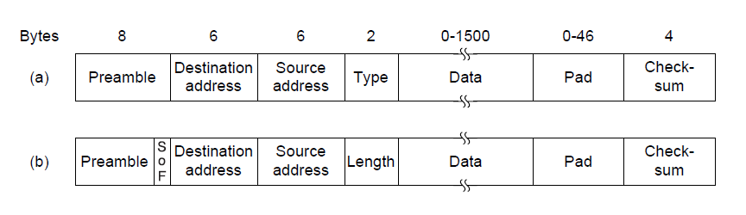
MAC Sublayer Protocol (1)
Frame formats. (a) Ethernet (DIX). (b) IEEE 802.3.

Slide 38
MAC Sublayer Protocol
Preamble: 8 bytes, each containing the bit pattern 10101010
except the last byte.
Last byte of preamble is called the Start of Frame delimiter for 802.3.(10101011)
Next come two addresses, one for the destination and one for the source. They are each 6 bytes long.
The first transmitted bit of the destination address is a 0 for ordinary addresses and a 1 for group addresses.
Sending to a group of stations is called multicasting.
The special address consisting of all 1 bits is reserved for broadcasting.
station source addresses is globally unique, assigned centrally by IEEE.
The address is 48-bit number.

Slide 39
MAC Sublayer Protocol
Ethernet uses a Type field to tell the receiver what to do
with the frame.
Example:0x0800 means that the data contains
an IPv4 packet.
But In IEEE 802.3 we require addition of another header for the LLC (Logical Link Control) protocol within the data. It uses 8 bytes to convey the 2 bytes of protocol type information.
Now the rule is that any number there less than or equal to 0x600 (1536) can be interpreted as Length, and any number greater than 0x600 can be interpreted as Type.
Next come the data, up to 1500 bytes.
To make it easier to distinguish valid frames from garbage, Ethernet requires that valid frames must be at least 64 bytes long, from destination address to checksum, including both.
If the data portion of a frame is less than 46 bytes, the Pad field is used to fill out the frame to the minimum size.

Slide 40
MAC Sublayer Protocol
If a station tries to transmit a very short frame, it is conceivable that a collision will occur, but the transmission will have completed before the noise burst gets back to the station at 2τ.
The sender will then incorrectly conclude that the frame was successfully sent.
Toprevent this situation from occurring, all frames must take more than 2τ to send so that the transmission is still taking place when the noise burst gets back to the sender.
The final field is the 32-bit CRC Checksum.It just does error detection, with the frame dropped if an error is
detected.

Slide 41
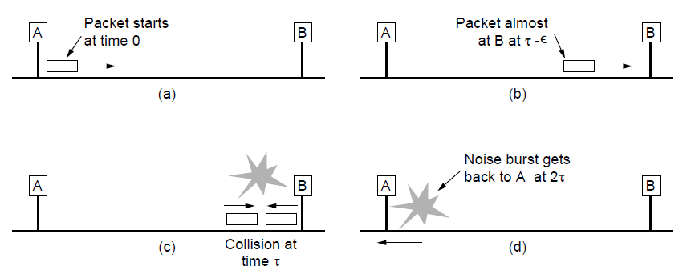
MAC Sublayer Protocol (2)
Collision detection can take as long as 2τ.

Slide 42
MAC Sublayer Protocol
CSMA/CD with Binary Exponential Backoff
Classic Ethernet uses the 1-persistent CSMA/CD algorithm.
Stations sense the medium when they have a frame to send and send the frame as soon as the medium becomes idle.
They monitor the channel for collisions as they send.
If there is a collision, they abort the transmission with a short jam signal and retransmit after a random interval.
After a collision, time is divided into discrete slots whose length is equal to 51.2 μsec(worst-case round trip propagation time).
After the first collision, each station waits either 0 or 1 slot times at random before trying again.
In general, after i collisions, a random number between 0 and 2i − 1 is chosen, and that number of slots is skipped.
This algorithm, called binary exponential backoff, was chosen to dynamically adapt to the number of stations trying to send.

Slide 43
MAC Sublayer Protocol
If the randomization interval for all collisions were 1023, the chance of two stations colliding for a second time would be negligible, but the average wait after a collision would be hundreds of slot times, introducing significant delay
If there is no collision, the sender assumes that the frame was probably successfully delivered.
This choice is appropriate for wired and optical fiber channels that have low error rates.
Any errors that do occur must then be detected by the CRC
and recovered by higher layers.
For wireless channels that have more errors, we will see that acknowledgements are used.

Slide 44
Ethernet Performance
If the mean frame takes P sec to transmit, when many stations have frames to send,
Channel efficiency =P/(P + 2τ/A)
A-probability that some station acquire the channel in a time slot.
With P = F/B, then
Channel efficiency = 1/(1 + 2BLe /(cF))
F=Frame Length L=cable length c=signal propagation speed
e=contention slots/frame.
Example:2τ = 51.2 μsec and a data rate of 10 Mbps.64-
byte slot time

Slide 45
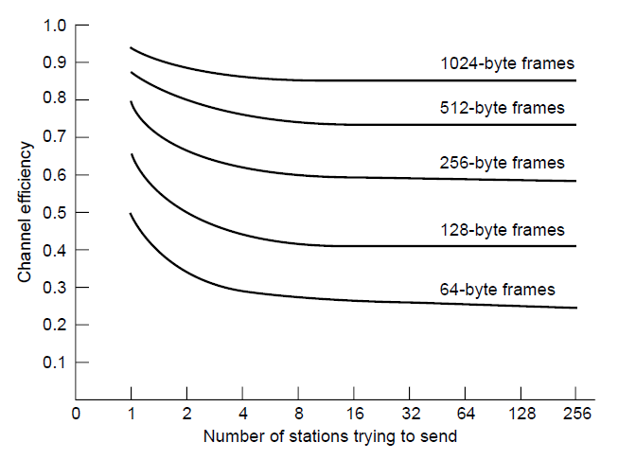
Ethernet Performance
Efficiency of Ethernet at 10 Mbps with 512-bit slot times.

Slide 46
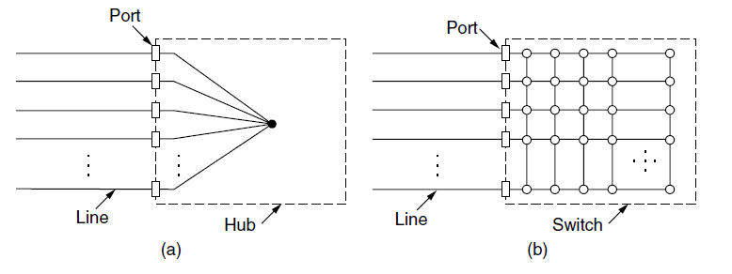
Switched Ethernet (1)
(a) Hub. (b) Switch.

Slide 47
Switched Ethernet (1)
each station has a dedicated cable running to a central hub.
A hub simply connects all the attached wires electrically,
Adding or removing a station is simpler in this configuration, and cable breaks can be detected easily.
Hubs do not increase capacity because they are logically equivalent to the single long cable of classic Ethernet.
Fortunately, there is an another way to deal with increased load: switched Ethernet.
The heart of this system is a switch containing a high-speed backplane that connects all of the ports
They are both boxes, typically with 4 to 48 ports, each with
a standard RJ-45 connector for a twisted-pair cable. Each cable connects the switch or hub to a single computer.

Slide 48
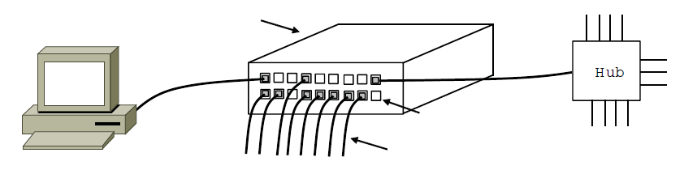
Switched Ethernet (2)
Switch
Hub
Switch ports
Twisted pair
An Ethernet switch.

Slide 49
Switched Ethernet
When a switch port receives an Ethernet frame from a station, the switch checks the Ethernet addresses to see which port the frame is destined to.
The backplane typically runs at many Gbps, using a proprietary protocol that does not need to be standardized because it is entirely hidden inside the switch.
The destination port then transmits the frame on the wire so that it reaches the intended station.
In a switch, each port is its own independent collision domain.
In the common case that the cable is full duplex, both the station and the port can send a frame on the cable at the same time, without worrying about other ports and stations.

Slide 50
Switched Ethernet
Advantages:
The capacity is used more efficiently.
Multiple frames can be sent simultaneously
The switch must have buffering so that it can temporarily queue an input frame until it can be transmitted to the output port.
With a switch, traffic is forwarded only to the ports where it is destined.
This restriction provides better isolation so that traffic will not easily escape and fall into the wrong hands.
It is possible to use some of the ports as concentrators.
Example:Connect to a 12-port hub.

Slide 51
Fast Ethernet
But even with Ethernet switches, the maximum bandwidth
of a single computer was limited by the cable that connected it to the switch port.
The committee decided to keep 802.3 the way it was, and just make it go faster.
The new design would also be backward compatible with existing Ethernet LANs.
802.3u was approved by IEEE in June 1995 which is an addendum to the existing 802.3 standard and it is called fast Ethernet.
Keep all the old frame formats, interfaces, and procedural rules, but reduce the bit time from 100 nsec to 10 nsec.
Fast Ethernet is based entirely on twisted-pair wiring.
There are 3 choices for cabling.

Slide 52
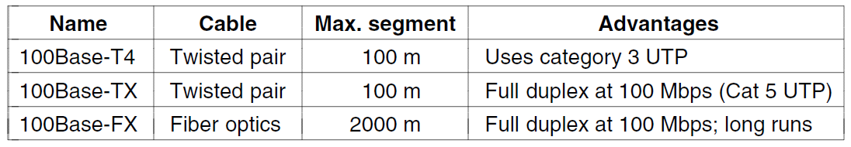
Fast Ethernet
The original fast Ethernet cabling.

Slide 53
Fast Ethernet
Category 3:
Also called 100Base-T4, used a signaling speed of 25 MHz, only 25% faster than standard Ethernet’s 20 MHz.
Uses four twisted pairs,one is always to the hub, one is always from the hub, and the other two are switchable to the current transmission direction.
It involves sending ternary digits with three different voltage levels.
Category 5:
Design is simpler because the wires can handle clock rates of 125 MHz.
Only two twisted pairs per station are used, one to the hub and one from it.
4 data bits are encoded as 5 signal bits and sent at 125 MHz to provide 100 Mbps.
The 100Base-TX system is full duplex.

Slide 54
Fast Ethernet
100Base-FX:
It uses two strands of multimode fiber, one for each direction, so it, too, can run full duplex with 100 Mbps in each direction.
the distance between a station and the switch can be up to 2 km.
To ensure that the CSMA/CD algorithm continues to work, the relationship between the minimum frame size and maximum cable length must be maintained as the network speed goes up from 10 Mbps to 100 Mbps.
2-km 100Base-FX cables aretoo long to permit a 100-Mbps hub with the normal Ethernet collision algorithm.
These cables must instead be connected to a switch and operate in a full-duplex mode so that there are no collisions.
virtually all fast Ethernet switches can handle a mix of 10-Mbps and 100-Mbps stations.
To make upgrading easy, the standard itself provides a mechanism called autonegotiation.

Slide 55
Gigabit Ethernet
The goal of gigabit Ethernet is to offer unacknowledged datagram service with both unicast and broadcast.
gigabit Ethernet use point-to-point links or uses a switch
or a hub connected to multiple computers
gigabit Ethernet supports two different modes of operation: full-duplex mode and half-duplex mode.
Normal case:
central switch connected to computers and all lines are buffered so each computer and switch is free to send frames whenever it wants to.
contention is impossible due to full duplex channel .
The maximum length of the cable is determined by signal strength issues rather than by how long it takes for a noise burst to propagate back to the sender
other case:
the computers are connected to a hub rather than a switch.
A hub does not buffer incoming frames.

Slide 56
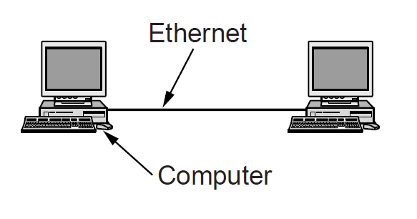
Gigabit Ethernet (1)
A two-station Ethernet

Slide 57
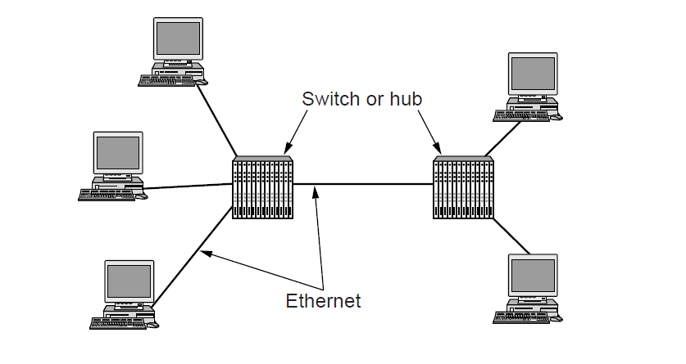
Gigabit Ethernet (2)
A two-station Ethernet

Slide 58
Gigabit Ethernet
In this mode, collisions are possible, so the standard
CSMA/CD protocol is required.
Two new features are added
Carrier extension :the maximum cable length to 200 meters and extend the normal frame to 512 bytes.
frame bursting:allows a sender to transmit a concatenated
sequence of multiple frames in a single transmission.
Gigabit Ethernet supports both copper and fiber cabling.
Signaling at the short wavelength can be achieved with cheaper LEDs.
It is used with multimode fiber and is useful for connections within a building, as it can run up to 500 m for 50-micron fiber.
Signaling at the long wavelength requires more expensive lasers.

Slide 59
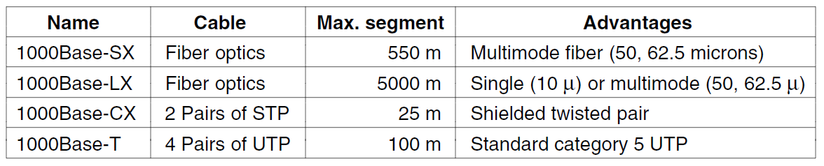
Gigabit Ethernet (3)
Gigabit Ethernet cabling.

Slide 60
Gigabit Ethernet
On the other hand, when combined with single mode (10-micron) fiber, the cable length can be up to 5 km.
This limit allows long distance connections between buildings, such as for a campus backbone, as a dedicated point-to-point link.
To send bits over these versions of gigabit Ethernet we use 8B/10B encoding.
Within a year, 1000Base-T came along to fill the gap, and it has been the most popular form of gigabit Ethernet ever since.
All four twisted pairs in the cable are used, and each pair is used in both directions at the same time by using digital signal
processing to separate signals.

Slide 61
Gigabit Ethernet
Over each wire, five voltage levels that carry 2 bits are used for signaling at 125 Msymbols/sec.
The gigabit Ethernet supports flow control.
The mechanism consists of one end sending a special control frame to the other end telling it to pause for some period of time.
These PAUSE control frames are normal Ethernet frames containing a type of 0x8808.
For gigabit Ethernet, the time unit is 512 nsec, allowing for pauses as long as 33.6 msec.
gigabit Ethernet supports Jumbo frames allow for frames to be longer than 1500 bytes, usually up to 9 KB.

Slide 62
10 Gigabit Ethernet
10 Gbps is 1000x faster than the original Ethernet.
It is neede inside data centers and exchanges to connect high-end routers, switches, and servers, as well as in long -distance, high bandwidth trunks(MAN).
All versions of 10-gigabit Ethernet support only full-duplex operation.
CSMA/CD is no longer part of the design, and the standards concentrate on the details of physical layers that can run at very high speed.
Multimode fiber with the 0.85μ (short) wavelength is used for medium distances, and singlemode fiber at 1.3μ (long) and 1.5μ (extended) is used for long distances.
10GBase-ER can run for distances of 40 km, making it suitable for wide area applications.

Slide 63
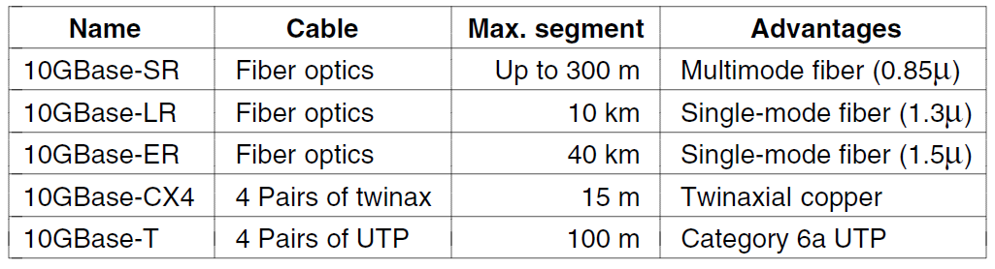
10 Gigabit Ethernet
Gigabit Ethernet cabling

Slide 64
All of these versions send a serial stream of information that is produced by scrambling the data bits, then encoding them with a 64B/66B code.
10GBase-CX4, uses a cable with four pairs of twinaxial copper wiring. Each pair uses 8B/10B coding and runs at 3.125 Gsymbols/second to reach 10 Gbps.
10GBase-T is the version that uses UTP cables.
Each of the four twisted pairs is used to send 2500 Mbps in
both directions.
This speed is reached using a signaling rate of 800 Msymbols /sec with symbols that use 16 voltage levels.
The symbols are produced by scrambling the data, protecting it with a LDPC

Slide 65
Retrospective on Ethernet
Ethernet is simple and flexible.
Reliable:Once the hub and switch architecture was adopted, failures became extremely rare.
Cheap :Twisted-pair wiring is relatively inexpensive and may be expensive when there is transition to new NICs or switches.
Easy to maintain:There is no software to install other than the
drivers and adding new hosts is as simple .
Ethernet interworks easily with TCP/IP, which has
become dominant.
Ethernet has been able to evolve for increasing speeds but does not required changing the software and have often allowed the existing cabling to be reused for a time.
Much effort is being put into carrier-grade Ethernet to let network providers offer Ethernet-based services to their customers for metropolitan and wide area networks.

Slide 66
Wireless Lans
802.11 architecture and protocol stack
802.11 physical layer
802.11 MAC sublayer protocol
802.11 frame structure
Services

Slide 67
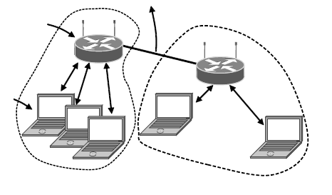
802.11 Architecture and Protocol Stack (1)
To Network
Access Point
Client
802.11 architecture – infrastructure mode

Slide 68
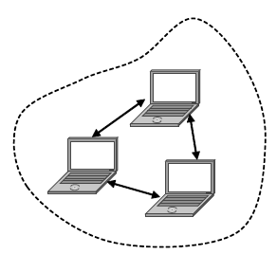
802.11 Architecture and Protocol Stack (2)
802.11 architecture – ad-hoc mode

Slide 69
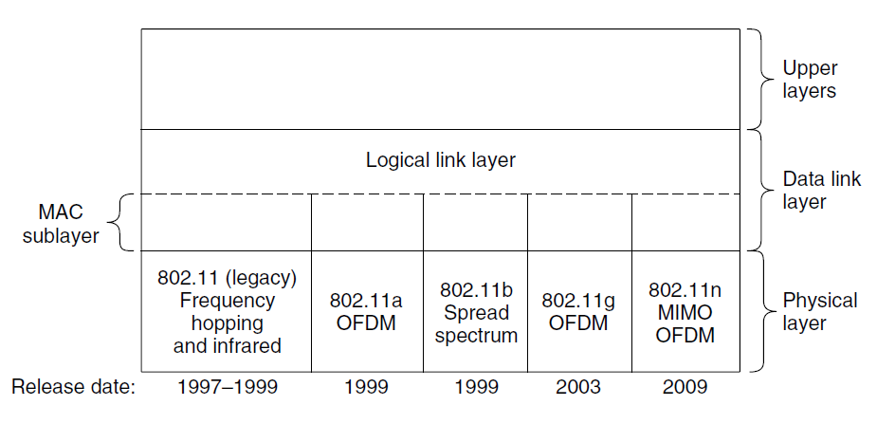
802.11 Architecture and Protocol Stack (3)
Part of the 802.11 protocol stack.

Slide 70
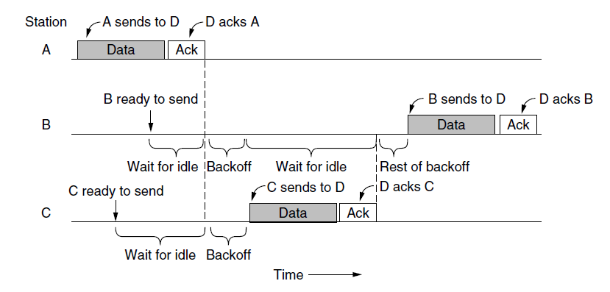
The 802.11 MAC Sublayer Protocol (1)
Sending a frame with CSMA/CA.

Slide 71
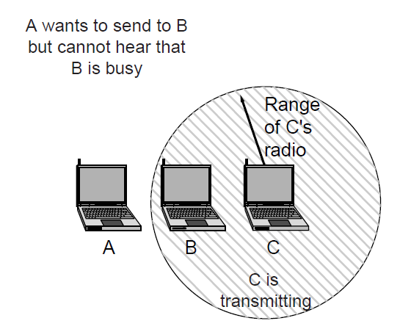
The 802.11 MAC Sublayer Protocol (2)
The hidden terminal problem.

Slide 72
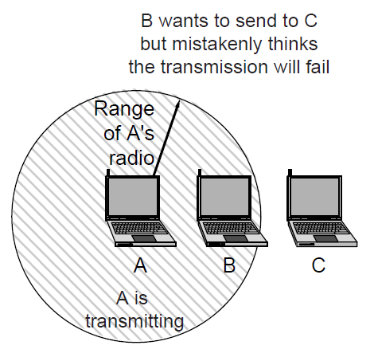
The 802.11 MAC Sublayer Protocol (3)
The exposed terminal problem.

Slide 73
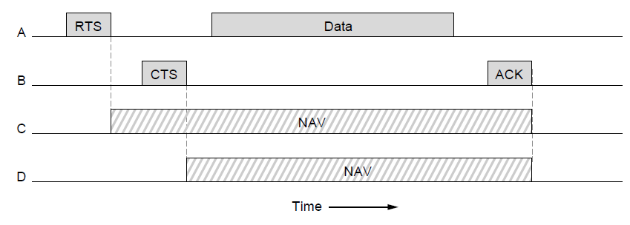
The 802.11 MAC Sublayer Protocol (4)
The use of virtual channel sensing using CSMA/CA.

Slide 74
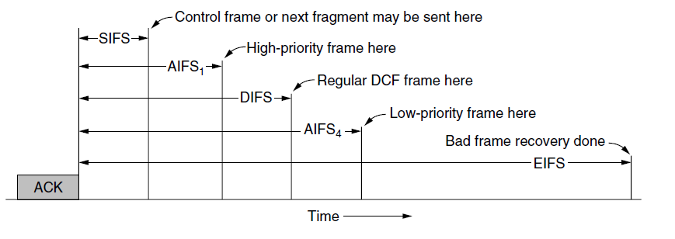
The 802.11 MAC Sublayer Protocol (5)
Interframe spacing in 802.11

Slide 75
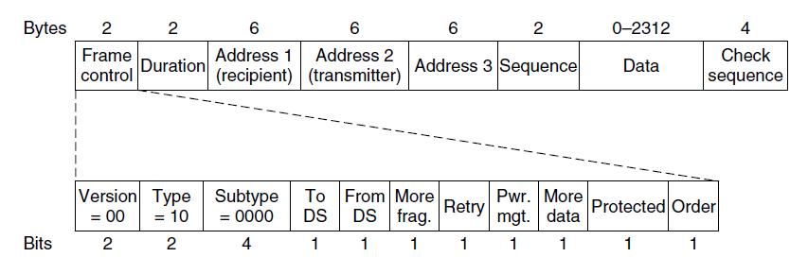
802.11 Frame Structure
Format of the 802.11 data frame

Slide 76
Broadband Wireless
Comparison of 802.16 with 802.11, 3G
802.16 architecture and protocol stack
802.16 physical layer
802.16 frame structure

Slide 77
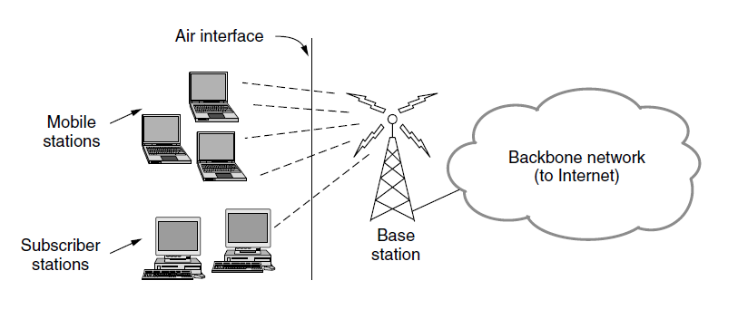
Comparison of 802.16 with 802.11 and 3G
The 802.16 architecture

Slide 78
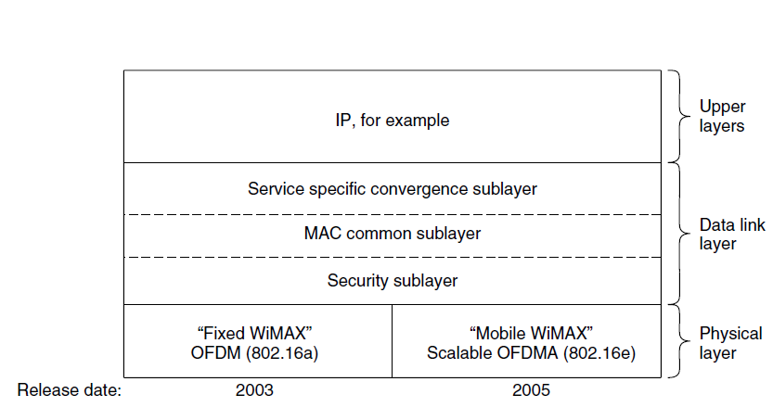
802.16 Architecture and Protocol Stack
The 802.16 protocol stack

Slide 79
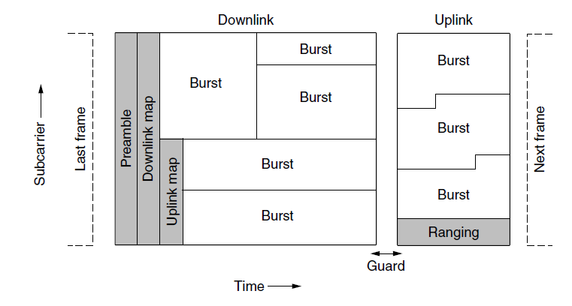
802.16 Physical Layer
Frames structure for OFDMA with time division duplexing.

Slide 80
802.16 MAC Sublayer Protocol
Classes of service
Constant bit rate service.
Real-time variable bit rate service.
Non-real-time variable bit rate service.
Best-effort service.

Slide 81
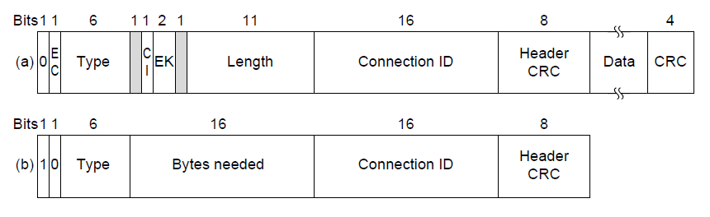
802.16 Frame Structure
(a) A generic frame. (b) A bandwidth request frame.

Slide 82
Bluetooth
Architecture
Applications
Protocol stack
Radio layer
Link layers
Frame structure

Slide 83
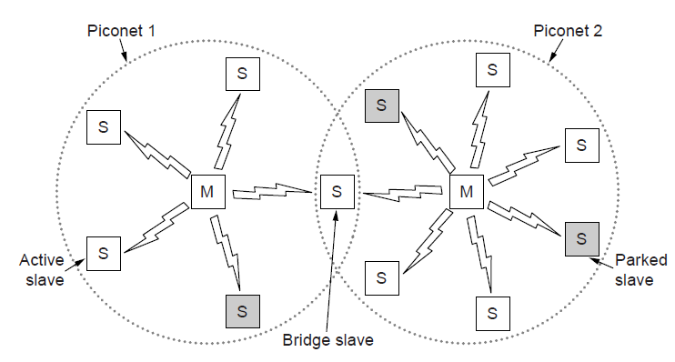
Bluetooth Architecture
Two piconets can be connected to form a scatternet

Slide 84
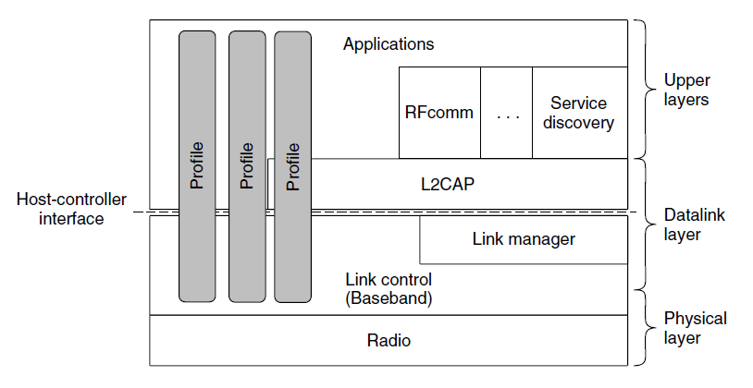
Bluetooth Protocol Stack
The Bluetooth protocol architecture.

Slide 85
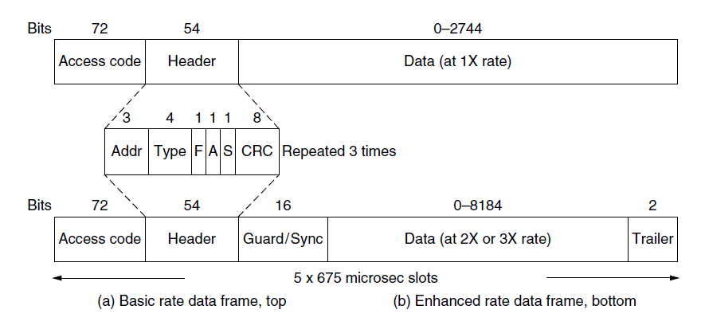
Bluetooth Frame Structure
Typical Bluetooth data frame at (a) basic, and (b) enhanced, data rates.

Slide 86
RFID
EPC Gen 2 architecture
EPC Gen 2 physical layer
EPC Gen 2 tag identification layer
Tag identification message formats

Slide 87
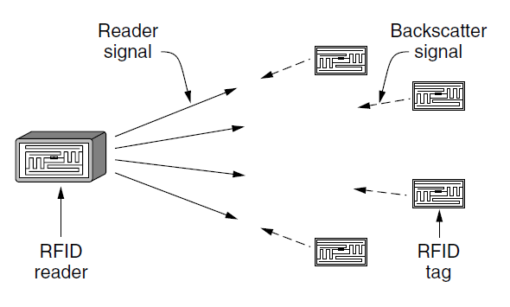
EPC Gen 2 Architecture
RFID architecture.

Slide 88
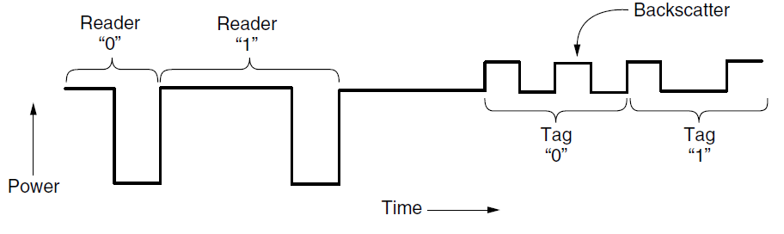
EPC Gen 2 Physical Layer
Reader and tag backscatter signals.

Slide 89
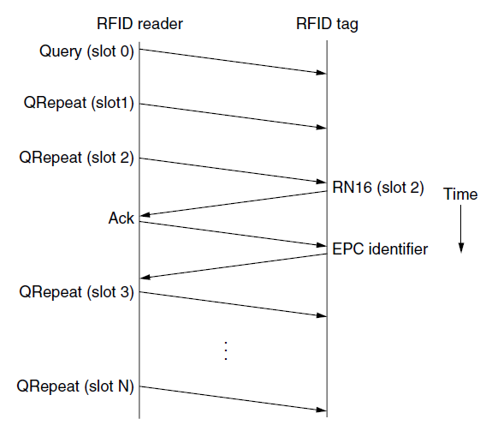
EPC Gen 2 Tag Identification Layer
Example message exchange to identify a tag.

Slide 90
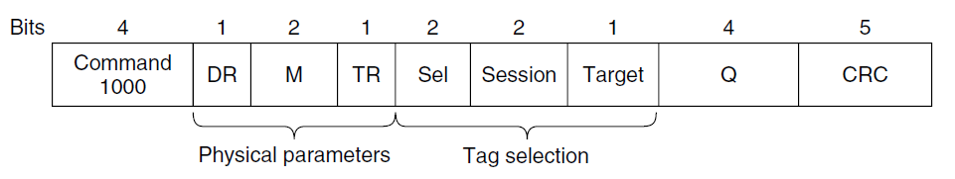
Tag Identification Message Formats
Format of the Query message.

Slide 91
Data Link Layer Switching
Uses of bridges
Learning bridges
Spanning tree bridges
Repeaters, hubs, bridges, switches, routers, and gateways
Virtual LANs

Slide 92
Data Link Layer Switching
Many organizations have multiple LANs and wish to connect them.
We can do this when the connections are made with devices called bridges.
Bridges operate in the data link layer, so they examine the data link layer addresses to forward frames.
Uses of Bridges
Bridges are needed to provide interaction between different departments of universities or corporate offices.
Organization may be geographically spread over several buildings and it is cheaper have separate LANs in each building and connect them with bridges
It may be necessary to split what is logically a single LAN into separate
LANs (connected by bridges) to accommodate the load.

Slide 93
Data Link Layer Switching
Two separate LANs have twice the capacity of a single LAN.
By deciding what to forward and what not to forward, bridges act like fire doors in a building
Ideally bridges should be completely transparent.
The operation of the existing LANs should not be affected by the bridges at all.
Two algorithms are used
Backward learning algorithm to stop traffic being sent where it is not needed;
Spanning tree algorithm :to break loops that may be formed when switches are cabled together willy-nilly.

Slide 94
Learning Bridges
Case 1: Two multidrop LANs, such as classic Ethernets, are
joined by a special station ,the bridget that sits on both LANs
Case2:LANs with point-to-point cables, including one hub, are joined together.
The bridges are the devices to which the stations and hub are attached.
If the LAN technology is Ethernet, the bridges are better known as Ethernet switches.
All of the stations attached to the same port on a bridge belong to the same collision domain, and this is different than the collision domain for other ports.
If there is more than one station the CSMA/CD protocol
is used to send frames.

Slide 95
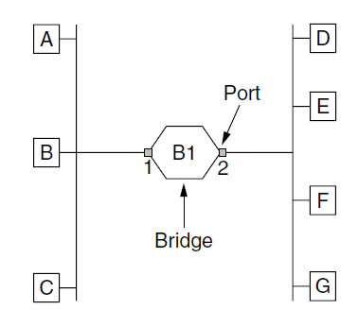
Learning Bridges (1)
Bridge connecting two multidrop LANs

Slide 96
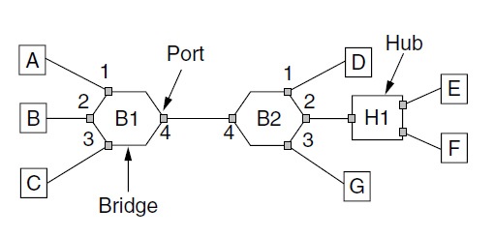
Learning Bridges (2)
Bridges (and a hub) connecting seven point-to-point stations.

Slide 97
Learning Bridges
In multidrop LAN a bridge is added as a new station where as in point-to-point LANs the hubs are either connected to a bridge or, preferably, replaced with a bridge.
Different kinds of cables can also be attached to one bridge.
Ex:fiber optic link,short-haul twisted-pair line.
Operation:
It accepts every frame transmitted by the stations attached to each of its ports.
The bridge must decide whether to forward or discard each frame.
The frame is forwarded to output port by using the destination address.
Ex:If station A sends a frame to station B.B1 recieves and discard because it is already on the correct port.
Implement a big a big (hash) table inside the bridge.
The table can list each possible destination and which output port it belongs on.

Slide 98
Learning Bridges
When the bridges are first plugged in, all the hash tables are empty.
None of the bridges know where any of the destinations are, so they use a flooding algorithm.
Every incoming frame for an unknown destination is output on all the ports.
Once a destination is known, frames destined for it are put only on the proper port; they are not flooded.
The algorithm used by the bridges is backward learning.
By looking at the source addresses, they can tell which machines are accessible on which ports.
To handle dynamic topologies, whenever a hash table entry is made, the arrival time of the frame is noted in the entry.

Slide 99
Learning Bridges
Periodically, a process in the bridge scans the hash table and purges all entries more than a few minutes old.
If a machine is quiet for a few minutes, any traffic sent to it will have to be flooded until it next sends a frame itself.
The routing procedure is
If the port for the destination address is the same as the source port, discard the frame.
If the port for the destination address and the source port are different, forward the frame on to the destination port.
If the destination port is unknown, use flooding and send the frame on all ports except the source port.
Example:If E sends a frame to F.
The above procedure is implemented with special-purpose VLSI chips(complete the process in msec).
The routing is cut-through switching or wormhole routing and is usually handled in hardware.

Slide 100
Learning Bridges
Example:Consider a frame sent from station A to station D.
The packet comes from a higher layer and descends into the Ethernet MAC layer.
It acquires an Ethernet header .
This unit is passed to the physical layer, goes out over the cable, and is picked up by the bridge.
In the bridge, the frame is passed up from the physical layer to the Ethernet MAC layer.
It passes the frame to a relay, still within the MAC layer.
The bridge relay function uses only the Ethernet MAC header to determine how to handle the frame.
In this case, it passes the frame to the Ethernet MAC layer of
the port used to reach station D, and the frame continues on its way.

Slide 101
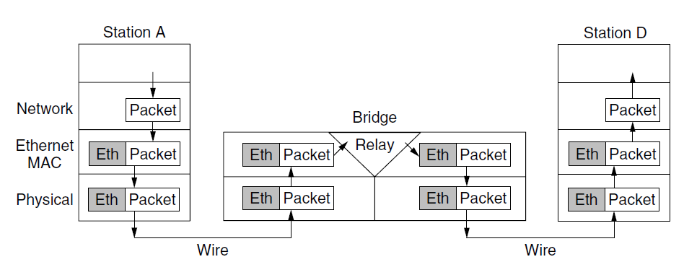
Learning Bridges (3)
Protocol processing at a bridge.

Slide 102
Spanning Tree Bridges
To increase reliability, redundant links can be used between bridges.
However, this redundancy introduces some additional problems because it creates loops in the topology
Ex:
Call the frame from A that reaches bridge B1 frame F0.
The bridge sends copies of this frame out all of its other ports.
Since there are two links from B1 to B2, two copies of the frame will reach B2.
B2 does not know that they are copies of the same frame,takes F1 and F2 sends copies of it out all the other ports.
Bridge B1 then sees two new frames with unknown destinations and copies them again.
This cycle goes on forever.

Slide 103
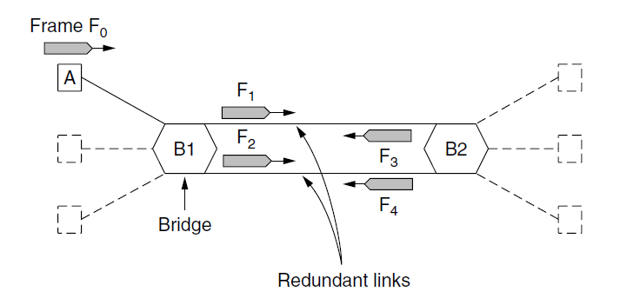
Spanning Tree Bridges (1)
Bridges with two parallel links

Slide 104
Spanning Tree Bridges
The solution is bridges to communicate with each other and overlay the actual topology with a spanning tree that reaches every bridge.
Ex: five bridges that are interconnected and also have stations connected to them.
This topology can be thought of as a graph in which the bridges are the nodes and the point-to-point links are the edges.
The graph can be reduced to a spanning tree, which has no cycles by definition,by dropping the links.
Using this spanning tree, there is exactly one path from every station to every other station.
Once the bridges have agreed on the spanning tree, all forwarding between stations follows the spanning tree.

Slide 105
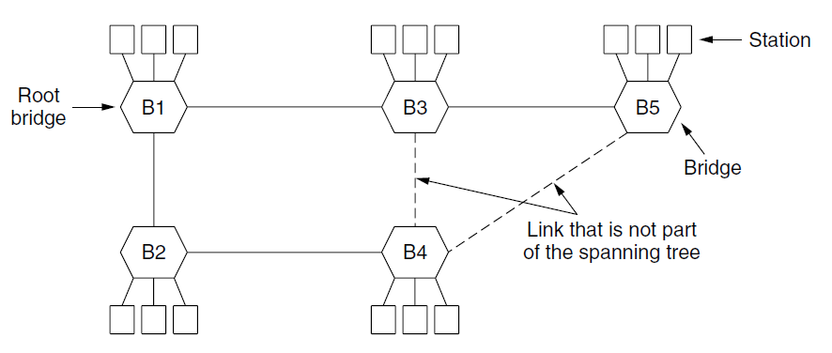
Spanning Tree Bridges (2)
A spanning tree connecting five bridges. The dotted lines are links that are not part of the spanning tree.

Slide 106
Spanning Tree Bridges
To build the spanning tree, the bridges run a distributed algorithm.
Each bridge periodically broadcasts a configuration message out all of its ports to its neighbors and processes the messages it receives from other bridges.
The bridges must first choose one bridge to be the root of the spanning tree.
To make this choice, they each include an identifier based on their MAC address in the configuration message, as well as the identifier of the bridge they believe to be the root.
The bridges choose the bridge with the lowest identifier to be the root.
After enough messages have been exchanged to spread the news, all bridges will agree on which bridge is the root.
Ex:B1 becomes root.

Slide 107
Spanning Tree Bridges
Next, a tree of shortest paths from the root to every bridge is constructed.
So bridges B2 and B3 can each be reached from bridge B1 directly, in one hop that is a shortest path.
B4 is reached via B2(lowest identifier). Bridge B5 can be reached in two hops via B3.
Even after the spanning tree has been established, the algorithm continues to run during normal operation to automatically detect topology changes and update the tree.
The algorithm for constructing the spanning tree was invented by Radia Perlman.

Slide 108
Poem by Radia Perlman (1985) Algorithm for Spanning Tree (1)
I think that I shall never see
A graph more lovely than a tree.
A tree whose crucial property
Is loop-free connectivity.
A tree which must be sure to span.
So packets can reach every LAN.
. . .

Slide 109
Poem by Radia Perlman (1985) Algorithm for Spanning Tree (2)
. . .
First the Root must be selected
By ID it is elected.
Least cost paths from Root are traced
In the tree these paths are placed.
A mesh is made by folks like me
Then bridges find a spanning tree.

Slide 110
Repeaters, Hubs, Bridges, Switches, Routers, and Gateways
Example transmission
The user generates some data to be sent to a remote machine.
Those data are passed to the transport layer, which then adds a header and passes the resulting unit down to the network layer.
The network layer adds its own header to form a network layer packet .
Then the packet goes to the data link layer, which adds its own header and checksum (CRC) and gives the resulting
frame to the physical layer for transmission, for example, over a LAN.

Slide 111
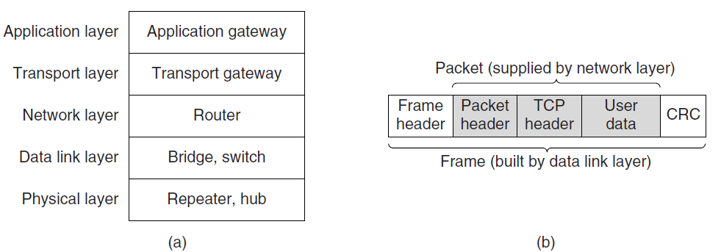
Repeaters, Hubs, Bridges, Switches, Routers, and Gateways
(a) Which device is in which layer. (b) Frames, packets, and headers.

Slide 112
Repeaters, Hubs, Bridges, Switches, Routers, and Gateways
Repeater:
Analog devices that work with signals on the cables to which they are connected.
A signal appearing on one cable is cleaned up, amplified, and put out on another cable.
Repeaters do not understand frames, packets, or headers. They understand the symbols that encode bits as volts
Ex:with 4 repeaters the maximum cable length from 500 meters to 2500 meters.
Hubs:
Hub is a physical layer device and has a number of input lines that it joins electrically.
Frames arriving on any of the lines are sent out on all the others.
If two frames arrive at the same time, they will collide, just as on a coaxial cable.

Slide 113
Repeaters, Hubs, Bridges, Switches, Routers, and Gateways
They do not (usually) amplify the incoming signals.
Bridges:
Connects two or more LANs.
A modern bridge has multiple ports, usually enough for 4 to 48
input lines
Each port is isolated to be its own collision domain and if the port has a full-duplex point-to-point line, the CSMA/CD algorithm is not needed
Extracts the destination address from the frame header and looks it up in a table to see where to send the frame.
The bridge only outputs the frame on the port where it is needed and can forward multiple frames at the same time.
Bridges offer much better performance than hubs and Input lines may run at different speeds.
Buffering within the bridge is needed and If frames come in faster
the bridge may run out of buffer space and have to start discarding frames.

Slide 114
Repeaters, Hubs, Bridges, Switches, Routers, and Gateways
Modern bridges usually work for one network type because of
different frame formats,security and quality of service.
Switches:
Switches are modern bridges by another name.
Bridges have relatively few ports where as switches will tend to have many ports because of poin-point links.
Routers:
When a packet comes into a router, the frame header and trailer are stripped off and the packet located in the frame’s payload field is passed to the routing software.
This software uses the packet header to choose an output line.
Ex:32-bit IPV4 or 128-bit IPV6 address.
The routing software does not see the frame addresses and does not even know whether the packet came in on a LAN

Slide 115
Repeaters, Hubs, Bridges, Switches, Routers, and Gateways
Transport gateways:
Connect two computers that use different connection-oriented transport protocols.
Ex:TCP and SCTP
The transport gateway can copy the packets from one connection to the other, reformatting them as need be.
Application gateways:
Understand the format and contents of the data and can translate messages from one format to another
Ex:email gateway translate Internet messages into SMS messages for mobile phones.

Slide 116

Virtual LANs (1)
A building with centralized wiring using hubs and a switch.

Slide 117
Virtual LANs
Network administrators like to group users on LANs to reflect the organizational structure rather than the physical layout of the building.
Reasons:
Security:One LAN might host Web servers and other computers intended for public use. Another LAN might host computers containing the records of the Human Resources department that are not to be passed outside of the department.Putting all the computers on a single LAN does make any sense.
Load:Some LANs are more heavily used than others and it may be desirable to separate them.
Broadcast traffic:Each broadcast consumes more of the LAN capacity than a regular frame.By keeping LANs no larger than they need to be, the impact of broadcast traffic is reduced.

Slide 118
Virtual LANs
Broadcast storm: A network interface will break down or be misconfigured and begin generating an endless stream of
broadcast frames.
It leads to
the entire LAN capacity is occupied by these frames
all the machines on all the interconnected LANs are crippled just processing and discarding all the frames
Building a physical topology to reflect the organizational
structure can add work and cost, even with centralized wiring and switches.
Ex:Multiple departments with different number of people.
In response to customer requests for more flexibility, network vendors began working on a way to rewire buildings entirely in software.
The resulting concept is called a VLAN (Virtual LAN).

Slide 119
Virtual LANs
To set up a VLAN-based network, the network administrator decides how many VLANs there will be, which computers will be on which VLAN, and what the VLANs will be called.
Often the VLANs are (informally) named by colors, since it is then possible to print color diagrams showing the physical layout of the machines,
In this way, both the physical and logical layouts are visible in a single view.
Example:
Nine of the machines belong to the G (gray) VLAN and five belong to the W (white) VLAN.

Slide 120
Virtual LANs
To make the VLANs function correctly, configuration tables have to be set up in the bridges.
These tables tell which VLANs are accessible via which ports.
When a frame comes in from, say, the gray VLAN, it must be forwarded on all the ports marked with a G.
Ex:One station in B1 sends a frame and the destination is not Known.It will be flooded to B1,B2 and Hub because gray stations are there.

Slide 121

Virtual LANs (2)
Two VLANs, gray and white, on a bridged LAN.

Slide 122
The IEEE 802.1Q Standard
To implement VLAN scheme, bridges need to know to which VLAN an incoming frame belongs.
If we were designing a new type of LAN, it would be easy enough to just add a VLAN field in the header but But what to do about Ethernet?
The new format was published in IEEE standard 802.1Q, issued in 1998.
The new format contains a VLAN tag;
A few questions that come to mind are:
1. Need we throw out several hundred million existing Ethernet cards?
2. If not, who generates the new fields?
3. What happens to frames that are already the maximum size?

Slide 123
The IEEE 802.1Q Standard
The key to the solution is to realize that the VLAN fields are only actually used by the bridges and switches and not by the user machines.
As to throwing out all existing Ethernet cards, the answer is no.
Because there can be computers (and switches) that are not VLAN aware, the first VLAN-aware bridge to touch a frame adds VLAN fields and the last one down the road removes them.
Example:
VLAN-aware computers generate tagged (i.e., 802.1Q)
frames directly, and further switching uses these tags.
The shaded symbols are VLAN-aware and the empty ones are not.

Slide 124

The IEEE 802.1Q Standard (1)
Bridged LAN that is only partly VLAN-aware. The shaded symbols are VLAN aware. The empty ones are not.

Slide 125
With 802.1Q, frames are colored depending on the port on which they are received.
The bridge can use the higher-layer protocol to select the color.
Ex:IP frames or PPP frames.
The MAC address can also be used to select the VLAN color
Ex: laptop sending the frames via different ports as they move.
802.1Q just raised the limit of frame size to be to 1522 bytes.
VLAN-aware computers and switches must support these longer frames.

Slide 126

The IEEE 802.1Q Standard (2)
The 802.3 (legacy) and 802.1Q Ethernet frame formats.

Slide 127
The IEEE 802.1Q Standard
The only change is the addition of a pair of 2-byte fields.
VLAN protocol ID.:0x8100.Ethernet cards interpret it as a type rather than a length
The second 2-byte field contains three subfields.
The main one is the VLAN identifier, occupying the low-order 12 bits.
The 3-bit Priority field makes it possible to distinguish hard real-time traffic from soft real-time traffic from time insensitive
traffic in order to provide better quality of service over Ethernet.
Ex:voice over ethernet.
The last field, CFI (Canonical format indicator), should have been called the CEI (Corporate ego indicator).
This indicates the payload contains a freeze-dried 802.5 frame that is hoping to find another 802.5 LAN at the destination while being carried by Ethernet in between.

Slide 128
The IEEE 802.1Q Standard
When a tagged frame arrives at a VLAN-aware switch, the switch uses the VLAN identifier as an index into a table to find out which ports to send it on.
VLAN-aware bridges can also autoconfigure themselves based on observing the tags that come by.
If a frame tagged as VLAN 4 comes in on port 3, apparently some machine on port 3 is on VLAN 4.
The 802.1Q standard explains how to build the tables dynamically, mostly by referencing appropriate portions
of the 802.1D standard.

Slide 129
End
Chapter 4

