Slide 1
The Network Layer
Chapter 5

Slide 2
Network Layer Design Isues
Store-and-Forward Packet Switching
Services Provided to the Transport Layer
Implementation of Connectionless Service
Implementation of Connection-Oriented Service
Comparison of Virtual-Circuit and Datagram Subnets

Slide 3
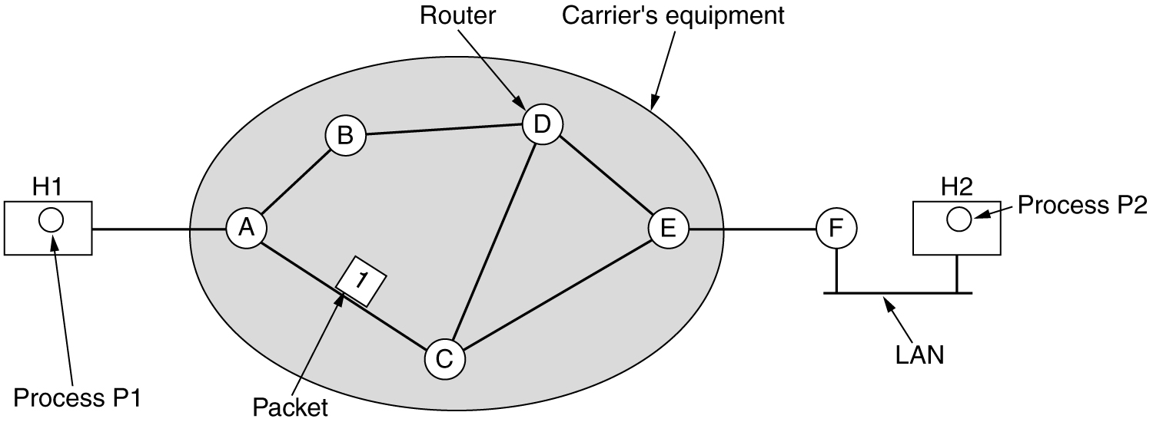
Store-and-Forward Packet Switching
fig 5-1
The environment of the network layer protocols.

Slide 4
Store-and-Forward Packet Switching
The major components of the network are the ISP’s equipment
(routers connected by transmission lines), shown inside the shaded oval, and the customers’ equipment, shown outside the oval.
Host H1 is directly connected to one of the ISP’s routers, A, perhaps as a home computer that is plugged into a DSL modem.
In contrast, H2 is on a LAN, which might be an office Ethernet,
with a router, F, owned and operated by the customer.
This router has a leased line to the ISP’s equipment.
We have shown F as being outside the oval because it does not belong to the ISP.
Routers on customer premises are considered part of the ISP network because they run the same algorithms as the ISP’s routers

Slide 5
Services Provided to the Transport Layer
The services need to be carefully designed with the following goals in mind:
The services should be independent of the router technology.
The transport layer should be shielded from the number, type, and topology of the routers present.
The network addresses made available to the transport layer should use a uniform numbering plan, even across LANs and WANs.
Two solutions
The routers’ job is moving packets around and nothing else. The hosts should do error control (i.e., error detection and correction) and flow control themselves.

Slide 6
Services Provided to the Transport Layer
The network service should be connectionless, with primitives SEND PACKET and RECEIVE PACKET
No packet ordering and flow control should be done.
Each packet must carry the full destination address, because each packet sent is carried independently of its predecessors.
Reliable service
Without connections in the network, quality of service is very difficult to achieve, especially for real-time traffic such as voice and video.

Slide 7
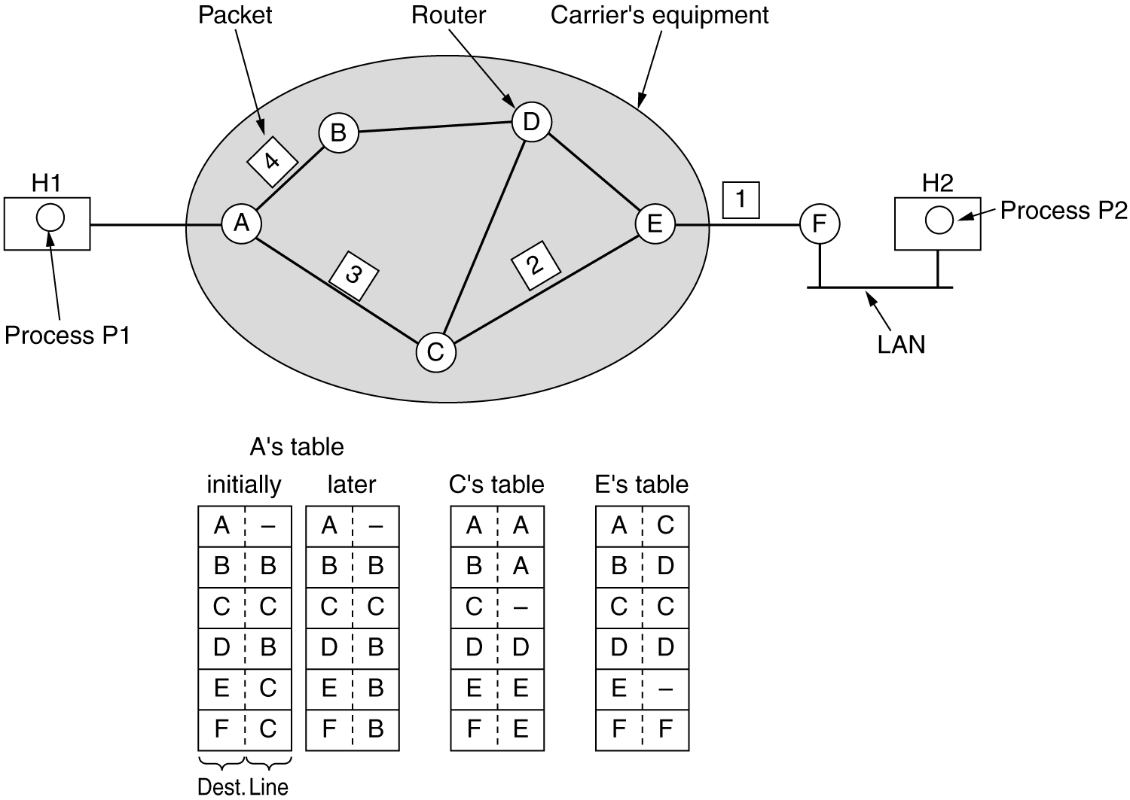
Implementation of Connectionless Service
Routing within a diagram subnet.

Slide 8
Implementation of Connectionless Service
Two different organizations are possible, depending on the type of service offered.
Connectionless service:
Packets are injected into the network individually and routed independently of each other.
No advance setup is needed.
The packets are frequently called datagrams and the network is called a datagram network.
Connection-oriented service:
Path from the source router all the way to the destination router must be established before any
data packets can be sent.
This connection is called a VC (virtual circuit), and the network is called a virtual-circuit network.

Slide 9
Implementation of Connectionless Service
Example: Process P1 has a long message for P2.
P1 hands the message to the transport layer, with instructions to deliver it to process P2 on host H2.
The transport layer prepends a transport header to the front of the message and hands the result to the network layer.
The network layer has to break it into four packets, 1, 2,3 and 4 as the message size is four times longer than the maximum packet size.
Send each packet to router A using some point-to-point protocol,
Every router has an internal table telling it where to send packets for each of the possible destinations.
Each table entry is a pair consisting of a destination and the outgoing line to use for that destination.

Slide 10
Implementation of Connectionless Service
Example: A has only two outgoing lines—to B and to C—so every incoming packet must be sent to one of these routers
Upon receiving packets from incoming link and had their checksums verified each packet is forwarded according to A’s table, onto the outgoing link to C within a new frame.
Packet 1 is then forwarded to E and then to F.
When it gets to F, it is sent within a frame over the LAN to H2. Packets 2 and 3 follow the same route.
Packet 4 sent to router B, even though it is also destined for F for some reasons.
Ex: Traffic jam and updated its routing table.
The algorithm that manages the tables and makes the routing decisions is called the routing algorithm.
Eg: IP protocol.

Slide 11
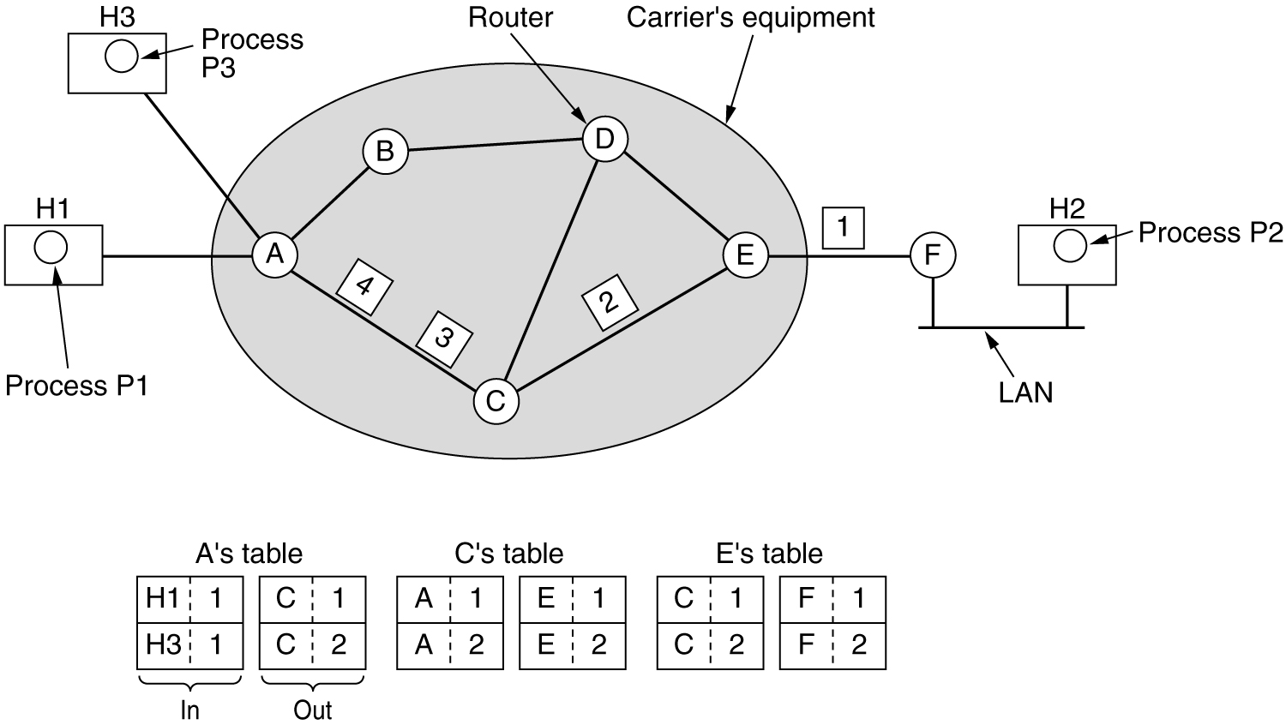
Implementation of Connection-Oriented Service
Routing within a virtual-circuit subnet.

Slide 12
Implementation of Connection-Oriented Service
When a connection is established, a route from the source machine to the destination machine is chosen as part of the connection setup and stored in tables inside the routers.
That route is used for all traffic flowing over the connection
When the connection is released, the virtual circuit is
also terminated.
With connection-oriented service, each packet carries an identifier
telling which virtual circuit it belongs to.
Example:
Host H1 has established connection 1 with host H2. This connection is remembered as the first entry in each of the routing tables.
If H3 also wants to establish a connection to H2 and chooses a connection identifier 1
This leads to the second row in the tables.

Slide 13
Implementation of Connection-Oriented Service
A assigns a different connection identifier to the outgoing traffic for the second connection.
This process is called label switching.
Ex: MPLS (MultiProtocol Label Switching).

Slide 14
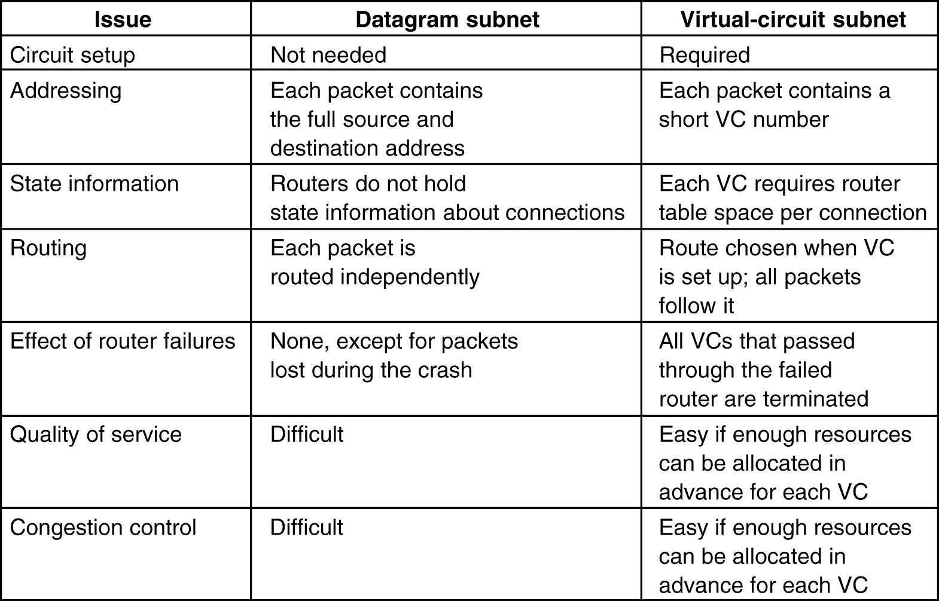
Comparison of Virtual-Circuit and Datagram Subnets
5-4

Slide 15
Routing Algorithms
The Optimality Principle
Shortest Path Routing
Flooding
Distance Vector Routing
Link State Routing
Hierarchical Routing
Broadcast Routing
Multicast Routing

Slide 16
Routing Algorithms
The routing algorithm is that part of the network layer software responsible for deciding which output line an incoming packet should be transmitted on.
If the network uses datagrams internally, this decision must be made anew for every arriving data packet
If the network uses virtual circuits internally, routing decisions are made only when a new virtual circuit is being set up.
This is sometimes called session routing because a route remains in force for an entire session
Routing Vs Forwarding:
In routers one process handles each packet as it arrives, looking up the outgoing line to use for it in the routing tables. This process is forwarding.
The other process is responsible for filling in and updating the routing tables.This is routing.

Slide 17
Routing Algorithms
When new connections are established, certain properties are desirable in a routing algorithm: correctness, simplicity, robustness, stability, fairness, and efficiency
Routing algorithms can be grouped into two major classes: non-adaptive and adaptive.
Non adaptive -the choice of the route is computed in advance, offline, and downloaded to the routers when the network is booted. This procedure is sometimes called static routing.
Adaptive algorithms, in contrast, change their routing decisions to reflect changes in the topology, and sometimes changes in the traffic as well.

Slide 18
Routing Algorithms-Optimalitity Principle
It states that if router J is on the optimal path from router I to router K, then the optimal path from J to K also falls along the same route.
As a direct consequence of the optimality principle, we can see that the set of optimal routes from all sources to a given destination form a tree rooted at the destination
Such a tree is called a sink tree and is illustrated in Fig. 5-6(b), where the distance metric is the number of hops.
The goal of all routing algorithms is to discover and use the sink trees for all routers.
Since a sink tree is indeed a tree, it does not contain any loops.

Slide 19
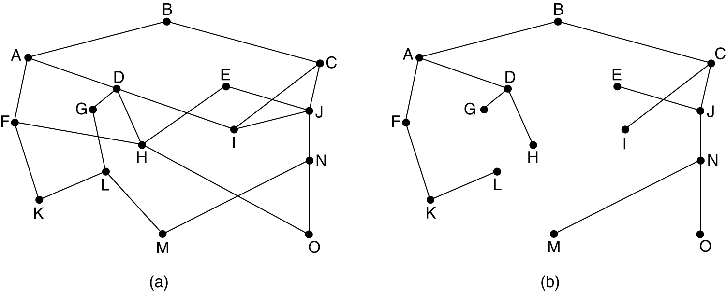
The Optimality Principle
(a) A subnet. (b) A sink tree for router B.

Slide 20
Shortest Path Routing
The idea is to build a graph of the network, with each node of the graph representing a router and each edge of the graph representing a communication line, or link.
To choose a route between a given pair of routers, the algorithm just
finds the shortest path between them on the graph.
For finding the shortest path the general metrics are no.of hops,geographical distance,mean delay,
But practically,the labels on the edges could be computed as a function of the distance, bandwidth, average traffic, communication cost, measured delay, and other factors.
Several algorithms for computing the shortest path between two nodes of a graph are known.
This one is due to Dijkstra (1959) and finds the shortest paths
between a source and all destinations in the network.

Slide 21
Shortest Path Routing
Initially, no paths are known, so all nodes are labeled with infinity.
As the algorithm proceeds and paths are found,each node is labeled (inparentheses) with its distance from the source node along the best known path.
The distances must be non-negative.
A label may be either tentative or permanent.
Initially, all labels are tentative.
When it is discovered that a label represents the shortest possible path from the source to that node, it is made permanent and never changed thereafter.
Example: Consider the following weighted undirected graph find the shortest path from A to D.

Slide 22
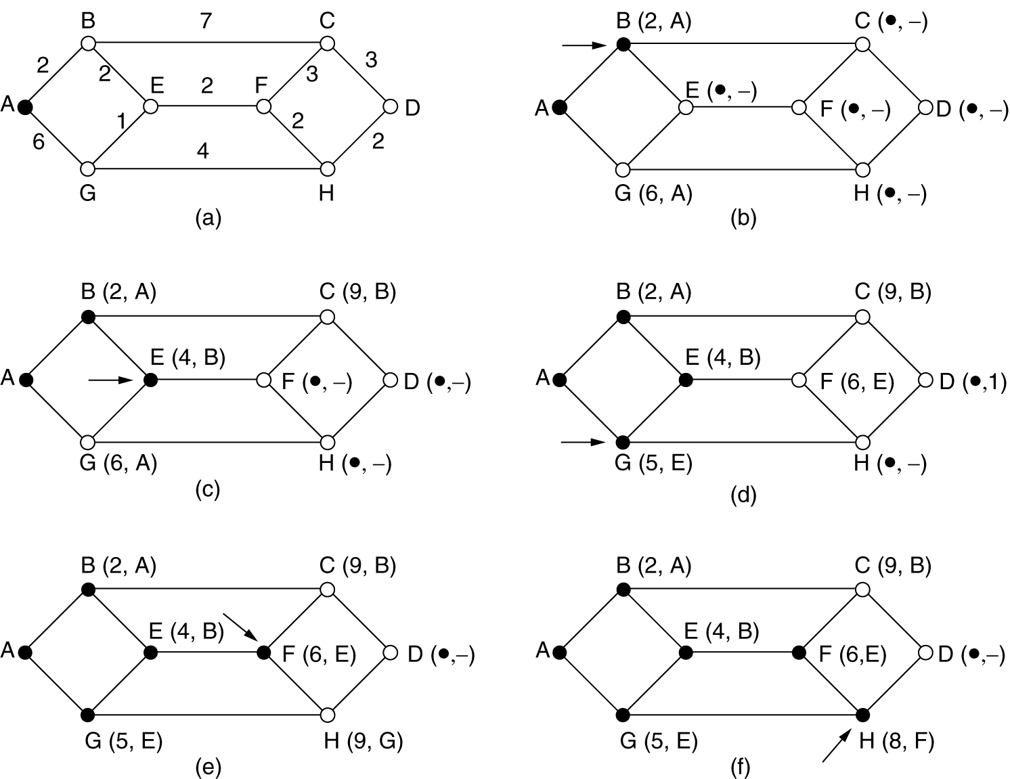
Shortest Path Routing
The first 5 steps used in computing the shortest path from A to D. The arrows indicate the working node.

Slide 23
Shortest Path Routing
Mark node A as permanent, indicated by a filled-in circle.
Examine each of the nodes adjacent to A,relabel the adjacent nodes with the distance to A and mark them tentative.
Mark the smallest label nodes as permanent . Ex:B(2,A) as permanent.
We now start at B and examine all nodes adjacent to it.
Now repeat the steps 2 and 3 .Ex:E(4,B) as permanent.
The above steps are repeated until all the nodes are labeled .
Find the shortest path between the given source node and destination by visiting the nodes which has smallest values.

Slide 24
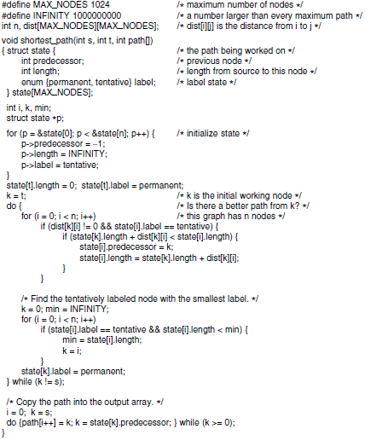

Slide 25
Flooding
When a routing algorithm is implemented, each router must make decisions based on local knowledge, not the complete picture of the network.
A simple local technique is flooding, in which every incoming packet is sent out on every outgoing line except the one it arrived on.
Flooding obviously generates vast numbers of duplicate packets, in fact, an infinite number unless some measures are taken to damp the process.
One such measure is to have a hop counter contained in the header of each packet that is decremented at each hop, with the packet being discarded when the counter reaches zero.

Slide 26

Flooding
Ideally, the hop counter should be initialized to the length of the path from source to destination.
If the sender does not know how long the path is, it can initialize the counter to the worst case, namely, the full diameter of the network.
Flooding with a hop count can produce an exponential number of duplicate packets as the hop count grows and routers duplicate packets they have seen before.
A better technique for damming the flood is to have routers keep track of which packets have been flooded, to avoid sending them out a second time.
One way to achieve this goal is to have the source router put a sequence number in each packet it receives from its hosts.

Slide 27
Flooding
Each router then needs a list per source router telling which sequence numbers originating at that source have already been seen.
If an incoming packet is on the list, it is not flooded.
To prevent the list from growing without bound, each list should be augmented by a counter, k, meaning that all sequence numbers through k have been seen.
First, it ensures that a packet is delivered to every node in the network.
In wireless networks, all messages transmitted by a station can be received by all other stations within its radio range, which is, in fact, flooding, and some algorithms utilize this property.
Second, flooding is tremendously robust.
Used as a building block for other routing algorithms.

Slide 28


Distance Vector Routing
This is a dynamic routing algorithm and it finds shortest paths for the
current topology
Each router maintain a table (i.e., a vector) giving the best known distance to each destination and which link to use to get there.
These tables are updated by exchanging information with the neighbors.
It is also called bellman-ford routing algorithm.
Each router maintains a routing table indexed by, and containing one entry for each router in the network.
The entry has two parts: the preferred outgoing line to use for that destination and an estimate of the distance to that destination.
The distance might be measured as the number of hops
or propagation delay.

Slide 29
If the metric is propagation delay, the router can measure it directly with special ECHO packets that the receiver just timestamps and sends back as fast as it can.
Example:
J gets the delay vectors from its neighbours A,I,H,K
J has measured the delay to neighbours as 8,10,12,6 msec
J computes the route to G as follows
From A J knows that the delay is 26msec(8+18).
Similarly from I ,H,K J Knows that the delay is 41,18,37 respectively.
The best of these values is 18, so it makes an entry in its routing table that the delay to G is 18 msec and that the route
to use is via H.
Same claculation is performed for all the other destinations.

Slide 30
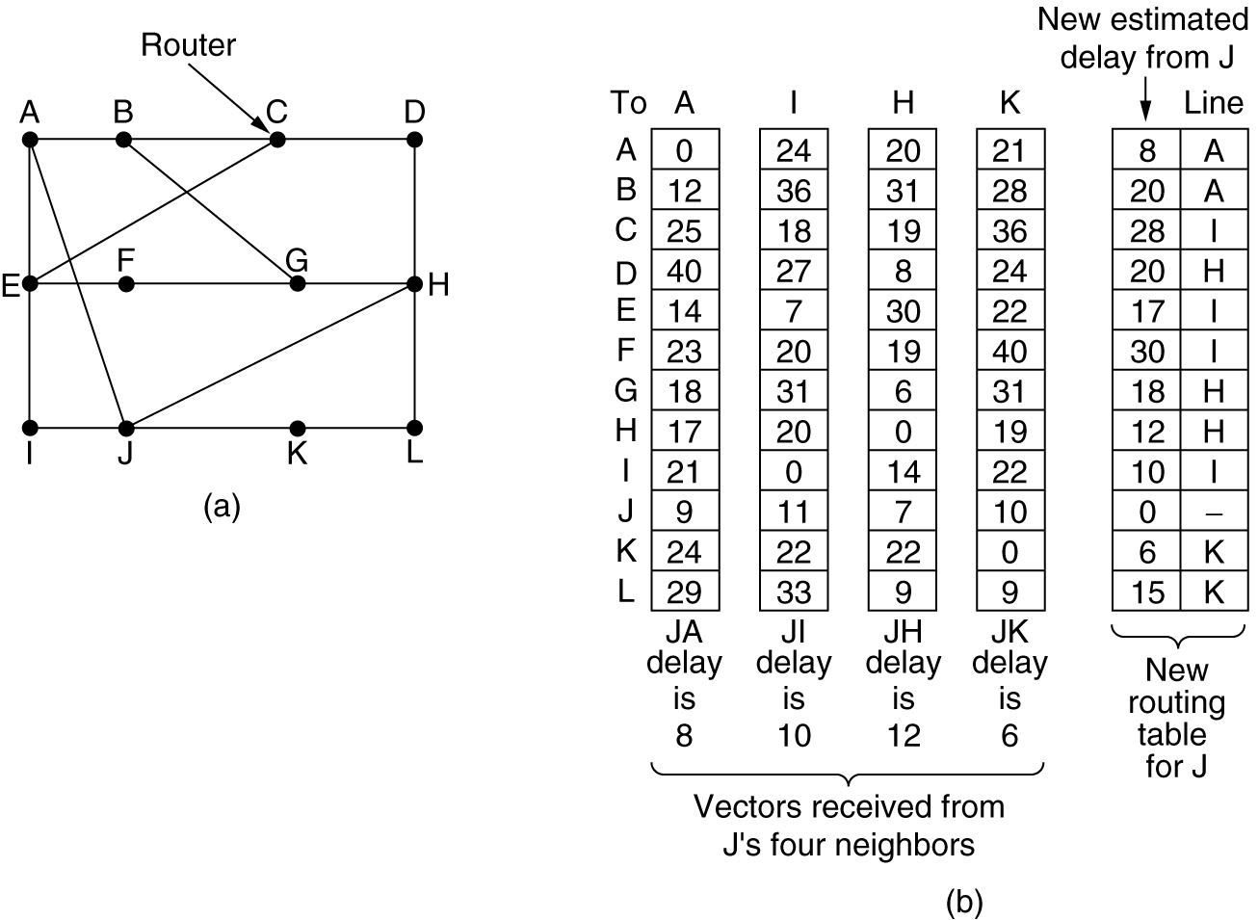
Distance Vector Routing
(a) A subnet. (b) Input from A, I, H, K, and the new
routing table for J.

Slide 31

The Count-to-Infinity Problem
The settling of routes to best paths across the network is called convergence.
Distance vector routing is useful as a simple technique by which routers can collectively compute shortest paths
It reacts rapidly to good news, but leisurely to bad news.
Example:
Suppose A is down initially and all the other routers know this.
They have all recorded the delay to A as infinity.
When A comes up, the other routers learn about it via the vector exchanges.
At the time of the first exchange, B learns that its left-hand neighbor has zero delay to A.
B now makes an entry in its routing table indicating that A is one hop away to the left.
On next exchnages the other routers update the entries.

Slide 32
The Count-to-Infinity Problem
Suddenly, either A goes down or the link between A and B is
cut
At the first packet exchange, B does not hear anything from A.
C says ‘‘Do not worry; I have a path to A of length 2
As a result, B thinks it can reach A via C, with a path
length of 3. D and E do not update their entries for A on the first exchange.
On the second exchange, C notices that each of its neighbors claims to have a path to A of length 3. It picks one of them at random and makes its new distance to A 4
Subsequent exchanges produce the history shown in the figure.
This problem is known as the count-to-infinity problem.
The core of the problem is that when X tells Y that it has a path somewhere, Y has no way of knowing whether it itself is on the path.

Slide 33
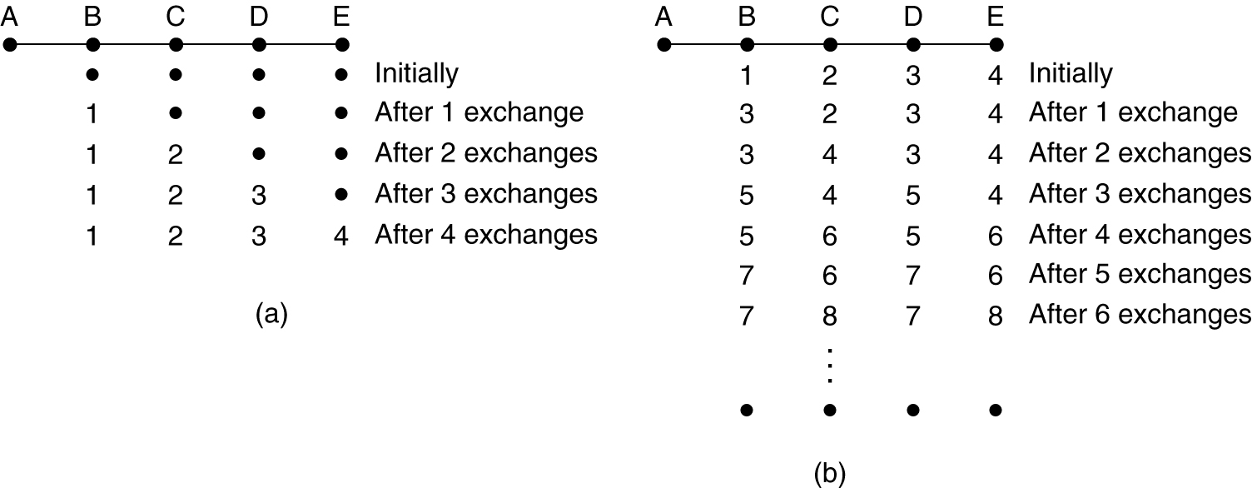
Distance Vector Routing (2)
The count-to-infinity problem.

Slide 34
Link State Routing
The primary problem that caused Distance vectore routing algorithm to demise was that the algorithm often took too long to converge after the network topology changed
Consequently, it was replaced by an entirely new algorithm, now called link state routing.
Variants of link state routing called IS-IS and OSPF are the routing algorithms that are most widely used inside large networks and the Internet today.
In effect, the complete topology is distributed to every router.
Then Dijkstra’s algorithm can be run at each router to find the shortest path to every other router.

Slide 35
Link State Routing
Each router must do the following:
Discover its neighbors, learn their network address- special HELLO packets.
Measure the delay or cost to each of its neighbors-special ECHO packets.
Construct a packet telling all it has just learned.
Send this packet to all other routers- flooding
Compute the shortest path to every other router.

Slide 36
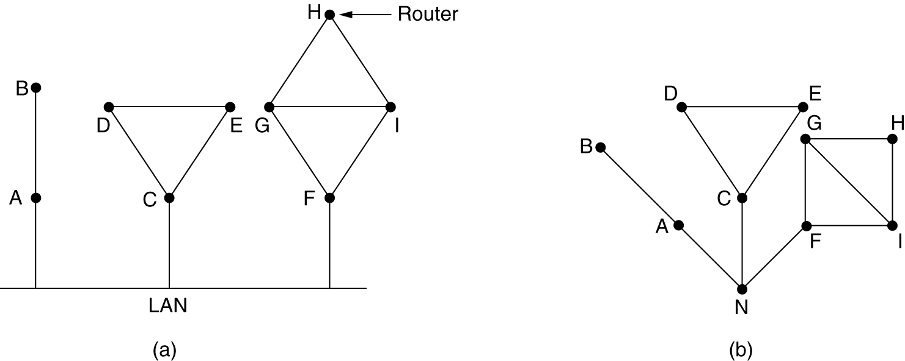
Learning about the Neighbors
(a) Nine routers and a LAN. (b) A graph model of (a).

Slide 37
Learning about the Neighbors
Router learn its neighbours by sending a special HELLO packet on each point-to-point line.
The router on the other end is expected to send back a reply giving its name.
Modeling the LAN as many point-to-point links increases the size
of the topology and leads to wasteful messages.
A better way to model the LAN is to consider it as a node itself.
For example we have introduced a new, artificial node, N, to which A, C, and F are connected.
One designated router on the LAN is selected to play the role of N in the routing protocol.

Slide 38
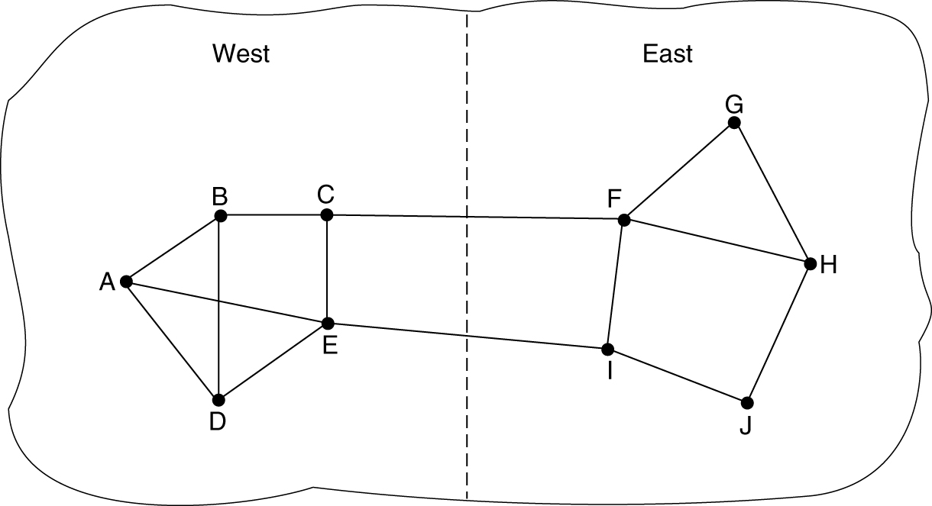
Measuring Line Cost
A subnet in which the East and West parts are connected by two lines.

Slide 39
Measuring Line Cost
The cost to reach neighbors can be set automatically, or configured by the network operator.
A common choice is to make the cost inversely proportional to the bandwidth of the link
If the network is geographically spread out, the delay of the links may be factored into the cost
The most direct way to determine this delay is to send over the line a special ECHO packet that the other side is required to send back immediately.
By measuring the round-trip time and dividing it by two, the sending router can get a reasonable estimate of the delay.

Slide 40
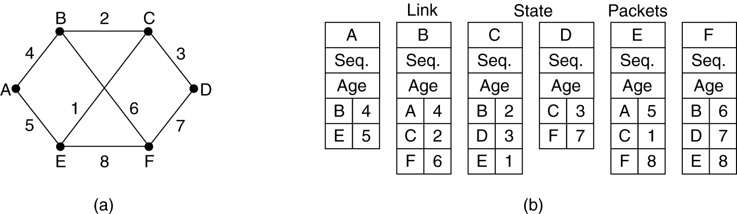
Building Link State Packets
(a) A subnet. (b) The link state packets for this subnet.

Slide 41
Building Link State Packets
The next step is for each router to build a packet containing all the data.
The packet starts with the identity of the sender, followed by a sequence number and age and a list of neighbors.
Building the link state packets is easy. The hard part is determining when to build them.
One possibility is to build them periodically, that is, at regular intervals.
Another possibility is to build them when some significant event occurs
Ex: line or neighbor going down or coming back up again

Slide 42
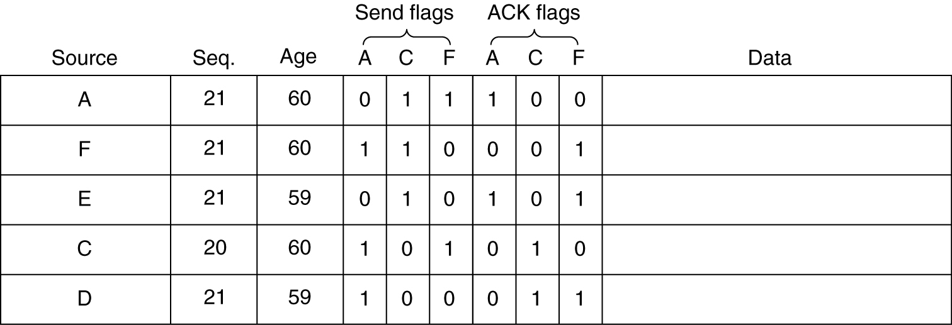
Distributing the Link State Packets
The packet buffer for router B in the previous slide (Fig. 5-13).

Slide 43
Distributing the Link State Packets
The fundamental idea is to use flooding to distribute the link state packets to all routers.
To keep the flood in check, each packet contains a sequence number that is incremented for each new packet sent.
Routers keep track of all the (source router, sequence) pairs they see. When a new link state packet comes in, it is checked against the list of packets already seen.
If it is new, it is forwarded on all lines except the one it arrived on. If it is a duplicate, it is discarded.
If a packet with a sequence number lower than the highest one seen so far ever arrives, it is rejected as being obsolete as the router has more recent data.

Slide 44
Distributing the Link State Packets
This algorithm has a few problems, but they are manageable.
First, if the sequence numbers wrap around, confusion will reign.
The solution here is to use a 32-bit sequence number.
With one link state packet per second, it would take 137 years to wrap around, so this possibility can be ignored.
Second, if a router ever crashes, it will lose track of its sequence number. If it starts again at 0, the next packet it sends will be rejected as a duplicate.
Third, if a sequence number is ever corrupted and 65,540 is received instead of 4 (a 1-bit error), packets 5 through 65,540 will be rejected as obsolete, since the current sequence number will be thought to be 65,540.

Slide 45
Distributing the Link State Packets
The solution to all these problems is to include the age of each packet after the sequence number and decrement it once per second.
When the age hits zero, the information from that router is discarded.
The Age field is also decremented by each router during the initial flooding process, to make sure no packet can get lost and live for an indefinite period of time (a packet whose age is zero is discarded).
The data structure used by router B for the network shown in Fig. 5-12(a) is depicted in Fig. 5-13.
Each row here corresponds to a recently arrived, but as yet not fully processed, link state packet.

Slide 46
Distributing the Link State Packets
The table records where the packet originated, its sequence number and age, and the data.
In addition, there are send and acknowledgement flags for each of B’s three links (to A, C, and F, respectively).
The send flags mean that the packet must be sent on the indicated link.
The acknowledgement flags mean that it must be acknowledged there.
In Fig. 5-13, the link state packet from A arrives directly, so it must be sent to C and F and acknowledged to A, as indicated by the flag bits.

Slide 47
Distributing the Link State Packets
Similarly, the packet from F has to be forwarded to A and C and acknowledged to F.
However, the situation with the third packet, from E, is different.
It arrives twice, once via EAB and once via EFB.
Consequently, it has to be sent only to C but must be acknowledged to both A and F, as indicated by the bits.
If a duplicate arrives while the original is still in the buffer, bits have to be changed.
For example, if a copy of C’s state arrives from F before the fourth entry in the table has been forwarded, the six bits will be changed to 100011 to indicate that the packet must be acknowledged to F but not sent there.

Slide 48
Computing new routes
Once a router has accumulated a full set of link state packets, it can construct the entire network graph because every link is represented.
Every link is, in fact, represented twice, once for each direction.
The different directions may even have different costs.
The shortest-path computations may then find different paths from router A to B than from router B to A.
Now Dijkstra’s algorithm can be run locally to construct the shortest paths to all possible destinations.
Compared to distance vector routing, link state routing requires more memory and computation.

Slide 49
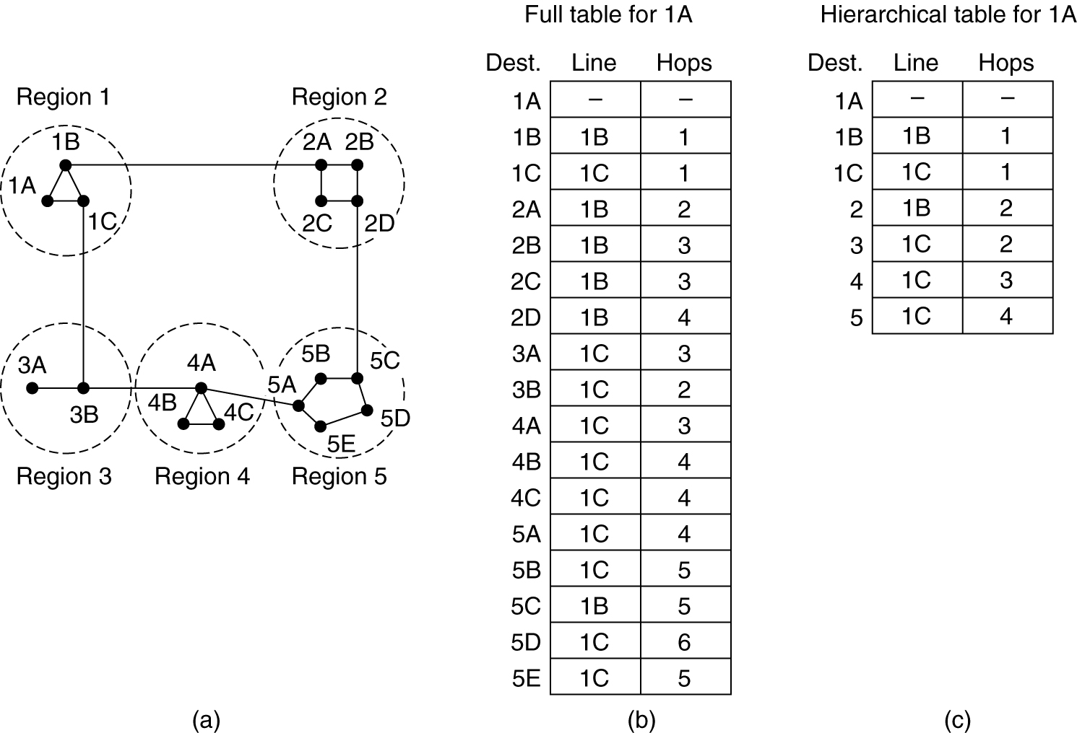
Hierarchical Routing
Hierarchical routing.

Slide 50
Hierarchical Routing
As networks grow in size, the router routing tables grow proportionally.
The router memory is consumed by ever-increasing tables and more CPU time is needed to scan them and more bandwidth is needed to send status reports about them.
When hierarchical routing is used, the routers are divided into what we will call regions.
Each router knows all the details about how to route packets to destinations within its own region but knows nothing about the internal structure of other regions.
For huge networks, a two-level hierarchy may be insufficient; it may be necessary to group the regions into clusters, the clusters into zones, the zones into groups, and so on,
Ex: routing in a two-level hierarchy with five regions.
There is a penalty to be paid: increased path length.Ex: from 1A to 5C
The optimal number of levels for an N router network is ln N, requiring a total of e ln N entries per router.

Slide 51
Broadcast Routing
Broadcasting to all nodes is the method wasteful of bandwidth and slow, but it also requires the source to have a complete list of all destinations.
This method is not desirable in practice, even though it is widely applicable.
An improvement is multidestination routing, in which each packet contains either a list of destinations or a bit map indicating the desired destinations.
When a packet arrives at a router, the router checks all the destinations to determine the set of output lines that will be needed
The router generates a new copy of the packet for each output line to be used and includes in each packet only those destinations that are to use the line.

Slide 52
Broadcast Routing
After a sufficient number of hops, each packet will carry only
one destination like a normal packet.
The network bandwidth is therefore used more efficiently.
We have already seen a better broadcast routing technique: flooding.
When implemented with a sequence number per source, flooding uses links efficiently with a decision rule at routers that is relatively simple.
Although flooding is ill suited for ordinary point-to-point communication, it rates serious consideration for broadcasting.
However, it turns out that we can do better still once the shortest path routes for regular packets have been computed.

Slide 53
Broadcast Routing
The idea for reverse path forwarding is elegant and remarkably simple once it has been pointed out.
When a broadcast packet arrives at a router, the router checks to see if the packet arrived on the link that is normally used for sending packets toward the source of the broadcast.
If so,there is an excellent chance that the broadcast packet itself followed the best route from the router and is therefore the first copy to arrive at the router.
Thiss being the case, the router forwards copies of it onto all links except the one it arrived on.
If, however, the broadcast packet arrived on a link other than the preferred one for reaching the source, the packet is discarded as a likely duplicate.

Slide 54
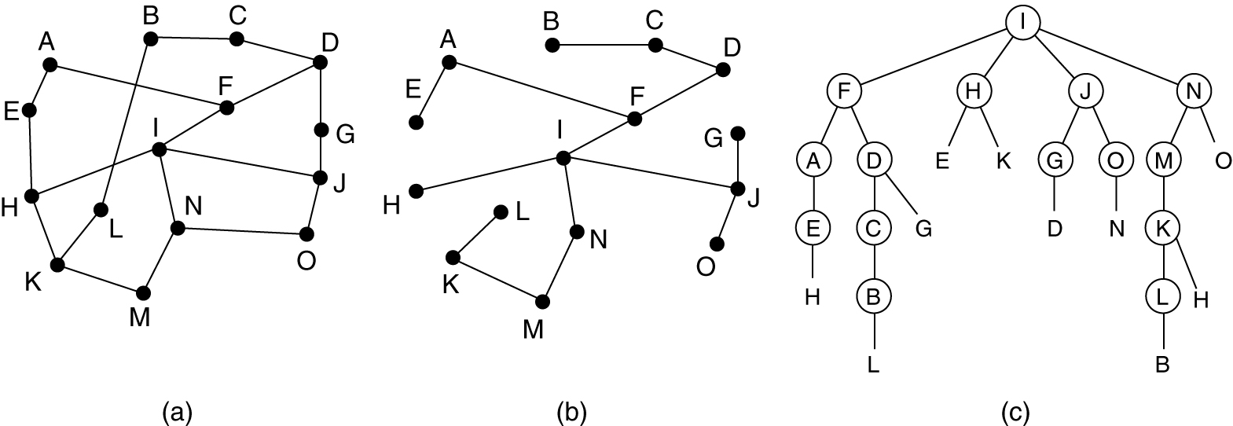
Broadcast Routing
Reverse path forwarding. (a) A subnet. (b) a Sink tree. (c) The tree built by reverse path forwarding.

Slide 55
Broadcast Routing
Ex:On the first hop, I sends packets to F, H, J, and N, as indicated by the second row of the tree.
Each of these packets arrives on the preferred path to I.
On the second hop,eight packets are generated and five of these arrive along the preferred line.
Of the six packets generated on the third hop, only three arrive on the preferred path (at C, E, and K); the others are duplicates.
After five hops and 24 packets, the broadcasting terminates,
The principal advantage of reverse path forwarding is that it is efficient while being easy to implement
A spanning tree is a subset of the network that includes all the routers but contains no loops.
Sink trees are spanning trees.

Slide 56
Broadcast Routing
If each router knows which of its lines belong to the spanning tree, it can copy an incoming broadcast packet onto all the spanning tree lines except the one it arrived on.
This method makes excellent use of bandwidth, generating the
absolute minimum number of packets necessary to do the job.
In the previous example the broadcast packet is sent with the minimum 14 packets.

Slide 57
Multicast Routing
Some applications, such as a multiplayer game or live video of a sports event streamed to many viewing locations, send packets to multiple receivers.
We will assume that each group is identified by a multicast address
and that routers know the groups to which they belong.
Multicast routing schemes build on the broadcast routing schemes.
The best spanning tree to use depends on whether the group is dense
or sparse.
If the group is dense, broadcast is a good start because it efficiently gets the packet to all parts of the network.
Prune the broadcast spanning tree by removing links that
do not lead to members.
Ex:Consider the two groups, 1 and 2, in the network shown in

Slide 58
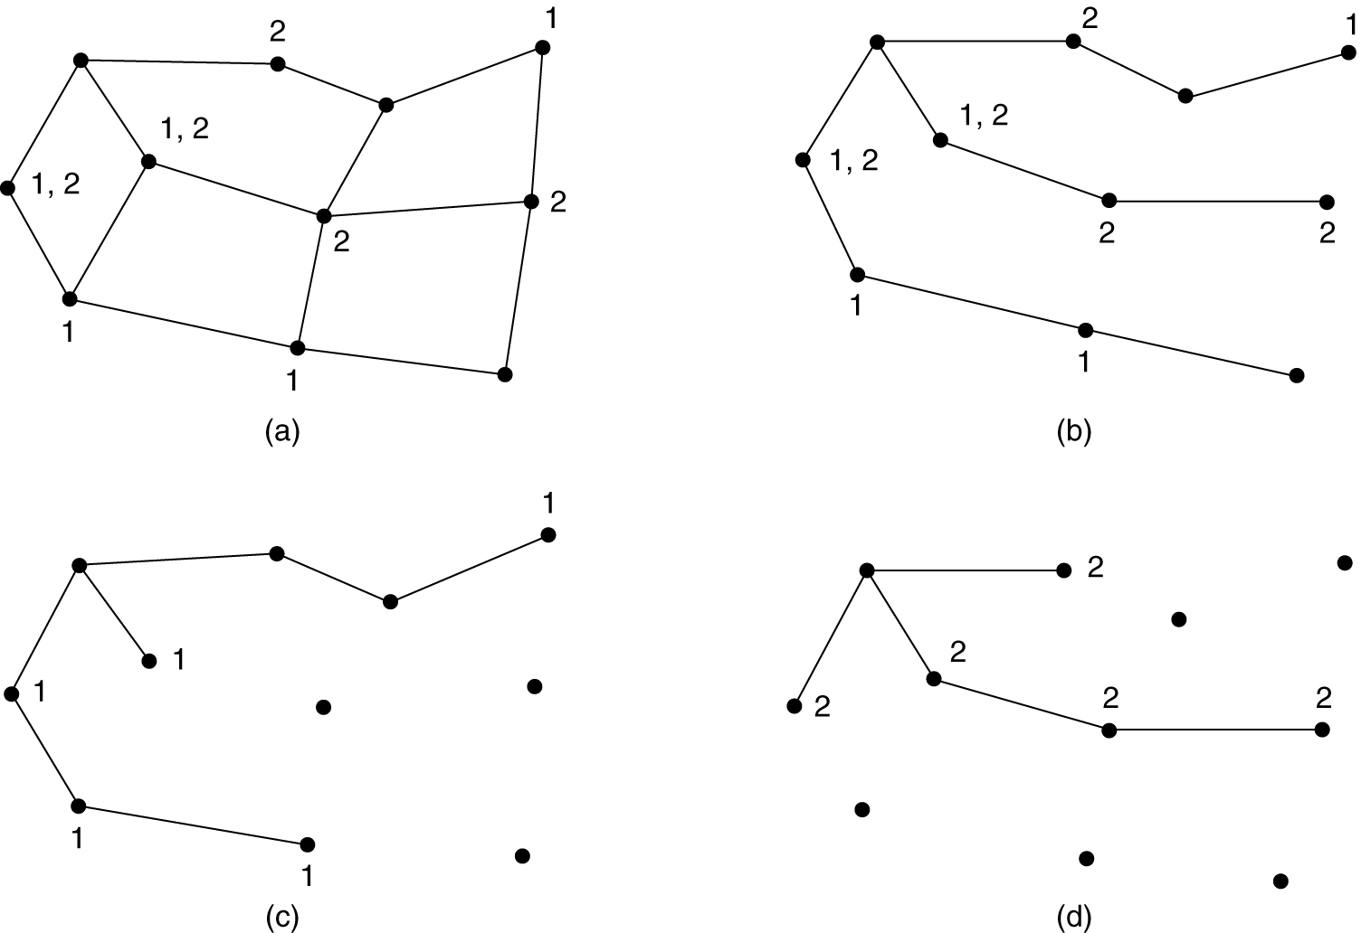
Multicast Routing
(a) A network. (b) A spanning tree for the leftmost router. (c) A multicast tree for group 1. (d) A multicast tree for group 2.

Slide 59
Multicast Routing
Various ways of pruning the spanning tree are possible.
The simplest one can be used if link state routing is used and each router is aware of the complete topology, including which hosts belong to which groups.
Each router can then construct its own pruned spanning tree for each sender to the group in question by constructing a sink tree for the sender as usual and then removing all links that do not connect group members to the sink node.
EX: MOSPF
With distance vector routing, a different pruning strategy can be followed.

Slide 60
Multicast Routing
The basic algorithm is reverse path forwarding.
Whenever a router with no hosts interested in a particular group and no connections to other routers receives a multicast message for that group, it responds with a PRUNE message, telling the neighbor that sent the message not to send it any more multicasts from the sender for that group.
When a router with no group members among its own hosts has received such messages on all the lines to which it sends the multicast, it, too, can respond with a PRUNE message.
In this way, the spanning tree is recursively pruned.
DVMRP (Distance Vector Multicast Routing Protocol) is an example of a multicast routing protocol that works this way.
One potential disadvantage is that it is lots of work for routers, especially for large networks.

Slide 61
Multicast Routing
A network has n groups, each with an average of m nodes. At each router and for each group, m pruned spanning trees must be stored, for a total of mn trees.
So considerable storage is needed to store all the trees.
An alternative design uses core-based trees to compute a single spanning tree for the group .
All of the routers agree on a root (called the core or rendezvous point) and build the tree by sending a packet from each member to the root.
The tree is the union of the paths traced by these packets.
Fig. 5-17(a) shows a core-based tree for group 1.
To send to this group, a sender sends a packet to the core.
When the packet reaches the core, it is forwarded down the tree. This is shown in Fig. 5-17(b) for the sender on the right hand side of the network.

Slide 62
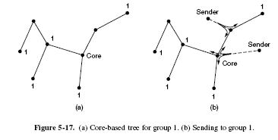
Multicast Routing
As a performance optimization, packets destined for the group do not need to reach the core before they are multicast.
Optimization is, it can be forwarded up toward the root, as well as down all the other branches.
This is the case for the sender at the top of Fig. 5-17(b).

Slide 63
Multicast Routing
Having a shared tree is not optimal for all sources.
Ex:the packet from the sender on the righthand side reaches the top-right group member via the core in three hops, instead of directly.
Also of note is that shared trees can be a major savings in storage costs, messages sent, and computation.
Shared tree approaches like core-based trees are used for multicasting to sparse groups in the Internet as part of popular protocols such as PIM(Protocol Independent Multicast).

