Slide 1
The Network Layer
Chapter 5

Slide 2
Congestion Control Algorithms
Approaches to congestion control
Traffic Aware Routing
Admission Control
Traffic throtlling
Load shedding

Slide 3
Congestion Control
Too many packets present in (a part of) the network causes packet delay and loss that degrades performance.
This situation is called congestion.
The network and transport layers share the responsibility for handling congestion.
In this chapter we will look at the network aspects of congestion.
When the number of packets hosts send into the network is well within its carrying capacity, the number delivered is proportional to the number sent.
As the offered load approaches the carrying capacity, bursts of traffic occasionally fill up the buffers inside routers and some packets
are lost.
These lost packets consume some of the capacity, so the number of delivered packets falls below the ideal curve.
The network is now congested.

Slide 4
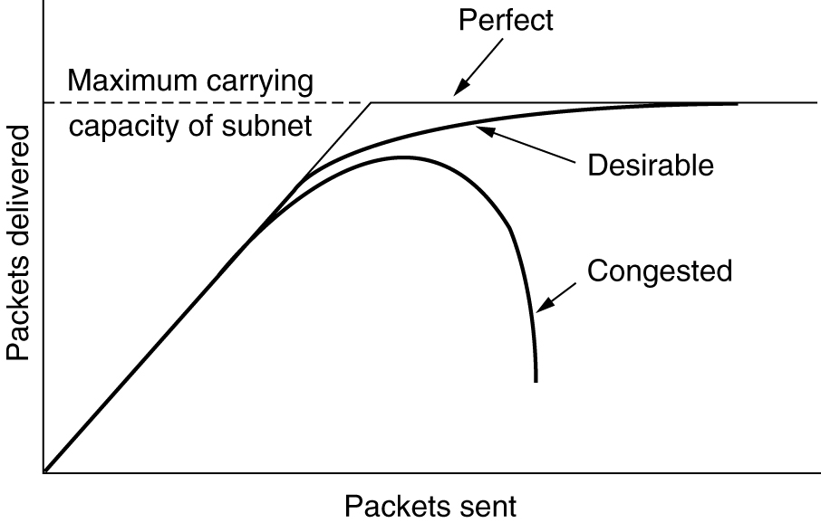
Congestion
When too much traffic is offered, congestion sets in and performance degrades sharply.

Slide 5
Congestion
We would like to design networks that avoid congestion where possible and do not suffer from congestion collapse if they do become congested.
Congestion cannot be wholly avoided.
If all of a sudden, streams of packets begin arriving on three or four input lines and all need the same output line, a queue will build up.
If there is insufficient memory to hold all of them, packets will be lost.
Adding more memory may help up to a point but
If routers have an infinite amount of memory, congestion gets worse, not better because by the time packets get to the front of the queue, they have already timed out (repeatedly).
Low-bandwidth links or routers that process packets more slowly than the line rate can also become congested.

Slide 6
Approaches to Congestion Control
The presence of congestion means that the load is (temporarily) greater than the resources (in a part of the network) can handle.
Two solutions come to mind: increase the resources or decrease the load.
As shown in Fig. 5-22, these solutions are usually applied on different time scales to either prevent congestion or react to it once it has occurred.

Slide 7
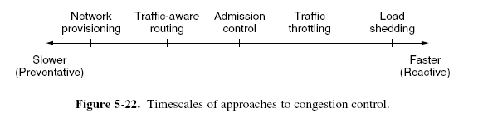
Approaches to Congestion Control

Slide 8
Approaches to Congestion Control
The most basic way to avoid congestion is to build a network that is well matched to the traffic that it carries.
If there is a low-bandwidth link on the path along which most traffic is directed, congestion is likely.
This can be added dynamically when there is serious congestion, for example, turning on spare routers or enabling lines that are normally used only as backups or purchasing bandwidth on the open market.

Slide 9
Approaches to Congestion Control
More often, links and routers that are regularly heavily utilized are upgraded at the earliest opportunity. This is called provisioning and happens on a time scale of months, driven by long-term traffic trends.
To make the most of the existing network capacity, routes can be tailored to traffic patterns that change during the day as network users wake and sleep in different time zones.

Slide 10
Approaches to Congestion Control
For example, routes may be changed to shift traffic away from heavily used paths by changing the shortest path weights. This is called traffic-aware routing. Splitting traffic across multiple paths is also helpful.
However, sometimes it is not possible to increase capacity. The only way then to beat back the congestion is to decrease the load. In a virtual-circuit network, new connections can be refused if they would cause the network to become congested. This is called admission control.

Slide 11
Approaches to Congestion Control
At a finer granularity, when congestion is imminent the network can deliver feedback to the sources whose traffic flows are responsible for the problem. The network can request these sources to throttle their traffic, or it can slow down the traffic itself.
Two difficulties with this approach are how to identify the onset of congestion, and how to inform the source that needs to slow down.
To tackle the first issue, routers can monitor the average load, queueing delay, or packet loss.
In all cases, rising numbers indicate growing congestion

Slide 12
Approaches to Congestion Control
To tackle the second issue, routers must participate in a feedback loop with the sources.
For a scheme to work correctly, the time scale must be adjusted carefully.
Finally, when all else fails, the network is forced to discard packets that it cannot deliver.
The general name for this is load shedding.
A good policy for choosing which packets to discard can help to prevent congestion collapse.

Slide 13
Approaches to Congestion Control
Traffic-Aware Routing
These schemes adapted to changes in topology, but not to changes in load.
The most direct way to do this is to set the link weight to be a function of the (fixed) link bandwidth and propagation delay plus the (variable) measured load or average queuing delay.
Least-weight paths will then favor paths that are more lightly loaded, all else being equal.

Slide 14
Approaches to Congestion Control
Traffic-Aware Routing
Consider the network of Fig. 5-23, which is divided into two parts, East and West, connected by two links, CF and EI.
Suppose that most of the traffic between East and West is using link CF, and, as a result, this link is heavily loaded with long delays.
Including queueing delay in the weight used for the shortest path calculation will make EI more attractive.
Consequently, in the next update, CF will appear to be the shortest path. As a result, the routing tables may oscillate wildly, leading to erratic routing and many potential problems

Slide 15
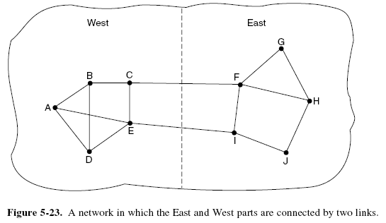
Approaches to Congestion Control
Traffic-Aware Routing

Slide 16
Approaches to Congestion Control
Traffic-Aware Routing
If load is ignored and only bandwidth and propagation delay are considered, this problem does not occur.
Attempts to include load but change weights within a narrow range only slow down routing oscillations.
Two techniques can contribute to a successful solution.
The first is multipath routing, in which there can be multiple paths from a source to a destination.
In our example this means that the traffic can be spread across both of the East to West links.
The second one is for the routing scheme to shift traffic across routes slowly enough that it is able to converge

Slide 17
Approaches to Congestion Control
Traffic-Aware Routing
Given these difficulties, in the Internet routing protocols do not generally adjust their routes depending on the load.
Instead, adjustments are made outside the routing protocol by slowly changing its inputs. This is called traffic engineering.

Slide 18
Approaches to Congestion Control
Admission Control
One technique that is widely used in virtual-circuit networks to keep congestion at bay is admission control.
The idea is simple: do not set up a new virtual circuit unless the network can carry the added traffic without becoming congested.
Thus, attempts to set up a virtual circuit may fail.
This is better than the alternative, as letting more people in when the network is busy just makes matters worse.

Slide 19
Approaches to Congestion Control
Admission Control
The network can decide whether to admit the new virtual circuit.
One possibility is for the network to reserve enough capacity along the paths of each of its virtual circuits that congestion will not occur.
In this case, the traffic description is a service agreement for what the network will guarantee its users
Even without making guarantees, the network can use traffic descriptions for admission control.

Slide 20
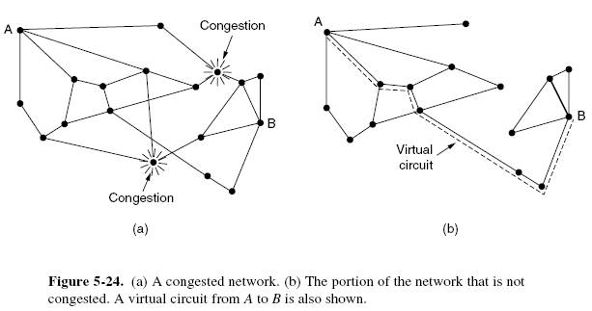
Approaches to Congestion Control
Admission Control

Slide 21
Approaches to Congestion Control
Admission Control
Suppose that a host attached to router A wants to set up a connection to a host attached to router B.
Normally, this connection would pass through one of the congested routers.
To avoid this situation, we can redraw the network as shown in Fig. 5-24(b), omitting the congested routers and all of their lines.
The dashed line shows a possible route for the virtual circuit that avoids the congested routers.

Slide 22
Approaches to Congestion Control
Traffic Throttling
When congestion is imminent, it must tell the senders to throttle back their transmissions and slow down. This feedback is business as usual rather than an exceptional situation.
Each approach must solve two problems.
First, routers must determine when congestion is approaching, ideally before it has arrived.
To do so, each router can continuously monitor the resources it is using.

Slide 23
Approaches to Congestion Control
Traffic Throttling
Three possibilities are the utilization of the output links, the buffering of queued packets inside the router, and the number of packets that are lost due to insufficient buffering.
Of these possibilities, the second one is the most useful.
Averages of utilization do not directly account for the burstiness of most traffic—a utilization of 50% may be low for smooth traffic and too high for highly variable traffic.
Counts of packet losses come too late. Congestion has already set in by the time that packets are lost.

Slide 24
Approaches to Congestion Control
Traffic Throttling
The queueing delay inside routers directly captures any congestion experienced by packets.
It should be low most of time, but will jump when there is a burst of traffic that generates a backlog.
To maintain a good estimate of the queueing delay, d, a sample of the instantaneous queue length, s, can be made periodically and d updated according to
d_{new} = αd_{old} + (1 − α)s
where the constant α determines how fast the router forgets recent history.

Slide 25
Approaches to Congestion Control
Traffic Throttling
This is called an EWMA (Exponentially Weighted Moving Average).
It smoothes out fluctuations and is equivalent to a low-pass filter. Whenever d moves above the threshold, the router notes the onset of congestion.
The second problem is that routers must deliver timely feedback to the senders that are causing the congestion.
Congestion is experienced in the network, but relieving congestion requires action on behalf of the senders that are using the network.

Slide 26
Approaches to Congestion Control
Traffic Throttling
To deliver feedback, the router must identify the appropriate senders.
It must then warn them carefully, without sending many more packets into the already congested network.
Different schemes use different feedback mechanisms,
as we will now describe.

Slide 27
Approaches to Congestion Control
Choke Packets
The most direct way to notify a sender of congestion is to tell it directly.
In this approach, the router selects a congested packet and sends a choke packet back to the source host, giving it the destination found in the packet.
The original packet may be tagged (a header bit is turned on) so that it will not generate any more choke packets farther along the path and then forwarded in the usual way.
To avoid increasing load on the network during a time of congestion, the router may only send choke packets at a low rate.

Slide 28
Approaches to Congestion Control
Choke Packets
When the source host gets the choke packet, it is required to reduce the traffic sent to the specified destination, for example, by 50%.
In a datagram network, simply picking packets at random when there is congestion is likely to cause choke packets to be sent to fast senders, because they will have the most packets in the queue.
The feedback implicit in this protocol can help prevent congestion yet not throttle any sender unless it causes trouble.

Slide 29
Approaches to Congestion Control
Choke Packets
For the same reason, it is likely that multiple choke packets will be sent to a given host and destination.
The host should ignore these additional chokes for the fixed time interval until its reduction in traffic takes effect.
After that period, further choke packets indicate that the network is still congested.
An example of a choke packet used in the early Internet is the SOURCE QUENCH message.

Slide 30
Approaches to Congestion Control
Explicit Congestion Notification
Instead of generating additional packets to warn of congestion, a router can tag any packet it forwards to signal that it is experiencing congestion.
When the network delivers the packet, the destination can note that there is congestion and inform the sender when it sends a reply packet.
The sender can then throttle its transmissions as before.

Slide 31
Approaches to Congestion Control
Explicit Congestion Notification
This design is called ECN (Explicit Congestion Notification) and is used in the Internet
Two bits in the IP packet header are used to record whether the packet has experienced congestion.
Packets are unmarked when they are sent, as illustrated in Fig. 5-25.
If any of the routers they pass through is congested, that router will then mark the packet as having experienced congestion as it is forwarded.

Slide 32
Approaches to Congestion Control
Explicit Congestion Notification
The destination will then echo any marks back to the sender as an explicit congestion signal in its next reply packet.
This is shown with a dashed line in the figure to indicate that it happens above the IP level (e.g., in TCP).
The sender must then throttle its transmissions, as in the case of choke packets.

Slide 33
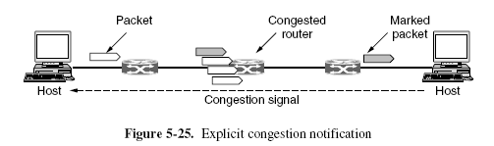
Approaches to Congestion Control
Explicit Congestion Notification

Slide 34
Approaches to Congestion Control
Hop-by-Hop Backpressure
At high speeds or over long distances, many new packets may be transmitted after congestion has been signaled because of the delay before the signal takes effect.
Consider, for example, a host in San Francisco (router A in Fig. 5-26) that is sending traffic to a host in New York (router D in Fig. 5-26) at the OC-3 speed of 155 Mbps.
If the New York host begins to run out of buffers, it will take about 40 msec for a choke packet to get back to San Francisco to tell it to slow down.

Slide 35
Approaches to Congestion Control
Hop-by-Hop Backpressure
An ECN indication will take even longer because it is delivered via the destination.
Choke packet propagation is illustrated as the second, third, and fourth steps in Fig. 5-26(a).
In those 40 msec, another 6.2 megabits will have been sent. Even if the host in San Francisco completely shuts down immediately, the 6.2 megabits in the pipe will continue to pour in and have to be dealt with.
Only in the seventh diagram in Fig. 5-26(a) will the New York router notice a slower flow.

Slide 36
Approaches to Congestion Control
Hop-by-Hop Backpressure
An ECN indication will take even longer because it is delivered via the destination.
Choke packet propagation is illustrated as the second, third, and fourth steps in Fig. 5-26(a).
In those 40 msec, another 6.2 megabits will have been sent. Even if the host in San Francisco completely shuts down immediately, the 6.2 megabits in the pipe will continue to pour in and have to be dealt with.
Only in the seventh diagram in Fig. 5-26(a) will the New York router notice a slower flow.

Slide 37
Approaches to Congestion Control
Hop-by-Hop Backpressure
An alternative approach is to have the choke packet take effect at every hop it passes through, as shown in the sequence of Fig. 5-26(b).
Here, as soon as the choke packet reaches F, F is required to reduce the flow to D.
Doing so will require F to devote more buffers to the connection, since the source is still sending away at full blast, but it gives D immediate relief, like a headache remedy in a television commercial. In the next step, the choke packet reaches E, which tells E to reduce the flow to F.

Slide 38
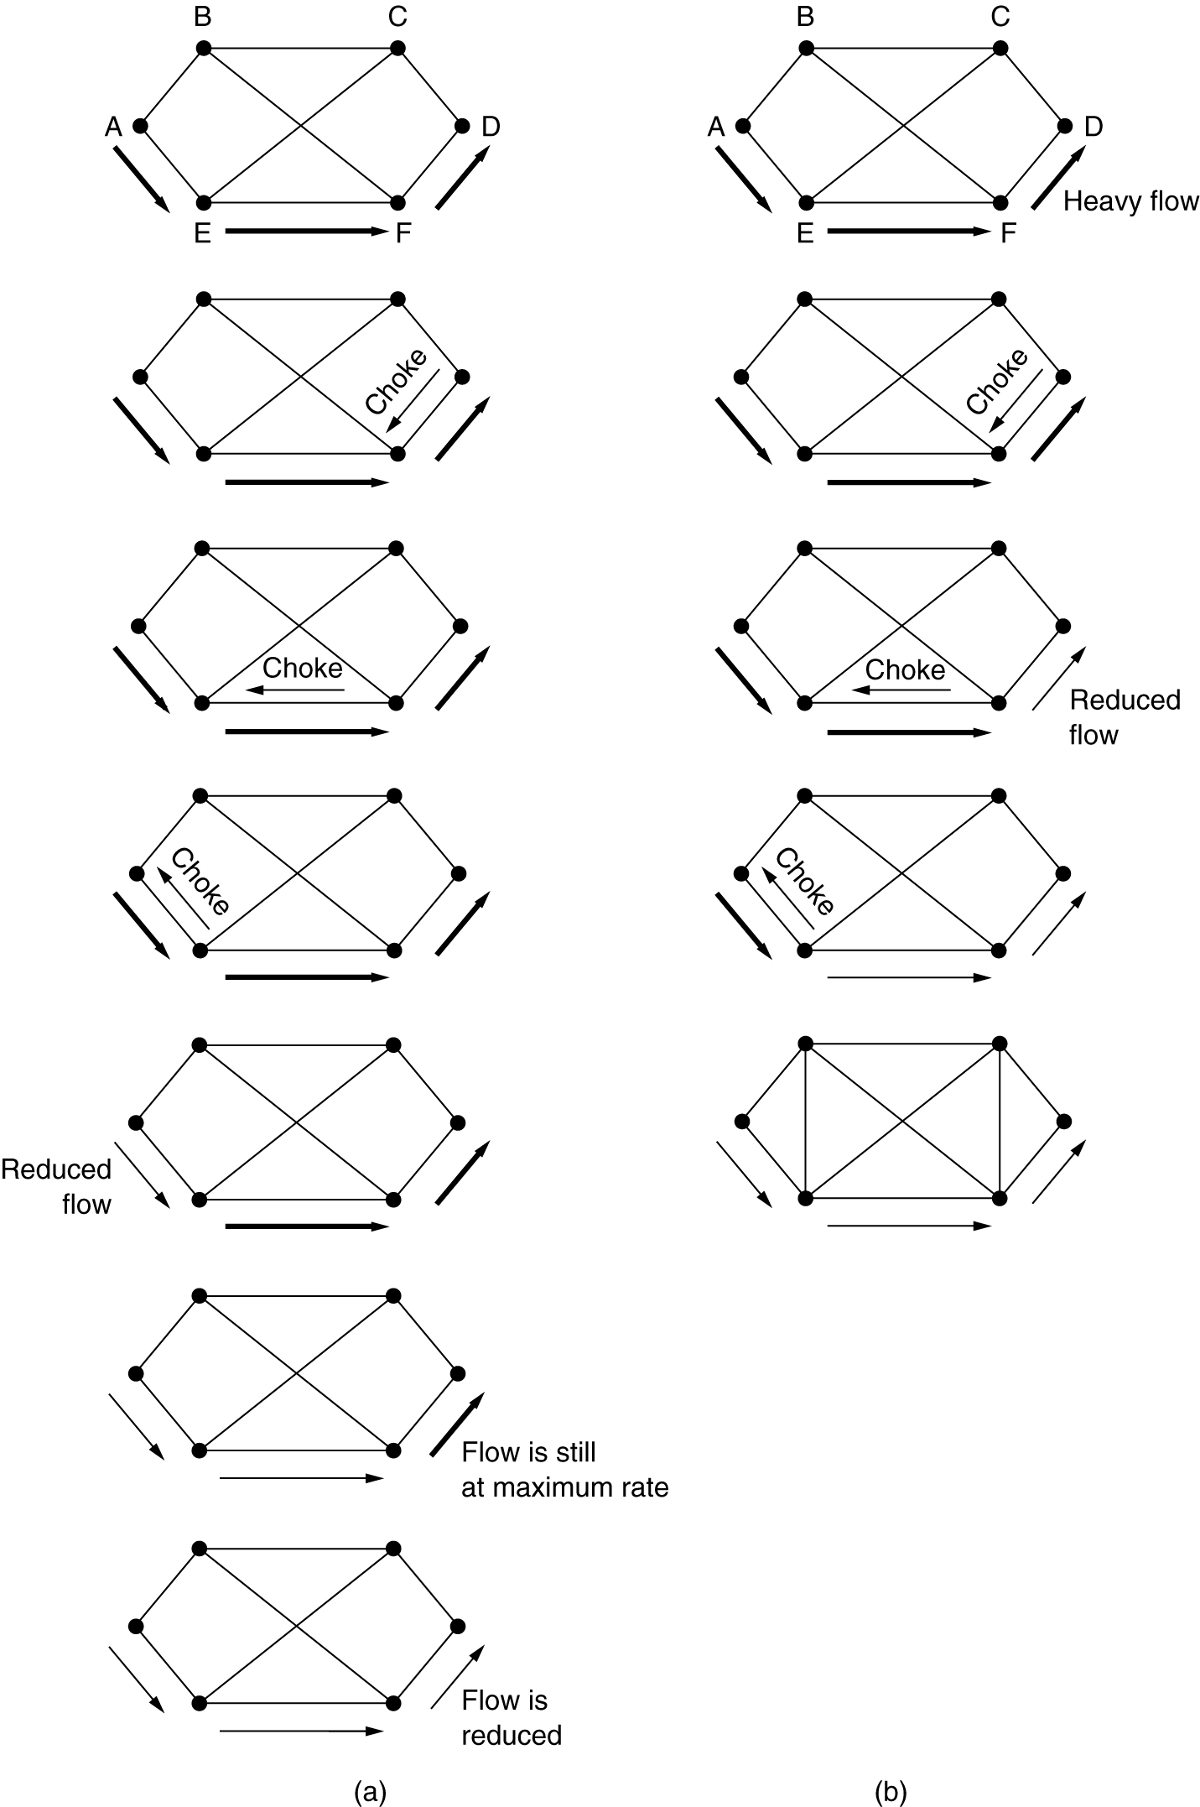
Hop-by-Hop Choke Packets
(a) A choke packet that affects only the source.
(b) A choke packet that affects each hop it passes through.

Slide 39
Approaches to Congestion Control
Hop-by-Hop Backpressure
This action puts a greater demand on E’s buffers but gives F immediate relief.
Finally, the choke packet reaches A and the flow genuinely slows down.
The net effect of this hop-by-hop scheme is to provide quick relief at the point of congestion, at the price of using up more buffers upstream.
In this way, congestion can be nipped in the bud without losing any packets.

Slide 40
Approaches to Congestion Control
Load Shedding
When none of the above methods make the congestion disappear, routers can bring out the heavy artillery: load shedding.
Load shedding is a fancy way of saying that when routers are being inundated by packets that they cannot handle, they just throw them away.
The term comes from the world of electrical power generation, where it refers to the practice of utilities intentionally blacking out certain areas to save the entire grid from collapsing on hot summer days when the demand for electricity greatly exceeds the supply.

Slide 41
Approaches to Congestion Control
Load Shedding
The key question for a router drowning in packets is which packets to drop.
The preferred choice may depend on the type of applications that use the network.
For a file transfer, an old packet is worth more than a new one. This is because dropping packet 6 and keeping packets 7 through 10, for example, will only force the receiver to do more work to buffer data that it cannot yet use.
In contrast, for real-time media, a new packet is worth more than an old one.

Slide 42
Approaches to Congestion Control
Load Shedding
This is because packets become useless if they are delayed and miss the time at which they must be played out to the user.
More intelligent load shedding requires cooperation from the senders.
An example is packets that carry routing information.
These packets are more important than regular data packets because they establish routes; if they are lost, the network may lose connectivity.

Slide 43
Approaches to Congestion Control
Load Shedding
Another example is that algorithms for compressing video, like MPEG, periodically transmit an entire frame and then send subsequent frames as differences from the last full frame.
In this case, dropping a packet that is part of a difference is preferable to dropping one that is part of a full frame because future packets depend on the full frame.
To implement an intelligent discard policy, applications must mark their packets to indicate to the network how important they are.

Slide 44
Approaches to Congestion Control
Load Shedding
Then, when packets have to be discarded, routers can first drop packets from the least important class, then the next most important class, and so on.
Of course, unless there is some significant incentive to avoid marking every packet as VERY IMPORTANT—NEVER, EVER DISCARD, nobody will do it.
Often accounting and money are used to discourage frivolous marking.

Slide 45
Approaches to Congestion Control
Load Shedding
For example, the network might let senders send faster than the service they purchased allows if they mark excess packets as low priority.
Such a strategy is actually not a bad idea because it makes more efficient use of idle resources, allowing hosts to use them as long as nobody else is interested, but without establishing a right to them when times get tough.

Slide 46
Approaches to Congestion Control
Random Early Detection
Dealing with congestion when it first starts is more effective than letting it gum up the works and then trying to deal with it.
This observation leads to an interesting twist on load shedding, which is to discard packets before all the buffer space is really exhausted.
The motivation for this idea is that most Internet hosts do not yet get congestion signals from routers in the form of ECN.
Instead, the only reliable indication of congestion that hosts get from the network is packet loss.

Slide 47
Approaches to Congestion Control
Random Early Detection
After all, it is difficult to build a router that does not drop packets when it is overloaded.
Transport protocols such as TCP are thus hardwired to react to loss as congestion, slowing down the source in response.
The reasoning behind this logic is that TCP was designed for wired networks and wired networks are very reliable, so lost packets are mostly due to buffer overruns rather than transmission errors.
Wireless links must recover transmission errors at the link layer to work well with TCP.

Slide 48
Approaches to Congestion Control
Random Early Detection
This situation can be exploited to help reduce congestion.
By having routers drop packets early, before the situation has become hopeless, there is time for the source to take action before it is too late.
A popular algorithm for doing this is called RED (Random Early Detection) (Floyd and Jacobson, 1993).
To determine when to start discarding, routers maintain a running average of their queue lengths.

Slide 49
Approaches to Congestion Control
Random Early Detection
When the average queue length on some link exceeds a threshold, the link is said to be congested and a small fraction of the packets are dropped at random.
Picking packets at random makes it more likely that the fastest senders will see a packet drop; this is the best option since the router cannot tell which source is causing the most trouble in a datagram network.
The affected sender will notice the loss when there is no acknowledgement, and then the transport protocol will slow down.

Slide 50
Approaches to Congestion Control
Random Early Detection
The lost packet is thus delivering the same message as a choke packet, but implicitly, without the router sending any explicit signal.
RED routers improve performance compared to routers that drop packets only when their buffers are full, though they may require tuning to work well.
For example, the ideal number of packets to drop depends on how many senders need to be notified of congestion.
However, ECN is the preferred option if it is available.

Slide 51
Approaches to Congestion Control
Random Early Detection
It works in exactly the same manner, but delivers a congestion signal explicitly rather than as a loss; RED is used when hosts cannot receive explicit signals.

