Slide 1
The Network Layer
Chapter 5

Slide 2
Quality of Service
Application Requirements
Traffic shaping
Packet scheduling
Admission Control
Integrated Services
Differentiated Services

Slide 3
QUALITY OF SERVICE
The techniques we looked at in the previous sections are designed to reduce congestion and improve network performance.
However, there are applications that demand stronger performance guarantees from the network than ‘‘the best that could be done under the circumstances.’’
Multimedia applications in particular, often need a minimum throughput and maximum latency to work.

Slide 4

QUALITY OF SERVICE
An easy solution to provide good quality of service is to build a network with enough capacity for whatever traffic will be thrown at it. The name for this solution is overprovisioning.
The resulting network will carry application traffic without significant loss and, assuming a decent routing scheme, will deliver packets with low latency.
Performance doesn’t get any better than this. To some extent, the telephone system is overprovisioned because it is rare to pick up a telephone and not get a dial tone instantly. There is simply so much capacity available that demand can almost always be met.

Slide 5
QUALITY OF SERVICE
The trouble with this solution is that it is expensive.
Four issues must be addressed to ensure quality of service:
  What applications need from the network.
  How to regulate the traffic that enters the network.
  How to reserve resources at routers to guarantee performance.
  Whether the network can safely accept more traffic.

Slide 6
QUALITY OF SERVICE
Application Requirements
A stream of packets from a source to a destination is called a flow.
The needs of each flow can be characterized by four primary parameters: bandwidth, delay, jitter, and loss. Together, these determine the QoS (Quality of Service) the flow requires.
Several common applications and the stringency of their network requirements are listed in Fig. 5-27.

Slide 7
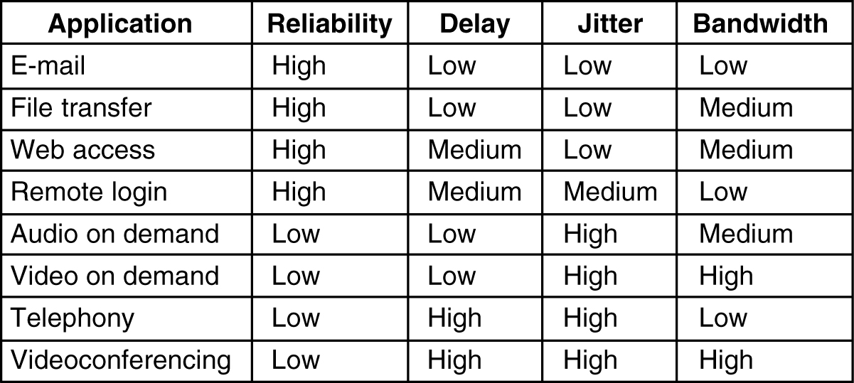
Requirements
5-30
Figure 5-27. Stringency of applications’ quality-of-service requirements.

Slide 8
Requirements
The applications differ in their bandwidth needs with email,rlogin,etc does not require much but file sharing and video ,etc require more.
Some applications can tolerate the delays(constant for all the packets) but some are sensitive to the delay.
Jitter(variation in packet arrival times) will afffect some applications very much ex:User watching a video.
In some applications the loss of data creates very high affect but for audio and video applications if one or two frames lost it will be tolerated.

Slide 9
QUALITY OF SERVICE
Traffic Shaping
Traffic shaping is a technique for regulating the average rate and burstiness of a flow of data that enters the network.
The goal is to allow applications to transmit a wide variety of traffic that suits their needs, including some bursts, yet have a simple and useful way to describe the possible traffic patterns to the network.
When a flow is set up, the user and the network (i.e., the customer and the provider) agree on a certain traffic pattern (i.e., shape) for that flow.

Slide 10
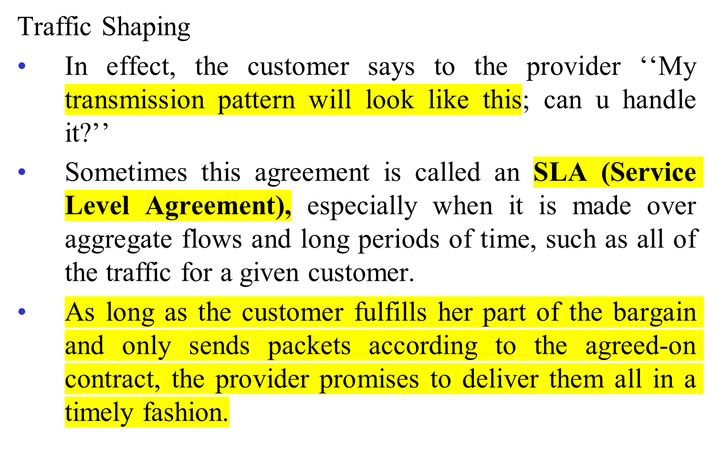
QUALITY OF SERVICE

Slide 11
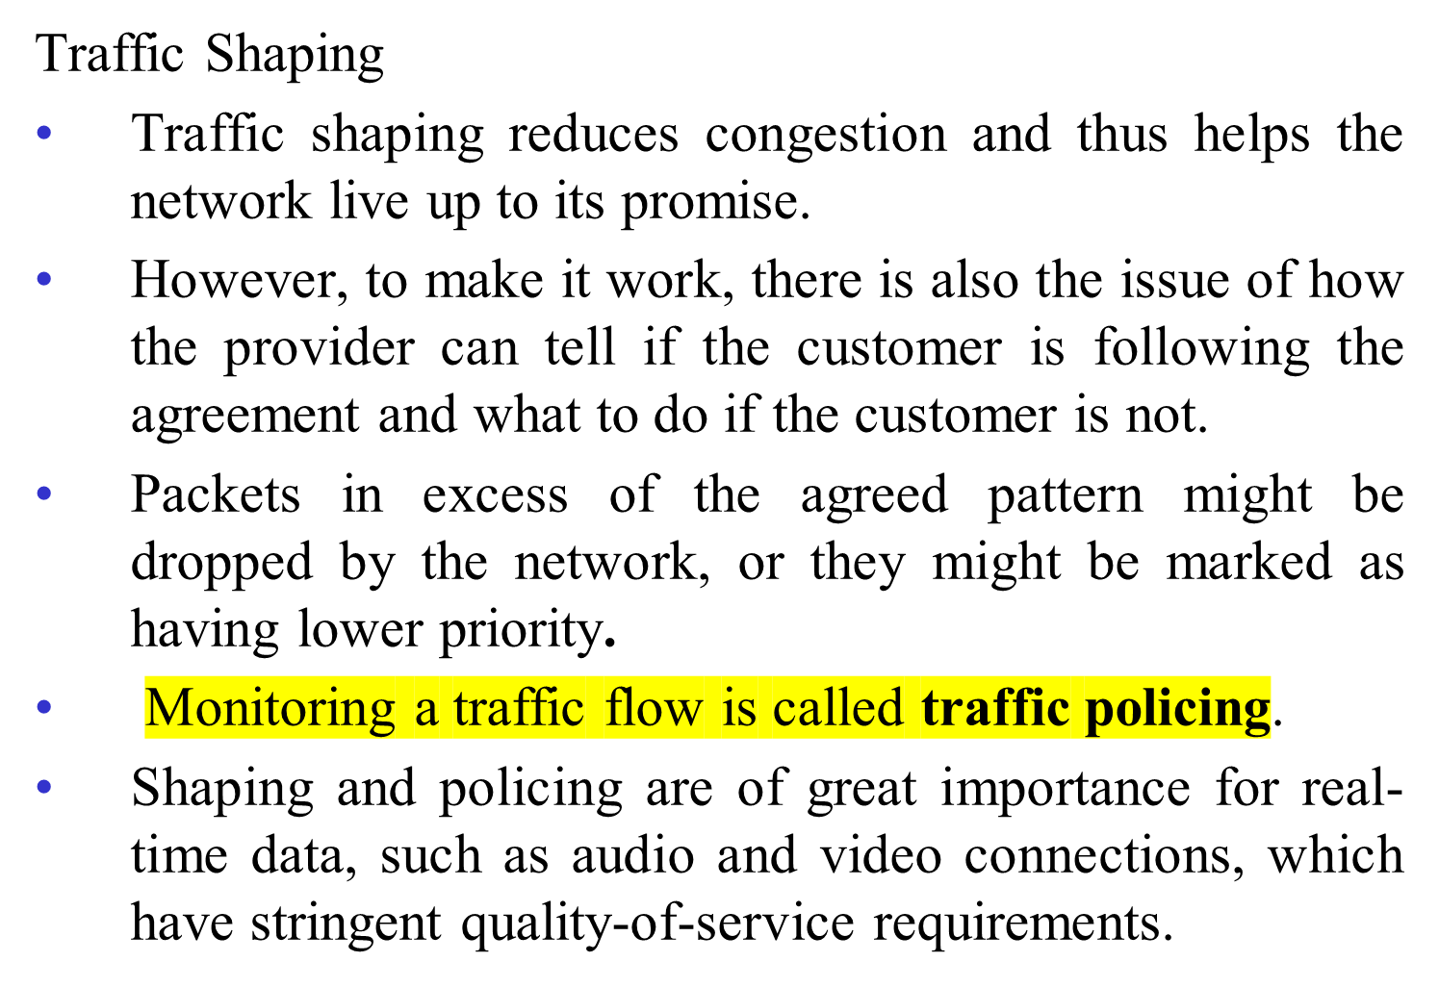
QUALITY OF SERVICE

Slide 12
QUALITY OF SERVICE
Leaky and Token Buckets
Try to imagine a bucket with a small hole in the bottom, as illustrated in Fig. 5-28(b).
No matter the rate at which water enters the bucket, the outflow is at a constant rate, R, when there is any water in the bucket and zero when the bucket is empty.
Also, once the bucket is full to capacity B, any additional water entering it spills over the sides and is lost.

Slide 13
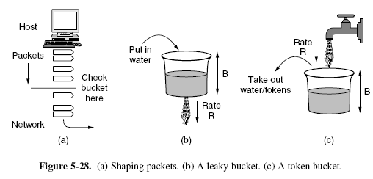
QUALITY OF SERVICE
Leaky and Token Buckets

Slide 14
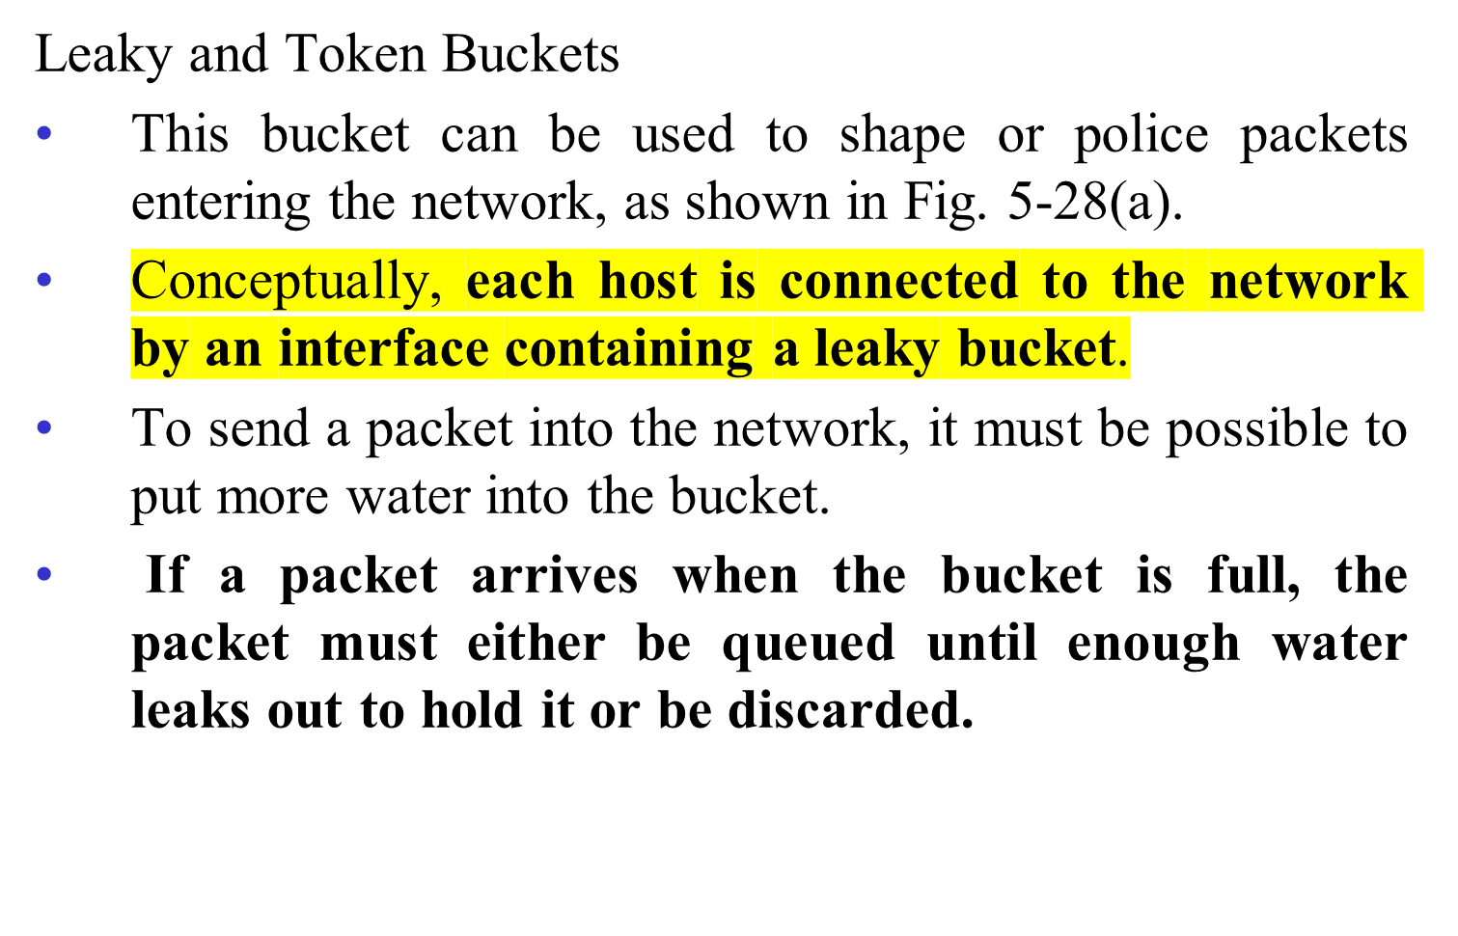
QUALITY OF SERVICE

Slide 15
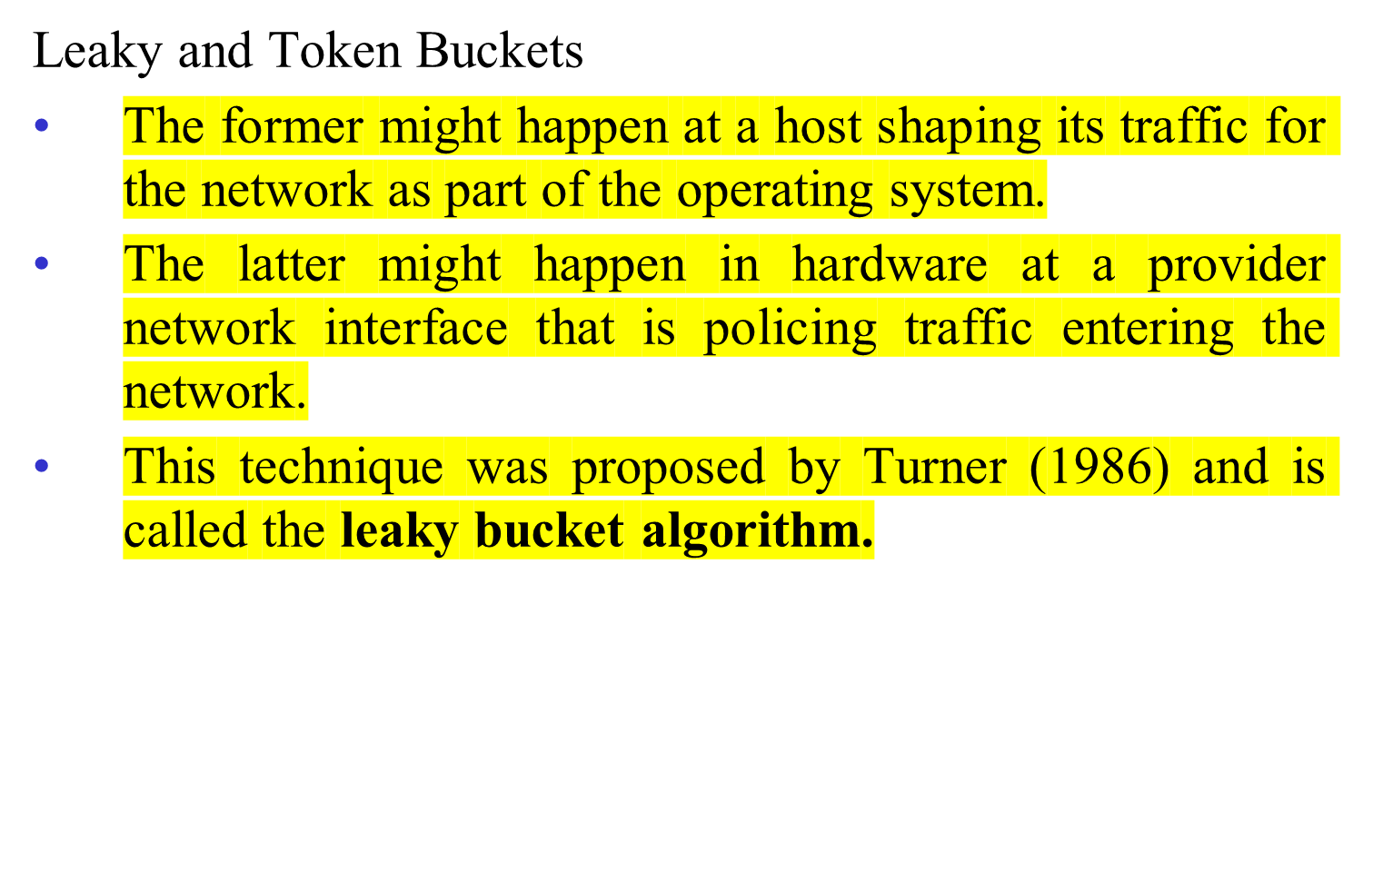
QUALITY OF SERVICE

Slide 16
QUALITY OF SERVICE
Leaky and Token Buckets
A different but equivalent formulation is to imagine the network interface as a bucket that is being filled, as shown in Fig. 5-28(c).
The tap is running at rate R and the bucket has a capacity of B, as before.
Now, to send a packet we must be able to take water, or tokens, as the contents are commonly called, out of the bucket (rather than putting water into the bucket).

Slide 17
QUALITY OF SERVICE
Leaky and Token Buckets
No more than a fixed number of tokens, B, can accumulate in the bucket, and if the bucket is empty, we must wait until more tokens arrive before we can send another packet.
This algorithm is called the token bucket algorithm.

Slide 18
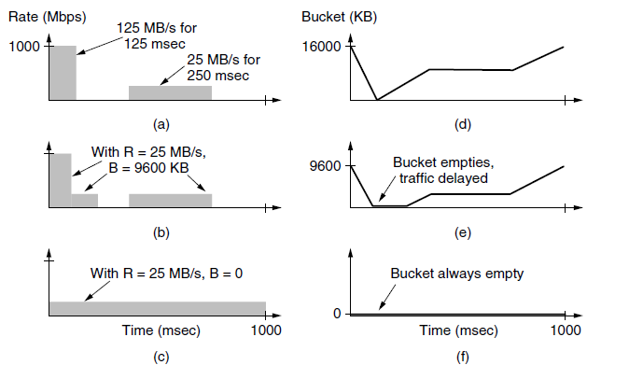
Example of token bucket

Slide 19
QUALITY OF SERVICE
Leaky and Token Buckets
Leaky and token buckets are easy to implement.
We will now describe the operation of a token bucket. Even though we have described water flowing continuously into and out of the bucket, real implementations must work with discrete quantities.
A token bucket is implemented with a counter for the level of the bucket.
The counter is advanced by R /ΔT units at every clock tick of ΔT seconds. Every time a unit of traffic is sent into the network, the counter is decremented, and traffic may be sent until the counter reaches zero..

Slide 20
QUALITY OF SERVICE
Leaky and Token Buckets
When the packets are all the same size, the bucket level can just be counted in packets
However, often variable sized packets are being used.
In this case, the bucket level is counted in bytes.
If the residual byte count is too low to send a large packet, the packet must wait until the next tick
If we call the burst length S sec., the maximum output rate M bytes/sec, the token bucket capacity B bytes, and the token arrival rate R bytes/sec, we can see that an output burst contains a maximum of B + RS bytes.

Slide 21
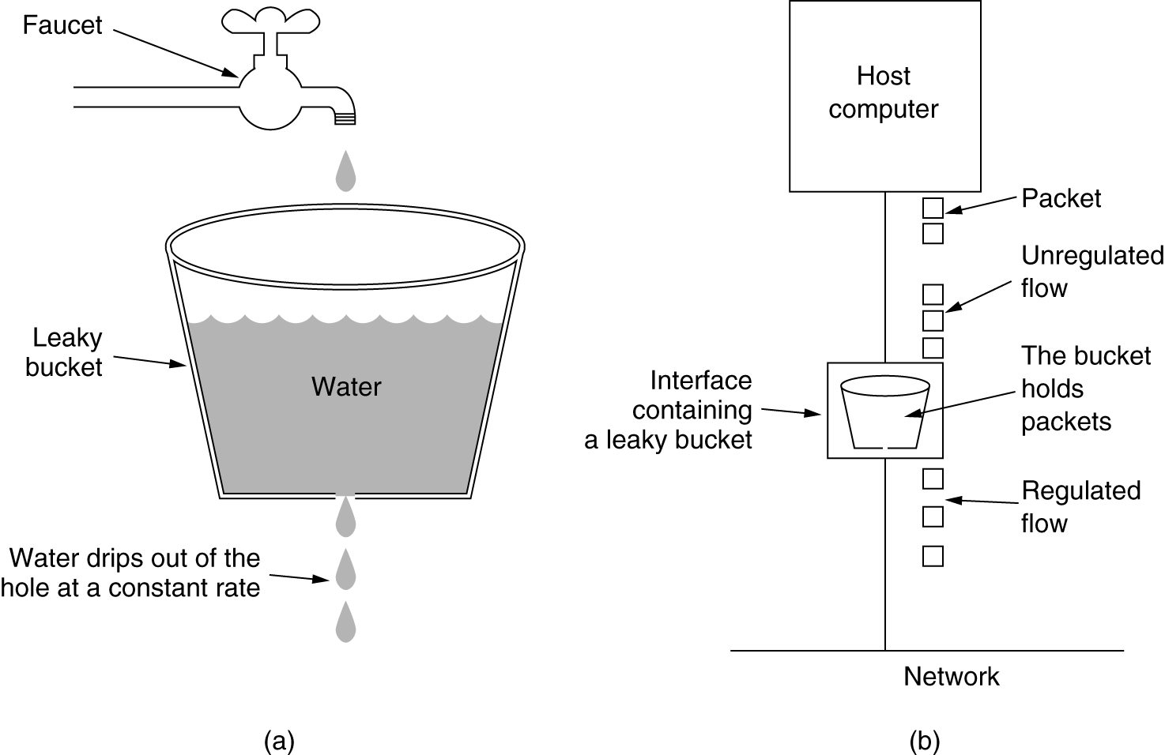
The Leaky Bucket Algorithm
(a) A leaky bucket with water. (b) a leaky bucket with packets.

Slide 22
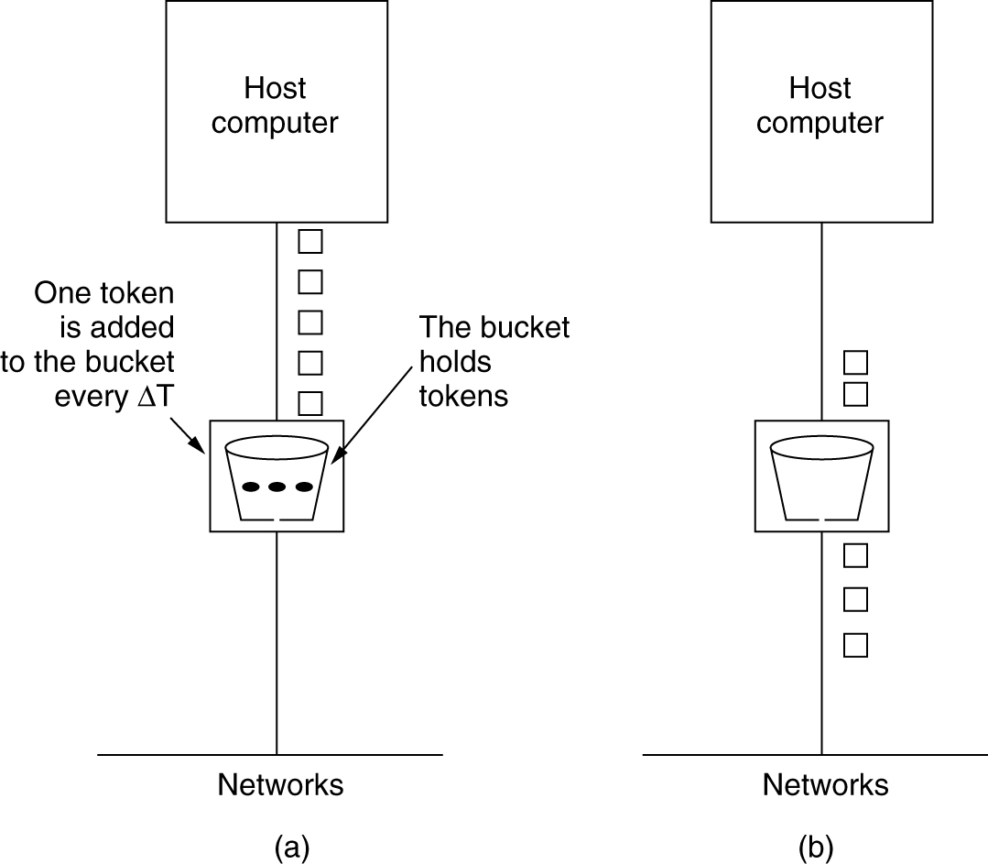
The Token Bucket Algorithm
5-34
(a) Before. (b) After.

Slide 23
QUALITY OF SERVICE
Packet Scheduling
Being able to regulate the shape of the offered traffic is a good start.
However, to provide a performance guarantee, we must reserve sufficient resources along the route that the packets take through the network.
To do this, we are assuming that the packets of a flow follow the same route.
Algorithms that allocate outer resources among the packets of a flow and between competing flows are called packet scheduling algorithms.

Slide 24
QUALITY OF SERVICE
Packet Scheduling
Three different kinds of resources can potentially be reserved for different flows:
Bandwidth.
Buffer space.
CPU cycles.

Slide 25
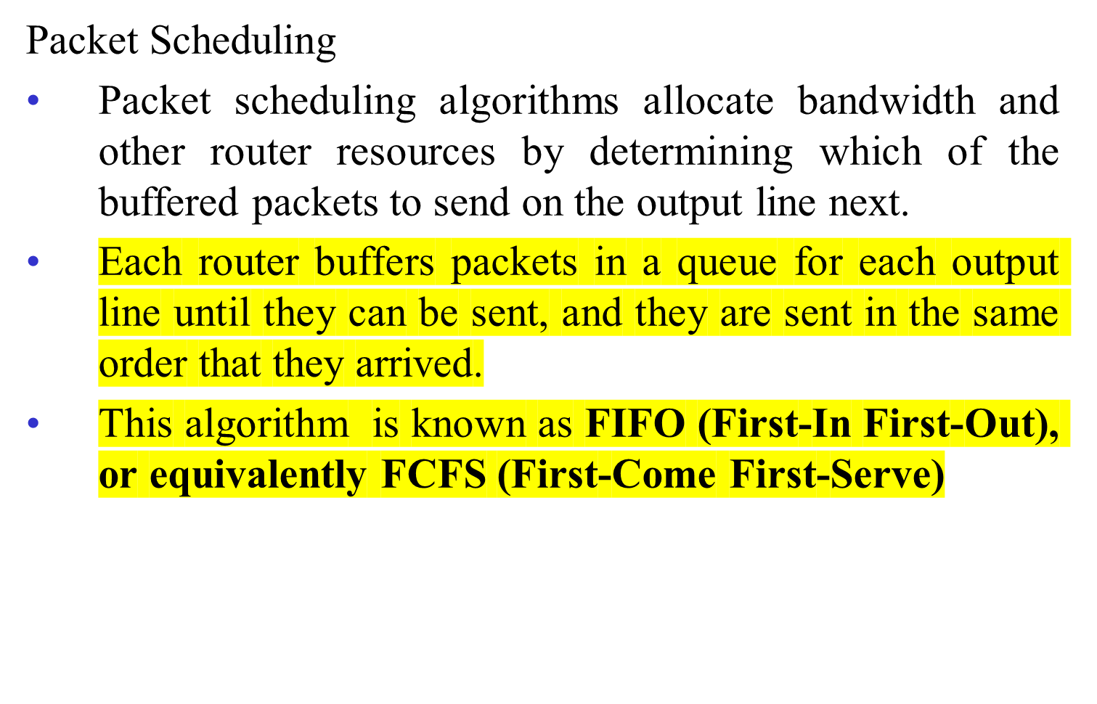
QUALITY OF SERVICE

Slide 26
QUALITY OF SERVICE
Packet Scheduling
FIFO routers usually drop newly arriving packets when the queue is full.
Since the newly arrived packet would have been placed at the end of the queue, this behavior is called tail drop.
The RED algorithm chose a newly arriving packet to drop at random when the average queue length grew large.
The other scheduling algorithms that we will describe also create other opportunities for deciding which packet to drop when the buffers are full.

Slide 27
QUALITY OF SERVICE
Packet Scheduling
FIFO scheduling is simple to implement, but it is not suited to providing good quality of service because when there are multiple flows, one flow can easily affect the performance of the other flows.
If the first flow is aggressive and sends large bursts of packets, they will lodge in the queue.
Processing packets in the order of their arrival means that the aggressive sender can hog most of the capacity of the routers its packets traverse, starving the other flows and reducing their quality of service

Slide 28
QUALITY OF SERVICE
Packet Scheduling
To add insult to injury, the packets of the other flows that do get through are likely to be delayed because they had to sit in the queue behind many packets from the aggressive sender.
Many packet scheduling algorithms have been devised that provide stronger isolation between flows and thwart attempts at interference
One of the first ones was the fair queueing algorithm devised by Nagle

Slide 29
QUALITY OF SERVICE
Packet Scheduling
The essence of this algorithm is that routers have separate queues, one for each flow for a given output line.
When the line becomes idle, the router scans the queues round-robin, as shown in Fig. 5-30. It then takes the first packet on the next queue.
In this way, with n hosts competing for the output line, each host gets to send one out of every n packets.
It is fair in the sense that all flows get to send packets at the same rate. Sending more packets will not improve this rate.

Slide 30
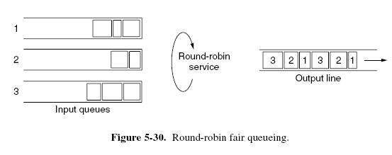
QUALITY OF SERVICE
Packet Scheduling

Slide 31
QUALITY OF SERVICE
Packet Scheduling
Although a start, the algorithm has a flaw: it gives more bandwidth to hosts that use large packets than to hosts that use small packets.
Solution is to simulate a byte-by-byte round-robin, instead of a packet-by-packet round-robin.
The trick is to compute a virtual time that is the number of the round at which each packet would finish being sent.
Each round drains a byte from all of the queues that have data to send. The packets are then sorted in order of their finishing times and sent in that order.

Slide 32
QUALITY OF SERVICE
Packet Scheduling
This algorithm and an example of finish times for packets arriving in three flows are illustrated in Fig. 5-31.
If a packet has length L, the round at which it will finish is simply L rounds after the start time.
The start time is either the finish time of the previous packet, or the arrival time of the packet, if the queue is empty when it arrives.

Slide 33
QUALITY OF SERVICE
Packet Scheduling
One shortcoming of this algorithm in practice is that it gives all hosts the same priority. In many situations, it is desirable to give, for example, video servers more bandwidth than, say, file servers.
This is easily possible by giving the video server two or more bytes per round. This modified algorithm is called WFQ (Weighted Fair Queueing).

Slide 34
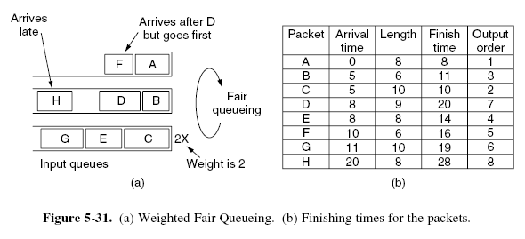
QUALITY OF SERVICE
Packet Scheduling

Slide 35
QUALITY OF SERVICE
Packet Scheduling
Other kinds of scheduling algorithms exist, too.
A simple example is priority scheduling, in which each packet is marked with a priority.
High-priority packets are always sent before any low-priority packets that are buffered.
Within a priority, packets are sent in FIFO order.
However, priority scheduling has the disadvantage that a burst of high-priority packets can starve low-priority packets, which may have to wait indefinitely.

Slide 36
QUALITY OF SERVICE
Packet Scheduling
WFQ often provides a better alternative. By giving the high-priority queue a large weight, say 3, high-priority packets will often go through a short line - yet some fraction of low priority packets will continue to be sent even when there is high priority traffic.
As a final example of a scheduler, packets might carry timestamps and be sent in timestamp order.
Timestamp records how far the packet is behind or ahead of schedule as it is sent through a sequence of routers on the path.

Slide 37
QUALITY OF SERVICE
Packet Scheduling
Packets that have been queued behind other packets at a router will tend to be behind schedule, and the packets that have been serviced first will tend to be ahead of schedule.
Sending packets in order of their timestamps has the beneficial effect of speeding up slow packets while at the same time slowing down fast packets.
The result is that all packets are delivered by the network with a more consistent delay.

Slide 38
QUALITY OF SERVICE
Admission Control
We have now seen all the necessary elements for QoS and it is time to put them together to actually provide it.
QoS guarantees are established through the process of admission control.
The user offers a flow with an accompanying QoS requirement to the network.
The network then decides whether to accept or reject the flow based on its capacity and the commitments it has made to other flows.
If it accepts, the network reserves capacity in advance at routers to guarantee QoS when traffic is sent on the new flow.

Slide 39
QUALITY OF SERVICE
Admission Control
The reservations must be made at all of the routers along the route that the packets take through the network.
Any routers on the path without reservations might become congested, and a single congested router can break the QoS guarantee.
Many routing algorithms find the single best path between each source and each destination and send all traffic over the best path.
This may cause some flows to be rejected if there is not enough spare capacity along the best path.

Slide 40
QUALITY OF SERVICE
Admission Control
QoS guarantees for new flows may still be accommodated by choosing a different route for the flow that has excess capacity. This is called QoS routing.
It is also possible to split the traffic for each destination over multiple paths to more easily find excess capacity.
A simple method is for routers to choose equal-cost paths and to divide the traffic equally or in proportion to the capacity of the outgoing links

Slide 41
QUALITY OF SERVICE
Admission Control
Given a path, the decision to accept or reject a flow is not a simple matter of comparing the resources (bandwidth, buffers, cycles) requested by the flow with the router’s excess capacity in those three dimensions.
It is a little more complicated than that.
To start with, although some applications may know about their bandwidth requirements, few know about buffers or CPU cycles, so at the minimum, a different way is needed to describe flows and translate this description to router resources

Slide 42
QUALITY OF SERVICE
Admission Control
Next, some applications are far more tolerant of an occasional missed deadline than others.
The applications must choose from the type of guarantees that the network can make, whether hard guarantees or behavior that will hold most of the time.
All else being equal, everyone would like hard guarantees, but the difficulty is that they are expensive because they constrain worst case behavior.
Guarantees for most of the packets are often sufficient for applications, and more flows with this guarantee can be supported for a fixed capacity.

Slide 43
QUALITY OF SERVICE
Admission Control
Finally, some applications may be willing to haggle about the flow parameters and others may not.
For example, a movie viewer that normally runs at 30 frames/sec may be willing to drop back to 25 frames/sec if there is not enough free bandwidth to support 30 frames/sec.
Similarly, the number of pixels per frame, audio bandwidth, and other properties may be adjustable.

Slide 44
QUALITY OF SERVICE
Admission Control
Because many parties may be involved in the flow negotiation (the sender, the receiver, and all the routers along the path between them), flows must be described accurately in terms of specific parameters that can be negotiated.
A set of such parameters is called a flow specification. Typically, the sender (e.g., the video server) produces a flow specification proposing the parameters it would like to use.

Slide 45
QUALITY OF SERVICE
Admission Control
As the specification propagates along the route, each router examines it and modifies the parameters as need be.
The modifications can only reduce the flow, not increase it (e.g., a lower data rate, not a higher one).
When it gets to the other end, the parameters can be established.

Slide 46
QUALITY OF SERVICE
Admission Control
As an example of what can be in a flow specification, consider the example of Fig. 5-32
It has five parameters.
The first two parameters, the token bucket rate and token bucket size, use a token bucket to give the maximum sustained rate the sender may transmit, averaged over a long time interval, and the largest burst it can send over a short time interval.
The third parameter, the peak data rate, is the maximum transmission rate tolerated, even for brief time intervals. The sender must never exceed this rate even for short bursts.

Slide 47
QUALITY OF SERVICE
Admission Control
The last two parameters specify the minimum and maximum packet sizes, including the transport and network layer headers (e.g., TCP and IP).
The minimum size is useful because processing each packet takes some fixed time, no matter how short.
The maximum packet size is important due to internal network limitations that may not be exceeded.

Slide 48
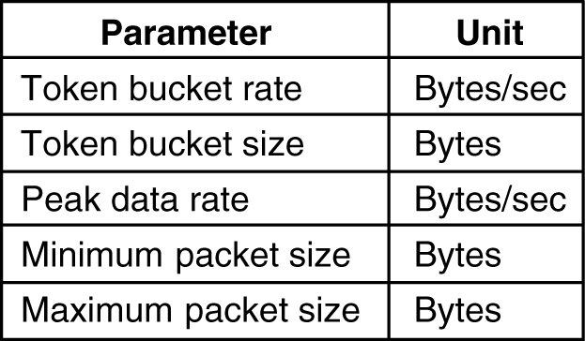
Admission Control
5-34
An example of flow specification.

Slide 49
Admission Control
Admission Control
An interesting question is how a router turns a flow specification into a set of specific resource reservations
One method of relating flow specifications to router resources that correspond to bandwidth and delay performance guarantees is given by Parekh and Gallagher (1993, 1994).
It is based on traffic sources shaped by (R, B) token buckets and WFQ at routers.
Each flow is given a WFQ weight W large enough to drain its token bucket rate R.
The largest queueing delay the flow will see is a function of the burst size of the token bucket.

Slide 50
Internetworking
How Networks Differ
How Networks Can Be Connected
Tunneling
Internetwork Routing
Packet Fragmentation

Slide 51
Internetworking
If you consider Internet, it is a combination of different networks which uses different protocols at each layer.
Getting packets from one network to another is not always so easy.
How Networks Differ
Fig. 5-38 we list some of the differences that can be exposed to the network layer.
When packets sent by a source on one network must transit one or more foreign networks before reaching the destination network, many problems can occur at the interfaces between networks.
To start with, the source needs to be able to address the destination.

Slide 52
Internetworking
How Networks Differ
What do we do if the source is on an Ethernet network and the destination is on a WiMAX network?
Assuming we can even specify a WiMAX destination from an Ethernet network, packets would cross from a connectionless network to a connection-oriented one.
This may require that a new connection be set up on short notice, which injects a delay, and much overhead if the connection is not used for many more packets.

Slide 53
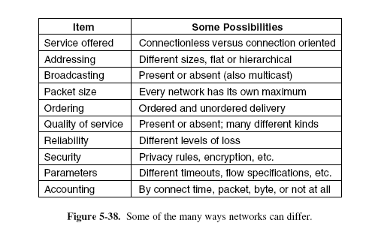
Internetworking
How Networks Differ

Slide 54
Internetworking
How Networks Can Be Connected
There are two basic choices for connecting different networks: we can build devices that translate or convert packets from each kind of network into packets for each other network, or, like good computer scientists, we can try to solve the problem by adding a layer of indirection and building a common layer on top of the different networks.
In either case, the devices are placed at the boundaries between networks.
Our focus in this section is interconnection devices that operate at the network layer, namely the routers.

Slide 55
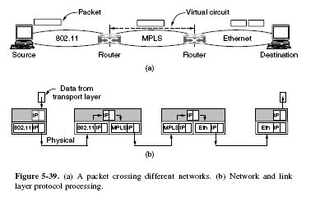
How Networks Can Be Connected

Slide 56
Internetworking
How Networks Can Be Connected
Early on, Cerf and Kahn (1974) argued for a common layer to hide the differences of existing networks.
Almost four decades later, IP is the foundation of the modern Internet.
IP provides a universal packet format that all routers recognize and that can be passed through almost every network.
A router that can handle multiple network protocols is called a multiprotocol router.
It must either translate the protocols, or leave connection for a higher protocol layer.

Slide 57
Internetworking
How Networks Can Be Connected
Neither approach is entirely satisfactory.
Connection at a higher layer, say, by using TCP, requires that all the networks implement TCP (which may not be the case).
Conversion is only rarely attempted. Ex:IPv6 and IPv4.
IP has worked so well by serving as a kind of lowest common denominator.
It requires little of the networks on which it runs, but offers only best-effort service as a result.

Slide 58
Tunneling
Handling the general case of making two different networks interwork is exceedingly difficult.
However, there is a common special case that is manageable even for different network protocols.
This case is where the source and destination hosts are on the same type of network, but there is a different network in between.
This situation is shown in Fig. 5-40.

Slide 59
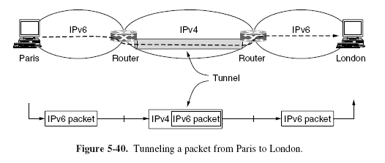
Tunneling

Slide 60
Tunneling
The solution to this problem is a technique called tunneling.
To send an IP packet to a host in the London office, a host in the Paris office constructs the packet containing an IPv6 address in London, and sends it to the multiprotocol router that connects the Paris IPv6 network to the IPv4 Internet.
When this router gets the IPv6 packet, it encapsulates the packet with an IPv4 header addressed to the IPv4 side of the multiprotocol router that connects to the London IPv6 network.

Slide 61
Tunneling
That is, the router puts a (IPv6) packet inside a (IPv4) packet.
When this wrapped packet arrives, the London router removes the original IPv6 packet and sends it onward to the destination host.
The path through the IPv4 Internet can be seen as a big tunnel extending from one multiprotocol router to the other.
The IPv6 packet just travels from one end of the tunnel to the other, snug in its nice box.
It does not have to worry about dealing with IPv4 at all.

Slide 62
Tunneling
Neither do the hosts in Paris or London.
Only the multiprotocol routers have to understand both IPv4 and IPv6 packets.
In effect, the entire trip from one multiprotocol router to the other is like a hop over a single link.
Consider a person driving her car from Paris to London.
Within France, the car moves under its own power, but when it hits the English Channel, it is loaded onto a high-speed train and transported to England through the Chunnel.

Slide 63
Tunneling
Effectively, the car is being carried as freight, as depicted in Fig. 5-41.
At the far end, the car is let loose on the English roads and once again continues to move under its own power.
Tunneling of packets through a foreign network works the same way.
The network that results is called an overlay since it has effectively been overlaid on the base network.
The disadvantage of tunneling is that none of the hosts on the network that is tunneled over can be reached because the packets cannot escape in the middle of the tunnel.

Slide 64
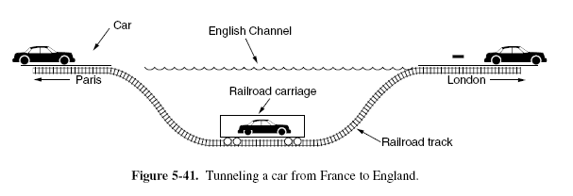
Tunneling

Slide 65
Internetwork Routing
Routing through an internet poses the same basic problem as routing within a single network, but with some added complications.
To start, the networks may internally use different routing algorithms.
For example, one network may use link state routing and another distance vector routing.
Since link state algorithms need to know the topology but distance vector algorithms do not, this difference alone would make it unclear how to find the shortest paths across the internet.

Slide 66
Internetwork Routing
Networks run by different operators lead to bigger problems.
First, the operators may have different ideas about what is a good path through the network. One operator may want the route with the least delay, while another may want the most inexpensive route.
This will lead the operators to use different quantities to set the shortest-path costs.
The weights will not be comparable across networks, so shortest paths on the internet will not be well defined.

Slide 67
Internetwork Routing
Worse yet, one operator may not want another operator to even know the details of the paths in its network, perhaps because the weights and paths may reflect sensitive information (such as the monetary cost) that represents a competitive business advantage.
Finally, the internet may be much larger than any of the networks that comprise it.
It may therefore require routing algorithms that scale well by using a hierarchy, even if none of the individual networks need to use a hierarchy.

Slide 68
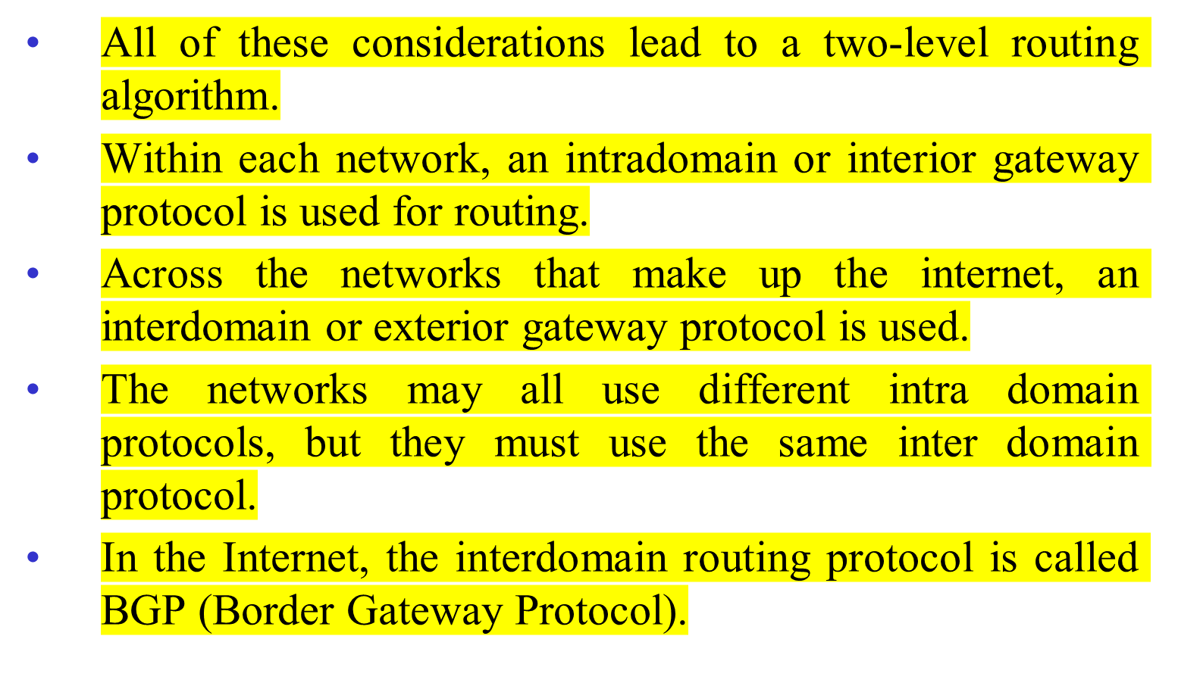
Internetwork Routing

Slide 69
Internetwork Routing
Since each network is operated independently of all the others, it is often referred to as an AS (Autonomous System).
A good mental model for an AS is an ISP network. In fact, an ISP network may be comprised of more than one AS, if it is managed, or, has been acquired, as multiple networks.
But the difference is usually not significant.

Slide 70
Packet Fragmentation
Each network or link imposes some maximum size on its packets.
These limits have various causes, among them
  Hardware (e.g., the size of an Ethernet frame).
  Operating system (e.g., all buffers are 512 bytes).
  Protocols (e.g., the number of bits in the packet length field).
  Compliance with some (inter)national standard.
  Desire to reduce error-induced retransmissions to some level.
  Desire to prevent one packet from occupying the channel too long.

Slide 71
Packet Fragmentation
The result of all these factors is that the network designers are not free to choose any maximum packet size they wish.
Hosts usually prefer to transmit large packets because this reduces packet overheads such as bandwidth wasted on header bytes.
An obvious internetworking problem appears when a large packet wants to travel through a network whose maximum packet size is too small.
This nuisance has been a persistent issue, and solutions to it have evolved along with much experience gained on the Internet.

Slide 72
Packet Fragmentation
One solution is to make sure the problem does not occur in the first place.
A source does not usually know the path a packet will take through the network to a destination, so it certainly does not know how small packets must be to get there.
This packet size is called the Path MTU (Path Maximum Transmission Unit).
Even if the source did know the path MTU, packets are routed independently in a connectionless network such as the Internet.
This routing means that paths may suddenly change, which can unexpectedly change the path MTU.

Slide 73
Packet Fragmentation
The alternative solution to the problem is to allow routers to break up packets into fragments, sending each fragment as a separate network layer packet.
However, as every parent of a small child knows, converting a large object into small fragments is considerably easier than the reverse process.
Packet-switching networks, too, have trouble putting the fragments back together again.

Slide 74
Packet Fragmentation
Two opposing strategies exist for recombining the fragments back into the original packet.
The first strategy is to make fragmentation caused by a ‘‘smallpacket’’ network transparent to any subsequent networks through which the packet must pass on its way to the ultimate destination. This option is shown in Fig. 5- 42(a).
In this approach, when an oversized packet arrives at G1, the router breaks it up into fragments.
Each fragment is addressed to the same exit router, G2, where the pieces are recombined.

Slide 75
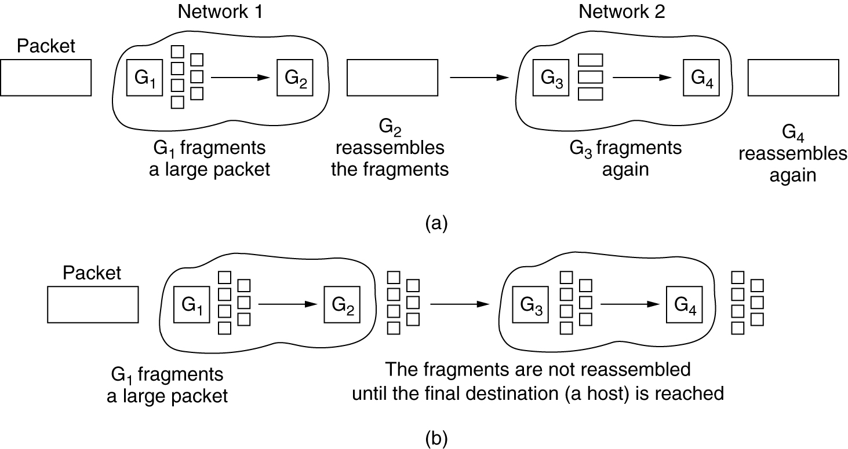
Fragmentation
(a) Transparent fragmentation. (b) Nontransparent fragmentation.

Slide 76
Packet Fragmentation
In this way, passage through the small-packet network is made transparent.
Subsequent networks are not even aware that fragmentation has occurred.
Transparent fragmentation is straightforward but has some problems.
For one thing, the exit router must know when it has received all the pieces, so either a count field or an ‘‘end of packet’’ bit must be provided.

Slide 77
Packet Fragmentation
Also, because all packets must exit via the same router so that they can be reassembled, the routes are constrained.
By not allowing some fragments to follow one route to the ultimate destination and other fragments a disjoint route, some performance may be lost.
More significant is the amount of work that the router may have to do.
It may need to buffer the fragments as they arrive, and decide when to throw them away if not all of the fragments arrive.

Slide 78
Packet Fragmentation
Some of this work may be wasteful, too, as the packet may pass through a series of small packet networks and need to be repeatedly fragmented and reassembled.
The other fragmentation strategy is to refrain from recombining fragments at any intermediate routers.
Once a packet has been fragmented, each fragment is treated as though it were an original packet.
The routers pass the fragments, as shown in Fig. 5-42(b), and reassembly is performed only at the destination host.

Slide 79
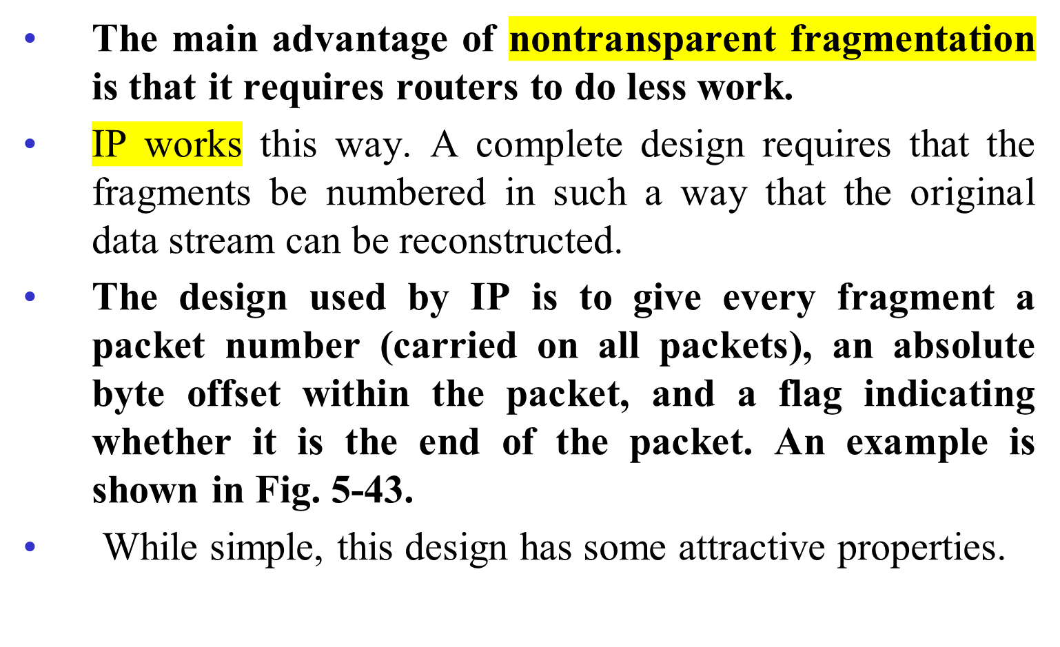
Packet Fragmentation

Slide 80
Packet Fragmentation
Fragments can be of arbitrary size, down to a single byte plus the packet header.
In all cases, the destination simply uses the packet number and fragment offset to place the data in the right position, and the end-of-packet flag to determine when it has he complete packet.

Slide 81
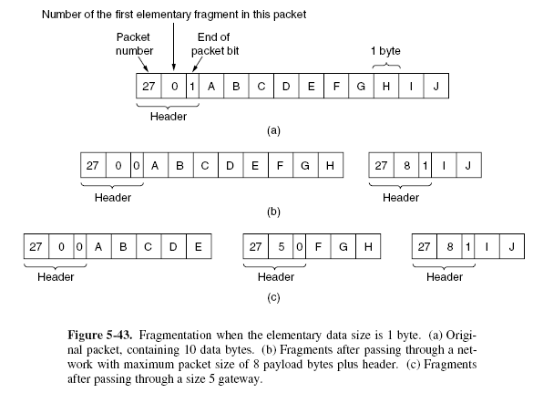
Packet Fragmentation

Slide 82
Packet Fragmentation
Unfortunately, this design still has problems.
The overhead can be higher than with transparent fragmentation because fragment headers are now carried over some links where they may not be needed.
But the real problem is the existence of fragments in the first place.
A whole packet is lost if any of its fragments are lost, and because fragmentation is more of a burden for hosts than was originally realized.

Slide 83
Packet Fragmentation
This leads us back to the original solution of getting rid of fragmentation in the network, the strategy used in the modern Internet.
The process is called path MTU discovery.
It works as follows. Each IP packet is sent with its header bits set to indicate that no fragmentation is allowed to be performed.
If a router receives a packet that is too large, it generates an error packet, returns it to the source, and drops the packet. This is shown in Fig. 5-44.

Slide 84
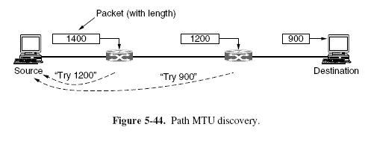
Packet Fragmentation

Slide 85
Packet Fragmentation
When the source receives the error packet, it uses the information inside to refragment the packet into pieces that are small enough for the router to handle.
If a router further down the path has an even smaller MTU, the process is repeated.
The advantage of path MTU discovery is that the source now knows what length packet to send.
If the routes and path MTU change, new error packets will be triggered and the source will adapt to the new path.

Slide 86
Packet Fragmentation
However, fragmentation is still needed between the source and the destination unless the higher layers learn the path MTU and pass the right amount of data to IP.
TCP and IP are typically implemented together to be able to pass this sort of information.
Even if this is not done for other protocols, fragmentation has still been moved out of the network and into the hosts.

Slide 87
Packet Fragmentation
The disadvantage of path MTU discovery is that there may be added startup delays simply to send a packet.
More than one round-trip delay may be needed to probe the path and find the MTU before any data is delivered to the destination.
This begs the question of whether there are better designs. The answer is probably ‘‘Yes.’’
Consider the design in which each router simply truncates packets that exceed its MTU.
This would ensure that the destination learns the MTU as rapidly as possible and receives some of the data.

