Slide 1
The Network Layer
Chapter 5

Slide 2
The Network Layer in the Internet
The IPv4 Protocol
IP Addresses
Ihe IPv6 Protocol
Internet control protocols
Label Switching and MPLS
OSPF – The Interior Gateway Routing Protocol
BGP – The Exterior Gateway Routing Protocol
Internet Multicasting
Mobile IP

Slide 3
Design Principles for Internet
Make sure it works.
Keep it simple.
Make clear choices.
Exploit modularity.
Expect heterogeneity.
Avoid static options and parameters.
Look for a good design; it need not be perfect.
Be strict when sending and tolerant when receiving.
Think about scalability.
Consider performance and cost.

Slide 4
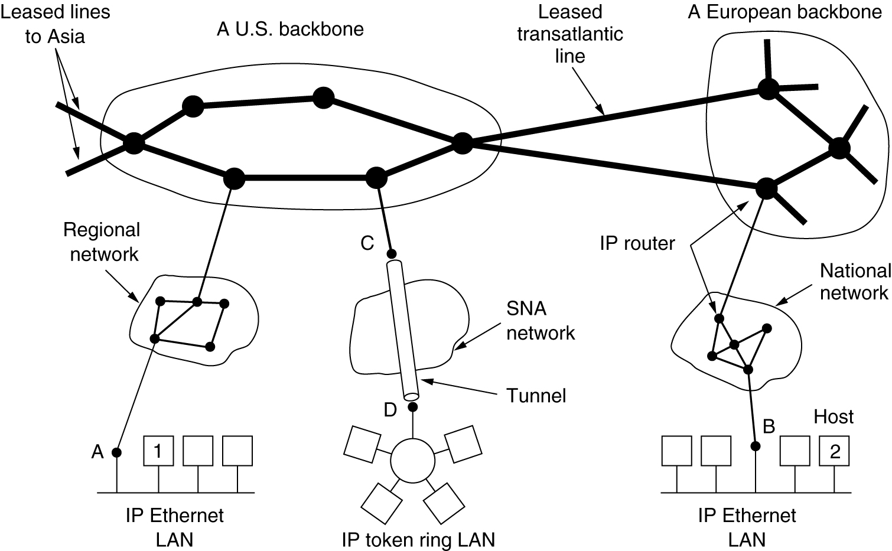
Collection of Subnetworks
The Internet is an interconnected collection of many networks.

Slide 5
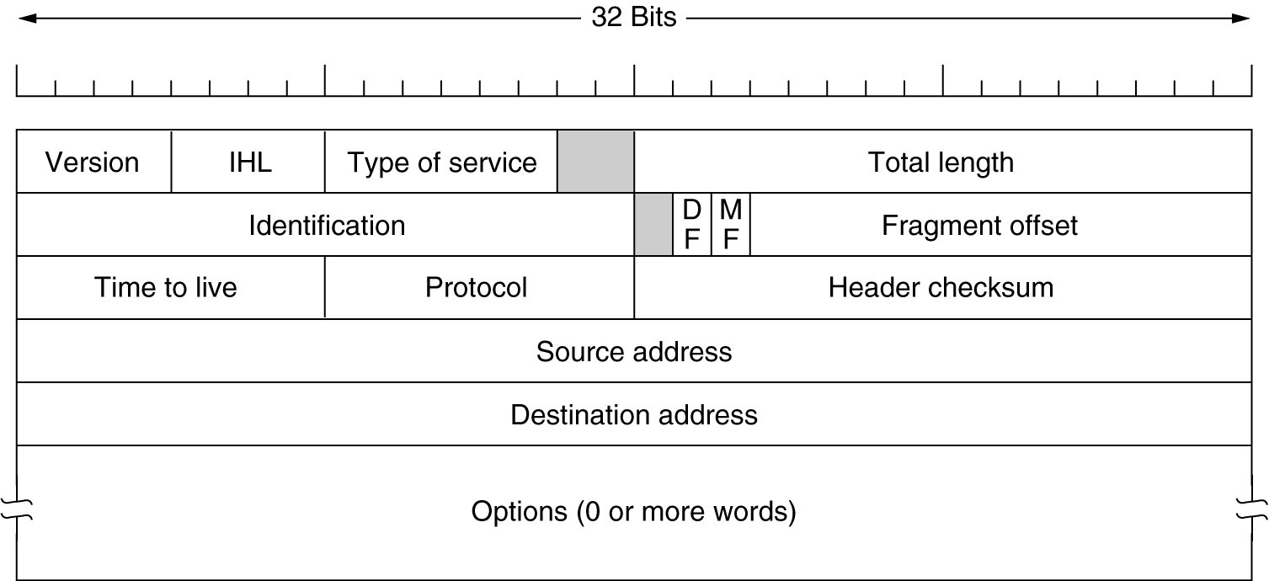
The IP Protocol
The IPv4 (Internet Protocol) header.

Slide 6
IP Header
The header has a 20-byte fixed part and a variable-length optional part.
The header format is shown in Fig. 5-46.
The bits are transmitted from left to right and top to bottom, with the high-order bit of the Version field going first.
This is a ‘‘big-endian’’ network byte order.
On little endian machines, such as Intel x86 computers, a software conversion is required on both transmission and reception.

Slide 7
IP Header
The Version field keeps track of which version of the protocol the datagram belongs to.
Since the header length is not constant, a field in the header, IHL, is provided to tell how long the header is, in 32-bit words.
The minimum value is 5, which applies when no options are present.
The maximum value of this 4-bit field is 15 , which limits the header to 60 bytes, and thus the Options field to 40 bytes.

Slide 8
IP Header
For some options, such as one that records the route a packet has taken, 40 bytes is far too small, making those options useless.
The Differentiated services field is one of the few fields that has changed its meaning (slightly) over the years. Originally, it was called the Type of service field.
The Type of service field provided 3 bits to signal priority and 3 bits to signal whether a host cared more about delay, throughput, or reliability.
The bottom 2 bits are used to carry explicit congestion notification information, such as whether the packet has experienced congestion

Slide 9
IP Header
The Total length includes everything in the datagram—both header and data. The maximum length is 65,535 bytes.
The Identification field is needed to allow the destination host to determine which packet a newly arrived fragment belongs to. All the fragments of a packet contain the same Identification value.
Next comes an unused bit
Then come two 1-bit fields related to fragmentation. DF stands for Don’t Fragment. It is an order to the routers not to fragment the packet.

Slide 10
IP Header
By marking the datagram with the DF bit, the sender knows it will either arrive in one piece, or an error message will be returned to the sender.
MF stands for More Fragments. All fragments except the last one have this bit set. It is needed to know when all fragments of a datagram have arrived.
The Fragment offset tells where in the current packet this fragment belongs.
Since 13 bits are provided, there is a maximum of 8192 fragments per datagram, supporting a maximum packet length up to the limit of the Total length field.

Slide 11
IP Header
The TtL (Time to live) field is a counter used to limit packet lifetimes.
It was originally supposed to count time in seconds, allowing a maximum lifetime of 255 sec.
It must be decremented on each hop and is supposed to be decremented multiple times when a packet is queued for a long time in a router.
In practice, it just counts hops. When it hits zero, the packet is discarded and a warning packet is sent back to the source host. This feature prevents packets from wandering around forever, something that otherwise might happen if the routing tables ever become corrupted.

Slide 12
IP Header
The Protocol field tells it which transport process to give the packet to. TCP is one possibility, but so are UDP and some others.
Since the header carries vital information such as addresses, it rates its own checksum for protection, the Header checksum.
The algorithm is to add up all the 16-bit halfwords of the header as they arrive, using one’s complement arithmetic, and then take the one’s complement of the result.
For purposes of this algorithm, the Header checksum is assumed to be zero upon arrival. Such a checksum is useful for detecting errors while the packet travels through the network.

Slide 13
IP Header
Note that it must be recomputed at each hop because at least one field always changes (the Time to live field), but tricks can be used to speed up the computation.
The Source address and Destination address indicate the IP address of the source and destination network interfaces.
The Options field was designed to provide an escape to allow subsequent versions of the protocol to include information not present in the original design, to permit experimenters to try out new ideas, and to avoid allocating header bits to information that is rarely needed.

Slide 14
IP Header
The options are of variable length.
Each begins with a 1-byte code identifying the option. Some options are followed by a 1-byte option length field, and then one or more data bytes.
The Options field is padded out to a multiple of 4 bytes.

Slide 15
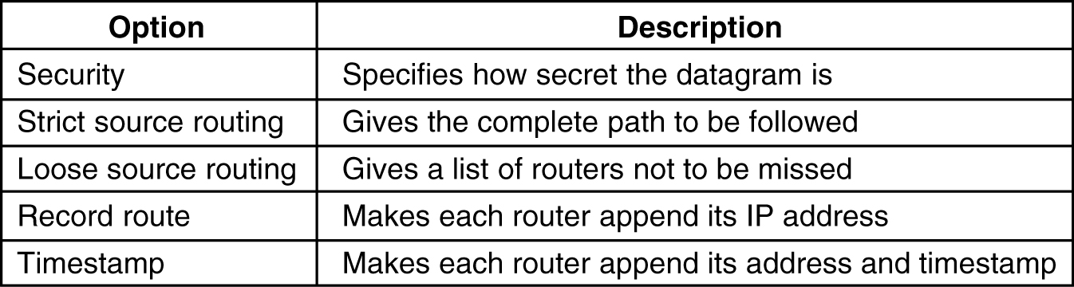
The IP Protocol
5-54
Some of the IP options.

Slide 16
IP addresses
IP address does not actually refer to a host.
It really refers to a network interface, so if a host is on two networks, it must have two IP addresses.
Most hosts are on one network and thus have one IP address where as routers have multiple interfaces and thus multiple IP addresses.
Prefixes
Each 32-bit address is comprised of a variable-length network portion in the top bits and a host portion in the bottom bits.
The network portion has the same value for all hosts on a single
network and is called prefix.
IP addresses are written in dotted decimal notation.
Ex:80D00297(hexadecimal number) ---->128.208.2.151

Slide 17
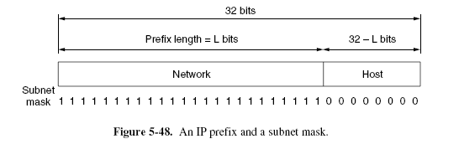
IP addresses

Slide 18
IP addresses
Sometimes prefixes are simply described by their length, as in a ‘‘/16’’ which is pronounced ‘‘slash 16.’’
The length of the prefix corresponds to a binary mask of 1s in the network portion.
When written out this way, it is called a subnet mask.
It can be ANDed with the IP address to extract only the network portion.
For our example, the subnet mask is 255.255.255.0.
The key advantage of prefixes is that routers can forward packets based on only the network portion of the address
This makes the routing tables much smaller.
The disadvantage is it needs mobile IP to keep the same IP address
and wasteful of addresses if not designed correctly.

Slide 19
IP addresses
Subnets Network numbers are managed by a nonprofit corporation called ICANN (Internet Corporation for Assigned Names and Numbers), to avoid conflicts.
In turn, ICANN has delegated parts of the address space to various regional authorities, which dole out IP addresses to ISPs and other companies.
This is the process by which a company is allocated a block of IP addresses.

Slide 20
IP addresses
Allow the block of addresses to be split into several parts for internal use as multiple networks, while still acting like a single network to the outside world.
This is called subnetting and the networks (such as Ethernet LANs) that result from dividing up a larger network are called subnets.
Fig. 5-49 shows how subnets can help with our example. The single /16 has been split into pieces.

Slide 21
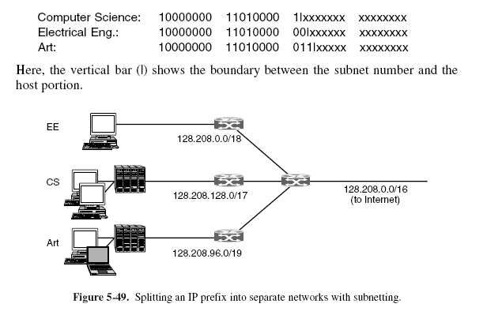
IP addresses

Slide 22
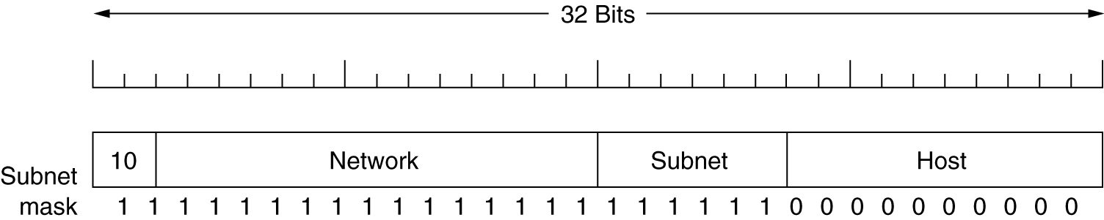
Subnets
A class B network subnetted into 64 subnets.

Slide 23
IP addresses
When a packet arrives, the router looks at the destination address of the packet and checks which subnet it belongs to.
The router can do this by ANDing the destination address with the mask for each subnet and checking to see if the result is the corresponding prefix.
Ex:128.208.2.151 is routed to EE department.
The subnet divisions can be changed later if necessary, by updating all subnet masks at routers inside the university.
CIDR—Classless InterDomain Routing
Even if blocks of IP addresses are allocated so that the addresses are used efficiently, there is still a problem that remains: routing table explosion.

Slide 24
IP addresses
Routers in ISPs and backbones in the middle of the Internet must know which way to go to get to every network.
These core routers are said to be in the default-free zone of the
Internet
No one really knows how many networks are connected to the Internet any more.
This can make for a very large table.
Routers at large ISPs may forward up to millions of packets per second.
Specialized hardware and fast memory are needed to process packets at these rates.
The larger the tables, the more information needs to be communicated and processed with other routers.
There is something we can do to reduce routing table sizes.

Slide 25
IP addresses
We combine multiple small prefixes into a single larger prefix. This process is called route aggregation.
The resulting larger prefix is sometimes called a supernet, to contrast with subnets as the division of blocks of addresses.
With aggregation, IP addresses are contained in prefixes of varying sizes. It is up to each router to have the corresponding prefix information.
This design works with subnetting and is called CIDR (Classless Inter Domain Routing).

Slide 26
IP addresses
A block of 8192 IP addresses is available starting at 194.24.0.0.
Cambridge University needs 2048 addresses and is assigned the addresses 194.24.0.0 through 194.24.7.255, along with mask 255.255.248.0.
Oxford University asks for 4096 addresses. Since a block of 4096 addresses must lie on a 4096-byte boundary,it gets 194.24.16.0 through 194.24.31.255, along with subnet mask 255.255.240.0.
The University of Edinburgh asks for 1024 addresses
and is assigned addresses 194.24.8.0 through 194.24.11.255 and mask 255.255.252.0.
All of the routers in the default-free zone are now told about the IP addresses in the three networks.
Routers close to the universities may need to send on a different
outgoing line for each of the prefixes

Slide 27
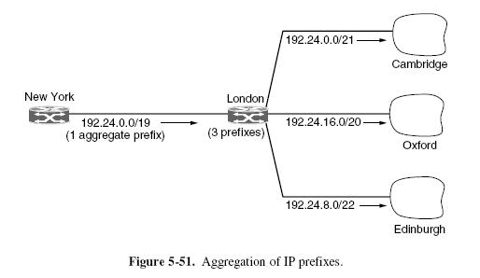
IP Protocol

Slide 28
For the distant router like New york they have to send to london for all the IP addresses belong to 3 universities.
London router combines the three prefixes into a single aggregate entry for the prefix 194.24.0.0/19 that it passes to the New York router
By using aggregation, three prefixes have been reduced to one.
It uses Longest matching prefix routing provides a useful degree of flexibility.
When a packet comes in, the routing table is scanned to determine if the destination lies within the prefix.
It is possible that multiple entries with different prefix lengths will match, in which case the entry with the longest prefix is used.

Slide 29
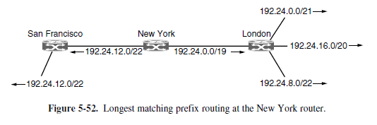

Slide 30
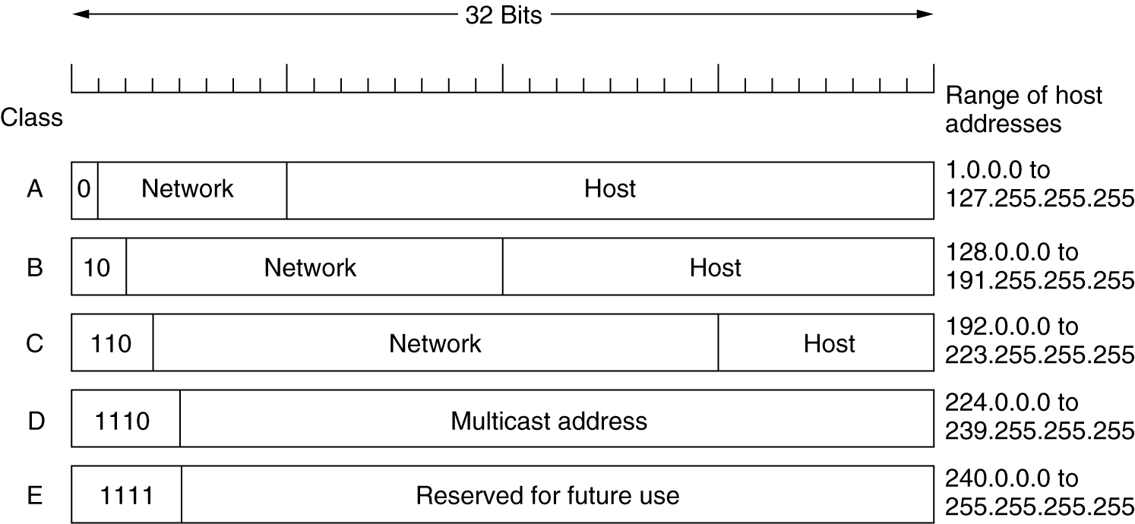
IP Addresses-Classful Addressing
IP address formats.

Slide 31
The class A, B, and C formats allow for up to 128 networks with 16 million hosts each, 16,384 networks with up to 65,536 hosts each, and 2 million networks (e.g., LANs) with up to 256 hosts each
Also supported is multicast (the class D format), in which a datagram is directed to multiple hosts.
Addresses beginning with 1111 are reserved for use in the future.
For most organizations, a class A network, with 16 million addresses, is too big, and a class C network, with 256 addresses is too small.
A class B network, with 65,536, is just right.
When a packet arrived at a router, a copy of the IP address was shifted right 28 bits to yield a 4-bit class number.
A 16-way branch then sorted packets into A, B, C
The network number was then looked up in the A, B, or C table
The network number was then looked up in the A, B, or C table

Slide 32
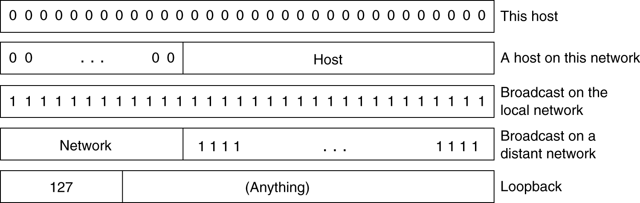
IP Addresses- Special Addressing
Special IP addresses.

Slide 33
NAT – Network Address Translation
IP addresses are scarce.
The long-term solution is for the whole Internet to migrate to IPv6, which has 128-bit addresses. This transition is slowly occurring, but it will be years before the process is complete.
The quick fix that is widely used today came in the form of NAT (Network Address Translation).
The basic idea behind NAT is for the ISP to assign each home or business a single IP address for Internet traffic.

Slide 34
NAT – Network Address Translation
Within the customer network, every computer gets a unique IP address, which is used for routing intramural traffic.
However, just before a packet exits the customer network and goes to the ISP, an address translation from the unique internal IP address to the shared public IP address takes place.

Slide 35
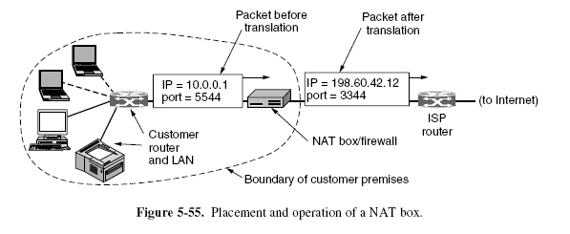
NAT – Network Address Translation

Slide 36
NAT – Network Address Translation
Here are some of the objections.
First, NAT violates the architectural model of IP, which states that every IP address uniquely identifies a single machine worldwide.
Second, NAT breaks the end-to-end connectivity model of the Internet, which says that any host can send a packet to any other host at any time.
Third, NAT changes the Internet from a connectionless network to a peculiar kind of connection-oriented network.
Fourth, NAT violates the most fundamental rule of protocol layering: layer k may not make any assumptions about what layer k + 1 has put into the payload field. If TCP is later upgraded to TCP-2, with a different header layout (e.g., 32-bit ports), NAT will fail.

Slide 37
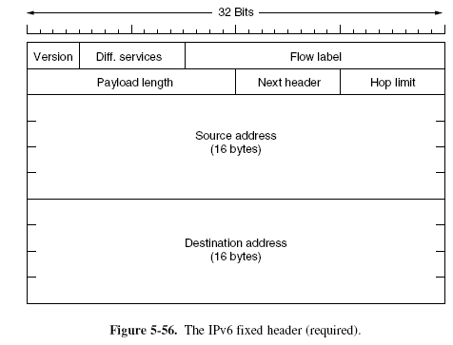
IP Version 6

Slide 38
IP Version 6
The Version field is always 6 for IPv6 (and 4 for IPv4).
The Differentiated services field (originally called Traffic class) is used to distinguish the class of service for packets with different real-time delivery requirements.
The Flow label field provides a way for a source and destination to mark groups of packets that have the same requirements and should be treated in the same way by the network, forming a pseudo connection.
The Payload length field tells how many bytes follow the 40-byte header of Fig. 5-56. The name was changed from the IPv4 Total length field because the meaning was changed slightly: the 40 header bytes are no longer counted as part of the length (as they used to be). This change means the payload can now be 65,535 bytes instead of a mere 65,515 bytes.

Slide 39
IP Version 6
There can be additional (optional) extension headers.
This Next header field tells which of the (currently) six extension headers, if any, follow this one.
If this header is the last IP header, the Next header field tells which transport protocol handler (e.g., TCP, UDP) to pass the packet to.
The Hop limit field is used to keep packets from living forever.
Next come the Source address and Destination address fields.
Advantages:
IPv6 has longer addresses than IPv4.
IPv6 is the simplification of the header.
support for options.
big advance is in security.

Slide 40
The address is written as eight groups of four hexadecimal digits with colons between the groups
8000:0000:0000:0000:0123:4567:89AB:CDEF.
8000::123:4567:89AB:CDEF(optimized representation).
IPv4 Vs IPV6
The IHL field is gone because the IPv6 header has a fixed length.
The Protocol field was taken out because the Next header field tells what follows the last IP header
all IPv6-conformant hosts are expected to dynamically determine the packet size to use.
Also, the minimum-size packet that routers must be able to forward has been raised from 576 to 1280 bytes
Finally, the Checksum field is gone because calculating it greatly reduces performance.

Slide 41
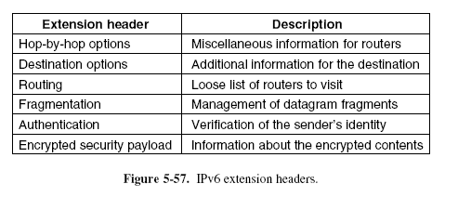
Extension Headers

Slide 42

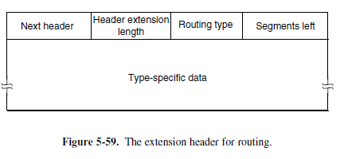

Slide 43
Internet Control Protocols
IMCP—The Internet Control Message Protocol
The operation of the Internet is monitored closely by the routers.
When something unexpected occurs during packet processing at a router, the event is reported to the sender by the ICMP (Internet Control Message Protocol).
ICMP is also used to test the Internet.
About a dozen types of ICMP messages are defined.
Each ICMP message type is carried encapsulated in an IP packet. The most important ones are listed in Fig. 5-60.

Slide 44
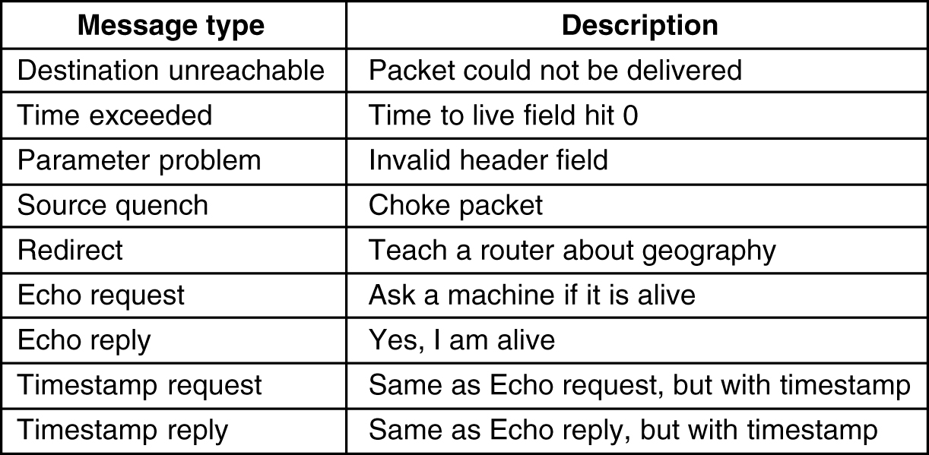
Internet Control Message Protocol
5-61
The principal ICMP message types.

Slide 45
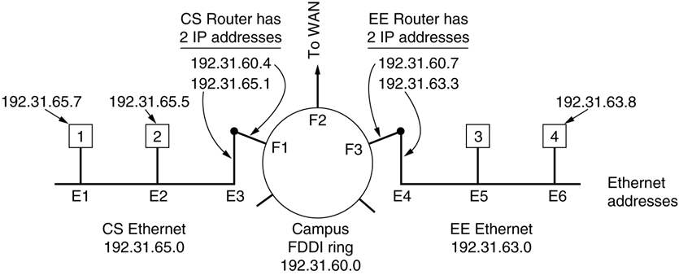
ARP– The Address Resolution Protocol

Slide 46
ARP– The Address Resolution Protocol
how do IP addresses get mapped onto data link layer addresses, such as Ethernet?
Example:a small university with two /24 networks is illustrated.
One network (CS) is a switched Ethernet in the Computer Science Dept. It has the prefix 192.32.65.0/24.
The other LAN (EE), also switched Ethernet, is in Electrical
Engineering and has the prefix 192.32.63.0/24. The two LANs are connected by an IP router.
Each machine on an Ethernet and each interface on the router has
a unique Ethernet address, labeled E1 through E6, and a unique IP address on the CS or EE network.

Slide 47
ARP– The Address Resolution Protocol
Host 1 sends a packet to a user on host 2 on the CS network.
sender knows the name of the intended receiver, possibly something like eagle.cs.uni.edu.
The first step is to find the IP address for host 2. This lookup is performed by DNS.
The upper layer software on host 1 now builds a packet with 192.32.65.5 in the Destination address field and gives it to the IP software to transmit.
The IP software can look at the address and see that the destination is on the CS network,
It still needs some way to find the destination’s Ethernet address to send the frame.
One solution is to have a configuration file somewhere in the system that maps IP addresses onto Ethernet addresses.
But keeping all these files up to date is an error-prone, time-consuming job.

Slide 48
ARP– The Address Resolution Protocol
better solution is for host 1 to output a broadcast packet onto the Ethernet asking who owns IP address 192.32.65.5.
Host 2 alone will respond with its Ethernet address (E2). In this way host 1 learns that IP address 192.32.65.5 is on the host with Ethernet address E2.
The protocol used for asking this question and getting the reply is called ARP (Address Resolution Protocol).
One of the optimization is it caches the result in case it needs to
contact the same machine shortly.
Other optimization is host 1 include its IP-to-Ethernet mapping in the ARP packet.
To allow mappings to change entries in the ARP cache
should time out after a few minutes.

Slide 49
ARP– The Address Resolution Protocol
Gratuitous ARP:every machine broadcast its mapping when it is configured
If the destination IP address is not on the CS network.
It knows to send all such off-network traffic to the router, which is also known as the default gateway.
By convention, the default gateway is the lowest address on the network(198.31.65.1)
It discovers the ethernet address by sending an ARP broadcast for 198.31.65.1, from which it learns E3
It is also possible to send a packet from host 1 to host 4 without host 1 knowing that host 4 is on a different network.
The router will then receive frames sent to 192.32.63.8 and forward them onto the EE network. This solution is called proxy ARP.
Ex:Mobile device.

Slide 50
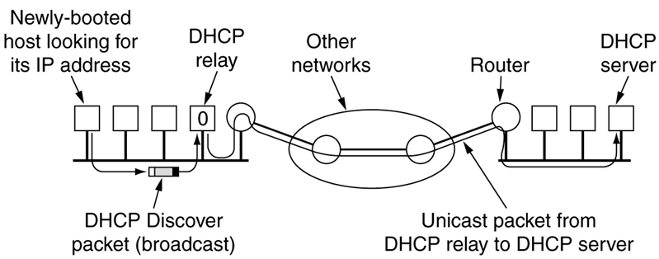
Dynamic Host Configuration Protocol

Slide 51
Dynamic Host Configuration Protocol
The better way to configure hosts is DHCP.
Every network must have a DHCP server that is responsible for
configuration.
When a computer is started, it has a built-in Ethernet or other link
layer address embedded in the NIC, but no IP address.
The computer broadcasts a request for an IP address on its network. It does this by using a DHCP DISCOVER packet.
This packet must reach the DHCP server. If not connected directly then router receives and relay them to the DHCP server, wherever it is located.
When the server receives the request, it allocates a free IP address and sends it to the host in a DHCP OFFER packet
IP address assignment may be for a fixed period of time, a technique
called leasing.

Slide 52
Label Switching and MPLS
There is also another kind of technology to move internet traffic across their networks in ISP is MPLS(MultiProtocol Label Switching).
MPLS adds a label in front of each packet, and forwarding is based on the label rather than on the destination address.
Making the label an index into an internal table makes finding the correct output line just a matter of table lookup.
Using this technique, forwarding can be done very quickly.
It is described in RFC 3031 and many other RFCs.
The main benefits over time have come to be routing that is flexible and forwarding that is suited to quality of service as well as fast.
A new MPLS header had to be added in front of the IP header.
The generic MPLS header is 4 bytes long and has four fields.

Slide 53
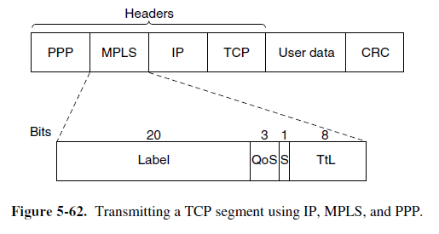
Label Switching and MPLS

Slide 54
Label Switching and MPLS
Label field, which holds the index.
The QoS field indicates the class of service.
The S field relates to stacking multiple labels (which is discussed below).
The TtL field indicates how many more times the packet may be forwarded
MPLS is sometimes described as a layer 2.5 protocol.
It is possible to build MPLS switches that can forward both IP packets and non-IP packets,
When an IP packet reaches the edge of an MPLS network. The LER (Label Edge Router) inspects the destination IP address and other fields to see which MPLS path the packet should follow, and puts the right label on the front of the packet.
Within the MPLS network, this label is used to forward the packet.

Slide 55
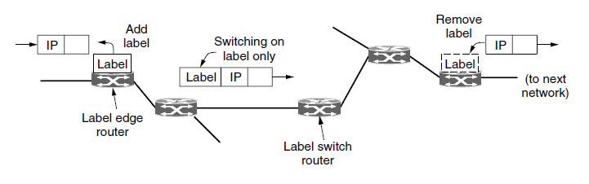
Label Switching and MPLS
At the other edge of the MPLS network, the label has served its purpose and is removed, revealing the IP packet again for the next network.

Slide 56
Label Switching and MPLS
It is more common for routers to group multiple flows that end at a particular router or LAN and use a single label for them.
The flows that are grouped together under a single label are said to belong to the same FEC(Forwarding Equivalence Class).
It can operate at multiple levels at once by adding more than one label to the front of a packet
This is called a stack of labels.
The outermost label guides the packets along the path.
It is removed at the end of the path, and the labels revealed, if any,
are used to forward the packet further. The S bit is used for this purpose.
The forwarding information is set up by protocols that are a combination of routing protocols and connection setup protocols intead by user.

