Slide 1
The Application Layer
Chapter 7

Slide 2
DNS – The Domain Name System
The DNS Name Space
Resource Records
Name Servers

Slide 3
DNS – The Domain Name System
The IP addresses are hard for people to remember.
If the Web server moves to a different machine with a different IP address, everyone needs to be told the new IP address.
Hence,high-level, readable names were introduced in order to decouple machine names from machine addresses
Ex:www.cs.washington.edu
The network itself understands only numerical addresses, some mechanism is required to convert the names to network addresses
It is DNS(Domain name System).
The essence of DNS is the invention of a hierarchical, domain-based naming scheme and a distributed database system for implementing this naming scheme.

Slide 4
DNS – The Domain Name System
Application program calls a library procedure called the resolver, passing the name as a parameter.
The resolver sends a query containing the name to a local
DNS server, which looks up the name and returns a response containing the IP address to the resolver, which then returns it to the caller.
The query and response messages are sent as UDP packets.

Slide 5
DNS – The Domain Name System
For the Internet, the top of the naming hierarchy is managed by an organization called ICANN (Internet Corporation for Assigned Names and Numbers).
ICANN was created for this purpose in 1998, as part of the maturing of the Internet to a worldwide, economic concern.
Conceptually, the Internet is divided into over 250 top-level domains, where each domain covers many hosts.
Each domain is partitioned into subdomains, and these are further partitioned, and so on.
All these domains can be represented by a tree, as shown in Fig. 7-1.

Slide 6
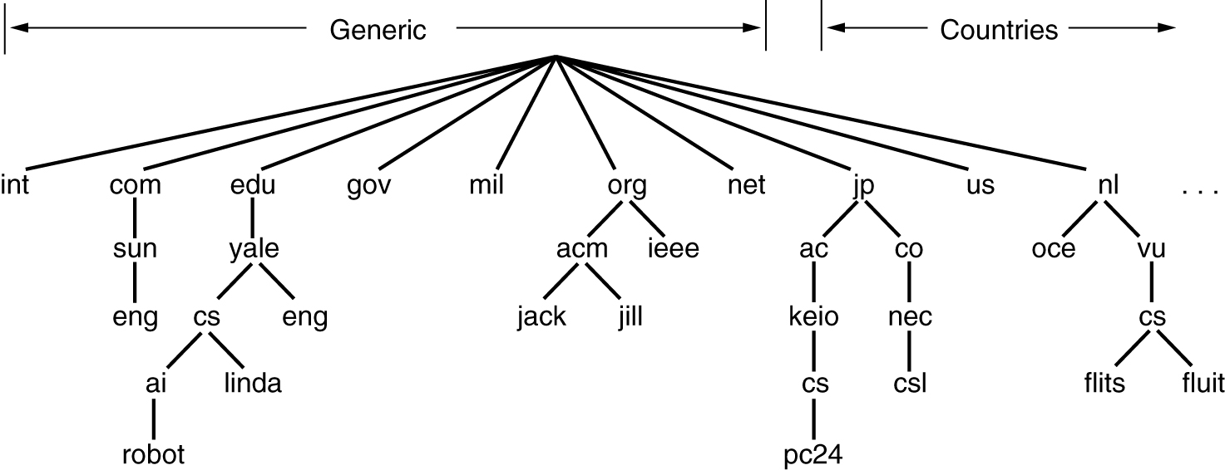
The DNS Name Space
A portion of the Internet domain name space.

Slide 7
DNS – The Domain Name System
The leaves of the tree represent domains that have no subdomains.
A leaf domain may contain a single host, or it may represent a company and contain thousands of hosts.
The top-level domains come in two flavors: generic and countries.
The generic domains, listed in Fig. 7-2, include original domains from the 1980s and domains introduced via applications to ICANN.
Other generic top-level domains will be added in the future.
The country domains include one entry for every country, as defined in ISO 3166.
The top-level domains are run by registrars.

Slide 8
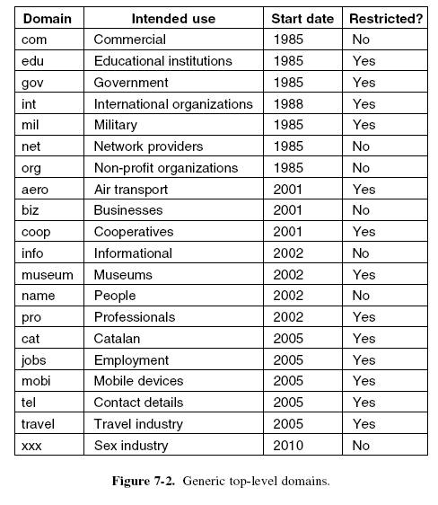
The DNS Name Space

Slide 9
DNS – The Domain Name System
Getting a name merely requires going to a corresponding registrar (for com in this case) to check if the desired name is available or not
If there are no problems, the requester pays the registrar a small annual fee and gets the name.
Some of the domains self-organize, while others have restrictions on who can obtain a name.
Ex:Pro domain(Professionals)
Each domain is named by the path upward from it to the (unnamed) root.
The components are separated by periods (pronounced ‘‘dot’’).
Thus, the engineering department at Cisco might be eng.cisco.com.,

Slide 10
DNS – The Domain Name System
Domain names can be either absolute or relative.
An absolute domain name always ends with a period (e.g., eng.cisco.com.), whereas a relative one does not.
Relative names have to be interpreted in some context to uniquely determine their true meaning.
In both cases, a named domain refers to a specific node in the tree and all the nodes under it.
Domain names are case-insensitive, so edu, Edu, and EDU mean the same thing.
Component names can be up to 63 characters long, and full path names must not exceed 255 characters.
Each domain controls how it allocates the domains under it.
Naming follows organizational boundaries, not physical networks.

Slide 11
DNS –Domain Resource Records
Every domain, whether it is a single host or a top-level domain, can have a set of resource records associated with it.
These records are the DNS database. For a single host, the most common resource record is just its IP address, but many other kinds of resource records also exist.
When a resolver gives a domain name to DNS, what it gets back are the resource records associated with that name.
Thus, the primary function of DNS is to map domain names onto resource records.

Slide 12
DNS –Domain Resource Records
A resource record is a five-tuple.
Although they are encoded in binary for efficiency, in most expositions resource records are presented as ASCII text, one line per resource record.
The format we will use is as follows:
Domain name Time to live Class Type Value
The Domain name tells the domain to which this record applies. Normally, many records exist for each domain and each copy of the database holds information about multiple domains.
This field is thus the primary search key used to satisfy queries. The order of the records in the database is not significant.

Slide 13
DNS –Domain Resource Records
The Time to live field gives an indication of how stable the record is.
Information that is highly stable is assigned a large value, such as 86400 (the number of seconds in 1 day).
Information that is highly volatile is assigned a small value, such as 60 (1 minute).
The third field of every resource record is the Class. For Internet information, it is always IN.
For non-Internet information, other codes can be used, but in practice these are rarely seen.
The Type field tells what kind of record this is. There are many kinds of DNS records. The important types are listed in Fig. 7-3.

Slide 14
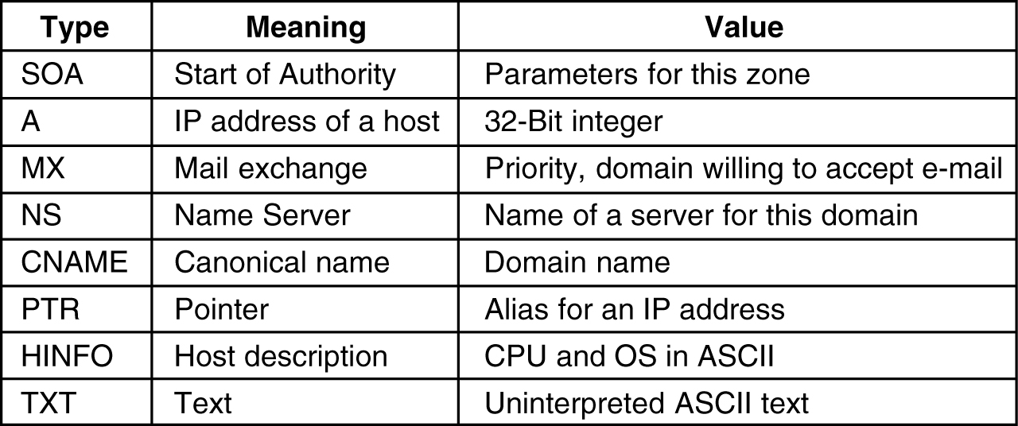
Resource Records
The principal DNS resource records types.

Slide 15
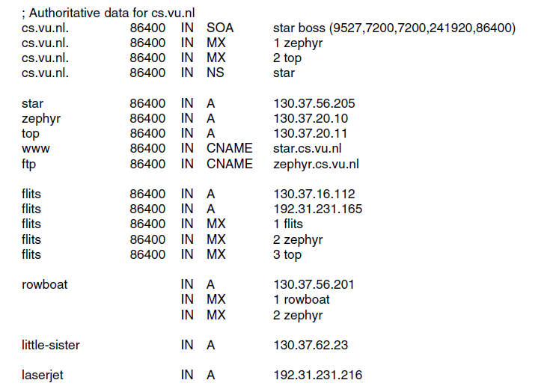
Example

Slide 16
DNS –Name servers
In theory at least, a single name server could contain the entire DNS database and respond to all queries about it.
In practice, this server would be so overloaded as to be useless. Furthermore, if it ever went down, the entire Internet would be crippled.
To avoid the problems associated with having only a single source of information, the DNS name space is divided into nonoverlapping zones.
One possible way to divide the name space of Fig. 7-1 is shown in Fig. 7-5.

Slide 17
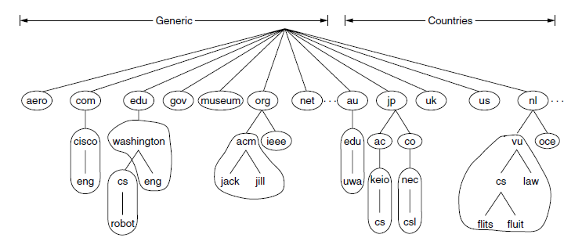
Name Servers
Part of the DNS name space showing the division into zones.

Slide 18
DNS –Name Server
Each zone is also associated with one or more name servers. These are hosts that hold the database for the zone.
The process of looking up a name and finding an address is called name resolution.
When a resolver has a query about a domain name, it passes the query to a local name server.
If the domain being sought falls under the jurisdiction of the name server, such as top.cs.vu.nl falling under cs.vu.nl, it returns the authoritative resource records. An authoritative record is one that comes from the authority that manages the record and is thus always correct.
Authoritative records are in contrast to cached records, which may be out of date.

Slide 19
DNS –Name Server
When flits.cs.vu.nl wants to find the IP address of robot.cs.washington.edu at UW (University of Washington)?
In this case, and if there is no cached information about the domain available locally, the name server begins a remote query.
This query follows the process shown in Fig. 7-6.

Slide 20
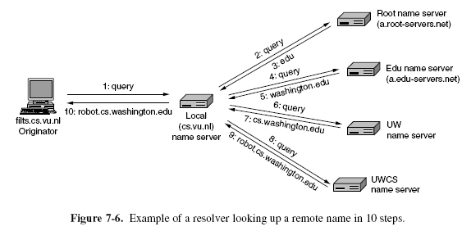
DNS –Name Server

Slide 21
DNS –Name Server
When the host flits.cs.vu.nl sends its query to the local name server, that name server handles the resolution on behalf of flits until it has the desired answer to return.
It does not return partial answers. This mechanism is called a recursive query.
On the other hand, the root name server (and each subsequent name server) does not recursively continue the query for the local name server.
It just returns a partial answer and moves on to the next query.

Slide 22
DNS –Name Server
The local name server is responsible for continuing the resolution by issuing further queries. This mechanism is called an iterative query
A recursive query may always seem preferable, but many name servers (especially the root) will not handle them. They are too busy. Iterative queries put the burden on the originator.
All of the answers, including all the partial answers returned, are cached.
Using cached answers greatly reduces the steps in a query and improves performance.
Time to live field is included in each resource record to tell remote name servers how long to cache records.
The transport protocol that is used for the queries and responses is UDP.

Slide 23
Electronic Mail
Architecture and Services
The User Agent
Message Formats
Message Transfer
Final Delivery

Slide 24
Electronic Mail
Faster and cheaper than paper mail, email has been a popular application since the early days of the Internet.
Other forms of network communication, such as instant messaging and voice-over-IP calls have expanded greatly in use over the past decade.
It is widely used within industry for intra company communication
The architecture of the email system is shown in Fig. 7-7.
It consists of two kinds of subsystems: the user agents, which allow people to read and send email, and the message transfer agents, which move the messages from the source to the destination.
We will also refer to message transfer agents informally as mail servers.

Slide 25
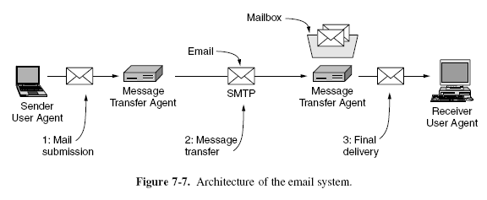
Electronic Mail

Slide 26
Electronic Mail
The user agent is a program that provides a graphical interface, or sometimes a text- and command-based interface that lets users interact with the email system.
It includes a means to compose messages and replies to messages, display incoming messages, and organize messages by filing, searching, and discarding them.
The act of sending new messages into the mail system for delivery is called mail submission.
The message transfer agents are typically system processes. They run in the background on mail server machines and are intended to be always available.
Their job is to automatically move email through the system from the originator to the recipient . This is the message transfer step.

Slide 27
Electronic Mail
Message transfer agents also implement mailing lists, in which an identical copy of a message is delivered to everyone on a list of email addresses.
Other advanced features are carbon copies, blind carbon copies, high-priority email, secret (i.e., encrypted) email, alternative recipients if the primary one is not currently available, and the ability for assistants to read and answer their bosses’ email.
Linking user agents and message transfer agents are the concepts of mailboxes and a standard format for email messages.
Mailboxes store the email that is received for a user. They are maintained by mail servers.

Slide 28
Electronic Mail
User agents simply present users with a view of the contents of their mailboxes.
To do this, the user agents send the mail servers commands to manipulate the mailboxes, inspecting their contents, deleting messages, and so on.
The retrieval of mail is the final delivery (step 3) in Fig. 7-7.
With this architecture, one user may use different user agents on multiple computers to access one mailbox.
Mail is sent between message transfer agents in a standard format.
The original format, RFC 822, has been revised to the current RFC 5322 and extended with support for multimedia content and international text.

Slide 29
Electronic Mail
Key idea in the message format is the distinction between the envelope and its contents.
The envelope encapsulates the message. It contains all the information needed for transporting the message, such as the destination address, priority, and security level, all of which are distinct from the message itself.
The message transport agents use the envelope for routing, just as the post office does.
The message inside the envelope consists of two separate parts: the header and the body.
The header contains control information for the user agents. The body is entirely for the human recipient.
Envelopes and messages are illustrated in Fig. 7-8.

Slide 30
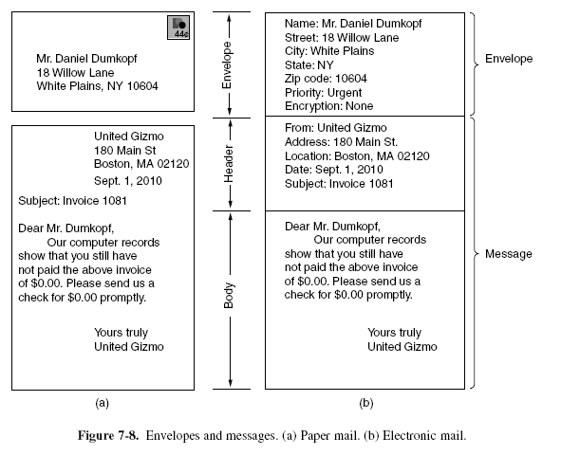
Electronic Mail

Slide 31
Electronic Mail-user agent
A user agent is a program (sometimes called an email reader) that accepts a variety of commands for composing, receiving, and replying to messages, as well as for manipulating mailboxes.
There are many popular user agents, including Google gmail, Microsoft Outlook, Mozilla Thunderbird, and Apple Mail.
They can vary greatly in their appearance.
Most user agents have a menu- or icon driven graphical interface that requires a mouse, or a touch interface on smaller mobile devices.
Older user agents, such as Elm, mh, and Pine, provide text-based interfaces and expect one-character commands from the keyboard.

Slide 32
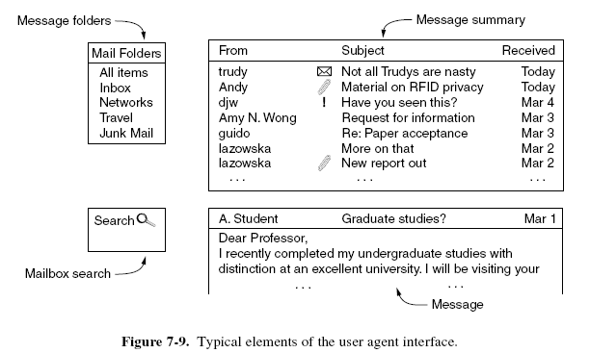
Electronic Mail-user agent
The typical elements of a user agent interface are shown in Fig. 7-9.

Slide 33
Electronic Mail-user agent
Many other fields or indications are possible.
The icons next to the message subjects in Fig. 7-9 might indicate, for example, unread mail (the envelope), attached material (the paperclip), and important mail, at least as judged by the sender (the exclamation point).
After a message has been read, the user can decide what to do with it.
This is called message disposition. Options include deleting the message, sending a reply, forwarding the message to another user, and keeping the message for later reference.
Most user agents can manage one mailbox for incoming mail with multiple folders for saved mail. The folders allow the user to save message according to sender, topic, or some other category.

Slide 34
Electronic Mail-user agent
Another useful feature is the ability to automatically respond to messages in some way.
One response is to forward incoming email to a different address.
These auto responders must run in the mail server because the user agent may not run all the time and may only occasionally retrieve email.
Because of these factors, the user agent cannot provide a true automatic response. However, the interface for automatic responses is usually presented by the user agent.

Slide 35
Electronic Mail-user agent
A different example of an automatic response is a vacation agent. This is a program that examines each incoming message and sends the sender an insipid reply such as: ‘‘Hi. I’m on vacation. I’ll be back on the 24th of August. Talk to you then.’’
Such replies can also specify how to handle urgent matters in the interim, other people to contact for specific problems, etc.
Most vacation agents keep track of whom they have sent canned replies to and refrain from sending the same person a second reply.

Slide 36
Electronic Mail-user agent
Other common features are appending a signature block to the bottom of a message, correcting spelling, and computing digital signatures that show the message is valid.
A final point we will touch on for sending mail is mailing lists, which let users send the same message to a list of people with a single command.
There are two choices for how the mailing list is maintained. It might be maintained locally, by the user agent.
In this case, the user agent can just send a separate message to each intended recipient.

Slide 37
Electronic Mail- Message Formats
RFC 5322—The Internet Message Format Messages consist of a primitive envelope , some number of header fields, a blank line, and then the message body.
Each header field (logically) consists of a single line of ASCII text containing the field name, a colon, and, for most fields, a value.
The original RFC 822 was designed decades ago and did not clearly distinguish the envelope fields from the header fields.

Slide 38
Electronic Mail- Message Formats
Although it has been revised to RFC 5322, completely redoing it was not possible due to its widespread usage.
In normal usage, the user agent builds a message and passes it to the message transfer agent, which then uses some of the header fields to construct the actual envelope, a somewhat old fashioned mixing of message and envelope.

Slide 39
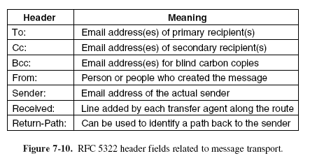
Message Formats

Slide 40
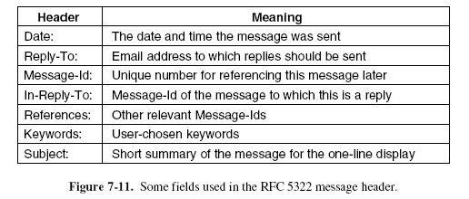
Message Formats

Slide 41
MIME – Multipurpose Internet Mail Extensions
Problems with international languages:
Languages with accents (French, German).
Languages in non-Latin alphabets (Hebrew, Russian).
Languages without alphabets (Chinese, Japanese).
Messages not containing text at all (audio or images).

Slide 42
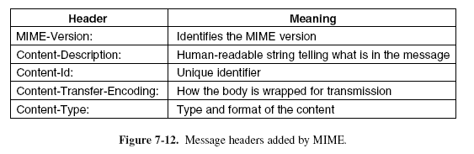
MIME

Slide 43
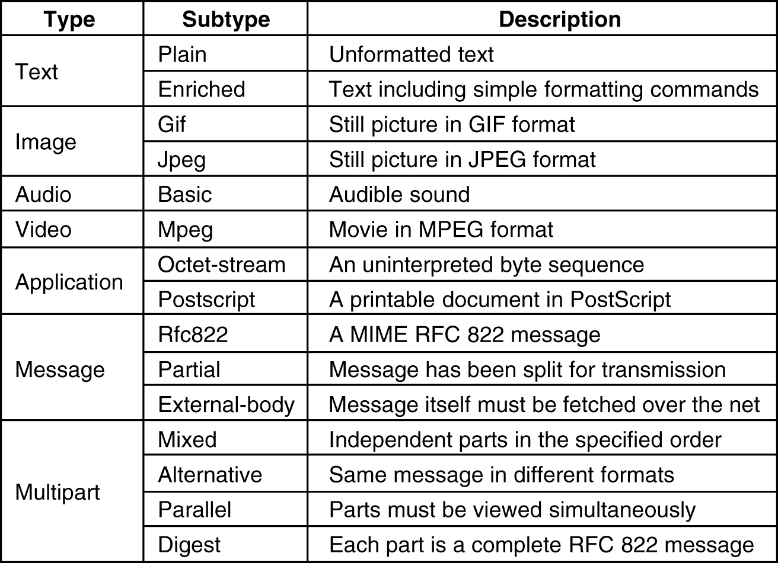
MIME
The MIME types and subtypes defined in RFC 2045.

Slide 44
Message Tansfer
The mail transfer is done with the SMTP protocol.
The simplest way to move messages is to establish a transport connection from the source machine to the destination machine and then just transfer the message.
This is how SMTP originally worked. Over the years, however, two different uses of SMTP have been differentiated.
The first use is mail submission, step 1 in the email architecture of Fig. 7-7. This is the means by which user agents send messages into the mail system for delivery.
The second use is to transfer messages between message transfer agents (step 2 in Fig. 7-7).

Slide 45
Message Tansfer
SMTP (Simple Mail Transfer Protocol) and Extensions
Within the Internet, email is delivered by having the sending computer establish a TCP connection to port 25 of the receiving computer.
Listening to this port is a mail server that speaks SMTP (Simple Mail Transfer Protocol). This server accepts incoming connections, subject to some security checks, and accepts messages for delivery.
If a message cannot be delivered, an error report containing the first part of the undeliverable message is returned to the sender.

Slide 46
Message Tansfer
SMTP is a simple ASCII protocol.
Using ASCII text makes protocols easy to develop, test, and debug.
After establishing the TCP connection to port 25, the sending machine, operating as the client, waits for the receiving machine, operating as the server, to talk first.
The server starts by sending a line of text giving its identity and telling whether it is prepared to receive mail.
If it is not, the client releases the connection and tries again later.

Slide 47
Message Tansfer
If the server is willing to accept email, the client announces whom the email is coming from and whom it is going to.
If such a recipient exists at the destination, the server gives the client the go-ahead to send the message.
Then the client sends the message and the server acknowledges it. No checksums are needed because TCP provides a reliable byte stream.
If there is more email, that is now sent. When all the email has been exchanged in both directions, the connection is released.

Slide 48
Message Tansfer
A sample dialog for sending the message of Fig. 7-14, including the numerical codes used by SMTP, is shown in Fig. 7-15.
The lines sent by the client (i.e., the sender) are marked C:. Those sent by the server (i.e., the receiver) are marked S:
The first command from the client is indeed meant to be HELO.

Slide 49
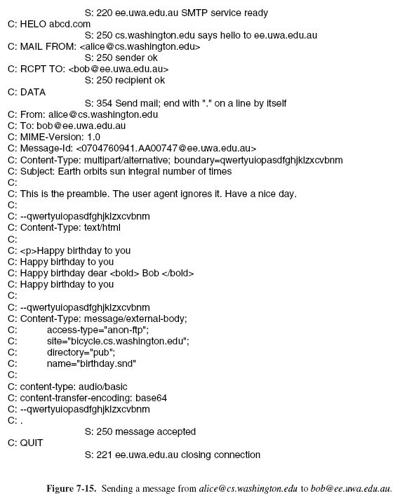
Message Tansfer

Slide 50
Message Tansfer
In Fig. 7-15, the message is sent to only one recipient, so only one RCPT command is used.
Such commands are allowed to send a single message to multiple receivers.
Each one is individually acknowledged or rejected. Even if some recipients are rejected (because they do not exist at the destination), the message can be sent to the other ones.

Slide 51
Message Tansfer
The basic SMTP works well, but it is limited in several respects.
It does not include authentication. This means that the FROM command in the example could give any sender address that it pleases. This is quite useful for sending spam.
Another limitation is that SMTP transfers ASCII messages, not binary data. This is why the base64 MIME content transfer encoding was needed.
However, with that encoding the mail transmission uses bandwidth inefficiently, which is an issue for large messages.
A third limitation is that SMTP sends messages in the clear. It has no encryption to provide a measure of privacy against prying eyes.

Slide 52
Message Tansfer
To allow these and many other problems related to message processing to be addressed, SMTP was revised to have an extension mechanism.
This mechanism is a mandatory part of the RFC 5321 standard.
The use of SMTP with extensions is called ESMTP (Extended SMTP).

Slide 53
Message Tansfer
Clients wanting to use an extension send an EHLO message instead of HELO initially.
If this is rejected, the server is a regular SMTP server, and the client should proceed in the usual way.
If the EHLO is accepted, the server replies with the extensions that it supports.
The client may then use any of these extensions.
Several common extensions are shown in Fig. 7-16.

Slide 54
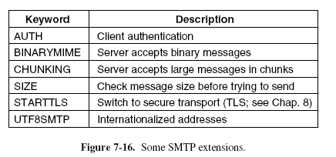
Message Tansfer

Slide 55
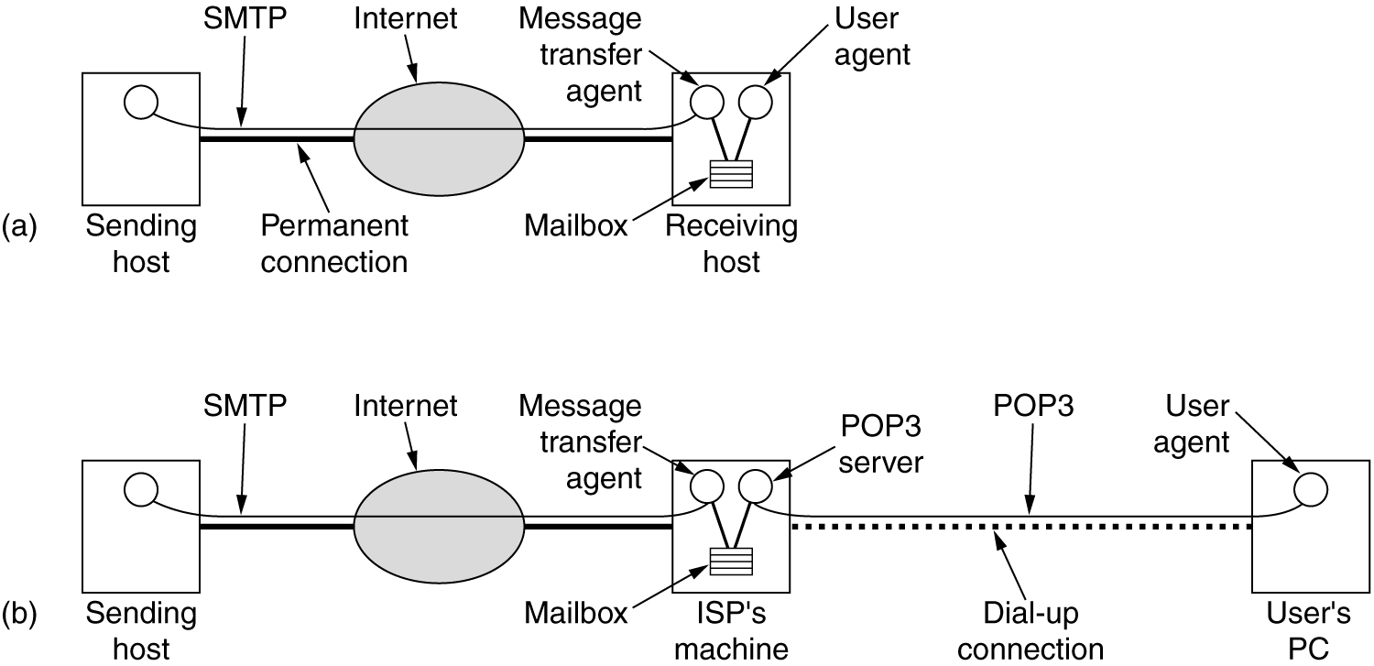
Final Delivery
(a) Sending and reading mail when the receiver has a permanent Internet connection and the user agent runs on the same machine as the message transfer agent. (b) Reading e-mail when the receiver has a dial-up connection to an ISP.

Slide 56
Final Delivery
This task was straightforward in the early Internet, when the user agent and mail transfer agent ran on the same machine as different processes.
The mail transfer agent simply wrote new messages to the end of the mailbox file, and the user agent simply checked the mailbox file for new mail.
Nowadays, the user agent on a PC, laptop, or mobile, is likely to be on a different machine than the ISP or company mail server.
Users want to be able to access their mail remotely, from wherever they are.

Slide 57
Final Delivery
The job of the user agent is to present a view of the contents of the mailbox, and to allow the mailbox to be remotely manipulated.
Several different protocols can be used for this purpose, but SMTP is not one of them.
SMTP is a push-based protocol. It takes a message and connects to a remote server to transfer the message.
Final delivery cannot be achieved in this manner both because the mailbox must continue to be stored on the mail transfer agent and because the user agent may not be connected to the Internet at the moment that SMTP attempts to relay messages.

Slide 58
Final Delivery
IMAP—The Internet Message Access Protocol
One of the main protocols that is used for final delivery is IMAP (Internet Message Access Protocol).
Version 4 of the protocol is defined in RFC 3501.
To use IMAP, the mail server runs an IMAP server that listens to port 143.
The user agent runs an IMAP client. The client connects to the server and begins to issue commands from those listed in Fig. 7-17.

Slide 59
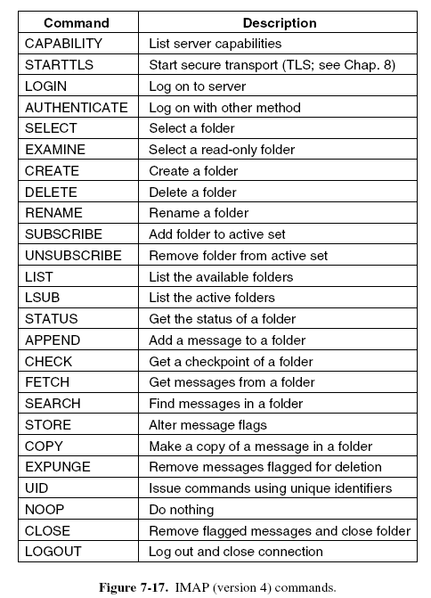
Final Delivery

Slide 60
Final Delivery
First, the client will start a secure transport if one is to be used and then log in or otherwise authenticate itself to the server.
Once logged in, there are many commands to list folders and messages, fetch messages or even parts of messages, mark messages with flags for later deletion, and organize messages into folders.
To avoid confusion, please note that we use the term ‘‘folder’’ here to be consistent with the rest of the material in this section, in which a user has a single mailbox made up of multiple folders.
However, in the IMAP specification, the term mailbox is used instead. One user thus has many IMAP mailboxes, each of which is typically presented to the user as a folder.

Slide 61
Final Delivery
IMAP has many other features, too.
It has the ability to address mail not by message number, but by using.
Searches can be performed on the server to find the messages that satisfy certain criteria so that only those messages are fetched by the client.
IMAP is an improvement over an earlier final delivery protocol, POP3 (Post Office Protocol, version 3), which is specified in RFC 1939.

Slide 62
Final Delivery
POP3 is a simpler protocol but supports fewer features and is less secure in typical usage.
Mail is usually downloaded to the user agent computer, instead of remaining on the mail server.
This makes life easier on the server, but harder on the user.
It is not easy to read mail on multiple computers, plus if the user agent computer breaks, all email may be lost permanently.

Slide 63
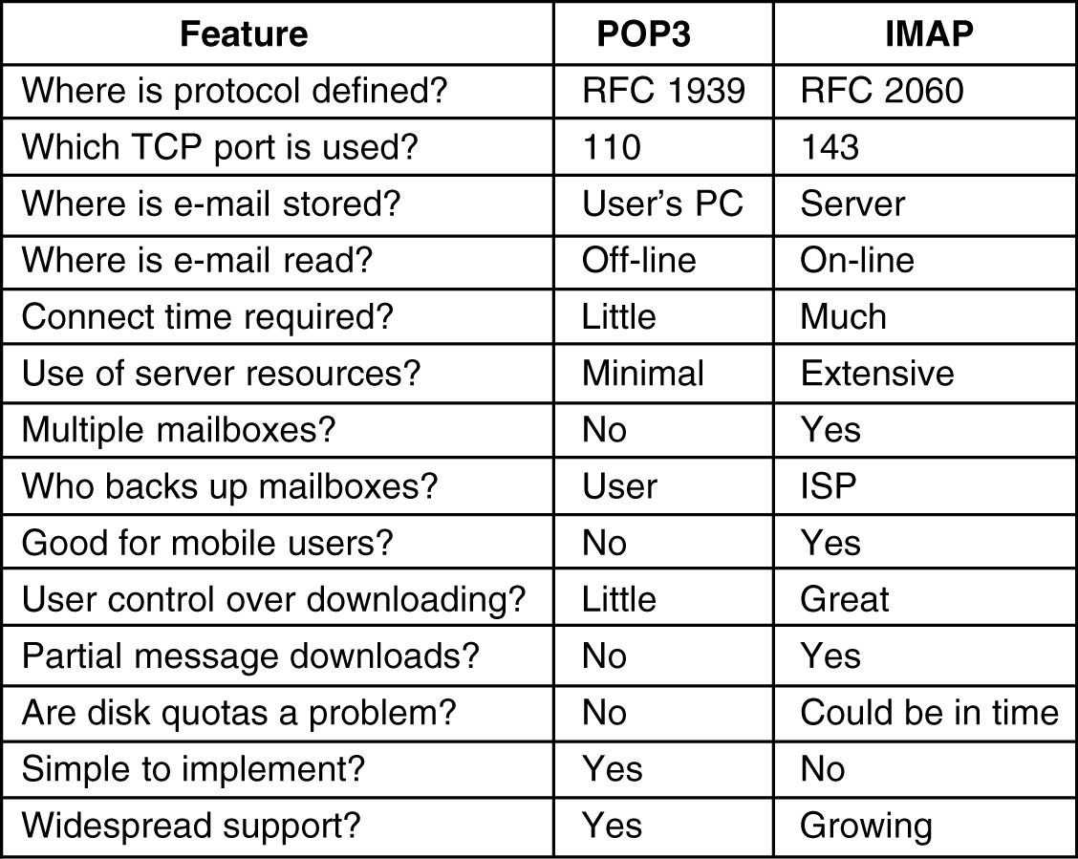
IMAP
A comparison of POP3 and IMAP.

Slide 64
Final Delivery
Proprietary protocols can also be used because the protocol runs between a mail server and user agent that can be supplied by the same company.
Microsoft Exchange is a mail system with a proprietary protocol.

Slide 65
Webmail
An increasingly popular alternative to IMAP and SMTP for providing email service is to use the Web as an interface for sending and receiving mail.
Widely used Webmail systems include Google Gmail, Microsoft Hotmail and Yahoo! Mail.
Webmail is one example of software (in this case, a mail user agent) that is provided as a service using the Web.
In this architecture, the provider runs mail servers as usual to accept messages for users with SMTP on port 25.
However, the user agent is different.

Slide 66
Webmail
Instead of being a standalone program, it is a user interface that is provided via Web pages.
This means that users can use any browser they like to access their mail and send new messages.
When the user goes to the email Web page of the provider, a form is presented in which the user is asked for a login name and password.
The login name and password are sent to the server, which then validates them.
If the login is successful, the server finds the user’s mailbox and builds a Web page listing the contents of the mailbox on the fly. The Web page is then sent to the browser for display.

Slide 67
Webmail
Many of the items on the page showing the mailbox are clickable, so messages can be read, deleted, and so on.
To make the interface responsive, the Web pages will often include JavaScript programs.
These programs are run locally on the client in response to local events (e.g., mouse clicks) and can also download and upload messages in the background, to prepare the next message for display or a new message for submission.
In this model, mail submission happens using the normal Web protocols by posting data to a URL.

Slide 68
Webmail
The Web server takes care of injecting messages into the traditional mail delivery system that we have described.
For security, the standard Web protocols can be used as well.
These protocols concern themselves with encrypting Web pages, not whether the content of the Web page is a mail message.

