Slide 1
The Transport Layer
Chapter 6

Slide 2
The Transport Service
Services Provided to the Upper Layers
Transport Service Primitives
Berkeley Sockets
An Example of Socket Programming:
An Internet File Server

Slide 3
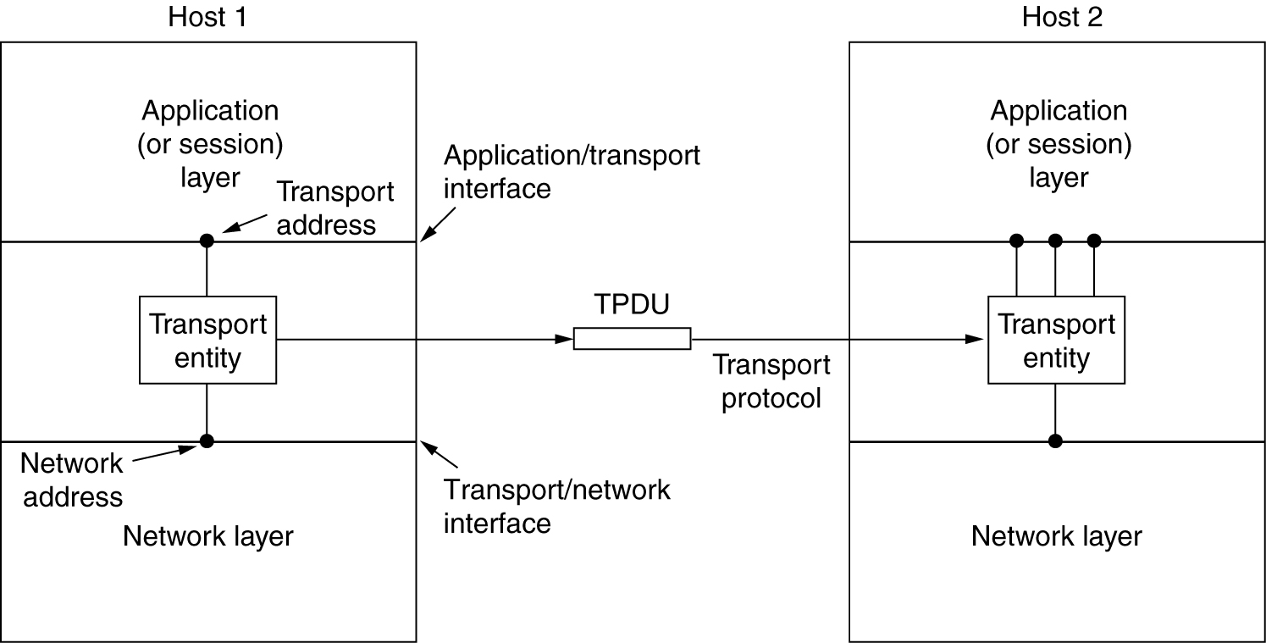
Services Provided to the Upper Layers
The network, transport, and application layers.

Slide 4
Services Provided to the Upper Layers
The goal of the transport layer is to provide efficient, reliable, and
cost-effective data transmission service to its users
To achieve this, the transport layer makes use of the services provided by the network layer.
The software and/or hardware within the transport layer that does the work is called the transport entity.
The transport entity can be located in operating system kernel, in a library package,in a separate user process, or even on the network interface card.
There are also two types of transport service.
connection-oriented transport service
connectionless.

Slide 5
Services Provided to the Upper Layers
Why transport layer?
The transport code runs entirely on the users’ machines, but the network layer mostly runs on the routers.
The existence of the transport layer makes it possible for the transport service to be more reliable than the underlying network.
The transport primitives can be implemented as calls to library procedures to make them independent of the network primitives.
Application programmers can write code according to a standard set of primitives and have these programs work on a wide variety of networks
The bottom four layers can be seen as the transport service provider, whereas the upper layer(s) are the transport service user.

Slide 6
Transport Service Primitives
The transport layer must provide some operations to application programs, that is, a transport service interface.
Each transport service has its own interface
Ex:connection-oriented transport service
It is reliable.
Error-free bit stream.
Network service vs transport service
network service is unreliable.
network service are seen few users(programs) whereas many programs sees transport services.
Example transport services primitives.
Consider client and server communication to understand the below service primitives.
The format of message is segments which is used by many protocols and some use TPDU.

Slide 7
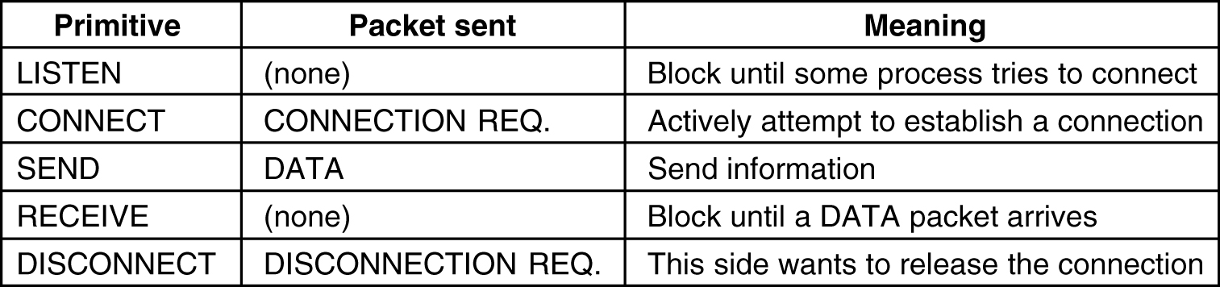
Transport Service Primitives
The primitives for a simple transport service.

Slide 8
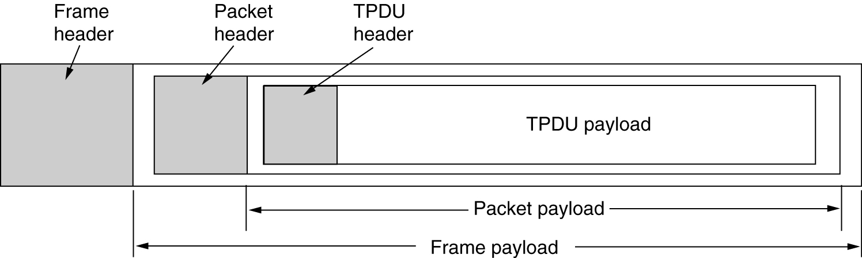
TPDU
The nesting of TPDUs, packets, and frames.

Slide 9
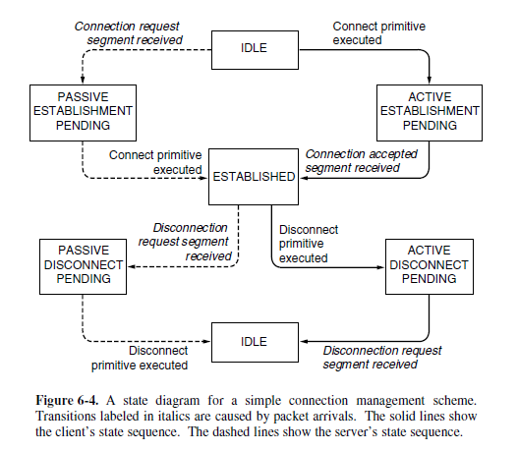

Slide 10
Elements of Transport Protocols
Addressing
Connection Establishment
Connection Release
Flow Control and Buffering
Multiplexing
Crash Recovery

Slide 11
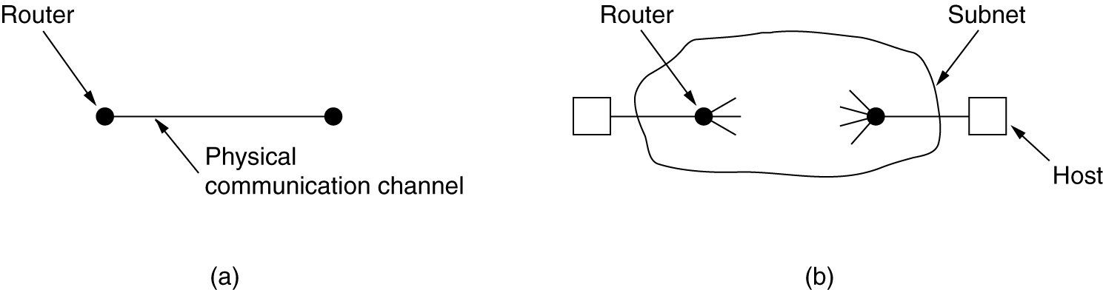
Transport Protocol
(a) Environment of the data link layer.
(b) Environment of the transport layer.

Slide 12
Transport Protocol
Transport protocols resemble the data link protocols as they both
have to deal with error control, sequencing, and flow control, among other issues.
Data Link layer vs Transport Layer:
At the data link layer, two routers communicate directly via a physical channel whereas at the transport layer, this physical channel is replaced by the entire network
It is usually not necessary for a router to specify which router it wants to talk to but in the transport layer, explicit addressing of destinations is required.
The process of establishing a connection is simple where as in the transport layer, initial connection establishment is complicated

Slide 13
Transport Protocol
When a router sends a packet over a link, it may arrive or be lost but considering the transport layer the packet bounce and emerge after other packets.
In data link layer, allocate a fixed number of buffers to each line but in transport layer as the larger number of connections that must be managed and variations in the bandwidth require many buffers.
Addressing
When an application (e.g., a user) process wishes to set up a connection to a remote application process, it must specify which one to connect to.
In the Internet, these endpoints are called ports(TSAP)
Application processes, both clients and servers, can attach
themselves to a local TSAP to establish a connection to a remote TSAP.

Slide 14
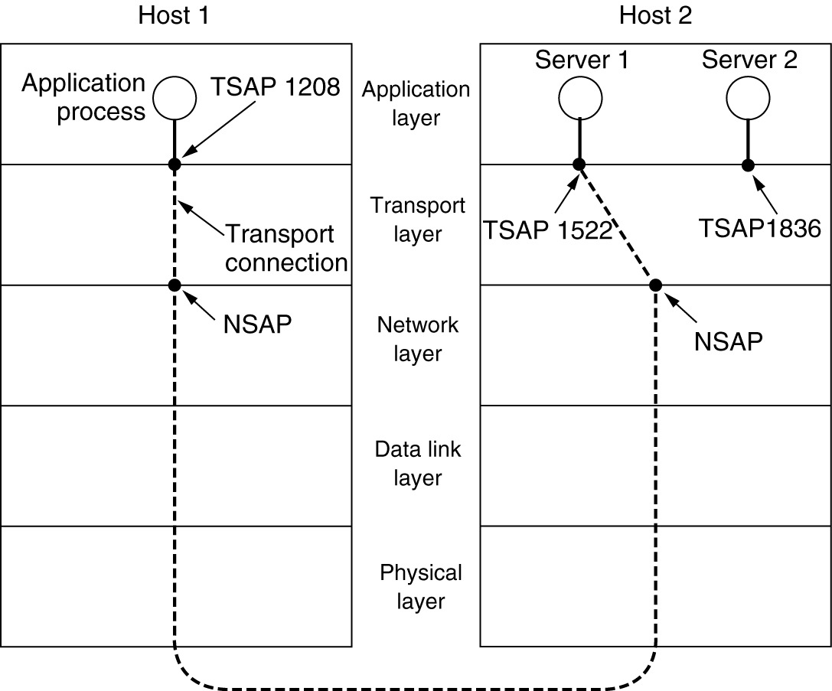
Addressing
TSAPs, NSAPs and transport connections.

Slide 15
Addressing
The purpose of having TSAPs is that in some networks, each computer has a single NSAP
So some way it is needed to distinguish multiple transport endpoints that share that NSAP.
Ex:
A mail server process attaches itself to TSAP 1522 on host 2 to wait
for an incoming connection.
An application process on host 1 wants to send an email message, so
it attaches itself to TSAP 1208 and issues a CONNECT request.
The application process sends over the mail message.
The mail server responds to say that it will deliver the message.
The transport connection is released.

Slide 16
Addressing
How does the user process on host 1 know that the mail server is attached to TSAP 1522?
The TSAP address is fixed(well-known) and is find from the file /etc/services in unix systems.
To find the TSAP address corresponding to a given service name a user sets up a connection to the portmapper then it replies with the TSAP address
The server systems consists of many processes and some of them will be rarely used.
It is wasteful to have each of them active and listening to a stable TSAP address all day long.
Each machine that wishes to offer services to remote users has a special process server will be there ex:inetd in unix systems.
It listens to a set of ports at the same time, waiting for a connection request.

Slide 17
Addressing
After it gets the incoming request, the process server spawns the requested server, allowing it to inherit the existing connection with the user.
The new server does the requested work, while the process server goes back to listening for new requests.

Slide 18
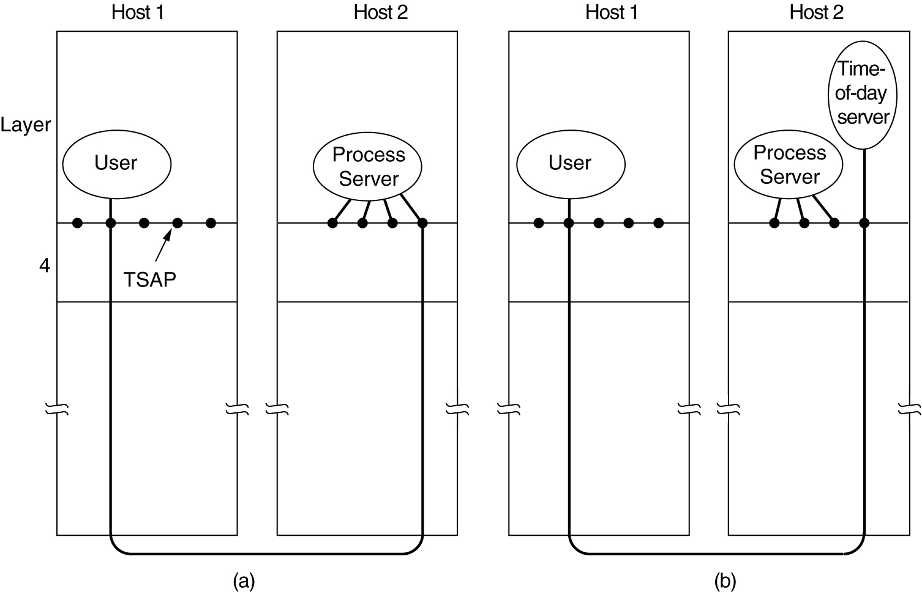
Connection Establishment
How a user process in host 1 establishes a connection with a time-of-day server in host 2.

Slide 19
Connection Establishment
Establishing a connection sounds easy, but the problem occurs when the network can lose, delay, corrupt, and duplicate packets. This behavior causes serious complications.
Ex: Bank Problem funds transfer from A to B.(Old duplicates)
The problem can be attacked in various ways, none of them very satisfactory.
One way is to use throw away transport addresses.
When a connection is released, the address is discarded and never used again.
Delayed duplicate packets then never find their way to a transport process and can do no damage. However, this approach makes it more difficult to connect with a process in the first place.

Slide 20
Connection Establishment
Another possibility is to give each connection a unique identifier (i.e., a sequence number incremented for each connection established) chosen by the initiating party and put in each segment, including the one requesting the connection.
After each connection is released, each transport entity can update a table listing obsolete connections as (peer transport entity, connection identifier) pairs.
Whenever a connection request comes in, it can be checked against the table to see if it belongs to a previously released connection.

Slide 21
Connection Establishment
Unfortunately, this scheme has a basic flaw: it requires each transport entity to maintain a certain amount of history information indefinitely.
This history must persist at both the source and destination machines.
Otherwise, if a machine crashes and loses its memory, it will no longer know which connection identifiers have already been used by its peers.
Instead, we need to take a different tack to simplify the problem. Rather than allowing packets to live forever within the network, we devise a mechanism to kill off aged packets that are still hobbling about. With this restriction, the problem becomes somewhat more manageable.

Slide 22
Connection Establishment
Packet lifetime can be restricted to a known maximum using one (or more) of the following techniques:
Restricted network design.(prevents packet from looping).
Putting a hop counter in each packet.
Timestamping each packet.(router discard any packet older than some agreed time)
We will need to guarantee not only that a packet is dead, but also
that all acknowledgements to it are dead
If we wait a time T secs after a packet has been sent, we can be sure that all traces of it are now gone
With packet lifetimes bounded, it is possible to devise a practical and foolproof way to reject delayed duplicate segments.
The source has to label segments with sequence numbers that will not be reused within T secs.

Slide 23
Connection Establishment
To get around the problem of a machine losing all memory of where it was after a crash, one possibility is to require transport entities to be idle for T secs after a recovery.
The idle period will let all old segments die off, so the sender can start again with any sequence number.
However, in a complex internetwork, T may be large, so this strategy is unattractive.
When a connection is set up, the low-order k bits of the clock are used as the k-bit initial sequence number.
Thus, unlike other protocols each connection starts numbering its segments with a different initial sequence number.

Slide 24
Connection Establishment
The clock-based method solves the problem of not being able to distinguish delayed duplicate segments from new segments.
However, there is a practical snag for using it for establishing connections.
Since we do not normally remember sequence numbers across connections at the destination, we still have no way of knowing if a CONNECTION REQUEST segment containing an initial sequence number is a duplicate of a recent connection.
To solve this specific problem, Tomlinson (1975) introduced the three-way handshake.

Slide 25
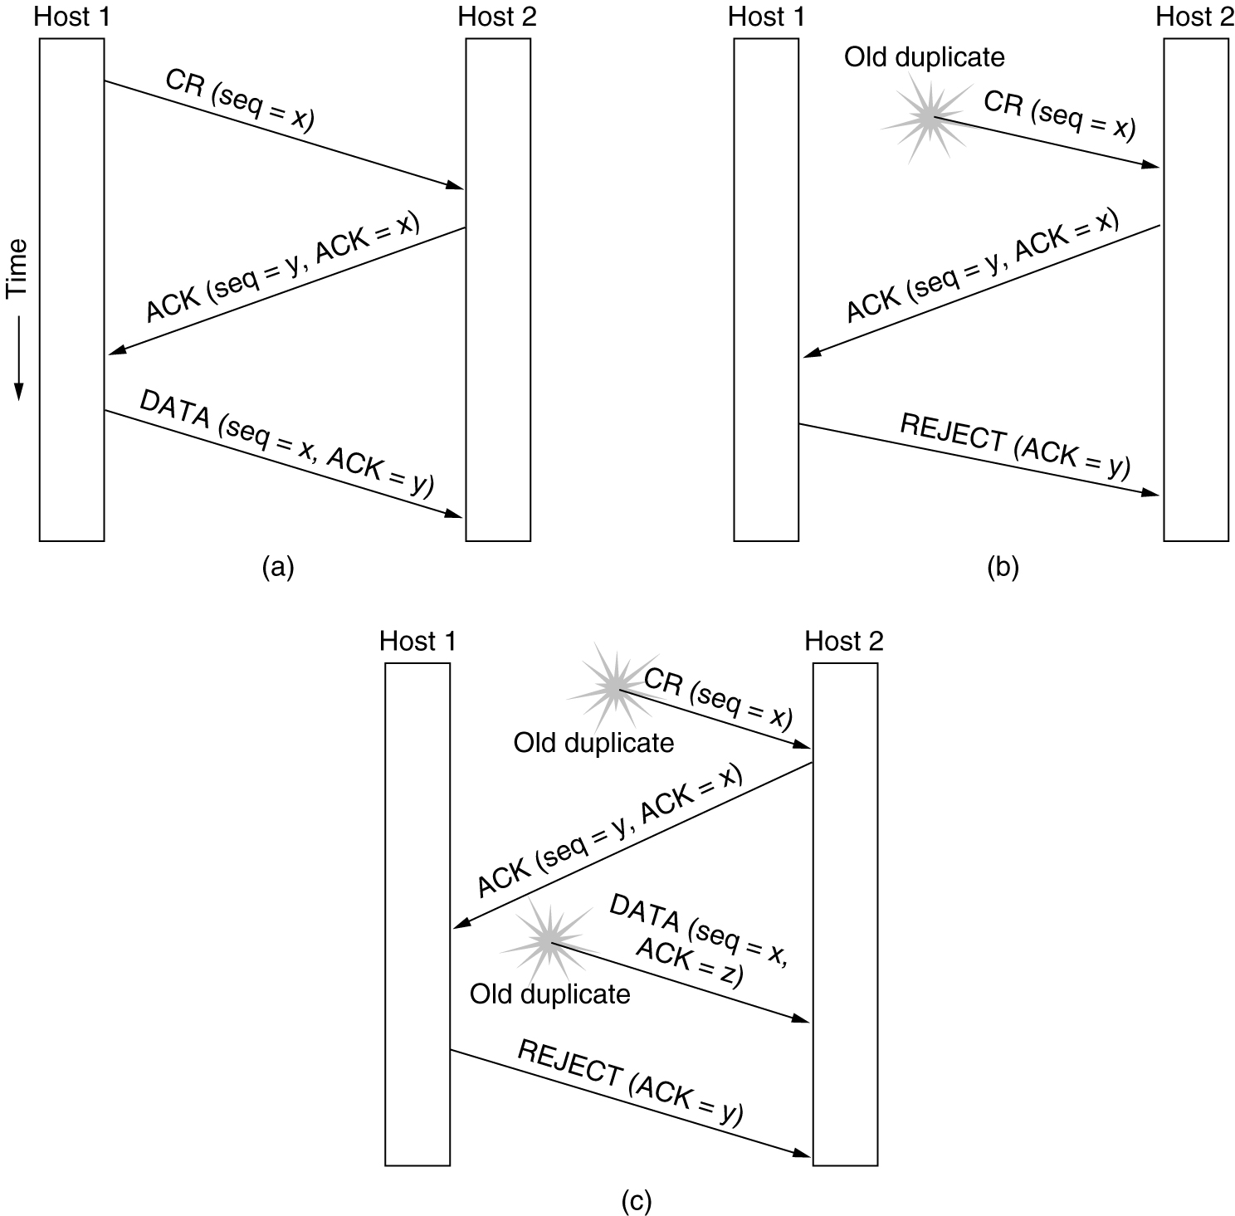
Connection Establishment
Three protocol scenarios for establishing a connection using a three-way handshake. CR denotes CONNECTION REQUEST. (a) Normal operation, (b) Old CONNECTION REQUEST appearing out of nowhere. (c) Duplicate CONNECTION REQUEST and duplicate ACK.

Slide 26
Connection Establishment
Normal Case:Host 1 chooses a sequence number: x, and sends a CONNECTION REQUEST segment to Host 2.Host 2 replies with an ACK segment acknowledging x and announcing its own initial sequence number, y. Host 1 acknowledges host 2’s choice of an initial sequence number in the first data segment that it sends.
Delayed duplicates: Host 2 got duplicate CONNECTION REQUEST and send ACK to Host1 .The Host1 rejects the attempt.
Delayed duplicate and ACK: Host 2 gets a delayed CONNECTION REQUEST and replies with sequence number “y”.Host2 got ACK for “Z” from Host 1. Then Host2 identifies that it is also duplicate.

Slide 27
Connection Release
Releasing a connection is easier than establishing one.
There are two styles of terminating a connection: asymmetric release and symmetric release.
Asymmetric release is the way the telephone system works: when one party hangs up, the connection is broken.
Symmetric release treats the connection as two separate unidirectional connections and requires each one to be released separately.
Asymmetric release is abrupt and may result in data loss. Consider the scenario of Fig. 6-12.

Slide 28
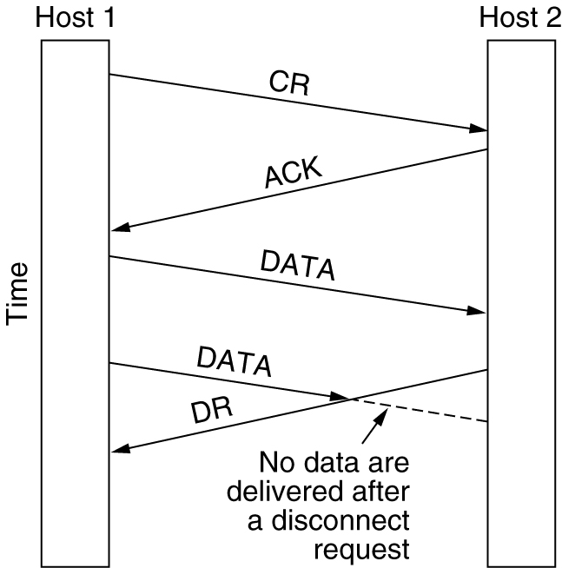
Connection Release
Abrupt disconnection with loss of data.

Slide 29
Connection Release
Clearly, a more sophisticated release protocol is needed to avoid data loss.
One way is to use symmetric release, in which each direction is released independently of the other one. Here, a host can continue to receive data even after it has sent a DISCONNECT segment.
Symmetric release does the job when each process has a fixed amount of data to send and clearly knows when it has sent it.
In other situations, determining that all the work has been done and the connection should be terminated is not so obvious.
Two army problem.

Slide 30
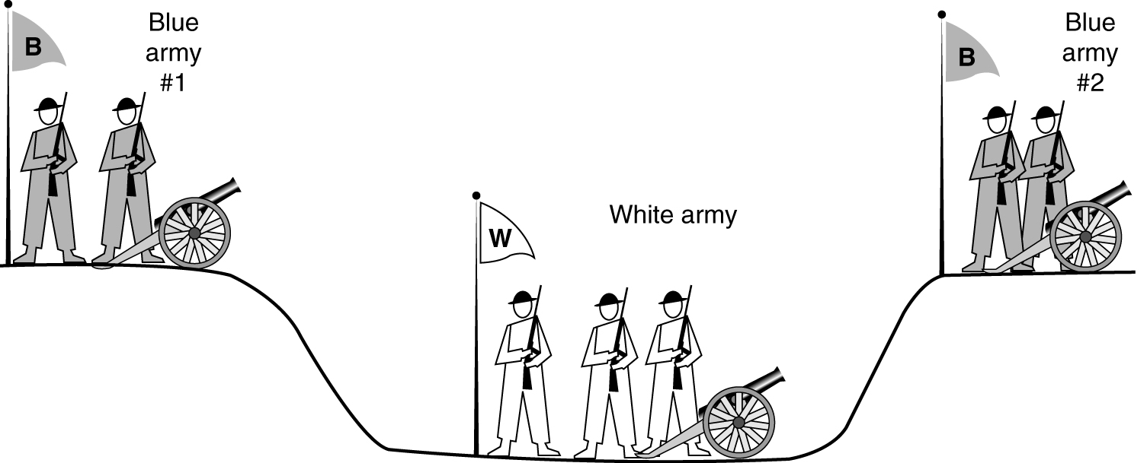
Connection Release
The two-army problem.

Slide 31
The white army is larger than either of the blue armies alone, but together the blue armies are larger than the white army
If the two blue armies attack simultaneously, they will be victorious otherwise they will be defeated
The question is: does a protocol exist that allows the blue armies to win?
Sol1:The commander of blue army #1 sends a message to blue army#2.The commander of blue army #2 agrees, and his reply gets safely back to blue army #1.Will the attack happen?Probably not
Sol2:Three- way handshake.Blue army #2 get an acknowledgement.
Now blue army1# does not know that his ack received or not.

Slide 32
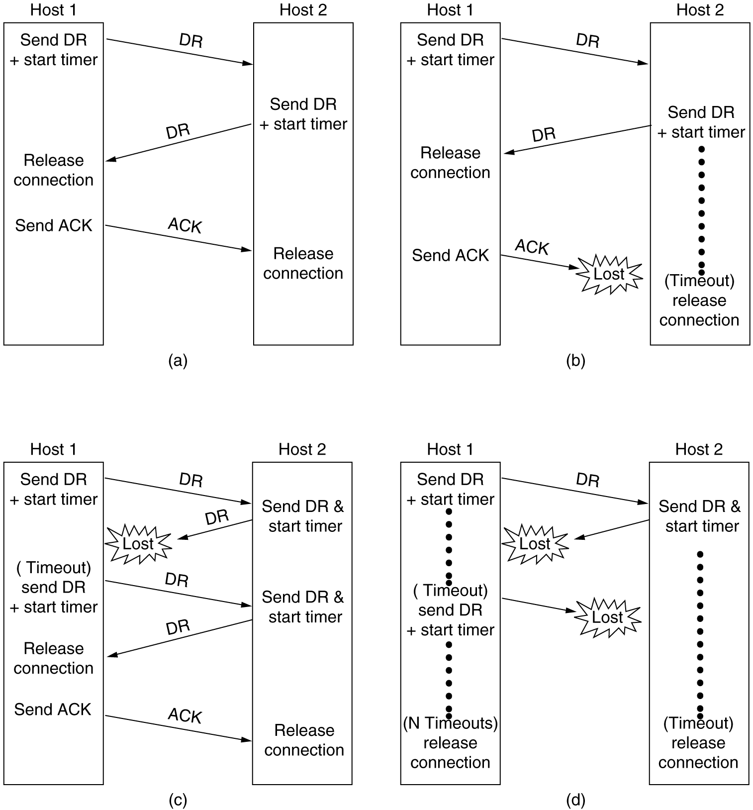
Connection Release
6-14, a, b
Four protocol scenarios for releasing a connection. (a) Normal case of a three-way handshake. (b) final ACK lost.

Slide 33
Connection Release
6-14, c,d
(c) Response lost. (d) Response lost and subsequent DRs lost.

Slide 34
Error control and flow control
Error control is ensuring that the data is delivered with the desired level of reliability, usually that all of the data is delivered without any errors.
Flow control is keeping a fast transmitter from overrunning a
slow receiver.
The solutions that are used at the transport layer are the same mechanisms that we studied in Chap. 3 but with little difference.
The link layer checksum protects a frame while it crosses a single link whereas the transport layer checksum protects a segment while it crosses an entire network path
The sliding window is one frame from the sender for data link layer where as the window size is more than one segment regarding the transport layer.
As window size large host need a substantial amount of buffering for the sliding windows.

Slide 35
Error control and flow control
The receiver may or may not dedicate specific buffers to specific connections
The best trade-off between source buffering and destination buffering depends on the type of traffic carried by the connection.
Ex:no buffering for interactive applications ,buffering for file transfer.
Organizing the buffer pool.
As segments of nearly same size,it is natural to organize the buffers as a pool of identically sized buffers, with one segment per buffer
If the buffer size is chosen to be equal to the largest possible segment,
space will be wasted whenever a short segment arrives
So,use variable-sized buffers.The advantage here is better memory utilization, at the price of more complicated buffer management.
Dedicate a single large circular buffer per connection.

Slide 36
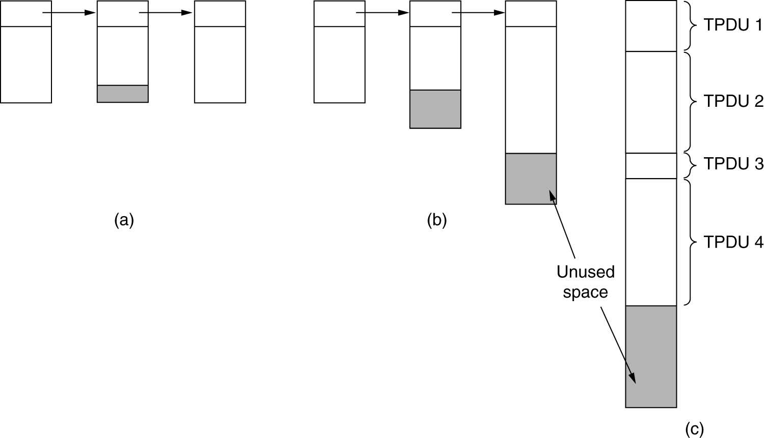
Flow Control and Buffering
(a) Chained fixed-size buffers. (b) Chained variable-sized buffers. (c) One large circular buffer per connection.

Slide 37
Flow Control and Buffering
Dynamic buffer allocation:
The sender requests a certain number of buffers, based on its
expected needs.
The receiver then grants as many of these as it can afford.
The receiver separately piggybacks both acknowledgements and buffer allocations onto the reverse traffic.
Example.
Problems with buffer allocation schemes of this kind can arise in datagram networks if control segments can get lost.
To prevent this situation, each host should periodically send control segments giving the acknowledgement and buffer status on each connection.

Slide 38
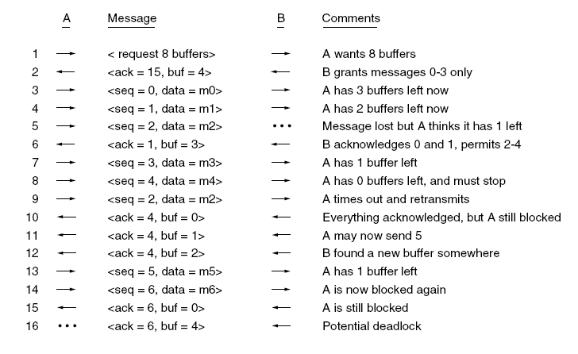
Flow Control and Buffering

Slide 39
Congestion Control
•Desirable bandwidth allocation
•Regulating the sending rate

Slide 40
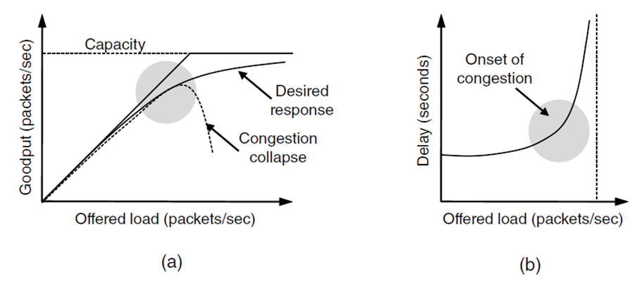
Desirable Bandwidth Allocation (1)
(a) Goodput and (b) delay as a function of offered load

Slide 41
Desirable Bandwidth Allocation (1)
If the transport entities send too many packets into the network
too quickly, the network will become congested
Controlling congestion to avoid this problem is the combined responsibility of the network and transport layers.
The only effective way to control congestion is for the transport protocols to send packets into the network more slowly.
The goal is to find a good allocation of bandwidth to the transport entities that are using the network.
Efficiency and Power
An efficient allocation of bandwidth across transport entities will use all of the network capacity that is available.
As the load increases goodput initially increases at the same rate, but as the load approaches the capacity, goodput rises more gradually

Slide 42
Desirable Bandwidth Allocation (1)
At on set of congestion routers discard packets and retransmitted packets have been delayed the network can enter into congestion collapse.
Initially the delay is fixed, representing the propagation delay across the network.
As the load approaches the capacity, the delay rises, slowly at first and then much more rapidly.
For both goodput and delay, performance begins to degrade at the onset of congestion.
We will obtain the best performance from the network if we allocate bandwidth up until the delay starts to climb rapidly.
The metric is power
power=load/delay.

Slide 43
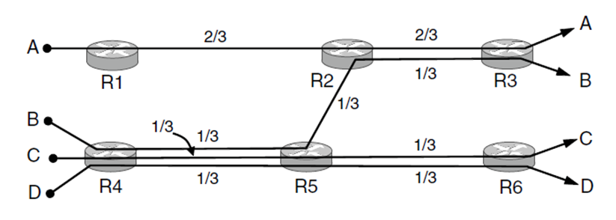
Desirable Bandwidth Allocation (2)
Max-min bandwidth allocations for four flows

Slide 44
How to divide bandwidth between different transport senders?
Give all the senders an equal fraction of the bandwidth.
But generally networks do not have a strict bandwidth reservation for each flow or connection.
IP routers often have all connections competing for the same bandwidth.
In this situation, it is the congestion control mechanism that is
allocating bandwidth to the competing connections.
The fair portion for flows is 1/N for N flows
But what happens if the flows have different, but overlapping,
network paths?
Fairness that does not depend on the length of the network path.

Slide 45
Max-Min fairness
The form of fairness that is often desired for network usage is max-min fairness.
An allocation is max-min fair if the bandwidth given to one flow cannot be increased without decreasing the bandwidth given to another flow with an allocation that is no larger.
Example
Three flows compete for the bottom-left link between routers
R4 and R5. Each of these flows therefore gets 1/3 of the link
The remaining flow, A, competes with B on the link from R2 to R3.
Since B has an allocation of 1/3, A gets the remaining 2/3 of the link.

Slide 46
Max-min allocations can be computed given a global knowledge of the network.
The rate for all of the flows starts at zero and is slowly increased.
When the rate reaches a bottleneck for any flow, then that flow stops increasing.
The other flows all continue to increase,
It is more important in practice that no connection be starved of bandwidth than that all connections get precisely the same amount of bandwidth.

Slide 47
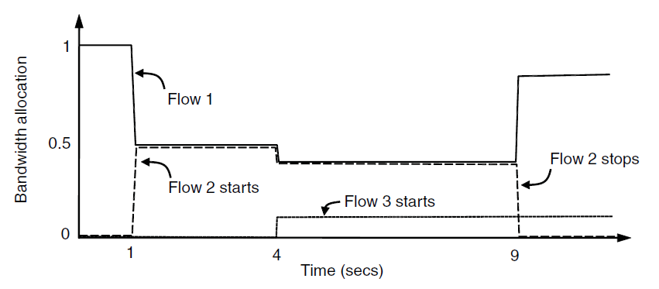
Desirable Bandwidth Allocation (3)
Changing bandwidth allocation over time

Slide 48
Convergence
Because of the variation in demand, the ideal operating point for the network varies over time.
A good congestion control algorithm should rapidly converge to
the ideal operating point, and it should track that point as it changes over time.
Example
Flow 1 has all of the bandwidth. One second later, flow 2 starts. It needs bandwidth as well.
The allocation quickly changes to give each of these flows half the bandwidth.
At 4 seconds, a third flow joins. However, this flow uses only 20% of the bandwidth,so flow 1 and2 quickly adjust and get 40% of share.
At 9 seconds, the second flow leaves, and the third flow remains unchanged,flow 1 gets 80% BANDWIDTH.

Slide 49
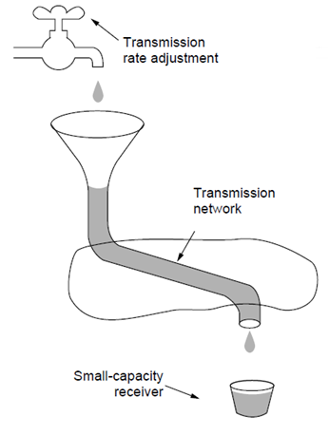
Regulating the Sending Rate (1)
A fast network feeding a low-capacity receiver

Slide 50
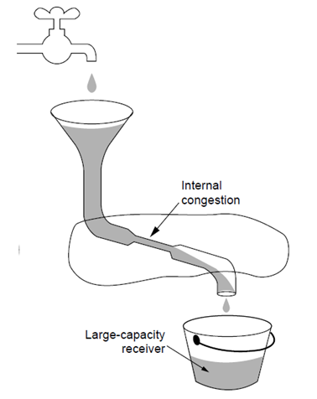
A slow network feeding a high-capacity receiver

Slide 51
Regulating the Sending Rate (1)
The sending rate may be limited by two factors.
The first is flow control, in the case that there is insufficient buffering at the receiver.
The second is congestion, in the case that there is insufficient capacity in the network.
The way that a transport protocol should regulate the sending rate depends on the form of the feedback returned by the network.
Different network layers may return different kinds of feedback.
The feedback may be explicit or implicit, and it may be precise or imprecise.
Precise design is when routers tell the sources the rate at which they may send.
Ex:XCP (eXplicit Congestion Protocol).
An explicit, imprecise design is the use of ECN (Explicit Congestion Notification) with TCP.

Slide 52
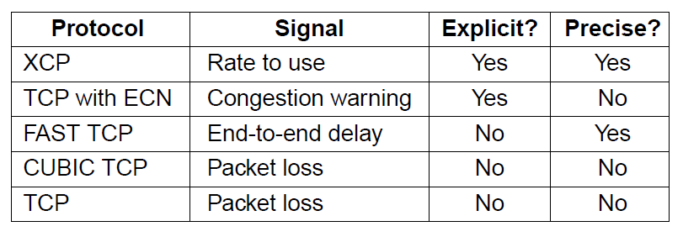
Some congestion control protocols

Slide 53
FAST TCP measures the round trip delay and uses that metric as a signal to avoid congestion
CUBIC TCP :TCP with drop-tail or RED routers,
The way in which the rates are increased or decreased is
given by a control law.
These laws have a major effect on performance.
AIMD (Additive Increase Multiplicative Decrease) is the appropriate
control law to arrive at the efficient and fair operating point.
EXAMPLE
When the allocation is fair, both users will receive the same amount of bandwidth.
This is shown by the dotted fairness line.
When the allocations sum to 100%, the capacity of the link, the allocation is efficient.

Slide 54
This is shown by the dotted efficiency line.
A congestion signal is given by the network to both users when the
sum of their allocations crosses this line.
The intersection of these lines is the desired operating point.
The users may each increase their sending rate by 1 Mbps every second
Operating point crosses the efficiency line and both users receive a congestion signal from the network.
At this stage, they must reduce their allocations. However,
an additive decrease would simply cause them to oscillate.
When both users multiplicatively increase their bandwidth over time until they receive a congestion signal.
If they then multiplicatively decrease their sending rates, the operating point of the users will simply oscillate

Slide 55
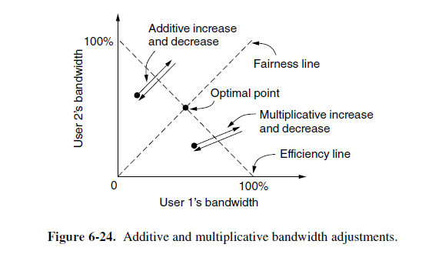

Slide 56
Users additively increase their bandwidth allocations and then multiplicatively decrease them when congestion is signaled.
This behavior is the AIMD control law
The path traced by this behavior does converge to the optimal point that is both fair and efficient.
This convergence happens no matter what the starting point, making AIMD broadly useful.

Slide 57
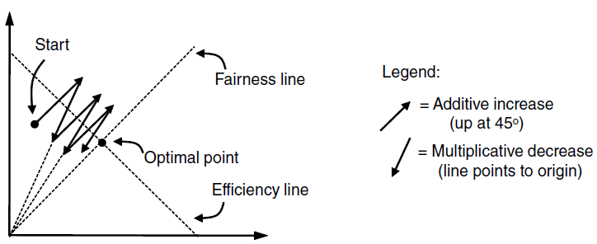
Additive Increase Multiplicative Decrease (AIMD) control law.

Slide 58
The Internet Transport Protocols: UDP
Introduction to UDP
Remote Procedure Call
The Real-Time Transport Protocol

Slide 59
Introduction to UDP
The Internet protocol suite supports a connectionless transport protocol called UDP (User Datagram Protocol).
UDP provides a way for applications to send encapsulated IP datagrams without having to establish a connection.
UDP transmits segments consisting of an 8-byte header followed by the payload.
The header is shown in Fig. 6-27.

Slide 60
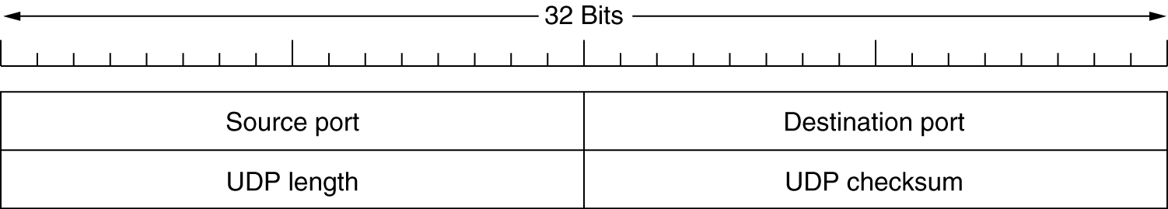
Introduction to UDP
The UDP header.

Slide 61
Introduction to UDP
The source port is primarily needed when a reply must be sent back to the source.
The UDP length field includes the 8-byte header and the data. The minimum length is 8 bytes, to cover the header.
The maximum length is 65,515 bytes, which is lower than the largest number that will fit in 16 bits because of the size limit on IP packets.
An optional Checksum is also provided for extra reliability. It checksums the header, the data, and a conceptual IP pseudo header. When performing this computation, the Checksum field is set to zero and the data field is padded out with an additional zero byte if its length is an odd number.

Slide 62
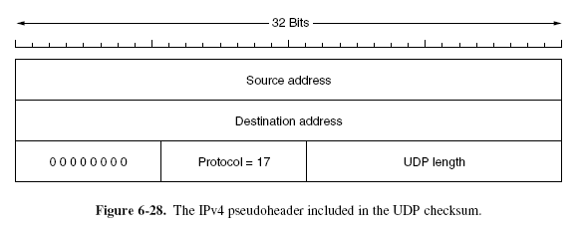
Introduction to UDP
The pseudoheader for the case of IPv4 is shown in Fig. 6-28.
It contains the 32-bit IPv4 addresses of the source and destination machines, the protocol number for UDP (17), and the byte count for the UDP segment.

Slide 63
Introduction to UDP
It is probably worth mentioning explicitly some of the things that UDP does not do.
It does not do flow control, congestion control, or retransmission upon receipt of a bad segment.
All of that is up to the user processes.
For applications that need to have precise control over the packet flow, error control, or timing, UDP provides just what the doctor ordered.
Ex:web request/reply,DNS(Domain Name System)

Slide 64
Remote Procedure Call
When a process on machine 1 calls a procedure on machine 2, the calling process on 1 is suspended and execution of the called procedure takes place on 2.
Information can be transported from the caller to the callee in the parameters and can come back in the procedure result.
No message passing is visible to the application programmer. This technique is known as RPC (Remote Procedure Call) and has become the basis for many networking applications.
Traditionally, the calling procedure is known as the client and the called procedure is known as the server.

Slide 65
Remote Procedure Call
The idea behind RPC is to make a remote procedure call look as much as possible like a local one.
In the simplest form, to call a remote procedure, the client program must be bound with a small library procedure, called the client stub, that represents the server procedure in the client’s address space.
Similarly, the server is bound with a procedure called the server stub.
These procedures hide the fact that the procedure call from the client to the server is not local

Slide 66
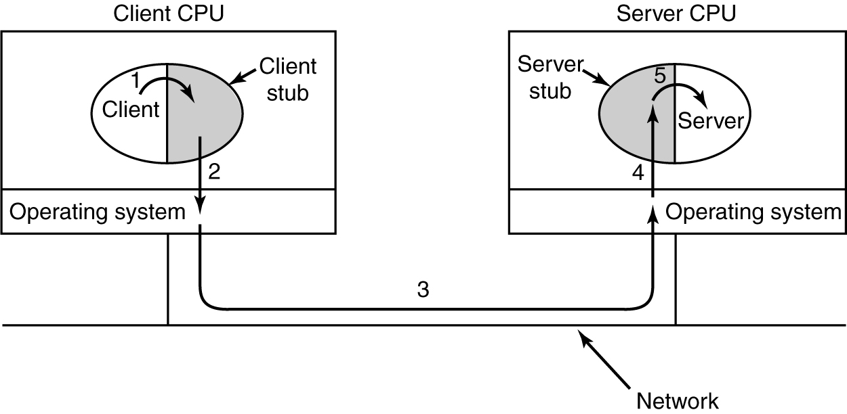
Remote Procedure Call
Steps in making a remote procedure call. The stubs are shaded.

Slide 67
Remote Procedure Call
The actual steps in making an RPC are shown in Fig. 6-29.
Step 1 is the client calling the client stub. This call is a local procedure call, with the parameters pushed onto the stack in the normal way.
Step 2 is the client stub packing the parameters into a message and making a system call to send the message. Packing the parameters is called marshaling.
Step 3 is the operating system sending the message from the client machine to the server machine.
Step 4 is the operating system passing the incoming packet to the server stub.
Finally, step 5 is the server stub calling the server procedure with the unmarshaled parameters. The reply traces the same path in the other direction.

Slide 68
Remote Procedure Call
Limitations
With RPC, passing pointers is impossible because the client and server are in different address spaces.
A second problem is that in weakly typed languages, like C, it is perfectly legal to write a procedure that computes the inner product of two vectors (arrays), without specifying how large either one is.
Each could be terminated by a special value known only to the calling and called procedures.
Under these circumstances, it is essentially impossible for the client stub to marshal the parameters: it has no way of determining how large they are.

Slide 69
Remote Procedure Call
Limitations
Third problem is that it is not always possible to deduce the types of the parameters, not even from a formal specification or the code itself.
An example is printf, which may have any number of parameters (at least one), and the parameters can be an arbitrary mixture of integers, shorts, longs, characters, strings, floating point numbers of various lengths, and other types.
Trying to call printf as a remote procedure would be practically impossible because C is so permissive.

Slide 70
Remote Procedure Call
Limitations
A fourth problem relates to the use of global variables.
Normally, the calling and called procedure can communicate by using global variables, in addition to communicating via parameters.
But if the called procedure is moved to a remote machine, the code will fail because the global variables are no longer shared.

Slide 71
Real-Time Transport Protocols
Client-server RPC is one area in which UDP is widely used. Another one is for real-time multimedia applications.
In particular, as Internet radio, Internet telephony, music-on-demand, videoconferencing, video-on-demand, and other multimedia applications
RTP normally runs in user space over UDP (in the operating system).
It operates as follows. The multimedia application consists of multiple audio, video, text, and possibly other streams.
These are fed into the RTP library, which is in user space along with the application.

Slide 72
Real-Time Transport Protocols
This library multiplexes the streams and encodes them in RTP packets, which it stuffs into a socket.
On the operating system side of the socket, UDP packets are generated to wrap the RTP packets and handed to IP for transmission over a link such as Ethernet.
The reverse process happens at the receiver.
The multimedia application eventually receives multimedia data from the RTP library.
It is responsible for playing out the media.
The protocol stack for this situation is shown in Fig. 6-30(a). The packet nesting is shown in Fig. 6-30(b).

Slide 73
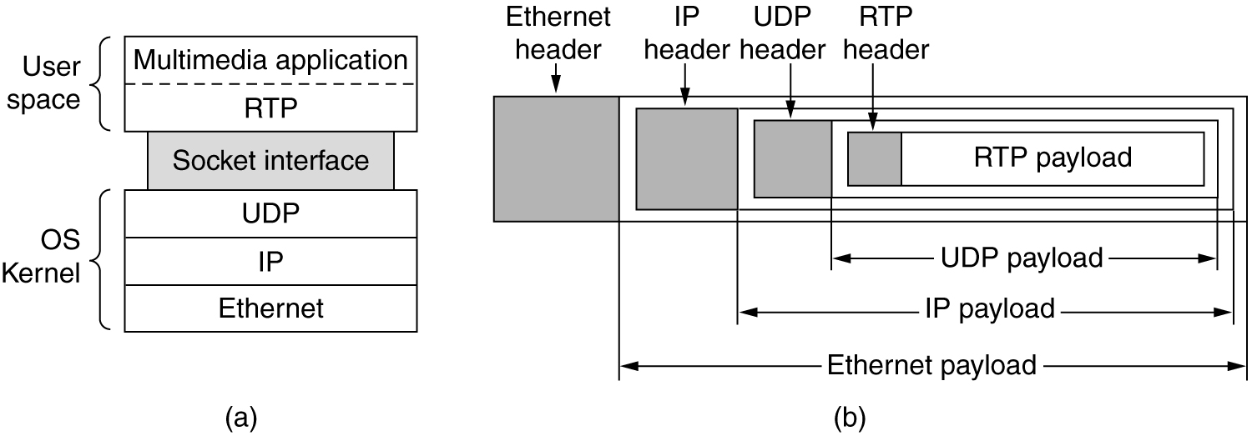
The Real-Time Transport Protocol
(a) The position of RTP in the protocol stack. (b) Packet nesting.

Slide 74
RTP just uses normal UDP, its packets are not treated specially by the routers unless some normal IP quality-of-service features are enabled
There are no special guarantees about delivery, and packets may be lost, delayed, corrupted, etc.
Each packet sent in an RTP stream is given a number one higher than its predecessor. This numbering allows the destination to determine if
any packets are missing.
If a packet is missing, the best action for the destination to take is up to the application.
To allow for interworking, RTP defines several profiles (e.g., a single audio stream), and for each profile, multiple encoding formats
may be allowed.

Slide 75
It allow the source to associate a timestamp with the first sample in each packet.
This mechanism allows the destination to do a small amount of buffering and play each sample the right number of milliseconds
Timestamping reduce the effects of variation in network delay,
but it also allows multiple streams to be synchronized with each other.
Ex:dubbing films(video with 2 audio streams).

Slide 76
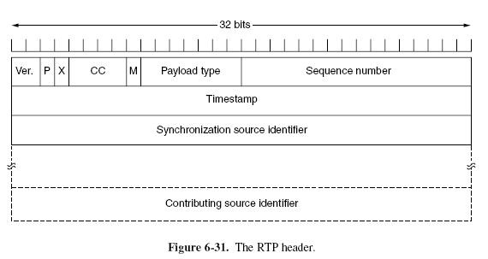
Real-Time Transport Protocols
The RTP header is illustrated in Fig. 6-31.

Slide 77
Real-Time Transport Protocols
It consists of three 32-bit words and potentially some extensions.
The first word contains the Version field, which is already at 2.
The P bit indicates that the packet has been padded to a multiple of 4 bytes. The last padding byte tells how many bytes were added.
The X bit indicates that an extension header is present. The format and meaning of the extension header are not defined.
The only thing that is defined is that the first word of the extension gives the length.

Slide 78
Real-Time Transport Protocols
The CC field tells how many contributing sources are present, from 0 to 15
The M bit is an application-specific marker bit. It can be used to mark the start of a video frame, the start of a word in an audio channel, or something else that the application understands.
The Payload type field tells which encoding algorithm has been used (e.g., uncompressed 8-bit audio, MP3, etc.).
Since every packet carries this field, the encoding can change during transmission.
The Sequence number is just a counter that is incremented on each RTP packet sent. It is used to detect lost packets.

Slide 79
Real-Time Transport Protocols
The Timestamp is produced by the stream’s source to note when the first sample in the packet was made. This value can help reduce timing variability called jitter at the receiver by decoupling the playback from the packet arrival time. The
Synchronization source identifier tells which stream the packet belongs to. It is the method used to multiplex and demultiplex multiple data streams onto a single stream of UDP packets.
Finally, the Contributing source identifiers, if any, are used when mixers are present in the studio. In that case, the mixer is the synchronizing source, and the streams being mixed are listed here.

Slide 80
RTCP—The Real-time Transport Control Protocol
RTP has a little sister protocol called RTCP (Realtime Transport Control Protocol).
It handles feedback, synchronization, and the user interface. It does not transport any media samples.
The first function can be used to provide feedback on delay, variation in delay or jitter, bandwidth, congestion, and other network properties to the sources.
This information can be used by the encoding process to increase the data rate (and give better quality) when the network is functioning well and to cut back the data rate when there is trouble in the network.

Slide 81
By providing continuous feedback, the encoding algorithms can be continuously adapted to provide the best quality possible under the current circumstances.
Ex:encoding may switch from MP3 to 8-bit PCM to delta encoding as required
RTCP also handles interstream synchronization. The problem is that different streams may use different clocks, with different granularities and different drift rates. RTCP can be used to keep them in sync.
Finally, RTCP provides a way for naming the various sources (e.g., in ASCII text). This information can be displayed on the receiver’s screen to indicate who is talking at the moment.

Slide 82
RTCP—The Real-time Transport Control Protocol
Playout with Buffering and Jitter Control:
RTP packets will take slightly different amounts of time to transit
the network.
This variation in delay is called jitter. Even a small amount of packet jitter can cause distracting media artifacts
The solution to this problem is to buffer packets at the receiver before they are played out to reduce the jitter.
In the example we can see that packet 8 has been delayed so much that it is not available when its play slot comes up.
There are two options.
Packet 8 can be skipped and the player can move on to subsequent packets.
Alternatively, playback can stop until packet 8 arrives,

Slide 83
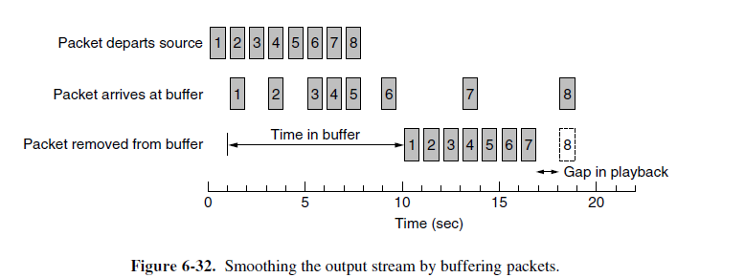

Slide 84
A key consideration for smooth playout is the playback point, or how long to wait at the receiver for media before playing it out.
Deciding how long to wait depends on the jitter.
To pick a good playback point, the application can measure the jitter by looking at the difference between the RTP timestamps and the arrival time.
Each differencegives a sample of the delay (plus an arbitrary, fixed offset).
The delay can change over time due to other, competing traffic and changing routes.
To accommodate this change, applications can adapt their playback point while they are running.

Slide 85
Changing the playback point can produce an observable glitch to the user.
One way to avoid this problem for audio is to adapt the playback point between talkspurts(gap in the cenversation).
RTP lets applications set the M marker bit to indicate the start of a new talkspurt for this purpose.

Slide 86
The Internet Transport Protocols: TCP
Introduction to TCP
The TCP Service Model
The TCP Protocol
The TCP Segment Header
TCP Connection Establishment
TCP Connection Release
TCP Connection Management Modeling
TCP Transmission Policy
TCP Congestion Control
TCP Timer Management
Wireless TCP and UDP
Transactional TCP

Slide 87
The Internet Transport Protocols: TCP
Introduction to TCP
Each machine supporting TCP has a TCP transport entity, either a library procedure, a user process, or most commonly part of the kernel
A TCP entity accepts user data streams from local processes, breaks them up into pieces not exceeding 64 KB and sends each piece as a separate IP datagram.
When datagrams containing TCP data arrive at a machine, they are given to the TCP entity, which reconstructs the original byte streams.

Slide 88
The Internet Transport Protocols: TCP
The TCP Service Model
TCP service is obtained by both the sender and the receiver creating end points, called sockets
Each socket has a socket number (address) consisting of the IP address of the host and a 16-bit number local to that host, called a port. A port is the TCP name for a TSAP
Port numbers below 1024 are reserved for standard services that can usually only be started by privileged users (e.g., root in UNIX systems). They are called well-known ports.
For example, any process wishing to remotely retrieve mail
from a host can connect to the destination host’s port 143 to contact its IMAP daemon.

Slide 89
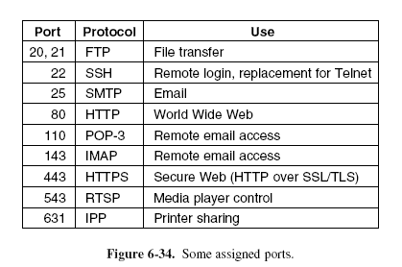
The Internet Transport Protocols: TCP
The TCP Service Model

Slide 90
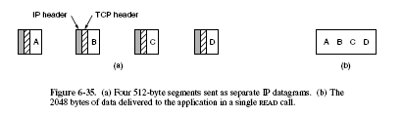
The Internet Transport Protocols: TCP
The TCP Service Model
All TCP connections are full duplex and point-to-point.
A TCP connection is a byte stream, not a message stream. Message boundaries are not preserved end to end.

Slide 91
The Internet Transport Protocols: TCP
When an application passes data to TCP, TCP may send it immediately or buffer it
To force data out, TCP has the notion of a PUSH flag( Not to delay) that is carried on packets.
Different operating systems have evolved different options to expedite transmission
e.g., TCP NODELAY in Windows and Linux.
When an application has high priority data that should be processed immediately then the sending application can put some control information in the data stream and give it to TCP along with the URGENT flag.
When the urgent data are received at the destination, the receiving application is interrupted so it can stop whatever it was
doing and read the data stream

Slide 92
The Internet Transport Protocols: TCP
The TCP Protocol
The sending and receiving TCP entities exchange data in the form of segments.
A TCP segment consists of a fixed 20-byte header (plus an optional part) followed by zero or more data bytes.
The TCP software decides how big segments should be.
It can accumulate data from several writes into one segment or can split data from one write over multiple segments.
Two limits restrict the segment size.
First, each segment, including the TCP header, must fit in the 65,515 byte IP payload.

Slide 93
The Internet Transport Protocols: TCP
The TCP Protocol
Second, each link has an MTU (Maximum Transfer Unit).
Each segment must fit in the MTU at the sender and receiver so that it can be sent and received in a single, unfragmented packet.
In practice, the MTU is generally 1500 bytes (the Ethernet payload size) and thus defines the upper bound on segment size.
The basic protocol used by TCP entities is the sliding window protocol with a dynamic window size.
When a sender transmits a segment, it also starts a timer.
When the segment arrives at the destination, the receiving TCP entity sends back a segment (with data if any exist, and otherwise without) bearing an acknowledgement number equal to the next sequence number it expects to receive and the remaining window size.
If the sender’s timer goes off before the acknowledgement
is received, the sender transmits the segment again.

Slide 94
The Internet Transport Protocols: TCP
The TCP Segment Header
Figure 6-36 shows the layout of a TCP segment.
Every segment begins with a fixed-format, 20-byte header. The fixed header may be followed by header options.
After the options, if any, up to 65,535 − 20 − 20 = 65,495 data bytes may follow, where the first 20 refer to the IP header and the second to the TCP header.
Segments without any data are legal and are commonly used for acknowledgements and control messages.
The Source port and Destination port fields identify the local end points of the connection.
The Sequence number and Acknowledgement number fields perform their usual functions.
It is a cumulative acknowledgement because it summarizes the received data with a single number.

Slide 95
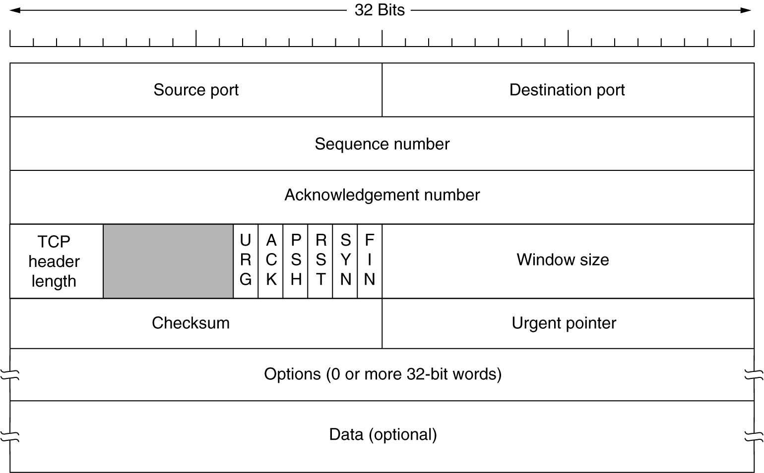
The TCP Segment Header
TCP Header.

Slide 96
The TCP header length tells how many 32-bit words are contained in the TCP header
Next comes a 4-bit field that is not used.
CWR and ECE are used to signal congestion when ECN.
Ex: Set ECE to ECN-Echo and set CWR to stop sending ECN-Echo by receiver.
URG is set to 1 if the Urgent pointer is in use.
The ACK bit is set to 1 to indicate that the Acknowledgement number is valid.
The PSH bit indicates PUSHed data.
The RST bit is used to abruptly reset a connection that has become confused due to a host crash or some other reason.
The SYN bit is used to establish connections.
Ex: SYN=1 ACK=0 Connection request
SYN=1 ACK=1 Connection Accepted

Slide 97
The FIN bit is used to release a connection.
Flow control in TCP is handled using a variable-sized sliding window. The Window size field tells how many bytes may be sent starting at the byte acknowledged.
A Checksum is also provided for extra reliability. It checksums the header, the data, and a conceptual pseudoheader in exactly the same way as UDP
The Options field provides a way to add extra facilities not covered by the regular header.
Ex:Manipulating MSS,Window scale option (for supporting data upto 2^30 bytes.,timestamp ,SACK(range of sequence numbers received).

Slide 98
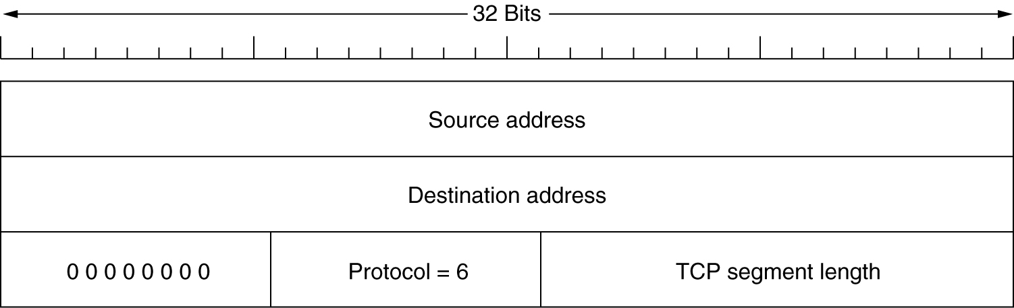
The TCP Segment Header (2)
The pseudoheader included in the TCP checksum.

Slide 99
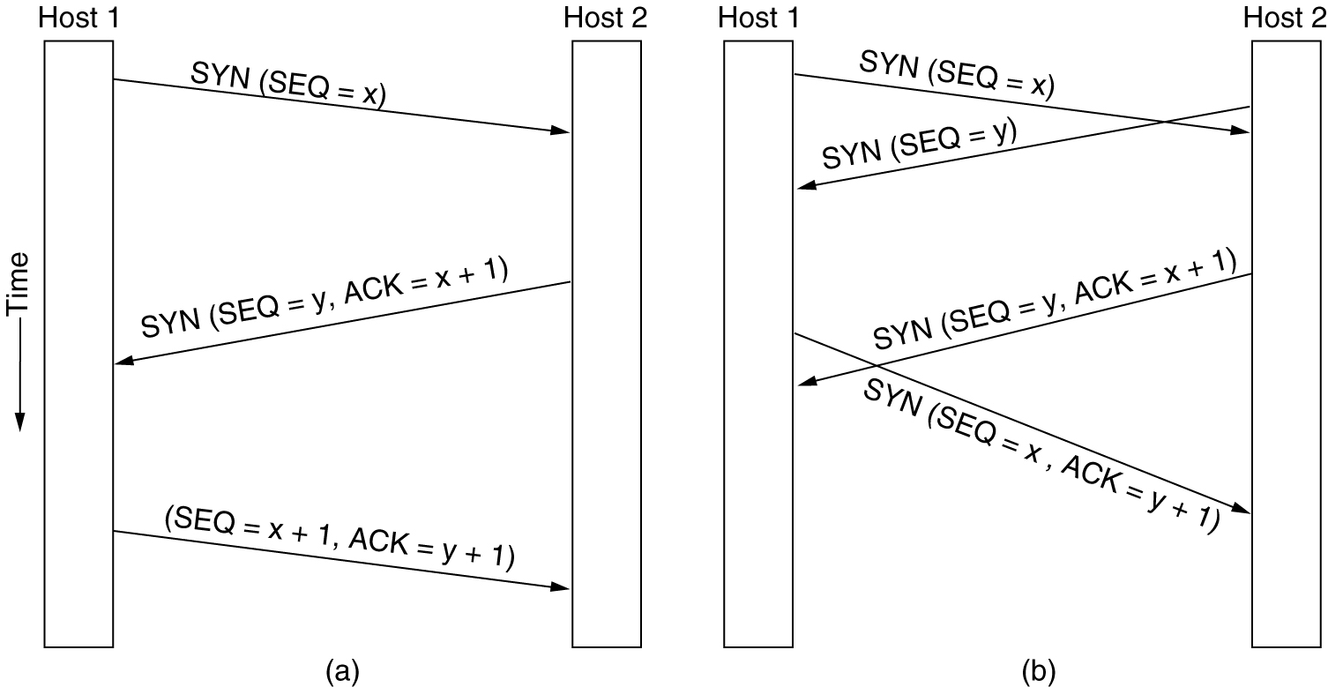
TCP Connection Establishment
6-31
(a) TCP connection establishment in the normal case.
(b) Call collision.

Slide 100
TCP Connection Establishment
Connections are established in TCP by means of the three-way handshake.
The server, passively waits for an incoming connection by executing the LISTEN and ACCEPT primitives.
The client, executes a CONNECT primitive, specifying the
IP address and port to which it wants to connect, the maximum TCP segment size it is willing to accept, and optionally some user data
The CONNECT primitive sends a TCP segment with the SYN bit on and ACK bit off and waits for a response.
When this segment arrives at the destination, the TCP entity there checks if there is a process that has done a LISTEN on the port or not.
If some process is listening to the port, that process is given the incoming TCP segment.

Slide 101
TCP Connection Establishment
It can either accept or reject the connection. If it accepts, an acknowledgement segment is sent back.
If not, it sends a reply with the RST bit on to reject the connection.
Two hosts simultaneously attempt to establish a connection
between the same two sockets.
The result of these events is that just one connection is established, not two, because connections are identified by their end points.

Slide 102
TCP Connection Establishment
However, a vulnerability with implementing the three-way handshake is that the listening process must remember its sequence number as soon it responds with its own SYN segment.
This means that a malicious sender can tie up resources on a host by sending a stream of SYN segments and never following through to complete the connection.
This attack is called a SYN flood, and it crippled many Web servers in the 1990s.
One way to defend against this attack is to use SYN cookies.
Instead of remembering the sequence number, a host chooses a cryptographically generated sequence number, puts it on the outgoing segment, and forgets it.

Slide 103
TCP Connection Establishment
If the three-way handshake completes, this sequence number (plus 1) will be returned to the host.
It can then regenerate the correct sequence number by running the same cryptographic function, as long as the inputs to that function are known, for example, the other host’s IP address and port, and a local secret.
This procedure allows the host to check that an acknowledged sequence number is correct without having to remember the sequence number separately.

Slide 104
TCP Connection Release
To release a connection, either party can send a TCP segment with the FIN bit set, which means that it has no more data to transmit.
When the FIN is acknowledged, that direction is shut down
for new data. Data may continue to flow indefinitely in the other direction, however.
When both directions have been shut down, the connection is released.
Normally, four TCP segments are needed to release a connection: one FIN and one ACK for each direction. However, it is possible for the first ACK and the second FIN to be contained in the same segment, reducing the total count to three.

Slide 105
TCP Connection Release
To avoid the two-army problem , timers are used.
If a response to a FIN is not forthcoming within two maximum packet lifetimes, the sender of the FIN releases the connection.
The other side will eventually notice that nobody seems to be listening to it anymore and will time out as well.

