Slide 1
Java OOPs Concepts

Slide 2
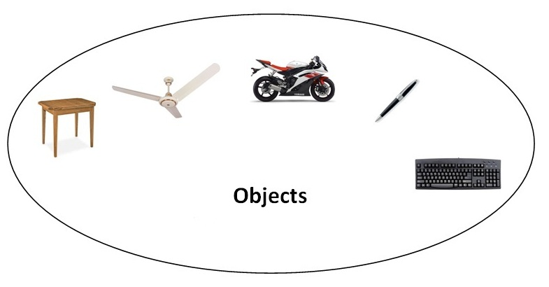
Object means a real word entity such as pen, chair, table etc.
Object-Oriented Programming is a methodology or paradigm to design a program using classes and objects.

Slide 3
OOPs Concepts
Object
Class
Inheritance
Polymorphism
Abstraction
Encapsulation

Slide 4
Object
Any entity that has state and behavior is known as an object. For example: chair, pen, table, keyboard, bike etc.
It can be physical and logical.
Class
Collection of objects is called class.
It is a logical entity.
Inheritance
When one object acquires all the properties and behaviors of parent object i.e. known as inheritance.
It provides code reusability. It is used to achieve runtime polymorphism.

Slide 5
Polymorphism
When one task is performed by different ways i.e. known as polymorphism.
For example: to convince the customer differently, to draw something e.g. shape or rectangle etc.
In java, we use method overloading and method overriding to achieve polymorphism.

Slide 6
Abstraction
Hiding internal details and showing functionality is known as abstraction.
For example: phone call, we don't know the internal processing.
In java, we use abstract class and interface to achieve abstraction.

Slide 7

Encapsulation
Binding (or wrapping) code and data together into a single unit is known as encapsulation. For example: capsule, it is wrapped with different medicines.
A java class is the example of encapsulation.

Slide 8
Advantages of OOPs over Procedure-oriented programming language
1)OOPs makes development and maintenance easier where as in Procedure-oriented programming language it is not easy to manage if code grows as project size grows.
2)OOPs provides data hiding whereas in Procedure-oriented programming language a global data can be accessed from anywhere.
3)OOPs provides ability to simulate real-world event much more effectively. We can provide the solution of real word problem if we are using the Object-Oriented Programming language.

Slide 9
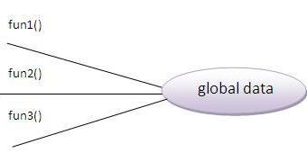
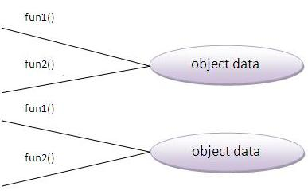
Advantage of OOPs over Procedure-oriented programming language

Slide 10
What is difference between object-oriented programming language and object-based programming language?
Object based programming language follows all the features of OOPs except Inheritance.
JavaScript and VBScript are examples of object based programming languages.
Java is a pure object oriented programming language.

Slide 11
Java Naming conventions
Java naming convention is a rule to follow as you decide what to name your identifiers such as class, package, variable, constant, method etc.
But, it is not forced to follow. So, it is known as convention not rule.
All the classes, interfaces, packages, methods and fields of java programming language are given according to java naming convention.
Advantage of naming conventions in java
By using standard Java naming conventions, you make your code easier to read for yourself and for other programmers.
It indicates that less time is spent to figure out what the code does.

Slide 12
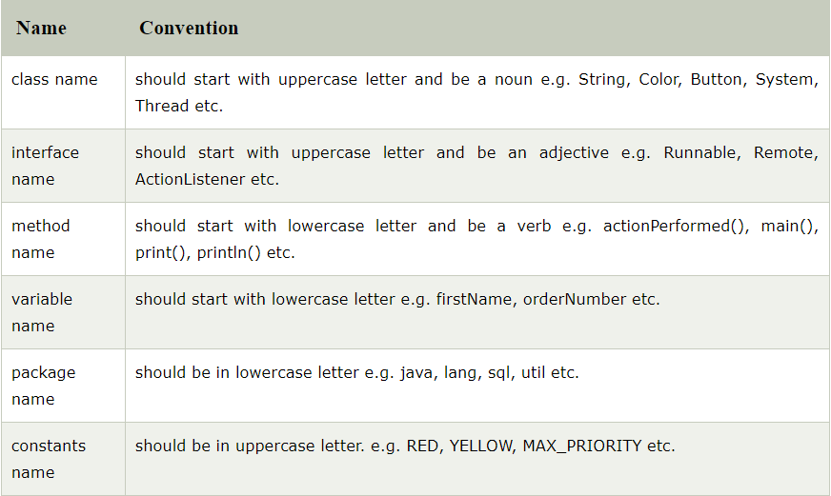
Naming conventions
If name is combined with two words, second word will start with uppercase letter always e.g. actionPerformed(), firstName, ActionEvent, ActionListener etc.

Slide 13
Object and Class in Java
Object is the physical as well as logical entity whereas class is the logical entity only.
An object has two characteristics:
state: represents data (value) of an object.
behavior: represents the behavior (functionality) of an object such as deposit, withdraw etc.
For Example: Pen is an object. Its name is Reynolds, color is white etc. known as its state.
It is used to write, so writing is its behavior.

Slide 14
Object is an instance of a class.
Class is a template or blueprint from which objects are created. So object is the instance(result) of a class.
Object Definitions:
Object is a real world entity.
Object is a run time entity.
Object is an entity which has state and behavior.
Object is an instance of a class.

Slide 15
Class in Java
A class is a group of objects which have common properties.
It is a template or blueprint from which objects are created. It is a logical entity. It can't be physical.
A class in Java can contain:
fields
methods
constructors
blocks
nested class and interface

Slide 16
Syntax to declare a class:
class <class_name>
{
fields;(Instance Variables)
methods;
}

Slide 17
Instance variable in Java
A variable which is created inside the class but outside the method, is known as instance variable.
Instance variable doesn't get memory at compile time.
It gets memory at run time when object(instance) is created. That is why, it is known as instance variable.

Slide 18
Method in Java
In java, a method is like function i.e. used to expose behavior of an object.
Advantage of Method
Code Reusability
Code Optimization

Slide 19
new keyword in Java
The new keyword is used to allocate memory at run time.
All objects get memory in Heap memory area.

Slide 20
Object and Class Example: main within class
Student.java
class Student
{
int id;//field or data member or instance variable
String name;
public static void main(String args[])
{
Student s1=new Student();//creating an object of Student
System.out.println(s1.id);//accessing member through reference variable
System.out.println(s1.name);
}
}
Output
0 null

Slide 21
Object and Class Example: main outside class
class Student TestStudent1.java
{
int id;
String name;
}
class TestStudent1
{
public static void main(String args[])
{
Student s1=new Student();
System.out.println(s1.id);
System.out.println(s1.name);
}
}
Output
0 null

Slide 22
3 ways to initialize object
There are 3 ways to initialize object in java.
By reference variable
By method
By constructor

Slide 23
1) Object and Class Example: Initialization through reference
Initializing object simply means storing data into object.
class Student
{
int id;
String name;
}
class TestStudent2
{
public static void main(String args[])
{
Student s1=new Student();
s1.id=101;
s1.name="Sonoo";
System.out.println(s1.id+" "+s1.name);//printing members with a white space
}
}
Output
101 Sonoo

Slide 24
multiple objects and store information in it through reference variable.
class Student
{
int id;
String name;
}
class TestStudent3
{
public static void main(String args[]){
//Creating objects
Student s1=new Student();
Student s2=new Student();
//Initializing objects
s1.id=101;
s1.name="Sonoo";
s2.id=102;
s2.name="Amit";
//Printing data
System.out.println(s1.id+" "+s1.name);
System.out.println(s2.id+" "+s2.name);
}
}
Output
101 Sonoo
102 Amit

Slide 25
2) Object and Class Example: Initialization through method
class Student
{
int rollno;
String name;
void insertRecord(int r, String n)
{
rollno=r;
name=n;
}
void displayInformation()
{
System.out.println(rollno+" "+name);
}
}
class TestStudent4
{
public static void main(String args[])
{
Student s1=new Student();
Student s2=new Student();
s1.insertRecord(1,"Kiran");
s2.insertRecord(2,"Arya");
s1.displayInformation();
s2.displayInformation();
}
}
1 Kiran
2 Arya

Slide 26
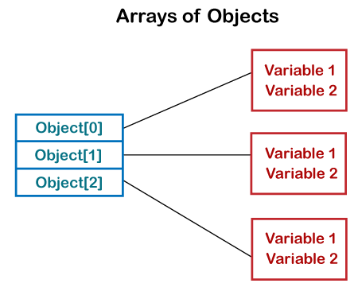
Array of Objects in Java
Java allows us to store objects in an array.
In Java, the class is also a user-defined data type.
An array that contains class type elements are known as an array of objects. It stores the reference variable of the object.

Slide 27
Example
// Creating a Student clas with
// id and name as a attributes
class Student {
public int id;
public String name;
public void setData(int id, String name)
{
this.id = id;
this.name = name;
}
public void display()
{
System.out.println("Student id is: " + id + " "+ "and Student name is: "+ name);
System.out.println();
}
}
class ArrayObj {
public static void main(String args[])
{
Student[] arr;
arr = new Student[2]; arr[0] = new Student();
arr[1] = new Student(); arr[0].setData(1, "SaiPavan");
arr[1].setData(2, "Madhav"); System.out.println("Student data in
student arr 0: ");
arr[0].display();
System.out.println("Student data in
student arr 1: ");
arr[1].display();
}
}

Slide 28
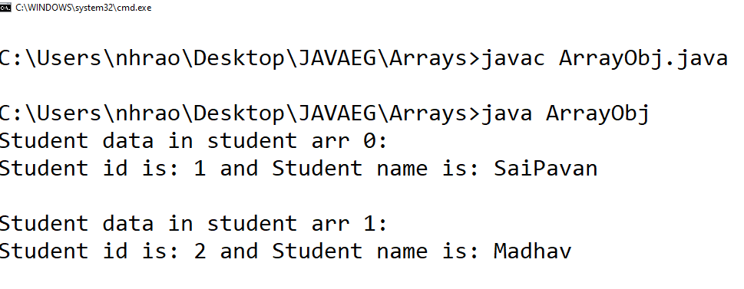
output

