Slide 1
UNIT-II Inheritance, Interfaces, Packages & Stings

Slide 2
Three Pillars of OOPS:

Slide 3
Inheritance
Inheritance is a mechanism in which one object acquires all the properties and behaviors of a parent object.
It is an important part of OOPs (Object Oriented programming system).
The idea behind inheritance in Java is that we can create new classes that are built upon existing classes.
When we inherit from an existing class, we can reuse methods and fields of the parent class.
We can add new methods and fields in our current class also.
Inheritance represents the IS-A relationship which is also known as a parent-child relationship.

Slide 4
Why inheritance in Java?
For Method Overriding (To implement runtime polymorphism can be achieved).
For Code Reusability.

Slide 5
Terms used in Inheritance
Class: A class is a group of objects which have common properties. It is a template or blueprint from which objects are created.
Sub Class/Child Class: Subclass is a class which inherits the other class. It is also called a derived class, extended class, or child class.
Super Class/Parent Class: Superclass is the class from where a subclass inherits the features. It is also called a base class or a parent class.
Reusability: As the name specifies, reusability is a mechanism which facilitates us to reuse the fields and methods of the existing class when you create a new class. We can use the same fields and methods already defined in the previous class.

Slide 6
The syntax of Java Inheritance
class Subclass-name extends Superclass-name
{
//methods and fields
}
The extends keyword indicates that we are making a new class that derives from an existing class.
The meaning of "extends" is to increase the functionality.

Slide 7
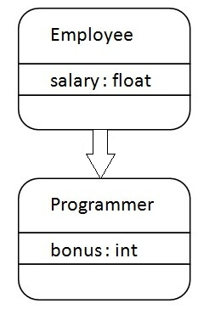
Example

Slide 8
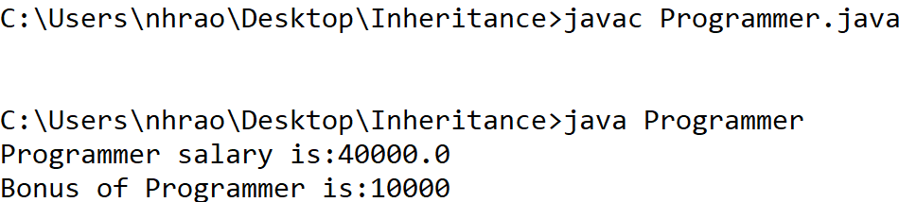
Program to demonstrate Inheritance
class Employee{
float salary=40000;
}
class Programmer extends Employee{
int bonus=10000;
public static void main(String args[]){
Programmer p=new Programmer();
System.out.println("Programmer salary is:"+p.salary);
System.out.println("Bonus of Programmer is:"+p.bonus);
}
}

Slide 9
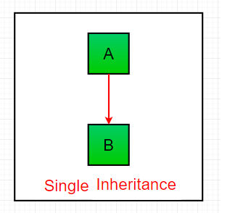
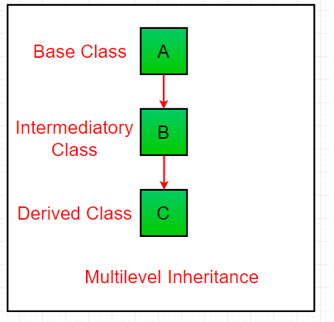
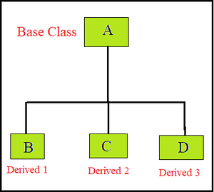
Types of Inheritance
Hierarchical Inheritance

Slide 10
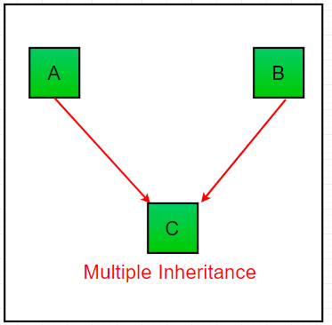
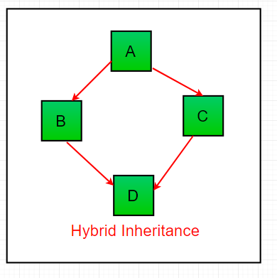
Multiple Inheritance & Hybrid Inheritance
Note: Multiple inheritance is not supported in Java through class.
Multiple and Hybrid inheritance is supported through interfaces only.

Slide 11
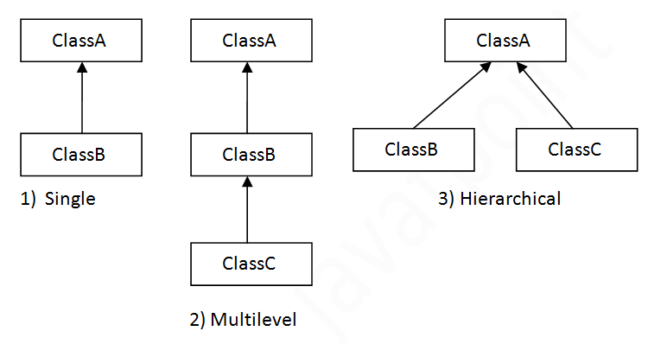
Types of inheritance in java

Slide 12
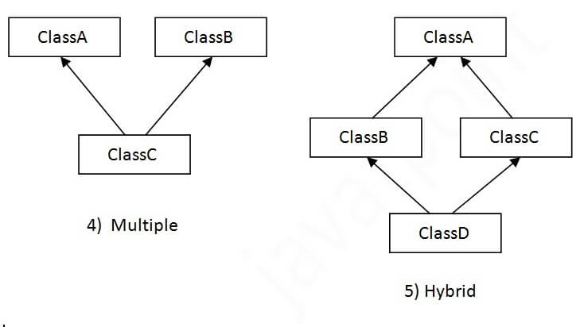
Multiple Inheritance & Hybrid Inheritance
Note: Multiple inheritance is not supported in Java through class.
Multiple and Hybrid inheritance is supported through interfaces only.

Slide 13
Single Inheritance Example
class Parent
{
String lastName="Nadendla";
void lastName()
{
System.out.println("LastName:="+lastName);
}
}
class Child extends Parent
{
String firstName="Hanu";
void firstName()
{
System.out.println("FirstName:="+firstName);
}
}
class SingleDemo
{
public static void main(String args[])
{
Child c=new Child();
c.firstName();
c.lastName();
Parent p=new Parent();
p.firstName(); //Compile time error
p.lastName();
}
}

Slide 14
Multi Level Inheritance
import javax.swing.JOptionPane;
class Student
{
int rno;
void readRno()
{
rno=Integer.parseInt(JOptionPane.showInput
Dialog("Enter RollNo"));
}
void printRno()
{
System.out.println("RollNo= "+rno);
}
}
class Exam extends Student
{
int m1,m2,m3;
void readMarks()
{
readRno();
m1=Integer.parseInt(JOptionPane.showInput
Dialog("Enter m1"));
m2=Integer.parseInt(JOptionPane.showInput
Dialog("Enter m2"));
m3=Integer.parseInt(JOptionPane.showInput
Dialog("Enter m3"));
}
void printMarks()
{
printRno();
System.out.println("m1= "+m1);
System.out.println("m2= "+m2);
System.out.println("m3= "+m3);
}
}
class Result extends Exam
{
float avg;
void printResult()
{
printMarks();
avg=(m1+m2+m3)/3;
System.out.println("Average= "+Math.round(avg));
if(avg<40)
System.out.println("FAIL");
if(avg>=40 && avg<50)
System.out.println("THIRD CLASS");
if(avg>=50 && avg<60)
System.out.println("SECOND CLASS");
if(avg>=60 && avg<70)
System.out.println("FIRST CLASS");
if(avg>=70)
System.out.println("DISTINCTION");
}
}
class MulLevInh
{
public static void main(String args[])
{
Result r=new Result();
r.readMarks();
r.printResult();
}
}

Slide 15
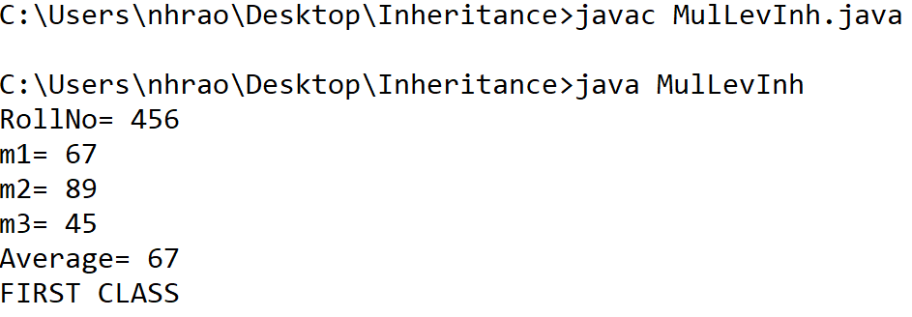
output

Slide 16
Hierarchical Inheritance Example
class Employee{
float salary = 40000;
void dispSalary()
{
System.out.println("The Employee salary is :" +salary);
}
}
class PermanentEmp extends Employee{
double hike = 0.5;
void incrementSalary()
{
super.dispSalary();
System.out.println("The Permanent Employee incremented
salary is :" +(salary+(salary * hike)) );
}
}
class TemporaryEmp extends Employee{
double hike = 0.35;
void incrementSalary()
{
super.dispSalary();
System.out.println("The Temporary Employee incremented salary is :" +(salary+(salary * hike)) );
}
}
class HerInheritanceDemo
{
public static void main(String args[]){
PermanentEmp p = new PermanentEmp();
TemporaryEmp t = new TemporaryEmp();
p.incrementSalary();
t.incrementSalary();
}
}

Slide 17
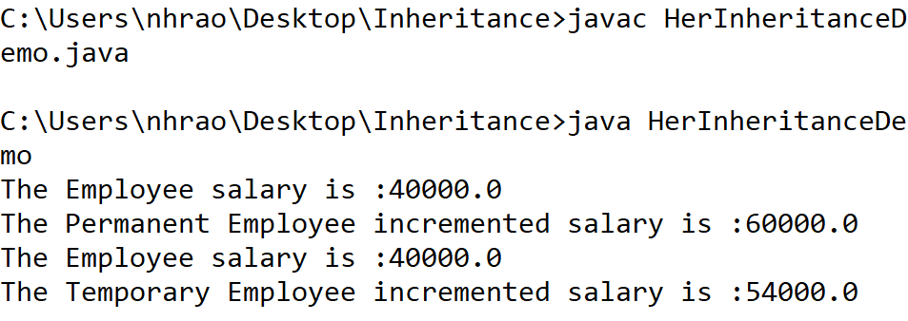
output

