Slide 1
Collections Framework in Java

Slide 2
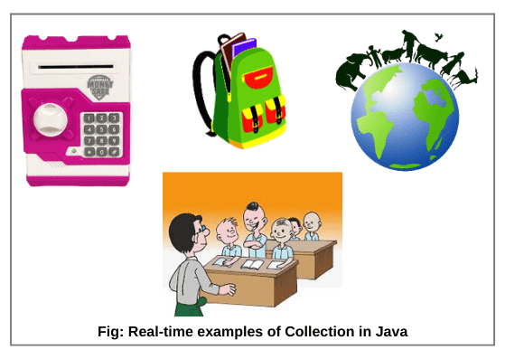
What is Collection in Java?
A collection is a group of objects.
In Java, these objects are called elements of the collection.

Slide 3
Technically, a collection is an object or container which stores a group of other objects as a single unit or single entity.
Therefore, it is also known as container object or collection object in java.
A container object means it contains other objects. In simple words, a collection is a container that stores multiple elements together.
JVM (Java Virtual Machine) stores the reference of other objects into a collection object.
It never stores physical copies of other objects because other objects are already available in the memory and storing another copy of objects into a collection object would be a wasting of memory.

Slide 4
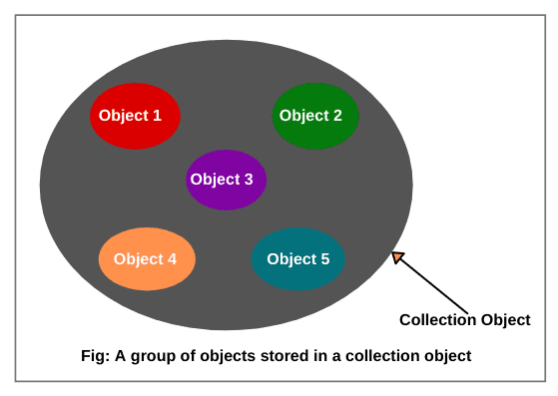
A group of objects stored in a collection object

Slide 5
A collection object has a class that is known as collection class or container class.
All collection classes are present in java.util package.
util stands for utility.
A group of collection classes is called collections framework in java.

Slide 6
A simple example of a collection:
// Create a container list of cities (objects or elements).
List<String> cities = new ArrayList<String>();
// Adding names of cities.
cities.add(“New York”);
cities.add(“Dhanbad”);
cities.add(“Mumbai”);

Slide 7
Types of Objects Stored in Collection (Container) Object
There are two types of objects that can be stored in a collection or container object.
1. Homogeneous objects:
Homo means same. Homogeneous objects are a group of multiple objects that belong to the same class.
For example, suppose we have created three objects Student s1, Student s2, and Student s3 of the same class ‘Student’.
2. Heterogeneous objects:
Hetero means different. Heterogeneous objects are a group of different objects that belong to different classes.
For example, suppose we have created two different objects of different classes such as one object Student s1, and another one object Employee e1. Here, student and employee objects together are called a collection of heterogeneous objects.

Slide 8
Duplicate objects:
The multiple objects of a class that contains the same data are called duplicate objects.
For example,
Person p1 = new Person( "abc");
Person p2 = new Person("abc");
Person p1 and Person p2. Both of these objects have the same data.

Slide 9
Unique objects:
The multiple objects of a class that contains different data are called unique objects.
For example:
Person p1 = new Person("abcd");
Person p2 = new Person("abcde");

Slide 10
What is a framework in Java?
It provides readymade architecture.
It represents a set of classes and interfaces.
It is optional.

Slide 11
What is Collection framework?
The Collection framework represents a unified architecture for storing and manipulating a group of objects.
It has:
Interfaces and its implementations, i.e., classes
Algorithm

Slide 12
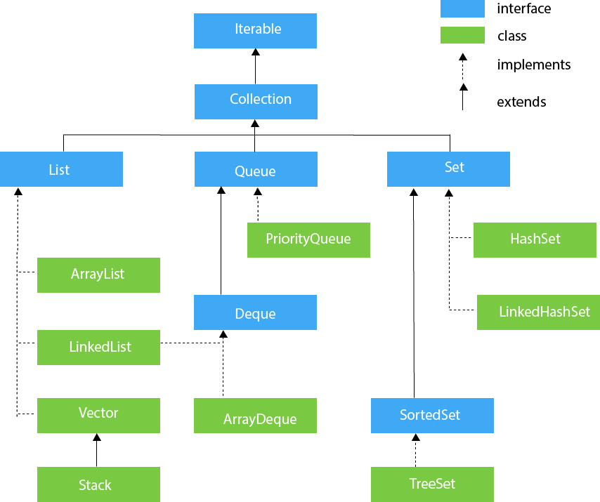
Hierarchy of Collection Framework
The java.util package contains all the classes and interfaces for the Collection framework.

Slide 13
Iterable Interface
The Iterable interface is the root interface for all the collection classes.
The Collection interface extends the Iterable interface and therefore all the subclasses of Collection interface also implement the Iterable interface.
It contains only one abstract method. i.e.,
Iterator<T> iterator()
It returns the iterator over the elements of type T.

Slide 14
Collection Interface
The Collection interface is the interface which is implemented by all the classes in the collection framework.
It declares the methods that every collection will have.

Slide 15
List Interface
List interface is the child interface of Collection interface.
It inhibits a list type data structure in which we can store the ordered collection of objects.
It can have duplicate values.
List interface is implemented by the classes ArrayList, LinkedList, Vector, and Stack.
List <data-type> list1= new ArrayList();
List <data-type> list2 = new LinkedList();
List <data-type> list3 = new Vector();
List <data-type> list4 = new Stack();

Slide 16
ArrayList
The ArrayList class implements the List interface.
It uses a dynamic array to store the duplicate element of different data types.
The ArrayList class maintains the insertion order and is non-synchronized.
The elements stored in the ArrayList class can be randomly accessed.

Slide 17
Example
import java.util.*;
class TestJavaCollection1{
public static void main(String args[]){
ArrayList<String> list=new ArrayList<String>();//Creating arraylist
list.add("Ravi");//Adding object in arraylist
list.add("Vijay");
list.add("Ravi");
list.add("Ajay");
//Traversing list through Iterator
Iterator itr=list.iterator();
while(itr.hasNext()){
System.out.println(itr.next());
}
}
}
Ravi
Vijay
Ravi
Ajay

