Slide 1
Aggregate Functions

Slide 2
Aggregate Functions
These functions operate on the multiset of values of a column of a relation, and return a value
avg: average value min: minimum value max: maximum value sum: sum of values count: number of values

Slide 3
Aggregate Functions (Cont.)
Find the average salary of instructors in the Computer Science department
select avg (salary) /* Can rename*/ from instructor where dept_name= ’Comp. Sci.’;
Find the total number of instructors who teach a course in the Spring 2010 semester
select count (distinct ID) from teaches where semester = ’Spring’ and year = 2010
Find the number of tuples in the course relation
select count (*) from course;

Slide 4
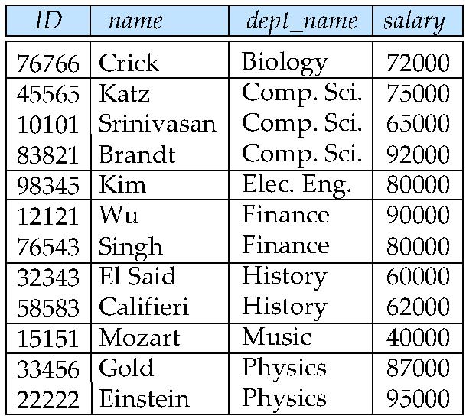
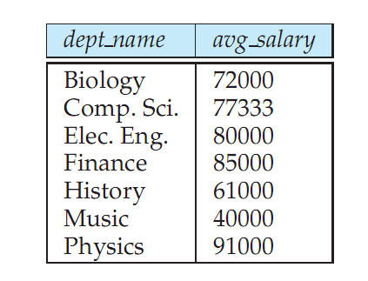
Aggregate Functions – Group By
Find the average salary of instructors in each department
select dept_name, avg (salary) from instructor group by dept_name;
Note: departments with no instructor will not appear in result

Slide 5
Aggregation (Cont.)
“Find the number of instructors in each department who teach a course in the Spring 2010 semester.”
select dept name, count (distinct ID) as instr count
from instructor natural join teaches
where semester = ’Spring’ and year = 2010
group by dept name;
Attributes in select clause outside of aggregate functions must appear in group by list
/* erroneous query bcoz ID is appeared in the select clause but not in group by*/ select dept_name, ID, avg (salary) from instructor group by dept_name;

Slide 6
Aggregate Functions – Having Clause
Find the names and average salaries of all departments whose average salary is greater than 42000
select dept_name, avg (salary)
from instructor
group by dept_name
having avg (salary) > 42000;
Note: predicates in the having clause are applied after the formation of groups whereas predicates in the where clause are applied before forming groups

Slide 7
Both Having and Where
For each course section offered in 2009, find the average total credits (tot cred) of all students enrolled in the section, if the section had at least 2 students.”
select course id, semester, year, sec id, avg (tot cred)
from takes natural join student
where year = 2009
group by course id, semester, year, sec id
having count (ID) >= 2;

Slide 8
Null Values and Aggregates
Total all salaries
select sum (salary ) from instructor
Above statement ignores null amounts
Result is null if there is no non-null amount
All aggregate operations except count(*) ignore tuples with null values on the aggregated attributes
What if collection has only null values?
count returns 0
all other aggregates return null

