Slide 1

PL/SQL
An Introduction

Slide 2

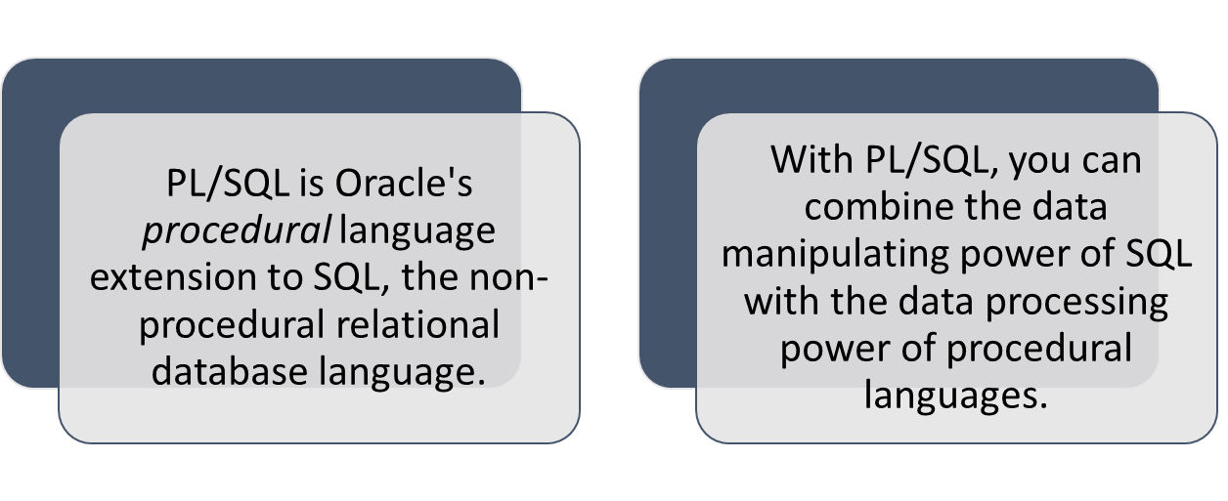
What is PL/SQL?

Slide 3
What is PL/SQL?
Many Oracle applications are built using client-server architecture. The Oracle database resides on the server.
The program that makes requests against this database resides on the client machine. (This program can be written in C, Java, or PL/SQL.)
While PL/SQL is not a stand-alone programming language. It is a part of the Oracle RDBMS, and it can reside in two environments, the client and the server.

Slide 4
Difference between PL/SQL and SQL
When a SQL statement is issued on the client computer, the request is made to the database on the server, and the result set is sent back to the client.
As a result, a single SQL statement causes two trips on the network. If multiple SELECT statements are issued, the network traffic increase significantly very fast. For example, four SELECT statements cause eight network trips.
If these statements are part of the PL/SQL block, they are sent to the server as a single unit. The SQL statements in this PL/SQL program are executed at the server and the result set is sent back as a single unit. There is still only one network trip made as is in case of a single SELECT statement.

Slide 5
PL/SQL Blocks
PL/SQL blocks can be divided into two groups:
  Named and
  Anonymous.
Named blocks are used when creating subroutines. These subroutines are procedures, functions, and packages.
The subroutines can be stored in the database and referenced by their names later on.
Anonymous PL/SQL blocks do not have names. As a result, they cannot be stored in the database and referenced later.

Slide 6
PL/SQL Block Structure
PL/SQL blocks contain three sections
  Declare section
  Executable section and
  Exception-handling section.
The executable section is the only mandatory section of the block.
Both the declaration and exception-handling sections are optional.

Slide 7
PL/SQL BLOCK STRUCTURE
PL/SQL block has the following structure:
  DECLARE
  Declaration statements
  BEGIN
  Executable statements
  EXCETION
  Exception-handling statements
  END ;

Slide 8
Declaration Section
The declaration section contains definitions of PL/SQL identifiers such as variables, constants, cursors and so on.
Example
  DECLARE
  v_first_name VARCHAR2(35) ;
  v_last_name VARCHAR2(35) ;
  v_counter NUMBER := 0 ;

Slide 9
Executable Section
The executable section contains executable statements that allow you to manipulate the variables that have been declared in the declaration section.
  BEGIN
  SELECT first_name, last_name
  INTO v_first_name, v_last_name
  FROM student
  WHERE student_id = 123 ;
  DBMS_OUTPUT.PUT_LINE
  (‘Student name :’ || v_first_name ||‘ ’|| v_last_name);
  END;

Slide 10
Exception-Handling Section
The exception-handling section contains statements that are executed when a runtime error occurs within a block.
Runtime errors occur while the program is running and cannot be detected by the PL/SQL compiler.
  EXCEPTION
  WHEN NO_DATA_FOUND THEN
  DBMS_OUTPUT.PUT_LINE
  (‘ There is no student with student id 123 ’)
  END;

Slide 11
Executing a PL/SQL Program in SQL*Plus
Open text editor using ed in SQL*Plus
Type the program
Save the program with .sql extension in your user
To execute a PL/SQL program, type the following command at the SQL prompt:
  SQL> @Z:\plsql\DisplayAge.sql

Slide 12
Generating Output
Like other programming languages, PL/SQL provides a procedure (i.e. PUT_LINE) to allow the user to display the output on the screen. For a user to able to view a result on the screen, two steps are required.
First, before executing any PL/SQL program, type the following command at the SQL prompt (Note: you need to type in this command only once for every SQL*PLUS session):
  SQL> SET SERVEROUTPUT ON;
or put the command at the beginning of the program, right before the declaration section.

Slide 13
Generating Output (Contd.,)
Second, use DBMS_OUTPUT.PUT_LINE in your executable section to display any message you want to the screen.
Syntax for displaying a message:
  DBMS_OUTPUT.PUT_LINE(<string>);
in which PUT_LINE is the procedure to generate the output on the screen, and DBMS_OUTPUT is the package to which the PUT_LINE belongs.
  DBMS_OUTPUT.PUT_LINE(‘My age is ‘ || num_age);

Slide 14
Variables
Variables are
  Used to store numbers, character strings, dates, and other data values
  Avoid using keywords, table names and column names as variable names
  Must be declared with data type before use:
    variable_name data_type_declaration;

Slide 15
Reference Variables
Reference variables directly reference a specific database field or record and assume the data type of the associated field or record
  %TYPE: same data type as a database field
  %ROWTYPE: same data type as a database record
    t_eno emp.eno%type;
    t_emp emp%rowtype;

Slide 16
%ROWTYPE Example
DECLARE
d dept%ROWTYPE;
BEGIN
SELECT deptno,dname,loc INTO d FROM dept WHERE deptno=10;
DBMS_OUTPUT.PUT_LINE(d.dname);
END;

Slide 17
Substitution Variables
SQL*Plus allows a PL/SQL block to receive input information with the help of substitution variables.
Substitution variables cannot be used to output the values because no memory is allocated for them.
Substitution variables are usually prefixed by the ampersand(&) character.
  v_student_id NUMBER := &sv_student_id;
When this example is executed, the user is asked to provide a value for the student ID.

Slide 18
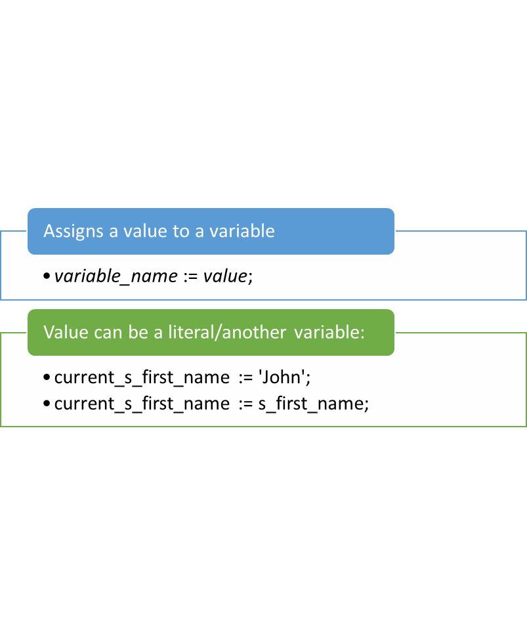
Assignment Statements

Slide 19
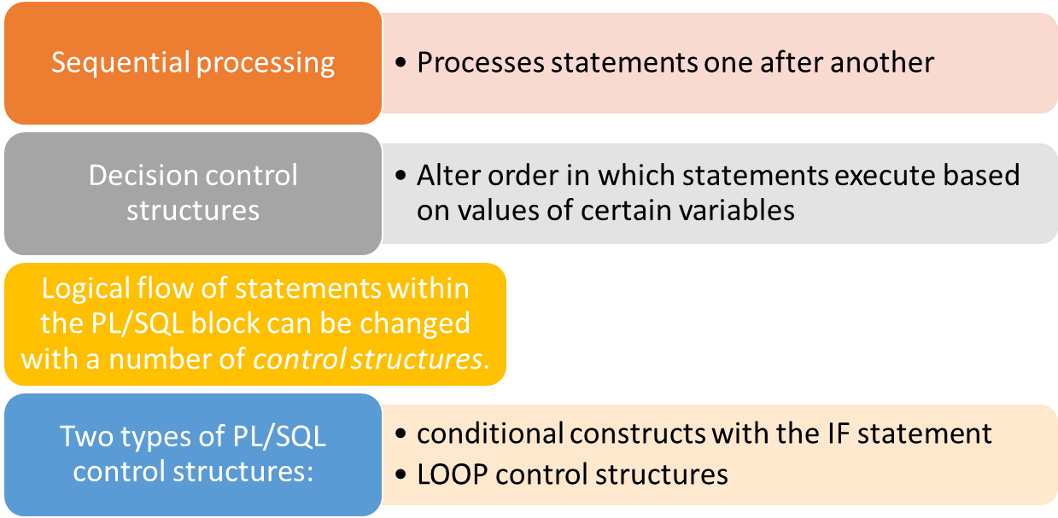
Decision Control Structures

Slide 20
IF Statements
Syntax
IF condition1 THEN
commands that execute if condition1 is TRUE;
ELSIF condition2 THEN
commands that execute if condition2 is TRUE;
ELSIF condition3 THEN
commands that execute if condition3 is TRUE;
...
ELSE
commands that execute if none of the
conditions are TRUE;
END IF;

Slide 21
Types of IF Statemnets
Simple IF statement:
  Set the manager ID to 22 if the employee name is Osborne.
    IF v_ename = 'OSBORNE' THEN v_mgr := 22;
    END IF;
  Set the job title to Salesman, the department number to 35, and the commission to 20% of the current salary if the last name is Miller
    IF v_ename = 'MILLER' THEN
    v_job := 'SALESMAN';
    v_deptno := 35;
    v_new_comm := sal * 0.20;
    END IF;

Slide 22
Types of IF Statemnets
IF-THEN-ELSE Statements
  Set a flag for orders where there are fewer than five days between order date and ship date.
  IF v_shipdate - v_orderdate < 5 THEN
    v_ship_flag := 'Acceptable';
    ELSE
    v_ship_flag := 'Unacceptable';
    END IF;

Slide 23
Types of IF Statemnets
Nested IF Statement
  For a given value, calculate a percentage of that value based on a condition.
  IF v_start > 100 THEN
    v_start := 2 * v_start;
    ELSIF v_start >= 50 THEN
    v_start := .5 * v_start;
    ELSE
    v_start := .1 * v_start;
    END IF;

Slide 24
Null in Expressions and Comparisons
You can handle null values with the IS NULL operator.
Any arithmetic expression containing a null value evaluates to NULL.
Concatenated expressions with null values treat null values as an empty string.
NULL acts as False
The IS NULL condition evaluates to TRUE only if the variable it is checking is NULL.

Slide 25
Loop Statements
Loops repeat a statement or sequence of statements multiple times.
There are three types of loop statements:
  Basic loop
  FOR loop
  WHILE loop

Slide 26
Basic Loop
Syntax
  LOOP
  statement1;
  . . .
  EXIT [WHEN condition];
  END LOOP;
A basic loop can contain multiple EXIT statements.

Slide 27
An Example
  DECLARE
  v_ordid item.ordid%TYPE := 601;
  v_counter NUMBER(2) := 1;
  BEGIN
  LOOP
  INSERT INTO item(ordid, itemid)
  VALUES(v_ordid, v_counter);
  v_counter := v_counter + 1;
  EXIT WHEN v_counter > 10;
  END LOOP;
  END;

Slide 28
FOR Loop
Syntax
  FOR counter in [REVERSE]
  lower_bound..upper_bound LOOP
  statement1;
  statement2;
  . . .
  END LOOP;
Do not declare the counter; it is declared implicitly.
The lower bound and upper bound of the loop range can be literals, variables, or expressions, but must evaluate to integers
Do not reference the counter as the target of an assignment. An error message rises if you do so.

Slide 29
An Example
  DECLARE
  v_ordid item.ordid%TYPE := 601;
  BEGIN
  FOR i IN 1..10 LOOP
  INSERT INTO item(ordid, itemid)
  VALUES(v_ordid, i);
  END LOOP;
  END;

Slide 30
WHILE Loop
Syntax
  WHILE condition LOOP
  statement1;
  statement2;
  . . .
  END LOOP;

Slide 31
An Example
  DECLARE
  v_count NUMBER(2) := 1;
  num_depts NUMBER := &num_depts ;
  BEGIN
  WHILE v_count <= num_depts LOOP
  INSERT INTO dept(deptno,dname)
  VALUES (v_count, &v_dept_name);
  v_count := v_count + 1;
  END LOOP;
  COMMIT;
  END;

Slide 32
PL/SQL Cursors

Slide 33
What is a Cursor?
A cursor is a temporary work area created in the system memory when an SQL statement is executed.
This temporary work area is used to store the data retrieved from the database, and manipulate this data.
A cursor can hold more than one row, but can process only one row at a time.
There are two types of cursors in PL/SQL:
  Implicit cursors:
  Explicit cursors:
Both implicit and explicit cursors have the same functionality, but they differ in the way they are accessed.

Slide 34
Implicit cursors
The name of implicit cursor is SQL
These are created by default when DML statements like, INSERT, UPDATE, and DELETE statements are executed.
They are also created when a SELECT statement that returns just one row is executed.
The purpose is to check whether the last DML is executed successful or failed.
Oracle provides few attributes called as implicit cursor attributes to check the status of DML operations.

Slide 35
Implicit Cursor Attributes
%found: Identifies whether the fetch executed on the cursor return a row. Returns true/False
%notfound : Identifies whether the fetch executed on the cursor did not return a row.
%rowcount: Identifies the number of records (rows) that were processed by this cursor.
Usage Eg: SQL%found, SQL%notfound, SQL%rowcount
%isopen: Identifies whether the cursor referred to is opened and ready for use.

Slide 36
Example
Declare
x emp.empno%type;
Begin
X= &empno;
Delete from emp where empno=x;
Commit;
End;
SQL> Enter value for empno: 1111
PL/SQL procedure executed successfully
Enter value for empno: 2222
PL/SQL procedure executed successfully

Slide 37
Declare
x emp.empno%type;
Begin
X= &empno;
Delete from emp where empno=x;
if SQL%found then
Dbms_output.put_line(‘record deleted’);
Else
Dbms_output.put_line(‘No such employee’);
End if;
Commit;
End;

Slide 38
SQL> Enter value for empno: 1111
Record Deleted
PL/SQL procedure executed successfully
Enter value for empno: 2222
No such record
PL/SQL procedure executed successfully

Slide 39
An Example
DECLARE var_rows number(5);
BEGIN
UPDATE employee SET salary = salary + 1000;
IF SQL%NOTFOUND THEN dbms_output.put_line('None of the salaries were updated');
ELSIF SQL%FOUND THEN
var_rows := SQL%ROWCOUNT; dbms_output.put_line('Salaries for ' || var_rows || 'employees are updated');
END IF;
END;

Slide 40
Explicit cursors
In PL/SQL, when we want to process multiple records we will use explicit cursor;
They must be created when you are executing a SELECT statement that returns more than one row.
Even though the cursor stores multiple records, only one record can be processed at a time, which is called as current row.

Slide 41
Explicit cursors
To use cursors we have to follow the following steps:
Declare cursor
Open cursor
Fetch records from table
Close the cursor

Slide 42
Declaration:
Always declared with a select statement;
Eg: Cousor c1 is select * from emp;
In declaration data is not loaded. The data is loaded only when we open a cursor.
Open coursor name:
Open c1;
Select statement is send to server.
The data is loaded in to some temporary memory area.
This is called PGA (Program Global Area)

Slide 43
Fetch: Using Fetch the data is copied from temporory memory area to PL/SQL
Fetch <Cursor_name> into <variables>;
Close <Cursor_name>
Close c1;

Slide 44
Declare
cursor c1 is select ename, sal from emp;
vename emp.ename%type;
vsal emp.sal%type;
Begin
Open c1;
loop
Fetch c1 into vanme, vsal ;
Exit when c1%notfound;
Dbms_output.put_line(vname||’ ‘||vsal);
End loop;
Close c1;
end;

Slide 45
An Example
DECLARE
myempid number;
mysal number;
CURSOR emp_crsr IS
SELECT empid, salary FROM employee;
BEGIN
OPEN emp_crsr;
LOOP
FETCH emp_crsr INTO myempid, mysal;
EXIT WHEN emp_crsr%NOTFOUND;
if myempid = 10 or myempid = 30 then
UPDATE employee SET salary = mysal + 5000 WHERE empid = myempid;
else
UPDATE emp SET salary = mysal + 1111 WHERE empid = myempid;
end if;
END LOOP;
END;

Slide 46
Exception Handling

Slide 47
Types of Exceptions
Named system exceptions.
Named programmer-defined exceptions.
Unnamed system exceptions.
Unnamed programmer-defined exceptions.

Slide 48
Named system exceptions
The exceptions which are already given names by PL/SQL are declared in the STANDARD package in PL/SQL.
You do not have to declare them in your own programs.
Example
  EXCEPTION
  WHEN CURSOR_ALREADY_OPEN
  THEN
  CLOSE my_cursor;
  END;

Slide 49
Some Predefined (System Defined) Exceptions in PL/SQL
ZERO_DIVIDE
VALUE_ERROR
INVALID_NUMBER
NO_DATA_FOUND
TOO_MANY_ROWS
Dup_Val_on_Index
CURSOR_ALREADY_OPEN
INVALID_CURSOR

Slide 50
Zero_Divide: Trying to divide a number by Zero
VALUE_ERROR: If the data type or size is mis-matched or exceeds.
Eg: x number(3); ---- 10000
x number(4)= ‘abc’; ---- type mismatch
Invalid_number: This raises when we are trying to perform the invalid mathematical operation.
Eg1: Sysdate +10; Eg: 06-FEB-2022 +10; 10 days ahead is added
Eg2: ‘06-FEB-2022’ +10 // String +number is invalid

Slide 51
No_data_found: Raises when data not found in the table
Eg1: Veno:=&empno;
Vename emp.ename%type;
Select ename into vename
From emp
Where empno=vno;

Slide 52
An Example
Declare
sal emp.salary%type;
BEGIN
select salary into sal from emp where eno = 1;
EXCEPTION
WHEN TOO_MANY_ROWS THEN
DBMS_OUTPUT.PUT_LINE(‘MORE THAN ONE ROW SELECTED…’ );
WHEN OTHERS THEN
DBMS_OUTPUT.PUT_LINE(‘OTHER TYPE OF ERROR HAS OCCURED…’ );
END;

Slide 53
User Defined Exceptions
Errors that are specific to the application program which are not handled by the system defined exceptions.
For User-Defined Exception can be raised in two ways.
Raise Exception: Raise my own exception and want to handle it
Raise_application_Error: Raised with the help of a code.
Raise the exception and don’t want to handle it.
the programmer should
  Name the Exception by declaring it in the declaration section of PL/SQL block.
  Check for the error and raise the exception
  Handle the exception

Slide 54
Example
Declare
a number(5);
b number(5);
C number(2);
One_divide Exception;
Begin
a:=&a;
b:=&b;
If b=1 then raise one_divide;
End if;
c:=a/b;
Dbms_output.put_line(c) ;

Slide 55
Exception
When zero_divide then
Dbms_output.put_line(‘Zero divide error’) ;
When one_divide then
Dbms_output.put_line(‘One divide error’) ;
When others then
Dbms_output.put_line(‘ Other error’) ;
End;

Slide 56
An Example
Declare
negative_salary EXCEPTION;
sal emp.salary%type;
BEGIN
select salary into sal from emp where eno = 1;
if (sal < 0) then
RAISE negative_salary;
else
DBMS_OUTPUT.PUT_LINE(‘Salary =‘||sal);
end if;
EXCEPTION
WHEN negative_salary THEN
DBMS_OUTPUT.PUT_LINE(‘INVALID SALARY…’ );
UPDATE EMP SET SALARY = 0 WHERE ENO = 1;
END;

Slide 57
Unnamed System Exceptions
It is an internal error raised by PL/SQL or the SQL engine, which is not given a predefined name
It is identified only by its internal error number
exception handlers need a name by which they can check for a match
Programmer can assign a name to that error that might be raised in his program and then write a specific exception handler for that custom-named exception.
The pragma EXCEPTION_INIT tells the compiler to associate an exception name with an Oracle error number.

Slide 58
An Example
DECLARE
e_MissingNull EXCEPTION;
PRAGMA EXCEPTION_INIT(e_MissingNull, -1400);
BEGIN
INSERT INTO Employee (id) VALUES (NULL)
EXCEPTION
WHEN e_MissingNull then
DBMS_OUTPUT.put_line('ORA-1400 occurred');
DBMS_OUTPUT.put_line(‘Can not insert null for ID’);
END;

Slide 59
Unnamed Programmer-Defined Exceptions
procedure RAISE_APPLICATION_ERROR lets you issue user-defined ORA- error messages from stored subprograms.
That way, you can report errors to your application and avoid returning unhandled exceptions.
Syntax for calling RAISE_APPLICATION_ERROR procedure is
raise_application_error(error_number, message);
error_number is a negative integer in the range -20000 .. -20999 and message is a character string up to 2048 bytes long.

Slide 60
An Example
DECLARE num_tables NUMBER;
BEGIN
SELECT COUNT(*) INTO num_tables FROM USER_TABLES;
IF num_tables < 1000 THEN raise_application_error(-20101, 'Expecting at least 1000 tables');
END IF;
END;

Slide 61
Functions & Procedures

Slide 62
A subprogram is a program unit/module that performs a particular task.
These subprograms are combined to form larger programs. This is basically called the 'Modular design'.
A subprogram can be invoked by another subprogram or program which is called the calling program.
PL/SQL subprograms are named PL/SQL blocks that can be invoked with a set of parameters. PL/SQL provides two kinds of subprograms −
Functions − These subprograms return a single value; mainly used to compute and return a value.
Procedures − These subprograms do not return a value directly; mainly used to perform an action.

Slide 63
Stored Procedures
Procedures are named PL/SQL blocks that are made up of:
  A declarative part
  An executable part, and
  An optional exception-handling part

Slide 64

Syntax for creating a Procedure
CREATE [or REPLACE]
PROCEDURE [user name] procedurename (
Arguementname [IN / OUT / IN OUT] datatype ,
Arguementname [IN / OUT / IN OUT] datatype ,… ) [IS / AS]
variable declarations
BEGIN
PL/SQL statements
EXCEPTION
exception section statements
END;

Slide 65
procedure-name specifies the name of the procedure.
[OR REPLACE] option allows the modification of an existing procedure.
The optional parameter list contains name, mode and types of the parameters. IN represents the value that will be passed from outside and OUT represents the parameter that will be used to return a value outside of the procedure.
procedure-body contains the executable part.
The AS keyword is used instead of the IS keyword for creating a standalone procedure.

Slide 66
An Example Procedure
PROCEDURE swapn(num_one IN OUT NUMBER,
num_two IN OUT NUMBER) IS
temp_num NUMBER;
BEGIN
temp_num := num_one;
num_one := num_two;
num_two := temp_num ;
END;

Slide 67
An Example Procedure
CREATE PROCEDURE FACT (n in number, f out number) AS
a number := 1;
b number;
BEGIN
b := n;
WHILE (b > 1) LOOP
a := a*b;
b := b-1;
END LOOP;
f := a;
END;

Slide 68
Invoking FACT procedure
DECLARE
m number := &m;
n number;
BEGIN
FACT(m,n);
dbms_output.put_line(n);
END;

Slide 69
Another Example Procedure
PROCEDURE raise_sal(eid in number, increase in number) AS
current_sal emp.sal%type;
BEGIN
SELECT sal INTO current_sal FROM emp
WHERE empid = eid;
UPDATE emp SET sal = sal + increase
WHERE empid = eid;
END raise_sal;

Slide 70
Functions
CREATE [or REPLACE]
FUNCTION [user name] functionname (
Arguementname [IN] datatype ,
Arguementname [IN] datatype ,… ) RETURN datatype [IS / AS]
variable declarations
BEGIN
PL/SQL statements
END;

Slide 71
An Example Function
CREATE FUNCTION fact (n number) RETURN number AS
f number := 1;
a number := n;
BEGIN
WHILE (a > 1 ) LOOP
f := f * a;
a := a - 1;
END LOOP;
RETURN f;
END;

Slide 72
Invoking FACT function
DECLARE
m number := &m;
n number;
BEGIN
n := FACT(m);
dbms_output.put_line(n);
END;

Slide 73
Triggers
CS/IT 352: RDBMS Lab

Slide 74
Triggers are stored programs, which are automatically executed or fired when some events occur.
Triggers are, in fact, written to be executed in response to any of the following events −
A database manipulation (DML) statement (DELETE, INSERT, or UPDATE)
A database definition (DDL) statement (CREATE, ALTER, or DROP).
A database operation (SERVERERROR, LOGON, LOGOFF, STARTUP, or SHUTDOWN).

Slide 75
Database Triggers
Triggers are procedures that run implicitly when an INSERT, UPDATE, or DELETE statement is issued against the associated table or, in some cases, against a view, or when database system actions occur.
A trigger has three basic parts:
  A triggering event or statement
    It is an SQL statement or event that causes a trigger to fire.
  A trigger restriction
    A trigger restriction specifies a Boolean expression that must be true for the trigger to fire.
  A trigger action
    A trigger action is the procedure that contains the SQL statements and code to be run when the trigger fires.

Slide 76
Types of Triggers
ROW TRIGGERS and STATEMENT TRIGGERS
BEFORE and AFTER Triggers

Slide 77
Basic Trigger Syntax
CREATE [OR REPLACE] TRIGGER <trigger_name>
{BEFORE|AFTER} {INSERT|DELETE|UPDATE} ON <table_name>
[REFERENCING [NEW AS <new_row_name>] [OLD AS <old_row_name>]]
[FOR EACH ROW]
WHEN (<trigger_condition>)]]
<trigger_body>

Slide 78
Operations On Triggers
Displaying Trigger Definition Errors
show errors trigger <trigger_name>;
Viewing Defined Triggers
select trigger_name from user_triggers;
Disabling Triggers
alter trigger <trigger_name> {disable|enable};

Slide 79
Trigger Example
CREATE TABLE T4 (a INTEGER, b CHAR(10));
CREATE TABLE T5 (c CHAR(10), d INTEGER);
CREATE TRIGGER trig1
AFTER INSERT ON T4 REFERENCING NEW AS newRow
FOR EACH ROW WHEN (newRow.a <= 10)
BEGIN
INSERT INTO T5 VALUES(:newRow.b, :newRow.a);
END trig1;

Slide 80
Another Trigger Example
create table Person (age int);
CREATE TRIGGER PersonCheckAge
AFTER INSERT OR UPDATE OF age ON Person
FOR EACH ROW
BEGIN
IF (:new.age < 0) THEN
RAISE_APPLICATION_ERROR(-20000, 'no negative age allowed');
END IF;
END;

Slide 81
Output Of Executing Previous Example
If we attempted to execute the insertion:
insert into Person values (-3);
we would get the error message:
ERROR at line 1:
ORA-20000: no negative age allowed
ORA-06512: at "MYNAME.PERSONCHECKAGE", line 3
ORA-04088: error during execution of trigger 'MYNAME.PERSONCHECKAGE'
and nothing would be inserted. In general, the effects of both the trigger and the triggering statement are rolled back.

Slide 82
Yet Another Example Trigger
create table emp(eno number, name char(12), dno number,sal number);
create table auditemp(eno number, name char(12), dno number,sal number,d date);
create trigger emptri after update or delete on emp
for each row
declare
op varchar2(15); id number; name char(12); sal number; dno number;
begin
if updating then op := 'update';
end if;
if deleting then op := 'delete';
end if;

Slide 83
id := :old.eno;
name := :old.ename;
sal := :old.sal;
dno := :old.deptno;
insert into auditemp values(id,name,sal,dno,op,sysdate);
end;

Slide 84
Packages
CS/IT 352: RDBMS Lab

Slide 85


PL/SQL Packages: Overview
PL/SQL packages:
  Group logically related components:
    PL/SQL types
    Variables, data structures, and exceptions
    Subprograms: Procedures and functions
  Consist of two parts:
    A specification
    A body
  Enable the Oracle server to read multiple objects into memory at once
Notes:
PL/SQL Packages: Overview
PL/SQL packages enable you to bundle related PL/SQL types, variables, data structures, exceptions, and subprograms into one container. For example, a Human Resources package can contain hiring and firing procedures, commission and bonus functions, and tax exemption variables.
A package usually consists of two parts stored separately in the database:
A specification
A body (optional)
The package itself cannot be called, parameterized, or nested. After writing and compiling, the contents can be shared with many applications.
When a PL/SQL-packaged construct is referenced for the first time, the whole package is loaded into memory. Subsequent access to constructs in the same package do not require disk input/output (I/O).

Slide 86


Components of a PL/SQL Package
Package
specification
variable
Public
Procedure A declaration;
variable
Procedure B definition …
Procedure A definition
BEGIN
…
END;
Private
variable
Package
body
Notes:
Components of a PL/SQL Package
You create a package in two parts:
The package specification is the interface to your applications. It declares the public types, variables, constants, exceptions, cursors, and subprograms available for use. The package specification may also include PRAGMAs, which are directives to the compiler.
The package body defines its own subprograms and must fully implement subprograms declared in the specification part. The package body may also define PL/SQL constructs, such as types, variables, constants, exceptions, and cursors.
Public components are declared in the package specification. The specification defines a public application programming interface (API) for users of package features and functionality—that is, public components can be referenced from any Oracle server environment that is external to the package.
Private components are placed in the package body and can be referenced only by other constructs within the same package body. Private components can reference the package public components.
Note: If a package specification does not contain subprogram declarations, then there is no requirement for a package body.

Slide 87

Visibility of Package Components
Package
specification
public_var
Procedure A;
External
code
private_var
Procedure B IS
BEGIN … END;
Procedure A IS
BEGIN
…
END;
local_var
Package
body
Notes:
Visibility of Package Components
The visibility of a component describes whether that component can be seen, that is, referenced and used by other components or objects. The visibility of components depends on whether they are locally or globally declared.
Local components are visible within the structure in which they are declared, such as the following:
Variables defined in a subprogram can be referenced within that subprogram, and are not visible to external components—for example, local_var can be used in procedure A.
Private package variables, which are declared in a package body, can be referenced by other components in the same package body. They are not visible to any subprograms or objects that are outside the package. For example, private_var can be used by procedures A and B within the package body, but not outside the package.
Globally declared components are visible internally and externally to the package, such as:
A public variable, which is declared in a package specification, can be referenced and changed outside the package (for example, public_var can be referenced externally).
A package subprogram in the specification can be called from external code sources (for example, procedure A can be called from an environment external to the package).
Note: Private subprograms, such as procedure B, can be invoked only with public subprograms, such as procedure A, or other private package constructs.

Slide 88





Developing PL/SQL Packages
1
Edit
2
Load
spec.sql
3
Create (compile and store)
body.sql
Specification
4
Execute
Use SHOW ERRORS
for compilation errors.
Body
Notes:
Developing PL/SQL Packages
To develop a package, perform the following steps:
1. Edit the text for the specification by using the CREATE PACKAGE statement within a SQL script file. Edit the text for the body (only if required; see the guidelines below) by using the CREATE PACKAGE BODY statement within a SQL script file.
2. Load the script files into a tool such as iSQL*Plus.
3. Execute the script files to create (that is, to compile and store) the package and package body in the database.
4. Execute any public construct within the package specification from an Oracle server environment.
Guidelines for Developing Packages
Consider saving the text for a package specification and a package body in two different script files to facilitate easier modifications to the package or its body.
A package specification can exist without a package body—that is, when the package specification does not declare subprograms, a body is not required. However, a package body cannot exist without a package specification.
Note: The Oracle server stores the specification and body of a package separately. This enables you to change the implementation of a program construct in the package body without invalidating other schema objects that call or reference the program construct.

Slide 89
Creating the Package Specification
CREATE [OR REPLACE] PACKAGE package_name IS|AS
public type and variable declarations
subprogram specifications
END [package_name];
  The OR REPLACE option drops and re-creates the package specification.
  Variables declared in the package specification are initialized to NULL by default.
  All the constructs declared in a package specification are visible to users who are granted privileges on the package.
Notes:
Creating the Package Specification
To create packages, you declare all public constructs within the package specification.
Specify the OR REPLACE option, if overwriting an existing package specification.
Initialize a variable with a constant value or formula within the declaration, if required; otherwise, the variable is initialized implicitly to NULL.
The following are definitions of items in the package syntax:
package_name specifies a name for the package that must be unique among objects within the owning schema. Including the package name after the END keyword is optional.
public type and variable declarations declares public variables, constants, cursors, exceptions, user-defined types, and subtypes.
subprogram specification specifies the public procedure or function declarations.
Note: The package specification should contain procedure and function headings terminated by a semicolon, without the IS (or AS) keyword and its PL/SQL block. The implementation of a procedure or function that is declared in a package specification is done in the package body.

Slide 90
Example of Package Specification: comm_pkg
CREATE OR REPLACE PACKAGE comm_pkg IS
std_comm NUMBER := 0.10; --initialized to 0.10
PROCEDURE reset_comm(new_comm NUMBER);
END comm_pkg;
/
  STD_COMM is a global variable initialized to 0.10.
  RESET_COMM is a public procedure used to reset the standard commission based on some business rules. It is implemented in the package body.
Notes:
Example of Package Specification: comm_pkg
The example in the slide creates a package called comm_pkg used to manage business processing rules for commission calculations.
The std_comm public (global) variable is declared to hold a maximum allowable percentage commission for the user session, and it is initialized to 0.10 (that is, 10%).
The reset_comm public procedure is declared to accept a new commission percentage that updates the standard commission percentage if the commission validation rules are accepted. The validation rules for resetting the commission are not made public and do not appear in the package specification. The validation rules are managed by using a private function in the package body.

Slide 91
Creating the Package Body
Syntax:
  The OR REPLACE option drops and re-creates the package body.
  Identifiers defined in the package body are private and not visible outside the package body.
  All private constructs must be declared before they are referenced.
  Public constructs are visible to the package body.
CREATE [OR REPLACE] PACKAGE BODY package_name IS|AS
private type and variable declarations
subprogram bodies
[BEGIN initialization statements]
END [package_name];
Notes:
Creating the Package Body
Create a package body to define and implement all public subprograms and supporting private constructs. When creating a package body, perform the following steps:
Specify the OR REPLACE option to overwrite an existing package body.
Define the subprograms in an appropriate order. The basic principle is that you must declare a variable or subprogram before it can be referenced by other components in the same package body. It is common to see all private variables and subprograms defined first and the public subprograms defined last in the package body.
Complete the implementation for all procedures or functions declared in the package specification within the package body.
The following are definitions of items in the package body syntax:
package_name specifies a name for the package that must be the same as its package specification. Using the package name after the END keyword is optional.
private type and variable declarations declares private variables, constants, cursors, exceptions, user-defined types, and subtypes.
subprogram specification specifies the full implementation of any private and/or public procedures or functions.
[BEGIN initialization statements] is an optional block of initialization code that executes when the package is first referenced.

Slide 92
Example of Package Body: comm_pkg
CREATE OR REPLACE PACKAGE BODY comm_pkg IS
FUNCTION validate(comm NUMBER) RETURN BOOLEAN IS
max_comm employees.commission_pct%type;
BEGIN
SELECT MAX(commission_pct) INTO max_comm
FROM employees;
RETURN (comm BETWEEN 0.0 AND max_comm);
END validate;
PROCEDURE reset_comm (new_comm NUMBER) IS BEGIN
IF validate(new_comm) THEN
std_comm := new_comm; -- reset public var
ELSE RAISE_APPLICATION_ERROR(
-20210, 'Bad Commission');
END IF;
END reset_comm;
END comm_pkg;
Notes:
Example of Package Body: comm_pkg
The slide shows the complete package body for comm_pkg, with a private function called validate to check for a valid commission. The validation requires that the commission be positive and lesser than the highest commission among existing employees. The reset_comm procedure invokes the private validation function before changing the standard commission in std_comm. In the example, note the following:
The std_comm variable referenced in the reset_comm procedure is a public variable. Variables declared in the package specification, such as std_comm, can be directly referenced without qualification.
The reset_comm procedure implements the public definition in the specification.
In the comm_pkg body, the validate function is private and is directly referenced from the reset_comm procedure without qualification.
Note: The validate function appears before the reset_comm procedure because the reset_comm procedure references the validate function. It is possible to create forward declarations for subprograms in the package body if their order of appearance needs to be changed. If a package specification declares only types, constants, variables, and exceptions without any subprogram specifications, then the package body is unnecessary. However, the body can be used to initialize items declared in the package specification.

Slide 93
Invoking Package Subprograms
  Invoke a function within the same package:
  Invoke a package procedure from iSQL*Plus:
  Invoke a package procedure in a different schema:
CREATE OR REPLACE PACKAGE BODY comm_pkg IS ...
PROCEDURE reset_comm(new_comm NUMBER) IS
BEGIN
IF validate(new_comm) THEN
std_comm := new_comm;
ELSE ...
END IF;
END reset_comm;
END comm_pkg;
EXECUTE comm_pkg.reset_comm(0.15)
EXECUTE scott.comm_pkg.reset_comm(0.15)
Notes:
Invoking Package Subprograms
After the package is stored in the database, you can invoke public or private subprograms within the same package, or public subprograms if external to the package. Fully qualify the subprogram with its package name when invoked externally from the package. Use the package_name.subprogram syntax.
Fully qualifying a subprogram when invoked within the same package is optional.
Example 1: Invokes the validate function from the reset_comm procedure within the same package. The package name prefix is not required; it is optional.
Example 2: Calls the reset_comm procedure from iSQL*Plus (an environment external to the package) to reset the prevailing commission to 0.15 for the user session.
Example 3: Calls the reset_comm procedure that is owned in a schema user called SCOTT. Using iSQL*Plus, the qualified package procedure is prefixed with the schema name. This can be simplified by using a synonym that references the schema.package_name.
Assume that a database link named NY has been created for a remote database in which the reset_comm package procedure is created. To invoke the remote procedure, use:
EXECUTE comm_pkg.reset_comm@NY(0.15)

Slide 94
Creating and Using Bodiless Packages
CREATE OR REPLACE PACKAGE global_consts IS
mile_2_kilo CONSTANT NUMBER := 1.6093;
kilo_2_mile CONSTANT NUMBER := 0.6214;
yard_2_meter CONSTANT NUMBER := 0.9144;
meter_2_yard CONSTANT NUMBER := 1.0936;
END global_consts;
BEGIN DBMS_OUTPUT.PUT_LINE('20 miles = ' ||
20 * global_consts.mile_2_kilo || ' km');
END;
CREATE FUNCTION mtr2yrd(m NUMBER) RETURN NUMBER IS
BEGIN
RETURN (m * global_consts.meter_2_yard);
END mtr2yrd;
/
EXECUTE DBMS_OUTPUT.PUT_LINE(mtr2yrd(1))
Notes:
Creating and Using Bodiless Packages
The variables and constants declared within stand-alone subprograms exist only for the duration that the subprogram executes. To provide data that exists for the duration of the user session, create a package specification containing public (global) variables and constant declarations. In this case, create a package specification without a package body, known as a bodiless package. As discussed earlier in this lesson, if a specification declares only types, constants, variables, and exceptions, then the package body is unnecessary.
Examples
The first code box in the slide creates a bodiless package specification with several constants to be used for conversion rates. A package body is not required to support this package specification.
The second code box references the mile_2_kilo constant in the global_consts package by prefixing the package name to the identifier of the constant.
The third example creates a stand-alone function mtr2yrd to convert meters to yards, and uses the constant conversion rate meter_2_yard declared in the global_consts package. The function is invoked in a DBMS_OUTPUT.PUT_LINE parameter.
Rule to be followed: When referencing a variable, cursor, constant, or exception from outside the package, you must qualify it with the name of the package.

Slide 95
Removing Packages
  To remove the package specification and the body, use the following syntax:
  To remove the package body, use the following syntax:
DROP PACKAGE package_name;
DROP PACKAGE BODY package_name;
Notes:
Removing Packages
When a package is no longer required, you can use a SQL statement in iSQL*Plus to remove it. A package has two parts; therefore, you can remove the whole package, or you can remove only the package body and retain the package specification.

Slide 96
Viewing Packages in the Data Dictionary
The source code for PL/SQL packages is maintained and is viewable through the USER_SOURCE and ALL_SOURCE tables in the data dictionary.
  To view the package specification, use:
  To view the package body, use:
SELECT text
FROM user_source
WHERE name = 'COMM_PKG' AND type = 'PACKAGE';
SELECT text
FROM user_source
WHERE name = 'COMM_PKG' AND type = 'PACKAGE BODY';
Notes:
Viewing Packages in the Data Dictionary
The source code for PL/SQL packages is also stored in the data dictionary tables such as stand-alone procedures and functions. The source code is viewable in the data dictionary when you execute a SELECT statement on the USER_SOURCE and ALL_SOURCE tables.
When querying the package, use a condition in which the TYPE column is:
Equal to 'PACKAGE' to display the source code for the package specification
Equal to 'PACKAGE BODY' to display the source code for the package body
Note: The values of the NAME and TYPE columns must be uppercase.

Slide 97


