Slide 1
Chapter 3: Introduction to SQL

Slide 2
Chapter 3: Introduction to SQL
Overview of the SQL Query Language
Data Definition
Basic Query Structure
Additional Basic Operations
Set Operations
Null Values
Aggregate Functions
Nested Subqueries
Modification of the Database
Notes:
1

Slide 3
Overview of SQL Query Language
IBM developed original version of SQL (Sequel) language developed as part of System R project at the IBM San Jose Research Laboratory in the early 1970s.
Renamed Structured Query Language (SQL)
ANSI and ISO standard SQL: SQL-86 in the year 1986.
SQL-89, SQL-92, SQL:1999, SQL:2003, SQL:2008
Commercial systems offer most, if not all, SQL-92 features, plus varying feature sets from later standards and special proprietary features.

Slide 4
The SQL language has several parts:
Data-definition language (DDL).
-Provides commands for defining relation schemas, deleting relations, and modifying relation schemas.
Data-manipulation language (DML).
- commands for defining relation schemas, deleting relations, and modifying relation schemas.
Integrity
- The SQL DDL includes commands for specifying integrity constraints that the data stored in the database must satisfy. Updates that violate integrity constraints are disallowed.

Slide 5
View definition. The SQL DDL includes commands for defining views.
Transaction control. SQL includes commands for specifying the beginning and ending of transactions.
Embedded SQL and dynamic SQL. Embedded and dynamic SQL define how SQL statements can be embedded within general-purpose programming languages, such as C, C++, and Java.
Authorization. The SQL DDL includes commands for specifying access rights to relations and views.

Slide 6
Data Definition Language
The SQL data-definition language (DDL) allows the specification of information about relations, including:
The schema for each relation.
The domain of values associated with each attribute.
The Integrity constraints
And as we will see later, also other information such as
  The set of indices to be maintained for each relation.
  Security and authorization information for each relation.
  The physical storage structure of each relation on disk.

Slide 7
Basic Types in SQL
char(n). Fixed length character string, with user-specified length n.
varchar(n). Variable length character strings, with user-specified maximum length n.
int. Integer (a finite subset of the integers that is machine-dependent).
smallint. Small integer (a machine-dependent subset of the integer domain type).
numeric(p,d). Fixed point number, with user-specified precision of p digits, with n digits to the right of decimal point.
real, double precision. Floating point and double-precision floating point numbers, with machine-dependent precision.
float(n). Floating point number, with user-specified precision of at least n digits.
Each type may include a special value called the null value

Slide 8
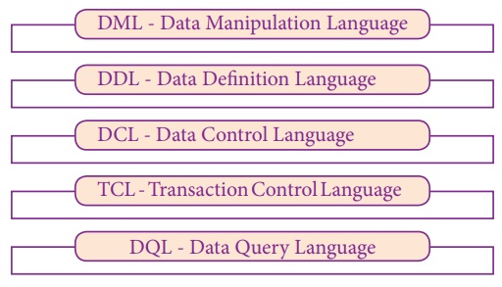

Slide 9
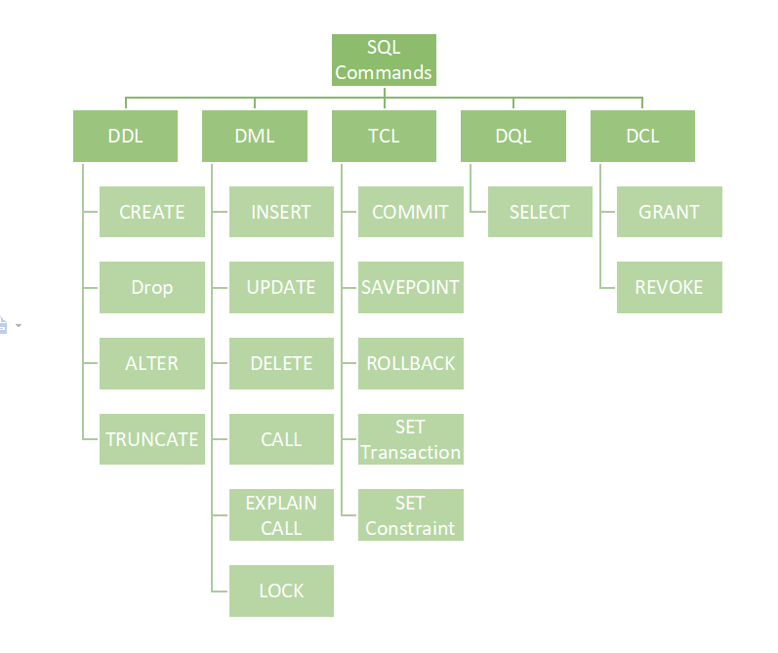

Slide 10
DDL Commands
Create
Alter
truncate
Drop
DML Commands
Select
Insert
Update
Delete

Slide 11
DCL Commands:
GRANT
REVOKE
TCL Commands:
START
TRANSACTION
COMMIT
ROLLBACK

Slide 12
Basic Schema Definition -
Create Table Construct
The general form of create table command i.e An SQL relation is defined using the
create table r (A₁ D₁,
A₂ D₂,
..., A_{n} D_{n},
(integrity-constraint₁),
...,
(integrity-constraint_{k}));
  r is the name of the relation
  each A_{i} is an attribute name in the schema of relation r
  D_{i} is the data type of values in the domain of attribute A_{i}

Slide 13
Example:
create table instructor (
ID char(5),
name varchar(20) not null,
dept_name varchar(20),
salary numeric(8,2))
To display the structure of the table:
DESC tablename; or
DESCRIBE Tablename;
Insert into tablename values(‘1111’, ‘Ramu’,’CSE’, 50000);
Insert into tablename values(‘2222’, ‘Raj’,’Physics’, 40000);

Slide 14
create table student (
name varchar(20),
ID varchar(10),
course varchar(10),
semester int(2));

Slide 15
Commit and Rollback
Commit: commits the current transaction;
that is, it makes the updates performed by the transaction become permanent in the database. After the transaction is committed, a new transaction is automatically started.
Rollback: causes the current transaction to be rolled back;
that is, it undoes all the updates performed by the SQL statements in the transaction.
-- Thus, the database state is restored to what it was before the first statement of the transaction was executed.

Slide 16
Drop and Truncate Table
Drop table Table name
  Deletes the table and its contents.
  We can Rollback
  Slow process
  TRUNCATE table Table name
  It also deletes the contents of table, and it’s table.
  We cannot rollback
  Faster

Slide 17
Alter command
The SQL ALTER TABLE command is used to add, delete or modify columns in an existing table.
The syntax of an ALTER TABLE command to add a New Column in an existing table is:
alter table Tablename add columnname Datatype;
The syntax of an ALTER TABLE command to DROP COLUMN in an existing table is:
alter table Tablename drop columnname;
The basic syntax of an ALTER TABLE command to change the DATA TYPE of a column in a table is:
alter table Tablename modify columnname datatype;
  alter table r drop A
    where A is the name of an attribute of relation r
    Dropping of attributes not supported by many databases

Slide 18
Select
The SQL SELECT statement is used to fetch the data from a database table which returns this data in the form of a result table. These result tables are called result-sets.
Syntax:
select column1,column2,… column n from tablename;
Ex: Select * from tablename;
select name,id, course from student;

Slide 19
Basic Structure of SQL Queries
The SQL data-manipulation language (DML) provides the ability to query information, and insert, delete and update tuples
A typical SQL query has the form:
select A₁, A₂, ..., A_{n}
from r₁, r₂, ..., r_{m}
where P
  A_{i} represents an attribute
  R_{i} represents a relation
  P is a predicate.
The result of an SQL query is a relation.
Notes:
2

Slide 20
The select Clause
The select clause list the attributes desired in the result of a query
  corresponds to the projection operation of the relational algebra
Example: find the names of all instructors:
select name
from instructor
NOTE: SQL names are case insensitive (i.e., you may use upper- or lower-case letters.)
  E.g. Name ≡ NAME ≡ name
  Some people use upper case wherever we use bold font.
Notes:
3

Slide 21
The select Clause (Cont.)
SQL allows duplicates in relations as well as in query results.
To force the elimination of duplicates, insert the keyword distinct after select.
Find the names of all departments with instructor, and remove duplicates
select distinct dept_name
from instructor
The keyword all specifies that duplicates not be removed.
select all dept_name
from instructor
Notes:
4

Slide 22
The select Clause
An asterisk in the select clause denotes “all attributes”
select *
from instructor
The select clause can contain arithmetic expressions involving the operation, +, –, *, and /, and operating on constants or attributes of tuples.
The query: select ID, name, salary/12
from instructor
Would return a relation that is the same as the instructor relation, except that the value of the attribute salary is divided by 12.
select ID, name, salary*1.5
from instructor
Notes:
5

Slide 23
The where Clause
The where clause specifies conditions that the result must satisfy
  Corresponds to the selection predicate of the relational algebra.
To find all instructors in Comp. Sci. dept with salary > 80000 select name
from instructor
where dept_name = ‘Comp. Sci.' and salary > 80000
Comparison results can be combined using the logical connectives and, or, and not.
Comparisons can be applied to results of arithmetic expressions.
The operands of the logical connectives can be expressions involving the comparison operators <, <=, >, >=, =, and <>.
Notes:
6

Slide 24
Select ID, Name, salary
from customers
where salary >20000 and age<=25;
Select ID, Name, salary
from customers
where salary >20000 or age<=25;

Slide 25
Update
The SQL UPDATE Query is used to modify the existing records in a table.
You can use the WHERE clause with the UPDATE query to update the selected rows, otherwise all the rows would be affected.
The basic syntax of the UPDATE query with a WHERE clause is:
update tablename
SET column1= value1, Column2 = value2,….column n= value n
where [condition];
Ex: update student
Set name= ‘Sunil’
Where ID=’11’ ;

Slide 26
The basic syntax of the DELETE query with the WHERE clause is as follows:
Syntax:
Delete from tablename
Where [condition];
Ex:
Delete from customers
where ID=‘6’;

Slide 27
like
The SQL LIKE clause is used to compare a value to similar values using wildcard operators. There are two wildcards used in conjunction with the LIKE operator.
--The percent sign (%)
--The underscore (_)
The basic syntax of % and _ is as follows
‘XXX%’ Eg: ‘30%’
‘%XX’ Eg: ‘%200’
‘-24%’ Eg:
‘24--%’

Slide 28
SQL Constraints
Constraints are the rules enforced on data columns on a table.
These are used to limit the type of data that can go into a table.
This ensures the accuracy and reliability of the data in the database.
Constraints can either be column level or table level. Column level constraints are applied only to one column whereas, table level constraints are applied to the entire table.

Slide 29
Constraints
some of the most commonly used constraints available in SQL.
a column can hold NULL values. If you do not want a column to have a NULL value, then you need to define such a constraint on this column specifying that NULL is now not allowed for that column.
A NULL is not the same as no data, rather, it represents unknown data.
NOT NULL constraint
Unique Constraint
Primary Key Constraint
Foreign Key Constraint
Check Constraint
Default Constraint

Slide 30
NOT NULL
Ensures that a column cannot have a NULL value.
Create table course
( course_name varchar(10) not null
course_id varchar (5) not null
department varchar(10)
);
/*
Alter Table student add department not null;
Alter table student modify course varchar(10) NOT NULL;
*/

Slide 31
User Defined Constraint Names
Create Table table_name
(Column1 data type constraint user defined name1 not null
Column2 data type constraint user defined name2 not null);
Eg: create table course
( course_name varchar(10) constraint cn not null
course_id varchar (5) constraint ci not null
department varchar(10)
);

Slide 32
Deletion of constraints
Alter table table_name drop not null;
Alter table table_name drop constraint constraint_name;
Eg: Alter table course drop
Any one of
/*Primary key, Not Null, check, unique, foreign key */
/* This syntax should not work for default constraint*/
/*We have to use modify while dropping default constraint*/

Slide 33
System Defined Constraint Names
Select constraint_name, Constraint_type from user_constraints
where table name= ‘TABLE NAME’ /* Should be capital*/
Consraint_Type
: P_primary key
R_Foreign key
U_Unique Key
C_Not Null & Check

Slide 34
Default
The DEFAULT constraint provides a default value to a column when the INSERT INTO statement does not provide a specific value.
Create table student
( ID varchar(10) NOT NULL
Name varchar(20) NOT NULL
Course varchar(10)
Semester int(2)
stipend numeric(5,2) default 5000.00
);
Alter table student modify stipend default null;

Slide 35
UNIQUE
The UNIQUE Constraint prevents two records from having identical values in a column
Create table student
( ID varchar(10) NOT NULL
Name varchar(20) UNIQUE
Course varchar(10)
Semester int(2)
stipend numeric(5,2)
);

Slide 36
User defined
Create table student
( ID varchar(10) NOT NULL
Name varchar(20) constraint SN UNIQUE
Course varchar(10)
Semester int(2)
stipend numeric(5,2)
);
Drop: Alter table student drop constraint SN;
Addtion: Alter Table student add UNIQUE(Name);

Slide 37
Primary Key
A primary key is a field in a table which uniquely identifies each row/record in a database table.
Primary keys must contain unique values.
A primary key column cannot have NULL values.
A table can have only one primary key, which may consist of single or multiple fields.
When multiple fields are used as a primary key, they are called a composite key.
If a table has a primary key defined on any field(s), then you cannot have two records having the same value of that field(s).

Slide 38
Creation and dropping of primary key
create table student
( ID varchar (5) not null,
name varchar (20) not null,
dept_name varchar (20),
tot_cred numeric (3,0) default 0,
primary key (ID)
);
Alter table student drop primary key ;
Alter table student add primary key (ID);

Slide 39
User Defined
create table student
( ID varchar (5) constraint not null,
name varchar (20) not null,
dept_name varchar (20),
tot_cred numeric (3,0) default 0,
primary key (ID)
);
Alter table student drop primary key ;
Alter table student add primary key (ID);

Slide 40
Foreign Key
A foreign key is a key used to link two tables together. This is sometimes also called as a referencing key.
A Foreign Key is a column or a combination of columns whose values match a Primary Key in a different table.
The relationship between 2 tables matches the Primary Key in one of the tables with a Foreign Key in the second table.
If a table has a primary key defined on any field(s), then you cannot have two records having the same value of that field(s).

Slide 41
Foreign Key
Foreign key (Ak1 , Ak2, . . . , Akn ) references s:
The foreign key specification says that the values of attributes (Ak1 , Ak2, . . . , Akn ) for any tuple in the relation
must correspond to values of the primary key attributes of some tuple in relation s.
create table instructor(
ID varchar(5),
name varchar(20), not null
Dept_name varchar(20),
salary numeric (8,2), check (salary > 29000),
primary key (ID),
foreign key (dept_name) references department
);

Slide 42
Alter Table table name drop foreign key
Eg: Alter table instructor drop foreign key

Slide 43
The check clause
check (P)
where P is a predicate
Example: Ensure that semester is one of fall, winter, spring or summer:
CREATE TABLE Persons (
ID int NOT NULL,
LastName varchar(25) NOT NULL,
FirstName varchar(25),
Age int,
CHECK (Age>=18)
);

Slide 44
Retrieve the names of all instructors, along with their department names and department building name.
Query:
select name, instructor.dept name, building
from instructor, department
where instructor.dept name= department.dept name;

Slide 45

Relation - Instructor
attributes
(or columns)
tuples
(or rows)

Slide 46

Department - Relation

Slide 47
Queries on Multiple Relations
“Retrieve the names of all instructors, along with their department names and department building name.
” select name, instructor.dept name, building
from instructor, department
where instructor.dept name= department.dept name;

Slide 48
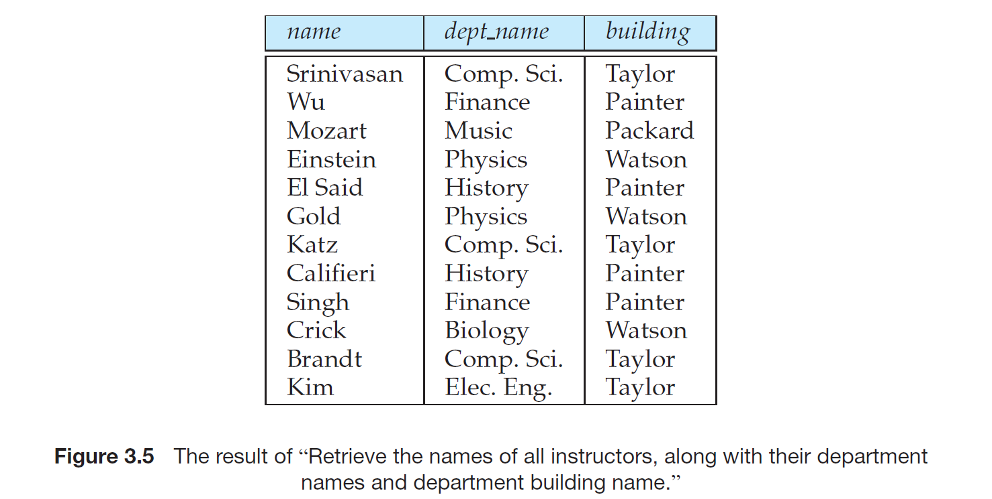

Slide 49
The from Clause
The clauses must be written in the order select, from, where.
The easiest way to understand the operations specified by the query is to consider the clauses in operational order: first from, then where, and then select.
The from clause lists the relations involved in the query
  Corresponds to the Cartesian product operation of the relational algebra.
Find the Cartesian product instructor X teaches
select *
from instructor, teaches
  generates every possible instructor – teaches pair, with all attributes from both relations
Cartesian product not very useful directly, but useful combined with where-clause condition (selection operation in relational algebra)
Notes:
8

Slide 50


Cartesian Product: instructor X teaches
instructor
teaches

Slide 51
If we only wished to find instructor names and course identifiers for instructors in the Computer Science department
select name, course id
from instructor, teaches
where instructor.ID= teaches.ID and instructor.dept name = ’Comp. Sci.’;

Slide 52

Joins
For all instructors who have taught some course, find their names and the course ID of the courses they taught.
select name, course_id
from instructor, teaches
where instructor.ID = teaches.ID
Find the course ID, semester, year and title of each course offered by the Comp. Sci. department
select section.course_id, semester, year, title
from section, course
where section.course_id = course.course_id and
dept_name = ‘Comp. Sci.'

Slide 53

Natural Join
Natural join matches tuples with the same values for all common attributes, and retains only one copy of each common column
select *
from instructor natural join teaches;

Slide 54
Natural Join Example
List the names of instructors along with the course ID of the courses that they taught.
  select name, course_id
  from instructor, teaches
  where instructor.ID = teaches.ID;
  select name, course_id
  from instructor natural join teaches;

Slide 55
Natural Join (Cont.)
Danger in natural join: beware of unrelated attributes with same name which get equated incorrectly
List the names of instructors along with the titles of courses that they teach
  Incorrect version (makes course.dept_name = instructor.dept_name)
    select name, title
    from instructor natural join teaches natural join course;
  Correct version
    select name, title
    from instructor natural join teaches, course
    where teaches.course_id = course.course_id;
  Another correct version
    select name, title
    from (instructor natural join teaches)
    join course using(course_id);

Slide 56
Additional Basic Operations- The Rename Operation
The SQL allows renaming relations and attributes using the as clause:
old-name as new-name.
Eg: select name, course id
from instructor, teaches
where instructor.ID= teaches.ID;
The result of this query is a relation with the following attributes:
name, course id
Notes:
9

Slide 57
Additional Basic Operations- The Rename Operation
The SQL allows renaming relations and attributes using the as clause:
old-name as new-name
E.g.
  select ID, name, salary/12 as monthly_salary
  from instructor
Find the names of all instructors who have a higher salary than
some instructor in ‘Comp. Sci’.
  select distinct T. name
  from instructor as T, instructor as S
  where T.salary > S.salary and S.dept_name = ‘Comp. Sci.’
Keyword as is optional and may be omitted
instructor as T ≡ instructor T
  Keyword as must be omitted in Oracle
Notes:
9

Slide 58
String Operations
SQL includes a string-matching operator for comparisons on character strings. The operator “like” uses patterns that are described using two special characters:
  percent (%). The % character matches any substring.
  underscore (_). The _ character matches any character.
Find the names of all instructors whose name includes the substring “dar”.
select name
from instructor
where name like '%dar%'
Match the string “100 %”
like ‘100 \%' escape '\'

Slide 59
String Operations (Cont.)
Patterns are case sensitive.
Pattern matching examples:
  ‘Intro%’ matches any string beginning with “Intro”.
  ‘%Comp%’ matches any string containing “Comp” as a substring.
  ‘_ _ _’ matches any string of exactly three characters.
  ‘_ _ _ %’ matches any string of at least three characters.
SQL supports a variety of string operations such as
  concatenation (using “||”)
  converting from upper to lower case (and vice versa)
  finding string length, extracting substrings, etc.

Slide 60
Attribute Specification in Select Clause
The asterisk symbol “ * ” can be used in the select clause to denote “all attributes.”
select instructor.*
from instructor, teaches
where instructor.ID= teaches.ID;

Slide 61
Ordering the Display of Tuples
List in alphabetic order the names of all instructors
select distinct name
from instructor
order by name
We may specify desc for descending order or asc for ascending order, for each attribute; ascending order is the default.
  Example: order by name desc
Can sort on multiple attributes
  Example: order by dept_name, name

Slide 62
Ordering the Display of Tuples Contd..
Suppose that we wish to list the entire instructor relation in descending order of salary
select *
from instructor
order by salary desc, name asc;

Slide 63
Where Clause Predicates
SQL includes a between comparison operator (Not Between)
Example: Find the names of all instructors with salary between $90,000 and $100,000 (that is, >$90,000 and < $100,000)
  select name
  from instructor
  where salary between 90000 and 100000
Notes:
7

Slide 64
SQL permits us to use the notation (v1, v2, . . . , vn) to denote a tuple of arity n containing values v1, v2, . . . , vn.
The comparison operators can be used on tuples,
and the ordering is defined lexicographically. For example, (a1, a2) <= (b1, b2)
Tuple comparison
  select name, course_id
  from instructor, teaches
  where (instructor.ID, dept_name) = (teaches.ID, ’Biology’);

Slide 65
Set Operations – Union, Intersect, Except
Find courses that ran in Fall 2009 or in Spring 2010
(select course_id from section where sem = ‘Fall’ and year = 2009)
union
(select course_id from section where sem = ‘Spring’ and year = 2010)
Find courses that ran in Fall 2009 and in Spring 2010
(select course_id from section where sem = ‘Fall’ and year = 2009)
intersect
(select course_id from section where sem = ‘Spring’ and year = 2010)
Find courses that ran in Fall 2009 but not in Spring 2010
(select course_id from section where sem = ‘Fall’ and year = 2009)
except
(select course_id from section where sem = ‘Spring’ and year = 2010)

Slide 66
Set Operations
Set operations union, intersect, and except
  Each of the above operations automatically eliminates duplicates
To retain all duplicates use the corresponding multiset versions union all, intersect all and except all.
Suppose a tuple occurs m times in r and n times in s, then, it occurs:
  m + n times in r union all s
  min(m,n) times in r intersect all s
  max(0, m – n) times in r except all s

Slide 67
Null Values
It is possible for tuples to have a null value, denoted by null, for some of their attributes
null signifies an unknown value or that a value does not exist.
The result of any arithmetic expression involving null is null
  Example: 5 + null returns null
The predicate is null can be used to check for null values.
  Example: Find all instructors whose salary is null.
select name
from instructor
where salary is null

Slide 68
Null Values and Three Valued Logic
Any comparison with null returns unknown
  Example: 5 < null or null <> null or null = null
Three-valued logic using the truth value unknown:
  OR: (unknown or true) = true,
  (unknown or false) = unknown
  (unknown or unknown) = unknown
  AND: (true and unknown) = unknown,
  (false and unknown) = false,
  (unknown and unknown) = unknown
  NOT: (not unknown) = unknown
  “P is unknown” evaluates to true if predicate P evaluates to unknown
Result of where clause predicate is treated as false if it evaluates to unknown

Slide 69
Aggregate Functions
These functions operate on the multiset of values of a column of a relation, and return a value
avg: average value
min: minimum value
max: maximum value
sum: sum of values
count: number of values

Slide 70
Aggregate Functions (Cont.)
Find the average salary of instructors in the Computer Science department
  select avg (salary) /* Can rename*/
  from instructor
  where dept_name= ’Comp. Sci.’;
Find the total number of instructors who teach a course in the Spring 2010 semester
  select count (distinct ID)
  from teaches
  where semester = ’Spring’ and year = 2010
Find the number of tuples in the course relation
  select count (*)
  from course;

Slide 71


Aggregate Functions – Group By
Find the average salary of instructors in each department
  select dept_name, avg (salary)
  from instructor
  group by dept_name;
  Note: departments with no instructor will not appear in result

Slide 72
Aggregation (Cont.)
“Find the number of instructors in each department who teach a course in the Spring 2010 semester.”
select dept name, count (distinct ID) as instr count
from instructor natural join teaches
where semester = ’Spring’ and year = 2010
group by dept name;
Attributes in select clause outside of aggregate functions must appear in group by list
  /* erroneous query bcoz ID is appeared in the select clause but not in group by*/
  select dept_name, ID, avg (salary)
  from instructor
  group by dept_name;

Slide 73
Aggregate Functions – Having Clause
Find the names and average salaries of all departments whose average salary is greater than 42000
select dept_name, avg (salary)
from instructor
group by dept_name
having avg (salary) > 42000;
Note: predicates in the having clause are applied after the formation of groups whereas predicates in the where
clause are applied before forming groups

Slide 74
Both Having and Where
For each course section offered in 2009, find the average total credits (tot cred) of all students enrolled in the section, if the section had at least 2 students.”
select course id, semester, year, sec id, avg (tot cred)
from takes natural join student
where year = 2009
group by course id, semester, year, sec id
having count (ID) >= 2;

Slide 75
Null Values and Aggregates
Total all salaries
select sum (salary )
from instructor
  Above statement ignores null amounts
  Result is null if there is no non-null amount
All aggregate operations except count(*) ignore tuples with null values on the aggregated attributes
What if collection has only null values?
  count returns 0
  all other aggregates return null

Slide 76
Nested Subqueries
SQL provides a mechanism for the nesting of subqueries.
A subquery is a select-from-where expression that is nested within another query.
A common use of subqueries is to perform tests for set membership, set comparisons, and set cardinality.

Slide 77
Example Query
Find courses offered in Fall 2009 and in Spring 2010
select distinct course_id
from section
where semester = ’Fall’ and year= 2009 and
course_id in (select course_id
from section
where semester = ’Spring’ and year= 2010);
Find courses offered in Fall 2009 but not in Spring 2010
select distinct course_id
from section
where semester = ’Fall’ and year= 2009 and
course_id not in (select course_id
from section
where semester = ’Spring’ and year= 2010);

Slide 78
Example Query
Find the total number of (distinct) studentswho have taken course sections taught by the instructor with ID 10101
select count (distinct ID)
from takes
where (course_id, sec_id, semester, year) in
(select course_id, sec_id, semester, year
from teaches
where teaches.ID= 10101);
Note: Above query can be written in a much simpler manner. The
formulation above is simply to illustrate SQL features.

Slide 79
Set Comparison
Find names of instructors with salary greater than that of some (at least one) instructor in the Biology department.
select distinct T.name
from instructor as T, instructor as S
where T.salary > S.salary and S.dept_name = ’Biology’;
Same query using > some clause
select name
from instructor
where salary > some (select salary
from instructor
where dept_name = ’Biology’);

Slide 80
SQL also allows < some, <= some, >= some, = some, and <> some comparisons.
= some is identical to in, whereas <> some
is not the same as not in.

Slide 81
Definition of Some Clause
F <comp> some r ⇔ ∃ t ∈ r such that (F <comp> t )
Where <comp> can be: <, ≤, >, =, ≠
0
(5 < some
5
) = true
(read: 5 < some tuple in the relation)
6
0
(5 < some
5
) = false
0
(5 = some
) = true
5
0
(5 ≠ some
5
) = true (since 0 ≠ 5)
(= some) ≡ in
However, (≠ some) ≡ not in

Slide 82
Example Query
Find the names of all instructors whose salary is greater than the salary of all instructors in the Biology department.
select name
from instructor
where salary > all (select salary
from instructor
where dept_name = ’Biology’);

Slide 83
Definition of all Clause
F <comp> all r ⇔ ∀ t ∈ r (F <comp> t)
0
(5 < all
5
) = false
6
6
(5 < all
) = true
10
4
(5 = all
) = false
5
4
(5 ≠ all
) = true (since 5 ≠ 4 and 5 ≠ 6)
6
(≠ all) ≡ not in
However, (= all) ≡ in

Slide 84
Test for Empty Relations
The exists construct returns the value true if the argument subquery is nonempty.
exists r ⇔ r ≠ Ø
not exists r ⇔ r = Ø

Slide 85
Correlation Variables
Yet another way of specifying the query “Find all courses taught in both the Fall 2009 semester and in the Spring 2010 semester”
select course_id
from section as S
where semester = ’Fall’ and year= 2009 and
exists (select *
from section as T
where semester = ’Spring’ and year= 2010
and S.course_id= T.course_id);
Correlated subquery
Correlation name or correlation variable

Slide 86
Not Exists
Find all students who have taken all courses offered in the Biology department.
select distinct S.ID, S.name
from student as S
where not exists ( (select course_id
from course
where dept_name = ’Biology’)
except
(select T.course_id
from takes as T
where S.ID = T.ID));
Note that X – Y = Ø ⇔ X ⊆ Y
Note: Cannot write this query using = all and its variants

Slide 87
Test for Absence of Duplicate Tuples
The unique construct tests whether a subquery has any duplicate tuples in its result.
  (Evaluates to “true” on an empty set)
Find all courses that were offered at most once in 2009
  select T.course_id
  from course as T
  where unique (select R.course_id
  from section as R
  where T.course_id= R.course_id
  and R.year = 2009);

Slide 88
Subqueries in the From Clause
SQL allows a subquery expression to be used in the from clause
Find the average instructors’ salaries of those departments where the average salary is greater than $42,000.
  select dept_name, avg_salary
  from (select dept_name, avg (salary) as avg_salary
  from instructor
  group by dept_name)
  where avg_salary > 42000;
Note that we do not need to use the having clause
Another way to write above query
  select dept_name, avg_salary
  from (select dept_name, avg (salary)
  from instructor
  group by dept_name)
  as dept_avg (dept_name, avg_salary)
  where avg_salary > 42000;

Slide 89
Subqueries in the From Clause (Cont.)
And yet another way to write it: lateral clause
  select name, salary, avg_salary
  from instructor I1,
  lateral (select avg(salary) as avg_salary
  from instructor I2
  where I2.dept_name= I1.dept_name);
Lateral clause permits later part of the from clause (after the lateral keyword) to access correlation variables from the earlier part.
Note: lateral is part of the SQL standard, but is not supported on many database systems; some databases such as SQL Server offer alternative syntax

Slide 90
With Clause
The with clause provides a way of defining a temporary view whose definition is available only to the query in which the with clause occurs.
Find all departments with the maximum budget
with max_budget (value) as
(select max(budget)
from department)
select budget
from department, max_budget
where department.budget = max_budget.value;

Slide 91
Complex Queries using With Clause
With clause is very useful for writing complex queries
Supported by most database systems, with minor syntax variations
Find all departments where the total salary is greater than the average of the total salary at all departments
with dept _total (dept_name, value) as
(select dept_name, sum(salary)
from instructor
group by dept_name),
dept_total_avg(value) as
(select avg(value)
from dept_total)
select dept_name
from dept_total, dept_total_avg
where dept_total.value >= dept_total_avg.value;

Slide 92
Scalar Subquery
Scalar subquery is one which is used where a single value is expected
E.g. select dept_name,
(select count(*)
from instructor
where department.dept_name = instructor.dept_name)
as num_instructors
from department;
E.g. select name
from instructor
where salary * 10 >
(select budget from department
where department.dept_name = instructor.dept_name)
Runtime error if subquery returns more than one result tuple

Slide 93
Modification of the Database
Deletion of tuples from a given relation
Insertion of new tuples into a given relation
Updating values in some tuples in a given relation

Slide 94
Modification of the Database – Deletion
Delete all instructors
delete from instructor
Delete all instructors from the Finance department
delete from instructor
where dept_name= ’Finance’;
Delete all tuples in the instructor relation for those instructors associated with a department located in the Watson building.
delete from instructor
where dept_name in (select dept_name
from department
where building = ’Watson’);

Slide 95
Deletion (Cont.)
Delete all instructors whose salary is less than the average salary of instructors
delete from instructor
where salary< (select avg (salary) from instructor);
  Problem: as we delete tuples from deposit, the average salary changes
  Solution used in SQL:
  1. First, compute avg salary and find all tuples to delete
  2. Next, delete all tuples found above (without recomputing avg or
  retesting the tuples)

Slide 96
Modification of the Database – Insertion
Add a new tuple to course
insert into course
values (’CS-437’, ’Database Systems’, ’Comp. Sci.’, 4);
or equivalently
insert into course (course_id, title, dept_name, credits)
values (’CS-437’, ’Database Systems’, ’Comp. Sci.’, 4);
Add a new tuple to student with tot_creds set to null
insert into student
values (’3003’, ’Green’, ’Finance’, null);

Slide 97
Insertion (Cont.)
Add all instructors to the student relation with tot_creds set to 0
insert into student
select ID, name, dept_name, 0
from instructor
The select from where statement is evaluated fully before any of its results are inserted into the relation (otherwise queries like
insert into table1 select * from table1
would cause problems, if table1 did not have any primary key defined.

Slide 98
Modification of the Database – Updates
Increase salaries of instructors whose salary is over $100,000 by 3%, and all others receive a 5% raise
  Write two update statements:
  update instructor
  set salary = salary * 1.03
  where salary > 100000;
  update instructor
  set salary = salary * 1.05
  where salary <= 100000;
  The order is important
  Can be done better using the case statement (next slide)

Slide 99
Case Statement for Conditional Updates
Same query as before but with case statement
update instructor
set salary = case
when salary <= 100000 then salary * 1.05
else salary * 1.03
end

Slide 100
Updates with Scalar Subqueries
Recompute and update tot_creds value for all students
update student S
set tot_cred = ( select sum(credits)
from takes natural join course
where S.ID= takes.ID and
takes.grade <> ’F’ and
takes.grade is not null);
Sets tot_creds to null for students who have not taken any course
Instead of sum(credits), use:
case
when sum(credits) is not null then sum(credits)
else 0
end

Slide 101
End of Chapter 3

Slide 102
Advanced SQL Features**
Create a table with the same schema as an existing table:
create table temp_account like account

Slide 103

Figure 3.02

Slide 104

Figure 3.03

Slide 105

Figure 3.04

Slide 106

Figure 3.05

Slide 107

Figure 3.07

Slide 108
Figure 3.08

Slide 109

Figure 3.09

Slide 110

Figure 3.10

Slide 111

Figure 3.11

Slide 112

Figure 3.12

Slide 113

Figure 3.13

Slide 114

Figure 3.16

Slide 115

Figure 3.17

Slide 116
Order by
Select * from student
limit 4;
Select * from customers
order by name, salary;
Select * from customers
order by salary desc;

Slide 117
Group by
The SQL GROUP BY clause is used in collaboration with the SELECT statement to arrange identical data into groups.
This GROUP BY clause follows the WHERE clause in a SELECT statement and precedes the ORDER BY clause.
Select column1, column2
from tablename
where condition
Group by column1, cloumn2
order by column1,column2;
Ex:
Select name, sum(salary) from customers
Group by name;

