Slide 1
Functional Dependencies
and
Normalization for Relational Databases

Slide 2
Chapter Outline
1 Informal Design Guidelines for Relational Databases
1.1Semantics of the Relation Attributes
1.2 Redundant Information in Tuples and Update Anomalies
1.3 Null Values in Tuples
1.4 Spurious Tuples
2 Functional Dependencies (FDs)
2.1 Definition of FD
2.2 Inference Rules for FDs
2.3 Equivalence of Sets of FDs
2.4 Minimal Sets of FDs

Slide 3
Chapter Outline
3 Normal Forms Based on Primary Keys
3.1 Normalization of Relations
3.2 Practical Use of Normal Forms
3.3 Definitions of Keys and Attributes Participating in Keys
3.4 First Normal Form
3.5 Second Normal Form
3.6 Third Normal Form
4 General Normal Form Definitions (For Multiple Keys)
5 BCNF (Boyce-Codd Normal Form)

Slide 4
Goodness of relation schemas
We have two levels to discuss goodness of relation schemas.
- Logical (or conceptual) level
How users interpret the relation schemas and the meaning of their attributes.
- Implementation (or physical storage) level
How the tuples in a base relation are stored and updated.

Slide 5
Database design approaches
- bottom-up design (design by synthesis)
It considers the basic relationships among individual attributes as the starting point and uses those to construct relation schemas.
- Top-down design (design by analysis)
Starts with a number of groupings of attributes into relations that exist together naturally
The relations are then analyzed individually and collectively, leading to further decomposition until all desirable properties are met

Slide 6
Implicit goals of the design
implicit goals of the design activity are
Information preservation
Minimum redundancy
Information preservation:- It includes attribute types, entity types, and relationship types as well as generalization/specialization relationships, which are described using a model such as the EER model

Slide 7
Minimum redundancy:-
Minimizing redundant storage of the same information and reducing the need for multiple updates to maintain consistency

Slide 8
Informal Design Guidelines for Relational Databases
We first discuss informal guidelines for good relational design
Informal Design Guidelines for Relational Databases
Semantics of the Relation Attributes
Reducing the redundant Information in Tuples and Update Anomalies
Reducing Null Values in Tuples
Disallowing the possibility of generating Spurious Tuples.

Slide 9
1.1 Semantics of the Relation Attributes
Whenever we group attributes to form a relation schema, we assume that attributes belonging to one relation have certain real-world meaning and a proper interpretation associated with them.
The semantics of a relation refers to its meaning resulting from the interpretation of attribute values in a tuple.
Ex: In EMPLOYEE relation schema Each tuple represents with values for the employee’s name (Ename), Social Security number (Ssn), birth date (Bdate), and address (Address), and the number of the department that the employee works for (Dnumber)

Slide 10
GUIDELINE 1: Design a relation schema so that it is easy to explain its meaning. Do not combine attributes from multiple entity types and relationship types into a single relation.
Informally, each tuple in a relation should represent one entity or relationship instance. (Applies to individual relations and their attributes).
Attributes of different entities (EMPLOYEEs, DEPARTMENTs, PROJECTs) should not be mixed in the same relation.
Only foreign keys should be used to refer to other entities.
Bottom Line: Design a schema that can be explained easily relation by relation. The semantics of attributes should be easy to interpret.

Slide 11
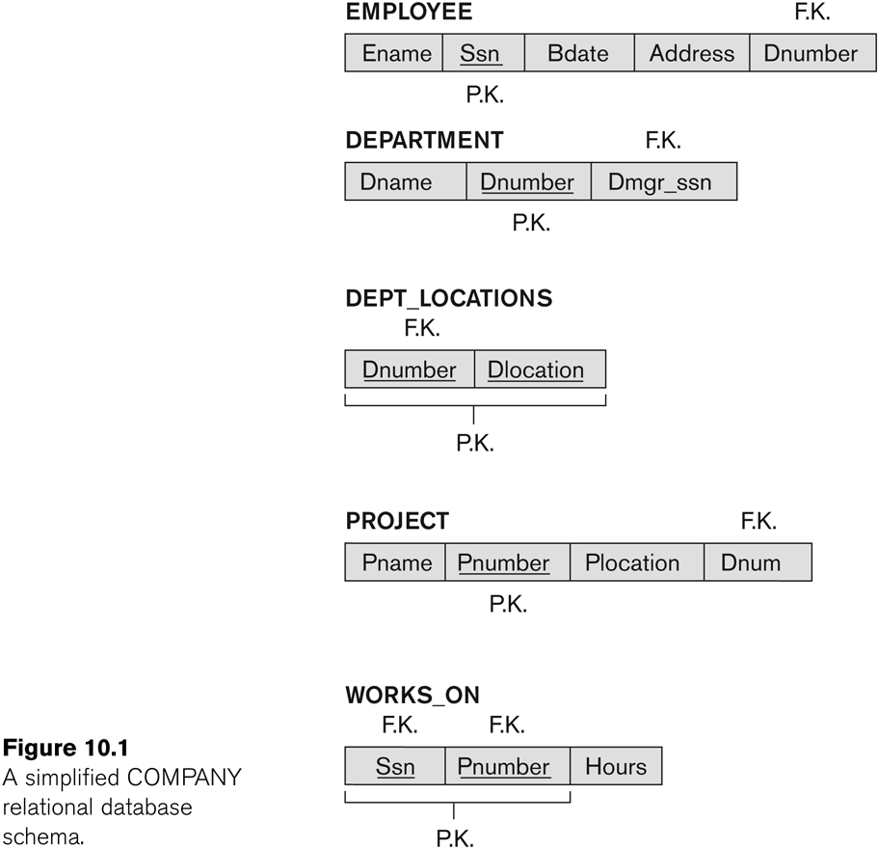
A simplified COMPANY relational database schema

Slide 12
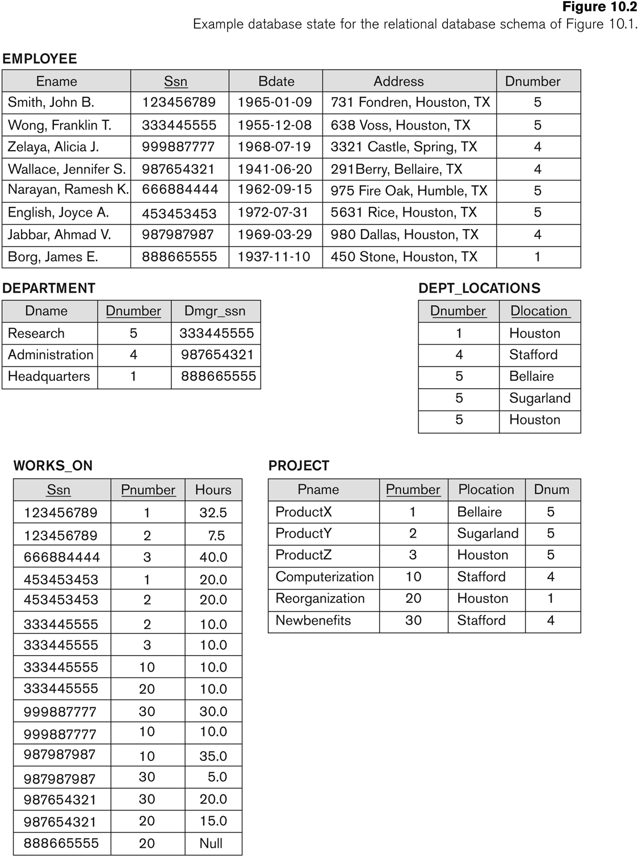

Slide 13
Example of violating guideline 1

Slide 14
1.2 Reducing the redundant Information in Tuples and Update Anomalies
One goal of schema design is to minimize the storage space used by the base relations
If Information is stored redundantly
Wastes storage
Causes problems with update anomalies
Insertion anomalies
Deletion anomalies
Modification anomalies

Slide 15
EXAMPLE OF AN UPDATE ANOMALY
Consider the relation:
EMP_PROJ(Ssn, Proj#, Ename, Pname, No_hours)
Modification Anomaly:
Changing the name of project number P1 from “Billing” to “Customer-Accounting” may cause this update to be made for all 100 employees working on project P1.

Slide 16
EXAMPLE OF AN INSERT ANOMALY
Consider the relation:
EMP_PROJ(Ssn, Proj#, Ename, Pname, No_hours)
Insert Anomaly:
Cannot insert a project unless an employee is assigned to it.
Conversely
Cannot insert an employee unless a he/she is assigned to a project.

Slide 17
EXAMPLE OF AN DELETE ANOMALY
Consider the relation:
EMP_PROJ(Ssn, Proj#, Ename, Pname, No_hours)
Delete Anomaly:
When a project is deleted, it will result in deleting all the employees who work on that project.
Alternately, if an employee is the sole employee on a project, deleting that employee would result in deleting the corresponding project.

Slide 18
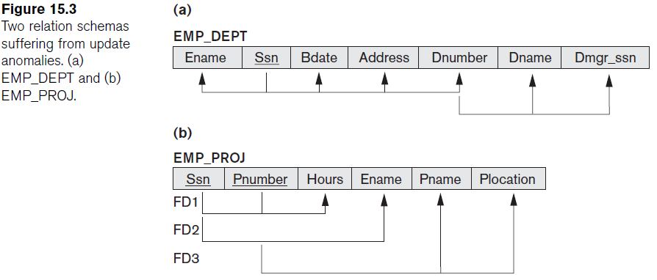
Two relation schemas suffering from update anomalies

Slide 19
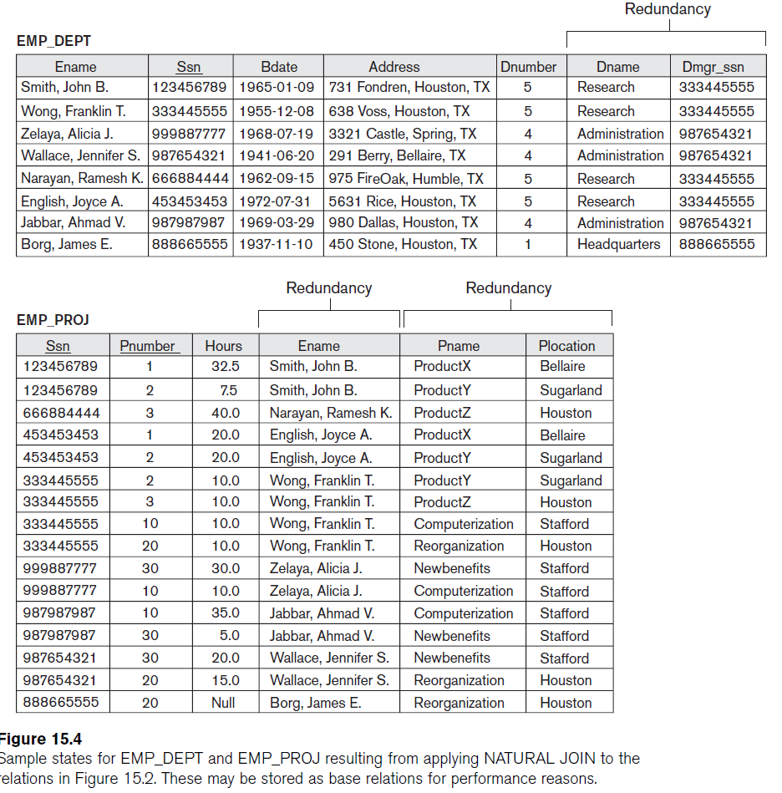
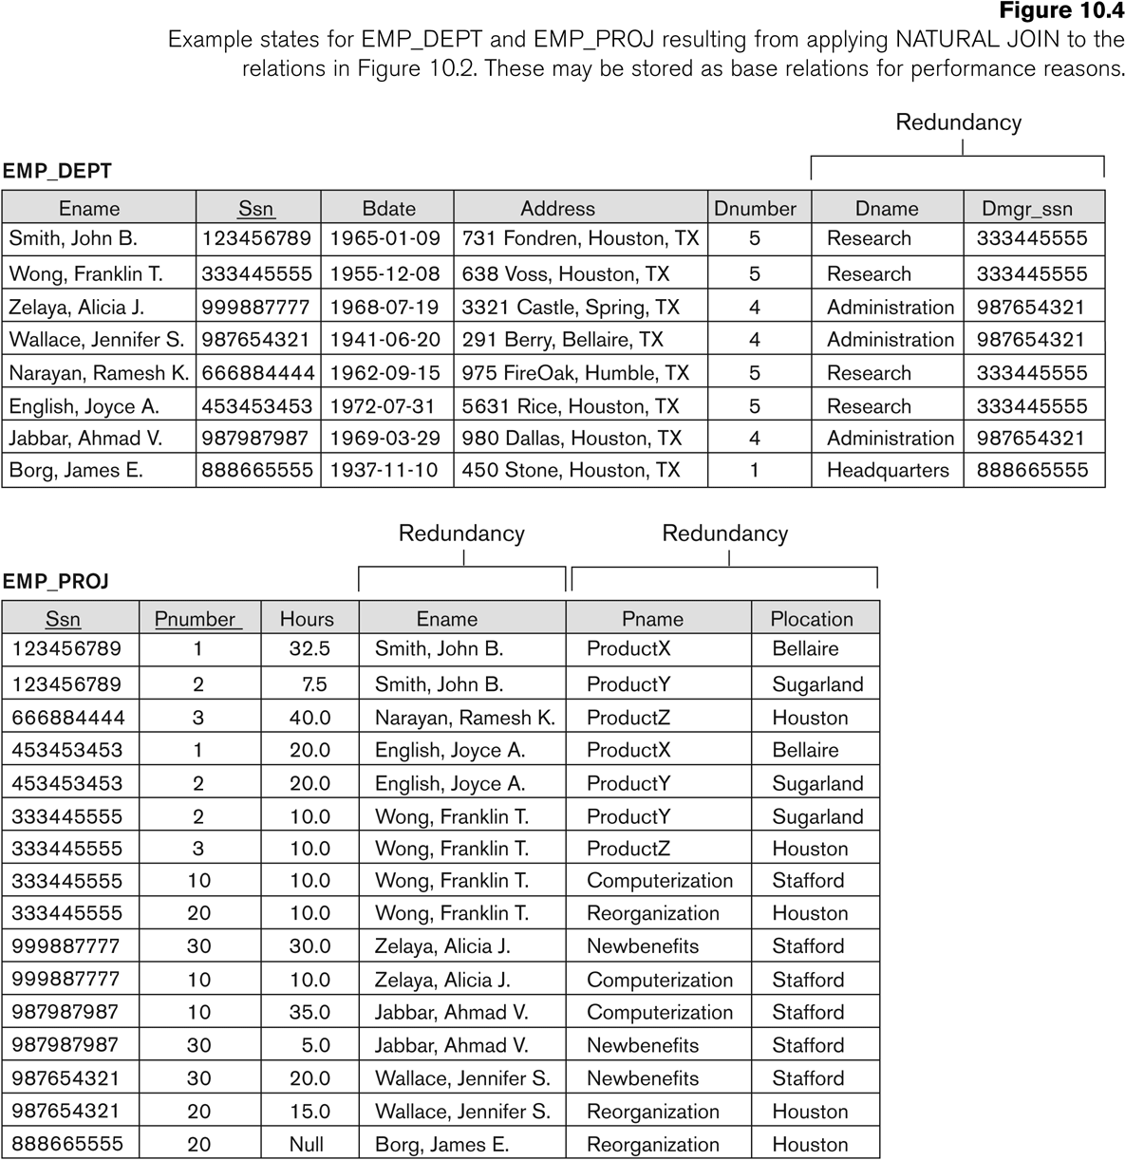
Base Relations EMP_DEPT and EMP_PROJ formed after a Natural Join : with redundant information

Slide 20
Guideline to Redundant Information in Tuples and Update Anomalies
GUIDELINE 2:
Design a schema that does not suffer from the insertion, deletion and update anomalies.
If there are any anomalies present, then note them so that applications can be made to take them into account.

Slide 21
1.3 Null Values in Tuples
GUIDELINE 3:
Relations should be designed such that their tuples will have as few NULL values as possible
Attributes that are NULL frequently could be placed in separate relations (with the primary key)
Reasons for nulls:
Attribute not applicable or invalid
Attribute value unknown (may exist)
Value known to exist, but unavailable

Slide 22
1.4 Spurious Tuples
Bad designs for a relational database may result in erroneous results for certain JOIN operations
The "lossless join" property is used to guarantee meaningful results for join operations

Slide 23
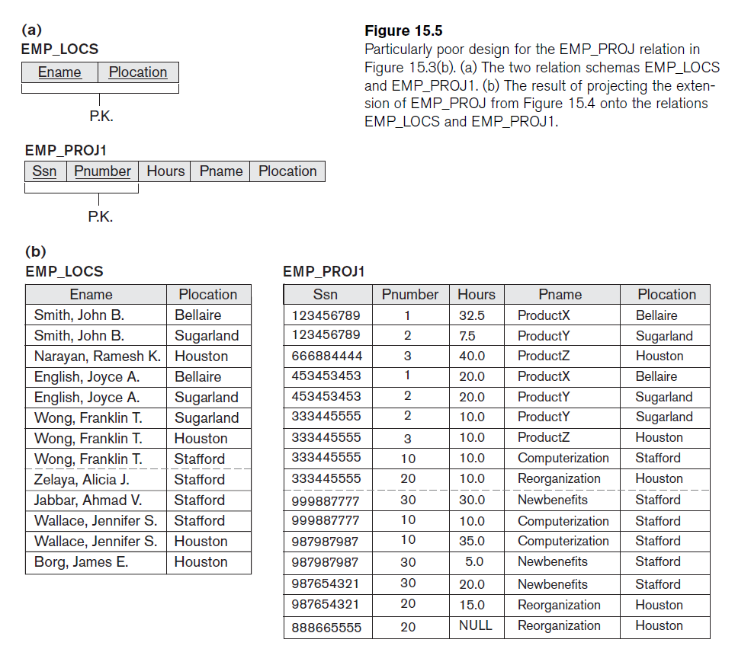

Slide 24
If we attempt a NATURAL JOIN operation on EMP_PROJ1 and EMP_LOCS, the result produces many more tuples than the original set of tuples in EMP_PROJ.
Additional tuples that were not in EMP_PROJ are called spurious tuples.

Slide 25
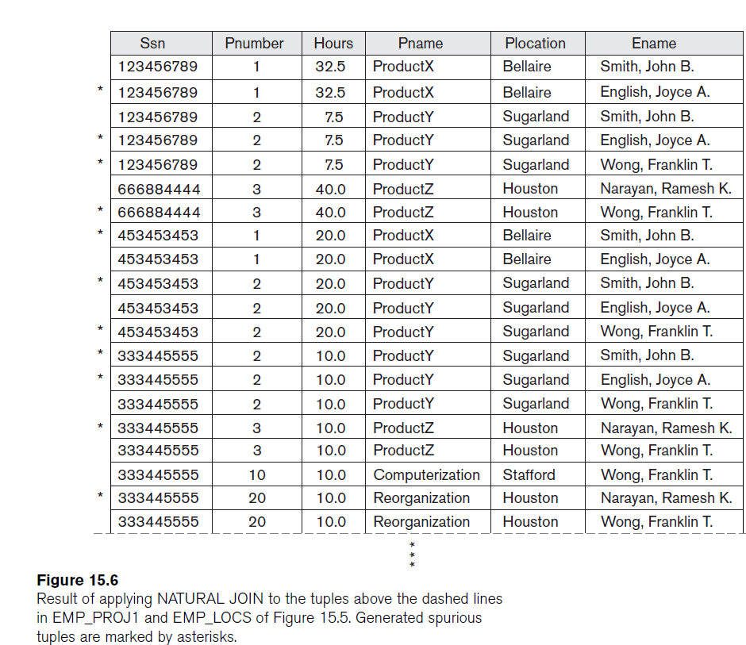

Slide 26
GUIDELINE 4:
The relations should be designed to satisfy the lossless join condition.
No spurious tuples should be generated by doing a natural-join of any relations.

Slide 27
Spurious Tuples (2)
There are two important properties of decompositions:
Non-additive or losslessness of the corresponding join
Preservation of the functional dependencies.
Note that:
Property (a) is extremely important and cannot be sacrificed.
Property (b) is less stringent and may be sacrificed.

Slide 28
2.1 Functional Dependencies
Functional dependency is a constraint that describes the relationship between attributes in a relation.
Given a relation R, a set of attributes X in R is said to functionally determine another set of attributes Y, also in R, (written X → Y) if, and only if, each X value in R is associated with unique Y value in R

Slide 29
Example
A | B | C
a1 | b1 | c1
a2 | b1 | c1
a1 | b2 | c2
a3 | b2 | c1
a2 | b1 | c1
X→ Y =>
A set of attributes X functionally determines a set of attributes Y
if the value of X determines a unique value for Y
A→ B ☒
A→ C ☒
B→ C ☒
AB→ C ☑
AC→ B ☑
BC → A ☒

Slide 30
2.1 Functional Dependencies (1)
Functional dependencies (FDs)
Are used to specify formal measures of the "goodness" of relational designs
Are constraints that are derived from the meaning and interrelationships of the data attributes
Functional dependencies (FDs) and keys are used to define normal forms for relations

Slide 31
Functional Dependencies (2)
X -> Y holds if whenever two tuples have the same value for X, they must have the same value for Y
For any two tuples t1 and t2 in any relation instance r(R): If t1[X]=t2[X], then t1[Y]=t2[Y]
The set of attributes X is called the left-hand side of the FD, and Y is called the right-hand side.
Written as X -> Y; can be displayed graphically on a relation schema as in Figures. ( denoted by the arrow: ).
FDs are derived from the real-world constraints on the attributes

Slide 32
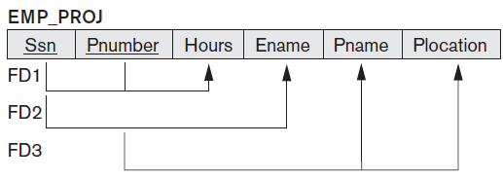
Examples of FD constraints (1)
Social security number determines employee name
SSN -> ENAME
Project number determines project name and location
PNUMBER -> {PNAME, PLOCATION}
Employee ssn and project number determines the hours per week that the employee works on the project
{SSN, PNUMBER} -> HOURS

Slide 33
Examples of FD constraints (2)
An FD is a property of the attributes in the schema R
The constraint must hold on every relation instance r(R)
If K is a key of R, then K functionally determines all attributes in R
(since we never have two distinct tuples with t1[K]=t2[K])

Slide 34
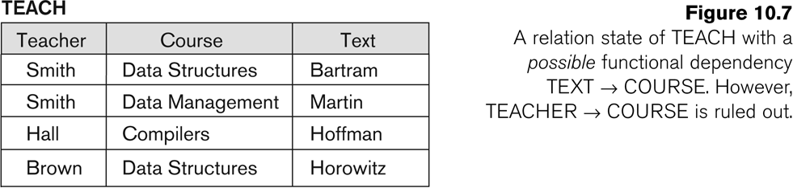
FD’s are a property of the meaning of data and hold at all times: certain FD’s can be ruled out based on a given state of the database

Slide 35
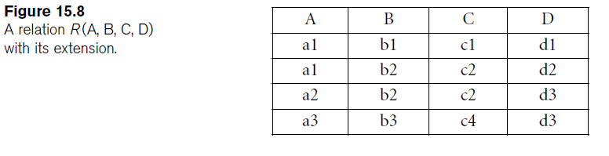
FDs
B → C; C → B; {A, B} → C; {A, B} → D; and {C, D} → B.
Not FDs
A → B and
D→C

Slide 36
2.2 Inference Rules for FDs (1)
Given a set of FDs F, we can infer additional FDs that hold whenever the FDs in F hold
Armstrong's inference rules:
IR1. (Reflexive) If Y subset-of X, then X → Y
IR2. (Augmentation) If X → Y, then XZ → YZ
(Notation: XZ stands for X U Z)
IR3. (Transitive) If X → Y and Y → Z, then X → Z
IR1, IR2, IR3 form a sound and complete set of inference rules
These are rules hold and all other rules that hold can be deduced from these

Slide 37
Inference Rules for FDs (2)
Some additional inference rules that are useful:
Decomposition: If X → YZ, then X → Y and X → Z
Union: If X → Y and X → Z, then X → YZ
Psuedo transitivity: If X → Y and WY → Z, then WX → Z
The last three inference rules, as well as any other inference rules, can be deduced from IR1, IR2, and IR3 (completeness property)

Slide 38
Closure
Closure of a set F of FDs is the set F⁺ of all FDs that can be inferred from F.
Closure of a set of attributes X with respect to F is the set X⁺ of all attributes that are functionally determined by X.
X⁺ can be calculated by repeatedly applying IR, IR2, IR3 using the FDs in F.

Slide 39
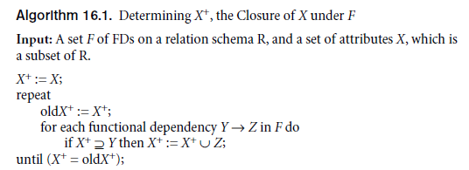
Closure

Slide 40
2.3 Equivalence of Sets of FDs
Two sets of FDs F and G are equivalent if:
Every FD in F can be inferred from G, and
Every FD in G can be inferred from F
Hence, F and G are equivalent if F⁺ =G⁺
Definition (Covers):
F covers G if every FD in G can be inferred from F
(i.e., if G⁺ subset-of F⁺)
F and G are equivalent if F covers G and G covers F
There is an algorithm for checking equivalence of sets of FDs

Slide 41
2.4 Minimal Sets of FDs (1)
A set of FDs is minimal if it satisfies the following conditions:
Every dependency in F has a single attribute for its RHS.
We cannot remove any dependency from F and have a set of dependencies that is equivalent to F.
We cannot replace any dependency X → A in F with a dependency Y → A, where Y proper-subset-of X ( Y subset-of X) and still have a set of dependencies that is equivalent to F.

Slide 42
Minimal Sets of FDs (2)
Every set of FDs has an equivalent minimal set
There can be several equivalent minimal sets
There is no simple algorithm for computing a minimal set of FDs that is equivalent to a set F of FDs
To synthesize a set of relations, we assume that we start with a set of dependencies that is a minimal set
E.g., see algorithms 11.2 and 11.4

Slide 43
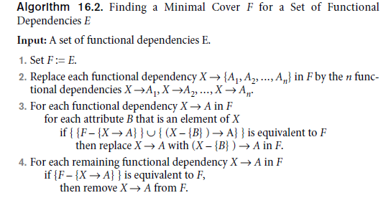
Minimal Cover

Slide 44
Computing the Minimal Sets of FDs
We illustrate the above algorithm with the following:
Let the given set of FDs be E : {B → A, D → A, AB → D}.We have to find the minimum
cover of E.
■ All above dependencies are in canonical form; so we have completed step 1
of Algorithm 10.2 and can proceed to step 2. In step 2 we need to determine
if AB → D has any redundant attribute on the left-hand side; that is, can it be
replaced by B → D or A → D?
■ Since B → A, by augmenting with B on both sides (IR2), we have BB → AB, or
B → AB (i). However, AB → D as given (ii).
■ Hence by the transitive rule (IR3), we get from (i) and (ii), B → D. Hence
AB → D may be replaced by B → D.
■ We now have a set equivalent to original E , say E′ : {B → A, D → A, B → D}.
No further reduction is possible in step 2 since all FDs have a single attribute
on the left-hand side.
■ In step 3 we look for a redundant FD in E′. By using the transitive rule on
B → D and D → A, we derive B → A. Hence B → A is redundant in E’ and can
be eliminated.
■ Hence the minimum cover of E is {B → D, D → A}.

Slide 45
3 Normal Forms Based on Primary Keys
3.1 Normalization of Relations
3.2 Practical Use of Normal Forms
3.3 Definitions of Keys and Attributes Participating in Keys
3.4 First Normal Form
3.5 Second Normal Form
3.6 Third Normal Form

Slide 46
3.1 Normalization of Relations (1)
Normalization:
Normalization of data can be considered a process of analyzing the given relation schemas based on their FDs and primary keys to achieve the desirable properties of (1) minimizing redundancy and (2) minimizing the insertion, deletion, and update anomalies.
The process of decomposing unsatisfactory "bad" relations by breaking up their attributes into smaller relations.
The normal form of a relation refers to the highest normal form condition that it meets, and hence indicates the degree to which it has been normalized.

Slide 47
Normalization of Relations (2)
1NF,2NF, 3NF, BCNF based on keys and FDs of a relation schema
Additional properties may be needed to ensure a good relational design (lossless join, dependency preservation)
The lossless join or non-additive join property, which guarantees that the spurious tuple generation problem does not occur with respect to the relation schemas created after decomposition (must be achieved at any cost).
The dependency preservation property, which ensures that each functional dependency is represented in some individual relation resulting after decomposition (desirable, sometimes sacrificed).

Slide 48
3.2 Practical Use of Normal Forms
Normalization is carried out in practice so that the resulting designs are of high quality and meet the desirable properties.
The practical utility of these normal forms becomes questionable when the constraints on which they are based are hard to understand or to detect.
The database designers need not normalize to the highest possible normal form.
(usually up to 3NF, BCNF or 4NF)
Denormalization is the process of storing the join of higher normal form relations as a base relation, which is in a lower normal form.
Denormalization is a database optimization technique in which we add redundant data to one or more tables. This can help us avoid costly joins in a relational database. Note that denormalization does not mean not doing normalization. It is an optimization technique that is applied after doing normalization.

Slide 49
3.3 Definitions of Keys and Attributes Participating in Keys (1)
A super key of a relation schema R = {A1, A2, ..., An} is a set of attributes S subset-of R with the property that no two tuples t1 and t2 in any legal relation state r of R will have t1[S] = t2[S]
A key K is a super key with the additional property that removal of any attribute from K will cause K not to be a super key any more.

Slide 50
Definitions of Keys and Attributes Participating in Keys (2)
If a relation schema has more than one key, each is called a candidate key.
One of the candidate keys is arbitrarily designated to be the primary key, and the others are called secondary keys.
An attribute of relation schema R is called a Prime attribute of R if it is a member of some candidate key of R.
An attribute is called nonprime if it is not a prime attribute—that is, it is not a member of any candidate key.

Slide 51
3.2 First Normal Form
First normal form (1NF) :A relation is in first normal form if and only if the domain of each attribute contains only atomic (indivisible) values, and the value of each attribute contains only a single value from that domain.
Disallows
composite attributes
multivalued attributes
nested relations: attributes whose values for an individual tuple are non-atomic
Considered to be part of the definition of relation

Slide 52
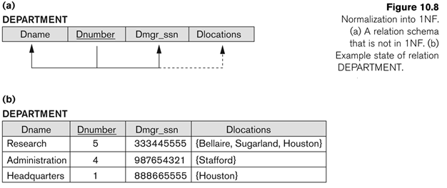
A relation schema that is not in 1NF

Slide 53
Normalization of multivalued attributes into 1NF
There are three main techniques to achieve first normal form for such a relation:
Remove the attribute Dlocations that violates 1NF and place it in a separate relation DEPT_LOCATIONS along with the primary key Dnumber of DEPARTMENT.

Slide 54
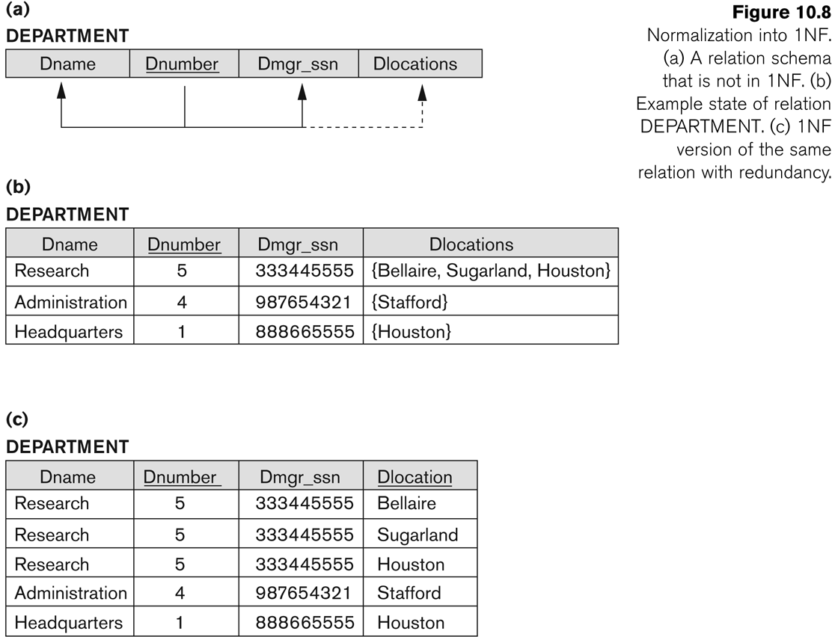
Normalization of multivalued attributes into 1NF
Expand the key so that there will be a separate tuple in the original DEPARTMENT relation for each location of a DEPARTMENT.
Fig: 1NF version of the same relation with redundancy

Slide 55
Normalization of multivalued attributes into 1NF
If a maximum number of values is known for the attribute – for example, if it is known that at most three locations can exist for a department – replace the Dlocations attribute by three atomic attributes: Dloc1, Dloc2, and Dloc3. This solution has the disadvantage of introducing NULL values if most departments have fewer than three locations.
Dname | Dnumber | Dmgr_ssn | Dloc1 | Dloc2 | Dloc3
Research | 5 | 333445555 | Bellaire | Sugarland | Houston
Administration | 4 | 987654321 | Stafford | NULL | NULL
Headquarters | 1 | 888665555 | Houston | NULL | NULL

Slide 56
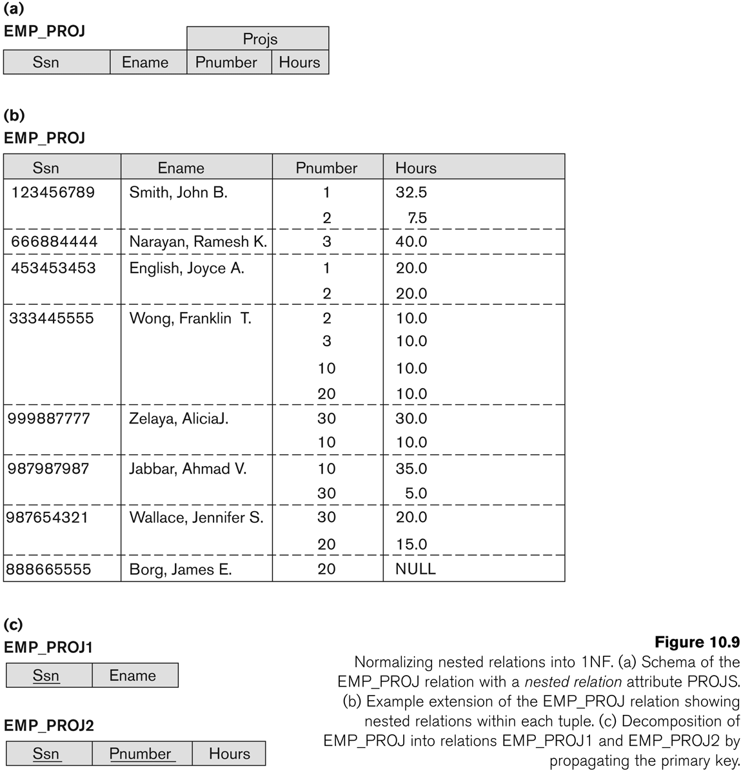
Normalization of nested relations into 1NF
EMP_PROJ(Ssn, Ename, {PROJS(Pnumber, Hours)})

Slide 57
Normalization into 1NF
Of the three solutions, the first is generally considered best because it does not suffer from redundancy and it is completely general, having no limit placed on a maximum number of values.

Slide 58
3.3 Second Normal Form
First it is in 1NF
A relation schema R is in 2NF if every nonprime attribute A in R is fully functionally dependent on the primary key of R.
Prime attribute: An attribute that is member of the primary key K
Full functional dependency: a FD Y → Z where removal of any attribute from Y means the FD does not hold any more.
Examples:
{SSN, PNUMBER} → HOURS is a full FD since neither SSN → HOURS nor PNUMBER → HOURS hold
{SSN, PNUMBER} → ENAME is not a full FD (it is called a partial dependency ) since SSN → ENAME also holds

Slide 59
Partial Dependency
A functional dependency X→Y is a partial dependency if some attribute A ∈ X can be removed from X and the dependency still holds;
that is, for some A ∈ X, (X – {A}) → Y.
If a relation contains partial dependency FD set(s) then we can say the relation is not in 2NF.
If a relation schema is not in 2NF, it can be normalized into a number of 2NF relations in which nonprime attributes are associated only with the part of the primary key on which they are fully functionally dependent.

Slide 60
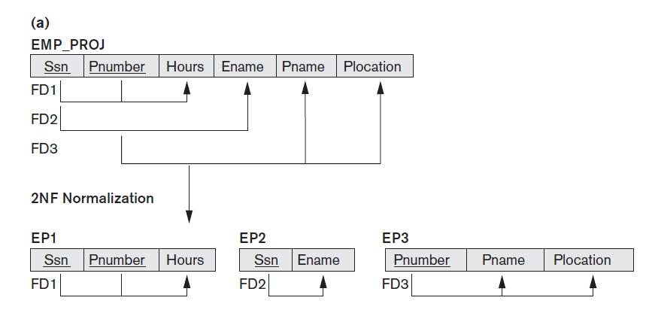
Normalizing into 2NF

Slide 61
Second Normal Form (2)
A relation schema R is in second normal form (2NF) if every non-prime attribute A in R is fully functionally dependent on the primary key
R can be decomposed into 2NF relations via the process of 2NF normalization
The test for 2NF involves testing for functional dependencies whose left-hand side attributes are part of the primary key.
If the primary key contains a single attribute, the test need not be applied at all.

Slide 62
3.4 Third Normal Form (1)
Definition:
Transitive functional dependency: a FD X → Z that can be derived from two FDs X → Y and Y → Z
Examples:
SSN → DMGRSSN is a transitive FD
Since SSN → DNUMBER and DNUMBER → DMGRSSN hold
SSN → ENAME is non-transitive
Since there is no set of attributes X where SSN → X and X → ENAME

Slide 63
Third Normal Form (2)
A relation schema R is in third normal form (3NF) if it is in 2NF and no non-prime attribute A in R is transitively dependent on the primary key
R can be decomposed into 3NF relations via the process of 3NF normalization
NOTE:
In X → Y and Y → Z, with X as the primary key, we consider this a problem only if Y is not a candidate key.
When Y is a candidate key, there is no problem with the transitive dependency .
E.g., Consider EMP (SSN, Emp#, Salary ).
Here, SSN -> Emp# -> Salary and Emp# is a candidate key.

Slide 64
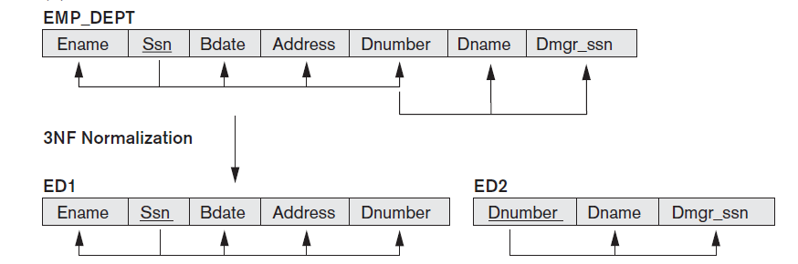
Normalizing into 3NF

Slide 65
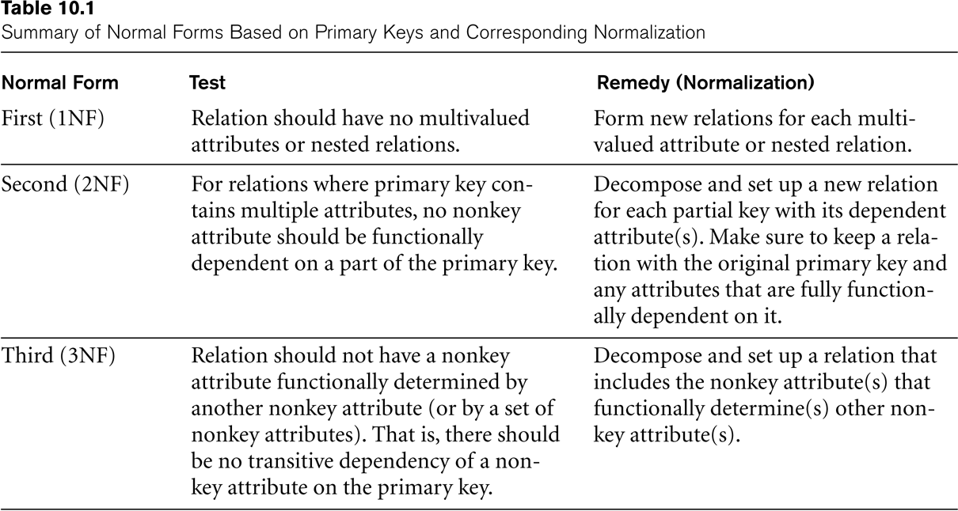
SUMMARY OF NORMAL FORMS based on Primary Keys

Slide 66
4 General Normal Form Definitions (For Multiple Keys) (1)
The above definitions consider the primary key only
The following more general definitions take into account relations with multiple candidate keys
A relation schema R is in second normal form (2NF) if every non-prime attribute A in R is fully functionally dependent on every key of R

Slide 67
General Normal Form Definitions (2)
Definition:
Superkey of relation schema R - a set of attributes S of R that contains a key of R
A relation schema R is in third normal form (3NF) if whenever a FD X → A holds in R, then either:
(a) X is a superkey of R, or
(b) A is a prime attribute of R
NOTE: Boyce-Codd normal form disallows condition (b) above

Slide 68
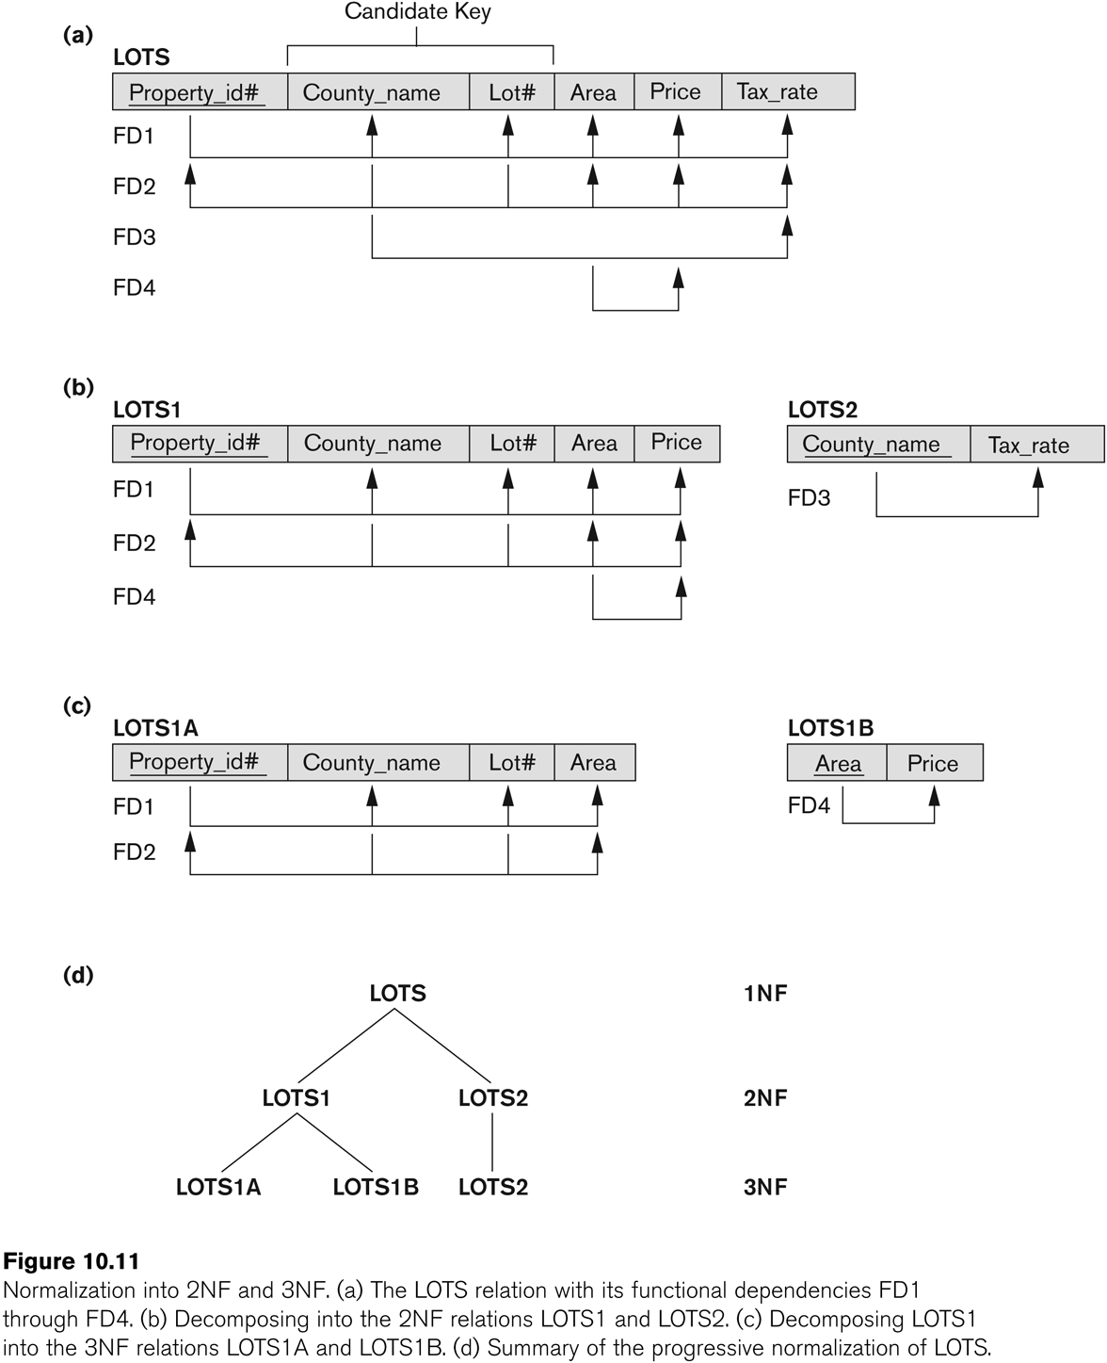
Successive Normalization of LOTS into 2NF and 3NF

Slide 69
5 BCNF (Boyce-Codd Normal Form)
A relation schema R is in Boyce-Codd Normal Form (BCNF) if whenever an FD X → A holds in R, then X is a super key of R
Each normal form is strictly stronger than the previous one
Every 2NF relation is in 1NF
Every 3NF relation is in 2NF
Every BCNF relation is in 3NF
There exist relations that are in 3NF but not in BCNF
The goal is to have each relation in BCNF (or 3NF)

Slide 70
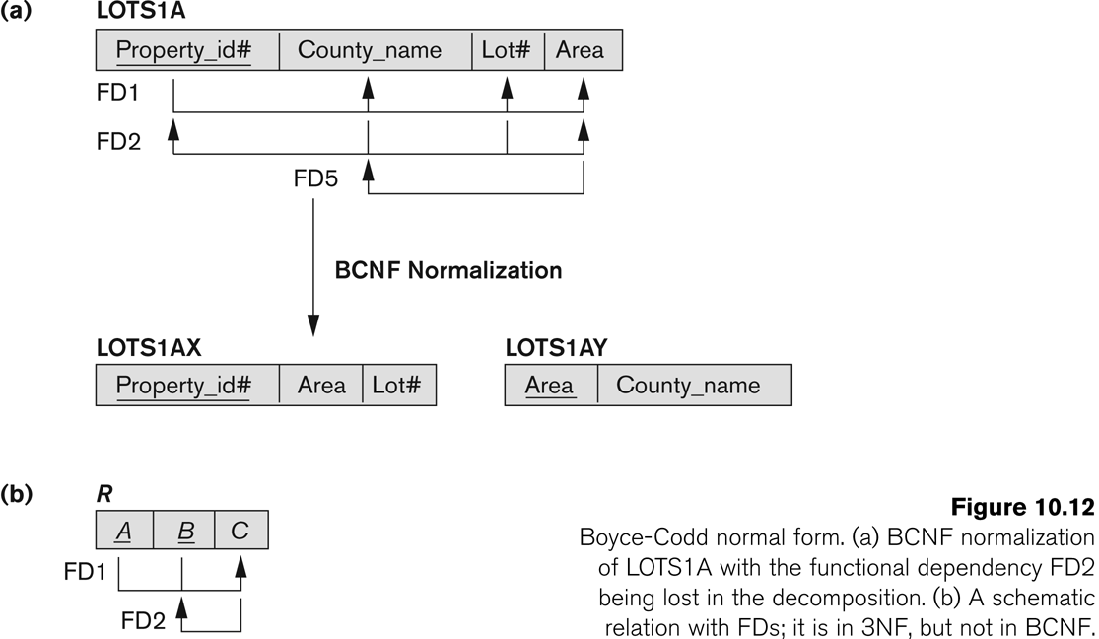
Boyce-Codd Normal Form
FD5 satisfies 3NF in LOTS1A because County_name is a prime attribute

Slide 71
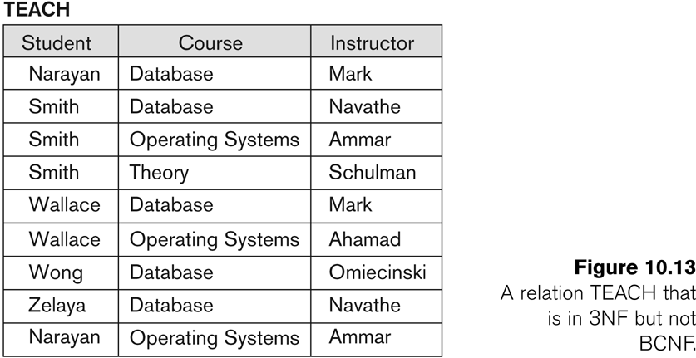
A relation TEACH that is in 3NF but not in BCNF

Slide 72
Achieving the BCNF by Decomposition (1)
Two FDs exist in the relation TEACH:
fd1: { student, course} → instructor
fd2: instructor → course
{student, course} is a candidate key for this relation and that the dependencies shown follow the pattern in Figure 10.12 (b).
So this relation is in 3NF but not in BCNF
A relation NOT in BCNF should be decomposed so as to meet this property, while possibly forgoing the preservation of all functional dependencies in the decomposed relations.
(See Algorithm 11.3)

Slide 73
Achieving the BCNF by Decomposition (2)
Three possible decompositions for relation TEACH
{student, instructor} and {student, course}
{course, instructor } and {course, student}
{instructor, course } and {instructor, student}
All three decompositions will lose fd1.
We have to settle for sacrificing the functional dependency preservation. But we cannot sacrifice the non-additivity property after decomposition.
Out of the above three, only the 3rd decomposition will not generate spurious tuples after join.(and hence has the non-additivity property).

Slide 74
Multivalued Dependency and Fourth Normal Form
Definition: A relation is in 4NF, if it is in BCNF and contains no multivalued dependency.
4NF is a level of database normalization where there are non-trivial multivalued dependencies.
If there is a relation R(A,B,C)
A has multiple values of B, and A has multiple values of C, but B and C are not related. A->>B, A->>C
As in this table trivial MVD exists so this table is suffering from all anamolies. So splitting of table is required.

Slide 75
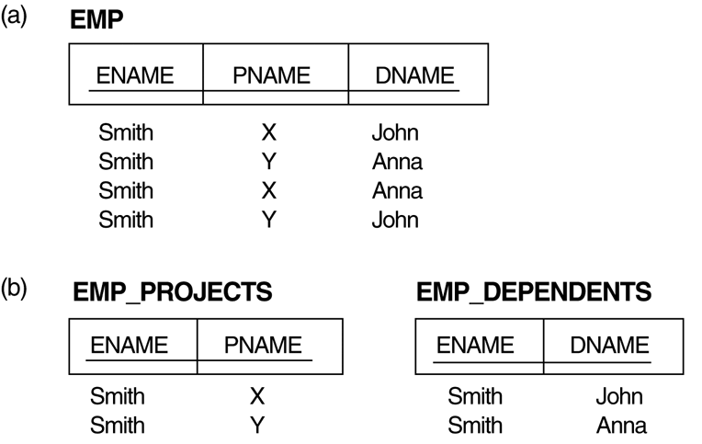
3. Multivalued Dependencies and Fourth Normal Form (1)
The EMP relation with two MVDs: ENAME —>> PNAME and ENAME —>> DNAME.
Decomposing the EMP relation into two 4NF relations EMP_PROJECTS and EMP_DEPENDENTS.

Slide 76
Multivalued Dependencies and Fourth Normal Form (2)
Definition:
A multivalued dependency (MVD) X —>> Y specified on relation schema R, where X and Y are both subsets of R, specifies the following constraint on any relation state r of R: If two tuples t₁ and t₂ exist in r such that t₁[X] = t₂[X], then two tuples t₃ and t₄ should also exist in r with the following properties, where we use Z to denote (R -- (X υ Y)):
t₃[X] = t₄[X] = t₁[X] = t₂[X].
t₃[Y] = t₁[Y] and t₄[Y] = t₂[Y].
t₃[Z] = t₂[Z] and t₄[Z] = t₁[Z].
An MVD X —>> Y in R is called a trivial MVD if (a) Y is a subset of X, or (b) X υ Y = R.
Informally, whenever two independent 1:N relationships A:B and A:C are mixed in the same relation, R(A, B, C), an MVD may arise.

Slide 78
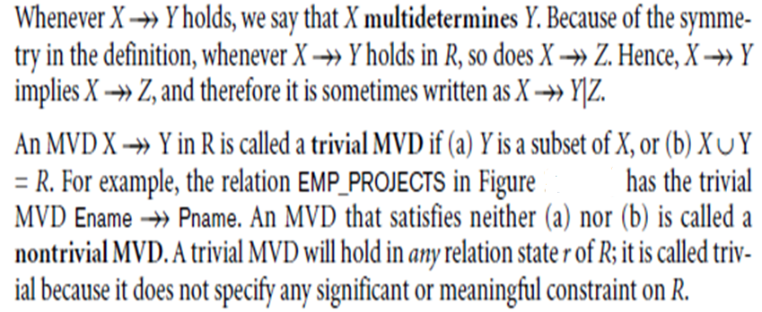
Multivalued Dependencies and Fourth Normal Form (2)

Slide 79
Multivalued Dependencies and Fourth Normal Form (4)
Definition:
A relation schema R is in 4NF with respect to a set of dependencies F (that includes functional dependencies and multivalued dependencies) if, for every nontrivial multivalued dependency X —>> Y in F⁺, X is a superkey for R.

Slide 80
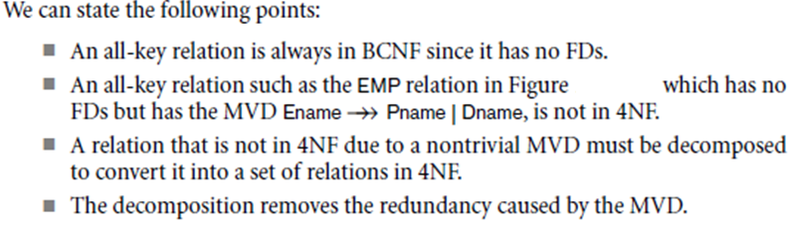
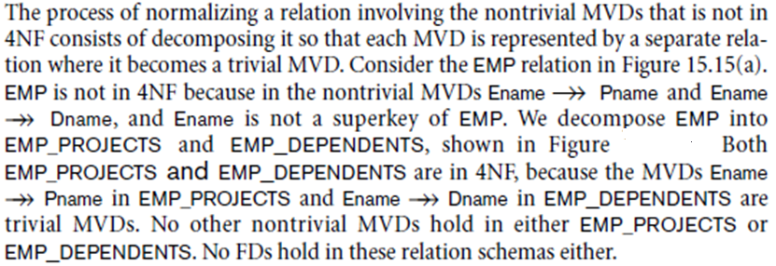
Multivalued Dependencies and Fourth Normal Form (4)

Slide 81
Multivalued Dependencies and Fourth Normal Form (6)
Lossless (Non-additive) Join Decomposition into 4NF Relations:
PROPERTY LJ1’
The relation schemas R₁ and R₂ form a lossless (non-additive) join decomposition of R with respect to a set F of functional and multivalued dependencies if and only if
(R₁ ∩ R₂) —>> (R₁ - R₂)
or by symmetry, if and only if
(R₁ ∩ R₂) —>> (R₂ - R₁)).

Slide 82
Fifth Normal Form/ Project-Join Normal form
A relation R is in Fifth Normal Form (5NF) if and only if the following conditions are satisfied simultaneously: 1. R is already in 4NF. 2. Not contains any join dependencies and joining should be lossless
5NF is of little practical use to the database designer
In considering 5NF, consideration must be given to tables where this non-loss decomposition can only be achieved by decomposition into three or more separate tables.

Slide 83
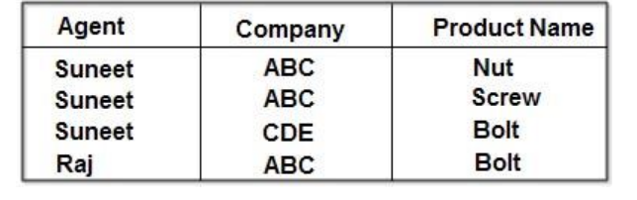
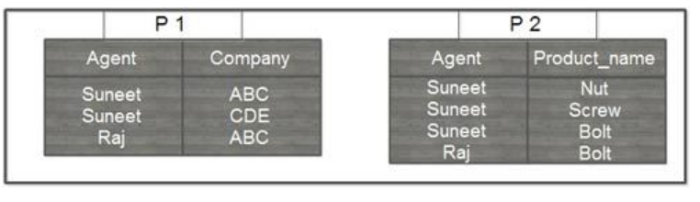
Agent_Company_Product Name

Slide 84
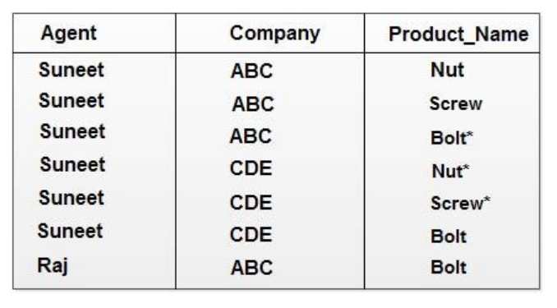
Spurious Tuples

Slide 85
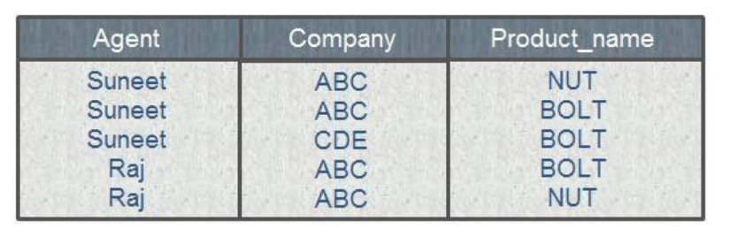
If a join is taken of all three projections, first of PI and P2 with the (spurious) result shown above, and then of this result with P3 over the ‘Company’ and ‘Product name’ column, the following table is obtained:
Still spurious Tuple

Slide 86
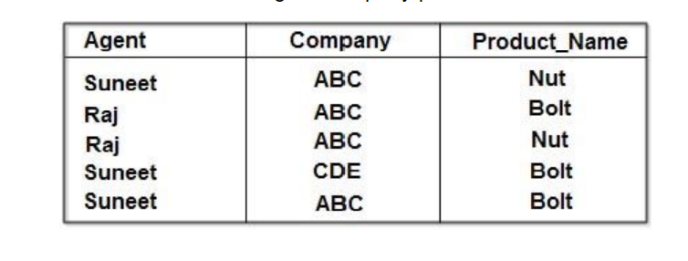
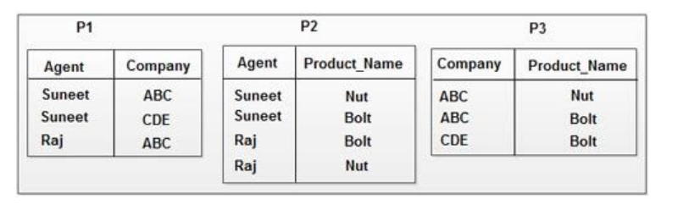
Another Example
Agent_Company_productName1

Slide 87
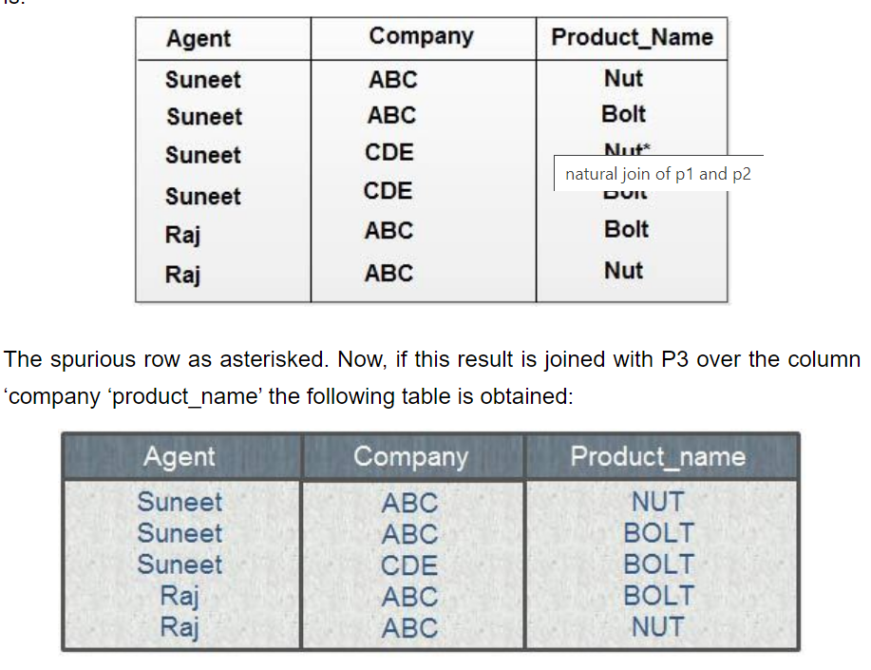

Slide 88
This is a correct de-composition of the original table and no loss decomposition into the three projections was achieved.
Again, the order in which the joins are performed does not affect the final result.
The original table, therefore, violated 5NF simply because it was lossless decomposable into its three projections.
Detecting that a table violates 5 NF is very difficult in practice and for this reason this normal form has little in any practical application.

