Slide 1
UNIT – IV
Backtracking – 0/1 KNAPSACK

Slide 2
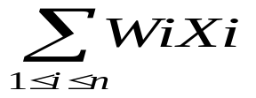

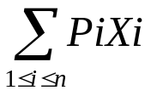
0/1 KNAPSACK
The problem is similar to the zero-one (0/1) knapsack optimization problem in dynamic programming algorithm.
We are given ‘n’ positive weights Wi and ’n’ positive profits Pi, and a positive number ‘m’ that is the knapsack capacity, then problem calls for choosing a subset of the weights such that,
is Maximized.
Xi →Constitute Zero-one valued Vector.
m and

Slide 3
The Solution space is the same as that for the N-Queens problem.
Bounding functions are needed to help kill some live nodes without expanding them. A good bounding function for this problem is obtained by using an upper bound on the value of the best feasible solution obtainable by expanding the given live node.
The profits and weights are assigned in descending order depend upon the ratio.
(i.e.) Pi/Wi > P(i+1) / W(i+1)

Slide 4
Procedure:
After assigning the profit and weights, we have to take the first object weights and check if the first weight is less than or equal to the capacity, if so then we include that object (i.e.) the unit is 1.(i.e.) K→ 1.
Then we are going to the next object, if the object weight is exceeded that object does not fit. So unit of that object is ‘0’.(i.e.) K=0.

Slide 5
Then we are going to the bounding function, this function determines an upper bound on the best solution obtainable at level K+1.
Repeat the process until we reach the optimal solution.

Slide 6
Algorithm
Algorithm Bknap(k,cp,cw)
// ‘m’ is the size of the knapsack;
// ‘n’ →no. of objects
//W[]&P[] are the weights
//Place objects in order of P[i]/W[i] > P[i+1]/W[i+1].
//fw→Final weights of knapsack.
//fp→ final max.profit.
//x[k] = 0 if W[k] is not the knapsack, else X[k]=1.

Slide 7
{
// Generate left child.
If((W+W[k]<=m) then
{
Y[k] =1;
If(k<n) then Bnap(k+1,cp+P[k],
Cw +W[k]) If((Cp + p[w] > fp) and (k=n)) then
{
fp = cp + P[k]; fw = Cw+W[k];

Slide 8
for j=1 to k do X[j] = Y[j];
} }
if(Bound(cp,cw,k) >=fp) then
{
y[k] = 0;
if(k<n) then Bnap (K+1,cp,cw);
if((cp>fp) and (k=n)) then
{
fp = cp;
fw = cw;
for j=1 to k do X[j] = Y[j];
} }
}

Slide 9
Algorithm for Bounding function:
Algorithm Bound(cp,cw,k)
// cp→ current profit total.
//cw→ current weight total.
//k→the index of the last removed item.
//m→the knapsack size.
{
b=cp;
c=cw;

Slide 10
for i =k+1 to n do
{
c= c+w[i];
if (c<m) then b=b+p[i];
else return b+ (1-(c-m)/W[i]) * P[i];
}
return b;
}
Note: To implement above algorithm we assume that the objects are arranged in non-increasing order of profits/ weights ratio. Initially take fp=-1.

Slide 11
Example:
Consider p=[23,24,15,13,16],w=[11,12,8,7,9]
Capacity m=26, n=4, the state space tree generated to solve this problem is:

Slide 12
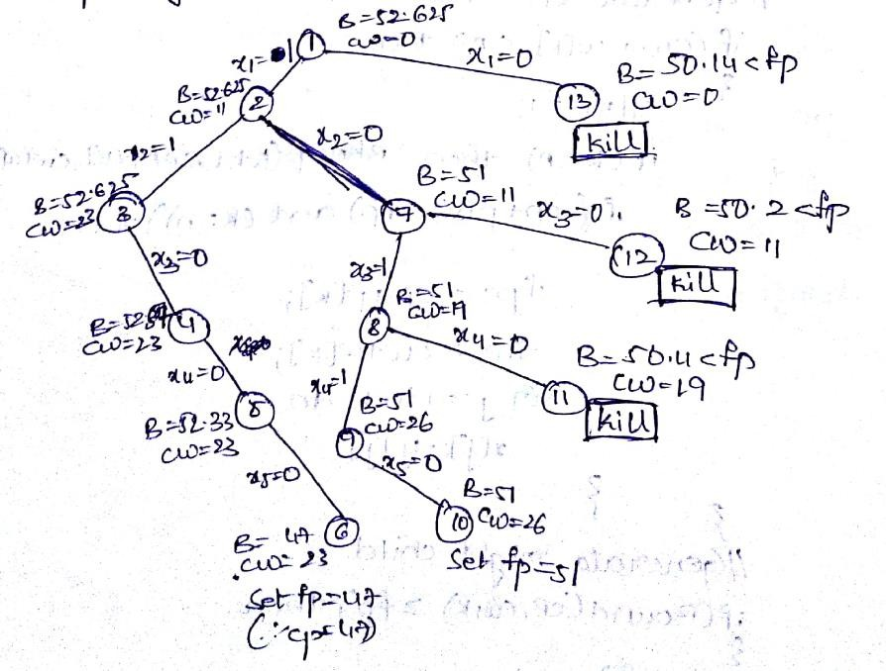
The state space tree generated to solve this problem is:
  ^{∴ Solution set (x}1^{,x}2^{,x}3^{,x}4^{,x}5^{) = (1,0,1,1,0)} Maximum profit =51
Solution set (x1,x2,x3,x4,x5) = (1,0,1,1,0) , Maximum profit =51
Note: In the above problem the node numbers are the order in which we are doing the recursive calls.

