Slide 1
UNIT-IV Branch & Bound General Method, Travelling Salesperson Problem, 0/1 Knapsack Problem

Slide 2
Branch & Bound (General method)
Branch and Bound is another method to systematically search a solution space. Just like backtracking, we will use bounding functions to avoid generating subtrees that do not contain an answer node.
However branch and Bound differs from backtracking in two important manners:
It has a branching function, which can be a depth first search, breadth first search or based on bounding function.
It has a bounding function, which goes far beyond the feasibility test as a mean to prune efficiently the search tree.
Branch and Bound refers to all state space search methods in which all children of the E-node are generated before any other live node becomes the E-node.

Slide 3
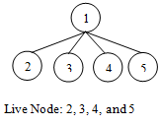
Terminology
Live node -> is a node that has been generated but whose children have not yet been generated.
E-node -> is a live node whose children are currently being explored.
Dead node -> Dead node is a generated node that is not to be expanded or explored any further. All children of a dead node have already been expanded.

Slide 4
Search Strategies in B&B
3 types search strategies we have in B&B
1. FIFO search
2. LIFO search
3. LC (Least Cost) search

Slide 5
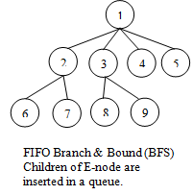
FIFO B&B
BFS→like state space search will be called FIFO (First In First Out) search as the list of live nodes is “First-in-first-out” list (or queue).

Slide 6
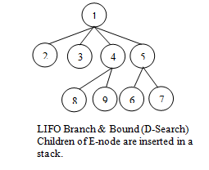
LIFO B&B
D-search (DFS)→ Like state space search will be called LIFO (Last In First Out) search as the list of live nodes is a “last-in-first-out” list (or stack).

Slide 7
LC B&B
The selection rule for the next E-node in FIFO or LIFO branch and bound is sometimes “blind”. i.e., the selection rule does not give any preference to a node that has a very good chance of getting the search to an answer node quickly.
The search for an answer node can often be speeded by using an “intelligent” ranking function. It is also called an approximate cost function “Ĉ”.
Expended node (E-node) is the live node with the best Ĉ value.
Each node X in the search tree is associated with a cost: Ĉ(X)
C=cost of reaching the current node, X(E-node) form the root + The cost of reaching an answer node form X.
Ĉ=g(X)+H(X).

Slide 8
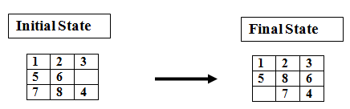
8-puzzle
Cost function: Ĉ = g(x) +h(x)
where h(x) = the number of misplaced tiles and g(x) = the number of moves so far
Assumption: move one tile in any direction cost 1.

Slide 9
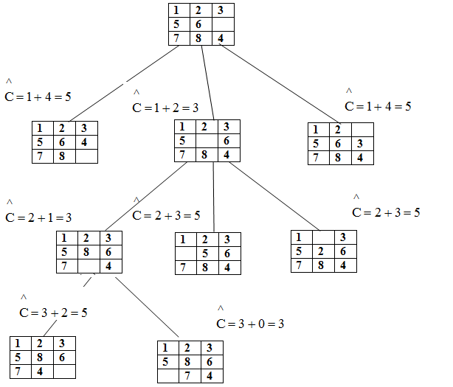

Slide 10
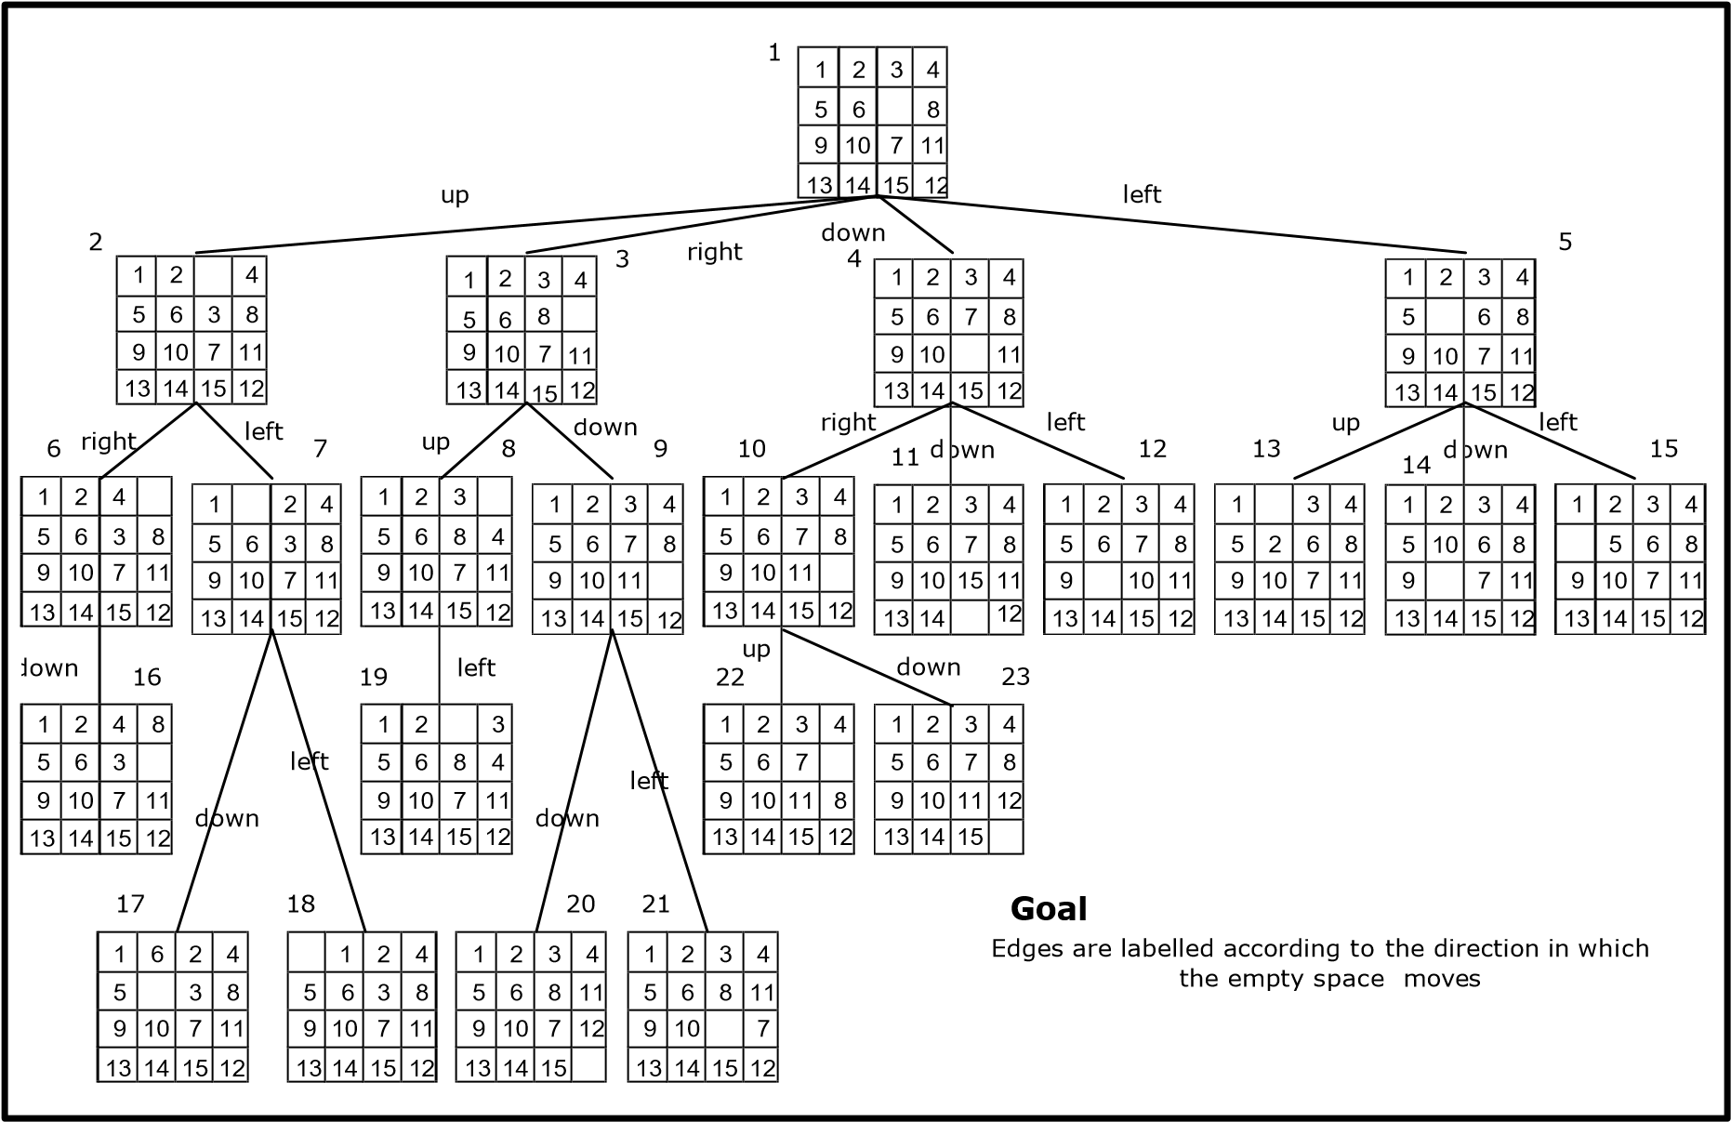
15-puzzle ( Part of the state space tree for 15-puzzle problem )

Slide 11
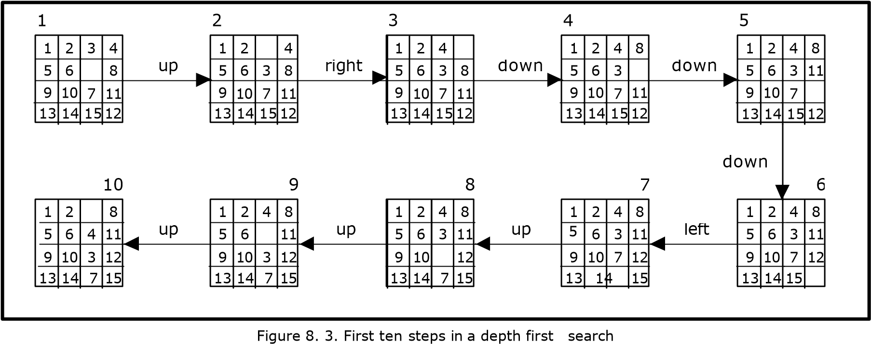

Slide 12
Travelling Salesman Problem
Def:- Find a tour of minimum cost starting from a node S going through other nodes only once and returning to the starting point S.
Time Complexity of TSP for Dynamic Programming algorithm is O(n²2^{n})
B&B algorithms for this problem, the worst case complexity will not be any better than O(n²2^{n}) but good bounding functions will enables these B&B algorithms to solve some problem instances in much less time than required by the dynamic programming algorithm.

Slide 13
Let G=(V,E) be a directed graph defining an instances of TSP.
Let C_{ij}→ cost of edge <i, j> ,C_{ij} =∞ if <i, j> ∉ E
|V|=n→ total number of vertices.
Assume that every tour starts & ends at vertex 1.
Solution Space S= {1, Π , 1 | Π is a permutation of (2, 3. 4. ----n) } then |S|=(n-1)!
The size of S reduced by restricting S
So that {1, i₁,i2,-----i_{n-1}, 1}∈ S iff <i_{j}, i_{j+1}>∈ E. O≤j≤n-1, i₀-i_{n}=1
S can be organized into “State space tree”.

Slide 14
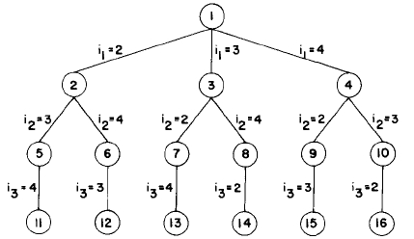
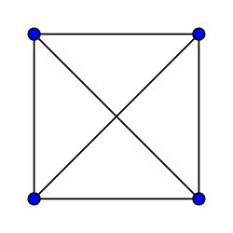
Consider the following Example
1
2
3
4
State space tree for the travelling salesperson problem with n=4 and i₀=i₄=1
The above diagram shows tree organization of a complete graph with |V|=4.
Each leaf node ‘L’ is a solution node and represents the tour defined by the path from the root to L.
Node 12 represents the tour. i₀=1, i₁=2, i₂=4, i₃=3, i₄=1
Node 14 represents the tour.i₀=1, i₁=3, i₂=4, i₃=2, i₄=1.

Slide 15
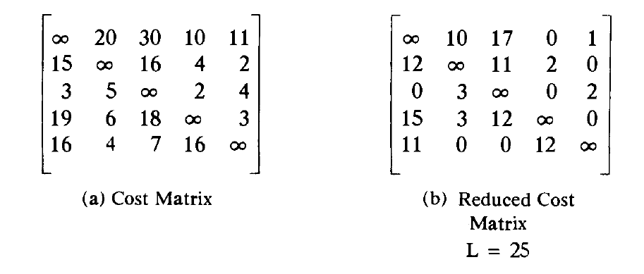
TSP is solved by using LC Branch & Bound:
To use LCBB to search the travelling salesperson “State space tree” first define a cost function C(.)
A better Ĉ(r) can be obtained by using the reduced cost matrix corresponding to G.
A row (column) is said to be reduced iff it contains at least one zero & remaining entries are non negative.
A matrix is reduced iff every row & column is reduced.

Slide 16
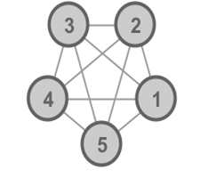
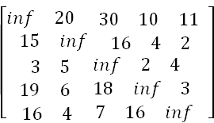
Example:
Given the following cost matrix:
The TSP starts from node 1: Node 1
Reduced Matrix: To get the lower bound of the path starting at node 1

Slide 18
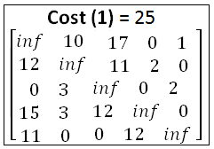
The reduced cost is: RCL = 25
So the cost of node 1 is: Cost (1) = 25
The reduced matrix is:

Slide 19
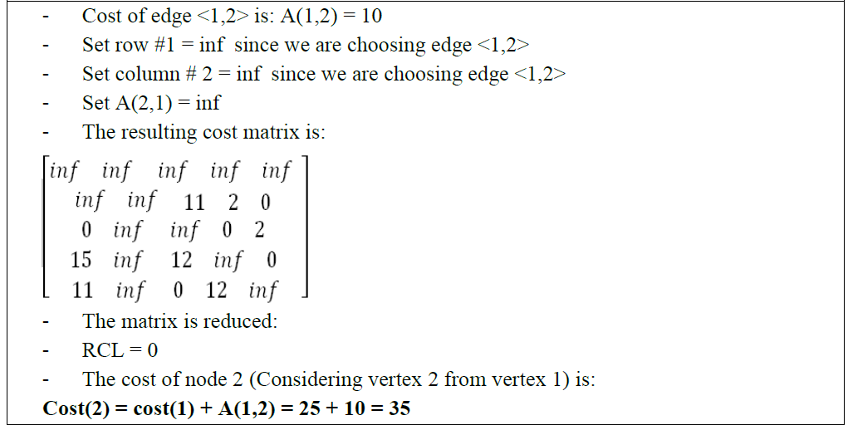
Choose to go to vertex 2: Node 2

Slide 23
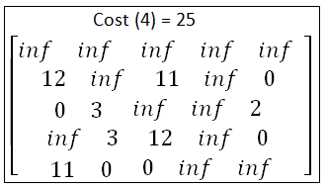
In summary:
So the live nodes we have so far are:
2: cost(2) = 35, path: 1->2
3: cost(3) = 53, path: 1->3
4: cost(4) = 25, path: 1->4
5: cost(5) = 31, path: 1->5
Explore the node with the lowest cost: Node 4 has a cost of 25
Vertices to be explored from node 4: 2, 3, and 5
Now we are starting from the cost matrix at node 4 is:

Slide 24
Choose to go to vertex 2: Node 6 (path is 1->4->2)

Slide 25
Choose to go to vertex 3: Node 7 ( path is 1->4->3 )

Slide 27
Choose to go to vertex 5: Node 8 ( path is 1->4->5 )

Slide 29
Choose to go to vertex 3: Node 9 ( path is 1->4->2->3 )

Slide 31
Choose to go to vertex 5: Node 10 ( path is 1->4->2->5 )

Slide 33
Choose to go to vertex 3: Node 11 ( path is 1->4->2->5->3 )

Slide 35


0/1 Knapsack – Branch& Bound
Knapsack problem is a problem in combinatorial optimization, Given a set of items, each with a mass & a value, determine the number of each item to include in a collection so that the total weight is less than or equal to a given limit & the total value is as large as possible.
The formula can be stated as
X_{i}=0 or 1 1 ≤ i ≤ n
To solve o/1 knapsack problem using B&B:
Knapsack is a maximization problem
Replace the objective function by the function to make it into a minimization problem.

Slide 36
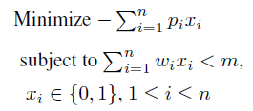
The modified knapsack problem is stated as
To solve this we need to calculate lower bound(L) and upper bound(U) for each node.
For calculating upper bound(U) we will not consider fraction of an object, but for Lower bounds(L) we will consider fraction of an object also.
Example: Consider the instance: M = 15, n = 4, (P₁, P₂, P₃, P₄) = (10, 10, 12, 18) and (w₁, w₂, w₃, w₄) = ( 2, 4, 6, 9).
Ans: Set upper = infinity
Place first item in knapsack.
Remaining weight of knapsack is 15 – 2 = 13.
Place next item w₂ in knapsack and the remaining weight of knapsack is 13 – 4 = 9.
Place next item w₃ in knapsack then the remaining weight of knapsack is 9 – 6 = 3.
No fractions are allowed in calculation of upper bound so w₄ cannot be placed in knapsack.

Slide 37
Profit = P₁ + P₂ + P₃ = 10 + 10 + 12
So, Upper bound = 32
To calculate lower bound we can place w₄ in knapsack since fractions are allowed in calculation of lower bound.
Lower bound = 10 + 10 + 12 + (3/9)X 18) = 32 + 6 = 38
Knapsack problem is maximization problem but branch and bound technique is applicable for only minimization problems. In order to convert maximization problem into minimization problem we have to take negative sign for upper bound and lower bound.
Therefore, Upper bound (U) = -32
Lower bound (L) = -38
upper=-32 ( because infinity >-32)

Slide 38



Now we will calculate upper bound and lower bound for nodes 2, 3.
For node 2, x₁= 1, means we should place first item in the knapsack.
U = 10 + 10 + 12 = 32, make it as -32
L = 10 + 10 + 12 + (3/9) x 18 = 32 + 6 = 38, make it as -38
For node 3, x₁ = 0, means we should not place first item in the knapsack.
U = 10 + 12 = 22, make it as -22
L = 10 + 12 + (5/9) x 18 = 10 + 12 + 10 = 32, make it as -32
U =
-
32
1
L =
-
38
x1
=
1
x1 =
0
U
=
-
32
U =
-
22
2
3
L =
-
38
L =
-
32

Slide 39





Choose node 2, since it has minimum L value
Now we will calculate lower bound and upper bound of node 4 and 5.
U
=
-
32
L =
1
-
38
x1
=
1
x1 =
0
U =
U
=
-
32
-
22
L
=
-
38
2
3
L =
-
32
x2
=
1
x2 =
0
U =
-
32
4
5
U
=
-
22
L =
-
38
L =
-
36
Choose node 4, since it has minimum L value
Now we will calculate lower bound and upper bound of node 6 and 7.

Slide 40







U =
-
32
1
L =
-
38
x1
=
1
x1 =
0
U
=
-
32
U =
2
3
-
22
L =
-
38
L =
-
32
x2
=
1
x2 =
0
U =
-
32
U =
4
5
-
22
L
=
-
38
L =
-
36
x3
=
1
x3 =
0
U =
-
32
U =
6
7
-
38
L
=
-
38
L =
-
38
Update upper because upper(-32) >U(-38) at node 7
upper=-38
Node 3 & 5 have L value > upper so kill node 3 and node 5.
Node 6 & 7 have minimum L value , so compare U values
Choose node 7, since it has minimum L value and U value
Now we will calculate lower bound and upper bound of node 8 and 9.

Slide 41









U =
-
32
L =
1
-
38
x1
=
1
x1 =
0
U
=
-
32
U =
2
3
-
22
L =
-
38
L =
-
32
x2
=
1
x2 =
0
U =
-
32
U =
L
=
-
38
4
5
L =
-
22
-
36
x3
=
1
x3 =
0
U =
-
32
U =
L
=
-
38
6
7
-
38
L =
-
38
x4
=
1
x4 =
0
U =
-
38
U =
8
9
-
20
L
=
-
38
L =
-
20
Node 9 has L value > upper so kill it and consider node 8 because node 6 & 8 have same L value but node 8 has U value < node 6 U value.
Consider the path from 1 ->2 -> 4 -> 7 -> 8
X₁ = 1 , X₂ = 1, X₃ = 0, X₄ = 1
The solution for 0/1 Knapsack problem is (x₁, x₂, x₃, x₄) = (1, 1, 0, 1) Maximum profit is:
∑ P_{i} x_{i} = 10 x 1 + 10 x 1 + 12 x 0 + 18 x 1 = 10 + 10 + 18 = 38.

