Slide 1
Hamiltonian Cycle Problem

Slide 2
Definition
Let G=(V,E) be a connected graph with ‘n’ vertices. A HAMILTONIAN CYCLE is a round trip path along ‘n’ edges of G that visits every vertex once and returns to its starting position.
If the Hamiltonian cycle begins at some vertex V1 belongs to G and the vertices of G are visited in the order of V1,V2…….Vn+1,then the edges (Vi,Vi+1) are in E,1<=i<=n, and the Vi are distinct except for V1 and Vn+1 which are equal.

Slide 3
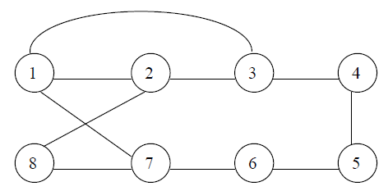
Example

Slide 4
1. Define a solution vector X(X1……..Xn) where Xi represents the ith visited
vertex of the proposed cycle.
2. Create a cost adjacency matrix for the given graph.
3. The solution array initialized to all zeros except X(1)=1,b’coz the cycle should start at vertex ‘1’.
4. Now we have to find the second vertex to be visited in the cycle.
5. The vertex from 1 to n are included in the cycle one by one by checking 2
Conditions,
1. There should be a path from previous visited vertex to current vertex.
2. The current vertex must be distinct and should not have been visited earlier.
6. When these two conditions are satisfied the current vertex is included in the Cycle; else the next vertex is tried.
7. When the nth vertex is visited we have to check, is there any path from nth vertex to first vertex. If no path, the go back one step and after the previous visited node.
8. Repeat the above steps to generate possible Hamiltonian cycle.

Slide 5
Algorithm Hamiltonian(k)
{
repeat
{
// generate values for X[k].
Nextvalue(k); // Assign a legal next value to X[k]
if (X[k]=0) then return;
if (k=n) then
Write(x[1:n]);
else Hamiltonian(k+1);
} until(false);
}

Slide 6
