Slide 1
UNIT – IV
Backtracking

Slide 2

Backtracking
Backtracking is a technique used to solve problems with a large search space, by systematically trying and eliminating possibilities.
A standard example of backtracking would be going through a maze.
  At some point in a maze, you might have two options of which direction to go:
Junction
Portion A
Portion B

Slide 3
Backtracking
One strategy would be to try going through Portion A of the maze.
  If you get stuck before you find your way out, then you "backtrack" to the junction.
At this point in time you know that Portion A will NOT lead you out of the maze,
  so you then start searching in Portion B
Junction
Portion B
Portion A

Slide 4

Backtracking
Clearly, at a single junction you could have even more than 2 choices.
The backtracking strategy says to try each choice, one after the other,
  if you ever get stuck, "backtrack" to the junction and try the next choice.
If you try all choices and never found a way out, then there IS no solution to the maze.
Junction
C
B
A

Slide 5
Backtracking
It is one of the most general algorithm design techniques.
Many problems which deal with searching for a set of solutions or for a optimal solution satisfying some constraints can be solved using the backtracking formulation.

Slide 6
To apply backtracking method, tne desired solution must be expressible as an n-tuple (x1…xn) where xi is chosen from some finite set Si.
The problem is to find a vector, which maximizes or minimizes a criterion function P(x1….xn).

Slide 7
The major advantage of this method is, once we know that a partial vector (x1,…xi) will not lead to an optimal solution that (m_{i+1}………..m_{n}) possible test vectors may be ignored entirely.
Many problems solved using backtracking require that all the solutions satisfy a complex set of constraints.

Slide 8
These constraints are classified as:
Explicit constraints.
Implicit constraints.
Explicit constraints:
Explicit constraints are rules that restrict each Xi to take values only from a given set.

Slide 9
Some examples are,
Xi >=0 or Si = {all non-negative real nos.}
Xi =0 or 1 or Si={0,1}.
Li <=Xi >=Ui or Si= {a: Li a Ui}
All tupules that satisfy the explicit constraint define a possible solution space for I.
Implicit constraints:
The implicit constraint determines which of the tuples in the solution space I can actually satisfy the criterion functions.

Slide 10
For 8-queens problem:
Explicit constraints using 8-tuple formation, for this problem are S= {1, 2, 3, 4, 5, 6, 7, 8}.
The implicit constraints for this problem are that no two queens can be the same (i.e., all queens must be on different columns) and no two queens can be on the same diagonal.

Slide 11
Algorithm IBacktracking (n)
// This schema describes the backtracking procedure .All solutions are generated in X[1:n] and printed as soon as they are determined.
{
k=1;
While (k != 0) do
{
if (there remains all untried
X[k] T (X[1],[2],…..X[k-1]) and Bk (X[1],…..X[k])) is true ) then
{
if(X[1],……X[k] )is the path to the answer node)
Then write(X[1:k]);
k=k+1; //consider the next step.
}
else k=k-1; //consider backtracking to the previous set.
}
}

Slide 12
Certain problems which are solved using backtracking method are,
1. Sum of subsets.
2. Graph coloring.
3. Hamiltonian cycle.
4. N-Queens problem.

Slide 13
Backtracking is a modified depth first search of a tree. Backtracking algorithms determine problem solutions by systematically searching the solution space for the given problem instance. This search is facilitated by using a tree organization for the solution space.
Backtracking is the procedure where by, after determining that a node can lead to nothing but dead end, we go back (backtrack) to the nodes parent and proceed with the search on the next child.
A backtracking algorithm need not actually create a tree. Rather, it only needs to keep track of the values in the current branch being investigated. This is the way we implement backtracking algorithm. We say that the state space tree exists implicitly in the algorithm because it is not actually constructed.

Slide 14
Terminology
Problem state is each node in the depth first search tree.
Solution states are the problem states “S” for which the path from the root node to “S” defines a tuple in the solution space.
Answer states are those solution states for which the path from root node to S defines a tuple that is a member of the set of solutions.

Slide 15
State space is the set of paths from root node to other nodes.
State space tree is the tree organization of the solution space. The state space trees are called static trees.
Live node is a node that has been generated but whose children have not yet been generated.
E-node is a live node whose children are currently being explored. In other words, an E-node is a node currently being expanded.
Dead node is a generated node that is not to be expanded or explored any further. All children of a dead node have already been expanded.
Branch and Bound refers to all state space search methods in which all children of an E-node are generated before any other live node can become the E-node.
Depth first node generation with bounding functions is called backtracking. State generation methods in which the E-node remains the E-node until it is dead, lead to branch and bound methods.

Slide 16

Backtracking – Eight Queens Problem
Find an arrangement of 8 queens on a single chess board such that no two queens are attacking one another.
In chess, queens can move all the way down any row, column or diagonal (so long as no pieces are in the way).
  Due to the first two restrictions, it's clear that each row and column of the board will have exactly one queen.

Slide 17

Backtracking – Eight Queens Problem
The backtracking strategy is as follows:
  Place a queen on the first available square in row 1.
  Move onto the next row, placing a queen on the first available square there (that doesn't conflict with the previously placed queens).
  Continue in this fashion until either:
    you have solved the problem, or
    you get stuck.
      When you get stuck, remove the queens that got you there, until you get to a row where there is another valid square to try.
Q
Q
Q
Q
Q
Q
Continue…
Animated Example:
http://www.hbmeyer.de/backtrack/achtdamen/eight.htm#up
https://www.youtube.com/watch?v=kdBzkxdJ7bI

Slide 18
Backtracking – Eight Queens Problem
When we carry out backtracking, an easy way to visualize what is going on is a tree that shows all the different possibilities that have been tried.
On the board we will show a visual representation of solving the 4 Queens problem (placing 4 queens on a 4x4 board where no two attack one another).

Slide 19
4 – Queens Problem
Let us see how backtracking works on the 4-queens problem. We start with the root node as the only live node. This becomes the E-node. We generate one child.
Let us assume that the children are generated in ascending order. Let us assume that the children are generated in ascending order. Thus node number 2 of figure is generated and the path is now (1). This corresponds to placing queen 1 on column 1.
Node 2 becomes the E-node. Node 3 is generated and immediately killed.
The next node generated is node 8 and the path becomes (1, 3). Node 8 becomes the E-node. However, it gets killed as all its children represent board configurations that cannot lead to an answer node. We backtrack to node 2 and generate another child, node 13. The path is now (1, 4). The board configurations as backtracking proceeds is as follows:

Slide 20

1
1
* | * | 2
1
* | * | 2
* | * | * | *
(a)
(b)
(c)
1
 |  |  | 2
* | 3
1
 |  |  | 2
* | 3
* | * | * | *
 | 1
(e)
(f)
(d)

Slide 21
 | 1
* | * | * | 2
 | 1
 |  |  | 2
3
 |  | 4
(g)
(h)

Slide 22
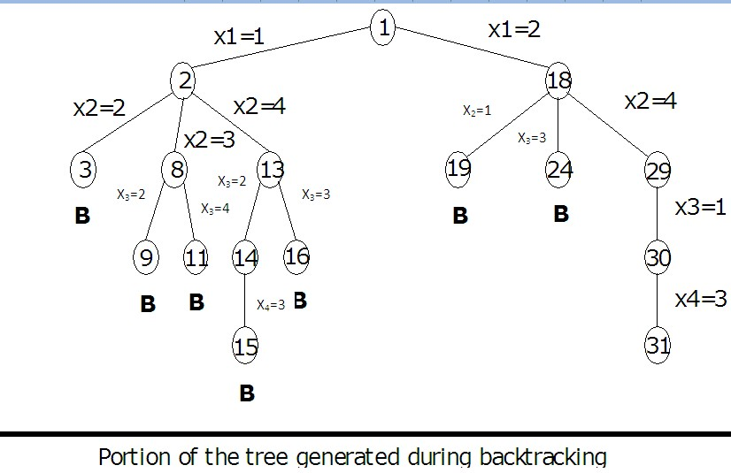

Slide 23
Complexity Analysis:
1 + n + n² ₊ n³ ₊ . . . . . . . . . . . +n^{n} ₌ (n^{n+1} -1) / (n-1)
For the instance in which n=8,the state space tree contains
(8⁸⁺¹ – 1) / (8-1) =19,173,961 nodes

Slide 24
Program for n queens problem
# include <stdio.h>
# include <conio.h>
# include <stdlib.h>
int x[10] = {5, 5, 5, 5, 5, 5, 5, 5, 5, 5};
place (int k)
{
int i;
for (i=1; i < k; i++)
{
if ((x [i] == x [k]) || (abs (x [i] – x [k]) == abs (i - k)))
return (0);
}
return (1);
}

Slide 25
nqueen (int n)
{
int m,k,i=0;
x [1] = 0; k = 1;
while (k > 0)
{
x [k] = x [k] + 1;
while ((x [k] <= n) && (!place (k)))
x [k] = x [k] +1;
if(x [k] <= n)
{
if (k == n)
{
i++;
printf (“\ncombination; %d\n”,i);

Slide 26
for (m=1;m<=n; m++)
printf(“row = %3d\t column=%3d\n”, m, x[m]);
getch();
}
else
{
k++;
x [k]=0;
}
}
else
k--;
}
return (0);
}

Slide 27
main ()
{
int n;
clrscr ();
printf (“enter value for N: “); scanf (“%d”, &n);
nqueen (n);
}

