Slide 1
CSE- 312
Design and Analysis of Algorithms
III Year 1st Semester
UNIT – II
Topics: Minimum Cost Spanning Tree- Pirms, Kruskals
Instructor:
M. Naveen
Asst.Prof.,
CSE Dept.,
RVR & JC CE.

Slide 2
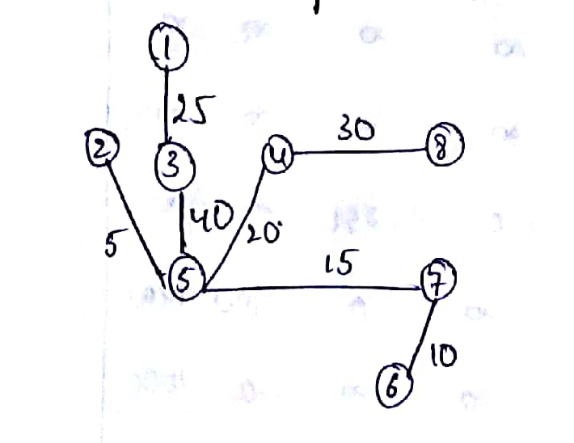
Home Work Solutions
Total Cost= 145

Slide 3
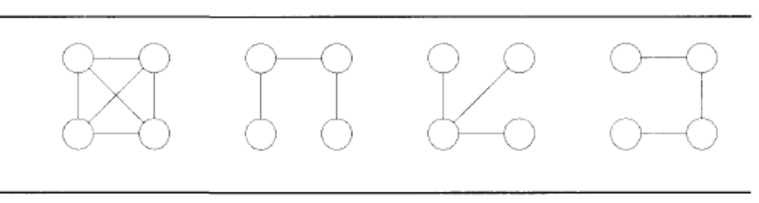
Spanning Tree
Let G = (V,E) be an undirected connected graph. A sub graph t = (V,E^{I} ) of G is a spanning tree of G iff t is a tree.
Example:

Slide 4
NOTE:
We have to visit all the nodes.
The subset tree (i.e) any connected graph with ‘N’ vertices must have at least N-1 edges and also it does not form a cycle.
Application of the spanning tree:
1. Analysis of electrical circuit.
2. Shortest route problems.

Slide 5
Minimum Cost Spanning Tree
The cost of spanning tree is the sum of costs (or) weights of the edges in tree
The minimum cost spanning tree is the spanning tree whose sum of costs (or) weights of the edges in tree is minimum in the given graph.
To find MST we have two algorithms
1. Prim’s
2. Kruskal’s

Slide 6
Prim’s Algorithm
Start from an arbitrary vertex (root). At each stage, add a new branch (edge) to the tree already constructed; the algorithm halts when all the vertices in the graph have been reached.

Slide 7
The prims algorithm will start with a tree that includes only a minimum cost edge of G.
Then, edges are added to the tree one by one. the next edge (i,j) to be added in such that I is a vertex included in the tree, j is a vertex not yet included, and cost of (i,j), cost[i,j] is minimum among all the edges.
The working of prims will be explained by following diagram

Slide 8
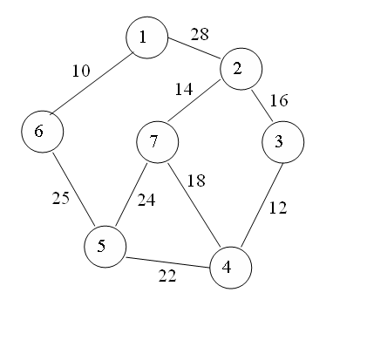
Consider the following graph:

Slide 9
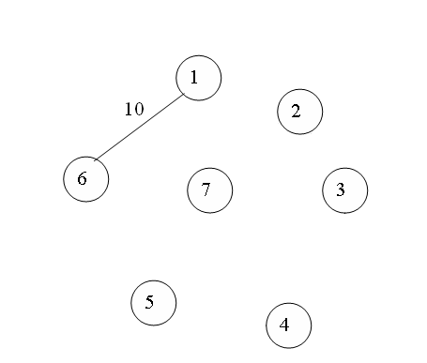
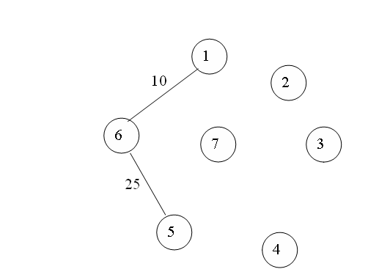
Step 1: Step 2:

Slide 10
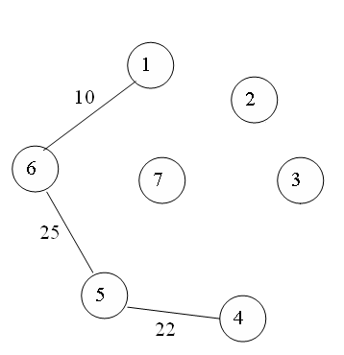
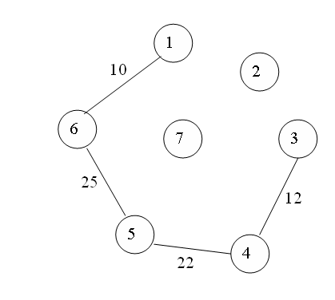
Step 3: Step 4:

Slide 11
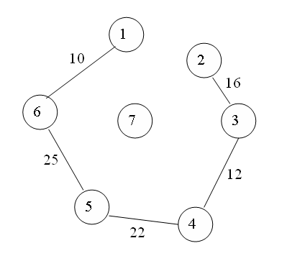
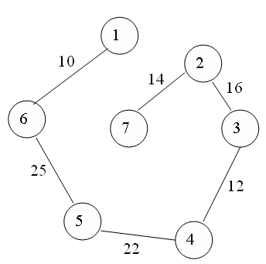
Step 5: Step 6:

Slide 12
Kruskal’s Algorithm
The algorithm also uses greedy method to get the minimum spanning tree.
Initially all the edges are arranged in the non-decreasing order, based on the cost of the edges.
At each stage an edge with the minimum cost is selected following the constraint that selection of this edge does not result in a cycle(or)loop.

Slide 13
Procedure:
Step1: Initially arrange the edges of a graph in the non-decreasing order of their cost .
Step2: Select the minimum cost edge & it is going to be first edge in the spanning tree.
Step3: Now select the minimum cost edge from the remaining edges following the constraint that the selection of that edge does not result in cycle or loop

Slide 14
Step4: If more than one edge has the same minimum cost then arbitrarily select any one of them.
Step5: repeat step3 until there are n-1 edges in the spanning tree

Slide 15
Consider the following graph:

Slide 16
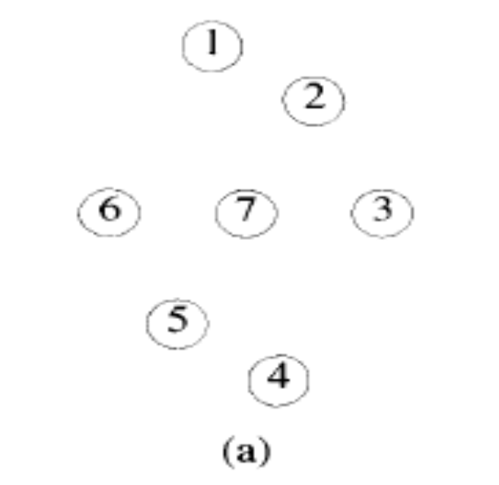
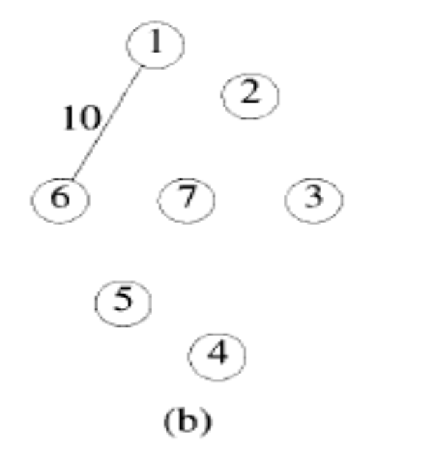
Example:

Slide 17
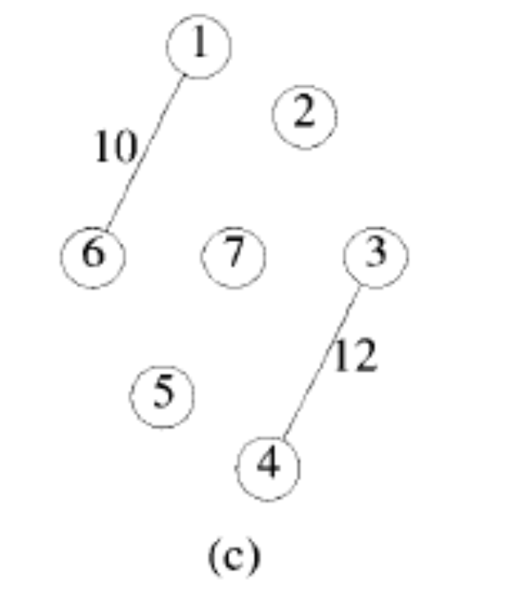
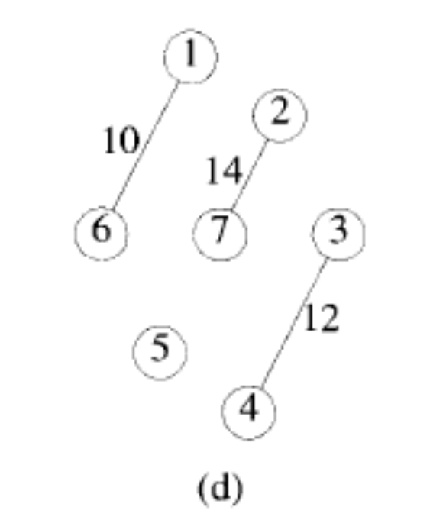

Slide 18
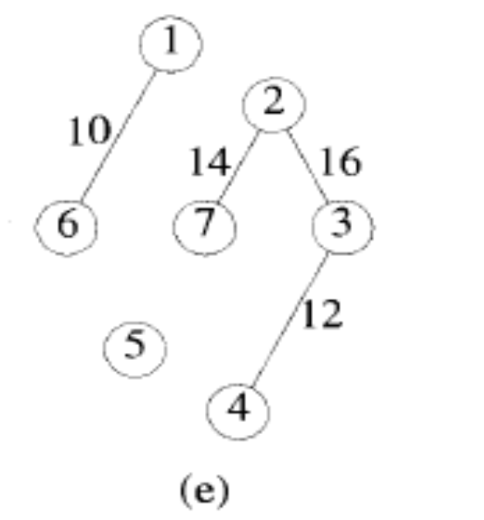
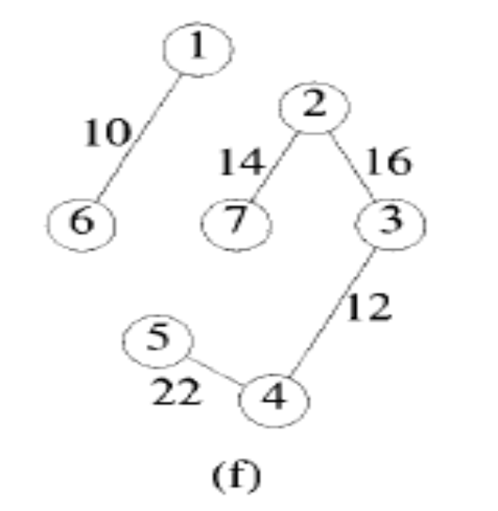

Slide 19
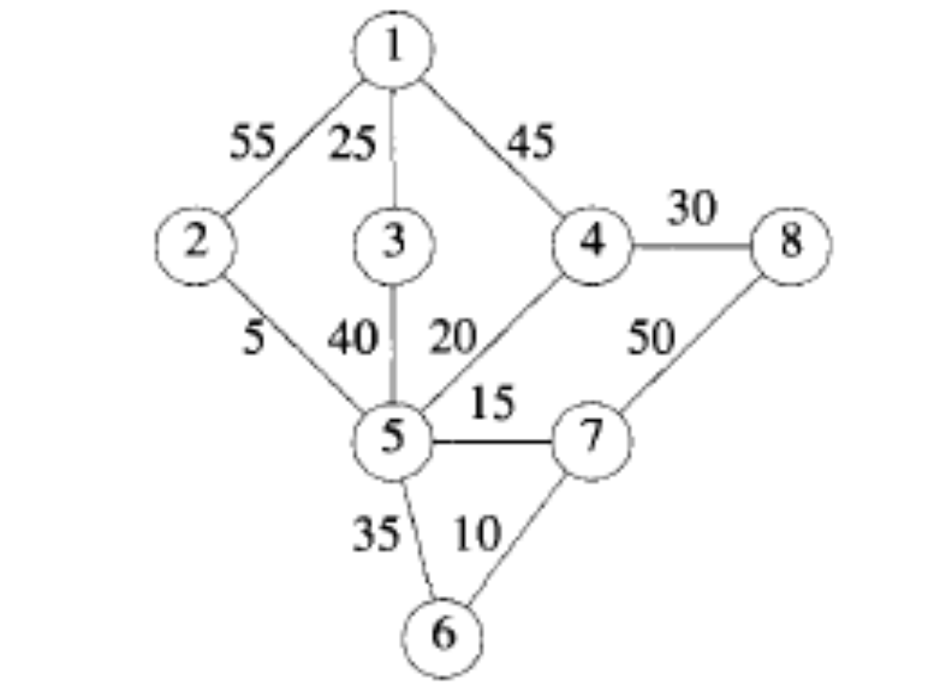
Home Work
Find the MST by using Prim’s and Kruskal’s

Slide 20
Prim’s Algorithm
Algorithm prims (E,c,n,t)
//E is the set of edges
//C[1:n,1:n] is cost adjacency matrix of 'n' vertices
//t[1:n-1,1:2] is the spanning tree generated
{
Let (k,l) be the minimum cost edge in E;
Minimum cost : = cost [k,l];
t[1,1] : = k; t[1,2] : = l;
For i : =1 to n do

Slide 21
If ( cost [i,k] < cost [ i ,l] )then
near[i] : = k;
else
near[i] := l;
near[k] := 0;
near[l] := 0;
for i:=2 to n-1 do
{
Let 'j' be the index such that Cost (j, near [j] ) is minimum

Slide 22
t [i,1] := j; t[i,2] := near[j];
minimum cost := minimum cost + cost [ j, near[j] ] ;
near[j] := 0;
for k:= 1 to n do
if (cost [k,near(k)] > cost[k,j] and near [k]≠0) then
near[k] := j;
}
return min cost;
}

Slide 23
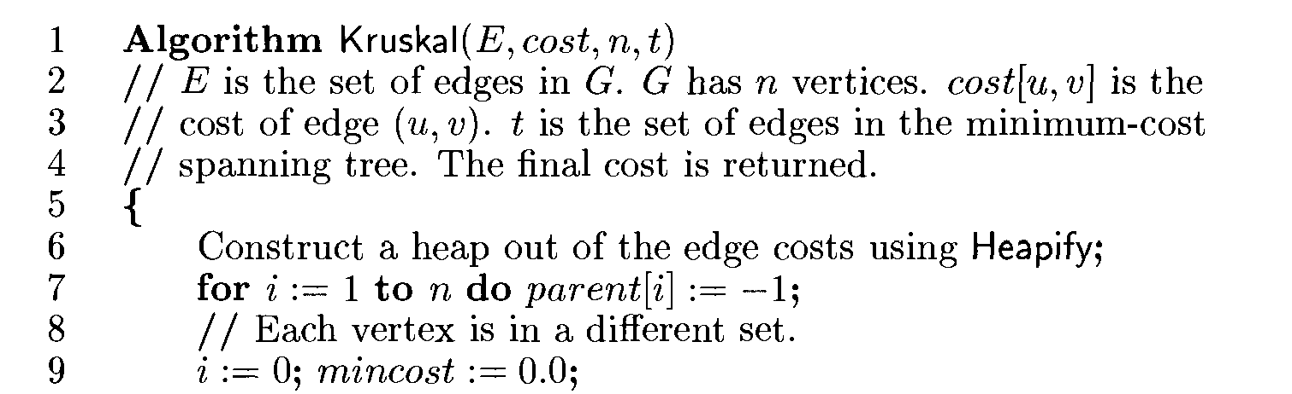
Kruskal’s Algorithm

Slide 24
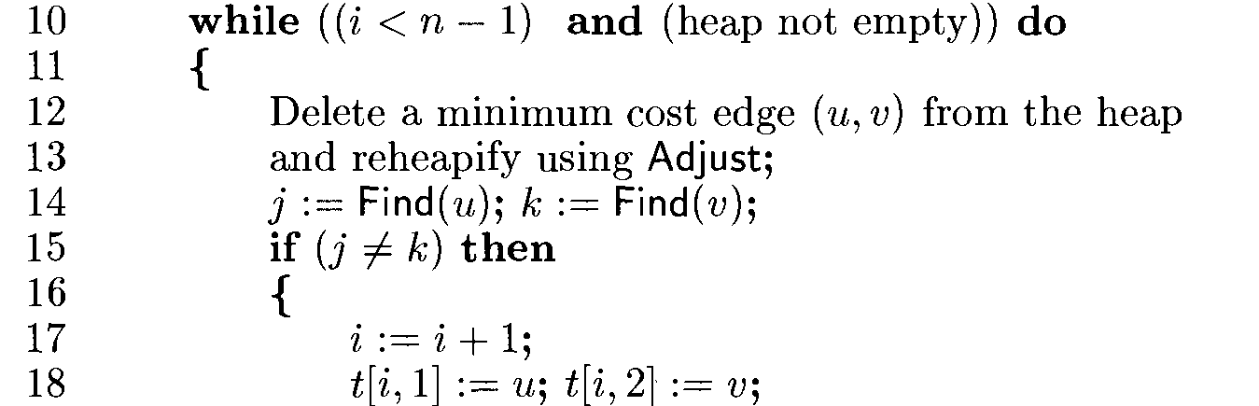

Slide 25
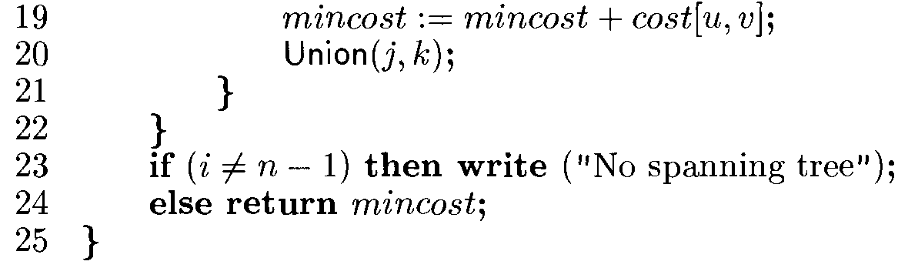

Slide 26
