Slide 1
CSE- 312
Design and Analysis of Algorithms
III Year 1st Semester
UNIT – II
Topics: Single source shortest paths
(Dijkstra's algorithm)
Instructor:
M. Naveen
Asst.Prof.,
CSE Dept.,
RVR & JC CE.

Slide 2
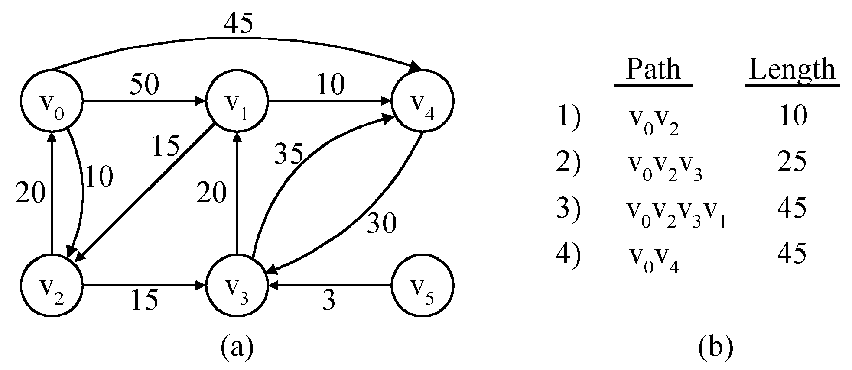
Single source shortest paths
Definition: Given a weighted directed graph G=(V,E,cost) and source vertex 'S', the objective of this problem is to find the shortest path from the given source vertex to every other vertex in the graph

Slide 3
Procedure
1. Let 'V' be the source vertex and cost[ ] be the 2-dimentional array of edge cost, distance [i] is the distance of each vertex i from source vertex 'v'.
2. Select the vertex which has the minimum distance value among unvisited vertices and declare it as visited. Let that vertex be 'u'.

Slide 4
3. Update the distance[i] values of adjacent unvisited vertices of vertex u by using the following condition:
Let 'W' be an adjacent vertex of 'u', if (distance[w] > distance[u]+cost[u,w])
Distance [w]= distance[u]+cost[u,w])
4. Repeat steps 2,3 until all the vertices are declared as visited.

Slide 5
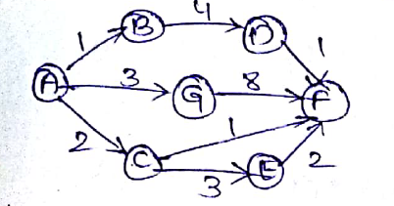
Problem 1
Find the shortest paths from source vertex 'A' to each vertex in the graph

Slide 6
Interaction | S(already visited set) | Selected vertex | dist[……..] A B C D E F G
initial | − | A | 0 1 2 ∞ ∞ ∞ 3
1 | A | B | 0 1 2 5 ∞ ∞ 3
2 | {A,B} | C | 0 1 2 5 5 3 3
3 | {A,B,C} | F | 0 1 2 5 5 3 3
4 | {A,B,C,F} | G | 0 1 2 5 5 3 3
5 | {A,B,C,F,G} | E | 0 1 2 5 5 3 3
6 | {A,B,C,E,F,G} | D | 0 1 2 5 5 3 3

Slide 7
Algorithm
Algorithm shortestpath (V,cost,dist,n)
{
//dist[j],1≤j≤n is set to the length of
//shortest path from source vertex V to vertex j
//in a digraph G with 'n' vertices. G is represented
//by cost adjacency matrix C[1:n,1:n]

Slide 8
For i:=1 to n do
{
S[i]:=false;
dist[i]:=cost[v,i];
}
S[v]:=true;
dist[v]:=0.0;
for num:= 2 to n do
{
Choose u from among the vertices
not in S, such that dist[u] is minimum;

Slide 9
S[u]:=true;
For (each w adjacent to u with s[w]=false) do
{
If(dist[w]>dist[u]+cost[u,w]) then
Dist[w]:=dist[u]+cost[u,w];
}
}
}

Slide 10
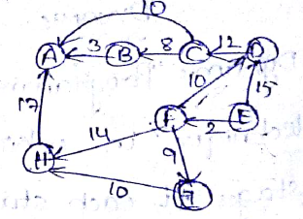
Solve shortest path problem ,Given source vertex is 'E'

Slide 11
Interaction | S(already selected set) | Selected vertex | dist[……..] A B C D E F G H
initial | − | E | ∞ ∞ ∞ 15 0 2 ∞ ∞
1 | {E} | F | ∞ ∞ ∞ 12 0 2 11 16
2 | {E,F} | G | ∞ ∞ ∞ 12 0 2 11 16
3 | {E,F,G} | D | ∞ ∞ 24 12 0 2 11 16
4 | {D,E,F,G} | H | 33 ∞ 24 12 0 2 11 16
5 | { D,E,F,G,H} | C | 33 32 24 12 0 2 11 16
6 | {C, D,E,F,G,H } | B | 33 32 24 12 0 2 11 16
7 | {B,C, D,E,F,G,H } | A | 33 32 24 12 0 2 11 16

