Slide 1
CSE- 312
Design and Analysis of Algorithms
III Year 1st Semester
UNIT – II
Topics: Job sequencing with deadlines
Instructor:
M. Naveen
Asst.Prof.,
CSE Dept.,
RVR & JC CE.

Slide 2
Job sequencing with dead lines
The problem is stated as below.
There are n jobs to be processed on a machine.
Each job i has a deadline d_{i}≥ 0 and profit p_{i}≥0 .
Pi is earned iff the job is completed by its deadline.
The job is completed if it is processed on a machine for unit time.
Only one machine is available for processing jobs.
Only one job is processed at a time on the machine.

Slide 3
Job sequencing with dead lines
A feasible solution is a subset of jobs J such that each job is completed by its deadline.
An optimal solution is a feasible solution with maximum profit value.

Slide 4
Example : Let n = 4, (p₁,p₂,p₃,p₄) = (100,10,15,27), (d₁,d₂,d₃,d₄) = (2,1,2,1)
Sr.No. Feasible Processing Profit value
Solution Sequence
(i) (1,2) (2,1) 110
(ii) (1,3) (1,3) or (3,1) 115
(iii) (1,4) (4,1) 127 is the optimal one
(iv) (2,3) (2,3) 25
(v) (3,4) (4,3) 42
(vi) (1) (1) 100
(vii) (2) (2) 10
(viii) (3) (3) 15
(ix) (4) (4) 27

Slide 5
GREEDY ALGORITHM TO OBTAIN AN OPTIMAL SOLUTION
Consider the jobs in the non increasing order of profits subject to the constraint that the resulting job sequence J is a feasible solution.
In the example considered before, the non-increasing profit vector is
  (100 27 15 10) (2 1 2 1)
  p₁ p₄ p₃ p₂ d₁ d₄ d₃ d₂

Slide 6
J = { 1} is a feasible one
J = { 1, 4} is a feasible one with processing sequence ( 4,1)
J = { 1, 3, 4} is not feasible
J = { 1, 2, 4} is not feasible
J = { 1, 4} is optimal

Slide 7
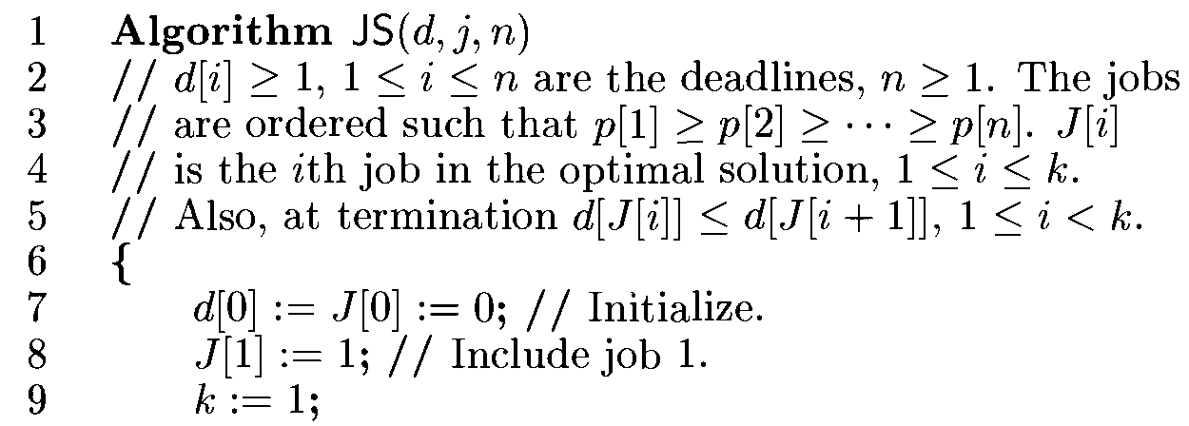
Algorithm

Slide 8
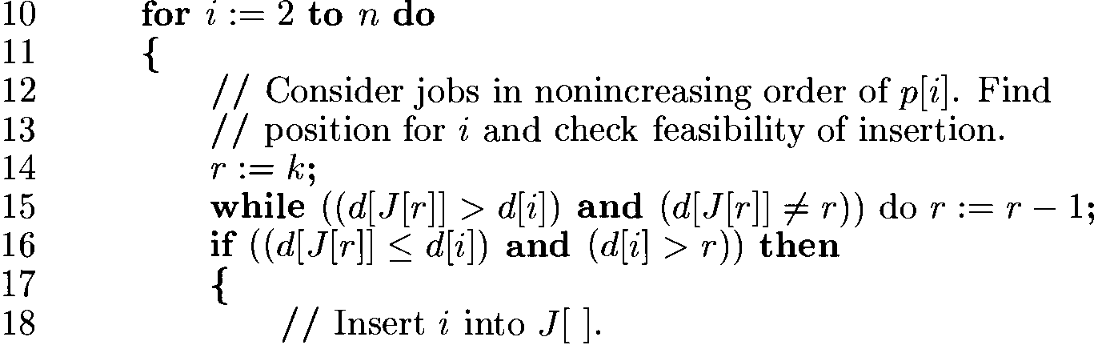

Slide 9
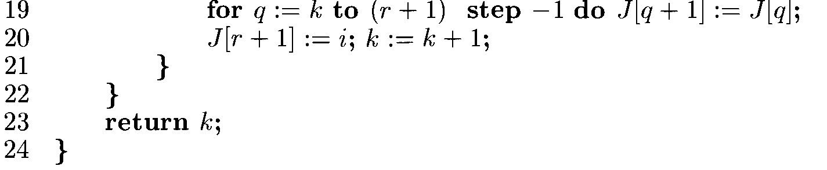
Note: Computing time of above algorithm is O(n²) ,it is reduced up to O(n) by using set
union and find algorithms.

Slide 10
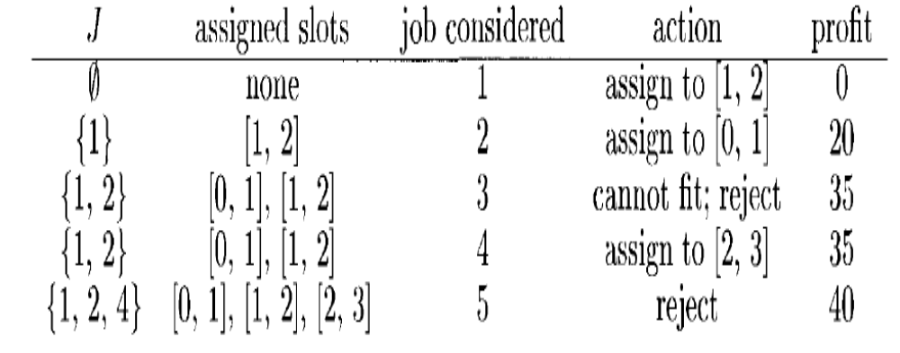
Example:
Let n=5,(p1,p2..p5)=(20,15,10,5,1) and (d1,…d5)=(2,2,1,3,3). Use the above algorithm

Slide 11
J assigned job action profit
slots considered
__________________________________________
Ø none 1 assign to[1,2] 0
{1} [1,2] 2 assign to[0,1] 20
{1,2} [0,1][1,2] 3 can not fit, reject 35
{1,2} [0,1][1,2] 4 assign to[2,3] 35
{1,2,4} [0,1][1,2][2,3] 5 reject 40

Slide 12
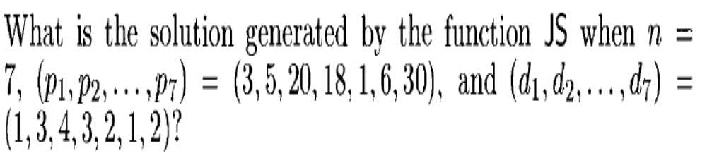
Home work
Week-2 Lab submission link:
https://forms.gle/ktAx4LJ7SMBVt6Gu6

