Slide 1
CSE- 312
Design and Analysis of Algorithms
III Year 1st Semester
UNIT – III
Topic: Dynamic Programming – All Pairs Shortest Paths
Instructor:
M. Naveen
Asst.Prof.,
CSE Dept.,
RVR & JC CE.

Slide 2
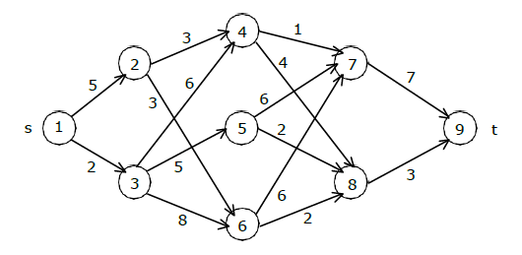
Home Work
Find the minimum cost path from s to t in the multistage graph of five stages shown below. Do this first using forward approach and then using backward approach.

Slide 3
Solution:
Forward & backward approach path cost=12
Path:1-3-5-8-9

Slide 4
All Pairs Shortest Paths
The problem: find the shortest path between every pair of vertices of a graph
The graph: may contain negative edges but no negative cycles
A representation: a weight matrix where
W(i,j)=0 if i=j.
W(i,j)=∞ if there is no edge between i and j.
W(i,j)=“weight of edge”
Note: we have shown principle of optimality applies to shortest path problems

Slide 5
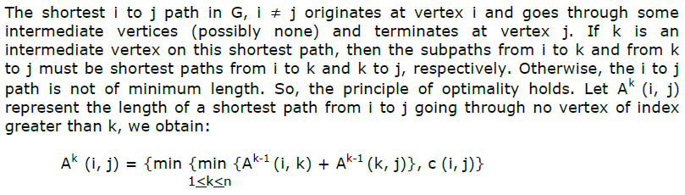
All Pairs Shortest Paths

Slide 6
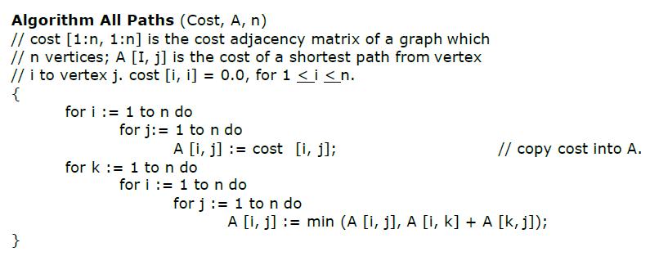

Slide 7
Complexity

Slide 8
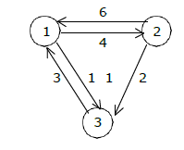
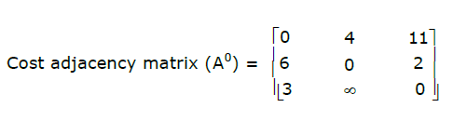
Example

Slide 9
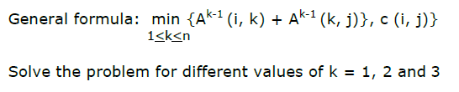

Slide 10
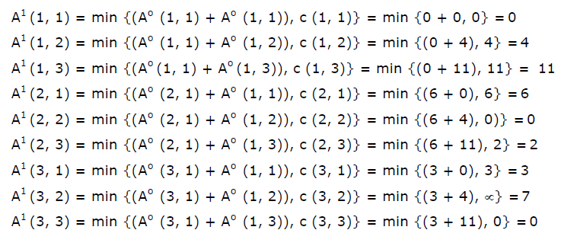
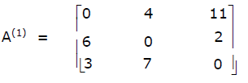

Slide 11
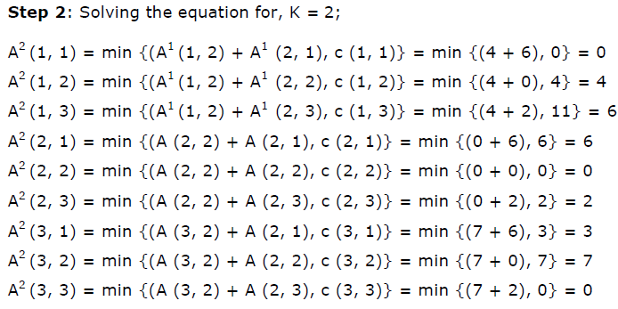
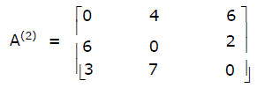

Slide 12
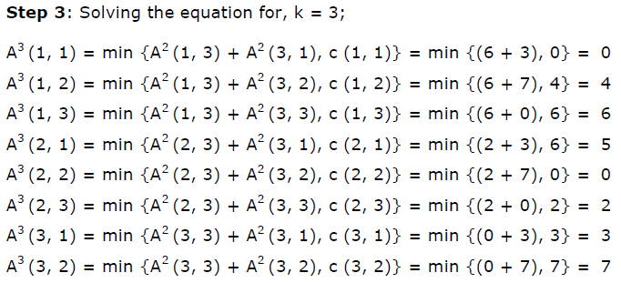
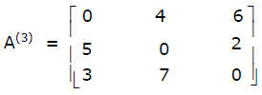

Slide 13
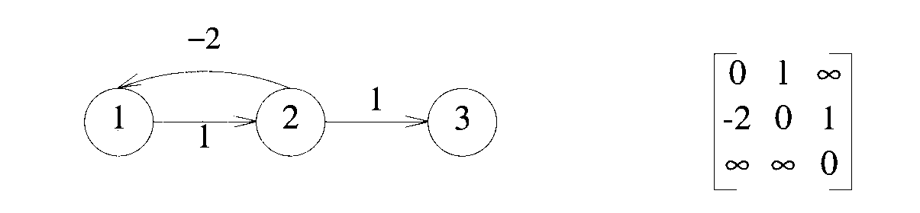
Example-2
This graph has cycle with negative cost (1-2-1 with cost -1) so there no possibility to find all pairs shortest paths.

