Slide 1
CSE- 312
Design and Analysis of Algorithms
III Year 1st Semester
UNIT – III
Topic: Dynamic Programming – Single Source Shortest Paths : General Weights
Instructor:
M. Naveen
Asst.Prof.,
CSE Dept.,
RVR & JC CE.

Slide 2
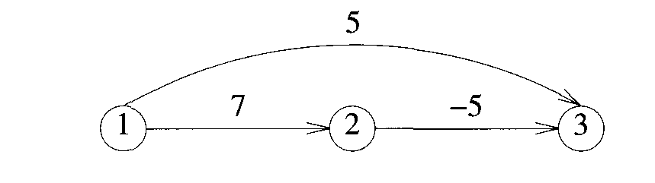
Single Source Shortest Paths
If we apply dijkstra’s algorithm for below graph we get dist[2] = 7 and dist[3]=5. but the shortest path from 1 to 3 is 1-2-3 with cost:2.
It means that, if negative edges are in the graph then dijkstra’s not give correct solution, so we need to go with other algorithm that is Bellman - ford algorithm.

Slide 3
Bellman - Ford Algorithm
This algorithms gives correct result for single source shortest path problem even graph contains negative cost edges.
But this algorithm also not worked properly for the graph which is having negative cycles.
Instead of calculating dist[u] we need to calculate dist^{k} [u] for all u, this is the length of path from ‘v’(source vertex) to ‘u’.

Slide 4
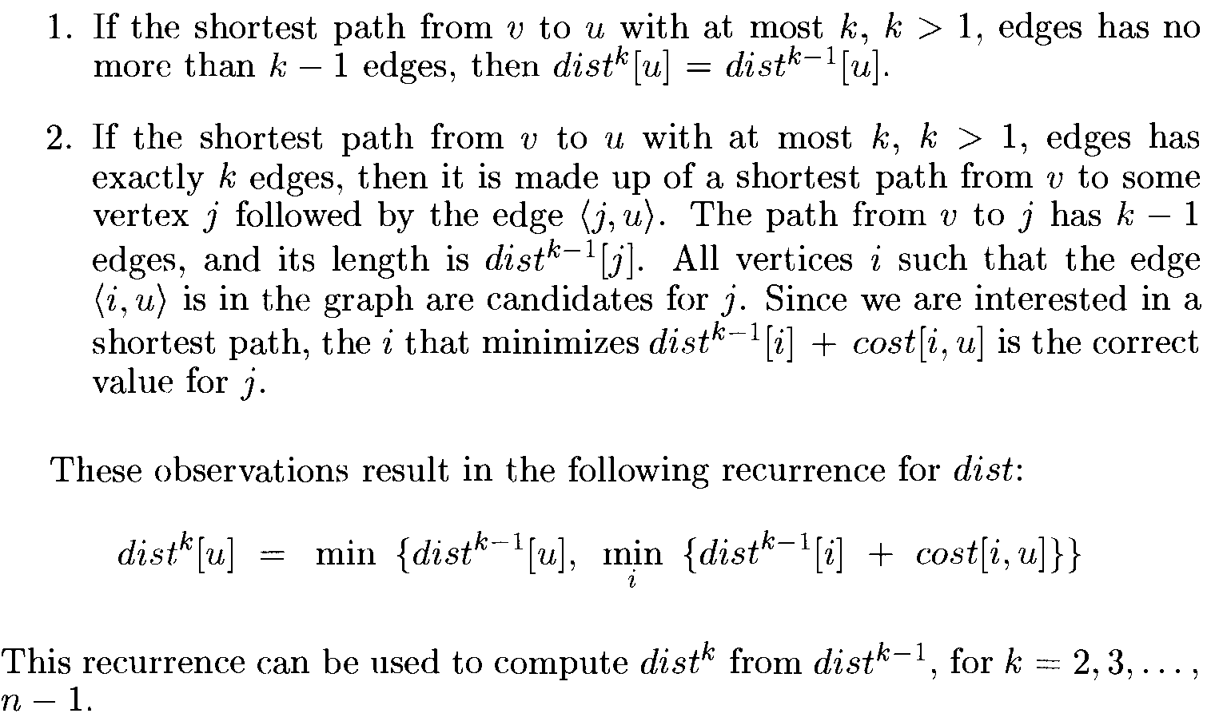
Consider the following observations:

Slide 5
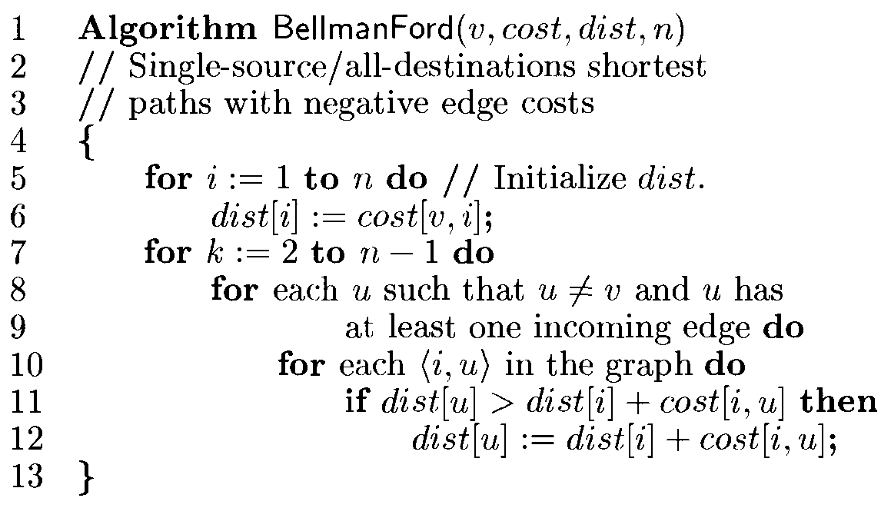
Bellman Ford Algorithm

Slide 6
Complexity
O(n³) when adjacency matrices are used
O(n . e) when adjacency lists are used

Slide 7
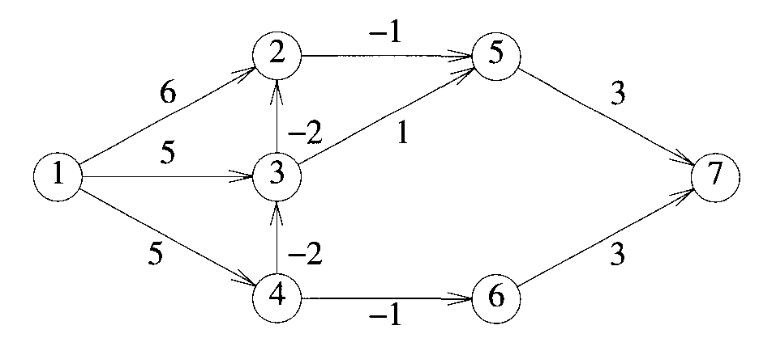
Problem
Consider the following 7 vertices graph and find the shortest paths from vertex 1 to remaining vertices.

Slide 8
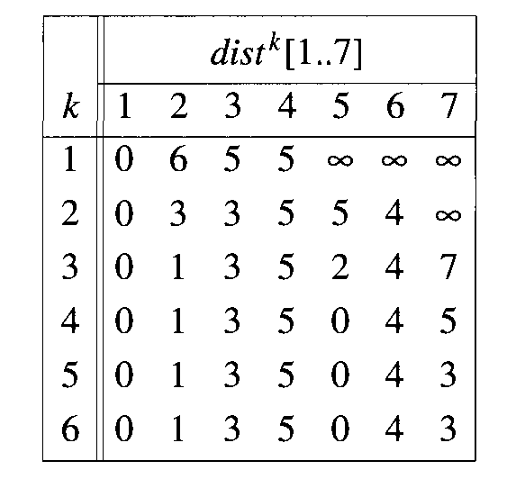
Solution
dist^{k} [1] = 0 for all k since 1 is source .
dist¹[2] =6
dist¹[3] = 5
dist¹ [4] = 5 since there are edges from 1 to these nodes.
dist¹ [ ] = infinite for nodes 5,6 and 7 since there is no edge from 1 to these nodes.

Slide 9
Here i=1,3,4,5,6 and 7
dist²[3] = min{dist¹[3] , min_{i}{dist¹[i]+cost[i, 3]}}
= min{5,0+5,6+∞,5-2,∞+∞,∞+∞,∞+ ∞}
= 3 (Here i=1,2,4,5,6 and 7)
dist²[4] = min{dist¹[4] , min_{i}{dist¹[i]+cost[i, 4]}}
= min{5,0+5,6+∞,5+∞,∞+∞,∞+∞,∞+ ∞}
= 5 (Here i=1,2,3,5,6 and 7)
Similarly dist²[5] =5, dist²[6]=4 and dist²[7] = ∞

Slide 11
dist³[2] = min{dist²[2] , min_{i}{dist²[i]+cost[i,2]}}
= min{3,0+6,3-2,5+∞,5+∞,4+∞,∞+ ∞}
= 1
Here i= 1,3,4,5,6, and 7
Similarly
dist³[3] =3, dist³[4]=5, dist³[5]=2, dist³[6]=4 and dist³[7] = 7

Slide 13
dist⁴[2] =1 ,dist⁴[3] =3, dist⁴[4]=5, dist⁴[5]=0, dist⁴[6]=4 and dist⁴[7] =5

Slide 14
dist⁵[2] =1 ,dist⁵[3] =3, dist⁵[4]=5, dist⁵[5]=0, dist⁵[6]=4 and dist⁵[7] =3

Slide 15
dist⁶[2] =1 ,dist⁶[3] =3, dist⁶[4]=5, dist⁶[5]=0, dist⁶[6]=4 and dist⁶[7] =3
last row of this table gives
shortest path cost
from vertex 1 to remaining
vertices.

Slide 16
