Slide 1
CSE- 312
Design and Analysis of Algorithms
III Year 1st Semester
UNIT – I
Topic: Divide & Conquer
Instructor:
M. Naveen
Asst.Prof.,
CSE Dept.,
RVR & JC CE.

Slide 2
Divide & Conquer
Given a function to compute on ‘n’ inputs the divide-and-conquer strategy suggests splitting the inputs into ‘k’ distinct subsets, 1<k<=n, yielding ‘k’ sub problems.
These sub problems must be solved, and then a method must be found to combine sub solutions into a solution of the whole.
If the sub problems are still relatively large, then the divide-and-conquer strategy can possibly be reapplied.

Slide 3
General Method
1. Algorithm D And C(P)
2. {
3. if small(P) then return S(P);
4. else
5. {
6. divide P into smaller instances
P1, P2… Pk, k>=1;
7. Apply D And C to each of these sub problems;
8. return combine (D And C(P1), D And C(P2),…….,D And C(Pk));
}
10.}

Slide 4
If the size of ‘p’ is n and the sizes of the ‘k’ sub problems are n1, n2 ….nk, respectively, then the computing time of D And C is described by the recurrence relation.
T(n)= g(n) n small
T(n1)+T(n2)+……………+T(nk)+f(n); otherwise.
Where
T(n) → is the time for D And C on any I/p of size ‘n’.
g(n) → is the time of compute the answer directly for small I/ps.
f(n) → is the time for dividing P & combining the solution to sub problems.

Slide 5
The complexity of many divide-and-conquer algorithms is given by recurrences of the form
T(n) = T(1) n=1 aT(n/b)+f(n) n>1
→ Where a & b are known constants.
→ We assume that T(1) is known & ‘n’ is a power of b(i.e., n=b^{k} )

Slide 6
One of the methods for solving any such recurrence relation is called the substitution method.
This method repeatedly makes substitution for each occurrence of the function. T is the Right-hand side until all such occurrences disappear.

Slide 7
Merge Sort
The merge sort algorithm works from “the bottom up”
  start by solving the smallest pieces of the main problem
  keep combining their results into larger solutions
  eventually the original problem will be solved

Slide 8
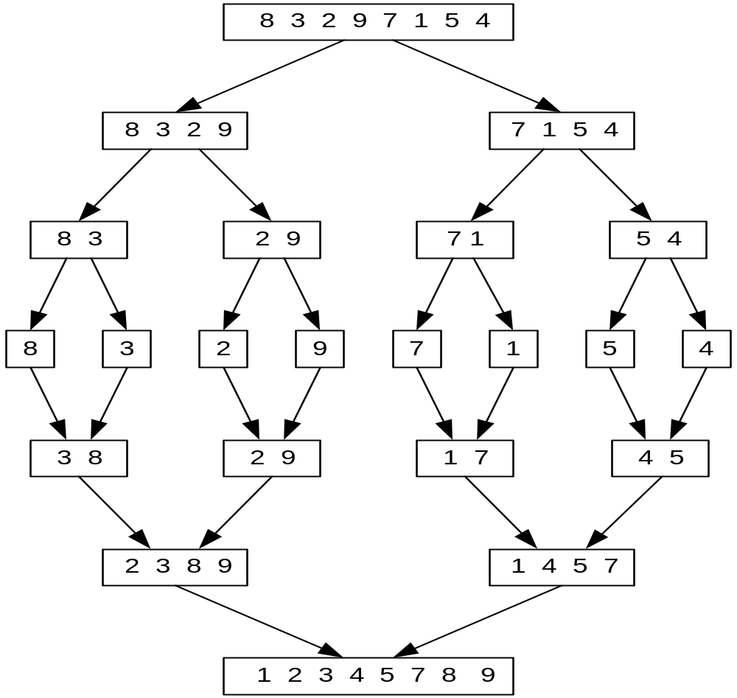

Slide 9
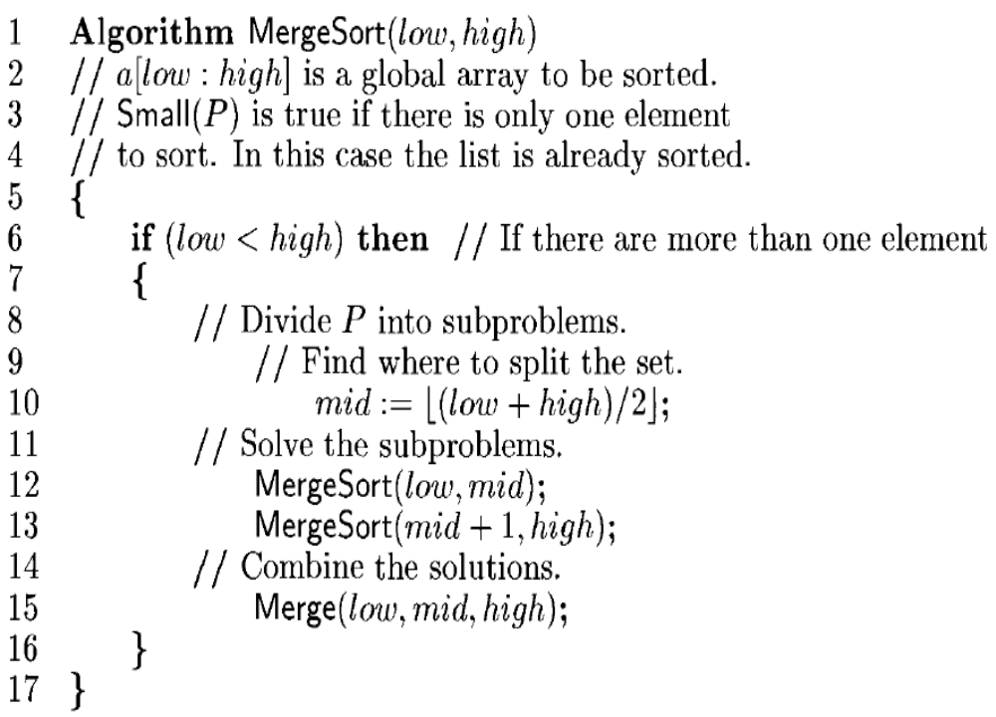

Slide 10
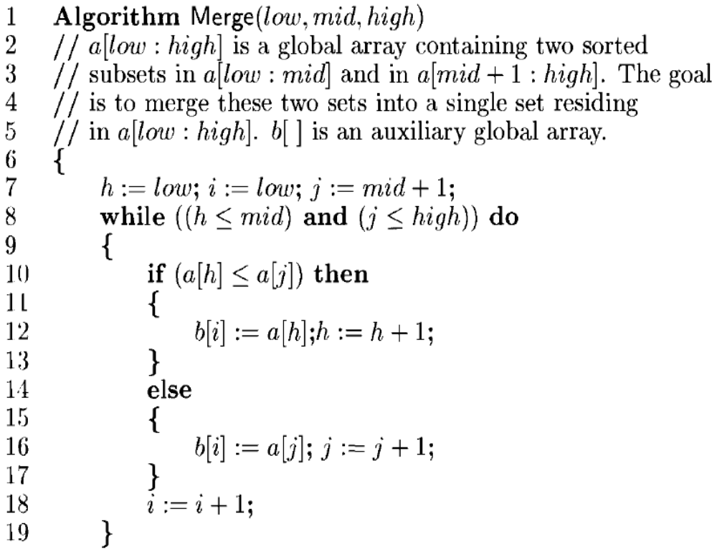

Slide 11
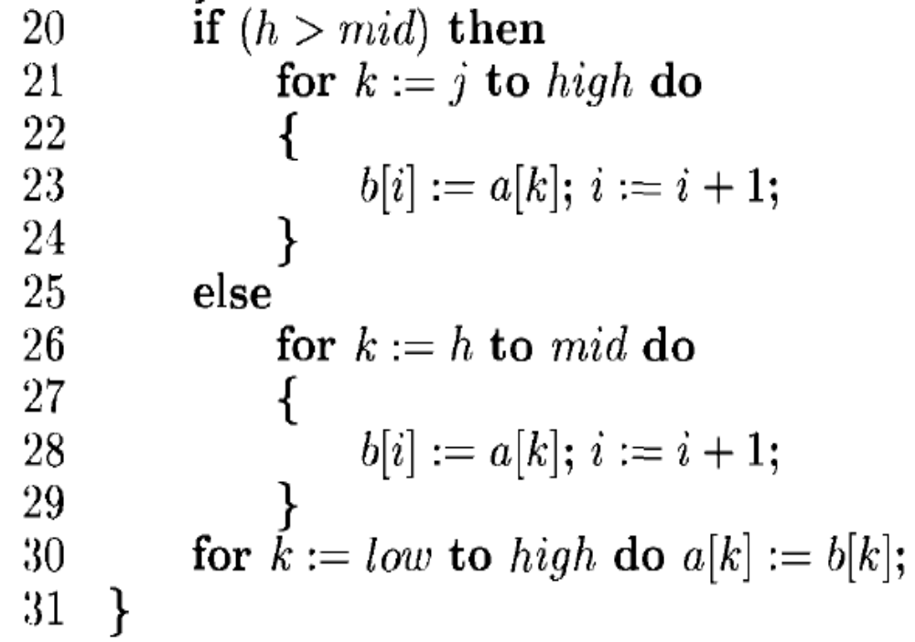

Slide 12
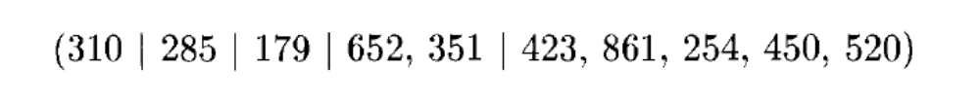
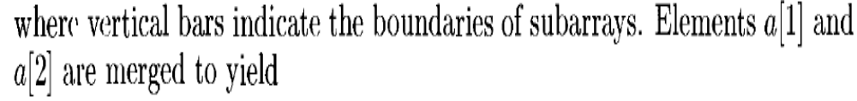
Example
Consider array of 10 elements a[1:10]=(310,285,179,652,351.423,861,254,450,521)
Alg Mergesort splits a[1:10] into a[1:5] & a[6:10]
a[1:5] into a[1:3] & a[4:5]
a[1:3] into a[1:2] & a[3:3]

Slide 13
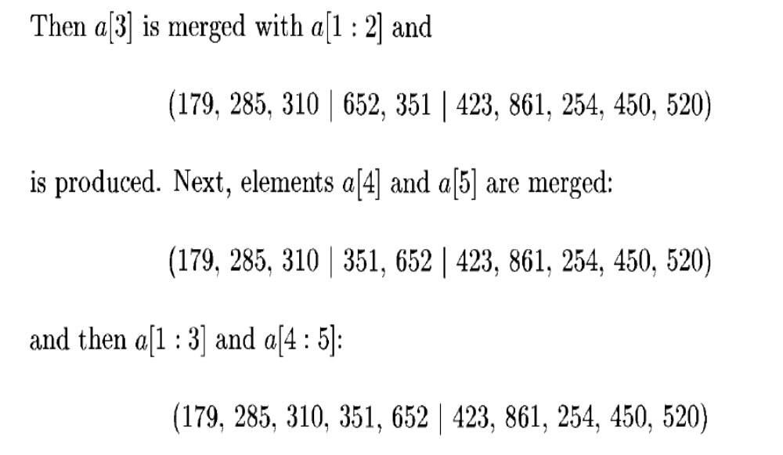

Slide 14
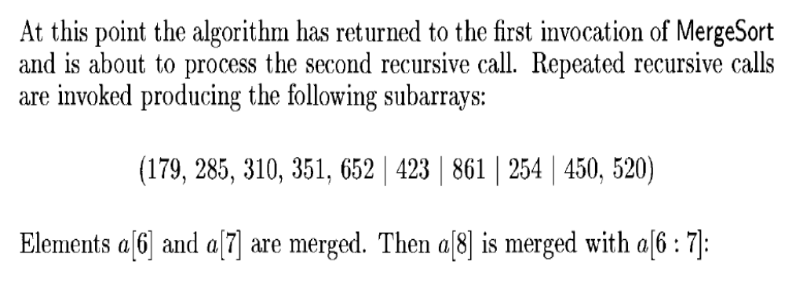
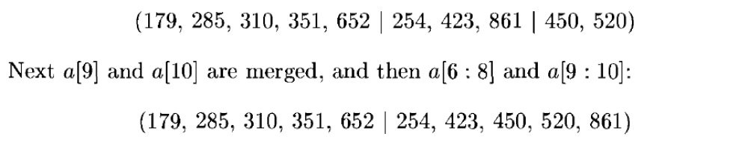

Slide 15
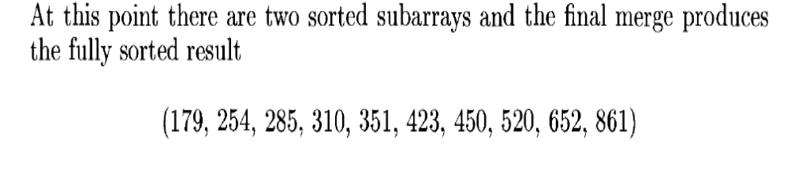
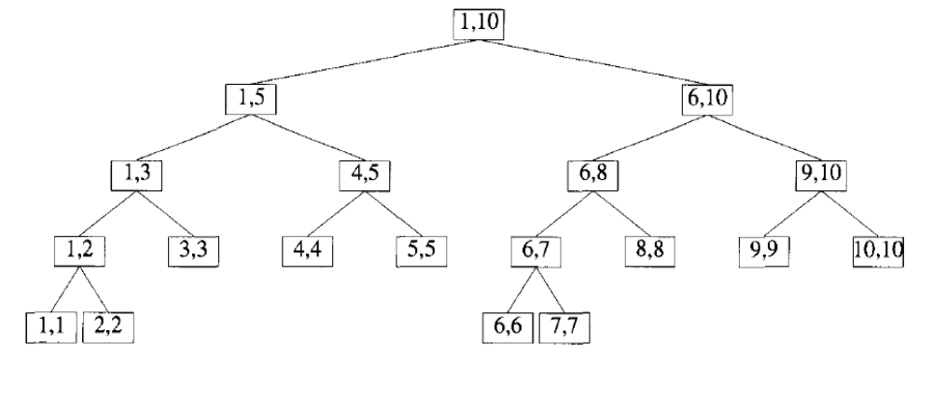
Tree calls of MergeSort(1,10)

Slide 16
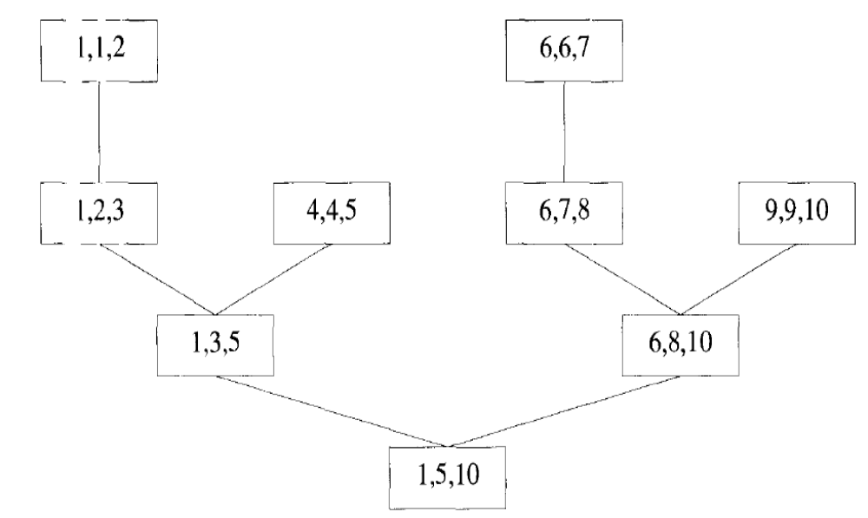
Tree Call of Merge

Slide 17
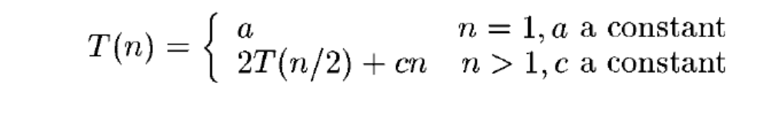
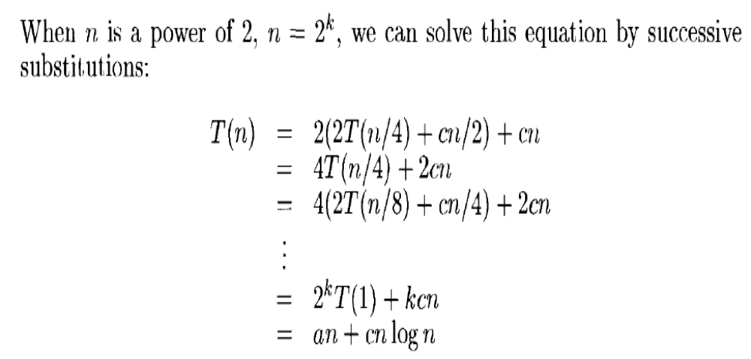
Time Complexity

Slide 18
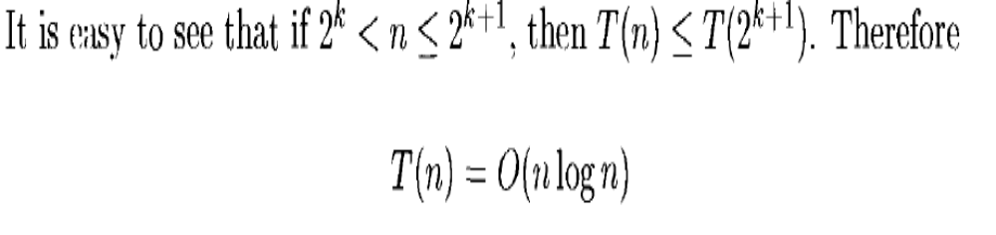

Slide 19
Example:
  Consider the case in which a=2 and b=2. Let T(1)=2 & f(n)=n.
We have,
T(n) = 2T(n/2)+n
= 2[2T(n/2/2)+n/2]+n
= [4T(n/4)+n]+n
= 4T(n/4)+2n
= 4[2T(n/4/2)+n/4]+2n
= 4[2T(n/8)+n/4]+2n
= 8T(n/8)+n+2n
= 8T(n/8)+3n

Slide 20
In general, we see that T(n)=2^{i} T(n/ 2^{i} )+in., for any log₂n >=i>=1.
→ T(n) =2^{log}₂^{n} T(n/ 2^{log}₂^{n}) + n log₂n
→Corresponding to the choice of i= log₂n
Thus, T(n) =2^{log}₂^{n} T(n/ 2^{log}₂^{n}) + n log₂n
= n. T(n/n) + n log₂n
= n. T(1) + n log₂n [since, log 1=0, 2^0=1]
= 2n + n log n

Slide 21
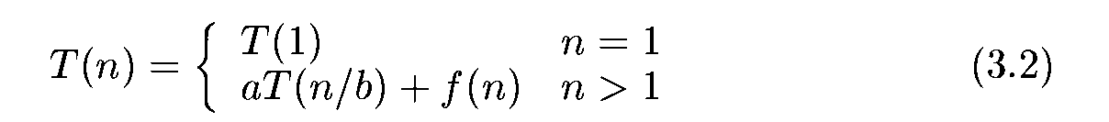
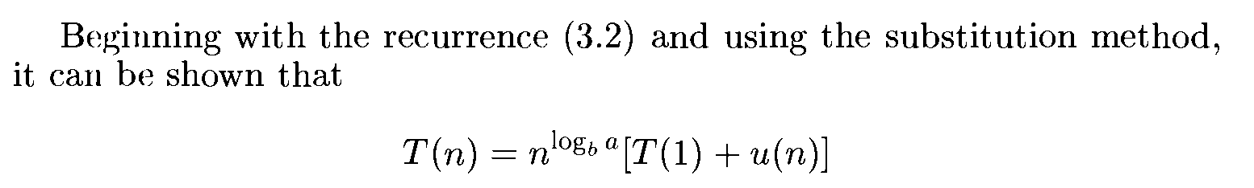
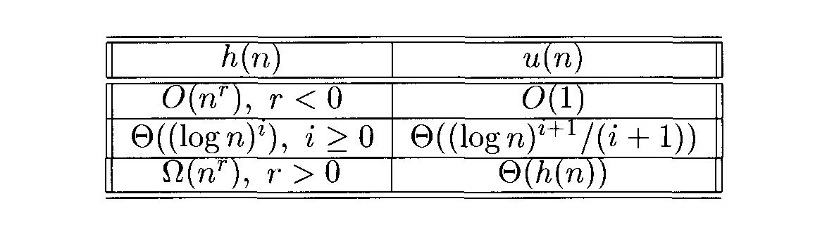
Masters Theorem for solving Recurrence functions

Slide 22
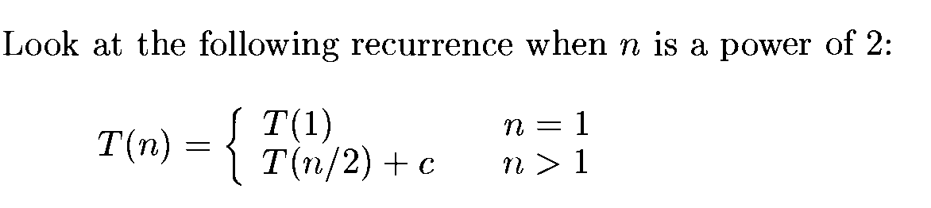
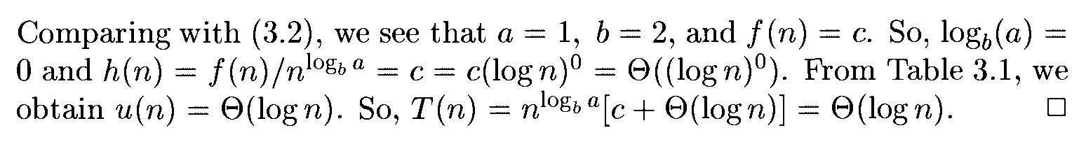

Slide 23
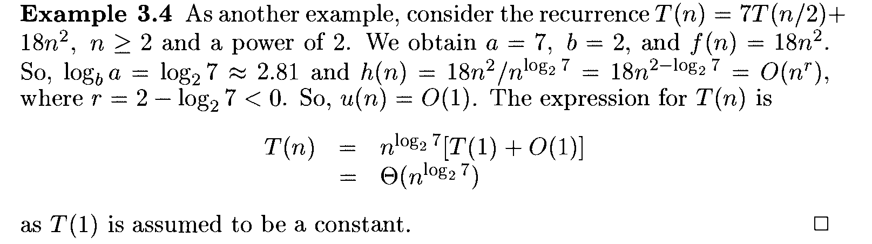

Slide 24
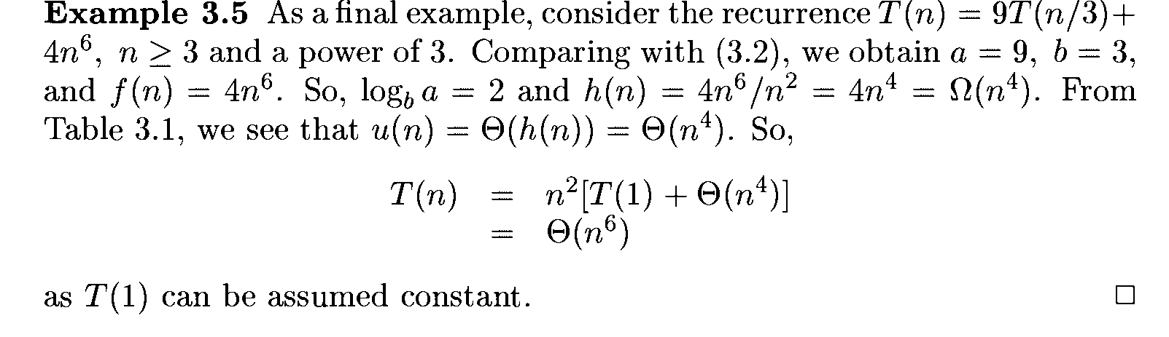

Slide 25
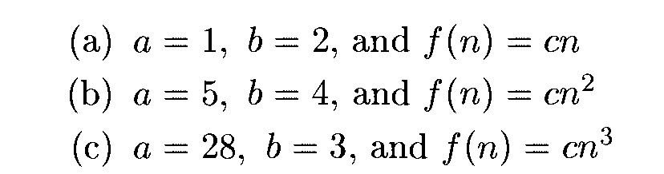
Home Work
a=2,b=2 and f(n) = cn

