Slide 1
CSE- 312
Design and Analysis of Algorithms
III Year 1st Semester
UNIT – I
Topic: Performance Analysis
Instructor:
M. Naveen
Asst.Prof.,
CSE Dept.,
RVR & JC CE.

Slide 2
Performance Analysis
Space Complexity:
The space complexity of an algorithm is the amount of memory it needs to run to compilation.
Time Complexity:
The time complexity of an algorithm is the amount of computer time it needs to run to compilation.

Slide 3
Performance evaluation can be divided into two major phases:
1. A Priori estimates – performance analysis
- Analysis done before execution.
- Priori estimates provides estimated values and uniform values.
- Priori estimates are independent of CPU,OS and System Architecture.

Slide 4
2. A Posterior testing – performance measurement
- Posterior testing is done after execution.
- Posterior testing provides exact values and these are non uniform vales .
- Posteriori values are dependent of CPU,OS and System Architecture.

Slide 5
Poll Question?
__________ is also known as Performance Analysis
A. A Priori Estimates
B. A Posteriori Testing
C. A&B
D. None

Slide 6
Space Complexity
→ The Space needed by each of these algorithms is seen to be the sum of the following component.
1.A fixed part that is independent of the characteristics (ex: number, size)of the inputs and outputs.
The part typically includes the instruction space (ie. Space for the code), space for simple variable and fixed-size component variables (also called aggregate) space for constants, and so on.

Slide 7
2. A variable part that consists of the space needed by component variables whose size is dependent on the particular problem instance being solved, the space needed by referenced variables (to the extent that is depends on instance characteristics), and the recursion stack space.
The space requirement s(p) of any algorithm p may therefore be written as,
S(P) = c+ Sp(Instance characteristics)
Where ‘c’ is a constant.

Slide 8
Example :
1. Algorithm abc(a,b,c)
{
return a+b++*c+(a+b-c)/(a+b) +4.0;
}
Assume that one word is adequate to store the values of each of a, b, c and result, we see that the space needed by abc is independent of the instance characteristics. So, S_{p} (instance characteristics) = 0.

Slide 9
2. Algorithm sum(a,n)
{
s=0.0;
for I=1 to n do
s= s + a[I];
return s;
}
The problem instances for this algorithm are characterized by n, the number of elements to be summed. The space needed d by ‘n’ is one word, since it is of type integer.

Slide 10
The space needed by ‘a’ is the space needed by variables of type array of floating point numbers.
This is at least ‘n’ words, since ‘a’ must be large enough to hold the ‘n’ elements to be summed.
So, we obtain Ssum(n)>=(n+3)
[ n for a[],one each for n, I & s]

Slide 11
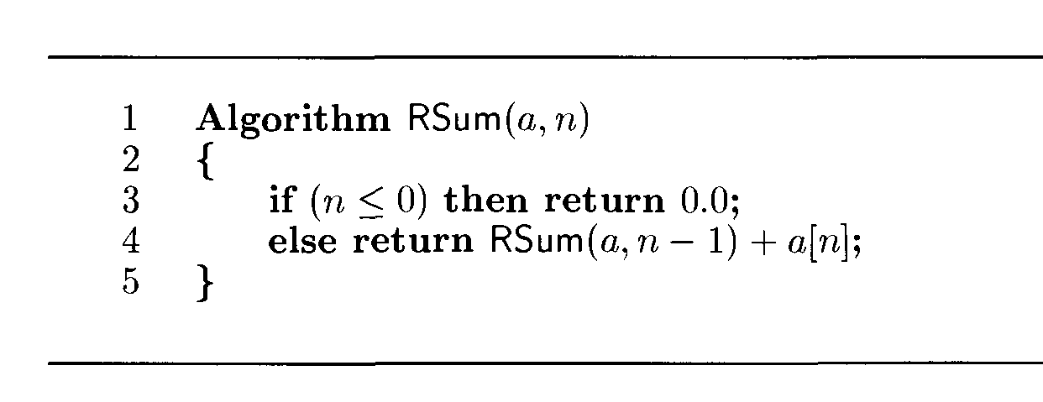
3. Recursive algorithms for Sum
The recursion stack space includes the space for all formal parameters ,the local variables and the return address. Assume that the return address requires only one word of memory.
Each call to RSum requires at least 3 words (n, return add, pointer to a[ ]).
Since the depth of recursion is (n+1) , the recursion stack space needed is >= 3(n+1).

Slide 12
Time Complexity
The time T(p) taken by a program P is the sum of the compile time and the run time.
→The compile time does not depend on the instance characteristics. Also we may assume that a compiled program will be run several times without recompilation .This run time is denoted by tp(instance characteristics).
→ The number of steps any problem statement is assigned depends on the kind of statement.

Slide 13
For example, comments → 0 steps.
Assignment statements → 1 steps.
[Which does not involve any calls to other algorithms]
Interactive statement such as for, while & repeat-until→ Control part of the statement.
Time Complexity is calculated by using either
Step Count Method or Step Table Method.

Slide 14
1. Step count method
      We introduce a variable, count into the program statement to increment count with initial value 0.Statement to increment count by the appropriate amount are introduced into the program.
This is done so that each time a statement in the original program is executes count is incremented by the step count of that statement.

Slide 15
Algorithm sum(a,n)
{
s= 0.0;
count = count+1;
for I=1 to n do
{
count =count+1;
s=s+a[I];
count=count+1;
}
count=count+1;
count=count+1;
return s;
}
Algorithm sum(a,n)
{
s=0.0;
for I=1 to n do
s= s + a[I];
return s;
}
If the count is zero to start with, then it will be 2n+3 on termination. So each invocation of sum execute a total of 2n+3 steps.

Slide 16
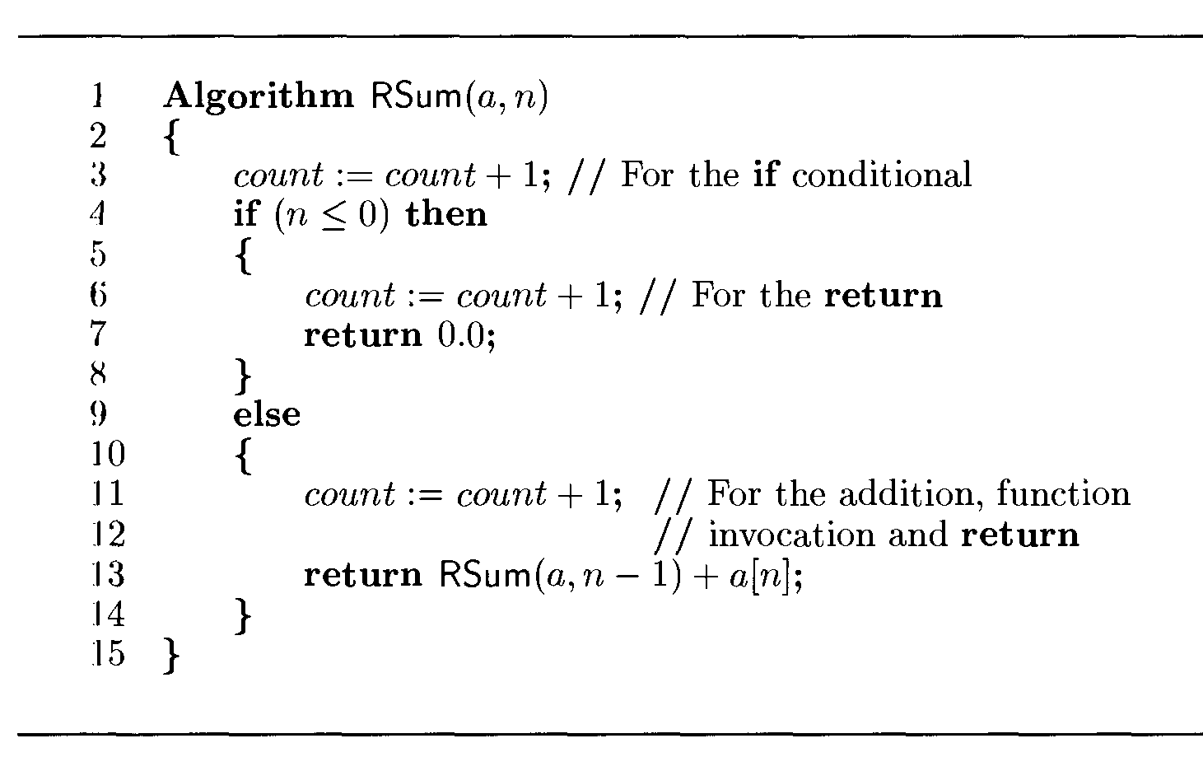
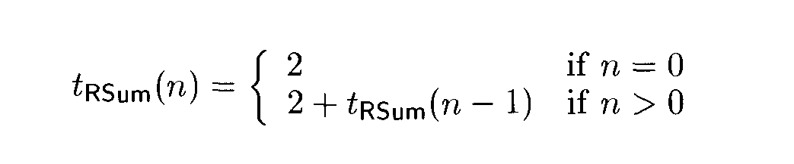

Slide 17
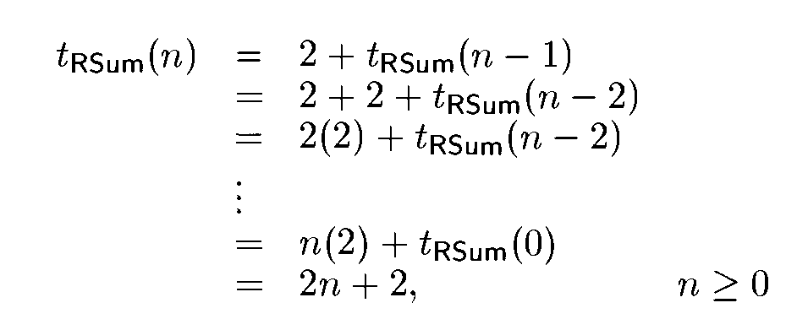

Slide 18
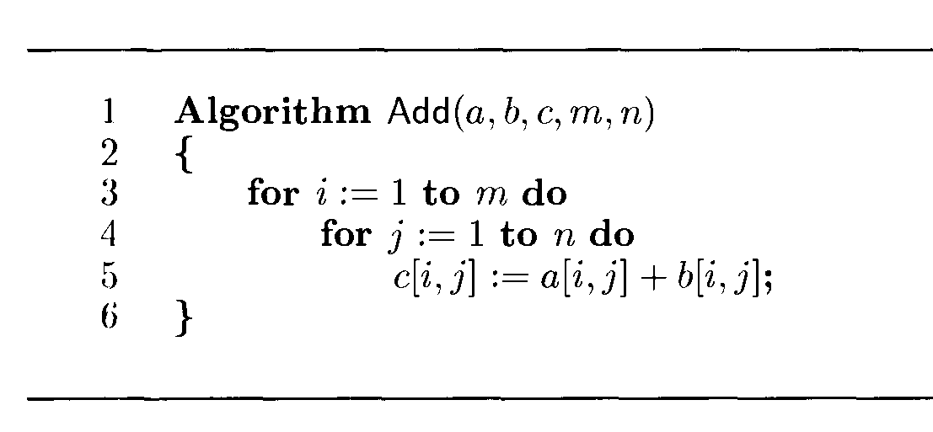
Matrix Addition

Slide 19
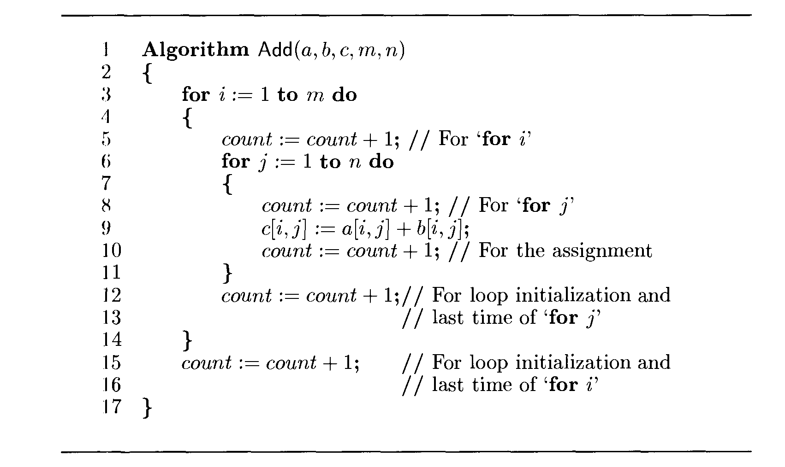
_{Tmatrixadd(m,n) = 2mn+2m+1}

Slide 20
2. Step Table Method
The second method to determine the step count of an algorithm is to build a table in which we list the total number of steps contributes by each statement.
→First determine the number of steps per execution (s/e) of the statement and the total number of times (ie., frequency) each statement is executed.
→By combining these two quantities, the total contribution of all statements, the step count for the entire algorithm is obtained.

Slide 21
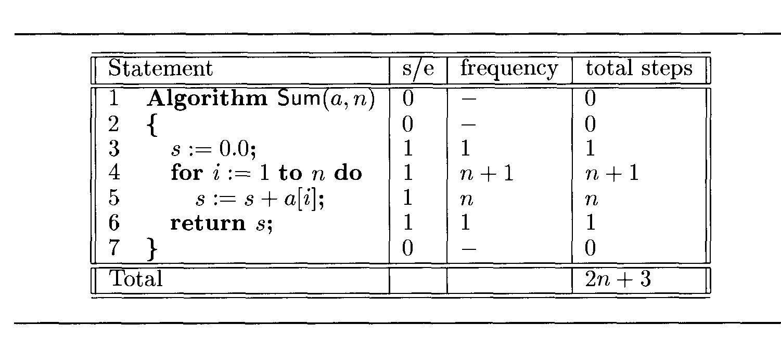
Algorithm Sum(a,n)

Slide 22
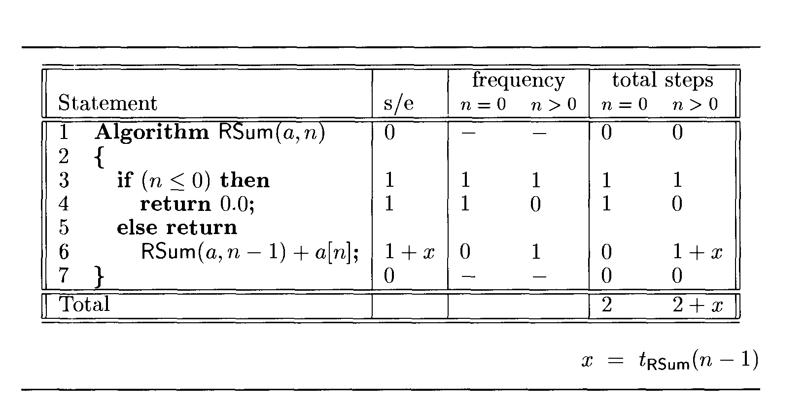
Algorithm RSum(a,n)

Slide 23
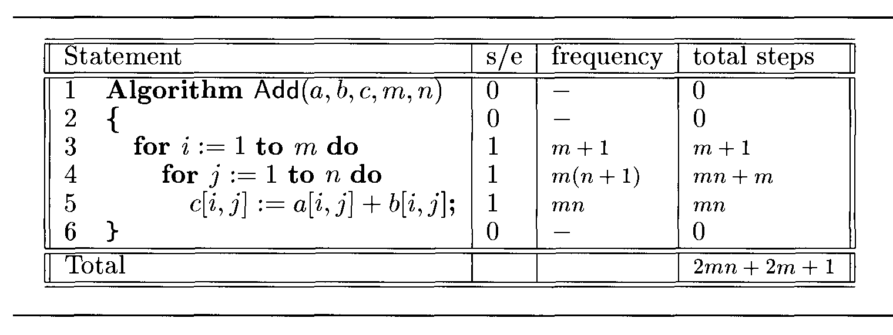
Matrix addition

Slide 24
Poll Question?
Recursive algorithms uses stack space for execution(Yes/No)

Slide 25
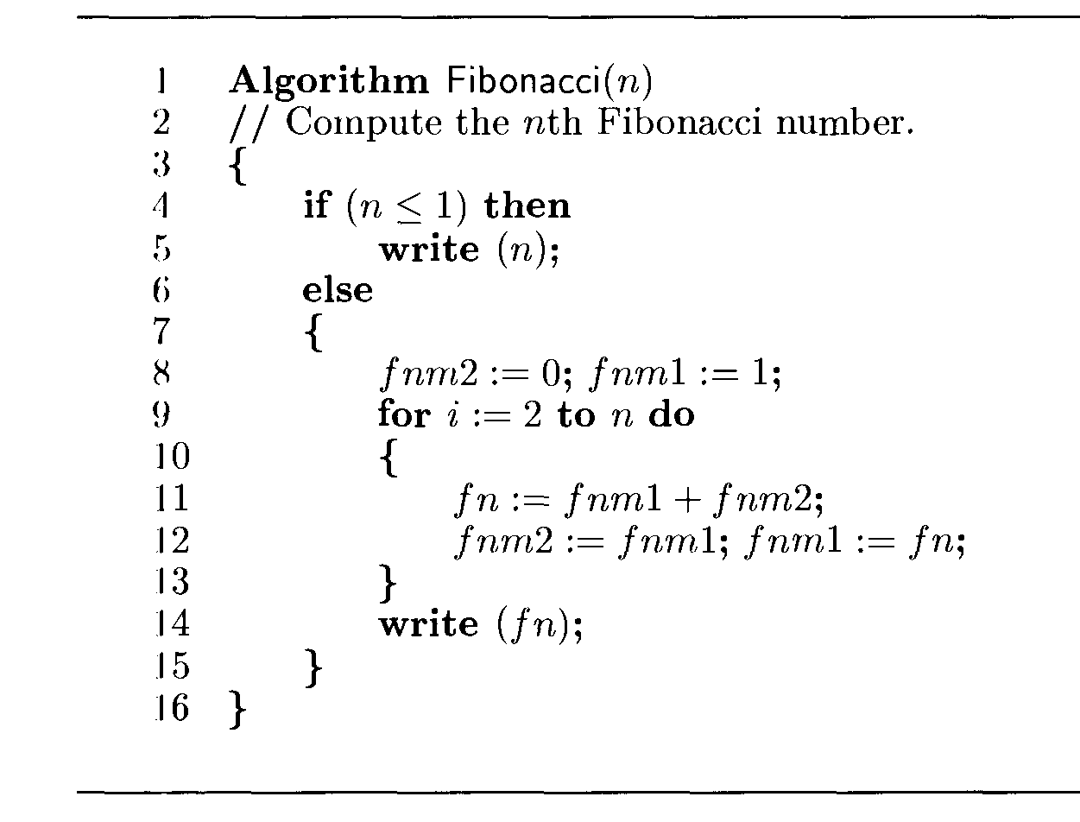

Slide 26
If n= 0 or 1 then total steps are 2
If n>1 then total steps are 4n+1

Slide 27
Algorithm Analysis
We have three cases to analyze an algorithm:
1) Worst Case 2) Average Case 3) Best Case
In the worst case analysis, we calculate upper bound on running time of an algorithm.
In average case analysis, we take all possible inputs and calculate computing time for all of the inputs. Sum all the calculated values and divide the sum by total number of inputs.
In the best case analysis, we calculate lower bound on running time of an algorithm.

Slide 28
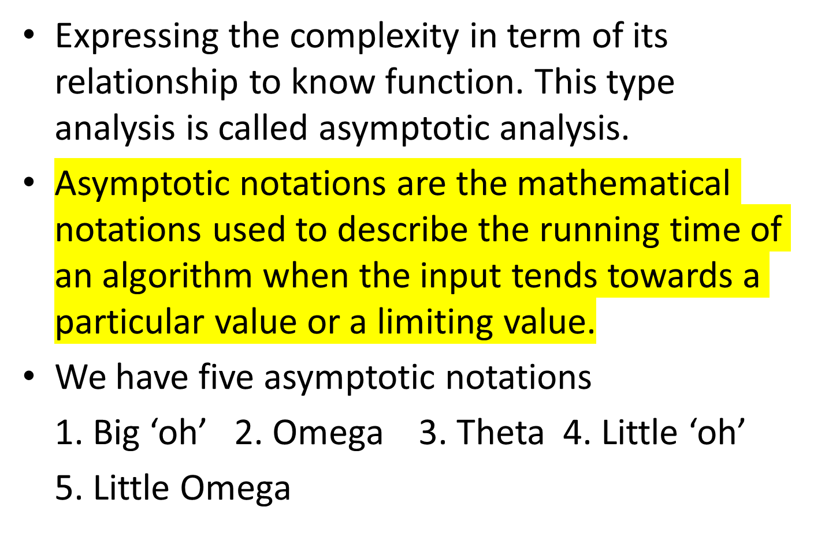
Asymptotic analysis

Slide 29
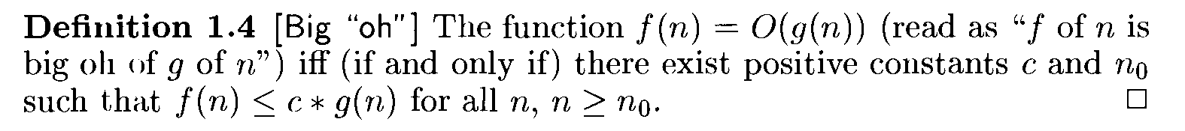
Big “oh” (O)
Ex: 1. 3n+2= O(n) as 3n+2<=4n for all n>=2
2. 3n+3= O(n) as 3n+3<=4n for all n>=3
3. 100n+6= O(n) as 100n+6<=101n for all n>=6
4. 10n² + 4n+2 = O(n²) as 10n² + 4n+2 <=11n²
for all n>=5
5. 6*2^{n} + n² = O(2^{n}) as 6*2^{n} + n² <=7*2^{n} for n>=4

Slide 30
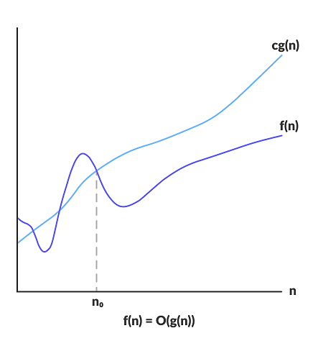

Slide 31
Big-O notation represents the upper bound of the running time of an algorithm.
It gives the worst case complexity of an algorithm.

Slide 33
Poll Question?
1000* n² + 100*n -6 = O(n² ) is it correct (yes/no)

Slide 34
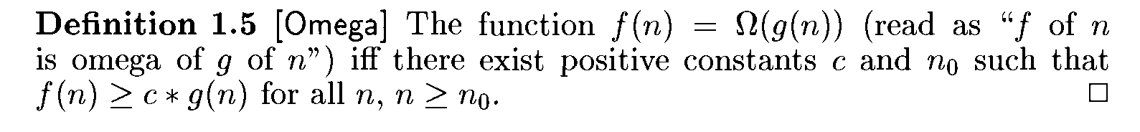
Omega (Ω)
Ex: 1. 3n+2= Ω(n) as 3n+2>=3n for all n>=1
2. 3n+3= Ω(n) as 3n+3>=3n for all n>=1
3. 100n+6= Ω(n) as 100n+6>=100n for all n>=1
4. 10n² + 4n+2 = Ω(n²) as 10n² + 4n+2 >=n²
for all n>=1

Slide 35
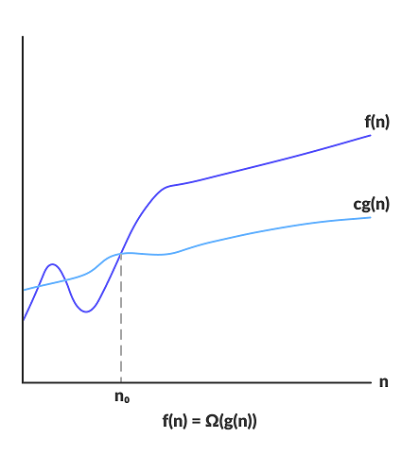

Slide 36
Omega notation represents the lower bound of the running time of an algorithm.
It provides best case complexity of an algorithm.

Slide 37
Poll Question?
6*2^{n} + n² = Ω (2^{n}) is it correct (Y/N)

Slide 38
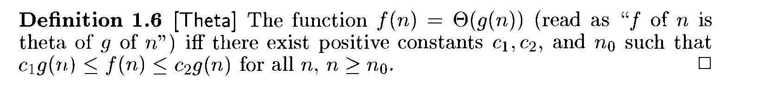
Theta (ө)
Ex: 1. 3n+2= ө(n) as 3n+2>=3n for all n>=2 and
3n+2<=4n for all n>=2
2. 3n+3= ө(n)
3. 100n+6= ө(n)
4. 10n² + 4n+2 = ө(n²)
5. 6*2^{n} + n² = ө(2^{n})
6. 10*log n+4 = ө(log n )

Slide 39
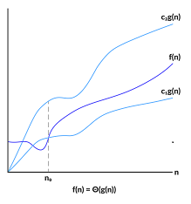

Slide 40
Theta notation encloses the function from above and below.
Since it represents the upper and the lower bound of the running time of an algorithm.
It is used for analyzing the average case complexity of an algorithm.

Slide 41
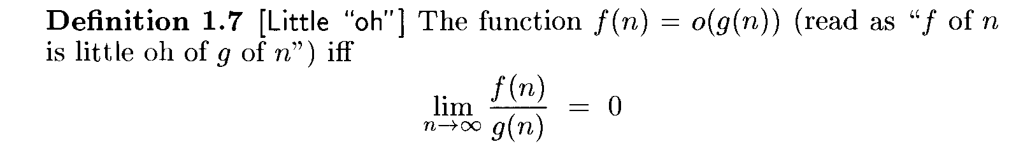
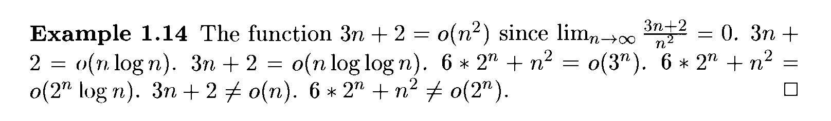
Little “oh” (o)

Slide 42
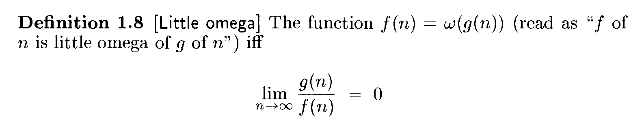
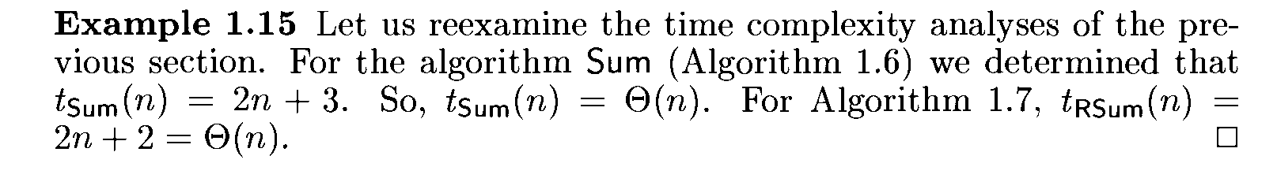
Little omega (ω)

Slide 43
Home Assignment
Find the time complexity of below algorithms by using step table method
Matrix Multiplication
Sorting Technique
Compute x^{n}

