Slide 1
CSE- 312
Design and Analysis of Algorithms
III Year 1st Semester
UNIT – I
Topics: Quick Sort
Instructor:
M. Naveen
Asst.Prof.,
CSE Dept.,
RVR & JC CE.

Slide 2
Poll Question?
Time Complexity of Merge Sort is
a. O(n²)
b. O(log n)
c. O(n * log n)
d. O(n)

Slide 3
Quick Sort
It is a divide-and-conquer approach can be used to arrive at an efficient sorting method different from merge sort.
In merge sort, the file a[1:n] was divided at its midpoint into sub arrays which were independently sorted & later merged.
In Quick sort, the division into 2 sub arrays is made so that the sorted sub arrays do not need to be merged later.

Slide 4
Quick Sort(Continue…)
This is accomplished by rearranging the elements in a[1:n] such that a[i]<=a[j] for all i between 1 & m and all j between (m+1) & n for some m, 1<=m<=n.
Thus the elements in a[1:m] & a[m+1:n] can be independently sorted.
No merge is needed. This rearranging is referred to as partitioning.

Slide 5
Quick Sort(Continue…)
Function partition of Algorithm accomplishes an in-place partitioning of the elements of a[m:p-1]
It is assumed that a[p]>=a[m] and that a[m] is the partitioning element. If m=1 & p-1=n, then a[n+1] must be defined and must be greater than or equal to all elements in a[1:n]
The assumption that a[m] is the partition element is merely for convenience, other choices for the partitioning element than the first item in the set are better in practice.

Slide 6
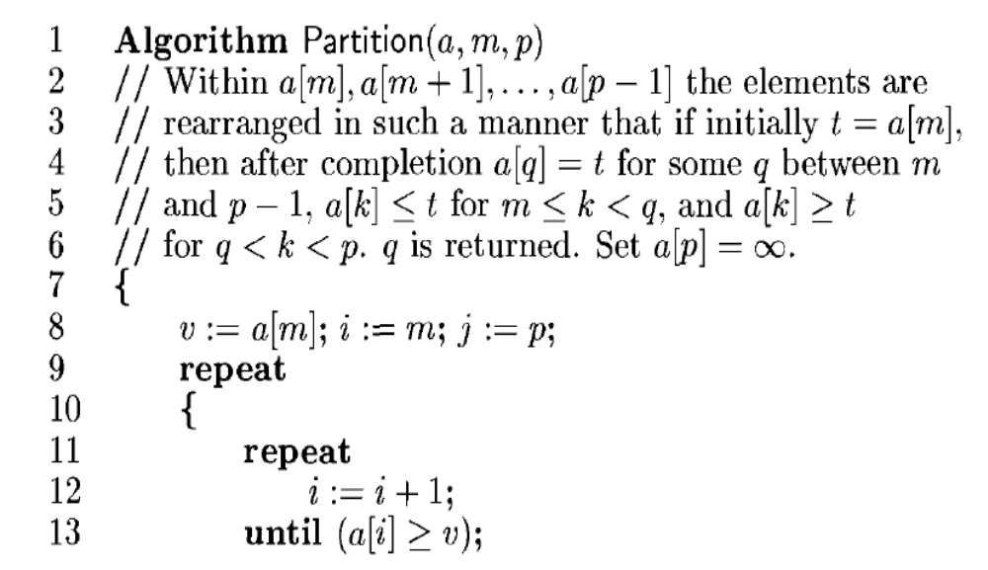
Algorithm for Partition

Slide 7
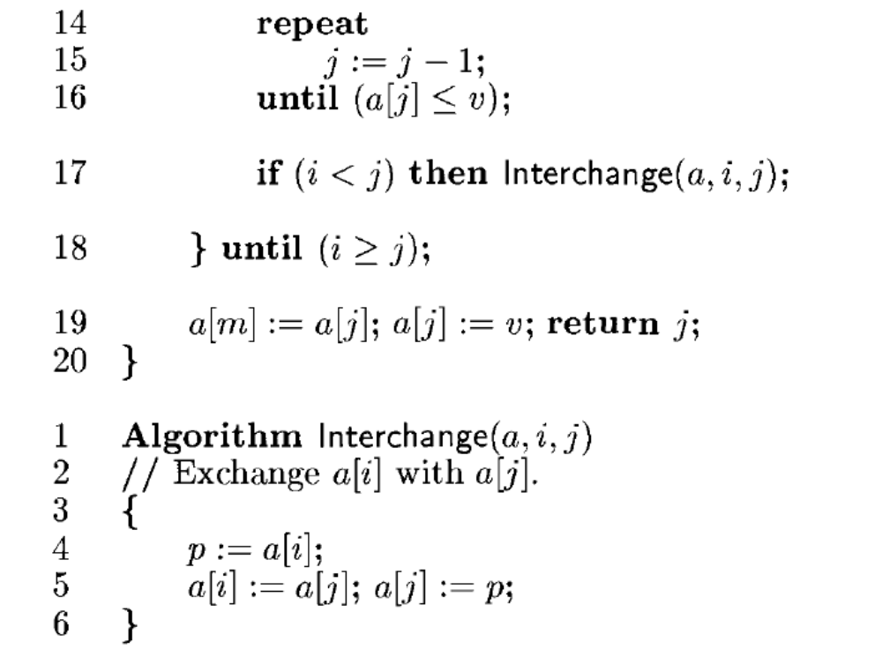

Slide 8
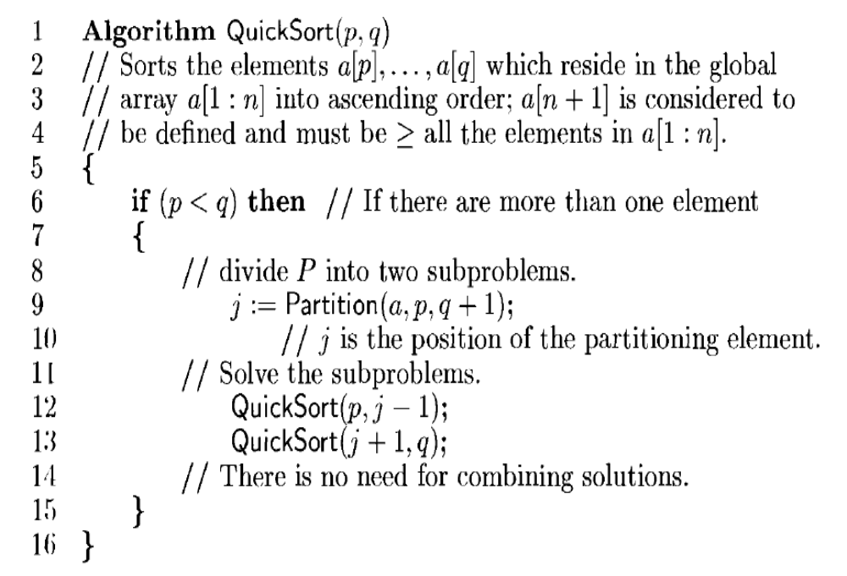
Algorithm for QuickSort

Slide 9
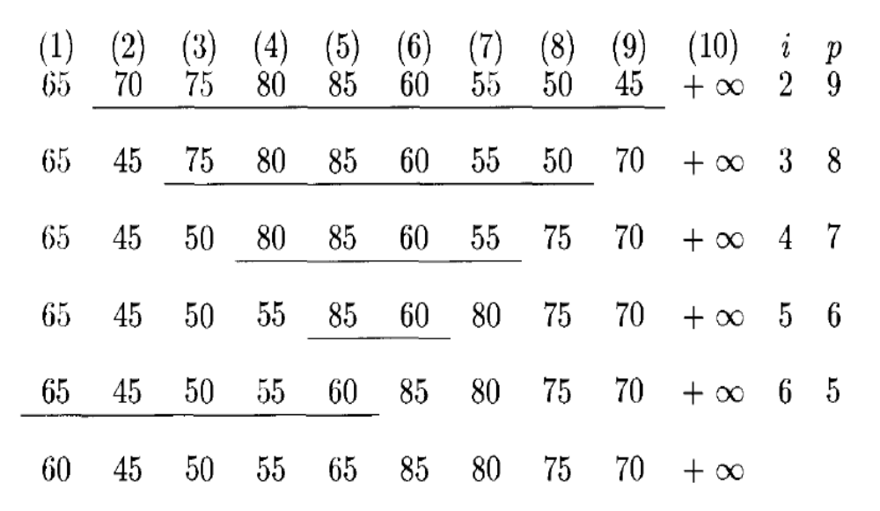
Example:

Slide 10
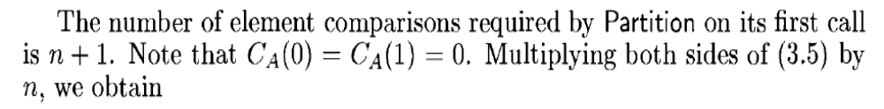
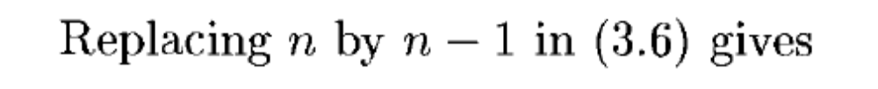
Time Complexity
Worst case complexity is O(n²)
Average case:

Slide 11
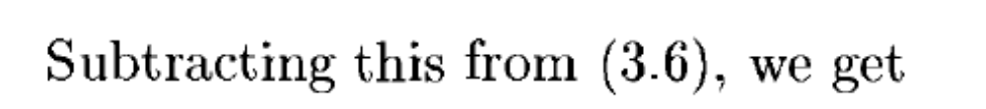
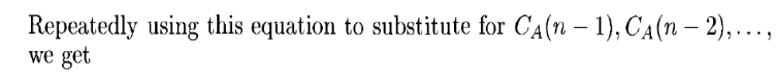
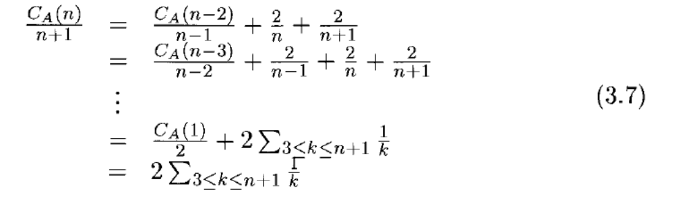

Slide 12
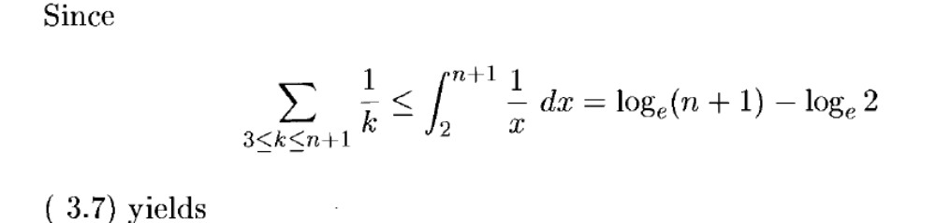
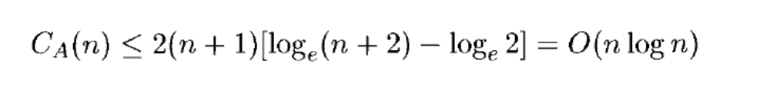

Slide 13
Poll Question?
Quick Sort is Faster than Merge Sort for all values.(Yes/No)

