Slide 1




Randomized Algorithms

Slide 2



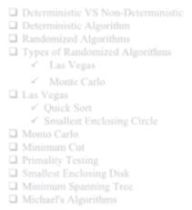

Outline
Randomized Algorithms
Types of Randomized Algorithms
Las Vegas
Monte Carlo
Identifying Repeated Element
Primality Testing
3

Slide 3

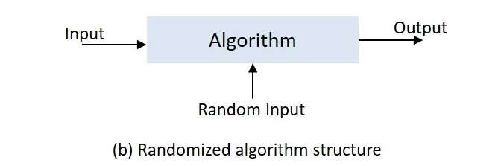
Randomized Algorithm
What is a Randomized Algorithm?
An algorithm that uses random numbers to decide what to do next any where in its logic is called Randomized Algorithm.
A randomized algorithm is an algorithm that employees a degree of randomness as a part of its logic.
A randomized algorithm is one that makes random choices during its execution.

Slide 4

Why use Randomized Algorithm
Simple and easy to implement. For example, Karger's min-cut algorithm
Faster and produces optimum output with very high probability.
To improve efficiency with faster run times. For example, we could use a randomized quicksort algorithm. Deterministic quicksort can be quite slow on certain worst case inputs (e.g., input that is almost sorted), but randomized quicksort is fast on all inputs.
To improve memory usage. Random sampling as a way to sparsify input and then working with this smaller input is a common technique.
In parallel/distributed computing, each machine only has a part of the data, but still has to make decisions that affect global outcomes. Randomization plays a key role in informing these decisions.

Slide 5




















Types of Randomized algorithm
Las Vegas algorith ms
Monte Carlo algorithm s

Slide 6





3
Las Vegas

Slide 7


Las Vegas
Always produces correct output.
Running time is random.
Time complexity is based on a random value and time complexity is evaluated as expected value.
So correctness is deterministic, time complexity is probabilistic.
Expected running time should be polynomial.
Use
Improve performance
Ex.: Randomized quicksort
Searching in solution space
14

Slide 8

Monte Carlo
1

Slide 9




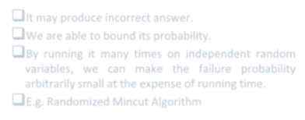

“
Outputs might differ from run to run (for the same input)
We are able to bound its probability.
By running it many times on independent random variables, we can make the failure probability
arbitrarily small at the expense of running time.
E.g. Primality test

Slide 10
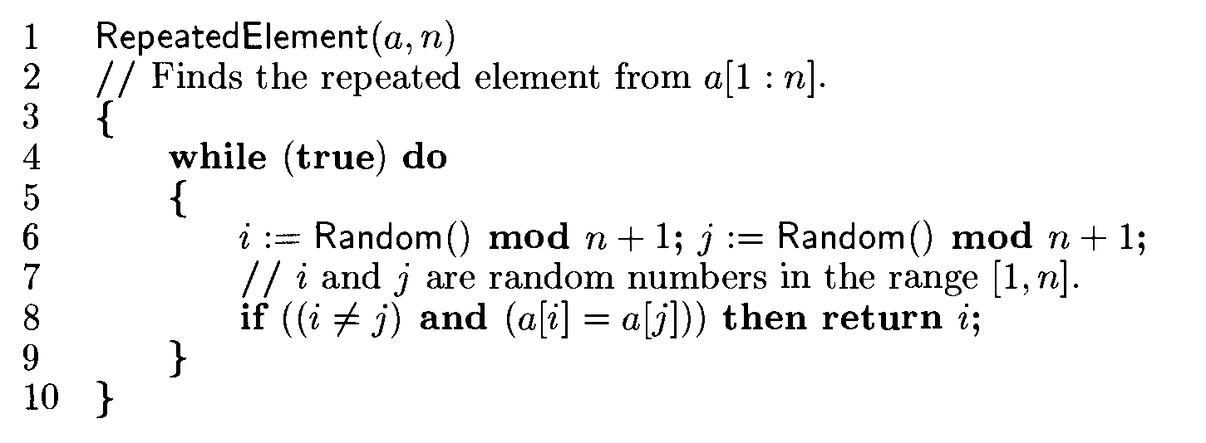

Slide 11
It is Las Vegas randomized algorithm and it takes O~(log n) time.

Slide 12



Primality Testing
Prime Number: divisible only by 1 and the number itself.
Ex: 1, 2, 3, 5, 7, 11, ………
Algorithm:
for i = 2 to N-1
{
if (x mod i == 0) return -1
}
return 1
Time Complexity: O(N)
Mathematical Result: 2, ….. , 𝑁
59

Slide 13


Primality Testing Cont….
Algorithm:
for i = 2 to 𝑁 { if (x mod i == 0) return -1
}
return 1
Time Complexity: O( 𝑁)

Slide 14


Primality Testing Cont….
Fermat’s Theorem: If n is prime, then 𝑎^{𝑛−1} ≡ 1 (mod n) for any integer a < n.
n = 3 , a = 2, then 2² % 3 = 4 % 3 = 1
n = 5, a = 2, then 2⁵⁻¹ % 5 = 16 % 5 = 1
n = 5, a = 3, then 3⁵⁻¹ % 5 = 81 % 5 = 1

Slide 15


Primality Testing Cont….
Input: Prime = n
Sufficient number of integers a < n
Algorithm:
if((𝑎^{𝑛−1})% = = 1) for(i = 1 to large) do
{
a = random (n) _{z = 𝑎}𝑛−1
if((z%n) ≠ 1)
return False
1, ………, n-1
}
return True
62

Slide 16
Primality Testing
Applications:
RSA-cryptosystem
Algebraic algorithms
63

Slide 17

Advantages of Randomized Algorithms
The algorithm is usually simple and easy to implement,
The algorithm is fast with very high probability, and
It produces optimum output with very high probability.

Slide 18

Difficulties in Randomized Algorithm
There is a finite probability of getting incorrect answer. However, the probability of getting a wrong answer can be made arbitrarily small by the repeated employment of randomness.
Analysis of running time or probability of getting a correct
answer is usually difficult.
Getting truly random numbers is impossible. One needs to depend on pseudo random numbers. So, the result highly
depends on the quality of the random numbers.
Its quality depends on quality of random number generator used as part of the algorithm.
The other disadvantage of randomized algorithm is hardware
failure.
73

Slide 19


Application & Scope

Slide 20

Application
Tool for sorting: Randomized Quick Sort, then there is no user that always gets worst case. Everybody gets expected O(n Log n) time.
Cryptography: Randomized algorithms have huge applications in
Cryptography, e.g: RSA Crypto-System.
Load Balancing.
Number-Theoretic Applications: Primality Testing
Data Structures: Hashing, Sorting, Searching, Order Statistic and
Computational Geometry.
Algebraic identities: Polynomial and matrix identity verification. Interactive proof systems.

Slide 21
Application
Mathematical programming: Faster algorithms for linear programming, Rounding linear program solutions to integer program solutions
Graph algorithms: Minimum spanning trees, shortest paths, minimum cuts. Counting and enumeration: Matrix permanent Counting combinatorial structures.
Parallel and distributed computing: Deadlock avoidance distributed consensus.
Probabilistic existence proofs: Show that a combinatorial object arises with
non-zero probability among objects drawn from a suitable probability space.

Slide 22

Thank You
Any Question

