Slide 1
DataSpark:Illuminating-Insights-for-Global-Electronics
EFFECTIVE SALES ANALYSIS ALLOWS A COMPANY TO ALLOCATE RESOURCES MORE EFFICIENTLY. IT HELPS DETERMINE WHICH PRODUCTS OR SERVICES ARE PERFORMING WELL AND WHICH ARE UNDERPERFORMING. THIS INSIGHT ENABLES BUSINESSES TO FOCUS ON PROMOTING HIGH-PERFORMING ITEMS AND REEVALUATING OR DISCONTINUING UNDERPERFORMERS

Slide 2
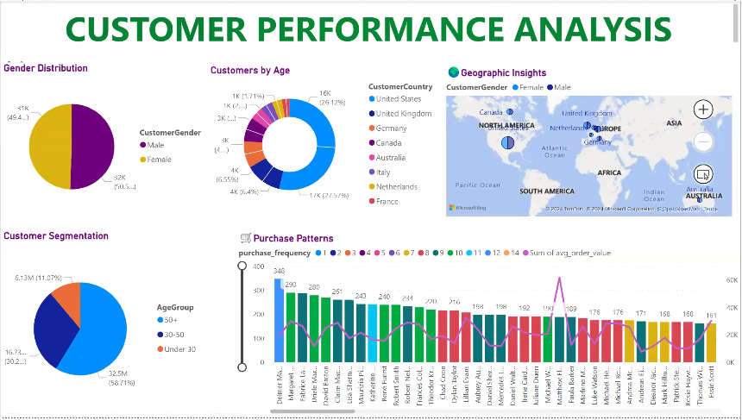

Slide 3
Small difference in male and female counts might indicate that your products or services appeal equally to both genders.
The age group of 60 and above has a higher count compared to other age groups, suggesting that older adults are a significant portion of the customer base.
US nearly have 6k-above customers, on other sides Italy,France,Netherlands having fewer than 1000 customers which implies that places need for increased focus

Slide 4
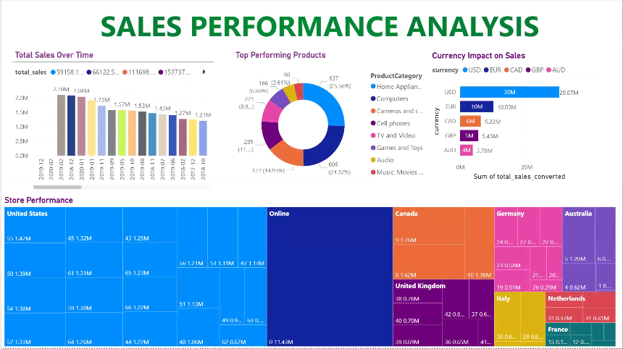

Slide 5
Growth and Decline: The data indicates a period of growth in sales from 2016 to 2019, peaking in 2019. After that, there is a significant decline in 2020 and 2021.
Profit Percentage Fluctuations: The profit percentages show large fluctuations. After a modest increase of 5.6% in 2017, there's a sharp rise of 72.12% in 2018 followed by a gain of 43.31% in 2019. Subsequently, there are significant declines of -49.08% in 2020 and -88.83% in 2021.

Slide 6
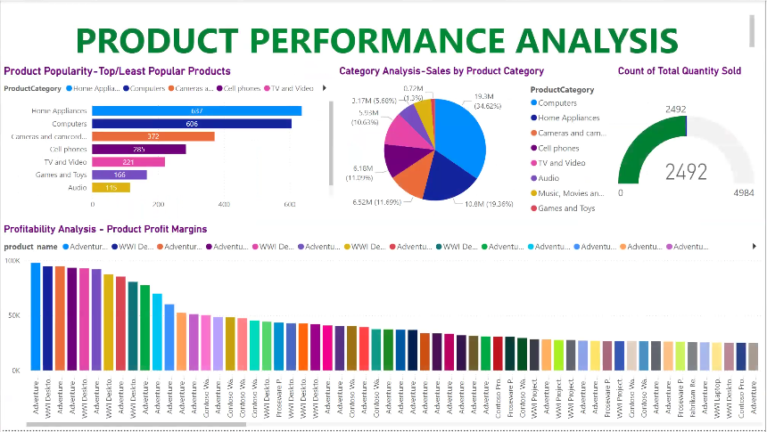

Slide 7
Enhance Product and Service Offerings
Product Innovation: Continuously innovate and improve your products or services based
on market trends and customer feedback.
Diversification: Expand your product line to cater to a wider range of customer needs or enter new markets.
Quality Assurance: Ensure high-quality standards for your products or services to build trust and
encourage repeat purchases.

Slide 8
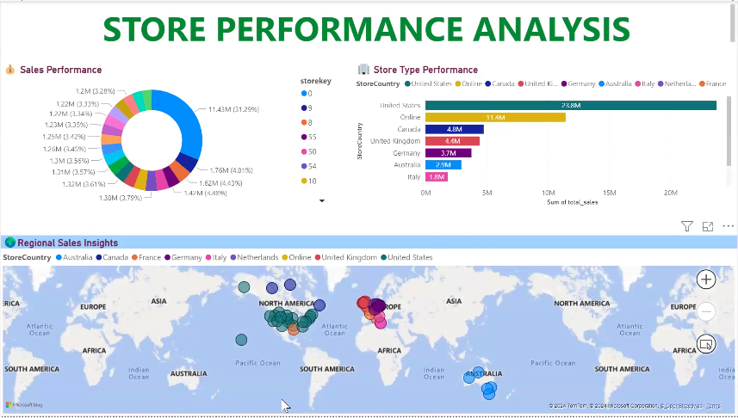

Slide 9
Optimize Pricing Strategies
Competitive Pricing: Analyze competitor pricing and adjust your pricing strategy to remain competitive
without compromising profitability.
Dynamic Pricing: Implement dynamic pricing models that adjust prices based on demand, customer segments,
or market conditions.
Bundling and Discounts: Offer product bundles or discounts to incentivize purchases and increase average order value.

Slide 10
Developed by
B.N.Piraviena

