Slide 1
DataSpark:Illuminating-Insights-for-Global-Electronics
EFFECTIVE ANALYSIS ALLOWS A COMPANY TO ALLOCATE RESOURCES MORE EFFICIENTLY. IT HELPS DETERMINE WHICH PRODUCTS OR SERVICES ARE PERFORMING WELL AND WHICH ARE UNDERPERFORMING. THIS INSIGHT ENABLES BUSINESSES TO FOCUS ON PROMOTING HIGH-PERFORMING ITEMS AND REEVALUATING OR DISCONTINUING UNDERPERFORMERS

Slide 2
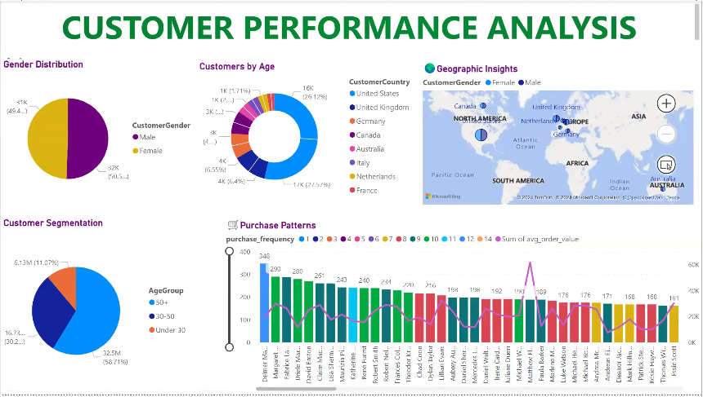

Slide 3
Customer Age Distribution
The majority of customers fall within the 46-60 and above 60 age range, indicating a some sort of senior customer base.
The analysis reveals significant variations in purchasing behavior among different age groups.
Geographic Analysis
Certain regions such as USA, UK, Germany demonstrate significantly higher sales compared to others, indicating market potential. O
Urban areas outperform rural areas in terms of sales volume.

Slide 4
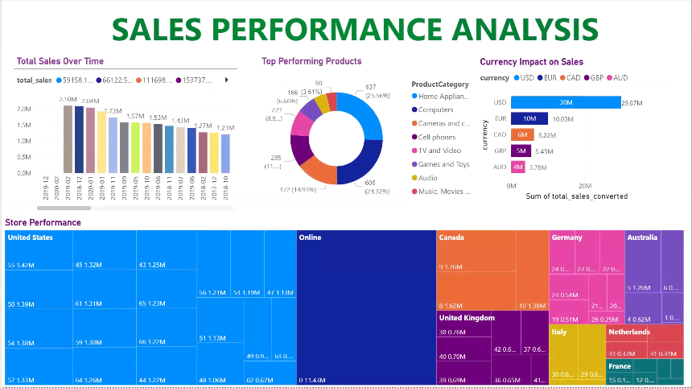

Slide 5
Top Selling Categories
Specific categories like
1. Computers
2. Home Appliances
3. Cameras and camcorders
Exchange Rates Affecting Sales
Exchange rate volatility has a notable impact on the pricing and profitability of international sales.

Slide 6
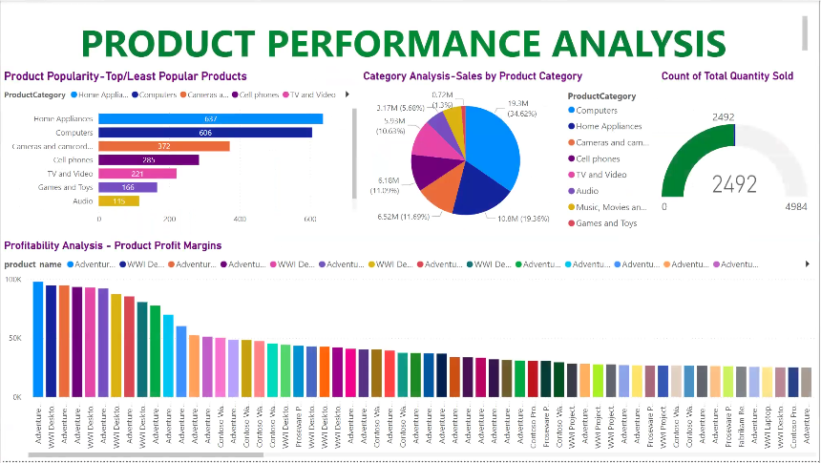

Slide 7
Product Performance Analysis
A small number of products like WWI Wireless Bluetooth Stereo Headphones M270 (Black, pink, white, silver) and WWI Wireless Transmitter and Bluetooth Headphones (Black, red, pink, white) contribute significantly to overall sales, indicating a potential focus on these items. o
Certain products show high profit margins while others underperform in terms of sales.

Slide 8
Top 10 Profitable Products
The top 10 products contribute a substantial portion of overall profits, indicating their importance to the business strategy. These products are:
1. WWI Desktop PC2.33 X2330 Black
2. Adventure Works Desktop PC2.33 XD233 Brown
3. Adventure Works Desktop PC2.33 XD233 Black
4. Adventure Works Desktop PC2.33 XD233 Silver
5. Adventure Works Desktop PC2.33 XD233 White
6. WWI Desktop PC2.33 X2330 White
7. WWI Desktop PC2.33 X2330 Brown
8. Adventure Works 52" LCD HDTV X590 White
9. Adventure Works 52" LCD HDTV X590 Black
10. WWI Desktop PC2.33 X2330 Silver

Slide 9
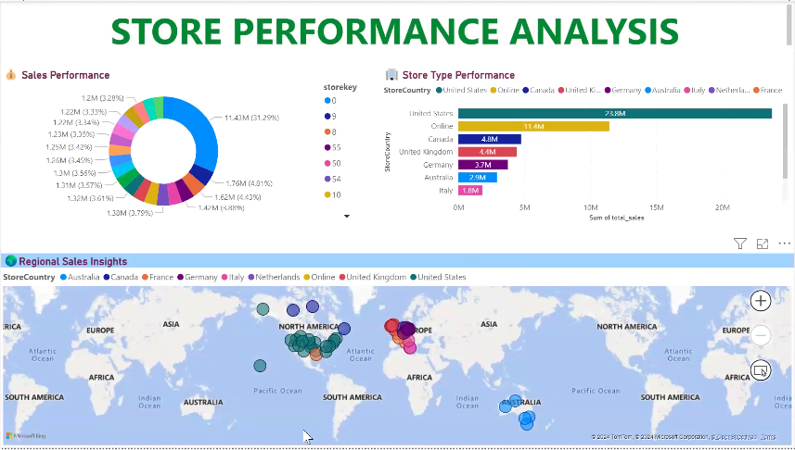

Slide 10
Store Performance
Variability in performance among stores highlights the need for targeted interventions.
Some stores with store keys like 0, 55, 54 significantly perform better than others, suggesting best practices exist that can be replicated.

Slide 11
Developed by
B.N.Piraviena

