Slide 1
Angular Session-2

Slide 2
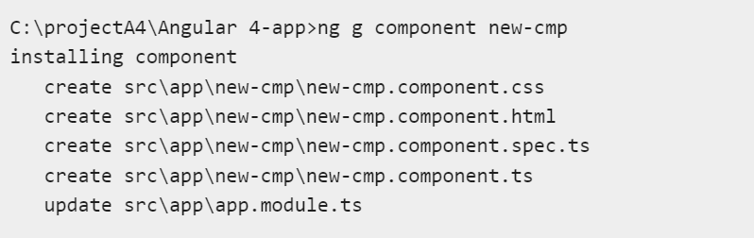
Component Creation
Major part of the development with Angular 4 is done in the components. Components are basically classes that interact with the .html file of the component.
ng g component new-cmp

Slide 3
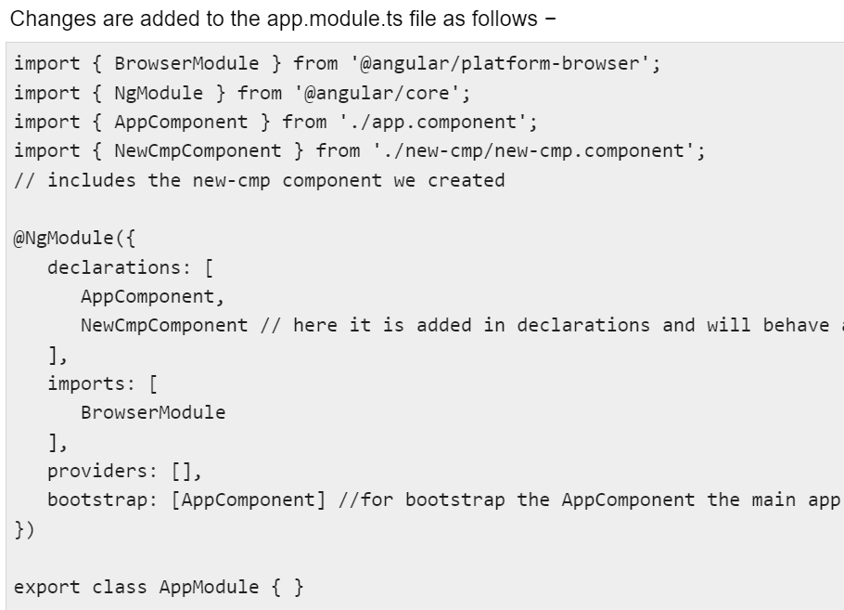

Slide 4
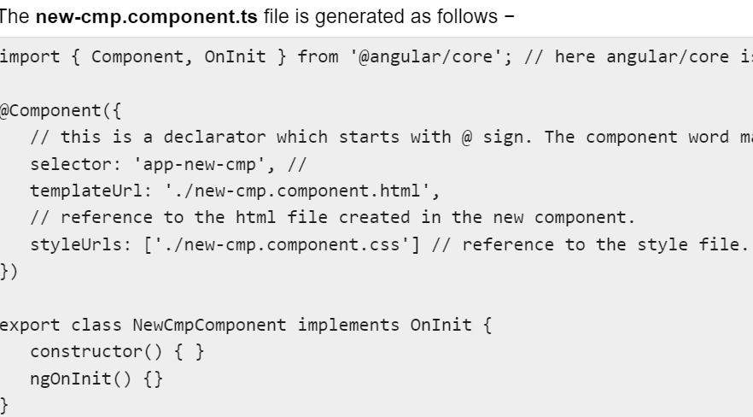

Slide 5
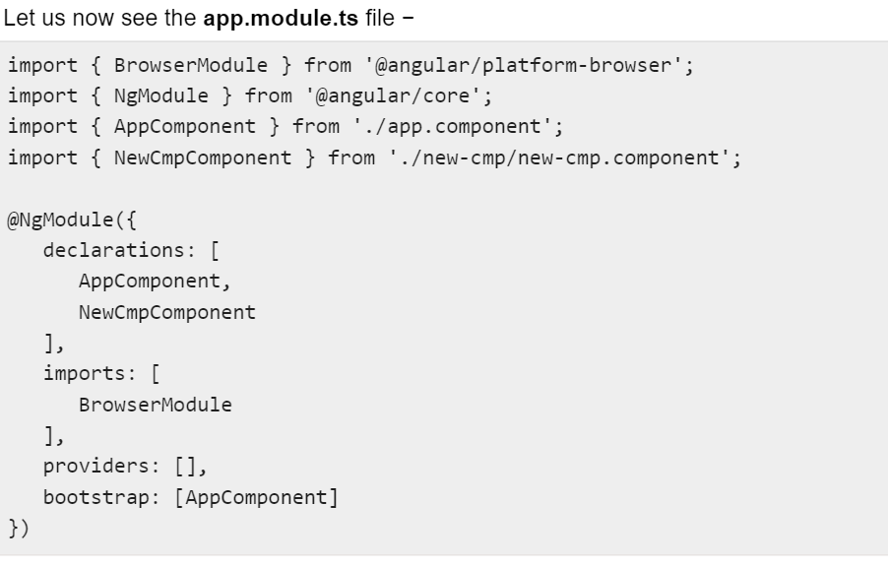

Slide 6
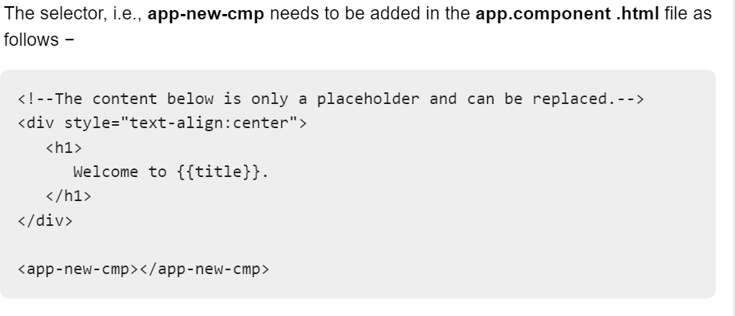

Slide 7
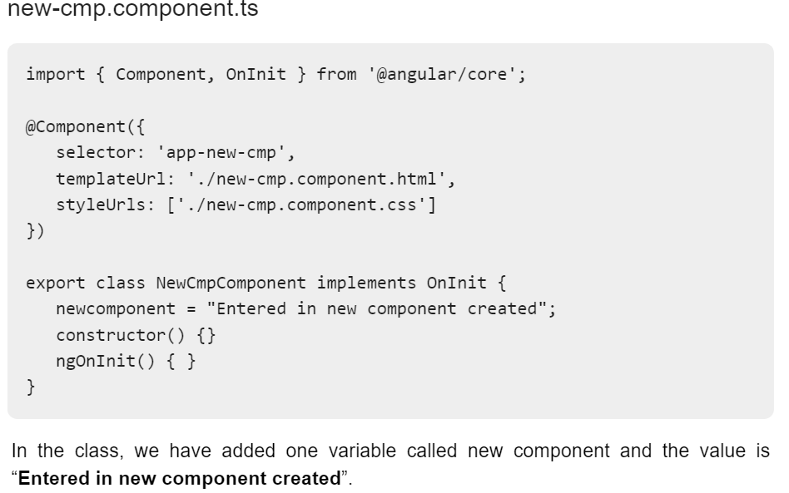

Slide 8
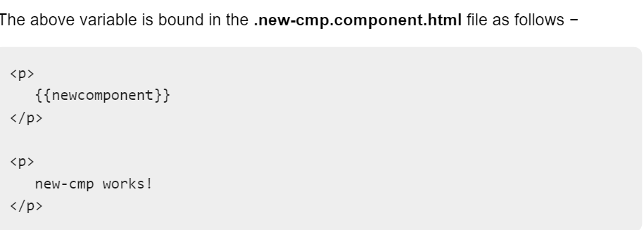

Slide 9
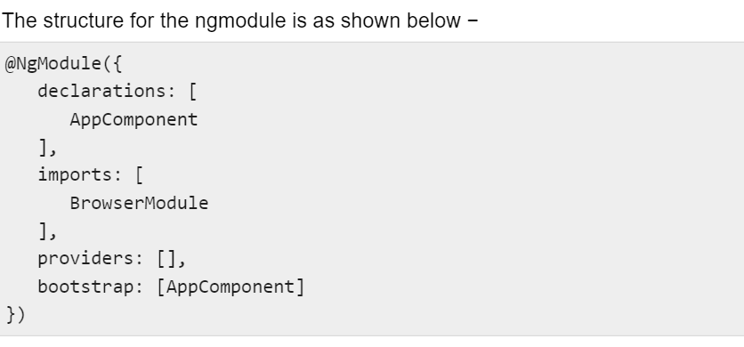
Angular 4 - Module
Module in Angular refers to a place where you can group the components, directives, pipes, and services, which are related to the application.

Slide 10
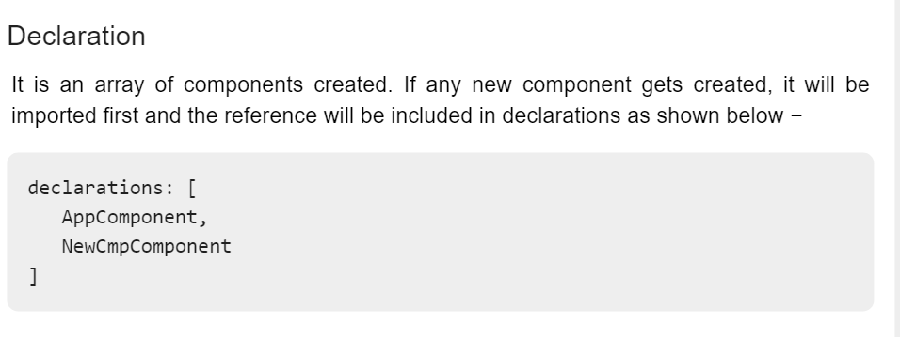

Slide 11
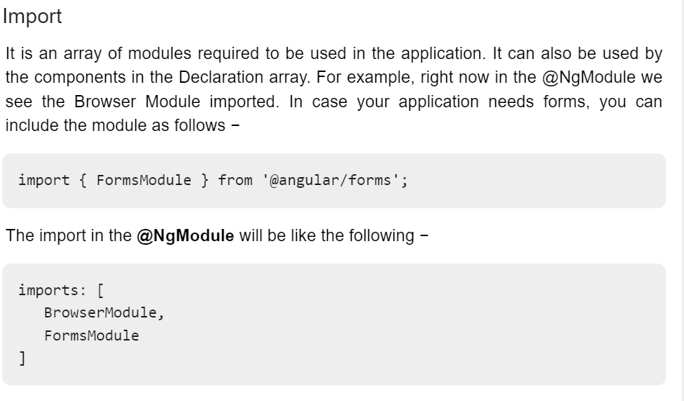

Slide 12
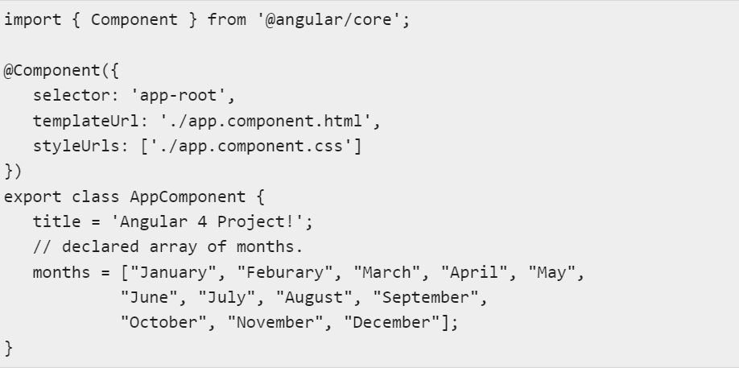
Angular 4 - Data Binding
Data Binding is available right from AngularJS, Angular 2 and is now available in Angular 4 as well. We use curly braces for data binding - {{}}; this process is called interpolation.
Ex: {{title}}
create a dropdown of months in the browser

Slide 13
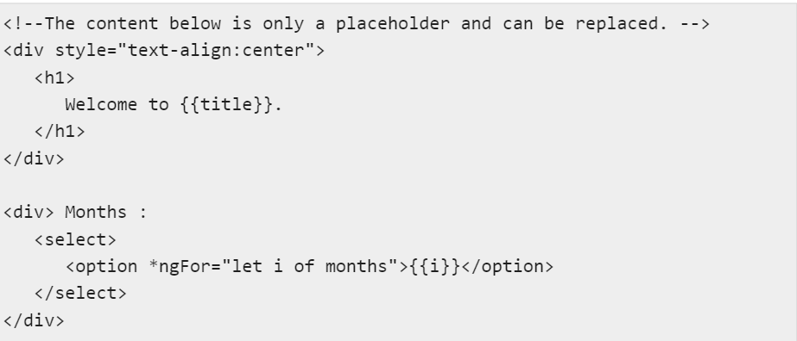

Slide 14
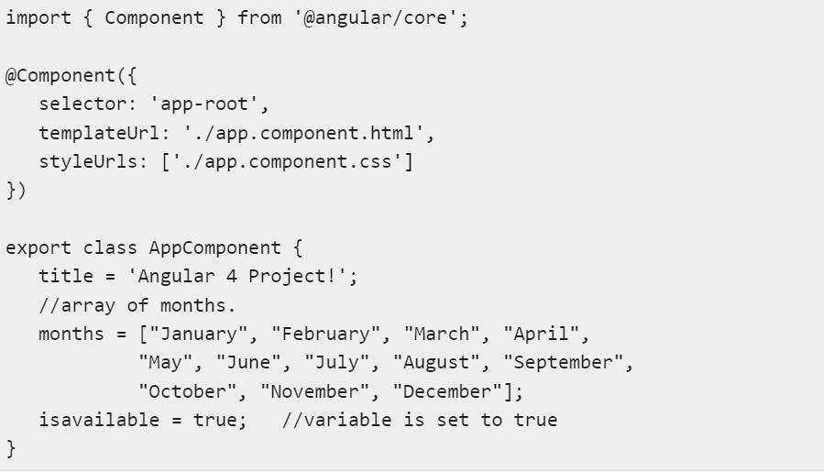

Slide 15
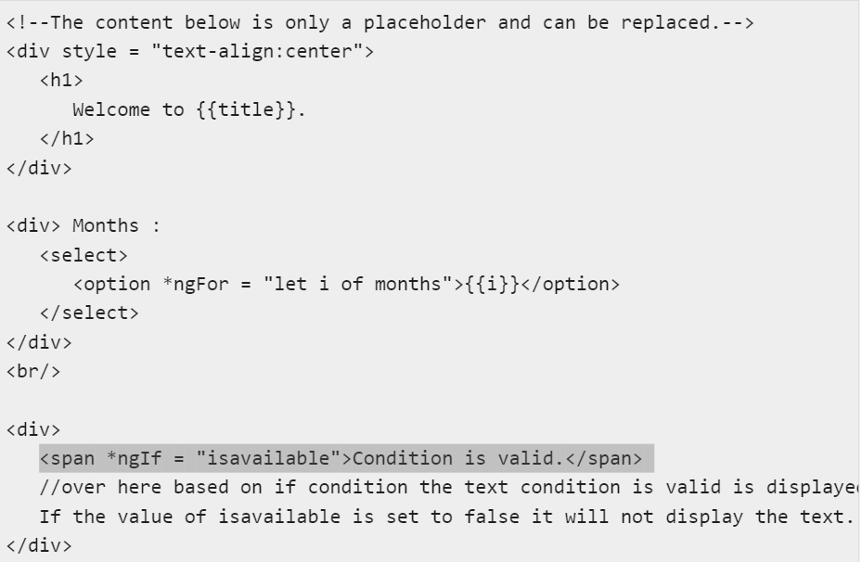

Slide 16
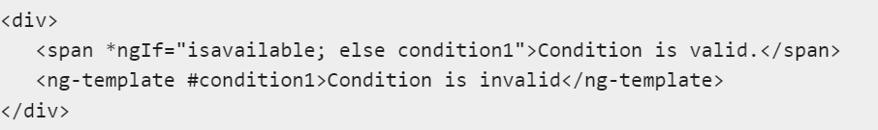
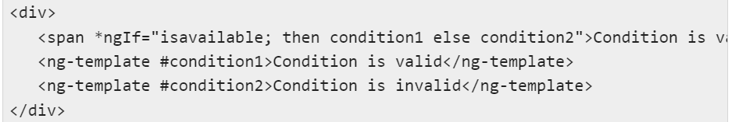
If-then-else

Slide 17
