Slide 1
Angular session-3

Slide 2
Angular 4 - Directives
Directives in Angular is a js class, which is declared as @directive. We have 3 directives in Angular.
Component Directives
These form the main class having details of how the component should be processed, instantiated and used at runtime.
Structural Directives
A structure directive basically deals with manipulating the dom elements. Structural directives have a * sign before the directive. For example, *ngIf and *ngFor.

Slide 3
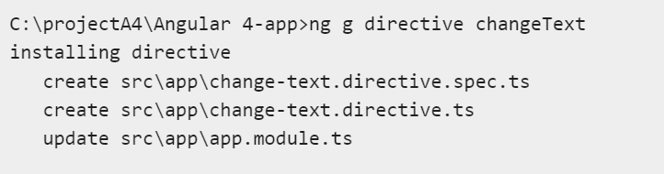
Attribute Directives
Attribute directives deal with changing the look and behavior of the dom element. You can create your own directives as shown below.
Create Custom Directives
ng g directive change

Slide 4
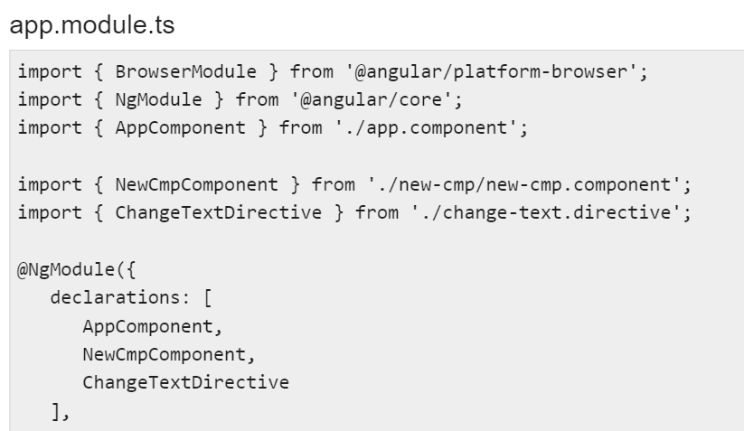

Slide 5
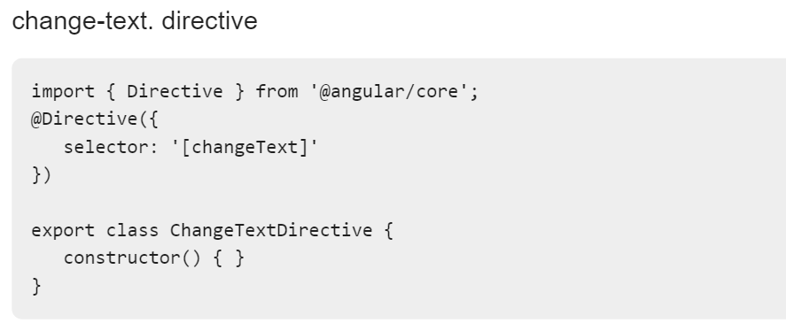

Slide 6
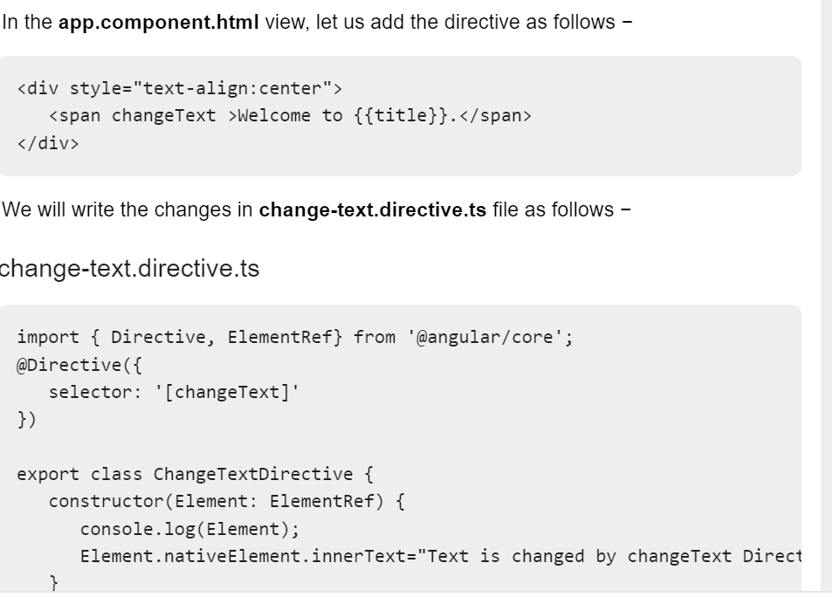

Slide 7
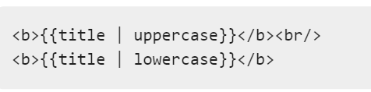
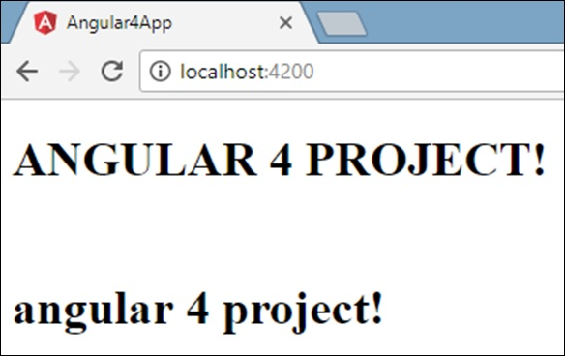
Angular 4 - Pipes
Pipes were earlier called filters in Angular1 and called pipes in Angular 2 and 4.
The | character is used to transform data.
Angular 4 provides some built-in pipes.
The pipes are listed below −
Lowercasepipe
Uppercasepipe
Datepipe
Currencypipe
Jsonpipe
Percentpipe
Decimalpipe
Slicepipe

Slide 8
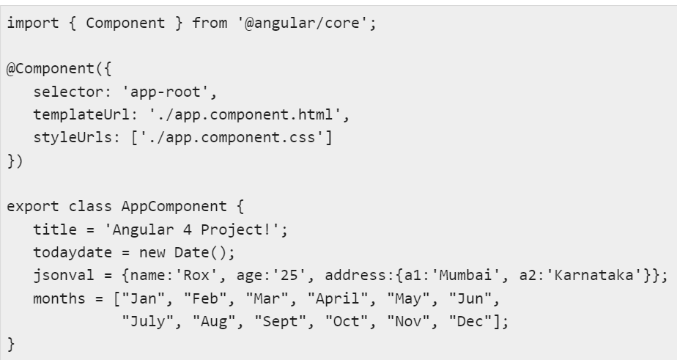

Slide 9
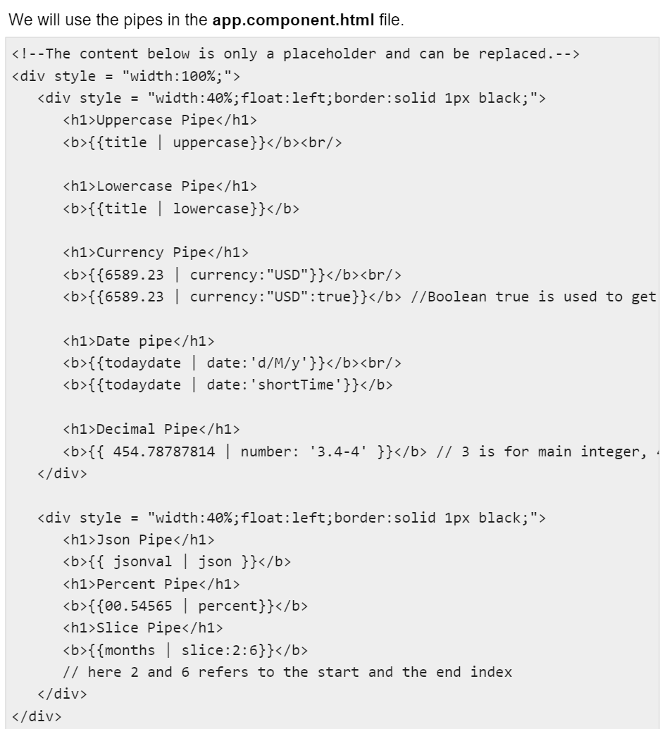

Slide 10
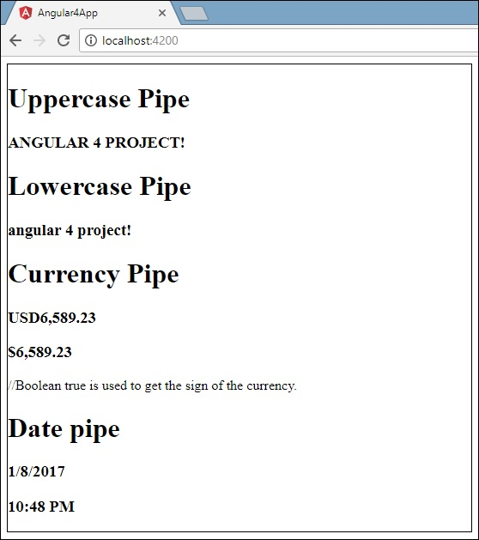

Slide 11
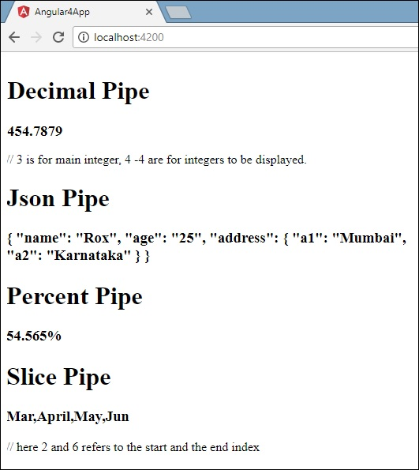

Slide 12
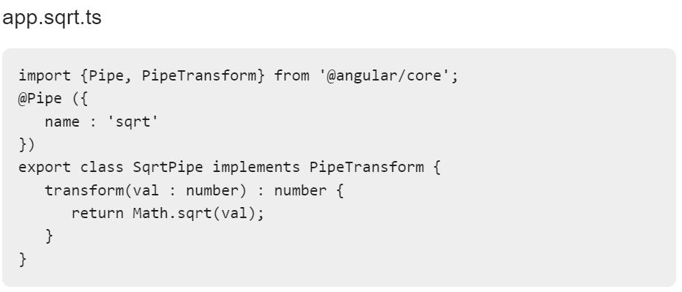
Create a Custom Pipe

Slide 13
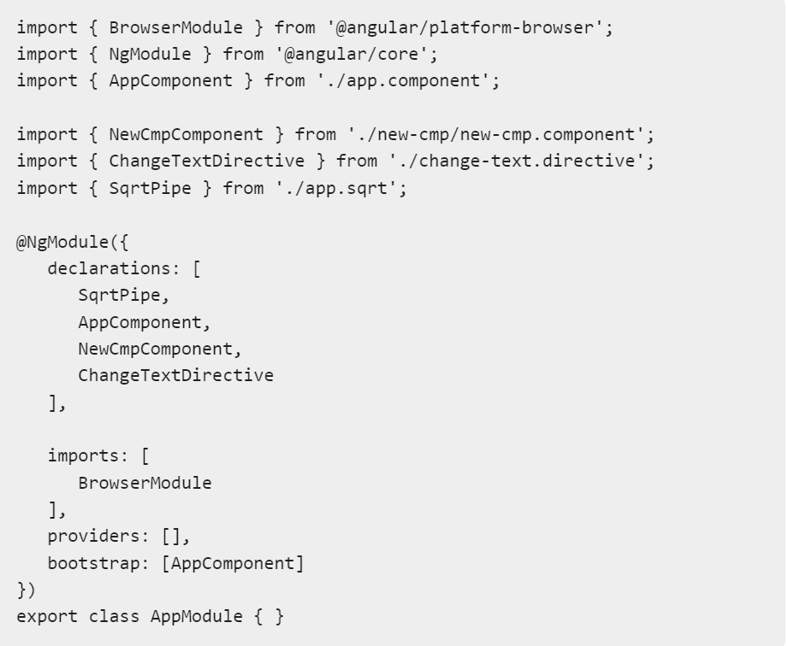

Slide 14
