Slide 1
Angular session-4

Slide 2
Angular 4 - Routing
Routing basically means navigating between pages. You have seen many sites with links that direct you to a new page. This can be achieved using routing.
In the main parent component app.module.ts,
import { RouterModule} from '@angular/router';
imports: [
BrowserModule,
RouterModule.forRoot([
{
path: 'new-cmp',
component: NewCmpComponent
}
])
],

Slide 3
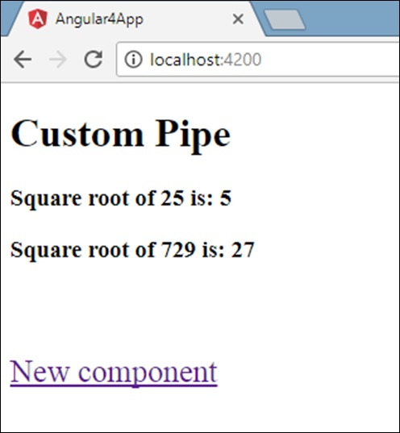
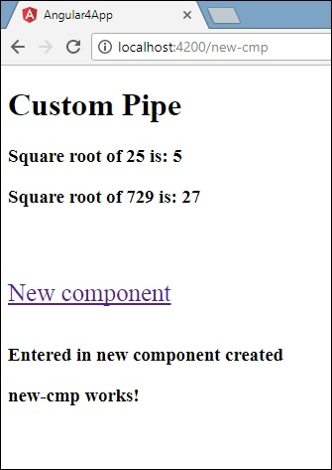
add the router details in the app.component.html.
<a routerLink = "new-cmp">New component</a>
<router-outlet></router-outlet>
When a user clicks new component, the page should display the content. For this, we need the following tag - <router-outlet> </router-outlet>.

Slide 4
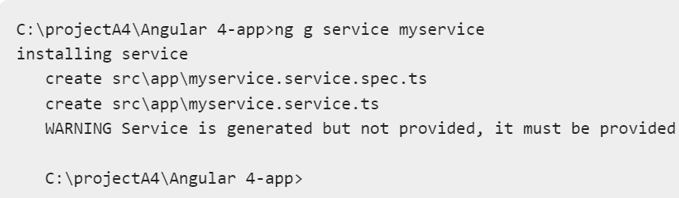
Angular 4 - Services
We might come across a situation where we need some code to be used everywhere on the page.
It can be for data connection that needs to be shared across components, etc. Services help us achieve that.
With services, we can access methods and properties across other components in the entire project.

Slide 5

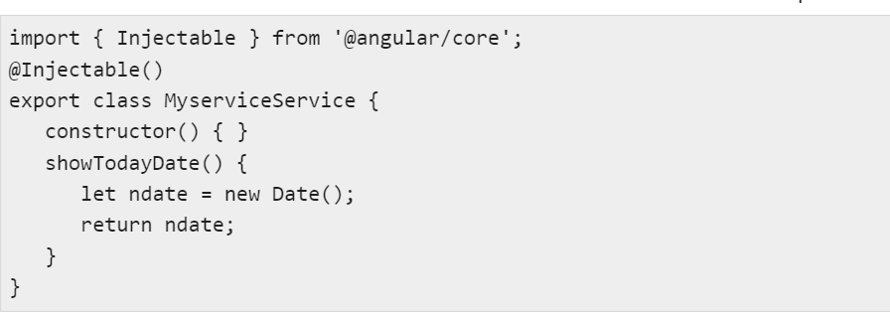
include the service created in the main parent app.module.ts.
myservice.service.ts

Slide 6
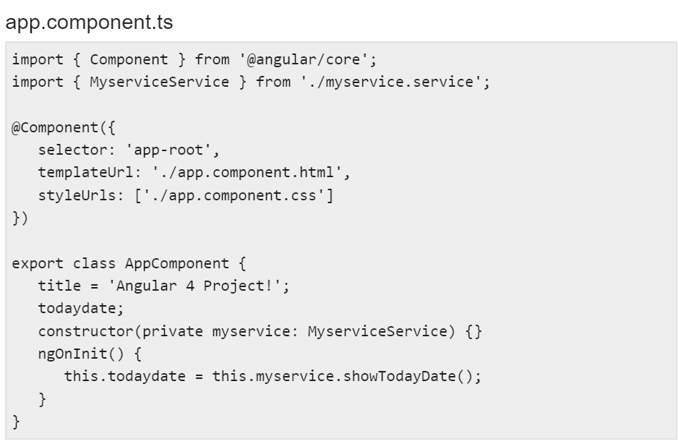

Slide 7
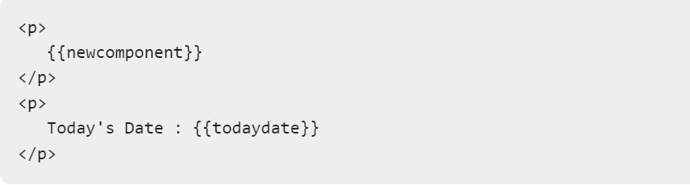
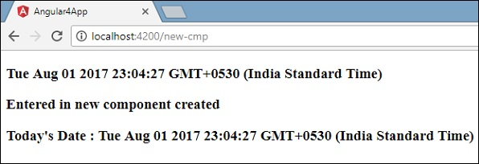

Slide 8
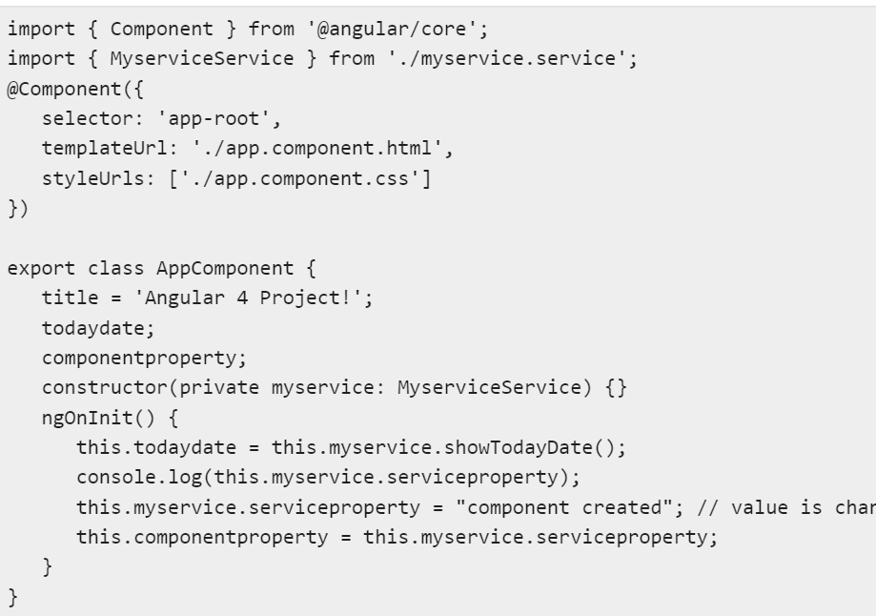

Slide 9
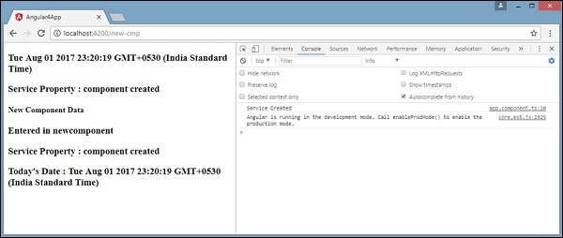

Slide 10
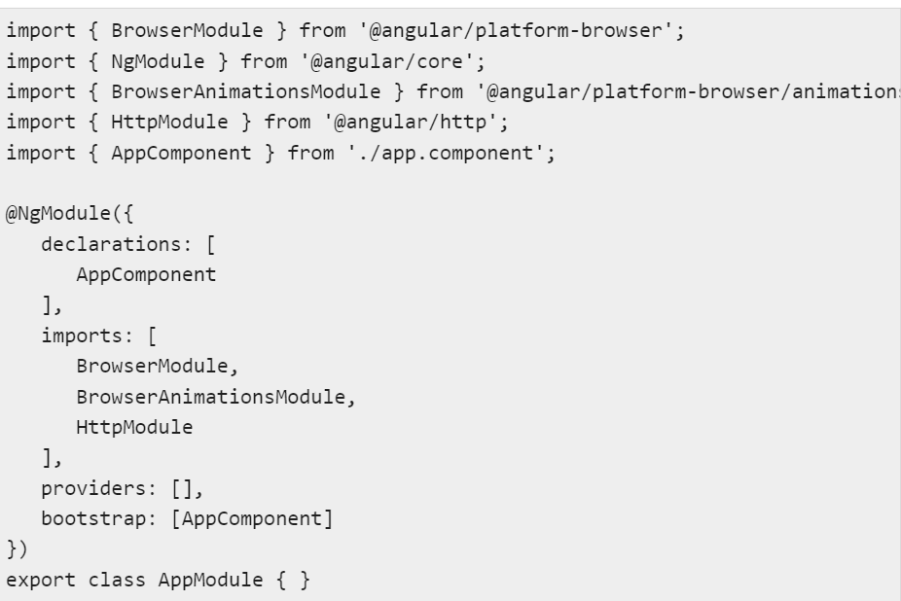
Angular 4 - Http Service

Slide 11
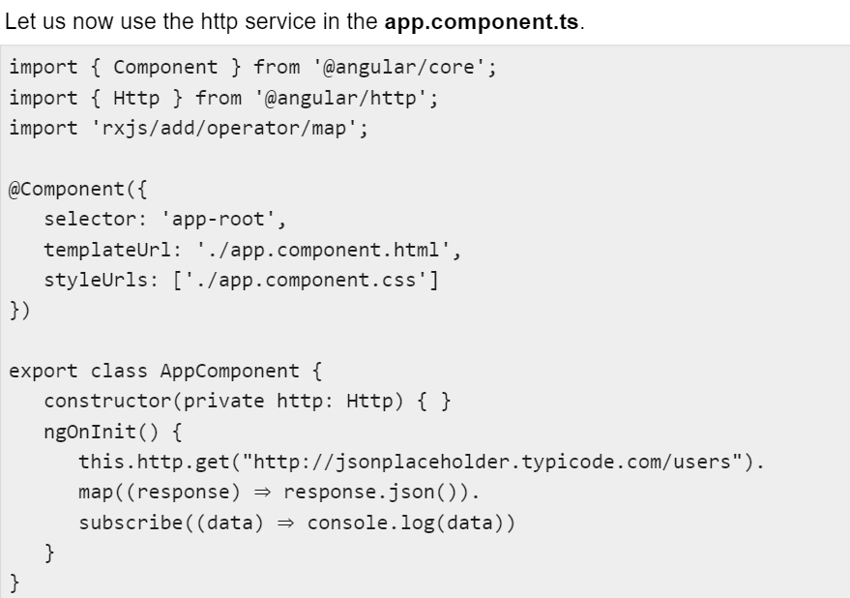

Slide 12
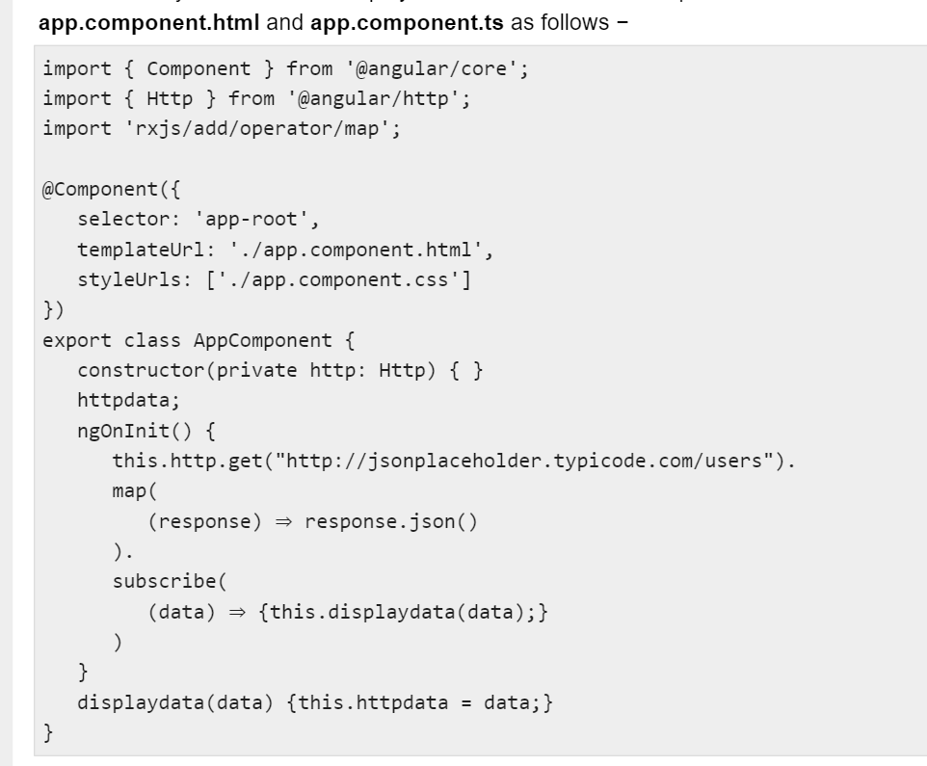

Slide 13
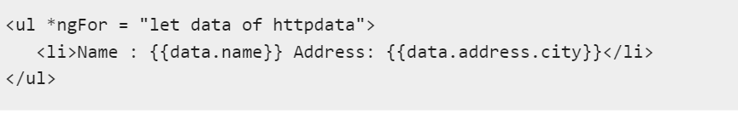
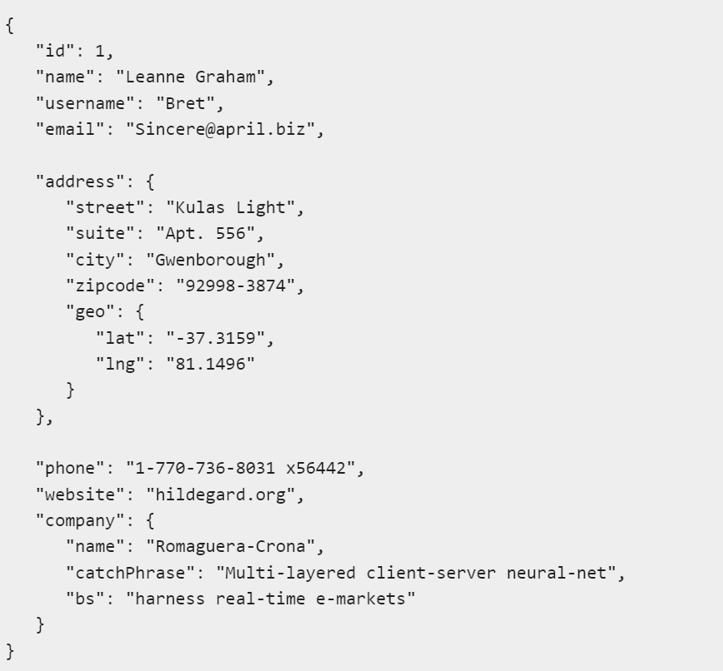
The json object is as follows −

Slide 14


Slide 15
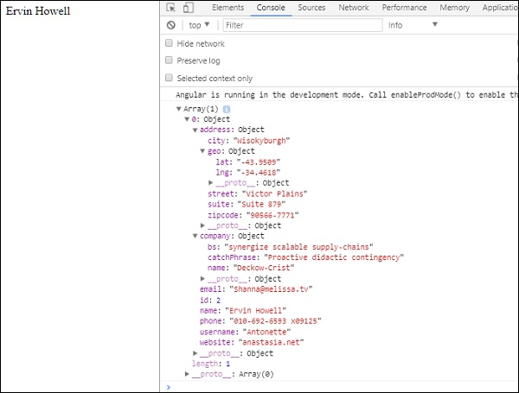
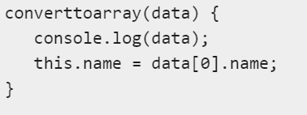
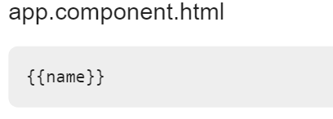
app.component.ts

