Slide 1
Angular session 5

Slide 2
Angular 4 - Forms
app.module.ts
import { FormsModule } from '@angular/forms';
imports: [
BrowserModule,
HttpModule,
FormsModule,
RouterModule.forRoot([
{path: 'new-cmp',component: NewCmpComponent}
])
],

Slide 3
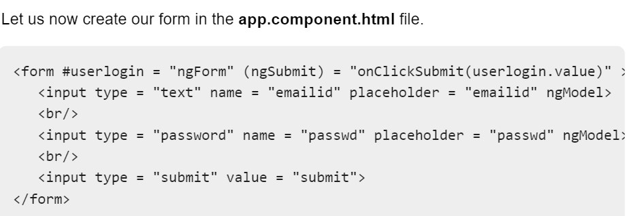

Slide 4
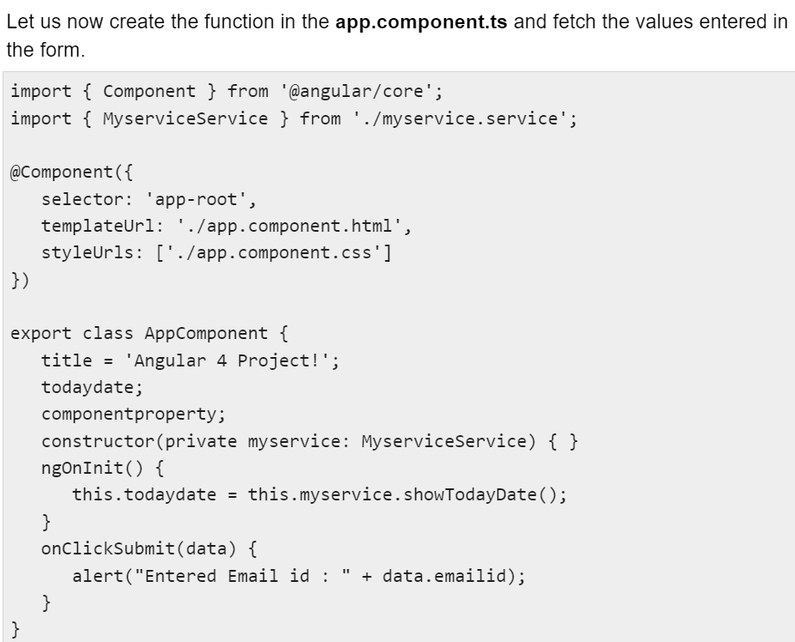

Slide 5
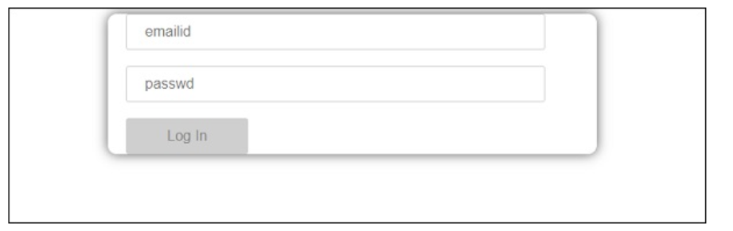
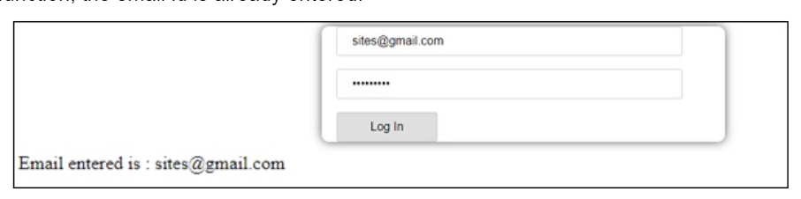

Slide 6
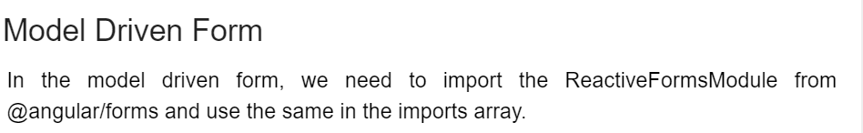
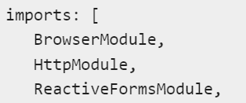
import { ReactiveFormsModule } from '@angular/forms';
In app.component.ts, we need to import a few modules for the model driven form. For example, import { FormGroup, FormControl } from '@angular/forms'.
import { FormGroup, FormControl } from '@angular/forms';

Slide 7
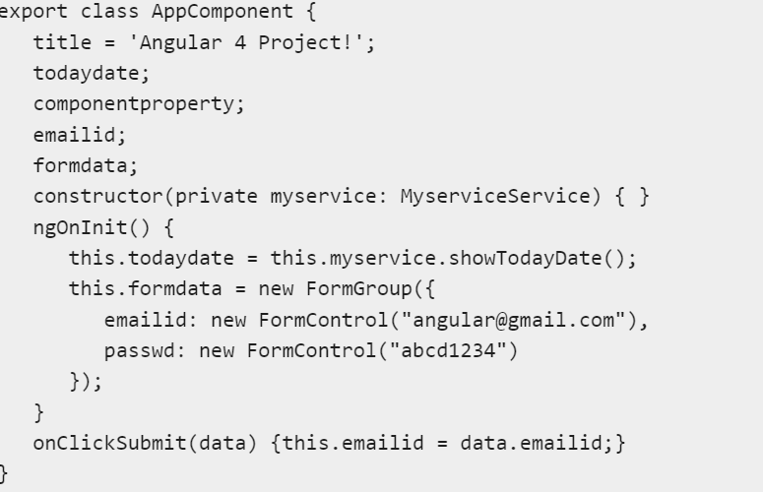

Slide 8
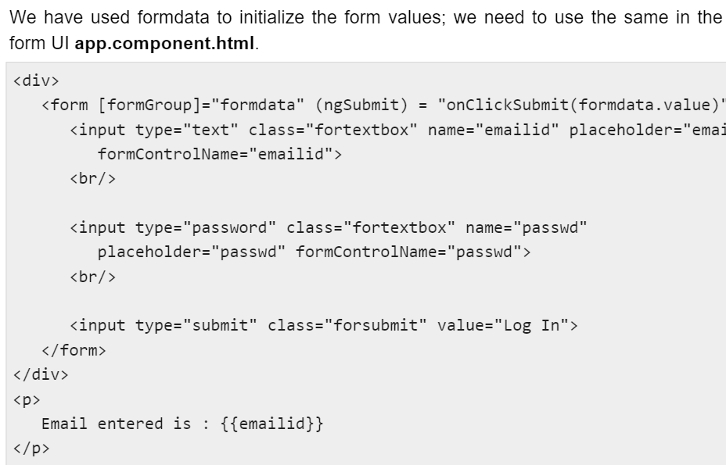

Slide 9
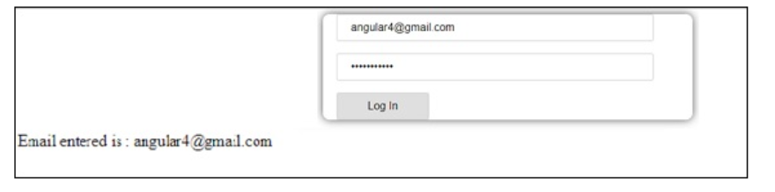
Form Validation
Let us now discuss form validation using model driven form. You can use the built-in form validation or also use the custom validation approach.
import { FormGroup, FormControl, Validators} from '@angular/forms'
Angular has built-in validators such as mandatory field, minlength, maxlength, and pattern. These are to be accessed using the Validators module.

Slide 10
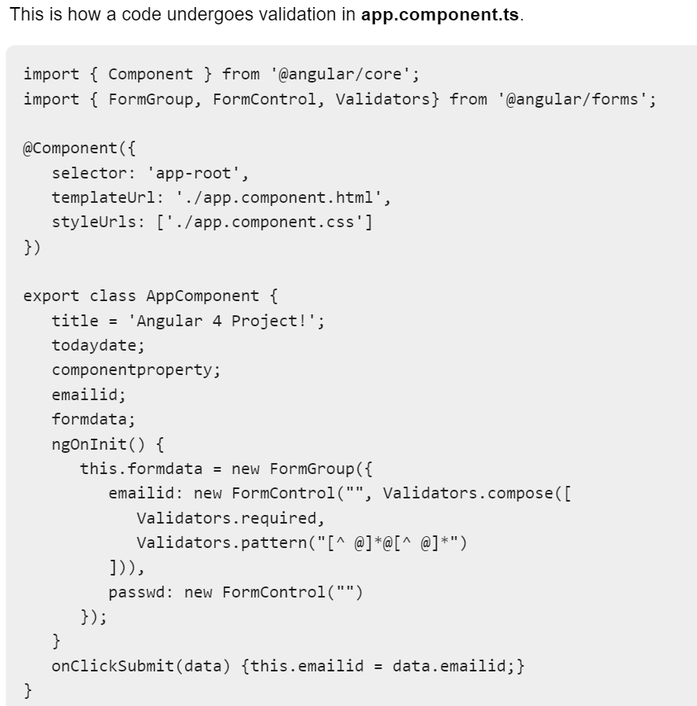

Slide 11
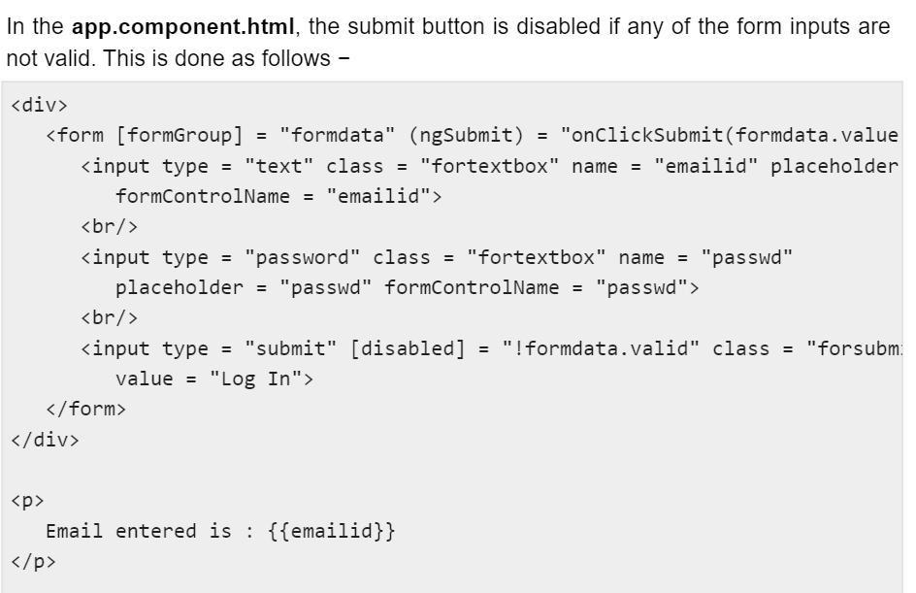

Slide 12
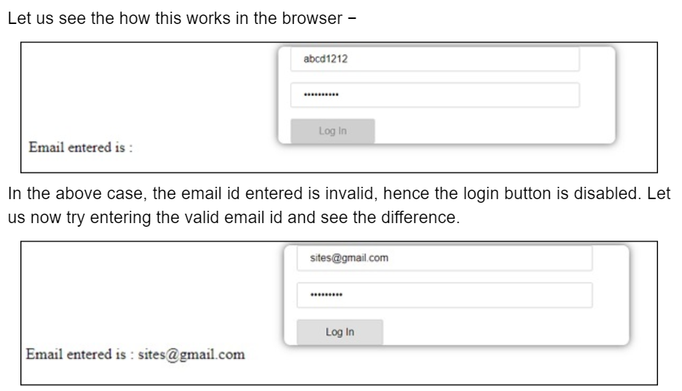

Slide 13
