Slide 1




Binary Trees

Slide 2


Parts of a binary tree
A binary tree is composed of zero or more nodes
Each node contains:
A value (some sort of data item)
A reference or pointer to a left child (may be null), and
A reference or pointer to a right child (may be null)
A binary tree may be empty (contain no nodes)
If not empty, a binary tree has a root node
Every node in the binary tree is reachable from the root
node by a unique path
A node with neither a left child nor a right child is called a leaf
In some binary trees, only the leaves contain a value

Slide 3





Picture of a binary tree
a
b
c
d
e
f
g
h
i
j
k
l

Slide 4

Size and depth
The size of a binary tree is the number of nodes in it
This tree has size 12
The depth of a node is its distance from the root
a is at depth zero
e is at depth 2
The depth of a binary tree is the depth of its deepest node
This tree has depth 4
a
b
c
d e
f
g h i j k
l

Slide 5

Balance
a
a
b
c
b
c e
d e f g
d
f
h i j
A balanced binary tree
g h
i j
An unbalanced binary tree
A binary tree is balanced if every level above the lowest is “full”
(contains 2^{n} nodes)
In most applications, a reasonably balanced binary tree is desirable

Slide 6
Binary search in an array
Look at array location (lo + hi)/2
Searching for 5:
(0+6)/2 = 3
Using a binary search tree
7
hi = 2;
(0 + 2)/2 = 1
lo = 2; (2+2)/2=2
3
13
11 17
0 1 2 3 4 5 6
2 | 3 | 5 | 7 | 11 | 13 | 17
2
5

Slide 7

Tree traversals
A binary tree is defined recursively: it consists of a root, a left subtree, and a right subtree
To traverse (or walk) the binary tree is to visit each node in the binary tree exactly once
Tree traversals are naturally recursive
Since a binary tree has three “parts,” there are six possible ways to traverse the binary tree:
root, left, right
left, root, right
left, right, root
root, right, left
right, root, left
right, left, root

Slide 8

Preorder traversal
In preorder, the root is visited first
Here’s a preorder traversal to print out all the elements in the binary tree:
public void preorderPrint(BinaryTree bt) { if (bt == null) return; System.out.println(bt.value); preorderPrint(bt.leftChild);
preorderPrint(bt.rightChild);
}

Slide 9
Inorder traversal
In inorder, the root is visited in the middle
Here’s an inorder traversal to print out all the elements in the binary tree:
public void inorderPrint(BinaryTree bt) { if (bt == null) return; inorderPrint(bt.leftChild); System.out.println(bt.value);
inorderPrint(bt.rightChild);
}

Slide 10

Postorder traversal
In postorder, the root is visited last
Here’s a postorder traversal to print out all the elements in the binary tree:
public void postorderPrint(BinaryTree bt) { if (bt == null) return; postorderPrint(bt.leftChild); postorderPrint(bt.rightChild); System.out.println(bt.value);
}
10

Slide 11
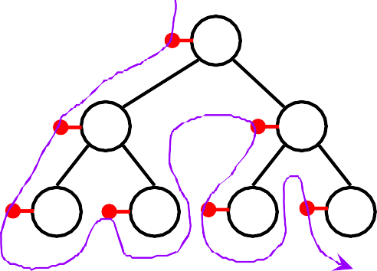
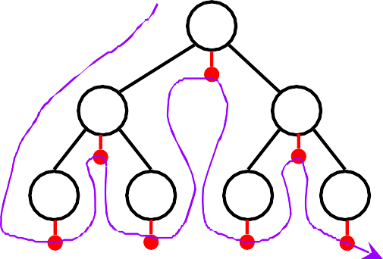
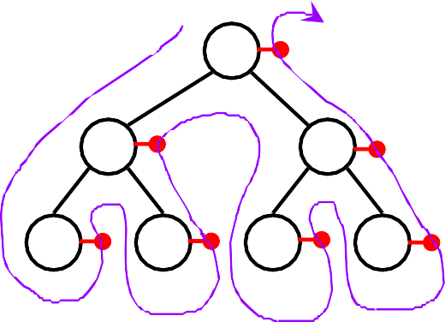
Tree traversals using “flags”
The order in which the nodes are visited during a tree traversal can be easily determined by imagining there is a “flag” attached to each node, as follows:
preorder inorder
To traverse the tree, collect the flags:
A A
B C B C
D E F G D E F G A B D E C F G D B E A F C G
postorder
A
B
C
D E F G
D E B F G C A
10

Slide 12

Copying a binary tree
In postorder, the root is visited last
Here’s a postorder traversal to make a complete copy of a given binary tree:
public BinaryTree copyTree(BinaryTree bt) { if (bt == null) return null;
BinaryTree left = copyTree(bt.leftChild); BinaryTree right = copyTree(bt.rightChild); return new BinaryTree(bt.value, left, right);
}
10

Slide 13

Other traversals
The other traversals are the reverse of these three standard ones
That is, the right subtree is traversed before the left subtree is traversed
Reverse preorder: root, right subtree, left subtree
Reverse inorder: right subtree, root, left subtree
Reverse postorder: right subtree, left subtree, root
10

Slide 14


The End
10

