Slide 1
UNIT - 1 INTRODUCTION TO DATA
STRUCTURES, SEARCHING AND SORTING

Slide 2
Contents
Introduction to Data Structures
Classification and Operations on Data Structures
Preliminaries of Algorithm
Algorithm Analysis and Complexity
Recursive Algorithms
Searching Techniques - Linear, Binary, Fibonacci
Sorting Techniques- Bubble, Selection, Insertion, Quick and Merge Sort
Comparison of Sorting Algorithms
2

Slide 3
Introduction to Data Structures
A data structure is a way of storing data in a computer so that it can be used efficiently and it will allow the most efficient algorithm to be used.
A data structure should be seen as a logical concept that must address two fundamental
concerns.
First, how the data will be stored, and
Second, what operations will be performed on it.
3

Slide 4
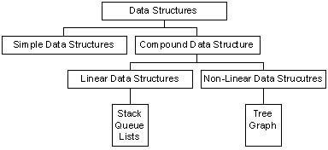
Classification of Data Structures
Data structures can be classified as
Simple data structure
Compound data structure
Linear data structure
Non linear data structure
Fig. Classification of Data Structures
4

Slide 5
Simple and Compound Data Structures
Simple Data Structure: Simple data structure can be constructed with the help of primitive data structure. A primitive data structure used to represent the standard data types of any one of the computer languages. Variables, arrays, pointers, structures, unions, etc. are examples of primitive data structures. Compound Data structure: Compound data structure can be constructed with the help of any one of the primitive data structure and it is having a specific functionality. It can be designed by user. It can be classified as
Linear data structure
Non-linear data structure
5

Slide 6
Linear and Non-linear Data Structures
Linear Data Structure: Linear data structures can be constructed as a continuous arrangement of data elements in the memory. It can be constructed by using array data type. In the linear Data Structures the relationship of adjacency is maintained between the data elements.
Non-linear
structure can
Data Structure: Non-linear data be constructed as a collection of
randomly distributed set of data item joined together by using a special pointer (tag). In non-linear Data structure the relationship of adjacency is not maintained between the data items.
6

Slide 7
Operations on Data Structures
Add an element
Delete an element
Traverse
Sort the list of elements
Search for a data element
7

Slide 8
Abstract Data Type
An abstract data type, sometimes abbreviated ADT, is a logical description of how we view the data and the operations that are allowed without regard to how they will be implemented.
By providing this level of abstraction, we are creating an encapsulation around the data. The idea is that by encapsulating the details of the implementation, we are hiding them from the user‘s view. This is called information hiding.
8

Slide 9
Algorithm Definition
An Algorithm may be defined as a finite sequence of instructions each of which has a clear meaning and can be performed with a finite amount of effort in a finite length of time.
The word algorithm originates from the Arabic word Algorism which is linked to the name of the Arabic Mathematician AI Khwarizmi.
AI Khwarizmi is considered to be the first algorithm designer for adding numbers.
9

Slide 10
Structure of an Algorithm
An algorithm has the following structure:
Input Step
Assignment Step
Decision Step
Repetitive Step
Output Step
10

Slide 11
Properties of an Algorithm
Finiteness:- An algorithm must terminate after finite number of steps.
Definiteness:-The steps of the algorithm must be precisely defined.
Generality:- An algorithm must be generic enough to solve all problems of a particular class.
Effectiveness:- The operations of the algorithm must be basic enough to be put down on pencil and paper.
11

Slide 12
Input-Output:- The algorithm must have certain initial and precise inputs, and outputs that may be generated both at its intermediate and final steps

Slide 13
Algorithm Analysis and Complexity
The performances of algorithms can be measured on the scales of Time and Space.
The Time Complexity of an algorithm or a program is a function of the running time of the algorithm or a program.
The Space Complexity of an algorithm or a program is a function of the space needed by the algorithm or program to run to completion.
13

Slide 14
Algorithm Analysis and Complexity
The Time Complexity of an algorithm can be computed either by an
Empirical or Posteriori Testing
Theoretical or AprioriApproach
The Empirical or Posteriori Testing approach calls for implementing the complete algorithm and executes them on a computer for various instances of the problem.
The Theoretical or Apriori Approach calls for mathematically determining the resources such as time and space needed by the algorithm, as a function of parameter related to the instances of the problem considered.
14

Slide 15
Algorithm Analysis and Complexity
Apriori analysis computed the efficiency of the program as a function of the total frequency count of the statements comprising the program.
Example: Let us estimate the frequency count of the statement x = x+2 occurring in the following three program segments A, B and C.
15

Slide 16
Total Frequency Count of Program Segment A
Program Statements
..…………………
x = x+ 2
….……………….
Total Frequency Count
Frequency Count
1
1
Time Complexity of Program Segment A is O(1).
16

Slide 17
Total Frequency Count of Program Segment B
Program Statements
..…………………
for k = 1 to n do
x = x+ 2;
end
….……………….
Total Frequency Count
Frequency Count
(n+1)
n
n
……………………
3n+1
Time Complexity of Program Segment B is O(n).
17

Slide 18
Total Frequency Count of Program Segment C
Program Statements
..………………… for j = 1 to n do
for k = 1 to n do
x = x+ 2;
end
end
….……………….
Frequency Count
(n+1)
(n+1)n _{n}2
_{n}2
n
…………………………
3n² +3n+1
Total Frequency Count
Time Complexity of Program Segment C is O(n²).
18

Slide 19
Asymptotic Notations
Big oh(O): f(n) = O(g(n)) ( read as f of n is big oh of g of n), if there exists a positive integer n₀ and a positive number c such that |f(n)| ≤ c
|g(n)| for all n ≥ n_{0.}
f(n) | g(n)
16n³ + 45n² +12n | _{n}3 | f(n) = O(n³ )
34n – 40 | n | f(n) = O(n)
50 | 1 | f(n) = O(1)
Here g(n) is the upper bound of the function f(n).
19

Slide 20
Asymptotic Notations
Omega(Ω): f(n) = Ω(g(n)) ( read as f of n is omega of g of n), if there exists a positive integer n₀ and a positive number c such that
|f(n)| ≥ c |g(n)| for all n ≥ n_{0.}
f(n) | g(n)
16n³ + 8n² +2 | _{n}3 | f(n) = Ω (n³ )
24n +9 | n | f(n) = Ω (n)
Here g(n) is the lower bound of the function f(n).
20

Slide 21
Asymptotic Notations
Theta(Θ): f(n) = Θ(g(n)) (read as f of n is theta of g of n), if there exists a positive integer n₀ and two positive constants c₁ and c₂ such that c₁ |g(n)| ≤ |f(n)| ≤ c₂ |g(n)| for all n ≥
^{n}0.
f(n) | g(n)
16n³ + 30n² – 90 | _{n}2 | f(n) = Θ(n² )
7. 2^{n} + 30n | ₂n | f(n) = Θ (2^{n})
The function g(n) is both an upper bound and a lower bound for the function f(n) for all values
of n, n ≥ n₀
20

Slide 22
Asymptotic Notations
Little oh(o): f(n) = O(g(n)) ( read as f of n is little oh of g of n), if f(n) = O(g(n)) and f(n) ≠ Ω(g(n)).
f(n) | g(n)
18n + 9 | _{n}2 | f(n) = o(n²) since f(n) = O(n² ) and f(n) ≠ Ω(n² ) however f(n) ≠ O(n).
22

Slide 23
Time Complexity
Complexity | Notation | Description
Constant | O(1) | Constant number of operations, not depending on the input data size.
Logarithmic | O(logn) | Number of operations proportional of log(n) where n is the size of the input data.
Linear | O(n) | Number of operations proportional to the input data size.
Quadratic | O(n² ) | Number of operations proportional to the square of the size of the input data.
Cubic | O(n³ ) | Number of operations proportional to the cube of the size of the input data.
Exponential | O(2^{n}) | Exponential number of operations, fast growing.
 | O(k^{n} )
 | O(n!)
23

Slide 24
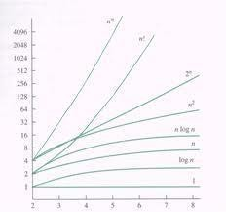
Time Complexities of various Algorithms
24

Slide 25
Recursion Examples
Factorial Function
Factorial(Fact, N)
If N = 0, then set Fact :=1, and return.
Call Factorial(Fact, N-1)
Set Fact := N* Fact
Return
25

Slide 26
Fibonacci Sequence
Fibonacci(Fib, N)
If N=0 or N=1, then: Set Fib:=N, and return.
Call Fibonacci(FibA, N-2)
Call Fibonacci(FibB, N-1)
Set Fib:=FibA + FibB
Return
26

Slide 27
Towers of Hanoi
Tower(N, Beg, Aux, End)
If N=1, then:
Write: Beg -> End
Return
[Move N-1 disks from peg Beg to peg Aux] Call Tower(N-1, Beg, End, Aux)
Write: Beg -> End
[Move N-1 disks from peg Aux to peg End] Call Tower(N-1, Aux, Beg, End)
Return
27

Slide 28
Basic Searching Methods
Search: A search algorithm is a method of locating a specific item of information in a larger collection of data.
There are three primary algorithms used for searching the contents of an array:
Linear or Sequential Search
Binary Search
Fibonacci Search
28

Slide 29
Linear Search
Begins search at first item in list, continues searching sequentially(item by item) through list, until desired item(key) is found, or until end of list is reached.
Also called sequential or serial search.
Obviously not an searching ordered
efficient method for lists like phone
directory(which is ordered alphabetically).
29

Slide 30
Linear Search contd..
Advantages
Algorithm is simple.
List need not be ordered in any particular way.
Time Complexity of Linear Search is O(n).
30

Slide 31
Recursive Linear Search Algorithm
def linear_Search(l,key,index=0): if l:
if l[0]==key: return index
s=linear_Search(l[1:],key,(index+1)) if s is not false:
return s return false
31

Slide 32
Binary Search
List must be in sorted order to begin with Compare key with middle entry of list
For lists with even number of entries, either of the two middle entries can be used.
Three possibilities for result of comparison
Key matches middle entry --- terminate search with success
Key is greater than middle entry ---
matching entry(if exists) must be in upper
part of list (lower part of list can be
32
discarded from search)

Slide 33
Binary Search contd…
Key is less than middle entry ---matching entry (if exists) must be in lower part of list ( upper part of list can be discarded from search)
Keep applying above 2 steps to the progressively ―reduced‖ lists, until match is found or until no further list reduction can be done.
Time Complexity of Binary Search is O(logn).
33

Slide 34
Fibonacci Search
Fibonacci Search Technique is a method of searching a sorted array using a divide and conquer algorithm that narrows down possible locations with the aid of Fibonacci numbers.
Fibonacci search examines locations whose addresses have lower dispersion, therefore it has an advantage over binary search in slightly reducing the average time needed to access a storage location.
34

Slide 35
Fibonacci Search contd…
Fibonacci
O(log(n)).
Fibonacci
search has a complexity of
search was first devised by
Kiefer(1953) as a minimax search for the maximum (minimum) of a unimodal function in an interval.
35

Slide 36
Fibonacci Search Algorithm
Let k be defined as an element in F, the array of Fibonacci numbers. n = F_{m} is the array size. If the array size is not a Fibonacci number, let F_{m} be the smallest number in F that is greater than n.
The array of Fibonacci numbers is defined where F_{k+2}
= F_{k+1} + F_{k}, when k ≥ 0, F₁ = 1, and F₀ = 0.
36

Slide 37
To test whether an item is in the list of ordered numbers, follow these steps:
Set k = m.
If k = 0, stop. There is no match; the item is not in the array.

Slide 38
Fibonacci Search Algorithm Contd…
Compare the item against element in F_{k−1}.
If the item matches, stop.
If the item is less than entry F_{k−1}, discard the elements from positions F_{k−1} + 1 to n. Set k = k − 1 and return to step 2.
If the item is greater than entry
^{F}k−1,
discard the elements from positions 1 to
^{F}k−1.
Renumber the remaining elements
from 1 to F_{k−2}, set k = k − 2, and return to
step 2.
38

Slide 39
Basic Sorting Methods :-Bubble Sort
First Level Considerations
To sort list of n elements in ascending order
Pass 1 :make nth element the largest
Pass 2 :if needed make n-1th element the 2nd largest
Pass 3 :if needed make n-2th element the 3rd largest
Pass n-2: if needed make 3rd n-(n-3)^{th} element the (n-2)^{th} largest
Pass n-1 :if needed make 2nd n-(n-2)^{th} element the (n-1)^{th} largest
Maximum number of passes is (n-1).
39

Slide 40
Bubble Sort
Second Level Considerations
Pass 1: Make nth element the largest. Compare each successive pair of elements beginning with 1st 2nd and ending with n-1th nth and swap the elements if necessary.
Pass 2 : Make n-1th element the 2nd largest. Compare each successive pair of elements beginning with 1st 2nd and ending with n-2th n-1th and swap the elements if necessary
40

Slide 41
Pass n-1:Make 2nd n-(n-2)th element the (n-1)th largest.
Compare each successive pair of elements beginning with 1st 2nd and ending with n-(n-1) th n-(n-2)th 1st 2nd and swap the elements if necessary.
List is sorted when either of the following occurs No swapping involved in any pass
Pass n-1:the last pass has been executed

Slide 42
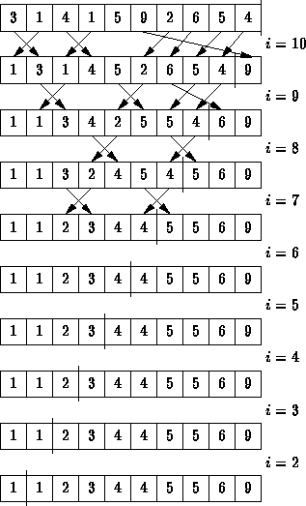
Bubble Sort Example
42

Slide 43
Selection Sort
First Level Considerations
To sort list of n elements in ascending order
Pass 1: make 1st element the smallest
Pass 2: make 2nd element the 2nd smallest
Pass 3: make 3rd element the 3rd smallest
Pass n-2: make (n-2)^{th} element the (n- 2)^{th} smallest
Pass n-1: make (n-1)^{th} element the (n- 1)^{th} smallest
Number of passes is (n-1).
43

Slide 44
Selection Sort
Second Level Considerations
Pass 1: Make 1st element the smallest
Examine list from 1st to last element locate element with smallest value and swap it with the 1st element where appropriate .
Pass 2: Make 2nd element the 2nd smallest
Examine list from 2nd to last element locate element with smallest value and swap it with the 2nd element where appropriate.
Pass n-1: Make (n-1)^{th} element the (n-1)^{th} smallest
Examine list from (n-1)^{th} to last element locate element with smallest value and swap it with the n-1th element where appropriate.
44

Slide 45
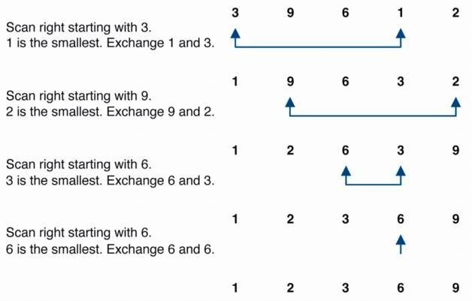
Selection Sort Example
45

Slide 46
Insertion Sort
First Level Considerations
To sort list of n items (stored as 1D array) in ascending order
NOTE: 1-element sub-array (1st) is always sorted
Pass 1: make 2-element sub-array (1st 2nd) sorted
Pass 2 :make 3-element sub-array (1st 2nd 3rd) sorted
Pass 3 :make 4-element sub-array (1st 4th) sorted
Pass n-2: make n-1-element sub-array (1st (n-1)^{th}) sorted
Pass n-1: make entire n-element array (1st n^{th}) sorted
Number of passes is (n-1)
46

Slide 47
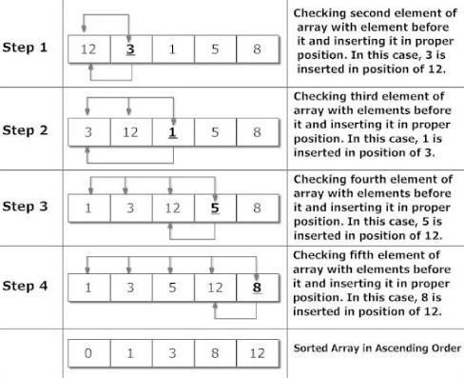
Insertion Sort Example
47

Slide 48
Quick Sort
It uses Divide-and-Conquer approach:
Divide: partition A[p..r] into two sub-arrays A[p..q-1] and A[q+1..r] such that each element of A[p..q-1] is ≤ A[q], and each element of A[q+1..r] is ≥ A[q]. Compute q as part of this partitioning.
Conquer: sort the sub-arrays A[p..q-1] and
A[q+1..r] by recursive calls to QUICKSORT.
Combine: the partitioning and recursive sorting leave us with a sorted A[p..r] – no work needed here.
48

Slide 49
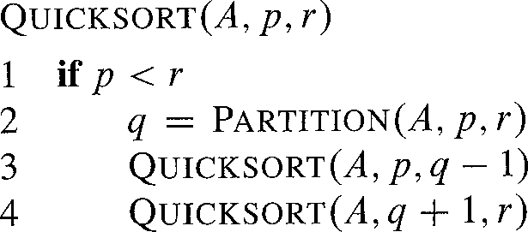
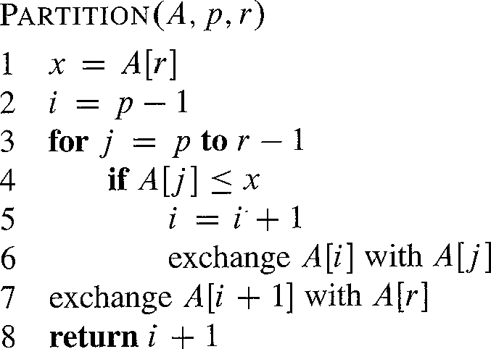
The Pseudo-Code of Quick Sort
49

Slide 50
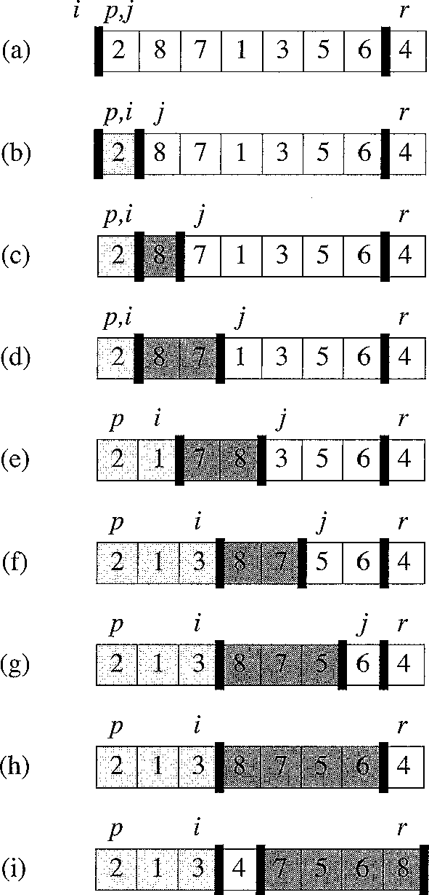
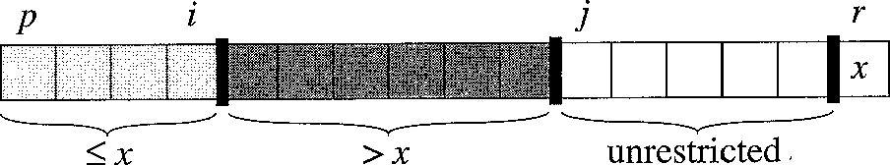
Quick Sort Contd…..
50

Slide 51
Quick sort Analysis
Best case running time: O(n log₂n)
Worst case running time: O(n²)!!!
51

Slide 52
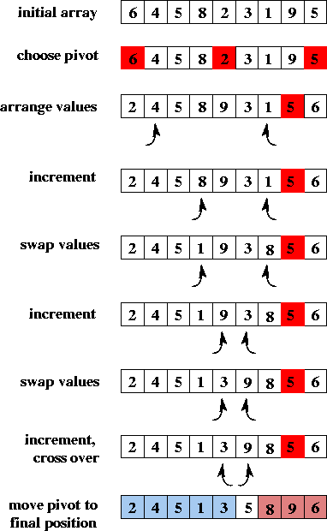
Quick Sort Example
52

Slide 53
Merge Sort
Merge-sort is a sorting algorithm based on the divide-and- conquer paradigm
Like heap-sort
It uses a comparator
It has O(n log n) running time
Unlike heap-sort
It does not use an auxiliary priority queue
It accesses data in a sequential manner (suitable to sort data on a disk)
Merge-sort on an input sequence S with n elements consists of three steps:
Divide: partition S into two sequences S1 and S2 of about
n/2 elements each
Recur: recursively sort S1 and S2
Conquer: merge S1 and S2 into a unique sorted sequence
53

Slide 54
Merge Sort Algorithm
Algorithm mergeSort(S, C)
Input sequence S with n elements, comparator C
Output sequence S sorted according to C
if S.size() > 1
(S₁, S₂) ← partition(S, n/2)
mergeSort(S₁, C) mergeSort(S₂, C)
S ← merge(S₁, S₂)
54

Slide 55
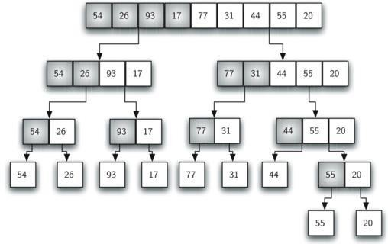
Merge Sort Example
55

Slide 56
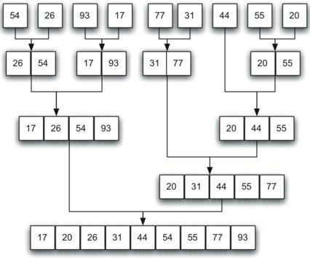
Merge Sort Example Contd…
56

Slide 57
Analysis of Merge Sort
The height h of the merge-sort tree is O(log n)
– at each recursive call we divide in half the sequence,
The overall amount or work done at the nodes of depth
i is O(n)
we partition and merge 2^{i} sequences of size n/2^{i}
we make 2^{i+1} recursive calls
Thus, the total running time of merge-sort is O(n log n)
57

Slide 58
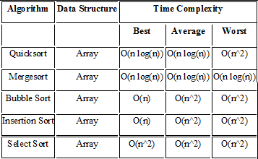
Comparison of Sorting Algorithms
58

Slide 59
UNIT - 2
LINEAR DATA STRUCTURES
B.Padmaja Associate Professor Department of CSE
Institute of Aeronauitcal Engineering

Slide 60
Contents
Stack - Primitive Operations and Implementation
Applications of Stack
Queue - Primitive Operations and Implementation
Linear Queue operations
Applications of Linear Queue
Circular Queue operations
Priority Queue
Double Ended Queue (Deque)

Slide 61
Stacks
A stack is a list of elements in which an element may be inserted or deleted only at one end, called the top of the stack.
The elements are removed from a stack in the reverse order of that in which they were inserted into the stack.
Stack is also known as a LIFO (Last in Fast out) list or Push down list.

Slide 62
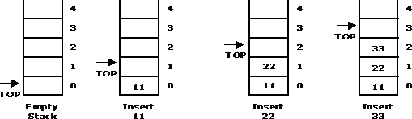
Basic Stack Operations
PUSH: It is the term used to insert an element into a stack.
PUSH operations on stack

Slide 63
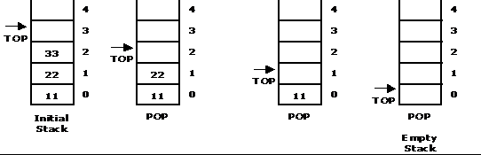
Basic Stack Operations
POP: It is the term used to delete an element from a stack.
POP operation from a stack

Slide 64
Standard Error Messages in Stack
Two standard error messages of stack are
Stack Overflow: If we attempt to add new element beyond the maximum size, we will encounter a stack overflow condition.
Stack Underflow: If we attempt to remove elements beyond the base of the stack, we will encounter a stack underflow condition.

Slide 65
Stack Operations
PUSH (STACK, TOP, MAXSTR, ITEM): This procedure pushes an ITEM onto a stack
If TOP = MAXSIZE, then Print: OVERFLOW, and Return.
Set TOP := TOP + 1 [Increases TOP by 1]
Set STACK [TOP] := ITEM. [Insert ITEM in TOP position]
Return
POP (STACK, TOP, ITEM): This procedure deletes the top element of STACK and assign it to the variable ITEM
If TOP = 0, then Print: UNDERFLOW, and Return.
Set ITEM := STACK[TOP]
Set TOP := TOP - 1 [Decreases TOP by 1]
Return

Slide 66
Applications of Stack
Converting algebraic expressions from one form to another. E.g. Infix to Postfix, Infix to Prefix, Prefix to Infix, Prefix to Postfix, Postfix to Infix and Postfix to prefix.
Evaluation of Postfix expression.
Parenthesis Balancing in Compilers.
Depth First Search Traversal of Graph.
Recursive Applications.

Slide 67
Algebraic Expressions
Infix: It is the form of an arithmetic expression in which we fix (place) the arithmetic operator in between the two operands. E.g.: (A + B) * (C - D)
Prefix: It is the form of an arithmetic notation in which we fix (place) the arithmetic operator before (pre) its two operands. The prefix notation is called as polish notation. E.g.: * + A B – C D
Postfix: It is the form of an arithmetic expression in which we fix (place) the arithmetic operator after (post) its two operands. The postfix notation is called as suffix notation and is also referred to reverse polish notation. E.g: A B + C D - *

Slide 68
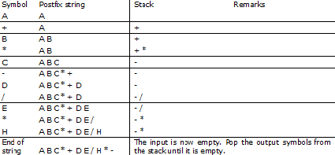
Conversion from Infix to Postfix
Convert the following infix expression A + B * C – D / E * H into its equivalentpostfix expression.

Slide 69
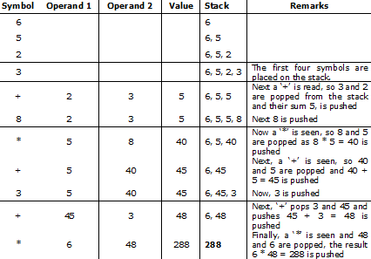
Evaluation of Postfix Expression
Postfix expression: 6 5 2 3 + 8 * + 3 + *

Slide 70
Queue
A queue is a data structure where items are inserted at one end called the rear and deleted at the other end called the front.
Another name for a queue is a ―FIFO‖ or
―First-in-first-out‖ list.
Operations of a Queue:
enqueue:which inserts an element at the end of the queue.
dequeue:which deletes an element at the front of the queue.

Slide 71



Representation of Queue
Initially the queue is empty.
Now, insert 11 to the queue. Then queue status will be:
Next, insert 22 to the queue. Then the queue status is:

Slide 72


Representation of Queue
Now, delete an element 11.
Next insert another element, say 66 to the queue. We cannot insert 66 to the
queue as it signals queue is full. The queue status is as follows:

Slide 73
Queue Operations using Array
Various operations of Queue are:
insertQ(): inserts an element at the end of queue Q.
deleteQ(): deletes the first element of Q.
displayQ(): displays the elements in the queue.
There are two problems associated with linear queue. They are:
Time consuming: linear time to be spent in shifting the elements to the beginning of the queue.
Signaling queue full: even if the queue is having vacant position.

Slide 74
Applications of Queue
It is used to schedule the jobs to be processed by the CPU.
When multiple users send print jobs to a printer, each printing job is kept in the printing queue. Then the printer prints those jobs according to first in first out (FIFO) basis.
Breadth first search uses a queue data structure to find an element from a graph.

Slide 75
Circular Queue
A circular queue is one in which the insertion of new element is done at the very first location of the queue if the last location of the queue is full.
Suppose if we have a Queue of n elements then after adding the element at the last index
i.e. (n-1)th , as queue is starting with 0 index, the next element will be inserted at the very first location of the queue which was not possible in the simple linear queue.

Slide 76
Circular Queue operations
The Basic Operations of a circular queue are
InsertionCQ: Inserting an element into a circular queue results in Rear = (Rear + 1) % MAX, where MAX is the maximum size of the array.
DeletionCQ : Deleting an element from a circular queue results in Front = (Front + 1) % MAX, where MAX is the maximum size of the array.
TraversCQ: Displaying the elements of a circular Queue.
Circular Queue Empty: Front=Rear=0.

Slide 77
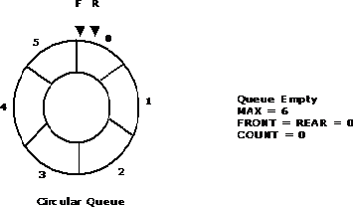
Circular Queue Representation using Arrays
Let us consider a circular queue, which can hold maximum (MAX) of six elements. Initially the queue is empty.

Slide 78
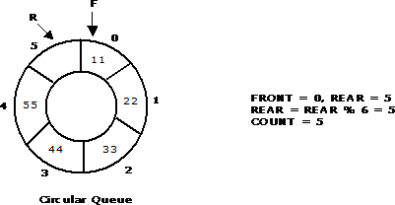
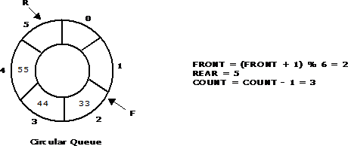
Insertion and Deletion operations on a Circular Queue
Insert new elements 11, 22, 33, 44 and 55 into the circular queue. The circular queue status is:
Now, delete two elements 11, 22 from the circular queue. The circular queue status is as
follows:

Slide 79
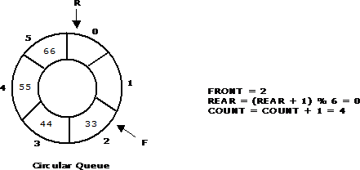
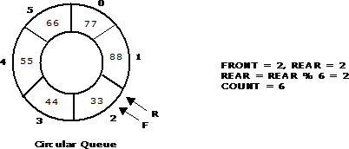
Insertion and Deletion operations on a Circular Queue
Again, insert another element 66 to the circular queue. The status of the circular queue is:
Again, insert 77 and 88 to the circular queue. The status of the Circular queue is:

Slide 80
Double Ended Queue (DEQUE)
It is a special queue like data structure that supports insertion and deletion at both the front and the rear of the queue.
Such an extension of a queue is called a double-ended queue, or deque, which is usually pronounced "deck" to avoid confusion with the dequeue method of the regular queue, which is pronounced like the abbreviation "D.Q."
It is also often called a head-tail linked list.

Slide 81
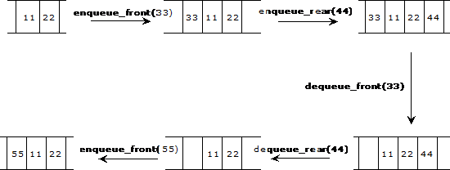
DEQUE Representation using arrays

Slide 82
Types of DEQUE
There are two variations of deque. They are:
Input restricted deque (IRD)
Output restricted deque (ORD)
An Input restricted deque is a deque, which allows insertions at one end but allows deletions at both ends of the list.
An output restricted deque is a deque, which allows deletions at one end but allows insertions at both ends of the list.

Slide 83
Priority Queue
A priority queue is a collection of elements that each element has been assigned a priority and such that order in which elements are deleted and processed comes from the following riles:
An element of higher priority is processed before any element of lower priority.
Two element with the same priority are processed according to the order in which they were added to the queue.

Slide 84
Priority Queue Operations and Usage
Inserting new elements.
Removing the largest or smallest element.
Priority Queue Usages are:
Simulations: Events are ordered by the time at which they should be executed.
Job scheduling in computer systems: Higher priority jobs should be executed first.
Constraint systems: Higher priority constraints should be satisfied before lower priority constraints.

Slide 85
UNIT - 3 LINKED LISTS

Slide 86
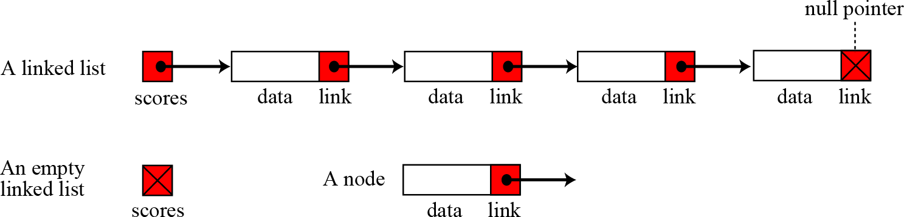
Introduction to Linked List
A linked list is a collection of data in which each
element contains
the location each element
of the next
two
element—that is,
contains
parts: data and link.
86

Slide 87
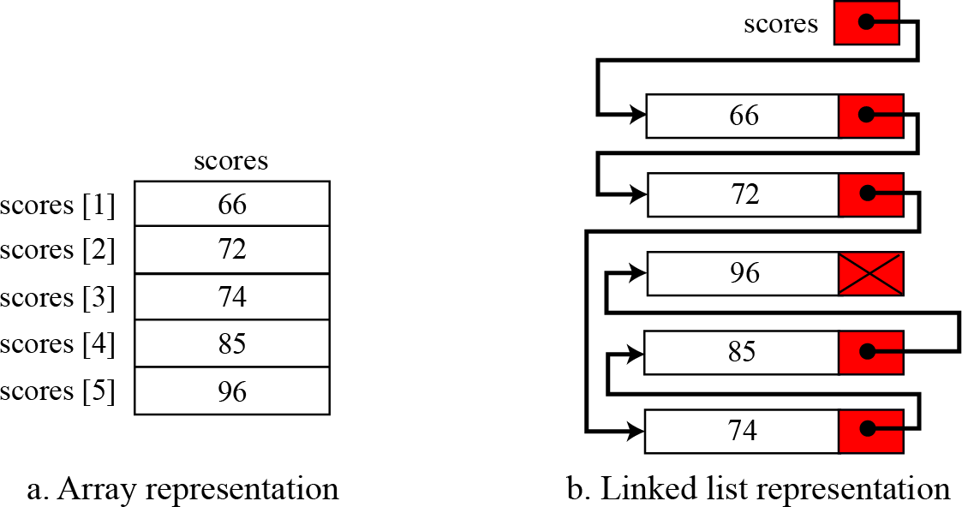
Arrays versus Linked Lists
Both an array and a linked list are representations of a list of items in memory. The only difference is the way in which the items are linked together. The Figure below compares the two representations for a list of five integers.
87

Slide 88
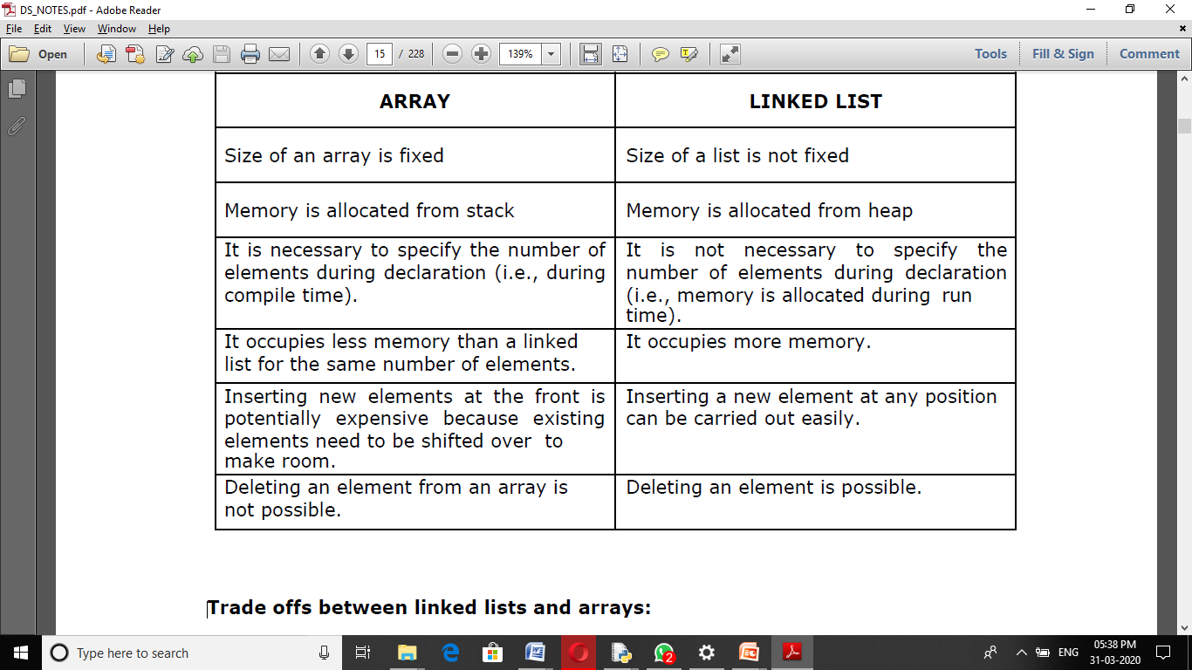

Slide 89
Linked List: A Dynamic Data Structure
A data structure that can shrink or grow during program execution.
The size of a dynamic data structure is not necessarily known at compilation time, in most programming languages.
Efficient insertion and deletion of elements.
The data in a dynamic data structure can be stored in non-contiguous (arbitrary) locations.
Linked list is an example of a dynamic data structure.
89

Slide 90
Advantages of linked list
1. Linked lists are dynamic data structures. i.e., they can grow or shrink during the execution of a program.
2. Linked lists have efficient memory utilization. Here, memory is not pre- allocated. Memory is allocated whenever it is required and it is de-allocated (removed) when it is no longer needed.
3. Insertion and Deletions are easier and efficient. Linked lists provide flexibility in inserting a data item at a specified position and deletion of the data item from the given position.
4. Many complex applications can be easily carried out with linked lists.
90

Slide 91
Disadvantages
Disadvantages of linked lists:
1. It consumes more space because every node requires a additional pointer to store address of the next node.
2. Searching a particular element in list is difficult and also time consuming.

Slide 92
Applications of linked list
Linked lists are used to represent and manipulate polynomial. Polynomials are expression containing terms with non zero coefficient and exponents. For example:
P(x) = a₀ X^{n} + a₁ X^{n-1} + …… + a_{n-1} X + a_{n}
Represent very large numbers and operations of the large number such as addition, multiplication and division.
Linked lists are to implement stack, queue, trees and graphs.
Implement the symbol table in compiler construction.
92

Slide 93
Types of linked lists
There are four types of Linked lists:
Single linked list
Begins with a pointer to the first node
Terminates with a null pointer
Only traversed in one direction
Circular single linked list
Pointer in the last node points back to the first node
Doubly linked list
Two ―start pointers‖ – first element and last element
Each node has a forward pointer and a backward pointer
Allows traversals both forwards and backwards
Circular double linked list
Forward pointer of the last node points to the first node and
backward pointer of the first node points to the last node
93

Slide 94
Singly Linked Lists
A singly linked list is a concrete data structure consisting of a sequence of nodes
Each node stores
next
element
link to the next node
elem
node
∅
A
B
C
D
94

Slide 95
Singly Linked Lists
A linked list allocates space for each element separately in its own block of memory called a "node".
Each node contains two fields; a "data" field to store whatever element, and a "next" field which is a pointer used to link to the next node.
Each node is allocated in the heap using malloc(), so the node memory continues to exist until it is explicitly de-allocated using free().
The front of the list is a pointer to the ―start‖ node.
95

Slide 96
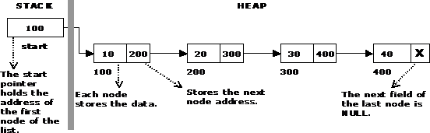

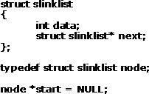

Single Linked List
96

Slide 97
Operations on Linked Lists
The basic operations of a single linked list are
Creation
Insertion
Deletion
Traversing
97

Slide 98

Creating a node for Single Linked List:
Sufficient memory has to be allocated for creating a node. The information is stored in the memory, allocated by using the malloc() function. The function getnode(), is used for creating a node, after allocating memory for the structure of type node, the information for the item (i.e., data) has to be read from the user, set next field to NULL and finally returns the address of the node.
98

Slide 99
Creation
struct slinklist
{
int data;
struct slinklist* next;
};
typedef struct slinklist node; node *start = NULL;

Slide 100
node* getnode()
{
node* newnode;
newnode = (node *) malloc(sizeof(node)); printf("\n Enter data: ");
scanf("%d", &newnode -> data); newnode -> next = NULL; return newnode;
}

Slide 101

Creating a single linked list with N nodes

Slide 102
Create a new linked list
void createlist( int n)
{
int i;
node * newnode; node * tem p;
for( i = 0 ; i < n ; i+ +)
{
ne w no de = get no de(); if(st a rt = = NU LL)
{
sta rt = ne w no de;
}
e ls e
{
te m p = st a rt;
w hile(t e m p - > ne xt ! = NU LL) te m p = t e m p - > ne xt;
te m p - > ne xt = ne w no de;
} }
}

Slide 103
Inserting a node
Inserting a node into a single linked list can be done at
Inserting into an empty list.
Insertion at the beginning of the list.
Insertion at the end of the list.
Insertion in the middle of the list.

Slide 104
Inserting a node at the beginning
void insert_at_beg()
{
node *newnode; newnode = getnode(); if(start == NULL)
{
first = newnode;
}
else
{
newnode -> next = start;
start = newnode;
}
}
102

Slide 105
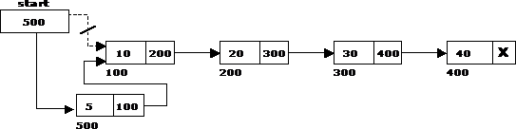
Inserting a node at the beginning

Slide 106
Inserting a node at the end
The following steps are followed to insert a new node at the end of the list:
# This function is defined in Linked List class # Appends a new node at the end. This method is defined inside LinkedList class shown above def append(self, new_data):
# Create a new node, Put in the data, Set next as None
new_node = Node(new_data)

Slide 107
Inserting a node at the end
void insert_at_end()
{
node *newnode, *temp;
newnode = getnode();
if(first == NULL)
{
first = newnode;
}
else
{
temp = start;
while(temp -> next != NULL)
temp = temp -> next;
temp -> next = newnode;
}
}

Slide 108
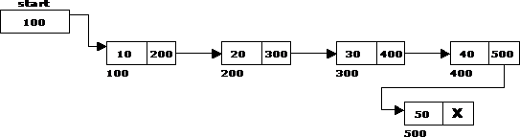
Inserting a node at the end

Slide 109
Inserting a node at intermediate position
void insert_at_mid()
{
node *newnode, *temp, *prev;
int pos, nodectr, ctr = 1;
newnode = getnode();
printf("\n Enter the position: ");
scanf("%d", &pos);
nodectr = countnode(start);
if(pos > 1 && pos < nodectr)
{
temp = prev = start;
while(ctr < pos)
{
prev = temp;
temp = temp -> next;
ctr++;
}
}
else
{
prev -> next = newnode;
newnode -> next = temp;
printf("position %d is not a middle position", pos);
}
}

Slide 110
Insert New Node in the middle by value
void insert_at_mid()
{
node *newnode, *temp;
int val;
newnode = getnode();
printf("\n Enter the position: ");
scanf("%d", &val);
temp=first;
while(temp->next->data!=val)
temp=temp->next
newnode ->next=temp->next->next;
temp->next=newnode;
}

Slide 111
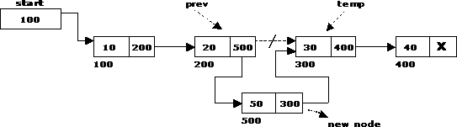
Inserting a node at intermediate position
109

Slide 112
Deletion of a node
Another primitive operation that can be done in a singly linked list is the deletion of a node. Memory is to be released for the node to be deleted. A node can be deleted from the list from three different places namely.
Deleting a node at the beginning.
Deleting a node at the end.
Deleting a node at intermediate position.
110

Slide 113
Deleting a node at the beginning
The following steps are followed, to delete a node at the beginning of the list:
If list is empty then display ‘Empty List’ message.
• If the list is not empty, follow the steps given below:
temp = start;
start = start -> next;
free(temp);

Slide 114

Deleting a node at the beginning

Slide 115
Deleting a node at the end
The following steps are followed to delete a node at the end of the list:
If list is empty then display ‗Empty List‘message.
If the list is not empty, follow the steps given below:
temp = prev = start; while(temp -> next != NULL)
{
prev = temp;
temp = temp -> next;
}
prev -> next = NULL; free(temp);

Slide 116

Deleting a node at the end

Slide 117
Deleting a node at Intermediate position
void delete_at_mid()
{
int ctr = 1, pos, nodectr;
node *temp, *prev;
printf("\n Enter position of node to delete: "); scanf("%d", &pos);
nodectr = countnode(start);
temp = prev = start;

Slide 118
while(ctr < pos)
{
prev = temp;
temp = temp -> next;
ctr ++;
}
prev -> next = temp -> next; free(temp);
printf("\n Node deleted..");
}

Slide 119
While(temp->next->data!=val)
{
prev = temp;
temp = temp -> next;
}
prev -> next = temp -> next;
free(temp);
printf("\n Node deleted..");
}
Delete Node Based on value
void delete_at_mid()
{
int val;
node *temp, *prev;
printf("\n Enter value of node to delete: "); scanf("%d", &val);
temp = prev = start;

Slide 120
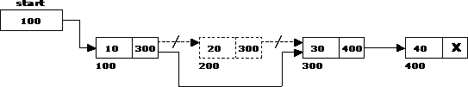
Deleting a node at Intermediate
110

Slide 121
Traversal and displaying a list
To display the information, you have to traverse (move) a linked list, node by node from the first node, until the end of the list is reached. Traversing a list involves the following steps:
Assign the address of start pointer to a temp pointer.
Display the information from the data field of each node.
120

Slide 122
Traversing
void traverse()
{
node *temp;
temp = start;
printf("\n The contents of List (Left to Right): \n"); while (temp != NULL)
{
printf("%d ->", temp -> data);
temp = temp -> next;
}
printf("X");
}

Slide 123
Double Linked List
A double linked list is a two-way list in which all nodes will have two links. This helps in accessing both successor node and predecessor node from the given node position. It provides bi-directional traversing. Each node contains three fields:
Left link.
Data.
Right link.
The left link points to the predecessor node and the right link points to the successor node. The data field stores the required data.

Slide 124
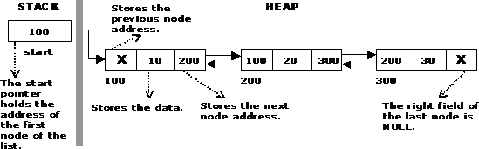
A Double Linked List

Slide 125
Basic operations in a double linked list
Creation
Insertion
Deletion
Traversing
The beginning of the double linked list is stored in a "start" pointer which points to the first node. The first node‘s left link and last node‘s right link is set to NULL.

Slide 126
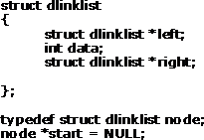

Structure of a Double Linked List

Slide 127
Creating a Double Linked List with N number of nodes
vo id c re at e list( int n)
{
int i;
no de * ne w no de; no de * t e m p;
fo r( i = 0 ; i < n; i+ +)
{
ne w no de = get no de(); if(st a rt = = NU LL)
{
sta rt = ne w no de;
}
e ls e
{
te m p = st a rt;
w hile(t e m p - > right)
te m p = t e m p - > right; te m p - > right = ne w no de;
ne w no de - > left = t e m p;
}
}
}

Slide 128

Creating a Double Linked List with N number of nodes

Slide 129
Inserting a node at the beginning
The following steps are to be followed to insert a new node at the beginning of the list:
Get the new node using getnode(). newnode=getnode();
If the list is empty then start = newnode.
If the list is not empty, follow the steps given below:
newnode -> right = start; start -> left = newnode; start = newnode;

Slide 130
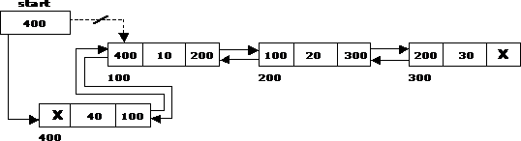
Inserting a node at the beginning

Slide 131
Inserting a node at the end
The following steps are followed to insert a new node at the end of the list:
Get the new node using getnode()
newnode=getnode();
If the list is empty then start = newnode.
If the list is not empty follow the steps given below: temp = start;
while(temp -> right != NULL) temp = temp -> right;
temp -> right = newnode; newnode -> left = temp;
120

Slide 132
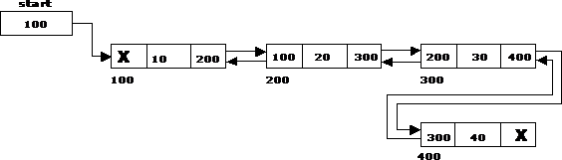
Inserting a node at the end
130

Slide 133
Inserting a node at an intermediate position
The following steps are followed, to insert a new node in an
intermediate position in the list:
Get the new node using getnode(). newnode=getnode();
Ensure that the specified position is in between first node and last node. If not, specified position is invalid. This is done by countnode() function.
Store the starting address (which is in start pointer) in temp and prev pointers. Then traverse the temp pointer upto the specified position followed by prev pointer.
After reaching the specified position, follow the steps given below: newnode -> left = temp;
newnode -> right = temp -> right; temp -> right -> left = newnode;
temp -> right = newnode;
•
•

Slide 134
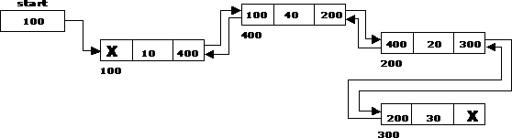
Inserting a node at an intermediate position

Slide 135
Deleting a node at the beginning
The following steps are followed, to delete a node at the beginning of the list:
If list is empty then display ‗Empty List‘ message.
If the list is not empty, follow the steps given below:
temp = start;
start = start -> right;
start -> left = NULL; free(temp);

Slide 136

Deleting a node at the beginning

Slide 137
Deleting a node at the end
The following steps are followed to delete a node at the end of the list:
If list is empty then display ‗Empty List‘ message
If the list is not empty, follow the steps given below:
temp = start;
while(temp -> right != NULL)
{
temp = temp -> right;
}
temp -> left -> right = NULL; free(temp);

Slide 138

Deleting a node at the end

Slide 139
Deleting a node at Intermediate
position
The following steps are followed, to delete a node from an intermediate position in the list.
If list is empty then display ‗Empty List‘ message.
If the list is not empty, follow the steps given below:
Get the position of the node to delete.
Ensure that the specified position is in between first node and last node. If not, specified position is invalid.
Then perform the following steps:
if(pos > 1 && pos < nodectr)
{
temp = start; i = 1;
while(i < pos)
{
temp = temp -> right; i++;
}
temp -> right -> left = temp -> left; temp -> left -> right = temp -> right; free(temp);
printf("\n node deleted..");
}

Slide 140
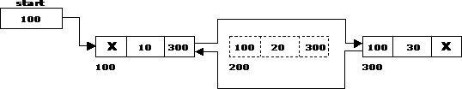
Deleting a node at Intermediate position

Slide 141
Traversal and displaying a list (Left to Right)
The following steps are followed, to traverse a list from left to right:
If list is empty then display ‗Empty List‘ message.
If the list is not empty, follow the steps given
below: temp = start;
while(temp != NULL)
{
print temp -> data; temp = temp -> right;
}
130

Slide 142
Traversal and displaying a list (Right to Left)
The following steps are followed, to traverse a list from right to left:
If list is empty then display ‗Empty List‘ message.
If the list is not empty, follow the steps given below: temp = start;
while(temp -> right != NULL) temp = temp -> right; while(temp != NULL)
{
print temp -> data; temp = temp -> left;
}
140

Slide 143
Advantages and Disadvantages of Double Linked List
The major disadvantage of doubly linked lists (over singly linked lists) is that they require more space (every node has two pointer fields instead of one). Also, the code to manipulate doubly linked lists needs to maintain the prev fields as well as the next fields; the more fields that have to be maintained, the more chance there is for errors.
The major advantage of doubly linked lists is that they make some operations (like the removal of a given node, or a right-to-left traversal of the list) more efficient.

Slide 144
Circular Single Linked List
It is just a single linked list in which the link field of the last node points back to the address of the first node.
A circular linked list has no beginning and no end. It is necessary to establish a special pointer called start pointer always pointing to the first node of the list.
Circular linked lists are frequently used instead of ordinary linked list because many operations are much easier to implement. In circular linked list no null pointers are used, hence all pointers contain valid address.

Slide 145
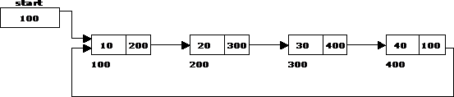
Circular Single Linked List and its basic operations
The basic operations in a circular single linked list are:
Creation
Insertion
Deletion
Traversing

Slide 146
Creating a circular single Linked List with N number of nodes
The following steps are to be followed to create ‗n‘ number of nodes:
Get the new node using getnode().
newnode = getnode();
If the list is empty, assign new node as start. start = newnode;
If the list is not empty, follow the steps given below: temp = start;
while(temp -> next != NULL) temp = temp -> next;
temp -> next = newnode; Repeat the above steps ‗n‘ times. newnode -> next =
•
•
start;
144

Slide 147
Inserting a node at the beginning
The following steps are to be followed to insert a new node at the beginning of the circular list:
Get the new node using getnode().
newnode = getnode();
If the list is empty, assign new node as start. start = newnode;
newnode -> next = start;
If the list is not empty, follow the steps given below: last = start;
while(last -> next != start) last = last -> next;
newnode -> next = start; start = newnode;
last -> next = start;
•
•

Slide 148
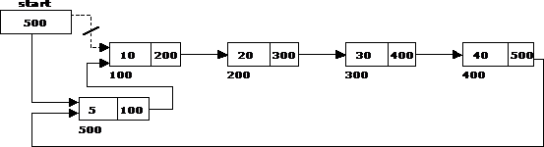
Inserting a node at the beginning

Slide 149
Inserting a node at the end
The following steps are followed to insert a new node at the end of the list:
Get the new node using getnode(). newnode = getnode();
If the list is empty, assign new node as start. start = newnode;
newnode -> next = start;
If the list is not empty follow the steps given below: temp = start;
while(temp -> next != start) temp = temp -> next;
temp -> next = newnode; newnode -> next = start;
•
•
•

Slide 150
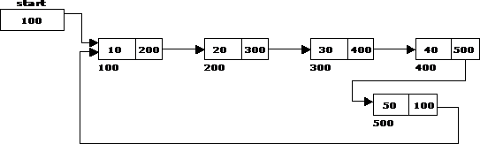
Inserting a node at the end

Slide 151
Deleting a node at the beginning
The following steps are followed, to delete a node at the beginning of the list:
If the list is empty, display a message ‘Empty List’.
If the list is not empty, follow the steps given below: last = temp = start;
while(last -> next != start) last = last -> next;
start = start -> next; last -> next = start;
After deleting the node, if the list is empty then start = NULL.
140

Slide 152
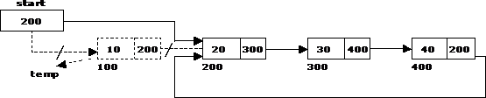
Deleting a node at the beginning
150

Slide 153
Deleting a node at the end
The following steps are followed to delete a node at the end of the list:
If the list is empty, display a message ‗Empty List‘.
If the list is not empty, follow the steps given below: temp = start;
prev = start;
while(temp -> next != start)
{
prev = temp;
temp = temp -> next;
}
prev -> next = start;
After deleting the node, if the list is empty then start = NULL.

Slide 154

Deleting a node at the end

Slide 155
Traversing a circular single linked list from left to right
The following steps are followed, to traverse a list from left to right:
If list is empty then display ‗Empty List‘ message.
If the list is not empty, follow the steps given below:
temp = start;
do
{
printf("%d ", temp -> data); temp = temp -> next;
} while(temp != start);

Slide 156
Advantages of Circular Lists
The major advantage of circular lists (over non-circular lists) is that they eliminate some extra-case code for some operations (like deleting last node).
Also, some applications lead naturally to circular list representations.
For example, a computer network might best be modeled using a circular list.

Slide 157

Applications of Linked Lists: Representing Polynomials
A polynomial is of the form:
Where, c_{i} is the coefficient of the i^{th} term and n is the degree of the polynomial
Some examples are:
5x² + 3x + 1
5x⁴ – 8x³ + 2x² + 4x¹ + 9x⁰
The computer implementation requires implementing polynomials as a list of pairs of coefficient and exponent. Each of these pairs will constitute a structure, so a polynomial will be represented as a list of structures. A linked list structure that represents polynomials 5x⁴ – 8x³ + 2x² + 4x¹ + 9x⁰ illustrated.

Slide 158
Addition of Polynomials
To add two polynomials, if we find terms with the same exponent in the two polynomials, then we add the coefficients; otherwise, we copy the term of larger exponent into the sum and go on. When we reach at the end of one of the polynomial, then remaining part of the other is copied into the sum.
To add two polynomials follow the following steps:
Read two polynomials.
Add them.
Display the resultant polynomial.

Slide 159
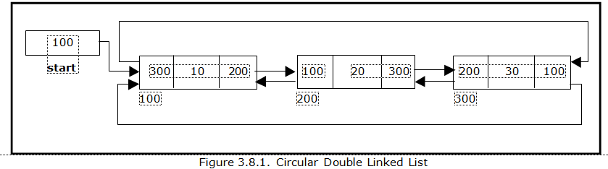
Circular Double Linked List
A circular double linked list has both successor pointer and predecessor pointer in circular manner.
The objective behind considering circular double linked list is to simplify the insertion and deletion operations performed on double linked list.
In circular double linked list the right link of the right most node points back to the start node and left link of the first node points to the last node.

Slide 160
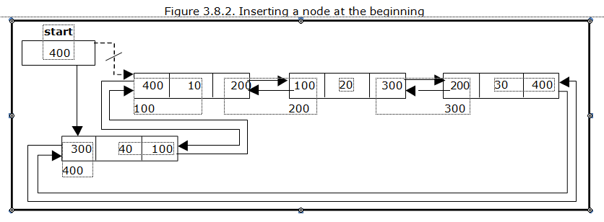
Insert At Begin Get the new node using getnode(). newnode=getnode(); If the list is empty, then start = newnode; newnode -> left = start; newnode -> right = start; If the list is not empty, follow the steps given below: newnode -> left = start -> left; newnode -> right = start; start -> left -> right = newnode; start -> left = newnode; start = newnode;

Slide 161
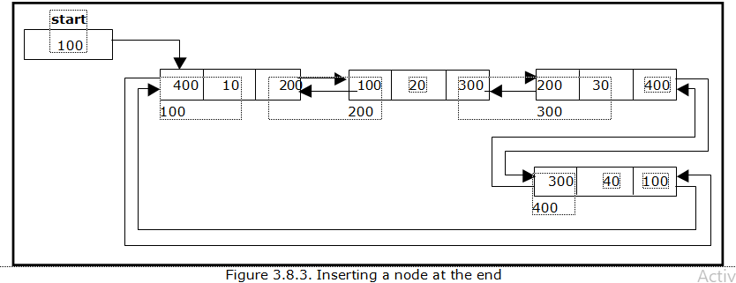
Inserting a node at the end:
Get the new node using getnode()
newnode=getnode();
If the list is empty, then
start = newnode;
newnode -> left = start;
newnode -> right = start;
If the list is not empty follow the steps given below:
newnode -> left = start -> left;
newnode -> right = start;
start -> left -> right = newnode;
start -> left = newnode;

Slide 162
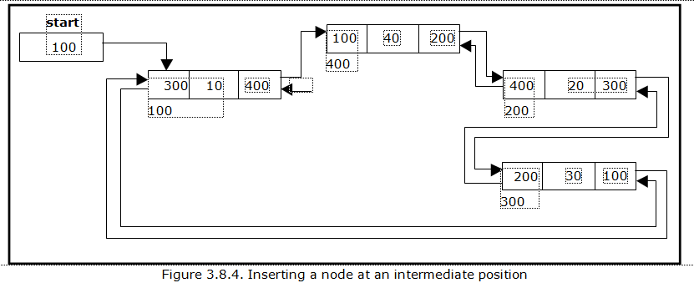
Insert a node at intermediate position
Get the new node using getnode().
newnode=getnode();
Ensure that the specified position is in between first node and last node. If not, specified position is invalid. This is done by countnode() function.
Store the starting address (which is in start pointer) in temp. Then traverse the temp pointer upto the specified position.
After reaching the specified position, follow the steps given below:
newnode -> left = temp;
newnode -> right = temp -> right;
temp -> right -> left = newnode;
temp -> right = newnode;
nodectr++;

Slide 163
Deleting a node at the beginning:
The following steps are followed, to delete a node at the beginning of the list:
If list is empty then display ‘Empty List’ message.
If the list is not empty, follow the steps given below:
temp = start;
start = start -> right;
temp -> left -> right = start;
start -> left = temp -> left;

Slide 164
Deleting a node at the end:
The following steps are followed to delete a node at the end of the list:
If list is empty then display ‘Empty List’ message
If the list is not empty, follow the steps given below:
temp = start;
while(temp -> right != start)
{
temp = temp -> right;
}
temp -> left -> right = temp -> right; temp -> right -> left = temp -> left;

Slide 165
Deleting a node at Intermediate position:
If list is empty then display ‘Empty List’ message.
If the list is not empty, follow the steps given below:
Get the position of the node to delete.
Ensure that the specified position is in between first node and last node. If not, specified position is invalid.Then perform the following steps:
if(pos > 1 && pos < nodectr)
{
temp = start; i = 1;
while(i < pos)
{
temp = temp -> right ;
i++;
}
temp -> right -> left = temp -> left;
temp -> left -> right = temp -> right;
free(temp);
printf("\n node deleted..");
nodectr--;
}

Slide 166
Traversing a circular double linked list from left to right:
The following steps are followed, to traverse a list from left to right:
If list is empty then display ‘Empty List’ message.
If the list is not empty, follow the steps given below:
temp = start;
Print temp -> data;
temp = temp -> right;
while(temp != start)
{
print temp -> data;
temp = temp -> right;
}

Slide 167
Traversing a circular double linked list from right to left:
The following steps are followed, to traverse a list from right to left:
temp = start;
do
{
temp = temp -> left;
print temp -> data;
} while(temp != start);

Slide 168
UNIT - 4
NON LINEAR DATA STRUCTURES

Slide 169
CONTENTS
Basic Tree Concepts, Binary Trees
Representation of Binary Trees
Operations on a Binary Tree
Binary Tree Traversals
Threaded Binary Trees
Basic Graph Concepts
Graph Traversal Techniques: DFS and BFS

Slide 170
Tree – a Hierarchical Data Structure
Trees are non linear data structure that can be represented in a hierarchical manner.
A tree contains a finite non-empty set of elements.
Any two nodes in the tree are connected with a relationship of parent-child.
Every individual elements in a tree can have any number of sub trees.

Slide 171
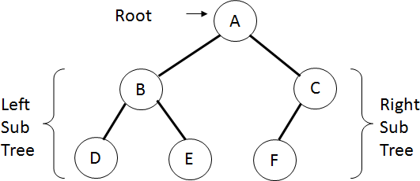
An Example of a Tree

Slide 172
Tree – Basic Terminology
Root : The basic node of all nodes in the tree. All operations on the tree are performed with passing root node to the functions.
Child : a successor node connected to a node is called child. A node in binary tree may have at most two children.
Parent : a node is said to be parent node to all its child nodes.
Leaf : a node that has no child nodes.
Siblings : Two nodes are siblings if they are children to the same parent node.

Slide 173
Tree – Basic Terminology Contd…
Ancestor : a node which is parent of parent node ( A is ancestor node to D,E and F ).
Descendent : a node which is child of child node ( D, E and F are descendent nodes of node A )
Level : The distance of a node from the root node, The root is at level – 0,( B and C are at Level 1 and D, E, F have Level 2 ( highest level of tree is called height of tree )
Degree : The number of nodes connected to a particular parent node.

Slide 174
Binary Tree
A binary tree is a hierarchy of nodes, where every parent node has at most two child nodes. There is a unique node, called the root, that does not have a parent.
A binary tree can be defined recursively as
Root node
Left subtree: left child and all its descendants
Right subtree: right child and all its descendants

Slide 175




Binary Tree
a
b
c
d
e
f
 | g
 | h
i
j
k
l

Slide 176
Full and Complete Binary Trees
A full tree is a binary tree in which
Number of nodes at level l is 2l–1
Total nodes in a full tree of height n is
A complete tree of height n is a binary tree
Number of nodes at level 1 l n–1 is 2l–1
Leaf nodes at level n occupy the leftmost positions in the tree

Slide 177
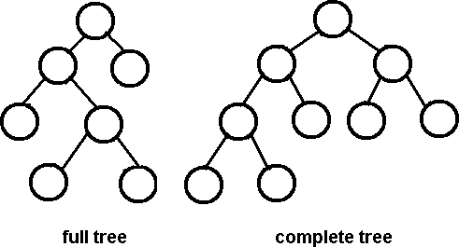
Full and Complete Binary Trees

Slide 178
Tree Traversals
A binary tree is defined recursively: it consists of a root, a left subtree, and a right subtree.
To traverse (or walk) the binary tree is to visit each node in the binary tree exactly once.
Tree traversals are naturally recursive.
Standard traversal orderings:
preorder
inorder
postorder
level-order

Slide 179
Preoder, Inorder, Postorder
In Preorder, the root is visited before (pre)
the subtrees traversals.
In Inorder, the root is
visited in-between left
and right subtree traversal.
In Preorder, the root
is visited after (pre)
the subtrees traversals.
Preorder Traversal: Visit the root Traverse left subtree Traverse right subtree
Inorder Traversal: Traverse left subtree Visit the root Traverse right subtree
Postorder Traversal: Traverse left subtree Traverse right subtree Visit the root

Slide 180
Example of Tree Traversal
Assume: visiting a node
is printing its data
Preorder: 15 8 2 6 3 7
11 10 12 14 20 27 22 30
Inorder: 2 3 6 7 8 10 11
12 14 15 20 22 27 30
Postorder: 3 7 6 2 10 14
12 11 8 22 30 27 20 15
15
8
20
2
11
27
6
10 12
22
30
3
7
14

Slide 181
Traversal Techniques
void preorder(tree *tree) { if (tree->isEmpty( )) return; visit(tree->getRoot( )); preOrder(tree->getLeftSubtree()); preOrder(tree->getRightSubtree()); }
void inOrder(Tree *tree){ if (tree->isEmpty( )) return; inOrder(tree->getLeftSubtree( )); visit(tree->getRoot( )); inOrder(tree->getRightSubtree( )); }
void postOrder(Tree *tree){ if (tree->isEmpty( )) return; postOrder(tree->getLeftSubtree( )); postOrder(tree->getRightSubtree( )); visit(tree->getRoot( )); }

Slide 182
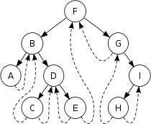
Threaded Binary Tree
A threaded binary tree
defined as:
"A binary tree is threaded by making all right child pointers that would normally be null point to the inorder successor of the node, and all left child pointers that would normally be null point to the inorder predecessor of the node

Slide 183
Graph Basics
Graphs are collections of nodes connected by edges – G = (V,E) where V is a set of nodes and E a set of edges.
Graphs are useful in a number of
applications including
Shortest path problems
Maximum flow problems
Graphs unlike trees are more general for they can have connected components.

Slide 184
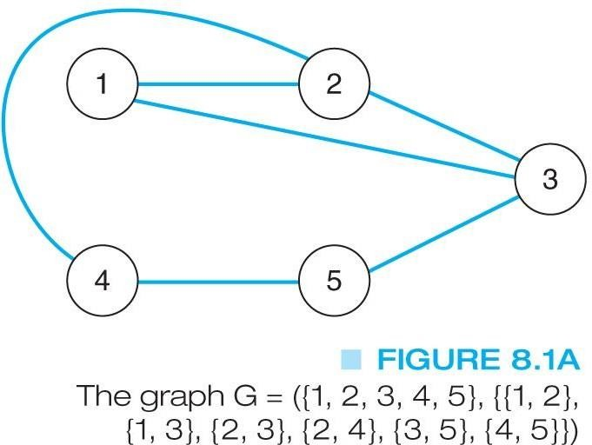

Graph Types
Directed Graphs: A directed graph
edges
allow travel in one direction.
Undirected Graphs: An undirected edges allow travel in either direction.
graph

Slide 185
Graph Terminology
A graph is an ordered pair G=(V,E) with a set of vertices or nodes and the edges that connect them.
A subgraph of a graph has a subset of the vertices and edges.
The edges indicate how we can move through the graph.
A path is a subset of E that is a series of edges between two nodes.
A graph is connected if there is at least one path between every pair of nodes.

Slide 186
Graph Terminology
The length of a path in a graph is the number of edges in the path.
A complete graph is one that has an edge between every pair of nodes.
A weighted graph is one where each edge has a cost for traveling between the nodes.
A cycle is a path that begins and ends at the same node.
An acyclic graph is one that has no cycles.
An acyclic, connected graph is also called an unrooted tree

Slide 187
Data Structures for Graphs An Adjacency Matrix
For an undirected graph, the matrix will be symmetric along the diagonal.
For a weighted graph, the adjacency matrix would have the weight for edges in the graph, zeros along the diagonal, and infinity (∞) every place else.

Slide 188

Adjacency Matrix Example 1

Slide 189


Adjacency Matrix Example 2

Slide 190
Data Structures for Graphs An Adjacency List
A list of pointers, one for each node of the graph.
These pointers are the start of a linked list of nodes that can be reached by one edge of the graph.
For a weighted graph, this list would also include the weight for each edge.

Slide 191

Adjacency List Example 1

Slide 192

Adjacency List Example 2

Slide 193
Graph Traversals
Some algorithms require that every vertex of a graph be visited exactly once.
The order in which the vertices are visited may be important, and may depend upon the particular algorithm.
The two common traversals:
depth-first
breadth-first

Slide 194
Graph Traversals: Depth First Search Traversal
We follow a path through the graph until we reach a dead end.
We then back up until we reach a node with an edge to an unvisited node.
We take this edge and again follow it until we reach a dead end.
This process continues until we back up to the starting node and it has no edges to unvisited nodes.

Slide 195

Depth First Search Traversal Example
Consider the following graph:
The order of the depth-first traversal of this graph starting at node 1 would be:
1, 2, 3, 4, 7, 5, 6, 8, 9

Slide 196
Breadth First Search Traversal
From the starting node, we follow all paths of length one.
Then we follow paths of length two that go to unvisited nodes.
We continue increasing the length of the paths until there are no unvisited nodes along any of the paths.

Slide 197
Breadth First Search Traversal Example
Consider the following graph:
The order of the breadth-first traversal of this graph starting at node 1 would be: 1, 2, 8, 3, 7, 4, 5, 9, 6

Slide 198
UNIT - 5
BINARY TREES ANDHASHING

Slide 199
CONTENTS
Binary Search Trees - Properties and Operations
Balanced Search Trees – AVLTrees
M – way Search Trees
B Trees
Hashing – Hash Table, Hash Function
Collisions
Applications of Hashing
170

Slide 200
Binary Search Trees
In a BST, each node stores some information including a unique key value, and perhaps some associated data. A binary tree is a BST iff, for every node n in the tree:
All keys in n's left subtree are less than the key in n, and
All keys in n's right subtree are greater than the key in n.
In other words, binary search trees are binary trees in which all values in the node‘s left subtree are less than node value all values in the node‘s right subtree are greater than node value.
180

Slide 201

BST Example
190

Slide 202
Properties and Operations
A BST is a binary tree of nodes ordered in the following way:
Each node contains one key (also unique)
The keys in the left subtree are < (less) than the key in its parent node
The keys in the right subtree > (greater) than the key in its parent node
Duplicate node keys are not allowed.

Slide 203
Inserting a node
A naïve algorithm for inserting a node into a BST is that, we start from the root node, if the node to insert is less than the root, we go to left child, and otherwise we go to the right child of the root.
We then insert the node as a left or right child of the leaf node based on node is less or greater than the leaf node. We note that a new node is always inserted as a leaf node.

Slide 204
Inserting a node
A recursive algorithm for inserting a node into a BST is as follows. Assume we insert a node N to tree T. if the tree is empty, the we return new node N as the tree. Otherwise, the problem of inserting is reduced to inserting the node N to left of right sub trees of T, depending on N is less or greater than T. A definition is as follows.
Insert(N, T) = N if T is empty
= insert(N, T.left) if N < T
= insert(N, T.right) if N > T

Slide 205
Searching for a node
Searching for a node is similar to inserting a node. We start from root, and then go left or right until we find (or not find the node). A recursive definition of search is as follows. If the node is equal to root, then we return true. If the root is null, then we return false. Otherwise we recursively solve the problem for T.left or T.right, depending on N < T or N > T. A recursive definition is as follows.
Search should return a true or false, depending on the node is found or not.

Slide 206
Searching for a node
Search(N, T) = false if T is empty Searching for a node is similar to inserting a node. We start from root, and then go left or right until we find (or not find the node).
A recursive definition of search is as follows. If the node is equal to root, then we return true. If the root is null, then we return false. Otherwise we recursively solve the problem for T.left or T.right, depending on N < T or N >
T. A recursive definition is as follows.
Search should return a true or false, depending on the node is found or not.
Search(N, T) = false if T is empty
= true if T = N
= search(N, T.left) if N < T
= search(N, T.right) if N > T
186

Slide 207

Deleting a node
A BST is a connected structure. That is, all nodes in a tree are connected to some other node. For example, each node has a parent, unless node is the root. Therefore deleting a node could affect all sub trees of that node. For example, deleting node 5 from the tree could result in losing sub trees that are rooted at 1 and 9.

Slide 208
Balanced Search Trees
A self-balancing (or height-balanced) binary search tree is any node-based binary search tree that automatically keeps its height (maximal number of levels below the root) small in the face of arbitrary item insertions and deletions.
AVL Trees: An AVL tree is another balanced binary search tree. Named after their inventors, Adelson-Velskii and Landis, they were the first dynamically balanced trees to be proposed. Like red-black trees, they are not perfectly balanced, but pairs of sub-trees differ in height by at most 1, maintaining an O(logn) search time. Addition and deletion operations also take O(logn) time.

Slide 209
AVL Tree - Definition
Definition of an AVL tree: An AVL tree is a binary search tree which has the following properties:
The sub-trees of every node differ in height by at most one.
Every sub-tree is an AVL tree.
Balance requirement for an AVL tree: the left and right sub-trees differ by at most 1 in height.

Slide 210

190

Slide 211
Balance Factor
To implement our AVL tree we need to keep track of a balance factor for each node in the tree. We do this by looking at the heights of the left and right subtrees for each node. More formally, we define the balance factor for a node as the difference between the height of the left subtree and the height of the right subtree.
balanceFactor=height(leftSubTree)−height(rightSubTree)
Using the definition for balance factor given above we say that a subtree is left-heavy if the balance factor is greater than zero. If the balance factor is less than zero then the subtree is right heavy. If the balance factor is zero then the tree is perfectly in balance.

Slide 212

Balance Factor

Slide 213

Introduction to M-Way Search Trees
A multiway tree is a tree that can have more than two children. A multiway tree of order m (or an m-way tree) is one in which a tree can have m children.
As with the other trees that have been studied, the nodes in an m-way tree will be made up of key fields, in this case m-1 key fields, and pointers to children.
Multiday tree of order 5

Slide 214

Properties of M-way Search Trees
m-way search tree is a m-way tree in which:
Each node has m children and m-1 key fields
The keys in each node are in ascending order.
The keys in the first i children are smaller than the ith key
The keys in the last m-i children are larger than the ith key
4-way search tree

Slide 215
B -Trees
An extension of a multiway search tree of order m is a B- tree of order m. This type of tree will be used when the data to be accessed/stored is located on secondary storage devices because they allow for large amounts of data to be stored in a node.
A B-tree of order m is a multiway search tree in which:
The root has at least two subtrees unless it is the only node in
the tree.
Each nonroot and each nonleaf node have at most m nonempty children and at least m/2 nonempty children.
The number of keys in each nonroot and each nonleaf node is one less than the number of its nonempty children.
iv. All leaves are on the same level.
iii.

Slide 216
Searching a B -Tree
Start at the root and determine which pointer to follow based on a comparison between the search value and key fields in the root node.
Follow the appropriate pointer to a child node.
Examine the key fields in the child node and continue to follow the appropriate pointers until the search value is found or a leaf node is reached that doesn't contain the desired search value.

Slide 217
Insertion into a B -Tree
The condition that all leaves must be on the same level forces a characteristic behavior of B-trees, namely that B-trees are not allowed to grow at the their leaves; instead they are forced to grow at the root.
When inserting into a B-tree, a value is inserted directly into a leaf. This leads to three common situations that can occur:
A key is placed into a leaf that still has room.
The leaf in which a key is to be placed is full.
The root of the B-tree is full.

Slide 218


Slide 219


Slide 220


Slide 221
Deleting from a B -Tree
The deletion process will basically be a reversal of the insertion process - rather than splitting nodes, it's possible that nodes will be merged so that B-tree properties, namely the requirement that a node must be at least half full, can be maintained.
There are two main cases to be considered:
Deletion from a leaf
Deletion from a non-leaf
210

Slide 222


Slide 223


Slide 224
Hashing
Hashing is the technique used for performing almost constant time search in case of insertion, deletion and find operation.
Taking a very simple example of it, an array with its index as key is the example of hash table. So each index (key) can be used for accessing the value in a constant search time. This mapping key must be simple to compute and must helping in identifying the associated value. Function which helps us in generating such kind of key- value mapping is known as Hash Function.
In a hashing system the keys are stored in an array which is called the Hash Table. A perfectly implemented hash
table would always promise an insert/delete/retrieval time of O(1).
average
204

Slide 225

Hashing Function
A function which employs some algorithm to computes the key K for all the data elements in the set U, such that the key K which is of a fixed size. The same key K can be used to map data to a hash table and all the operations like insertion, deletion and searching should be possible. The values returned by a hash function are also referred to as hash values, hash codes, hash sums, or hashes.

Slide 226
Hash Collision
A situation when the resultant hashes for two or more data elements in the data set U, maps to the same location in the has table, is called a hash collision. In such a situation two or more data elements would qualify to be stored / mapped to the same location in the hash table.
Hash collision resolution techniques:
Open Hashing (Separate chaining):Open Hashing, is a technique in which the data is not directly stored at the hash key index (k) of the Hash table. Rather the data at the key index (k) in the hash table is a pointer to the head of the data structure where the data is actually stored. In the most simple and common implementations the data structure adopted for storing the element is a linked-list.

Slide 227


Slide 228
Closed Hashing (Open Addressing)
In this technique a hash table with pre-identified size is considered. All items are stored in the hash table itself. In addition to the data, each hash bucket also maintains the three states: EMPTY, OCCUPIED, DELETED. While inserting, if a collision occurs, alternative cells are tried until an empty bucket is found. For which one of the following technique is adopted.
Liner Probing
Quadratic probing
Double hashing

Slide 229

A Comparative Analysis of Closed Hashing vs Open Hashing

Slide 230
Applications of Hashing
A hash function maps a variable length input string to fixed length output string -- its hash value, or hash for short. If the input is longer than the output, then some inputs must map to the same output -- a hash collision.
Comparing the hash values for two inputs can give us one of two answers: the inputs are definitely not the same, or there is a possibility that they are the same. Hashing as we know it is used for performance improvement, error checking, and authentication.
In error checking, hashes (checksums, message digests, etc.) are used to detect errors caused by either hardware or software. Examples are TCP checksums, ECC memory, and MD5 checksums on downloaded files.
210

Slide 231
Applications of Hashing
Construct a message authentication code (MAC)
Digital signature
Make commitments, but reveal message later
Timestamping
Key updating: key is hashed at specific intervals resulting in new key
211

Slide 232
THANK YOU

