Slide 1
There are three common types of Linked List.
Singly Linked List
Doubly Linked List
Circular Linked List

Slide 2
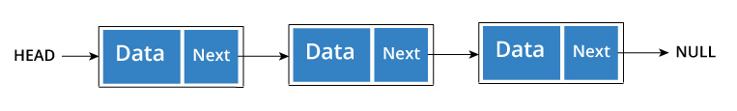
Singly Linked List
It is the most common. Each node has data and a pointer to the next node.
Node is represented as:
struct node
{
int data;
struct node *next;
}

Slide 3
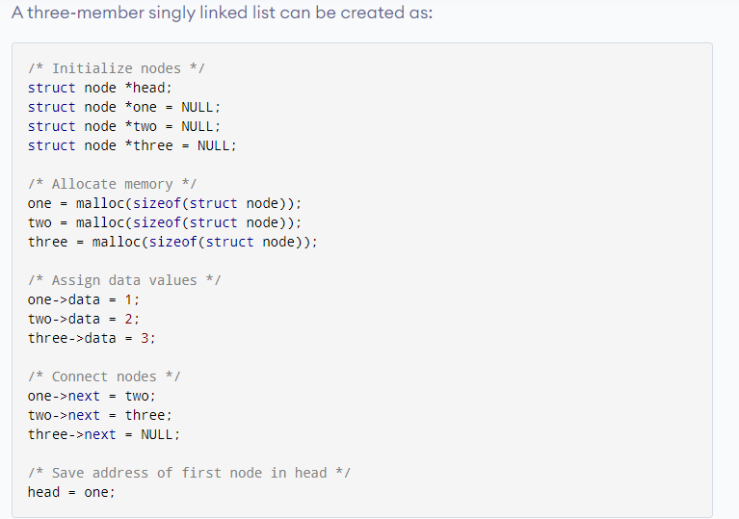

Slide 4
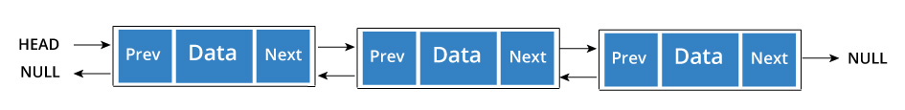
A node is represented as
struct node
{
int data;
struct node *next;
struct node *prev;
}

Slide 5
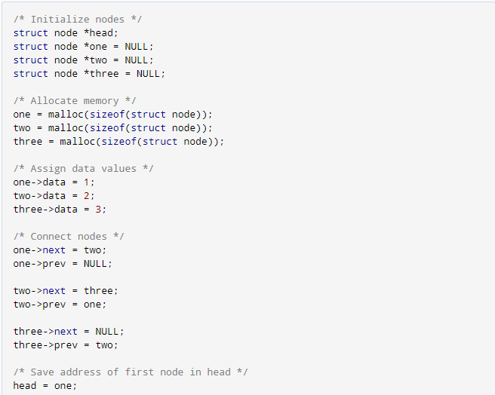

Slide 6
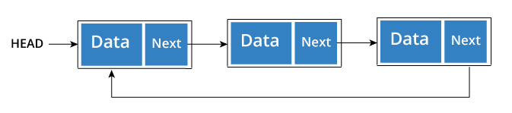
Circular Linked List A circular linked list is a variation of linked list in which the last element is linked to the first element. This forms a circular loop. A circular linked list can be either singly linked or doubly linked. for singly linked list, next pointer of last item points to the first item In doubly linked list, prev pointer of first item points to last item as well.

Slide 7
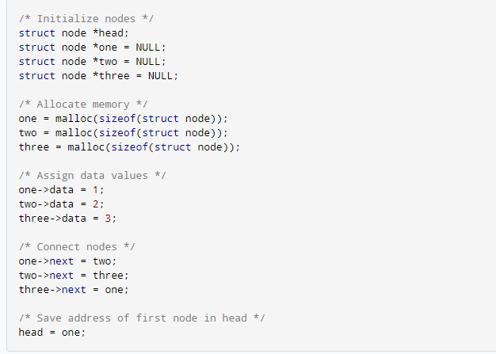

Slide 8
Assignment : Print the single linked list elements in reverse order. Write only creating linked list, reverse print linked list functions.
You are given the pointer to the head node of a linked list and you need to print all its elements in reverse order from tail to head, one element per line. The head pointer may be null meaning that the list is empty - in that case, do not print anything!
Input Format
You have to complete the void reversePrint(SinglyLinkedListNode* head) method which takes one argument - the head of the linked list. You should NOT read any input from stdin/console.
The first line of input contains , the number of test cases. The input of each test case is as follows:
The first line contains an integer , denoting the number of elements in the list.
The next n lines contain one element each, denoting the elements of the linked list in the order.
Output Format
Complete the reversePrint function in the editor below and print the elements of the linked list in the reverse order, each in a new line.

