Slide 1
Tree

Slide 2
Tree
A tree is a collection of nodes and edges
A tree has only one root
Trees are hierarchical:
Parent-child relationship between two nodes
basic operations of a tree:
tree traversals
insert node
delete node
searching

Slide 3
Level
root
0
E
1
A
Child (of root)
R
E
A
S
T
2
Leaves or terminal nodes
3
M
P
L
E
Depth of T: 2
Tree height: 4

Slide 4
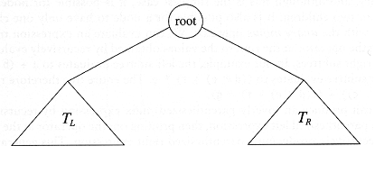
Binary Trees
A tree in which no node can have more than two children

Slide 5


Parts of a binary tree
A binary tree is composed of zero or more nodes
Each node contains:
  A value (some sort of data item)
  A reference or pointer to a left child (may be null), and
  A reference or pointer to a right child (may be null)
A binary tree may be empty (contain no nodes)
If not empty, a binary tree has a root node
  Every node in the binary tree is reachable from the root
node by a unique path
A node with neither a left child nor a right child is called a leaf
  In some binary trees, only the leaves contain a value

Slide 6
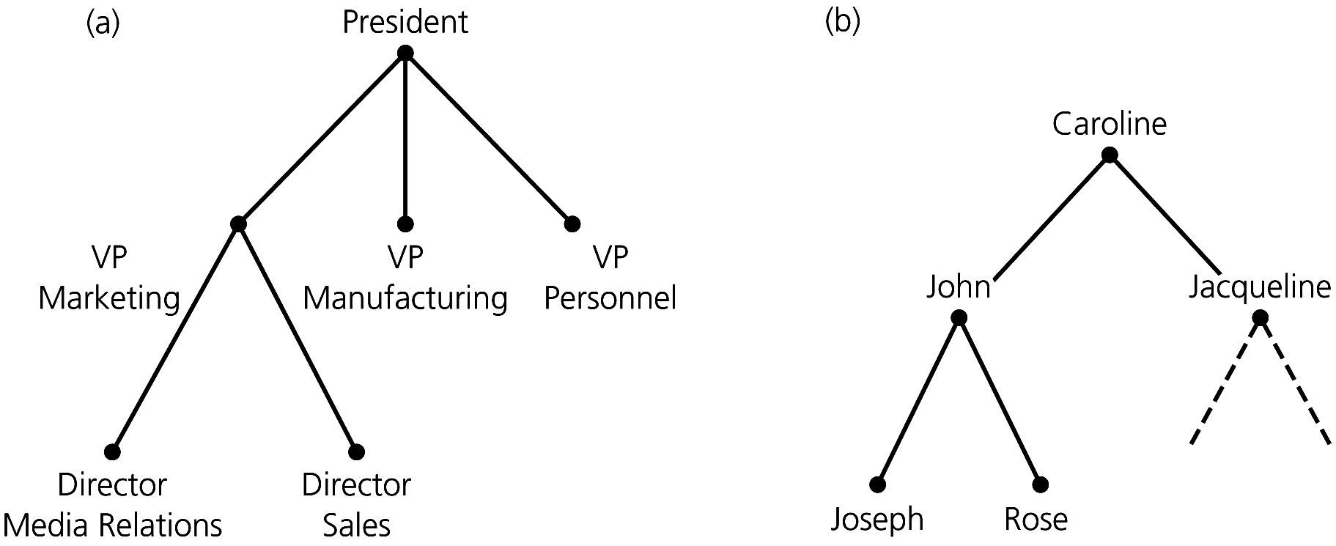
A General Tree & A Binary Tree

Slide 7





Picture of a binary tree
a
b
c
d
e
f
g
h
i
j
k
l

Slide 8

Size and depth
The size of a binary tree is the number of nodes in it
  This tree has size 12
The depth of a node is its distance from the root
  a is at depth zero
  e is at depth 2
The depth of a binary tree is the depth of its deepest node
  This tree has depth 4
a
b
c
d e
f
g h i j k
l

Slide 9

Balance
a
a
b
c
b
c e
d e f g
d
f
h i j
A balanced binary tree
g h
i j
An unbalanced binary tree
A binary tree is balanced if every level above the lowest is “full”
(contains 2^{n} nodes)
In most applications, a reasonably balanced binary tree is desirable

Slide 10
Example of tree application:
Represent algebraic formulas
Q: Write the following operations as binary tree and determine the (tree Depth, tree height, number of levels).
A. 2+3
+
1 | Tree depth
2 | Tree height
1 | Number of levels
2
3

Slide 11
B. (6/2) * (20-4)
2 | Tree depth
3 | Tree height
2 | Number of levels
*
/
-
6
2
6
2

Slide 12
Tree traversal
Type of Traversal
Inorder traversal
Preorder traversal
Postorder traversal

Slide 13

Tree traversals
A binary tree is defined recursively: it consists of a root, a left subtree, and a right subtree
To traverse (or walk) the binary tree is to visit each node in the binary tree exactly once
Tree traversals are naturally recursive
Since a binary tree has three “parts,” there are six possible ways to traverse the binary tree:

Slide 14
Inorder traversal
Recursively print out all data in the left subtree
Print the data at the root
Recursively print out all data in the right subtree
Pre-order traversal
Print the data at the root
Recursively print out all data in the left subtree
Recursively print out all data in the right subtree
Postorder traversal
Recursively print out all data in the left subtree
Recursively print out all data in the right subtree
Print the data at the root

Slide 15

Preorder traversal
In preorder, the root is visited first
Here’s a preorder traversal to print out all the elements in the binary tree:
public void preorderPrint(BinaryTree bt) { if (bt == null) return; System.out.println(bt.value); preorderPrint(bt.leftChild);
preorderPrint(bt.rightChild);
}

Slide 16
Inorder traversal
In inorder, the root is visited in the middle
Here’s an inorder traversal to print out all the elements in the binary tree:
public void inorderPrint(BinaryTree bt) { if (bt == null) return; inorderPrint(bt.leftChild); System.out.println(bt.value);
inorderPrint(bt.rightChild);
}

Slide 17

Postorder traversal
In postorder, the root is visited last
Here’s a postorder traversal to print out all the elements in the binary tree:
public void postorderPrint(BinaryTree bt) { if (bt == null) return; postorderPrint(bt.leftChild); postorderPrint(bt.rightChild); System.out.println(bt.value);
}

Slide 18
Traverse the following binary tree using the three types of tree traversal
Preorder (NLR)
6, 2, 1, 4, 3, 7, 10 , 9, 11
b. Postorder (LRN)
1, 3, 4, 2, 9, 11 ,10, 7, 6
c. Inorder (LNR)
1, 2, 3, 4, 6, 7, 9, 10, 11
6
2
7
1
4
10
3
9
11

Slide 19
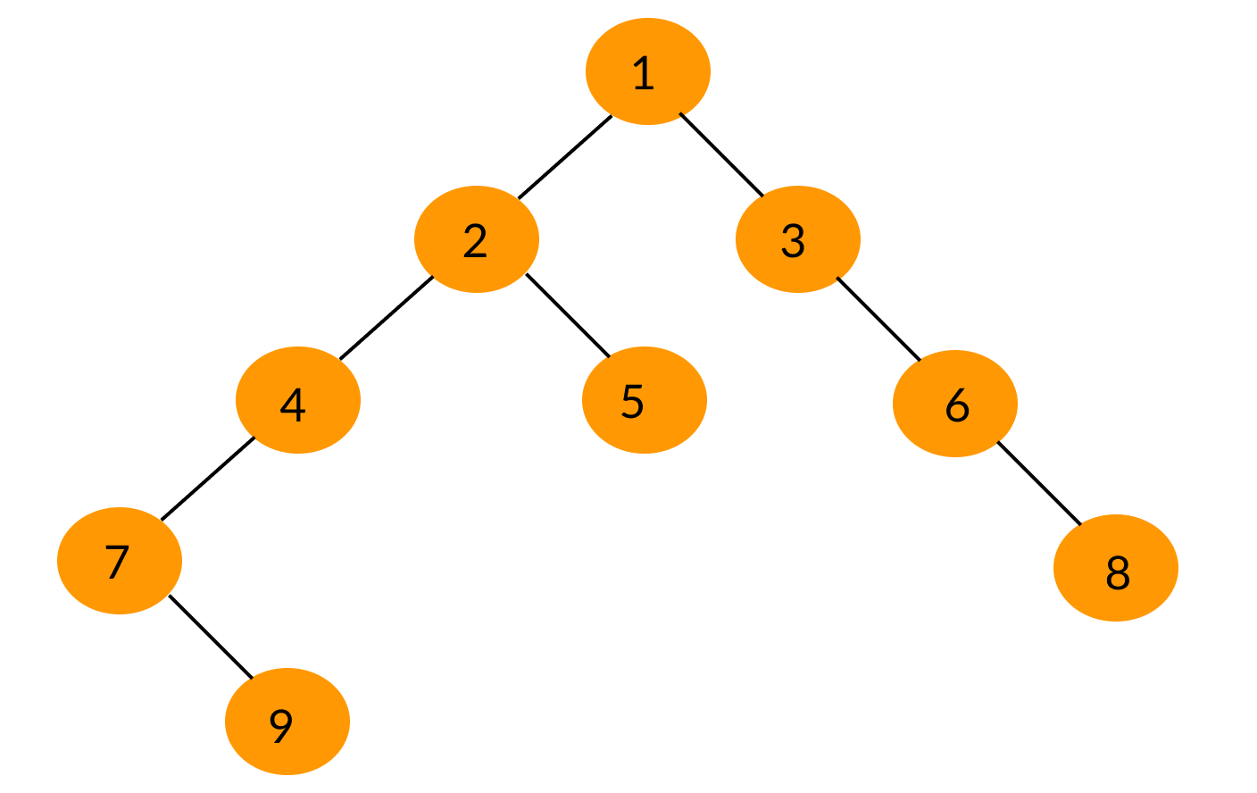
Preorder-Output: 1
Root,Left,Right
Root,Left,Right
Root,Left,Right
Root,Left,Right
Root,Left,Right
Root,Left,Right
Root,Left,Right
Root,Left,Right
Root,Left,Right

Slide 20
Preorder-Output: 1,2
Root,Left,Right
Root,Left,Right
Root,Left,Right
Root,Left,Right
Root,Left,Right
Root,Left,Right
Root,Left,Right
Root,Left,Right
Root,Left,Right

Slide 21
Preorder-Output: 1,2,4
Root,Left,Right
Root,Left,Right
Root,Left,Right
Root,Left,Right
Root,Left,Right
Root,Left,Right
Root,Left,Right
Root,Left,Right
Root,Left,Right

Slide 22
Preorder-Output: 1,2,4,7
Root,Left,Right
Root,Left,Right
Root,Left,Right
Root,Left,Right
Root,Left,Right
Root,Left,Right
Root,Left,Right
Root,Left,Right
Root,Left,Right

Slide 23
Preorder-Output: 1,2,4,7,9
Root,Left,Right
Root,Left,Right
Root,Left,Right
Root,Left,Right
Root,Left,Right
Root,Left,Right
Root,Left,Right
Root,Left,Right
Root,Left,Right

Slide 24
Preorder-Output: 1,2,4,7,9,5
Root,Left,Right
Root,Left,Right
Root,Left,Right
Root,Left,Right
Root,Left,Right
Root,Left,Right
Root,Left,Right
Root,Left,Right
Root,Left,Right

Slide 25
Preorder-Output: 1,2,4,7,9,5,3
Root,Left,Right
Root,Left,Right
Root,Left,Right
Root,Left,Right
Root,Left,Right
Root,Left,Right
Root,Left,Right
Root,Left,Right
Root,Left,Right

Slide 26
Preorder-Output: 1,2,4,7,9,5,3,6
Root,Left,Right
Root,Left,Right
Root,Left,Right
Root,Left,Right
Root,Left,Right
Root,Left,Right
Root,Left,Right
Root,Left,Right
Root,Left,Right

Slide 27
Preorder-Output: 1,2,4,7,9,5,3,6,8
Root,Left,Right
Root,Left,Right
Root,Left,Right
Root,Left,Right
Root,Left,Right
Root,Left,Right
Root,Left,Right
Root,Left,Right
Root,Left,Right

Slide 28
Inorder-Output:7
Left,Root,Right
Left,Root,Right
Left,Root,Right
Left,Root,Right
Left,Root,Right
Left,Root,Right
Left,Root,Right
Left,Root,Right
Left,Root,Right

Slide 29
Inorder-Output:7,9
Left,Root,Right
Left,Root,Right
Left,Root,Right
Left,Root,Right
Left,Root,Right
Left,Root,Right
Left,Root,Right
Left,Root,Right
Left,Root,Right

Slide 30
Inorder-Output:7,9,4
Left,Root,Right
Left,Root,Right
Left,Root,Right
Left,Root,Right
Left,Root,Right
Left,Root,Right
Left,Root,Right
Left,Root,Right
Left,Root,Right

Slide 31
Inorder-Output:7,9,4
Left,Root,Right
Left,Root,Right
Left,Root,Right
Left,Root,Right
Left,Root,Right
Left,Root,Right
Left,Root,Right
Left,Root,Right
Left,Root,Right

Slide 32
Inorder-Output:7,9,4,2
Left,Root,Right
Left,Root,Right
Left,Root,Right
Left,Root,Right
Left,Root,Right
Left,Root,Right
Left,Root,Right
Left,Root,Right
Left,Root,Right

Slide 33
Inorder-Output:7,9,4,2,5,1
Left,Root,Right
Left,Root,Right
Left,Root,Right
Left,Root,Right
Left,Root,Right
Left,Root,Right
Left,Root,Right
Left,Root,Right
Left,Root,Right

Slide 34
Inorder-Output:7,9,4,2,5,1,3
Left,Root,Right
Left,Root,Right
Left,Root,Right
Left,Root,Right
Left,Root,Right
Left,Root,Right
Left,Root,Right
Left,Root,Right
Left,Root,Right

Slide 35
Inorder-Output:7,9,4,2,5,1,3,6
Left,Root,Right
Left,Root,Right
Left,Root,Right
Left,Root,Right
Left,Root,Right
Left,Root,Right
Left,Root,Right
Left,Root,Right
Left,Root,Right

Slide 36
Inorder-Output:7,9,4,2,5,1,3,6,8
Left,Root,Right
Left,Root,Right
Left,Root,Right
Left,Root,Right
Left,Root,Right
Left,Root,Right
Left,Root,Right
Left,Root,Right
Left,Root,Right

Slide 37
Postorder-Output:9
Left,Right,Root
Left,Right,Root
Left,Right,Root
Left,Right,Root
Left,Right,Root
Left,Right,Root
Left,Right,Root
Left,Right,Root
Left,Right,Root

Slide 38
Postorder-Output:9,7
Left,Right,Root
Left,Right,Root
Left,Right,Root
Left,Right,Root
Left,Right,Root
Left,Right,Root
Left,Right,Root
Left,Right,Root
Left,Right,Root

Slide 39
Postorder-Output:9,7,4
Left,Right,Root
Left,Right,Root
Left,Right,Root
Left,Right,Root
Left,Right,Root
Left,Right,Root
Left,Right,Root
Left,Right,Root
Left,Right,Root

Slide 40
Postorder-Output:9,7,4,5
Left,Right,Root
Left,Right,Root
Left,Right,Root
Left,Right,Root
Left,Right,Root
Left,Right,Root
Left,Right,Root
Left,Right,Root
Left,Right,Root

Slide 41
Postorder-Output:9,7,4,5,2
Left,Right,Root
Left,Right,Root
Left,Right,Root
Left,Right,Root
Left,Right,Root
Left,Right,Root
Left,Right,Root
Left,Right,Root
Left,Right,Root

Slide 42
Postorder-Output:9,7,4,5,2,8
Left,Right,Root
Left,Right,Root
Left,Right,Root
Left,Right,Root
Left,Right,Root
Left,Right,Root
Left,Right,Root
Left,Right,Root
Left,Right,Root

Slide 43
Postorder-Output:9,7,4,5,2,8,6
Left,Right,Root
Left,Right,Root
Left,Right,Root
Left,Right,Root
Left,Right,Root
Left,Right,Root
Left,Right,Root
Left,Right,Root
Left,Right,Root

Slide 44
Postorder-Output:9,7,4,5,2,8,6,3,1
Left,Right,Root
Left,Right,Root
Left,Right,Root
Left,Right,Root
Left,Right,Root
Left,Right,Root
Left,Right,Root
Left,Right,Root
Left,Right,Root

