Slide 1
UNIT-I

Slide 2
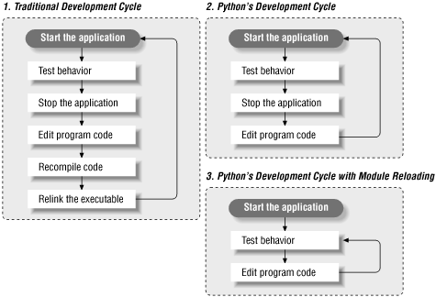
Program Development Cycle

Slide 3
Steps
Defining the Problem
Designing the Program
Coding the Program
Testing and Debugging the Program
Documenting the Program
Deploying and Maintaining the Program

Slide 4
Input,Processing and output
To get input from the user you can use the input function.
The user types a string of characters and presses enter.
Then the input function returns that string and Python continues running the program by executing the next statement after the input statement.
Python provides the function input(). input has an optional parameter, which is the prompt string
Syntax: variable = input(message)
Example: a=input(“Enter a no”)

Slide 5
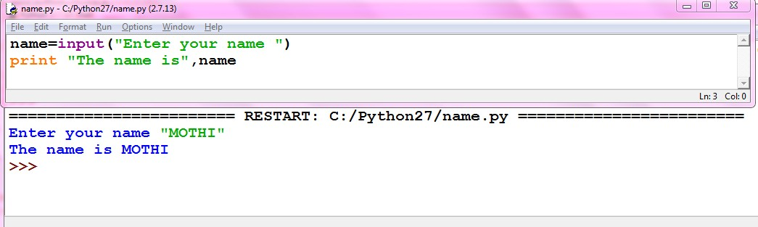

Slide 6
Output
The Python shell itself is such a program; its inputs are Python expressions or statements.
Its processing evaluates these items. Its outputs are the results displayed in the shell.
The programmer can also force the output of a value by using the print function. The simplest form for using this function looks like the following:
Syntax: print(*objects, sep=' ', end='\n', file=sys.stdout, flush=False)
Example: >>> print ("Hi there")
Hi there

Slide 7
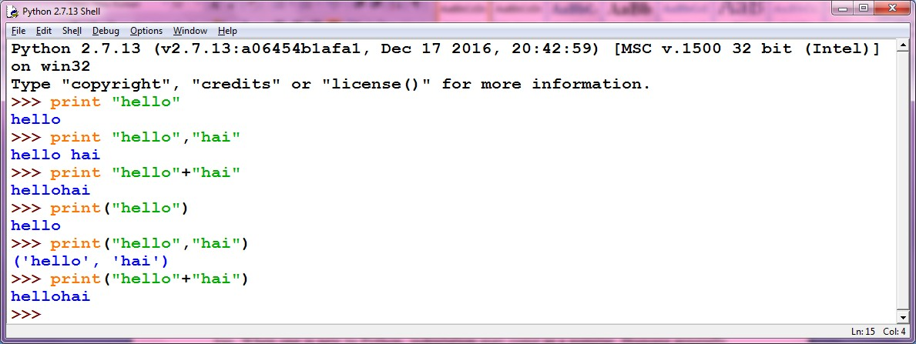
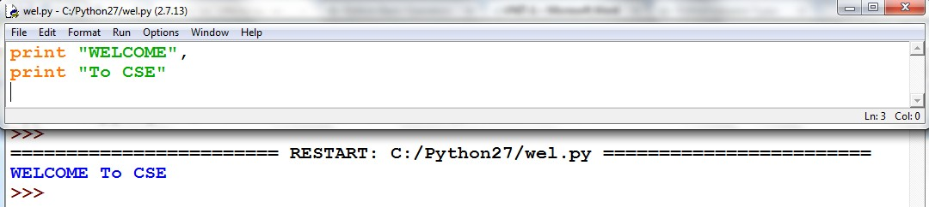

Slide 8
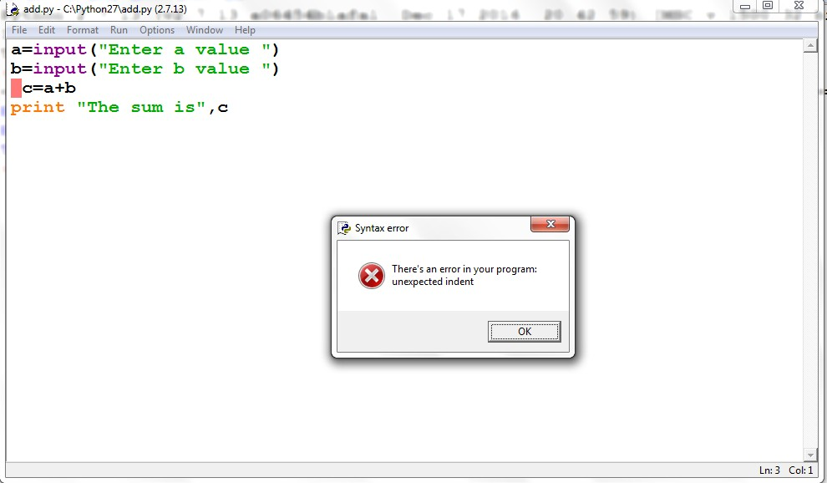
Indentation
indentation clearly identifies which block of code a statement belongs to
Python does not support braces to indicate blocks of code for class and function definitions or flow control
Blocks of code are denoted by line indentation.
All the continuous lines indented with same number of spaces would form a block. Python strictly follow indentation rules to indicate the blocks.

Slide 9
Editing, Saving, and Running a Script
1. Select the option New Window from the File menu of the shell window.
2. In the new window, enter Python expressions or statements on separate lines, in the order in which you want Python to execute them.
3. At any point, you may save the file by selecting File/Save. If you do this, you should use a . py extension. For example, your first program file might be named myprogram.
py.
4. To run this file of code as a Python script, select Run Module from the Run menu
or press the F5 key.

Slide 10
1. Which statements outputs data in a Python program?-------------
2. What is IDLE used to do?
a. Edit Python programs
b. Save Python programs to files
c. Run Python programs
d. All of the above
3. Which is used to specify a block of code in python -------------
Q1.Write a Python program that prints (displays) your name, address, and telephone number
Q2.Write and test a program that computes the area of a circle. This program should
request a number representing a radius as input from the user. It should use the formula 3.14 * radius ** 2 to compute the area and then output this result suitably labeled.
Q3. Write and test a program that accepts the user’s name (as text) and age (as a number) as input. The program should output a sentence containing the user’s name and age.

