Slide 1
UNIT-I

Slide 2
Operators
Types of Operators:
Python language supports the following types of operators.
Arithmetic Operators
Comparison (Relational) Operators
Assignment Operators
Logical Operators
Bitwise Operators
Membership Operators
Identity Operators

Slide 3
Arithmetic Operators
Operator | Description | Example
+ Addition | Adds values on either side of the operator. | a + b = 30
- Subtraction | Subtracts right hand operand from left hand operand. | a – b = -10
* Multiplication | Multiplies values on either side of the operator | a * b = 200
/ Division | Divides left hand operand by right hand operand | b / a = 2
% Modulus | Divides left hand operand by right hand operand and returns remainder | b % a = 0
** Exponent | Performs exponential (power) calculation on operators | a**b =10 to the power 20
// Floor Division | The division of operands where the result is the quotient in which the digits after the decimal point are removed. | 9//2 = 4 and 9.0//2.0 = 4.0

Slide 4
Example
a = 21
b = 10
print "Addition is", a + b
print "Subtraction is ", a - b
print "Multiplication is ", a * b
print "Division is ", a / b
print "Modulus is ", a % b
a = 2
b = 3
print "Power value is ", a ** b
a = 10
b = 4
print "Floor Division is ", a // b

Slide 5
Comparison (Relational) Operators
Operator | Description | Example
= = | If the values of two operands are equal, then the condition becomes true. | (a == b) is not true.
!= | If values of two operands are not equal, then condition becomes true. | (a != b) is true.
< > | If values of two operands are not equal, then condition becomes true. | (a <> b) is true. This is similar to != operator.
> | If the value of left operand is greater than the value of right operand, then condition becomes true. | (a > b) is not true.
< | If the value of left operand is less than the value of right operand, then condition becomes true. | (a < b) is true.
> = | If the value of left operand is greater than or equal to the value of right operand, then condition becomes true. | (a >= b) is not true.
< = | If the value of left operand is less than or equal to the value of right operand, then condition becomes true. | (a <= b) is true.

Slide 6
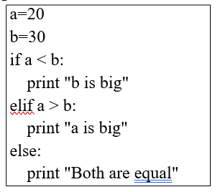
Example
Print “Greater than:”,a>b
Print “Lessthan:”,a<b
Print “equal:”,a=b
Print “lessthan or equal:”,a<=b

Slide 7
Assignment Operators
Operator | Description | Example
= | Assigns values from right side operands to left side operand | c = a + b assigns value of a + b into c
+= Add AND | It adds right operand to the left operand and assign the result to left operand | c += a is equivalent to c = c + a
-= Subtract AND | It subtracts right operand from the left operand and assign the result to left operand | c -= a is equivalent to c = c - a
*= Multiply AND | It multiplies right operand with the left operand and assign the result to left operand | c *= a is equivalent to c = c * a
/= Divide AND | It divides left operand with the right operand and assign the result to left operand | c /= a is equivalent to c = c / a
%= Modulus AND | It takes modulus using two operands and assign the result to left operand | c %= a is equivalent to c = c % a
**= Exponent AND | Performs exponential (power) calculation on operators and assign value to the left operand | c **= a is equivalent to c = c ** a
//= Floor Division | It performs floor division on operators and assign value to the left operand | c //= a is equivalent to c = c // a

Slide 8
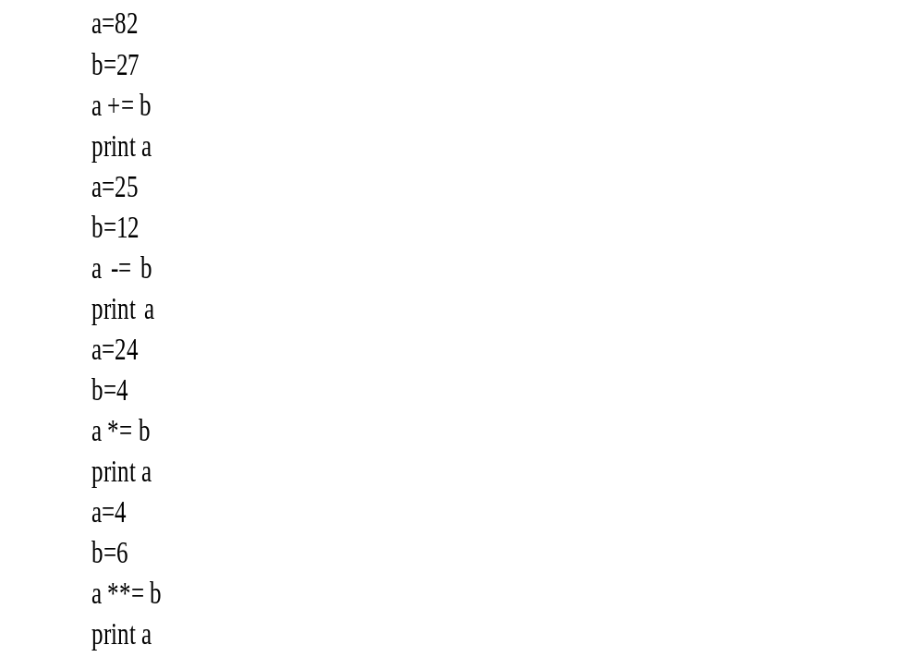
Example

Slide 9
Logical Operators
Operator | Description | Example
And Logical AND | If both the operands are true then condition becomes true. | (a and b) is true.
Or Logical OR | If any of the two operands are non-zero then condition becomes true. | (a or b) is true.
not Logical NOT | Used to reverse the logical state of its operand. | Not (a and b) is false.

Slide 10
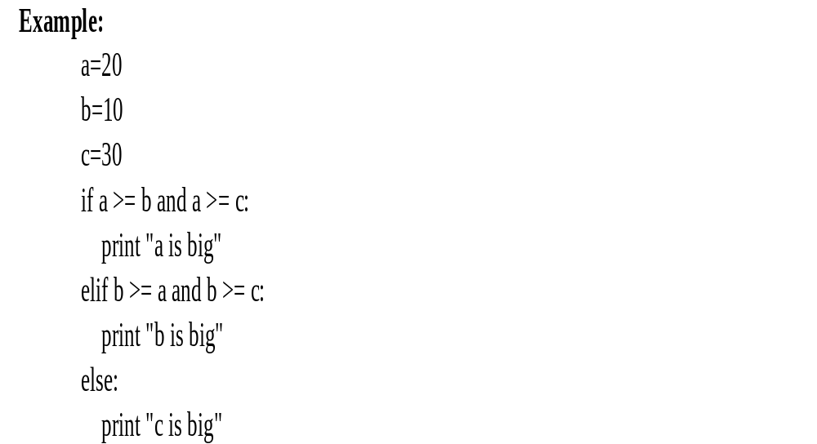

Slide 11
Bitwise Operators
Operator | Description | Example
& Binary AND | Operator copies a bit to the result if it exists in both operands. | (a & b) = 12 (means 0000 1100)
| Binary OR | It copies a bit if it exists in either operand. | (a | b) = 61 (means 0011 1101)
^ Binary XOR | It copies the bit if it is set in one operand but not both. | (a ^ b) = 49 (means 0011 0001)
~ Binary Ones Complement | It is unary and has the effect of 'flipping' bits. | (~a ) = -61 (means 1100 0011 in 2's complement form due to a signed binary number.
<< Binary Left Shift | The left operands value is moved left by the number of bits specified by the right operand. | a << 2 = 240 (means 1111 0000)
>> Binary Right Shift | The left operands value is moved right by the number of bits specified by the right operand. | a >> 2 = 15 (means 0000 1111)

Slide 12
Membership Operators
Operator | Description | Example
in | Evaluates to true if it finds a variable in the specified sequence and false otherwise. | x in y, here in results in a 1 if x is a member of sequence y.
not in | Evaluates to true if it does not finds a variable in the specified sequence and false otherwise. | x not in y, here not in results in a 1 if x is not a member of sequence y.

Slide 13
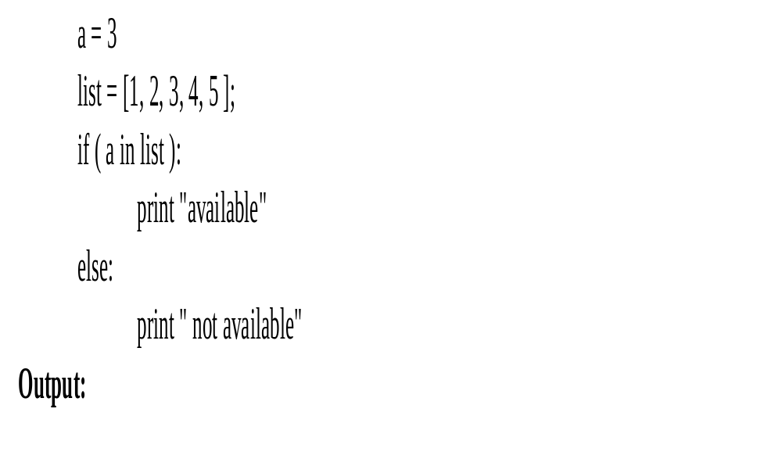
Example

Slide 14
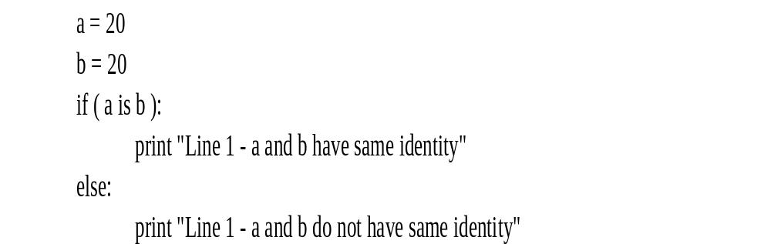
Identity Operators
Operator | Description | Example
is | Evaluates to true if the variables on either side of the operator point to the same object and false otherwise. | x is y, here is results in 1 if id(x) equals id(y).
is not | Evaluates to false if the variables on either side of the operator point to the same object and true otherwise. | x is not y, here is not results in 1 if id(x) is not equal to id(y).

Slide 15
Python Operators Precedence
Operator | Description
() | Parenthesis
** | Exponentiation (raise to the power)
~ x, +x, -x | Complement, unary plus and minus
* / % // | Multiply, divide, modulo and floor division
+ - | Addition and subtraction
>> << | Right and left bitwise shift
& | Bitwise 'AND'
^ | | Bitwise exclusive `OR' and regular `OR'
<= < > >= | Comparison operators
<> == != | Equality operators
= %= /= //= -= += *= **= | Assignment operators
is is not | Identity operators
in not in | Membership operators
not or and | Logical operators

Slide 16
Expression
Algebraic Expression | Python Expression
a x b – c | a * b – c
(m + n) (x + y) | (m + n) * (x + y)
(ab / c) | a * b / c
3x² +2x + 1 | 3*x*x+2*x+1
(x / y) + c | x / y + c

Slide 17
Evaluation of Expressions examples
3 4 5 | 2*6 => 12 8-6 => 2 8==8 => True 1000 > 100 => True ‘hello’ + ‘world’ => ‘helloworld’
1 2 3 4 | -(5/5) => -1 -(3*4) => -12 -(2**4) => -16 -10 => -10
1 2 3 | 3 * 2 + 1 => 7 2 + 6 * 2 => 14 (2 + 6) * 2 => 16

