Slide 1
UNIT-V
Brief Tour Of the Standard Library

Slide 2
Contents
Operating System Interface
String Pattern Matching
Mathematics
Internet Access
Dates and Times
Data Compression
Multithreading
GUI Programming
Turtle Graphics

Slide 3
Operating System Interface
The os module:
This module provides a unified interface to a number of operating system functions. Most of the functions in this module are implemented by platform specific modules, such as posix and nt. The os module automatically loads the right implementation module when it is first imported.

Slide 4
Working with files
The built-in open function lets you create, open, and modify files. This module adds those extra functions you need to rename and remove files:
import os
os.remove(temp)
Fi=open(file)
fi.readlines()
fi.close()
os.rename(file, back)

Slide 5
Working with directories
Example:Using the os module to list the files in a directory
import os
for file in os.listdir("samples"):
print file
O/P
sample.au
sample.jpg
sample.wav
Functions
os.getcwd()
os.chdir(dirname)
os.makedirs("test/multiple/levels")
os.removedirs("test/multiple/levels")
os.mkdir("test")
os.rmdir("test")

Slide 6
Example: Using the os module to get information about a file
# File:os-example-1.py
import os
import time
file = "samples/sample.jpg"
def dump(st):
mode, ino, dev, nlink, uid, gid, size, atime, mtime, ctime = st print "- size:", size, "bytes"
print "- owner:", uid, gid
print "- created:", time.ctime(ctime)
print "- last accessed:", time.ctime(atime)
print "- last modified:", time.ctime(mtime)
print "- mode:", oct(mode) print "- inode/dev:", ino, dev

Slide 7
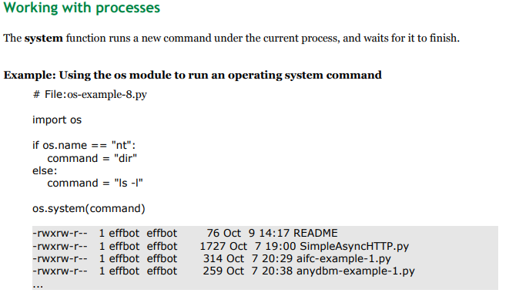

Slide 8
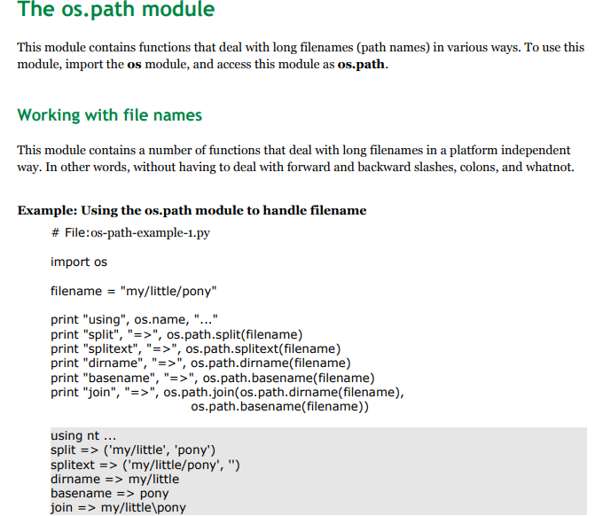

Slide 9
Math module

Slide 10
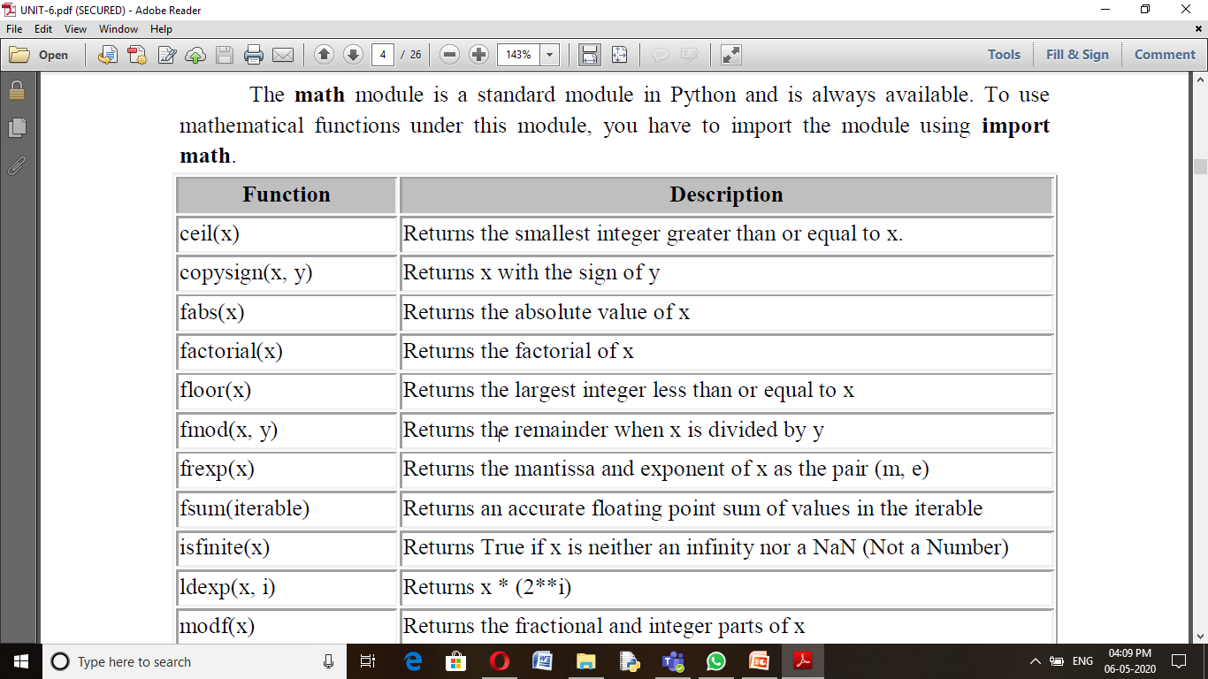

Slide 11
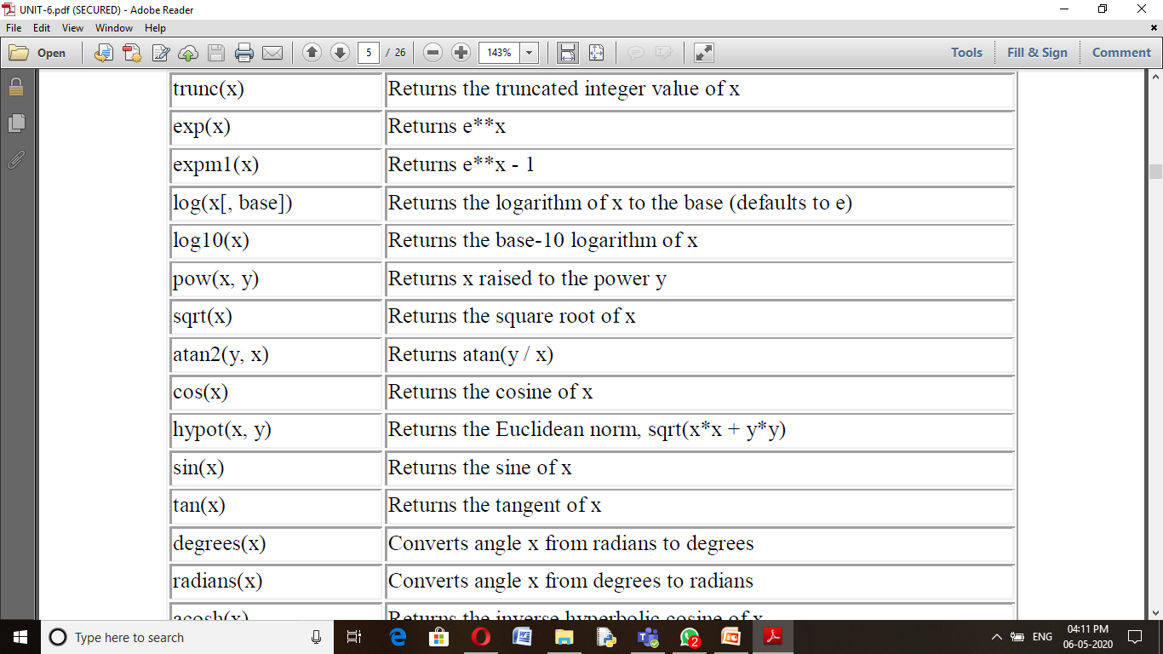

Slide 12
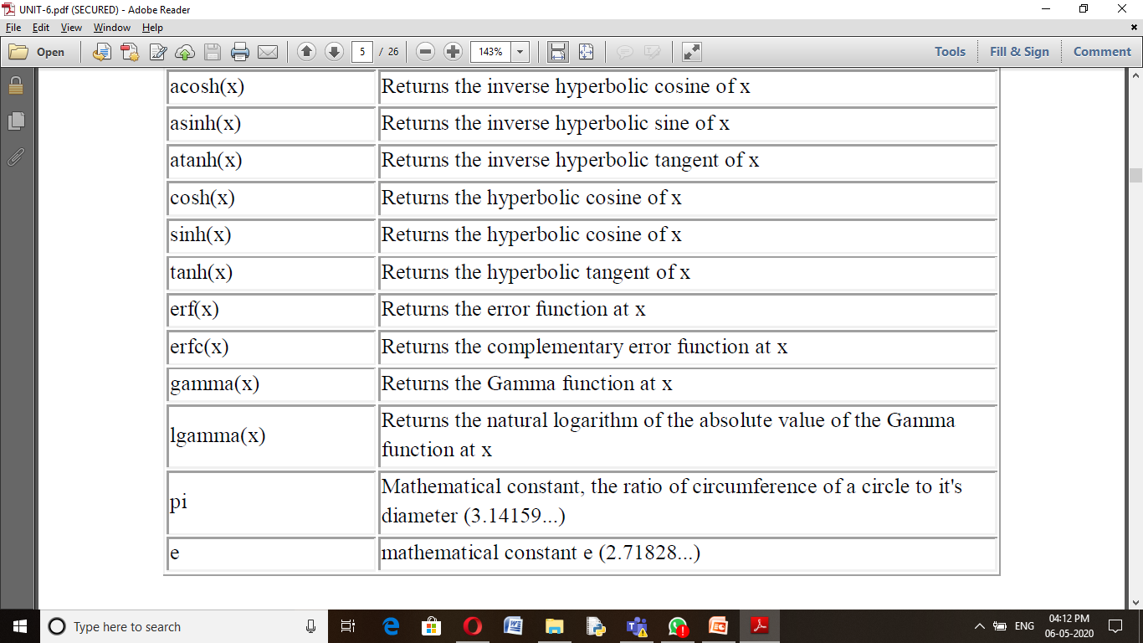

Slide 13
>>> import math >>>math.pi 3.141592653589793
>>>math.log10(10) 1.0
>>>math.exp(10) 1.0
>>>math.e 2.718281828459045
>>>math.e**10 22026.465794806703
>>>math.radians(30) 0.5235987755982988 >>>math.degrees(math.pi/6) 29.999999999999996
>>>math.pow(2,4) 16.0 >>>2**4 16
>>math.sin(0.5235987755982988) 0.49999999999999994 >>>math.cos(0.5235987755982988) 0.8660254037844387 >>>math.tan(0.5235987755982988) 0.5773502691896257
>>>math.sqrt(100) 10.0 >>>math.sqrt(3) 1.7320508075688772
>>>math.ceil(4.5867) 5 >>>math.floor(4.5687) 4
>>>math.log(10) 2.302585092994046

Slide 14
Internet Access Module
Simple Mail Transfer Protocol (SMTP) is a protocol, which handles sending e-mail and routing e-mail between mail servers.
Python provides smtplib module that can be used to send mail to any Internet machine.
import smtplib
smtpObj = smtplib.SMTP( [host [, port [, local_hostname]]] )

Slide 15
Example: Write a program to send email to any mail address. import smtplib
from email.mime.text
import MIMEText
body="The message you want to send. "
msg=MIMEText(body)
Fromaddr =“fromaddress@gmail.com”
toaddr="toaddress@gmail.com"
msg['From']=fromaddr
msg['To']=toaddr
msg['Subject']="Subject of mail"
server=smtplib.SMTP('smtp.gmail.com',587)
server.starttls()
server.login(fromaddr,"fromAddressPassword")
server.sendmail(fromaddr,toaddr,msg.as_string())
print "Mail Sent "
server.quit()
Output:
Mail Sent..........

Slide 16
urllib.request to retrive information from urls. Example:
>>> from urllib.request import urlopen
>>> with urlopen('http://tycho.usno.navy.mil/cgi-bin/timer.pl') as response:
for line in response:
line = line.decode('utf-8') # Decoding the binary data to text.
if 'EST' in line or 'EDT' in line: # look for Eastern Time
print(line)
OUTPUT:
Nov. 25, 09:43:32 PM EST

Slide 17
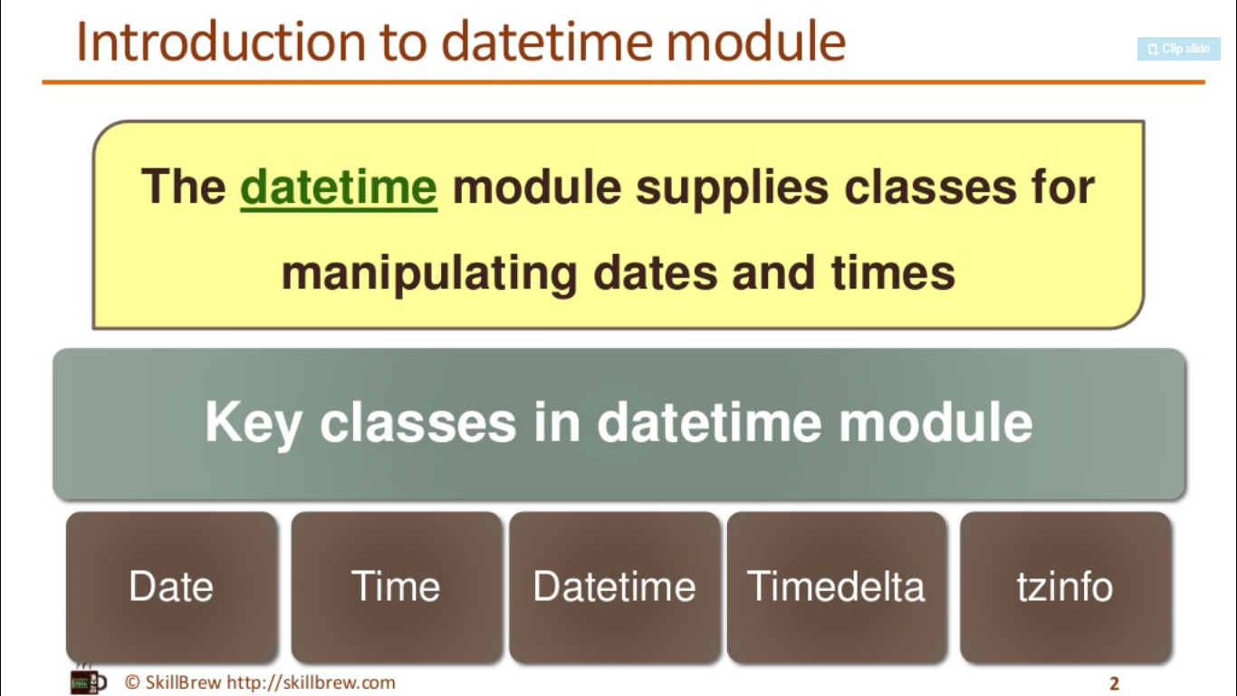

Slide 18
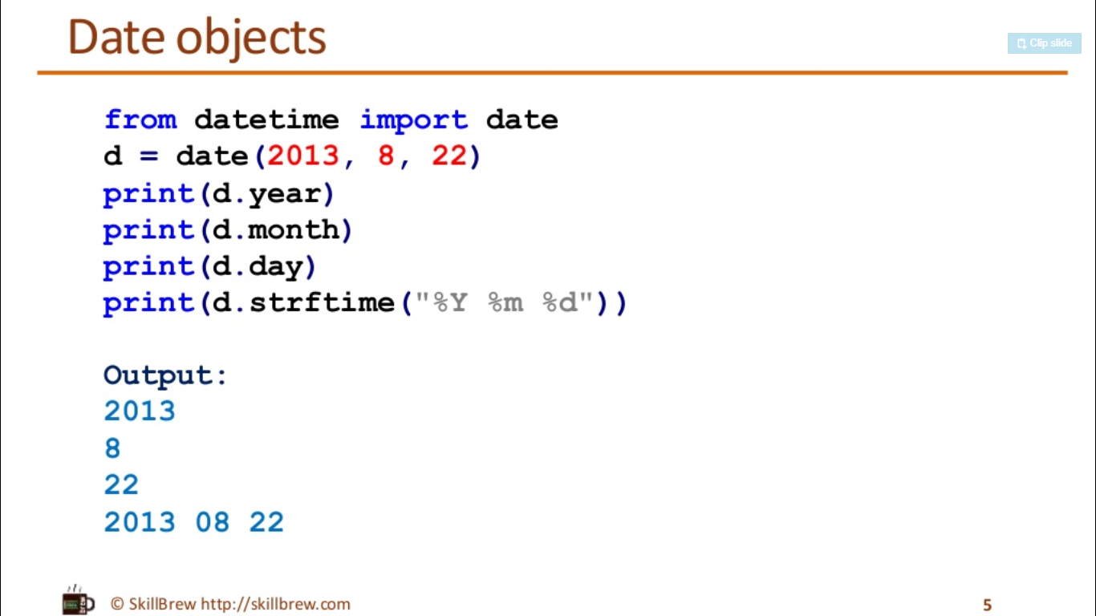

Slide 19
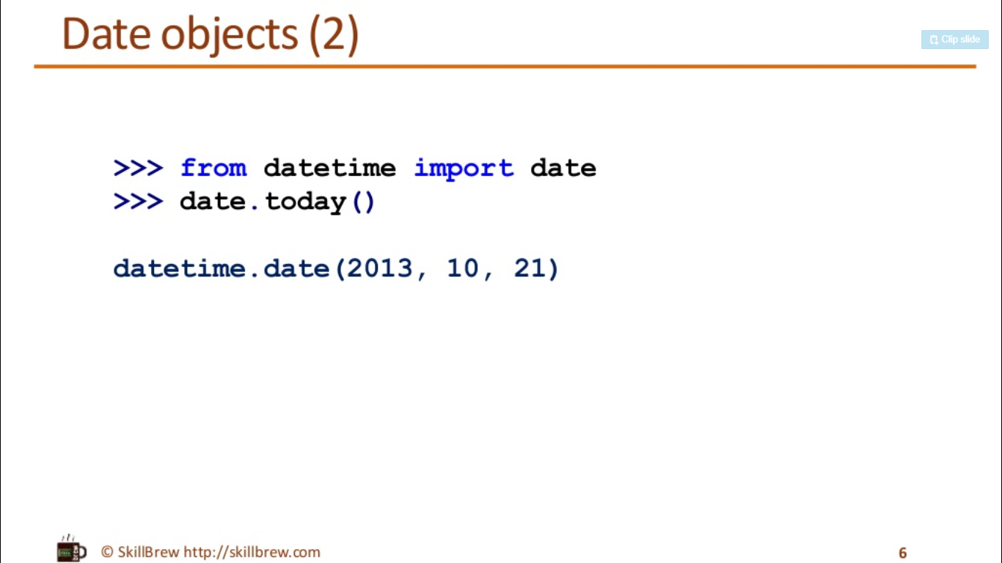

Slide 20
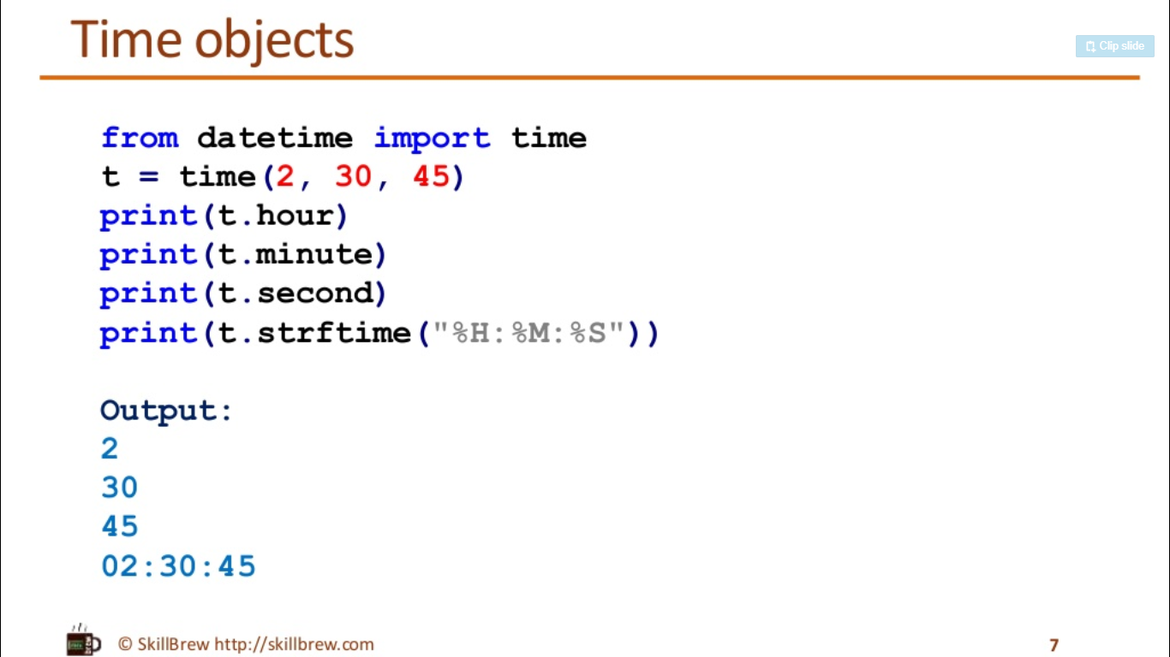

Slide 21
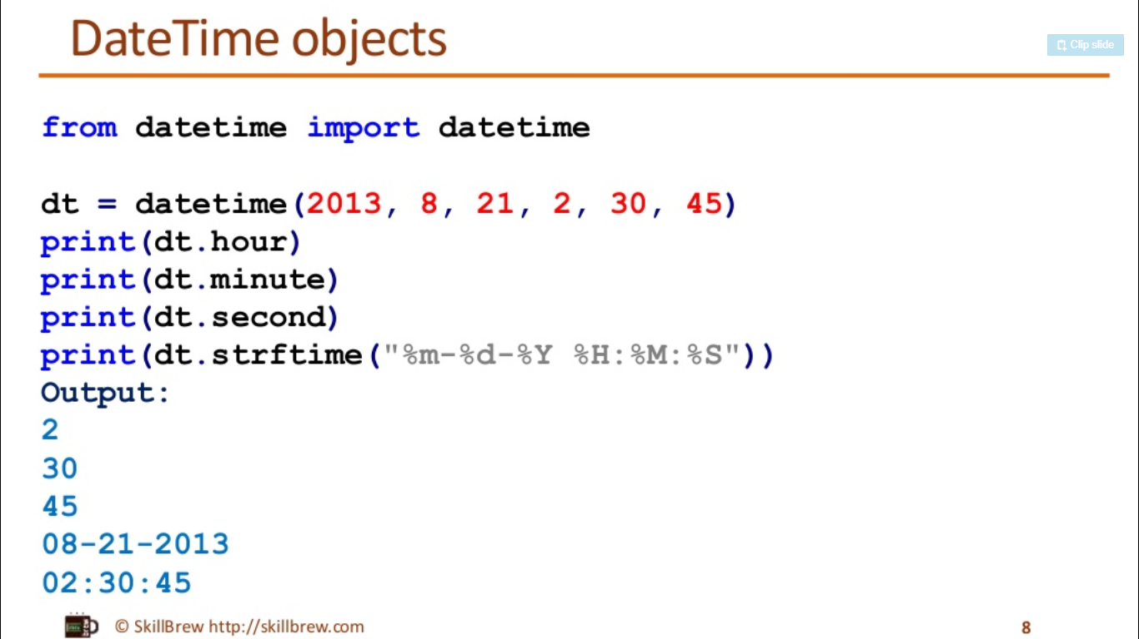

Slide 22
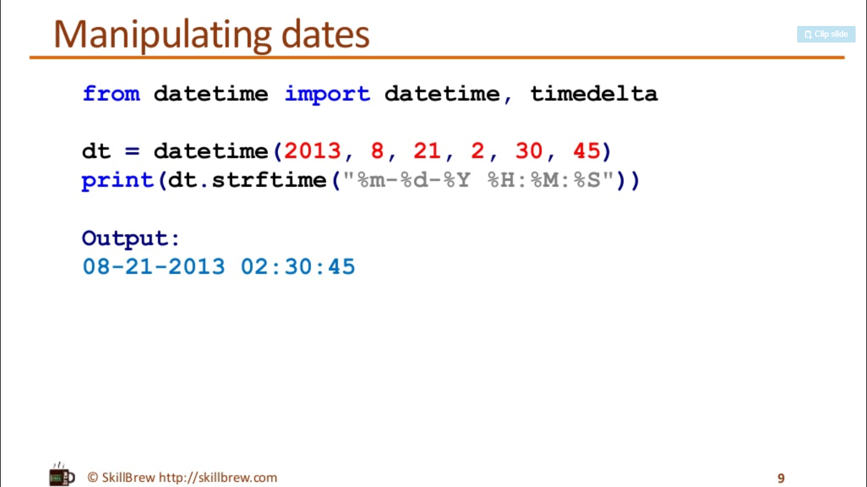

Slide 23
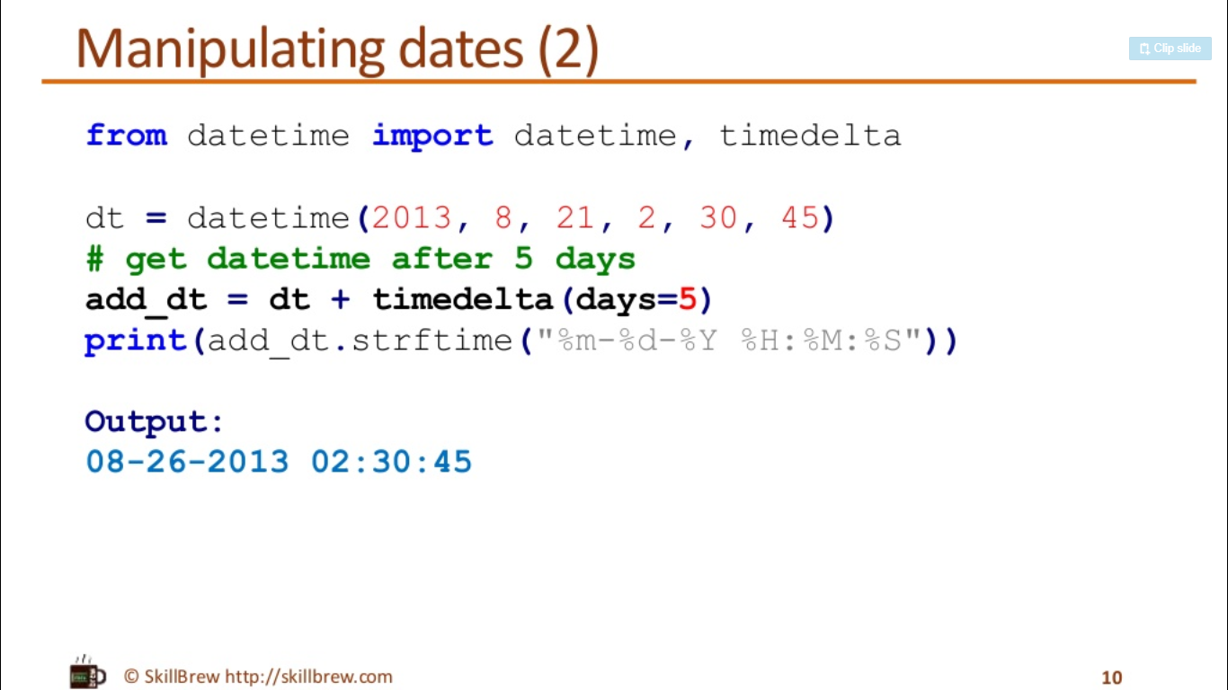

Slide 24
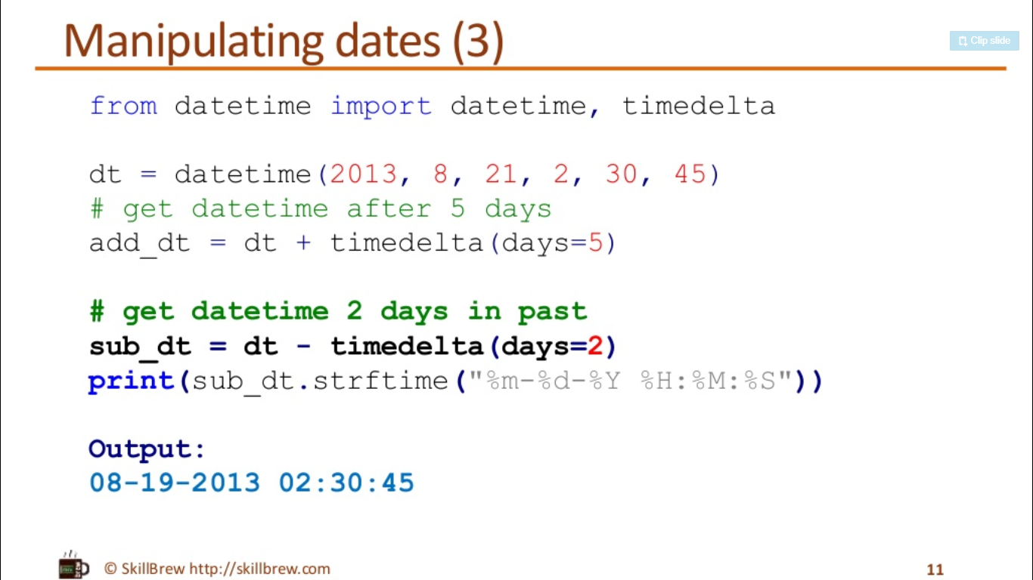

Slide 25
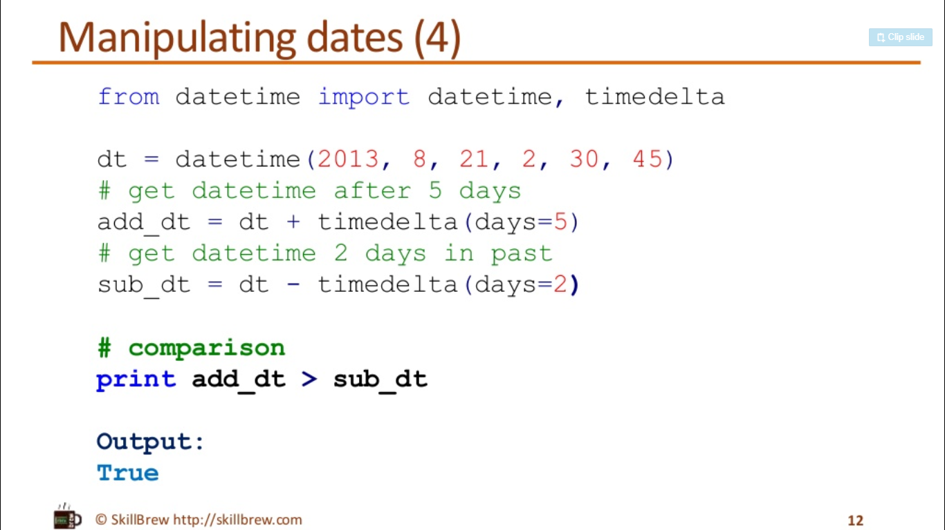

Slide 26
Data Compression
Data compression modules provided by python are zlib, gzip, bz2,zipfile, tarfile
The main use of the zlib library is in applications that require compression and decompression of arbitrary data, whether it be a string, structured in-memory content, or files.

Slide 27
Compressing a String of Data
Compress(data,level=-1):Here the argument data contains the bytes to be compressed, and level is an integer value that can take the values -1 or 0 to 9. This parameter determines the level of compression, where level 1 is the fastest and yields the lowest level of compression. Level 9 is the slowest, yet it yields the highest level of compression. The value -1 represents the default, which is level 6. The default value has a balance between speed and compression. Level 0 yields no compression.
import zlib
import binascii
data = 'Hello world'
compressed_data = zlib.compress(data, 2)
print('Original data: ' + data)
print('Compressed data: ' + binascii.hexlify(compressed_data))
$ python compress_str.py
Original data: Hello world
Compressed data: 785ef348cdc9c95728cf2fca49010018ab043d

Slide 28
Compressing Large Data Streams
compressobj(level=-1, method=DEFLATED, wbits=15, memLevel=8, strategy=Z_DEFAULT_STRATEGY[, zdict])
the wbits argument, which controls the window size, and whether or not the header and trailer are included in the output.
The method argument represents the compression algorithm used. Currently the only possible value is DEFLATED, which is the only method defined in the RFC 1950. The strategy argument relates to compression tuning.

Slide 29
Example
import zlib
import binascii
data = 'Hello world'
compress = zlib.compressobj(zlib.Z_DEFAULT_COMPRESSION, zlib.DEFLATED, -15)
compressed_data = compress.compress(data)
compressed_data += compress.flush() print('Original: ' + data)
print('Compressed data: ' + binascii.hexlify(compressed_data))
$ python compress_obj.py
Original: Hello world
Compressed data: f348cdc9c95728cf2fca490100

Slide 30
Compressing a File
We can also use the compress() function to compress the data in a file. The syntax is the same as in the first example.
The zlib.compress(...) line uses the constant Z_BEST_COMPRESSION, which, as the name suggests, gives us the best compression level this algorithm has to offer. The next line then calculates the level of compression based on the ratio of length of compressed data over length of original data.

Slide 31
Example
import zlib
original_data = open('logo.png', 'rb').read()
compressed_data = zlib.compress(original_data,zlib.Z_BEST_COMPRESSION)
compress_ratio = (float(len(original_data)) - float(len(compressed_data))) / float(len(original_data))
print('Compressed: %d%%' % (100.0 * compress_ratio))
$ python compress_file.py
Compressed: 13%

Slide 32
Decompressing a String of Data
A compressed string of data can be easily decompressed by using the decompress() function.
decompress(data, wbits=MAX_WBITS, bufsize=DEF_BUF_SIZE)
This function decompresses the bytes in the data argument. The wbits argument can be used to manage the size of the history buffer.

Slide 33
Example
import zlib
data = 'Hello world‘
compressed_data = zlib.compress(data, 2)
decompressed_data = zlib.decompress(compressed_data)
print('Decompressed data: ' + decompressed_data)
$ python decompress_str.py Decompressed data: Hello world

Slide 34
Decompressing Data from a File
import zlib
compressed_data = open('compressed.dat', 'rb').read()
decompressed_data = zlib.decompress(compressed_data)
print(decompressed_data)
$ python decompress_file.py
Hello world

Slide 35
GUI Programming
Python provides various options for developing graphical user interfaces (GUIs). Most important are listed below:
Tkinter: Tkinter is the Python interface to the Tk GUI toolkit shipped with Python..
wxPython: This is an open-source Python interface for wxWindows http://wxpython.org.
JPython: JPython is a Python port for Java which gives Python scripts seamless access to Java class libraries on the local machine http://www.jython.org.
There are many other interfaces available, which you can find them on the net.

Slide 36
Tkinter Programming
Tkinter is the standard GUI library for Python. Python when combined with Tkinter provides a fast and easy way to create GUI applications. Tkinter provides a powerful object- oriented interface to the Tk GUI toolkit.
Creating a GUI application using Tkinter is an easy task. All you need to do is perform the following steps:
Import the Tkinter module.
Create the GUI application main window.
Add one or more of the above-mentioned widgets to the GUI application.
Enter the main event loop to take action against each event triggered by the user.

Slide 37
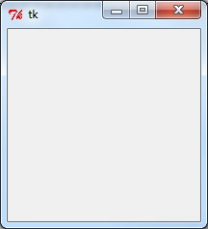
Example -1
import Tkinter
top = Tkinter.Tk()
# Code to add widgets will go here... top.mainloop()

Slide 38
Tkinter Widgets
Operator | Description
Button | The Button widget is used to display buttons in your application.
Canvas | The Canvas widget is used to draw shapes, such as lines, ovals, polygons and rectangles, in your application.
Checkbutton | The Checkbutton widget is used to display a number of options as checkboxes. The user can select multiple options at a time.
Entry | The Entry widget is used to display a single-line text field for accepting values from a user.
Frame | The Frame widget is used as a container widget to organize other widgets.
Label | The Label widget is used to provide a single-line caption for other widgets. It can also contain images.
Listbox | The Listbox widget is used to provide a list of options to a user.
Menubutton | The Menubutton widget is used to display menus in your application.
Menu | The Menu widget is used to provide various commands to a user. These commands are contained inside Menubutton.

Slide 39
Message | The Message widget is used to display multiline text fields for accepting values from a user.
Radiobutton | The Radiobutton widget is used to display a number of options as radio buttons. The user can select only one option at a time. Scale The Scale widget is used to provide a slider widget.
Scrollbar | The Scrollbar widget is used to add scrolling capability to various widgets, such as list boxes.
Text | The Text widget is used to display text in multiple lines.
Toplevel | The Toplevel widget is used to provide a separate window container.
Spinbox | The Spinbox widget is a variant of the standard Tkinter Entry widget, which can be used to select from a fixed number of values.
PanedWindow | A PanedWindow is a container widget that may contain any number of panes, arranged horizontally or vertically.
LabelFrame | A labelframe is a simple container widget. Its primary purpose is to act as a spacer or container for complex window layouts.
tkMessageBox | This module is used to display message boxes in your applications.

Slide 40
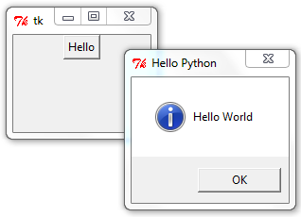
Button Example
import Tkinter
import tkMessageBox
top = Tkinter.Tk()
def helloCallBack():
tkMessageBox.showinfo( "Hello Python", "Hello World")
B = Tkinter.Button(top, text ="Hello", command = helloCallBack) B.pack()
top.mainloop()

Slide 41

Text Entry Example
from Tkinter import *
top = Tk()
L1 = Label(top, text="User Name")
L1.pack( side = LEFT)
E1 = Entry(top, bd =5)
E1.pack(side = RIGHT)
top.mainloop()

Slide 42
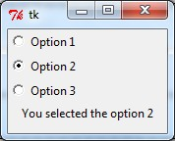
Radio Button Example
from Tkinter import *
def sel():
selection = "You selected the option " + str(var.get()) label.config(text = selection)
root = Tk()
var = IntVar()
R1 = Radiobutton(root,text="Option 1",variable=var,value=1,command=sel)
R1.pack( anchor = W )
R2 = Radiobutton(root,text="Option 2",variable=var,value=2,command=sel)
R2.pack( anchor = W )
R3 = Radiobutton(root,text="Option 3",variable=var,value=3,command=sel)
R3.pack( anchor = W)
label = Label(root)
label.pack()
root.mainloop()

