Slide 1
Installing packages using PIP

Slide 2
Download get-pip.py to a folder on your computer. Open a command prompt window and navigate to the folder containing get-pip.py. Then run python get-pip.py. This will install pip. Get the file from this url.
https://github.com/BurntSushi/nfldb/wiki/Python-&-pip-Windows-installation
https://bootstrap.pypa.io/get-pip.py

Slide 3
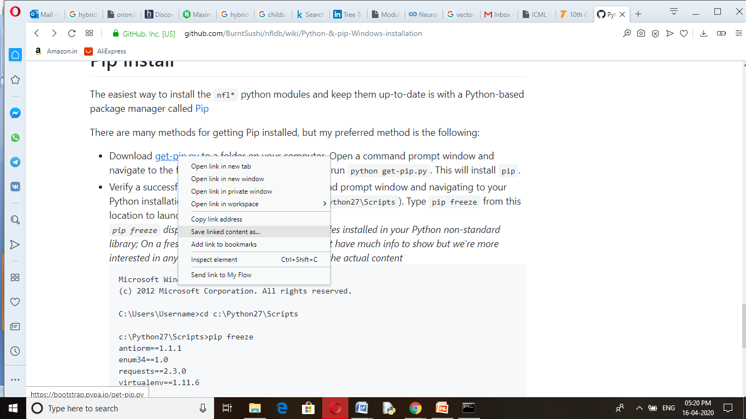

Slide 4
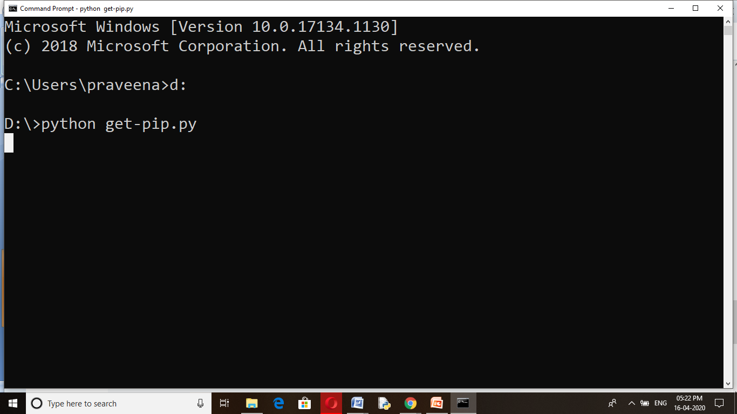

Slide 5
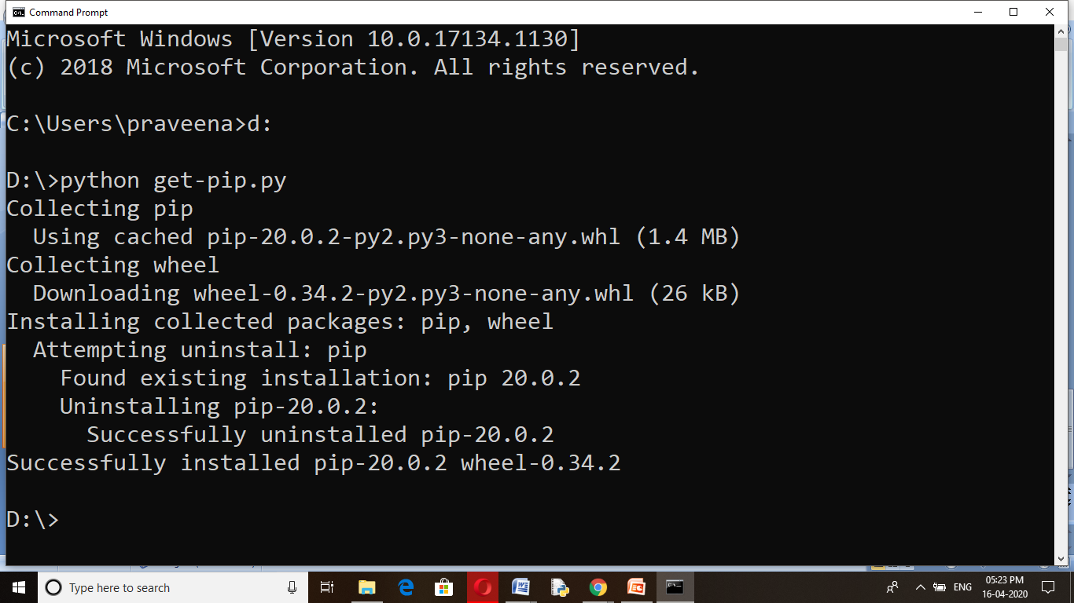

Slide 6
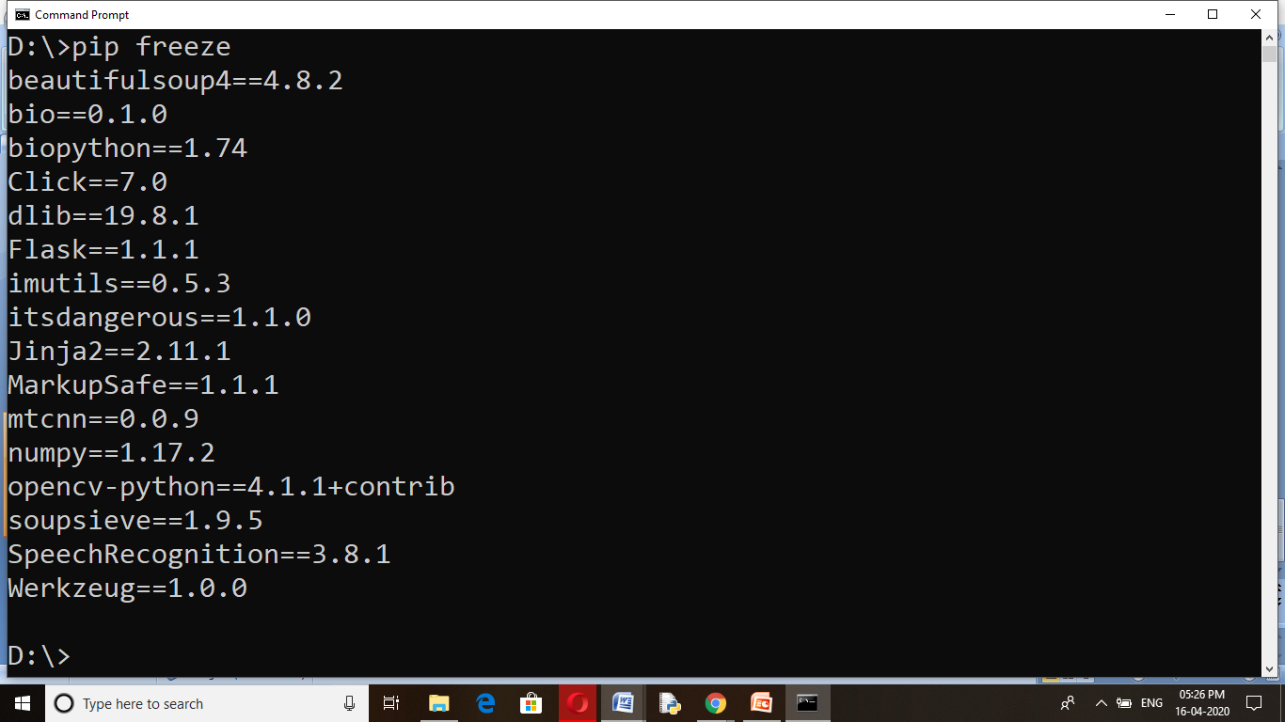

Slide 7
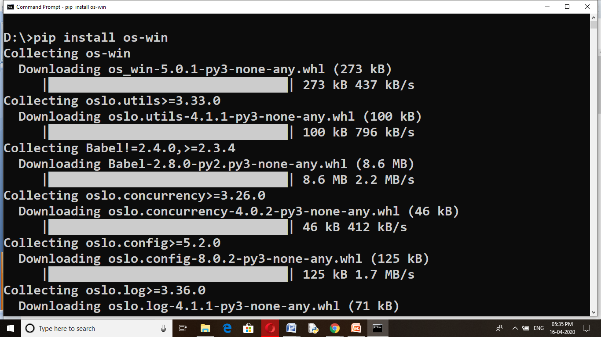
Python - OS Module
The OS module in Python provides functions for creating and removing a directory (folder), fetching its contents, changing and identifying the current directory, etc.

Slide 8
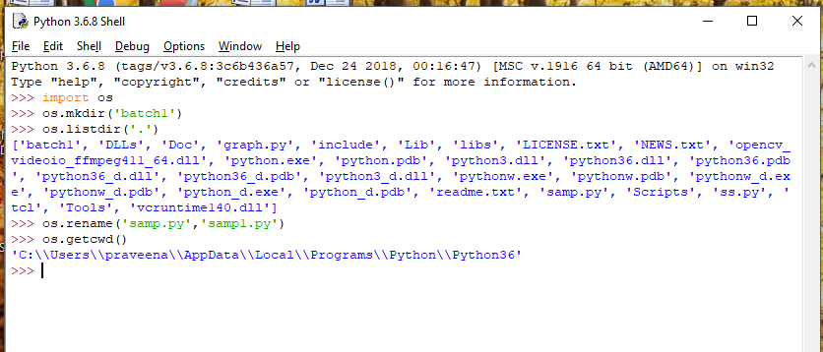
os.getcwd()
os.listdir(dirname)
os.rename(oldfilename,newfilename)
Os.mkdir(dirname)

