Slide 1



Exception Handling in Python

Slide 2

Exception
When writing a program, we, more often than not, will encounter errors.
Error caused by not following the proper structure (syntax) of the language is called syntax error or parsing error
Errors can also occur at runtime and these are called exceptions.
They occur, for example, when a file we try to open does not exist (FileNotFoundError), dividing a number by zero (ZeroDivisionError)
Whenever these type of runtime error occur, Python creates an exception object. If not handled properly, it prints a traceback to that error along with some details about why that error occurred.

Slide 3
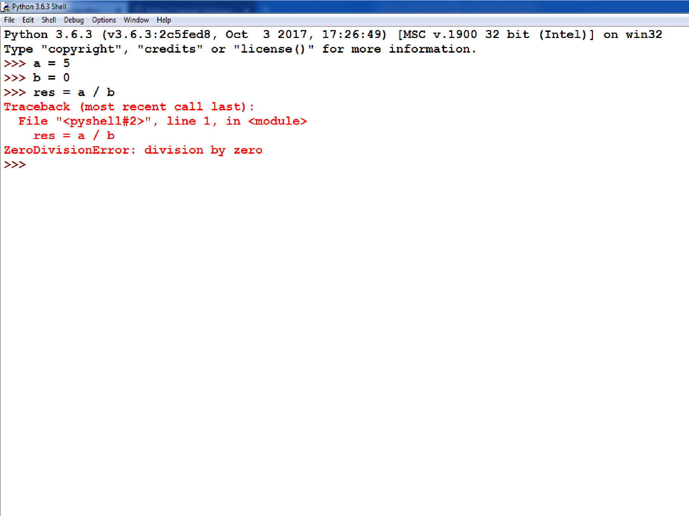

Slide 4

Exception Handling
To handle exceptions, and to call code when an exception occurs, we can use a try/except statement.
The try block contains code that might throw an exception.
If that exception occurs, the code in the try block stops being executed, and the code in the except block is executed.
If no error occurs, the code in the except
block doesn't execute.

Slide 5
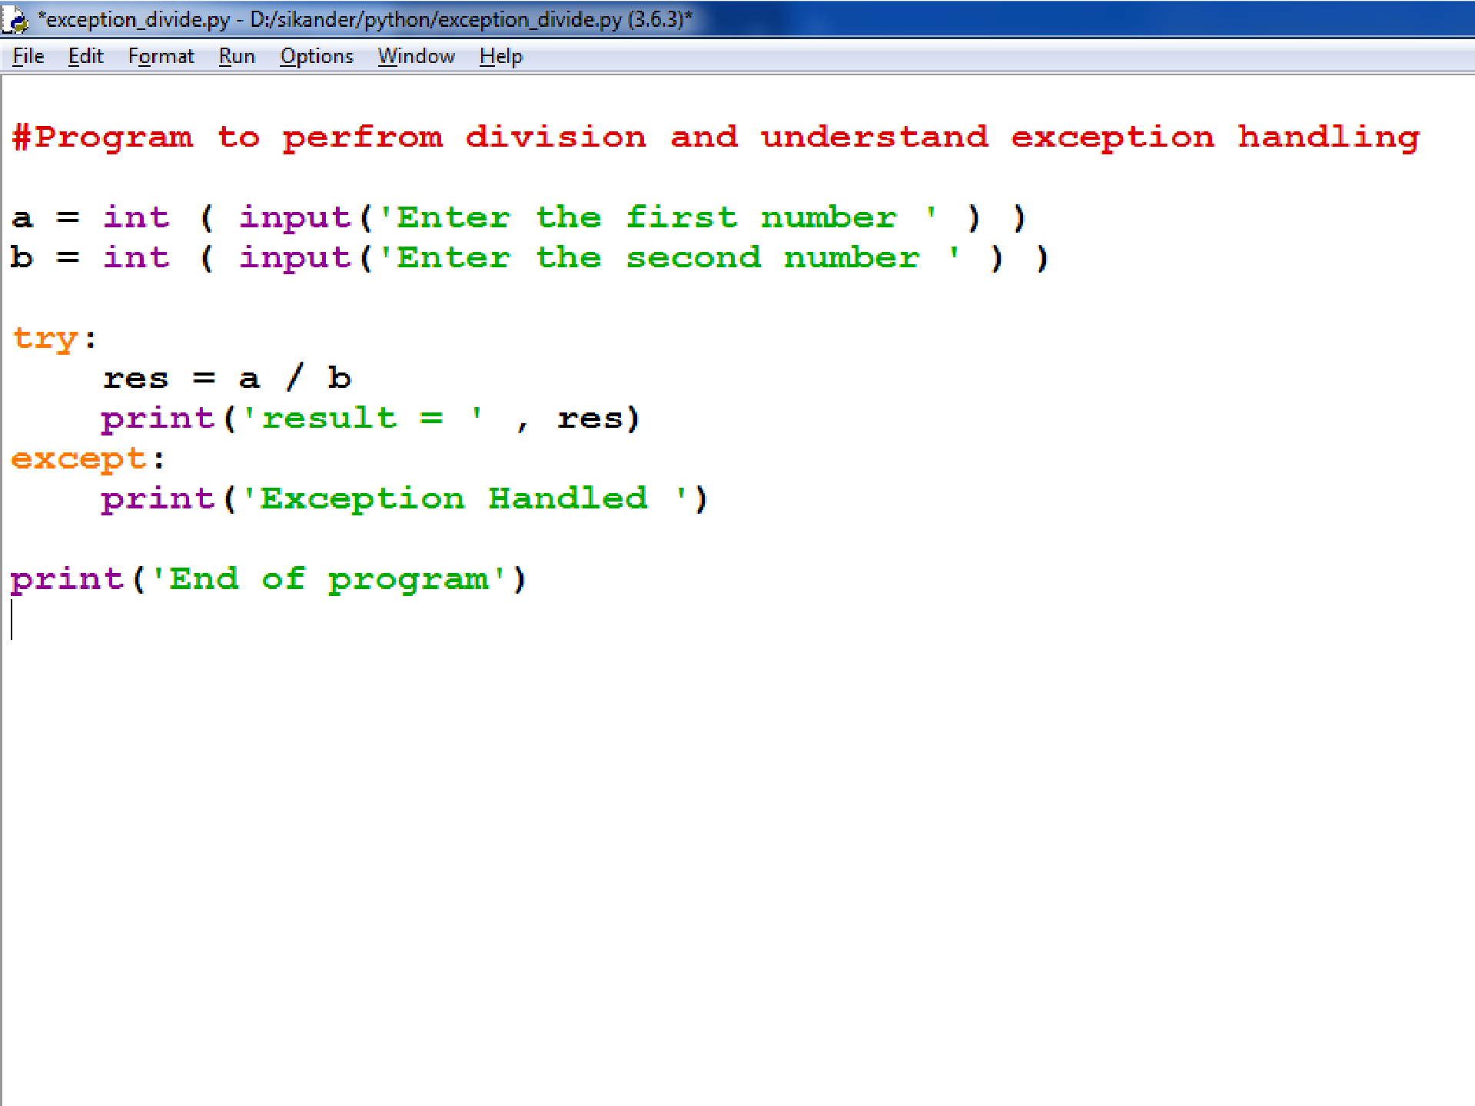

Slide 6

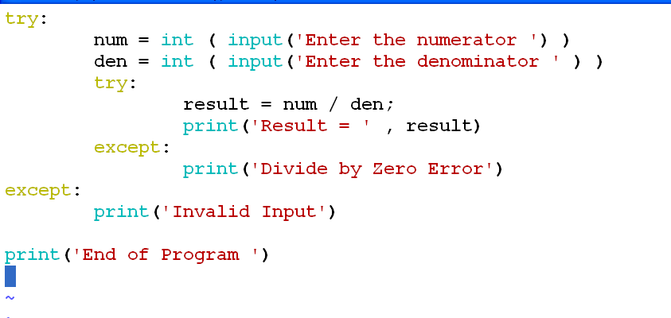
Nested Try Block

Slide 7
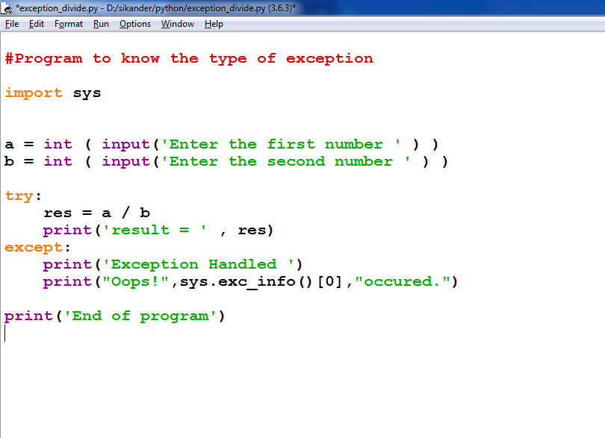

Slide 8
 A try statement can have multiple different except blocks to handle different exceptions.

Slide 9
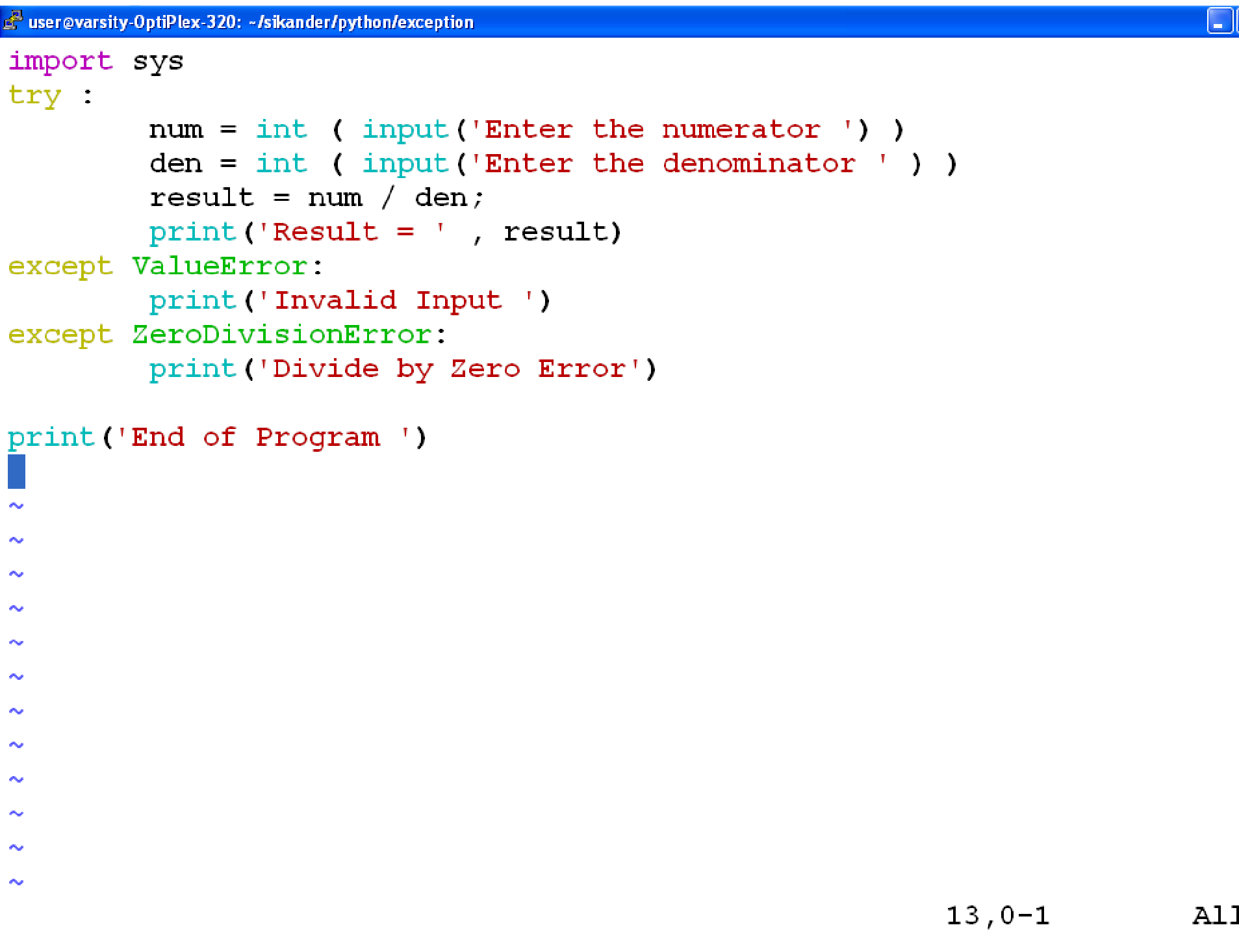

Slide 10
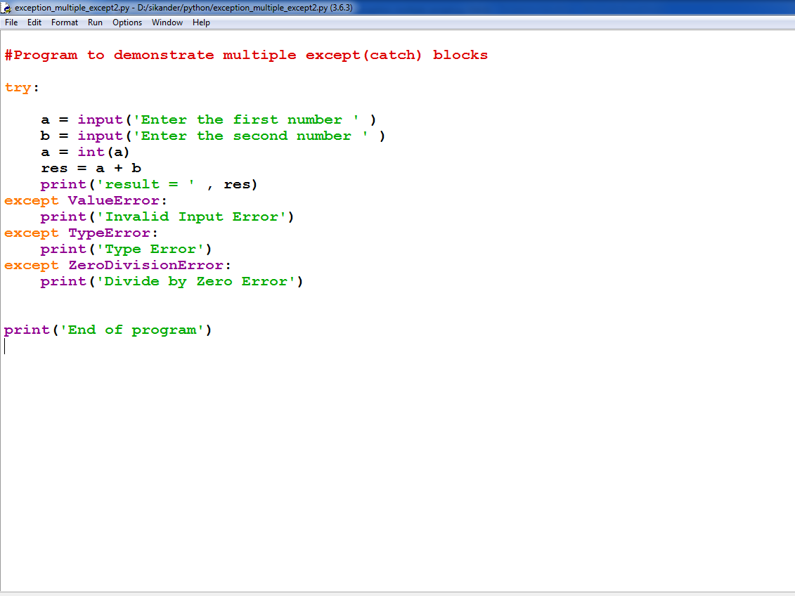
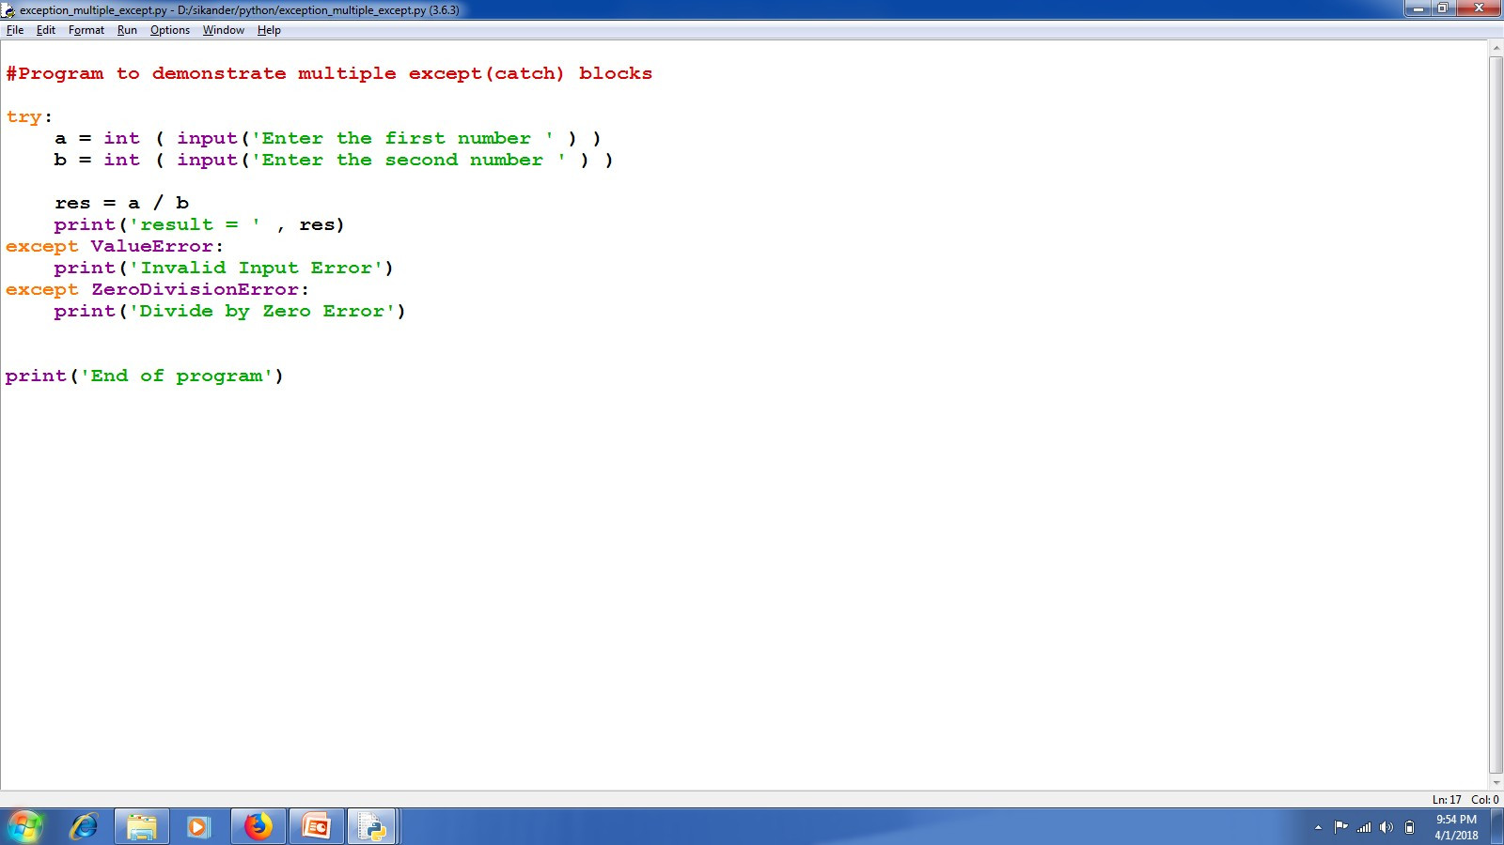

Slide 11
Multiple exceptions can also be put into a single except block using parentheses, to have the except block handle all of them.
MULTIPLE EXCEPTIONS IN ONE EXCEPT BLOCK

Slide 12
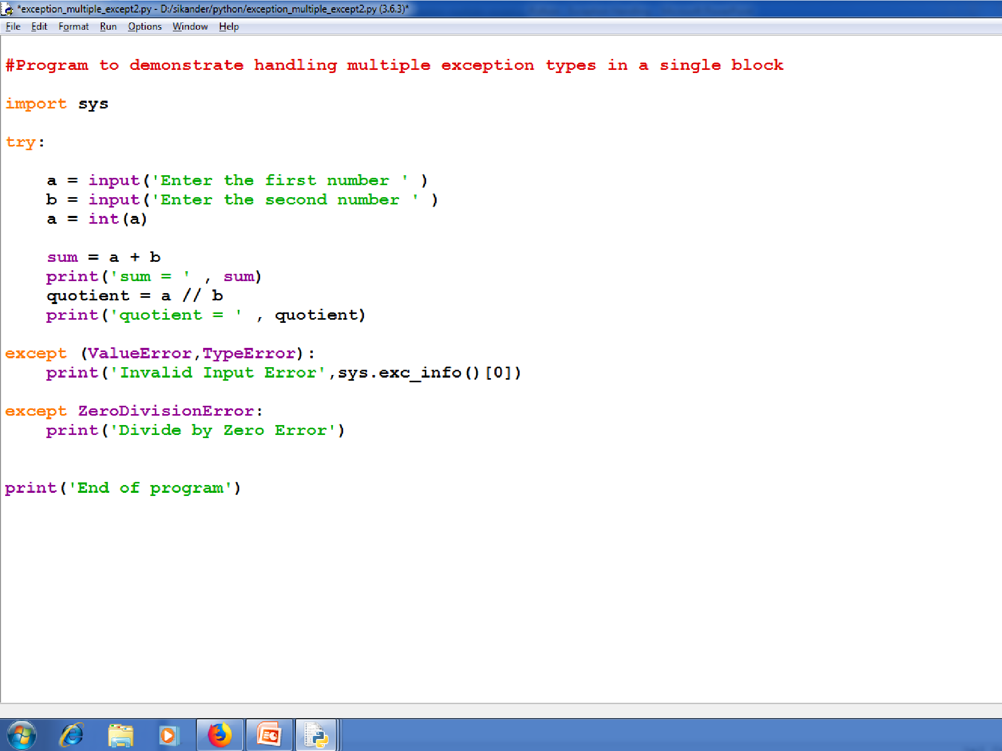

Slide 13
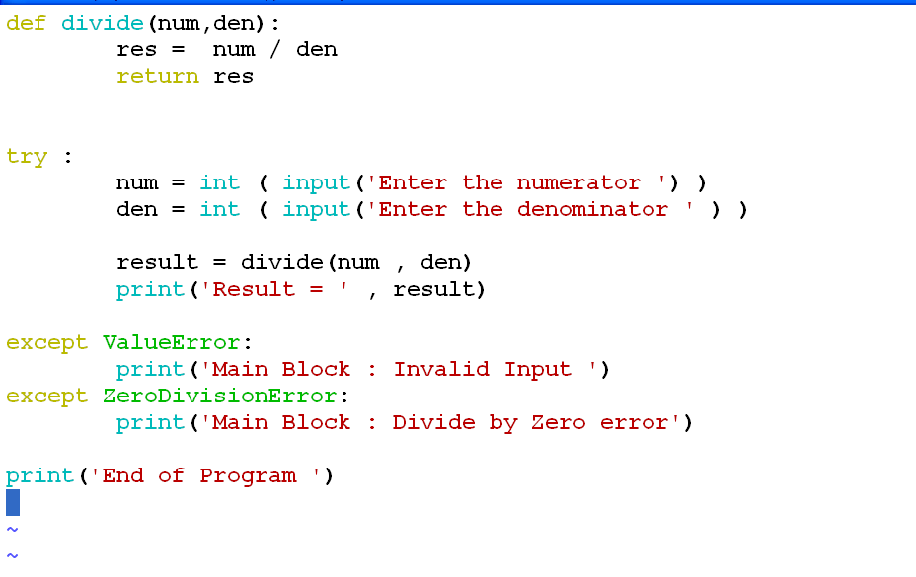

Slide 14

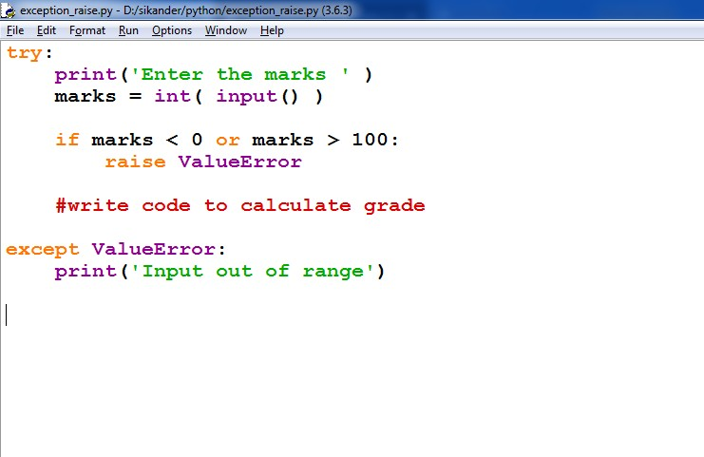
Raising Exceptions

Slide 15
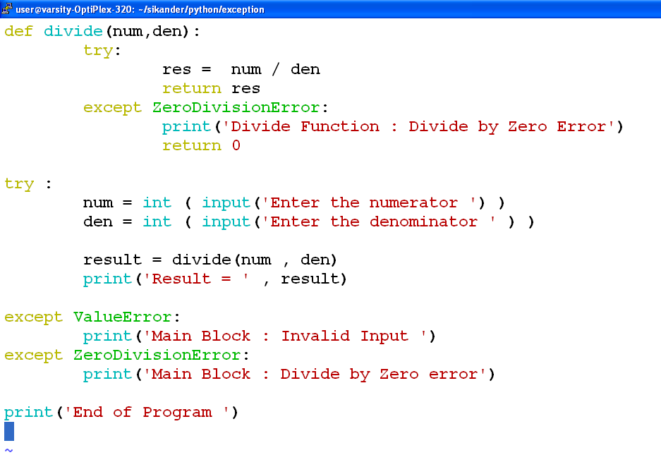

Slide 16

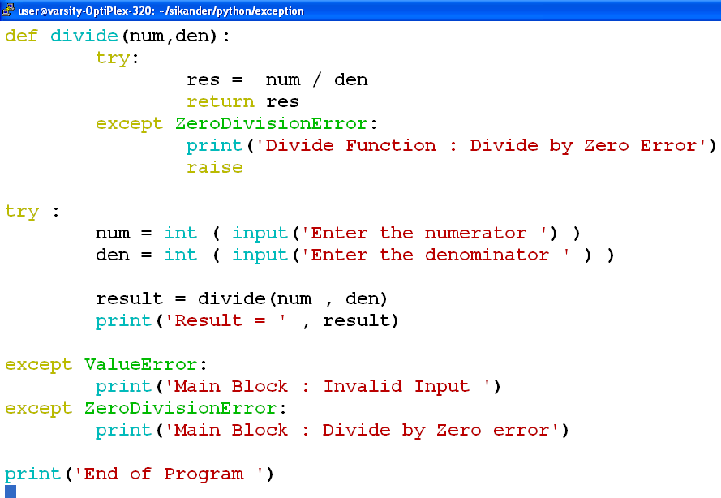
Raising Exception from Except Block

Slide 17

finally
To ensure some code runs no matter what errors occur, you can use a finally statement.
The finally statement is placed at the bottom of a try/except statement.
Code within a finally statement always runs after execution of the code in the try, and possibly in the except, blocks.

Slide 18
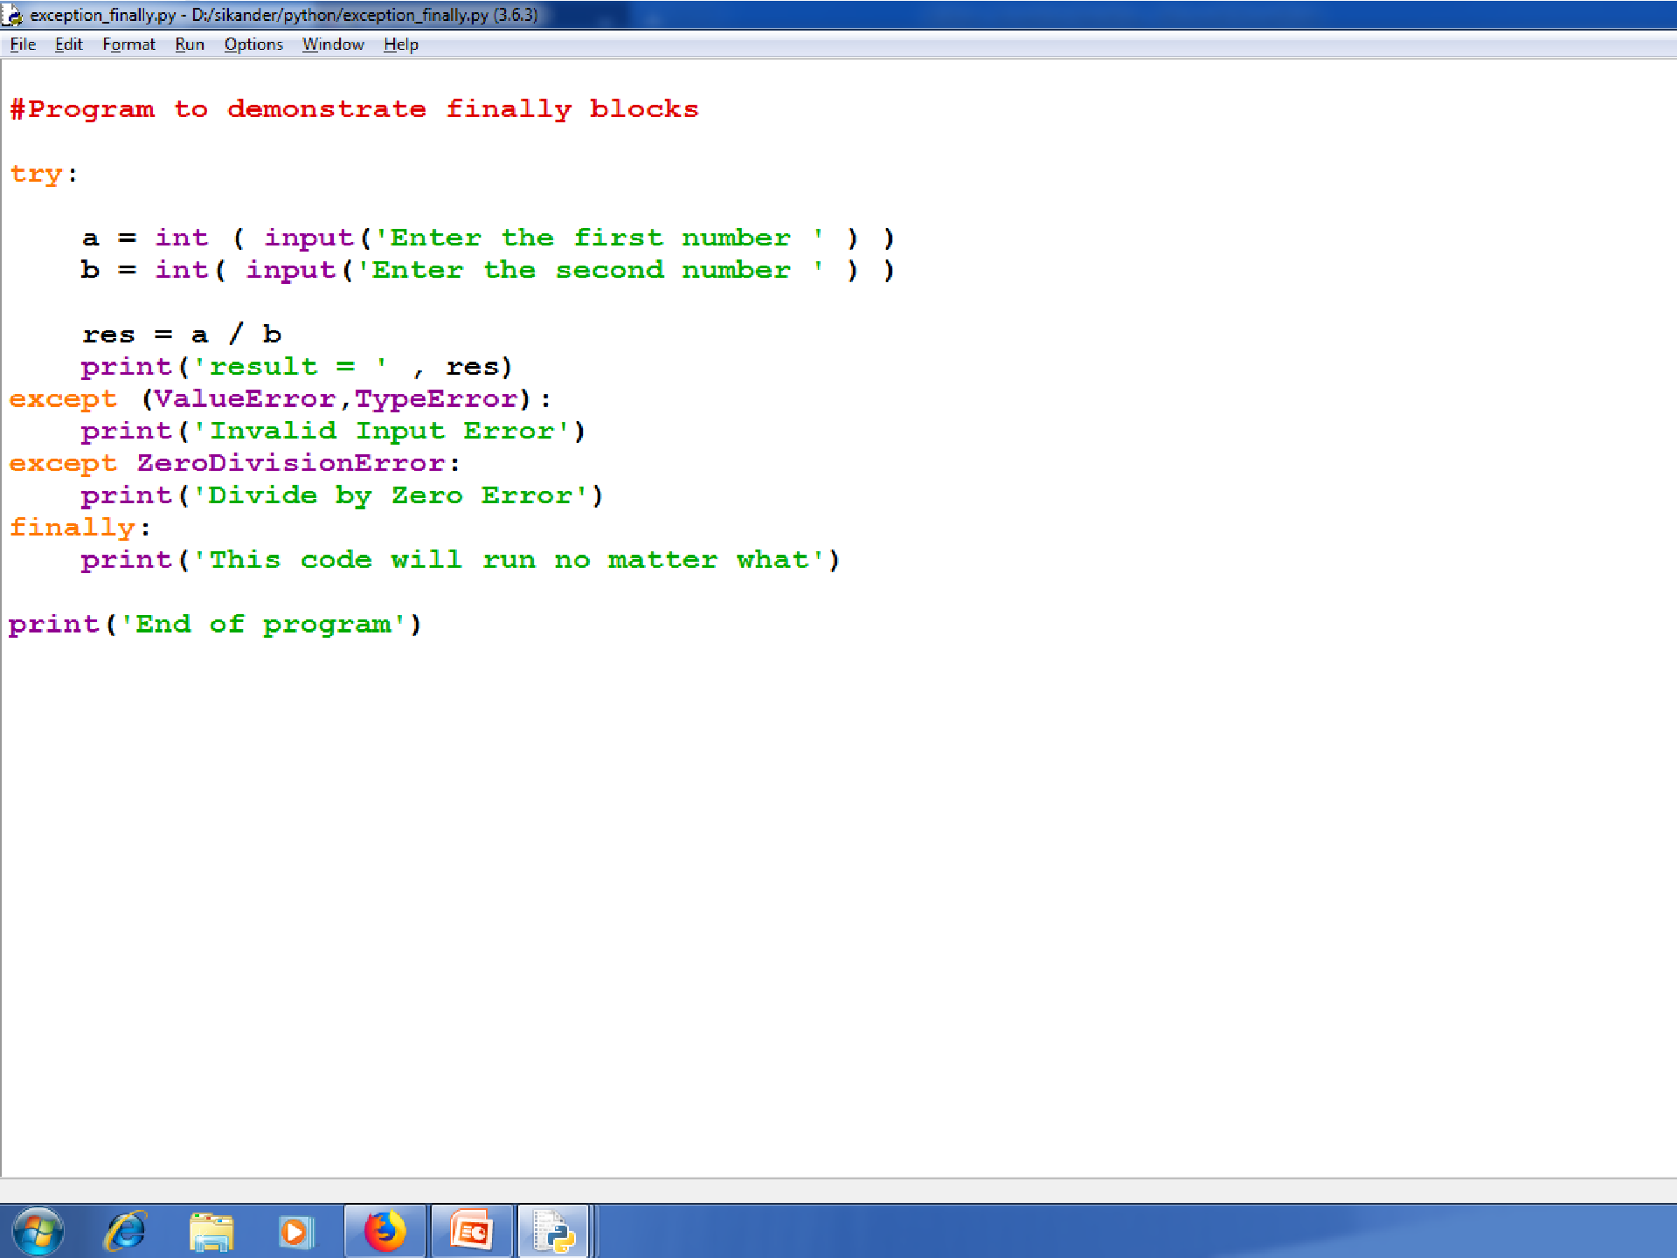

Slide 19
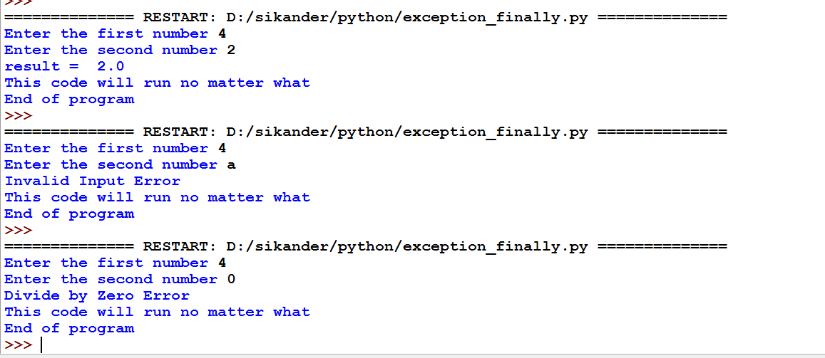

Slide 20
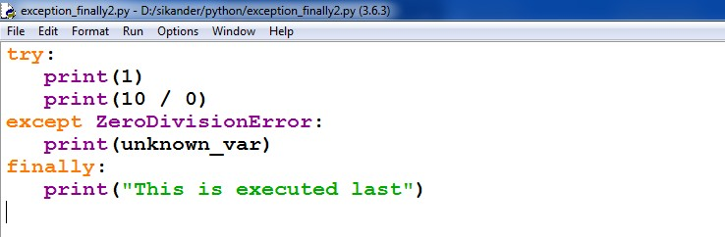
 Code in a finally statement even runs if an uncaught exception occurs in one of the preceding blocks.

Slide 21

Raising Exception
Raising exception is similar to throwing exception in C++/Java.
You can raise exceptions by using the raise statement

Slide 22
User-Defined Exceptions
Like the built-in exceptions of python, the programmer can also create his own exceptions which are called „User-defined exceptions‟ or „Custom exceptions‟.
For example the programmer wants an exception that is raised when the balance amount in a bank account is less than Rs. 2000.00. Since there is no such exception available in python, the programme has to create his/her own exception.

Slide 23
Creating User Defined Exception
User has to create a class for their own exception as a sub class to the in-built “Exception‟ class.
class MyException(Exception):
def init (self, arg):
self.msg = arg
2. When ever the programmer suspects the possibility of exception, he should raise his own exception using “raise‟ statement as:
raise MyException(‘message’)

Slide 24
Creating User Defined Exception
3. The programmer can insert the code inside a “try‟ block and catch the exception using
“except‟ block as:
try:
code
except MyException as me:
print me

Slide 25
Example
class MyException(Exception):
def init (self, arg):
self.msg = arg
def check(dict):
for k,v in dict.items():
print "Name=",k,"Balance=",v
if v<2000.00:
raise MyException("Balance amount is less "+k)
bank={"ravi":5000.00,"ramu":8500.00,"raju":1990.00}
try:
check(bank)
except MyException as me:
print me.msg
OUTPUT:
Name= ramu Balance= 8500.0
Name= ravi Balance= 5000.0
Name= raju Balance= 1990.0
Balance amount is less in the account of raju

Slide 26

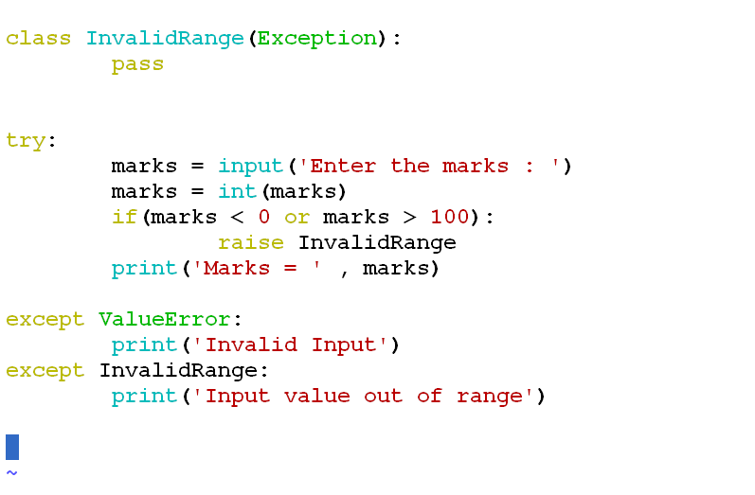
User Defined Exception

Slide 27
