Slide 1
Python Unit Testing

Slide 2
Why Software testing is important?
To point out the defects during the development phases.
To Ensure that the application works as expected.

Slide 3
Software testing is very important because of the following reasons:
Testing is really required to point out the defects and errors that were made during the development phases.
Testing is essential since it makes sure of the customer‟s reliability and their satisfaction in the application.
Testing is very important to ensure the quality of the product. Quality product delivered to the customers helps in gaining their confidence.
Testing is necessary in order to provide the facilities to the customers.
Testing is required for an effective performance of software application or product.
Testing is important to ensure that the application should not result into any failures because it can be very expensive in the future or in the later stages of the development.
Testing is required to stay in the business.

Slide 4
Unit testing in Python
Unit testing is nothing but testing individual „units‟, or functions of a program. It does not have a lot to say about system integration, whether the various parts of a program fit together.
The goals of unit testing framework are:
1. To make it easy to write tests. All a „test‟ needs to do is to say that, for this input, the function should give that result. The framework takes care of running the tests.
2. To make it easy to run tests. Usually this is done by clicking a single button or typing a single keystroke (F5 in IDLE). Ideally, you should be comfortable running tests after every change in the program, however minor.
3. To make it easy to tell if the tests passed. The framework takes care of reporting results; it either simply indicates that all tests passed, or it provides a detailed list of failures.

Slide 5
Test Methods
Method | Checks that
assertEqual(a, b) | a == b
assertNotEqual(a, b) | a != b
assertTrue(x) | bool(x) is True
assertFalse(x) | bool(x) is False
assertIs(a, b) | a is b
assertIsNot(a, b) | a is not b
assertIsNone(x) | x is None
assertIsNotNone(x) | x is not None
assertIn(a, b) | a in b
assertNotIn(a, b) | a not in b
assertIsInstance(a, b) | isinstance(a, b)
assertNotIsInstance(a, b) | not isinstance(a, b)

Slide 6
Test Driven Development.
The process of implementing code by writing your tests first, seeing them fail, then writing the code to make the tests pass.
Write Tests
Make Them fail
Write code.
Make them pass
Repeat

Slide 7
Python Unit test
Some Important Points
Every test class must be sub class of unittest.TestCase
Every test function should start with test name.
to check for an expected result use assert functions.
The setUp() method define instructions that will be executed before test case.
The tearDown() method define instructions that will be executed after test
case.
Run Test with python -m unittest -v test_module
Only test single part of code

Slide 8
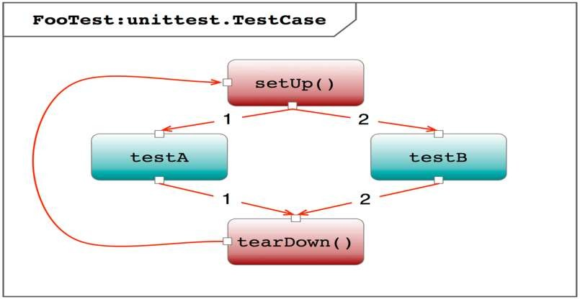

Slide 9
Let’s start
# tests/mul.py
def multiply(a, b):
return a*b
def add(a, b): return a+b

Slide 10
Test case
import unittest
from mul import multiply
class MultiplyTestCase(unittest.TestCase):
def test_multiplication_with_correct_values(self): self.assertEqual(multiply(5, 5), 25)
if name == ' main ':
unittest.main()

Slide 11
SetUp() and TearDown()
class MulTestCase(unittest.TestCase):
def setUp(self):
self.a = 10
self.b = 20
# Runs before every test method
def test_mult_with_correct_values(self):
self.assertEqual(multiply(self.a, self.b), 200) def tearDown(self): # runs after every test method
del self.a del self.b
if name == ' main ':
unittest.main()

Slide 12
Example
Example: Unittest for addition of two numbers.
import unittest
def add(a,b):
if isinstance(a,int) and isinstance(b,int):
return a+b
elif isinstance(a,str) and isinstance(b,str):
return int(a)+int(b)
else:
raise Exception('Invalid arguments')
class TestAdd(unittest.TestCase):
def test_add(self):
self.assertEqual(5,add(2,3))
self.assertEqual(15,add(-6,21))
self.assertRaises(Exception,add,4.0,5.0)
unittest.main()
Output:
.Ran 1 test in 0.008s
OK

