Slide 1
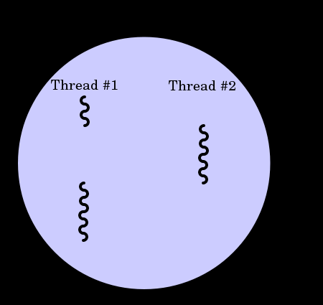
Multithreading
What are threads?
A thread is a light-weight process
A thread of execution is the smallest sequence of programmed instructions that can be managed independently by an operating
●
system scheduler
process
Time
A process with two threads of execution on a single processor.
●
for example copying a file and showing the progress, or playing a music while showing some pictures as a slideshow, or a listener handles cancel event for aborting a file copy operation

Slide 2
Multithreading generally occurs by time- division multiplexing. The processor switches between different threads
●
●
●
On a multiprocessor or multi-core system, threads can be truly concurrent, with every processor or core executing a separate thread simultaneously.
Many modern operating systems directly support both time-sliced and multiprocessor threading with a process scheduler.
The scheduler is an operating system module that selects the next jobs to be admitted into the system and the next process to run.
The kernel of an operating system allows programmers to manipulate threads via the system call interface
Multi-threading is a widespread programming and execution model that allows multiple threads to exist within the context of a single process
●
●
●
●

Slide 3
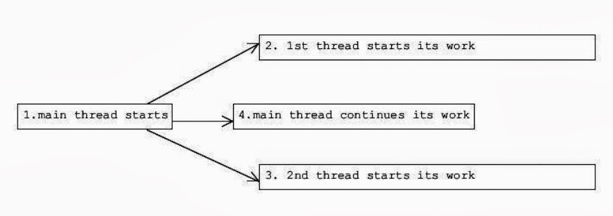
The following diagram shows how the application does that.

Slide 4
Python Threading:
●
A thread has a beginning, an execution sequence, and a conclusion. It has an instruction pointer that keeps track of where within its context it is currently running.
it can be pre-empted (interrupted)
It can temporarily be put on hold (also known as sleeping) while other threads are running this is called yielding.
●
●
Starting a New Thread:
To spawn another thread, you need to call following method available in thread module:
_thread.start_new_thread ( function, args[, kwargs] )
●
The method call returns immediately and the child thread starts and calls function with the passed list of args. When function returns, the thread terminates.
●
Here, args is a tuple of arguments; use an empty tuple to call function without passing any arguments. kwargs is an optional dictionary of keyword arguments.

Slide 5
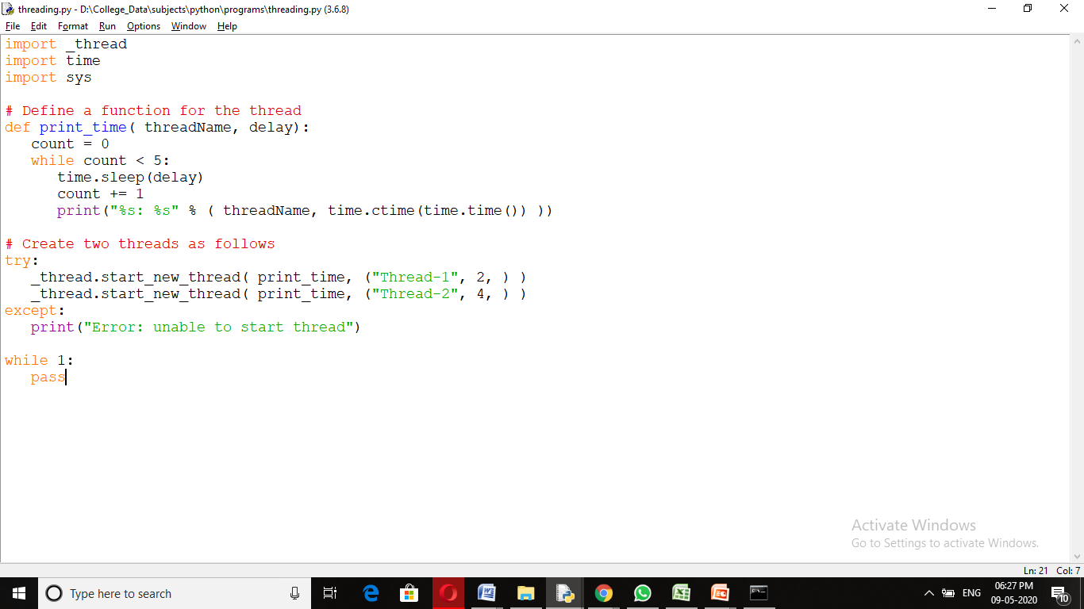

Slide 6
When the above code is executed, it produces the following result:
Thread-1: Tue Sep | 3 10:10:38 2013
Thread-2: Tue Sep | 3 10:10:40 2013
Thread-1: Tue Sep | 3 10:10:40 2013
Thread-1: Tue Sep | 3 10:10:42 2013
Thread-1: Tue Sep | 3 10:10:44 2013
Thread-2: Tue Sep | 3 10:10:44 2013
Thread-1: Tue Sep | 3 10:10:46 2013
Thread-2: Tue Sep | 3 10:10:48 2013
Thread-2: Tue Sep | 3 10:10:52 2013
Thread-2: Tue Sep | 3 10:10:56 2013

Slide 7
Threading Module
●
The newer threading module included with Python 2.4 provides much more powerful, high-level support for threads than the thread module discussed in the previous section.
The threading module exposes all the methods of the thread module and provides some additional methods:
●
threading.activeCount(): Returns the number of thread objects that are active.
threading.currentThread(): Returns the number of thread objects in the caller's thread control.
threading.enumerate(): Returns a list of all thread objects that are currently active.

Slide 8
In addition to the methods, the threading module has the Thread class that implements threading.
The methods provided by the Thread class are as follows: run(): The run() method is the entry point for a thread.
start(): The start() method starts a thread by calling the run method.
join([time]): The join() waits for threads to terminate.
isAlive(): The isAlive() method checks whether a thread is still executing. getName(): The getName() method returns the name of a thread. setName(): The setName() method sets the name of a thread.

Slide 9
Creating Thread using Threading Module:
To implement a new thread using the threading module, you have to do the following:
Define a new subclass of the Thread class.
Override the init (self [,args]) method to add additional arguments.
Then, override the run(self [,args]) method to implement what the thread should do when started.
●
●
●
●
Once you have created the new Thread subclass, you can create an instance of it and then start a new thread by invoking the start(), which will in turn call run() method.

Slide 10
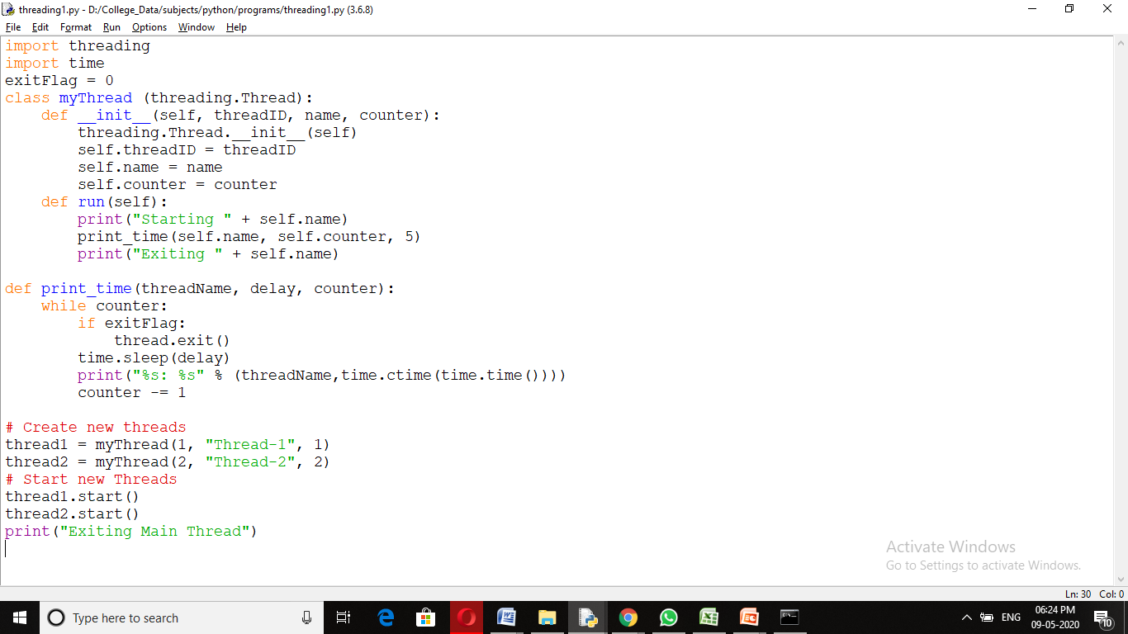

Slide 11
When the above code is executed, it produces the following result:
Starting Thread-1 Starting Thread-2 Exiting Main Thread
Thread-1: Thu Mar | 21 | 09:10:03 | 2013
Thread-1: Thu Mar | 21 | 09:10:04 | 2013
Thread-2: Thu Mar | 21 | 09:10:04 | 2013
Thread-1: Thu Mar | 21 | 09:10:05 | 2013
Thread-1: Thu Mar | 21 | 09:10:06 | 2013
Thread-2: Thu Mar | 21 | 09:10:06 | 2013
Thread-1: Thu Mar | 21 | 09:10:07 | 2013
Exiting Thread-1
Thread-2: Thu Mar | 21 | 09:10:08 | 2013
Thread-2: Thu Mar | 21 | 09:10:10 | 2013
Thread-2: Thu Mar | 21 | 09:10:12 | 2013
Exiting Thread-2

Slide 12
Synchronizing Threads:
●
The threading module provided with Python includes a simple-to- implement locking mechanism that will allow you to synchronize threads
●
A new lock is created by calling the Lock() method, which returns the new lock.
The acquire(blocking) method of the new lock object would be used to force threads to run synchronously
The optional blocking parameter enables you to control whether the thread will wait to acquire the lock.
If blocking is set to 0, the thread will return immediately with a 0 value if the lock cannot be acquired and with a 1 if the lock was acquired. If blocking is set to 1, the thread will block and wait for the lock to be released.
The release() method of the the new lock object would be used to release the lock when it is no longer required.
●
●
●
●

Slide 13
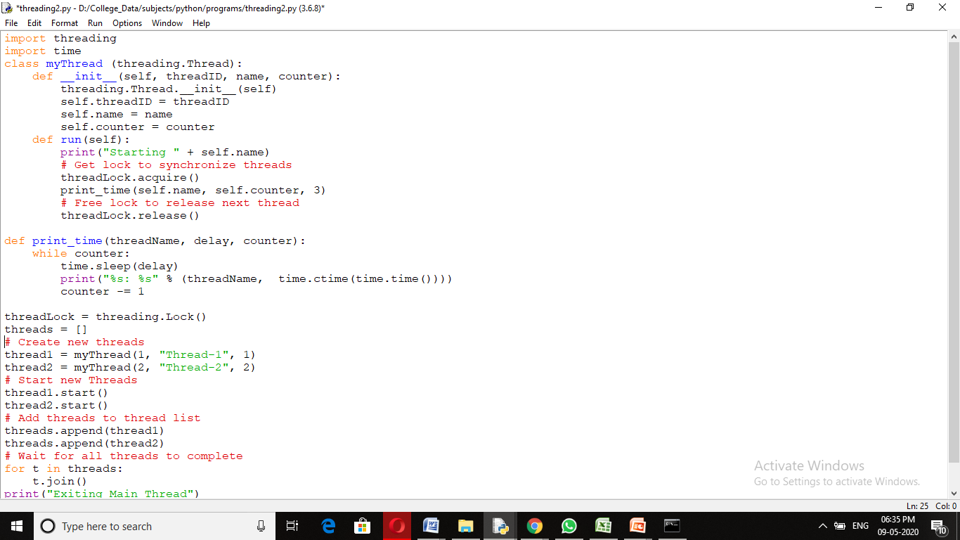

Slide 14
When the above code is executed, it produces the following result:
Starting Thread-1 Starting Thread-2
Thread-1: Thu Mar | 21 09:11:28 2013
Thread-1: Thu Mar | 21 09:11:29 2013
Thread-1: Thu Mar | 21 09:11:30 2013
Thread-2: Thu Mar | 21 09:11:32 2013
Thread-2: Thu Mar | 21 09:11:34 2013
Thread-2: Thu Mar | 21 09:11:36 2013
Exiting Main Thread

