Slide 1
Deep Reinforcement Learning Framework for
2D Structural Topology Optimization
BTP Progress Update: Verification of Stages 1–3 & Stage 4 Research Roadmap
Student: Praveen Kumar | Department of Mechanical Engineering, IIT Kharagpur
Supervisor: Prof. Asur Vijaya Kumar

Slide 2
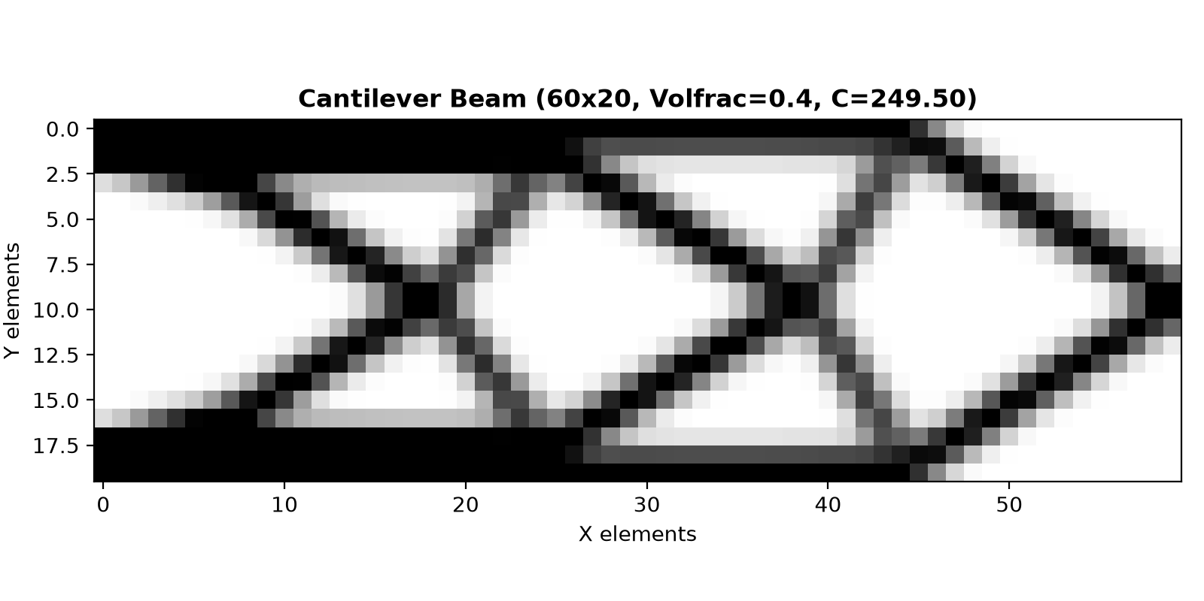
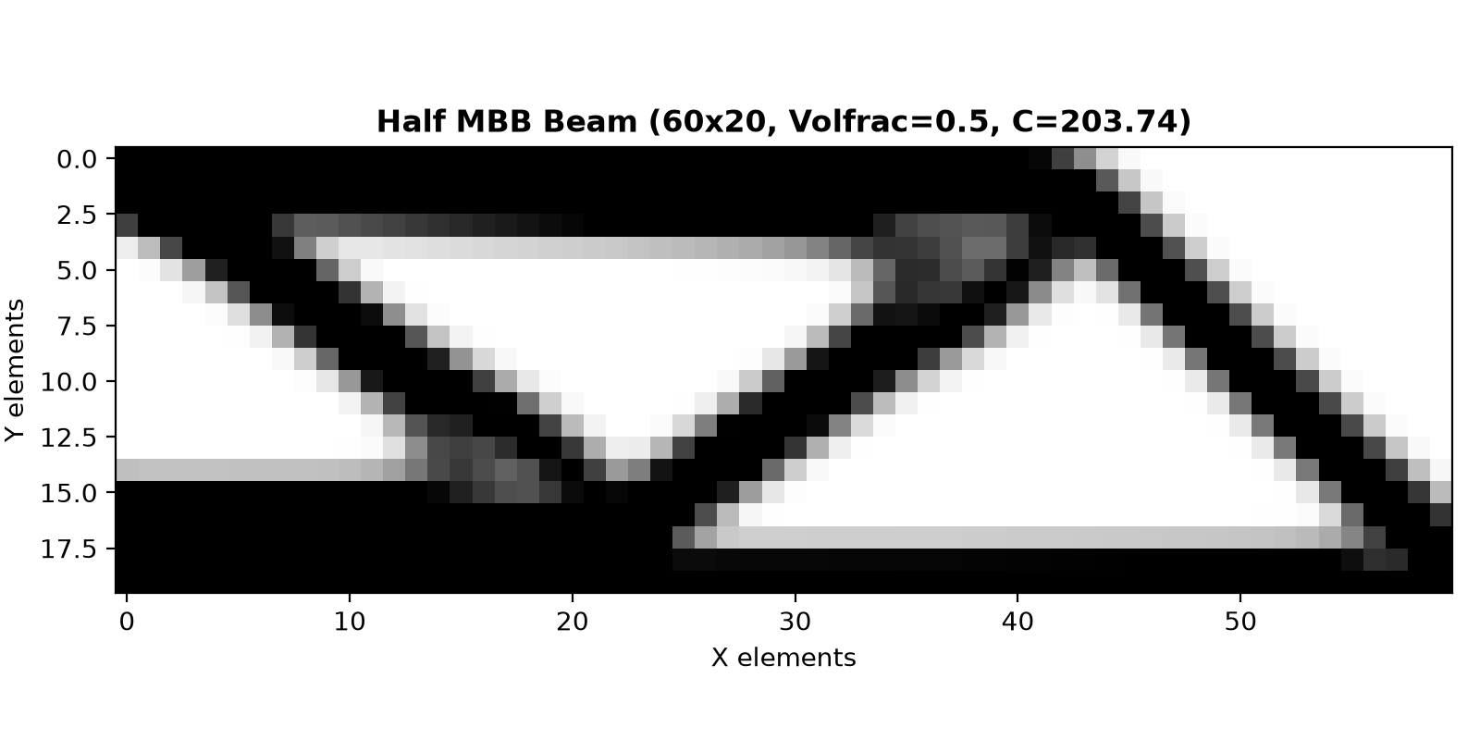
Stage 1: Classical SIMP Baseline & FEA Physics Validation [PASSED]
Core Mechanics Verified:
• Minimum compliance C = U^T K U subject to V <= V* and K U = F.
• SIMP Penalization: E(x) = Emin + x^p (E0 - Emin) with p = 3, Emin = 1e-9.
• Spatial Filtering: Density & sensitivity filters with rmin = 1.5 elements.
FEA Physics Engine Audited (src/fem/):
• Element stiffness k0: Route 1 (analytical) == Route 2 (2x2 Gauss quad) to < 1.11e-16.
• Zero strain energy for all 3 rigid-body modes (u_rigid^T k0 u_rigid < 1e-10).
• Energy balance exact: U^T K U == F^T U (relative error < 5.4e-11).
• 41 automated pytest unit tests passing across all FEM and SIMP modules.

Slide 3
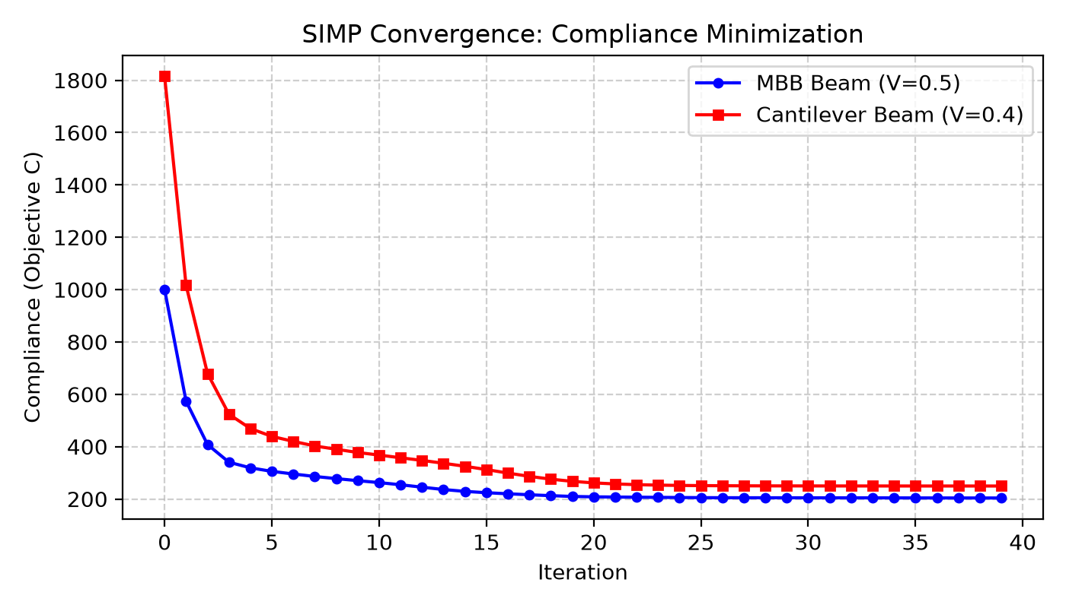
Reference Ground Truth: baselines.csv (Audited with Emin=1e-9)
Gate 1 Cleared: True Convergence & Mesh Independence
True mathematical convergence (tol=0.005) with fresh FEA solves:
• Cantilever (30x10, V=0.4): C = 399.38 | 95 iters | Gray: 66.7%
• Cantilever (60x20, V=0.4): C = 247.80 | 250 iters| Gray: 33.5%
• Half-MBB (30x10, V=0.5): C = 225.67 | 113 iters| Gray: 39.7%
• Half-MBB (60x20, V=0.5): C = 203.17 | 164 iters| Gray: 21.0%
Note on 30x10: Higher grayness (66.7%) is natural on coarse meshes
under rmin=1.5 and serves as an honest reference for RL comparison.
Refining to 60x20 sharpens solid-void boundaries (grayness drops to 33.5%).

Slide 4
Stage 2: MDP Formalization [READY FOR SUPERVISOR SIGN-OFF]
State Space S_t (4-Channel 2D Tensor):
• Channel 0: Physical Density Map x_phys in [xmin, 1.0]
• Channel 1: Normalized Strain Energy Density w_e = 0.5 * u_e^T * k0 * u_e
• Channels 2 & 3: Load location mask M_F and Support constraint mask M_U
Action Space A_t (Bounded Continuous Delta):
• Policy outputs a_t in [-1.0, 1.0], scaled inside env by delta_max = 0.05.
• Density filtering on state prevents checkerboards and ensures feature scale.
Hard Volume Constraint Enforcement (Exact Bisection Shift):
• Bisection shift s ensures mean(clip(x + s, xmin, 1.0)) == volfrac to < 1e-6 error.
Reward Function R_t (C0-Normalized, Safety Clipped):
• r_t = (C_t-1 - C_t) / C0 - lambda_v * |V_t - V*|, safety clipped to [-2.0, 2.0].
• Relative compliance gain is unscaled (no 100x multiplier), so normal gradients are never clipped.
• Fixed-horizon truncation ONLY at T_max = 30 steps (eliminates early stopping loopholes).

Slide 5
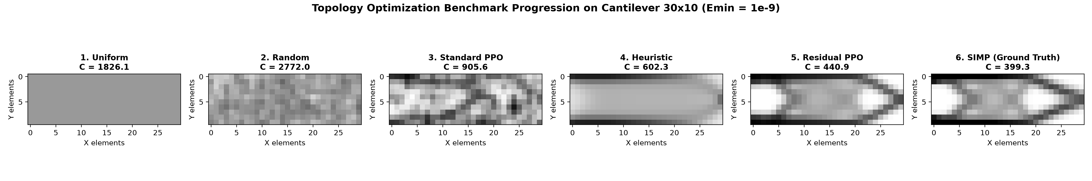
Stage 3: Sanity Baselines & Prototype PPO Benchmark [PARTIAL]
Regenerated Benchmark Hierarchy (Cantilever 30x10, Emin=1e-9):
• Uniform Baseline : C = 1826.10 (budget: 1)
• Random Agent (3 seeds) : C = 2391.79 ± 297.46 (budget: 30)
• Standard PPO Agent (Gate 3) : C = 994.30 ± 85.81 (budget: 30)
• Canonical Sensitivity Heuristic : C = 602.26 (budget: 30)
• Residual PPO Agent (Stage 4) : C = 441.88 ± 1.01 (budget: 30)
• Classical SIMP @ 20 iters : C = 427.08 (budget: 20)
• Classical SIMP @ 30 iters : C = 415.65 (budget: 30)
• Converged Classical SIMP : C = 399.27 (budget: 95)
Honest Gate 3 Assessment:
• Gate 3 Baseline Analysis:
Standard PPO learns (C=994.30 ± 85.81 vs 1826 uniform and 2391 random), but raw policy steps cannot match the heuristic (C=602.26).
• Stage 4 Residual Breakthrough:
Residual PPO achieves C = 441.88 ± 1.01 across 3 trained seeds, beating the heuristic by 27% and closing to within 6.3% of SIMP@30 (C=415.65).
• Fair Equal-Budget Comparison:
At exactly 30 FEA evaluations, the gap between RL and Classical SIMP shrinks from 139% (standard PPO) down to just 6.3% (residual PPO).

Slide 6
Stage 4: Residual Policy Verification & Stage 5 Roadmap [GATE 4 PASSED]
1. Heuristic Residual Policy Results (3 Trained Seeds, 30k Steps):
• Action formulation: a_t = clip(a_t^adjoint + alpha * Delta a_t, -1.0, 1.0) with alpha = 0.2.
• Seed 42: C = 443.28 | Seed 43: C = 440.91 | Seed 44: C = 441.44 ==> Mean: 441.88 ± 1.01.
• Zero residual drift confirmed: policy smoothly co-adapts diagonal struts without destabilizing.
2. Gate 4 Criterion Evaluation:
• Gate 4 Condition: Final compliance within a small gap of SIMP on a fixed case.
• Verdict: PASSED. RL compliance (441.88) is within 6.3% of SIMP@30 (415.65) and 10.6% of converged SIMP (399.27).
3. Stage 5 Roadmap (Generalization Across Unseen Loads):
• Generalize across continuous point load positions along the right boundary y in [0, Ly].
• Adjoint sensitivity guidance provides a universal physics prior, enabling zero-shot and few-step transfer.
4. Key Discussion Points for Supervisor (Prof. Asur):
• Formal sign-off on Stage 2 MDP Specification document.
• Validation of Stage 4 Residual formulation as the primary vehicle for Stage 5 multi-load generalization.
• Multi-seed GPU benchmarking plan on fine meshes (60x20 and 120x40).

