Slide 1

PROJECT PRESENTATION
Event Management
Mobile Application
✓
for Attendee Self-Service
QR
A digital platform for event discovery, booking,
QR ticketing, check-in, schedules and engagement.
DIGITAL TICKET
REVIEW - 1
TEAM MEMBERS
P. Srija — 2520090053
P. Praveena — 2520090057
D. Varun Teja Reddy — 2520090221
DBMS
2026

Slide 2
02
Abstract
A concise overview of the proposed solution
PROJECT ABSTRACT
The Event Management Mobile Application for Attendee Self-Service is a web-based application designed to simplify and digitize the event participation process. Traditional event management often involves manual registration, paper tickets, long queues, and difficulty accessing event-related information. This application addresses these challenges by providing attendees with a single platform to independently manage their event activities.
The system allows users to register for events, browse event details, book tickets, access digital QR-based tickets, check in, view schedules, receive announcements, and provide feedback. An admin module enables organizers to create and manage events, monitor registrations, manage attendees, verify QR-based check-ins, and view event-related information.
The proposed system reduces manual effort, minimizes paperwork, improves check-in efficiency, and provides a convenient self-service experience for attendees.
EVENT MANAGEMENT • ATTENDEE SELF-SERVICE

Slide 3
03
Introduction
Making event participation simple, digital and self-service
THE IDEA
ATTENDEE JOURNEY
One platform for the complete attendee journey.
1
DISCOVER
✓
Discover and search upcoming events
2
BOOK
✓
Register and book tickets online
3
CHECK-IN
✓
Access a digital ticket with QR code
✓
View schedules, venues and announcements
4
ENGAGE
✓
Give feedback after attending
EVENT MANAGEMENT • ATTENDEE SELF-SERVICE

Slide 4
04
Problem Statement & Objectives
The challenge and what the project aims to achieve
PROBLEM STATEMENT
OBJECTIVES
!
Manual registration and data entry
✓
Simplify registration and booking
✓
Enable attendee self-service
!
Long queues during event entry
✓
Speed up QR-based check-in
!
Paper tickets and manual verification
✓
Improve digital communication
!
Scattered schedules and announcements
✓
Support organizer management
✓
Improve overall attendee experience
EVENT MANAGEMENT • ATTENDEE SELF-SERVICE

Slide 5
05
Key Features
Core functionality for attendees and organizers
ATTENDEE FEATURES
ADMIN / ORGANIZER FEATURES
✓
Login & registration
✓
Event discovery & search
✓
Create & manage events
✓
Manage attendees
✓
Ticket booking
✓
Digital QR ticket
✓
Booking overview
✓
QR check-in verification
✓
Schedule & venue details
✓
Notifications & announcements
✓
Schedule management
✓
Announcements
✓
Booking history
✓
Feedback & ratings
✓
Feedback monitoring
✓
Dashboard analytics
EVENT MANAGEMENT • ATTENDEE SELF-SERVICE

Slide 6
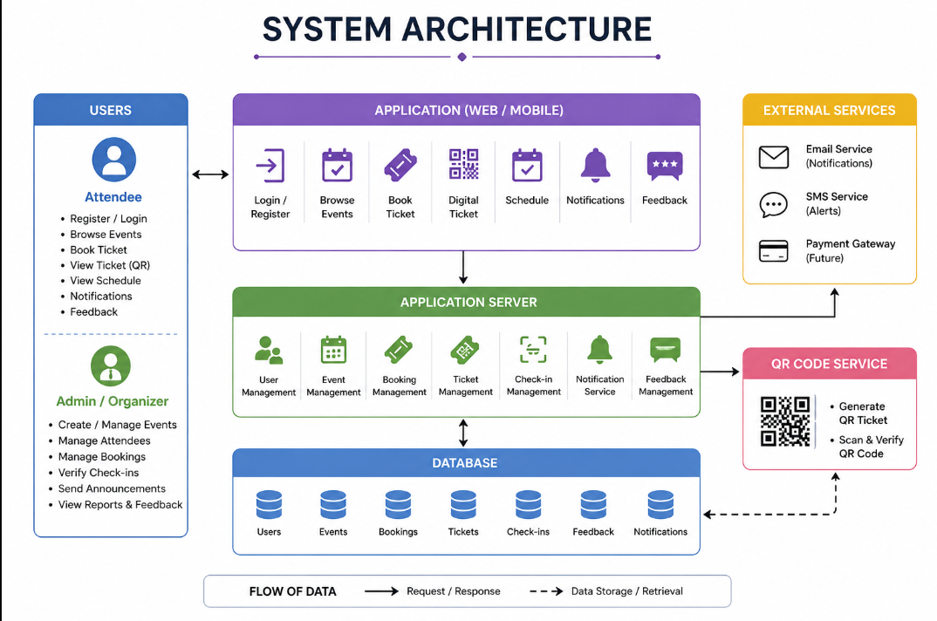
EVENT MANAGEMENT • SYSTEM ARCHITECTURE

Slide 7
07
Application Workflow
End-to-end attendee journey
1
Register / Login
2
Browse Events
3
View Details
4
Book Ticket
Self-service step
Self-service step
Self-service step
Self-service step
5
Get QR Ticket
6
Check In
7
Attend Event
8
Give Feedback
Self-service step
Self-service step
Self-service step
Self-service step
DISCOVER → BOOK → VERIFY → ATTEND → ENGAGE
EVENT MANAGEMENT • ATTENDEE SELF-SERVICE

Slide 8
08
Future Scope
Potential enhancements for a smarter event ecosystem
1
Online payments
Integrate secure payment gateways.
2
Push notifications
Send reminders and live updates.
3
AI recommendations
Suggest events based on attendee interests.
4
Maps integration
Provide directions and venue navigation.
5
Live event tracking
Show sessions, occupancy and real-time updates.
6
Advanced analytics
Measure registration, attendance and engagement.
Future vision: evolve from event booking into an intelligent event experience platform.
EVENT MANAGEMENT • ATTENDEE SELF-SERVICE

Slide 9
09
Conclusion
A unified platform for a smoother event experience
IN SUMMARY
KEY TAKEAWAY
The Event Management Mobile Application transforms the attendee journey by combining registration, booking, digital ticketing, QR check-in, schedules, notifications and feedback in one platform.
SELF-SERVICE
+
DIGITAL ACCESS
+
FASTER CHECK-IN
It reduces manual effort, minimizes paperwork and gives organizers a centralized way to manage events and attendees.
THANK YOU
Questions & Discussion
EVENT MANAGEMENT • ATTENDEE SELF-SERVICE

