Slide 1
Chapter 5
Hashing
Fall 2017

Slide 2
Hashing
Hashing is a technique that can perform inserts, deletions, and finds in constant average time.
It does not support some of the tree operations like findMin and findMax which require an ordering of elements.

Slide 3
Hashing
Consider an array of items.
We could directly access any item by its index if we knew which index to use.
Hashing works by converting the key of the item we wish to find into an index.
The conversion routine is called a hash function.

Slide 4
Hashing
Each key is mapped into some number in the range of the table (0 to array size – 1).
The mapping is the job of the hash function.
The hashing function should be a simple algorithm that distributes the keys evenly among the cells.

Slide 5
0
1
Tim
2
Joe
Sue
Tim
Bob
3
Bob
Hash Function
4
5
6
Joe
7
Here the hash function has
mapped Tim to index 1, Bob to 3,
Joe to 6, and Sue to 8.
8
Sue
9

Slide 6
Hash Function
How does the hash function convert a key to an index?
For integer keys, a simple function like “key mod tablesize” may work fine.
However, it could be trouble if the keys all end in zero, and the table size is 10.
It is best in such cases if the table size is a prime number.

Slide 7
Hash Function
For string keys, one simple algorithm sums the ASCII value of each character of the key, then mods the result by the table size.
This is simple but doesn’t result in a suitable distribution for a large table.
For example, if keys are at most 8 characters, and if the max ASCII value in the key is 127, then the table size is limited to 8*127 = 1016.
If the table is large (maybe 10000), then only the first 10% of the table is getting mapped into.

Slide 8
Hash Function
// use sum of ASCII vals mod tablesize to hash a key
public static int hash(String key, int tableSize)
{
int hashVal = 0;
for (int i=0; i < key.length( ); i++)
hashVal += key.charAt(i); // sum ASCII of each char
return hashVal % tableSize; // mod sum by size
}

Slide 9
Hash Function
Another hash function creates a larger range of values by using the first 3 characters of the key as values in a polynomial function (this assumes all keys have at least 3 characters).
However, this approach may be subject to the distribution of characters in the key.
For example, many keys might begin with “be” but none with “qz”. So, large areas of the table might never be hashed to.

Slide 10
Hash Functions
public static int hash(String key, int tableSize)
{
return (key.charAt(0) + 27 * key.charAt(1) +
729 * key.charAt(2) ) % tableSize;
}
// 729 is 27*27, and 27 is 26 letters plus space.

Slide 11
Hash Functions
An improved hash function uses Horner’s rule to extend the previous example to use all of the characters in a key.
If there are too many characters in the key, a sample of characters may be chosen (for example, every other character).

Slide 12
Horner’s Rule
Horner’s Rule gives us a simple way to compute a polynomial using multiplication and addition:
a₀ + a₁x +a₂x² … +a_{n}x^{n} = a₀ + x(a₁ + x(a₂ + … + xa_{n})…)
For example:
a₀ + a₁37 +a₂37² = a₀ + 37(a₁ + 37(a₂))

Slide 13
public static int hash(String key, int tableSize)
{
int hashVal = 0;
for (int i=0; i<key.length(); i++)
hashVal = 37*hashVal + key.charAt(i);
hashVal %= tableSize;
if (hashVal < 0)
hashVal += tableSize;
return hashVal;
}
If key = “ABC”, computes:
37 * 0 + 65 = 65
37 * 65 + 66 = 2471
37 * 2471 + 67 = 91494
same as:
C + B*37 + A*37²
67 + 66*37 + 65*1369 = 91494
Handle if
overflow
made
hashVal
negative

Slide 14
Collisions
It is possible for a hash function to hash two keys to the same location.
This is called a collision.
The next few slides deal with ways of handling collisions.

Slide 15
Separate Chaining
One way to handle collisions is to keep a list of all elements that hash to the same location.
A find can then be performed by first hashing to a location, then traversing the list at that location to find the element.
An insert can insert the element at the front of the list for easy access.
Duplicates can be handled by having a counter on each element.

Slide 16
0
Tim
Bob
1
2
Joe
Here both Tim
and Bob were
hashed to the same
index 0. A chain
in the form of a linked
list is used to keep
them there (separate
chaining).
3
Sue
4

Slide 17
Separate Chaining
The ratio of the number of elements to the table size is defined as λ.
So, if we want to hash 100 elements into a table of size 100, then λ=1.0.
The average list should therefore be 1 node.

Slide 18
Separate Chaining
An unsuccessful search traverses λ nodes on average.
A successful search traverses 1+(λ/2) nodes on average.
This is because the list will contain the target node plus some number of other nodes.
The expected number of other nodes would be (N-1)/M, which is N/M-1/M, which is λ-1/M.
If the table size M is large, then λ-1/M ≈ λ.
So, on average λ/2 other nodes would be traversed.
So, with separate chaining, the load factor should be around 1 (i.e., λ ≈ 1).

Slide 19
Open Addressing
Chaining has the drawback of having to allocate new nodes in the list, which in some languages takes time.
An approach called Open Addressing simply stores the colliding element in an alternate cell.
The alternate cell is determined by another function, known as the collision resolution strategy.
Alternate cells are tried until an empty cell is found (this is called probing).
Because all the data go inside the table, a bigger table is needed, with a load factor below λ = 0.5.

Slide 20
Open Addressing
More formally, cells h₀(x), h₁(x), h₂(x), … are tried in succession, where: h_{i}(x) = (hash(x) + f(i)) mod TableSize, with f(0) = 0.
The function, f, is the collision resolution strategy.

Slide 21
Collision Resolution Strategies
Three common collision resolution strategies:
Linear Probing
Quadratic Probing
Double Hashing

Slide 22
Linear Probing
Here the collision resolution strategy is a linear function, typically f(i) = i.
This means that cells are tried sequentially after the colliding cell until an empty cell is found.
This approach may suffer from primary clustering, where several values collide, requiring a long search for an empty cell, then taking that cell so that the next collision must search even farther.

Slide 23
Linear Probing
Expected number of probes required:
Insertions and unsuccessful searches:
½(1 + 1/(1-λ)²)
Successful searches:
½(1 + 1/(1-λ))

Slide 24
Linear Probing
We can see the effect of clustering by comparing with a random collision resolution strategy.
In this case, the expected number of probes is given by the fraction of empty cells: (1-λ)
For example, if λ=.75, 25% are empty.
The expected number of probes is 1/(1- λ).
1/(1-.75) = 1/.25 = 4 probes.
If λ=.90, 10% are empty. 1/(1-.9) = 10 probes.

Slide 25
Linear Probing
If clustering is included:
If table is 75% full, λ=.75:
Insert: ½(1 + 1/(1-.75)²) = ½(1+1/.0625) = 8.5
If table is 90% full, λ=.9:
Insert: ½(1 + 1/(1-.9)²) = ½(1+1/.01) = 50.5
So, for λ=.75 and λ=.90, it requires 8.5 and 50.5 probes versus 4 and 10 probes if clustering did not occur.

Slide 26
Linear Probing
If table is 50% full, λ=.5:
Unsuccessful search and insert:
½(1 + 1/(1-.5)²) = ½(1+1/.25) = 2.5
Successful search:
½(1 + 1/(1-.5)) = ½(1+1/.5) = 1.5
So, for linear probing, it is best if the table does not exceed half full.
A common choice would be to double the table size when the load factor would exceed 1/2, causing the load factor to stay between 1/4 and 1/2

Slide 27
Quadratic Probing
Here the function is quadratic, typically f(i) = i².
We first look at an element 1 away, then 4 away, then 9 away, etc., from the original cell.
While this avoids primary clustering, it leads to secondary clustering, because the same series of alternate cells will be searched on a collision.
If quadratic probing is used and the table size is prime, then a new element can always be inserted if the table is at least half empty.

Slide 28
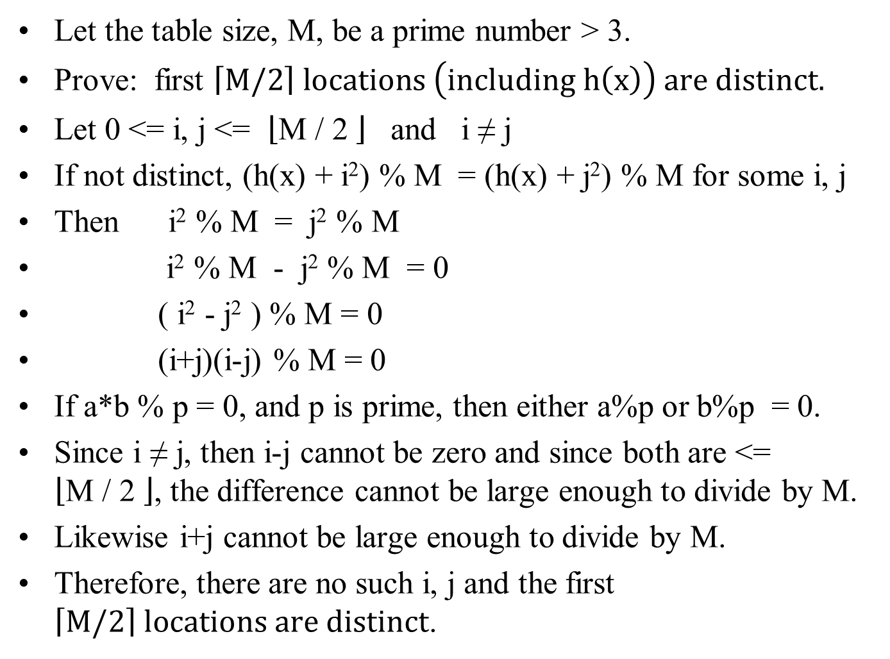
Let the table size, M, be a prime number > 3.
Prove: first $\left\lceil M/2\right\rceil locations \left(including h\left(x\right)\right) are distinct.$
Let 0 <= i, j <= $\left\lfloor \text{M}\text{ / 2 }\right\rfloor$ and i ≠ j
If not distinct, (h(x) + i²) % M = (h(x) + j²) % M for some i, j
Then i² % M = j² % M
i² % M - j² % M = 0
( i² - j² ) % M = 0
(i+j)(i-j) % M = 0
If a*b % p = 0, and p is prime, then either a%p or b%p = 0.
Since i ≠ j, then i-j cannot be zero and since both are <= $\left\lfloor \text{M}\text{ / 2 }\right\rfloor$, the difference cannot be large enough to divide by M.
Likewise i+j cannot be large enough to divide by M.
Therefore, there are no such i, j and the first $\left\lceil M/2\right\rceil locations are distinct$.

Slide 29
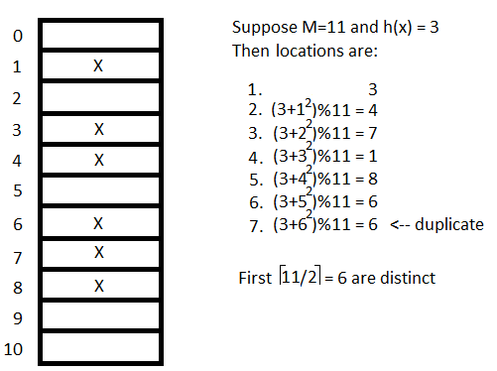

Slide 30
Double Hashing
If a collision occurs, a second hash function is applied to x and then multiplied by i.
Here a popular choice is f(i) = i*hash₂(x).
hash₂(x) could be R – (x mod R) where R is a prime smaller than the table size.
Double hashing can perform hashing well but is more complicated and likely to be slower than quadratic probing.

Slide 31
Rehashing
As a hash table becomes full, insertions will take longer and longer.
A solution is to build another table twice as large and use a new hash function to move everything from the original table to the new table.
Could rehash at some load factor, or perhaps when an insert fails.

Slide 32
Perfect Hashing
Is it possible to get worst-case O(1) access time rather than only average-case?
Consider separate chaining, the more lists there are, the shorter the lists will be.
Suppose N is known and the table is large enough so that the probability of a collision is ½.
The items could be hashed into the table and if a collision occurs, the table could be cleared, another hash function independent of the first chosen and the hashing repeated.
Since the collision probability is ½, this would only take 2 attempts on average.

Slide 33
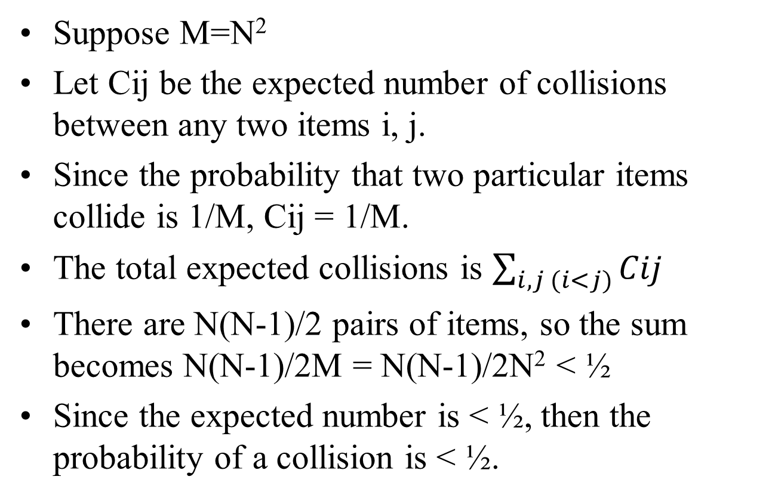
Perfect Hashing
Suppose M=N²
Let Cij be the expected number of collisions between any two items i, j.
Since the probability that two particular items collide is 1/M, Cij = 1/M.
The total expected collisions is $\sum_{i,j (i<j)}{Cij}$
There are N(N-1)/2 pairs of items, so the sum becomes N(N-1)/2M = N(N-1)/2N² < ½
Since the expected number is < ½, then the probability of a collision is < ½.

Slide 34
Perfect Hashing
However, N² is a large table size.
Suppose however that the table size is N, but collisions are resolved in a second hash table dedicated to that particular cell.
Since the collisions are expected to be small, this second hash table can be quadratic in the number of items colliding in the cell.

Slide 35
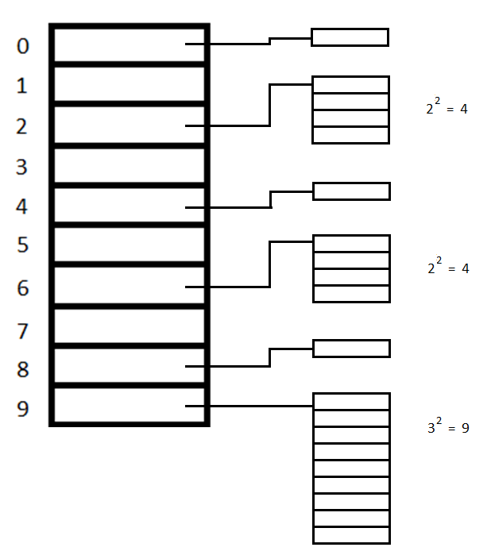

Slide 36
Perfect Hashing
Each secondary table can be constructed several times until it is collision free.
This scheme is known as Perfect Hashing.
With the proper choice of hash functions, the space used by the secondary tables can be made linear, implying O(1) worst case access time in linear space.

Slide 37
Cuckoo Hashing
Cuckoo hashing uses two hash tables.
Each item can be in one or the other, thus resulting in constant worst-case access time.
An item is placed into the first table, and if it is occupied, that item is bumped out and put into the other table.
This can cascade until an empty cell is found.
The likelihood of a cycle can be made very small by keeping the load < 0.5.

Slide 38
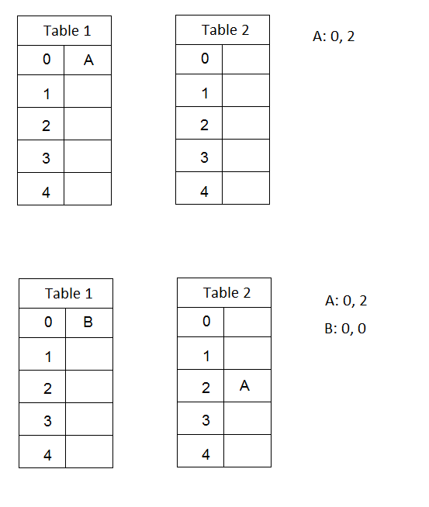

Slide 39
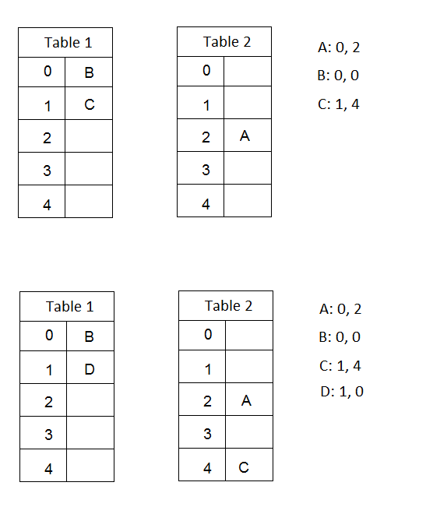

Slide 40
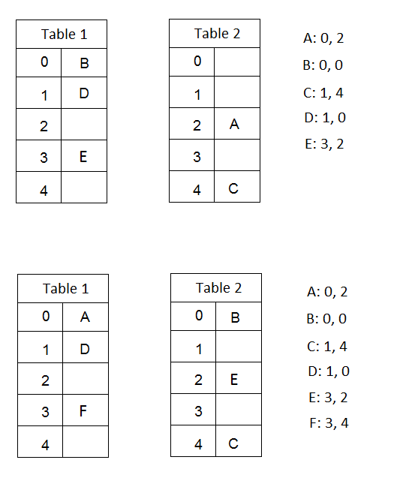

Slide 41
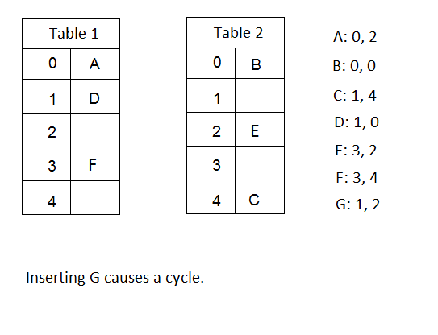

Slide 42
Hopscotch Hashing
An improvement on Linear Probing.
Guarantees an inserted item is no farther than a fixed distance from the hash location.
Frees a spot close to its hash location by sliding other entries down while maintaining their distance from their hash locations.
If unsuccessful, rehash.

Slide 43
Hopscotch Hashing
Since entries are within a constant distance of the hash location, finds can be done in constant worst-case time.

Slide 44
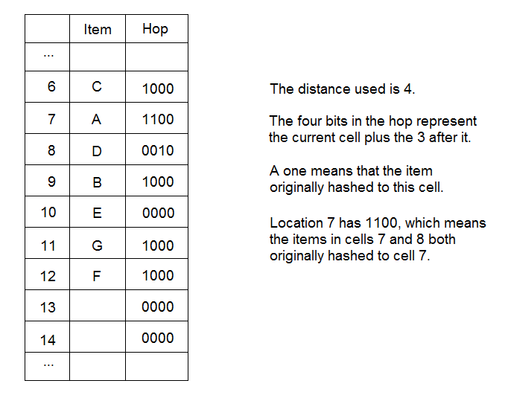

Slide 45
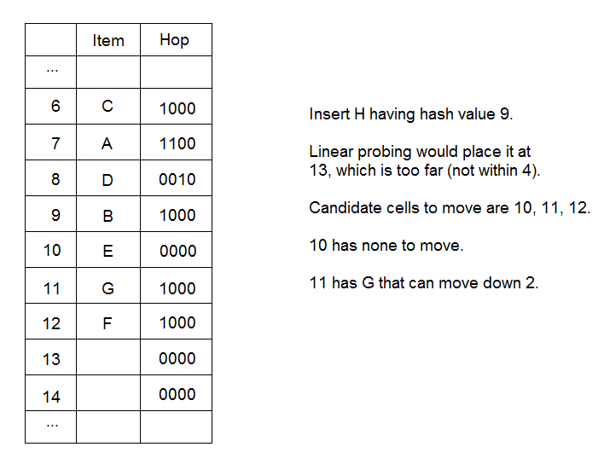

Slide 46
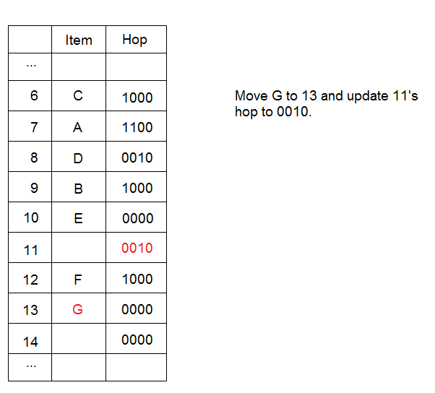

Slide 47
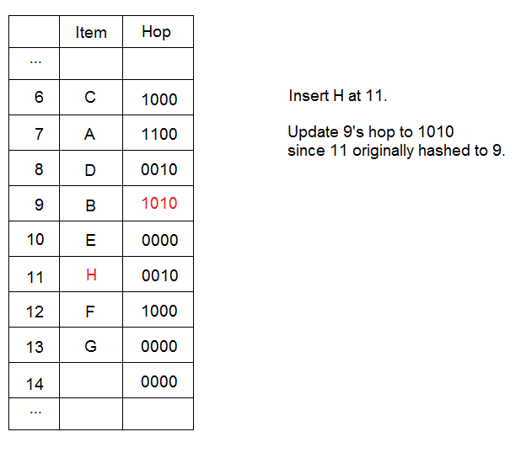

Slide 48
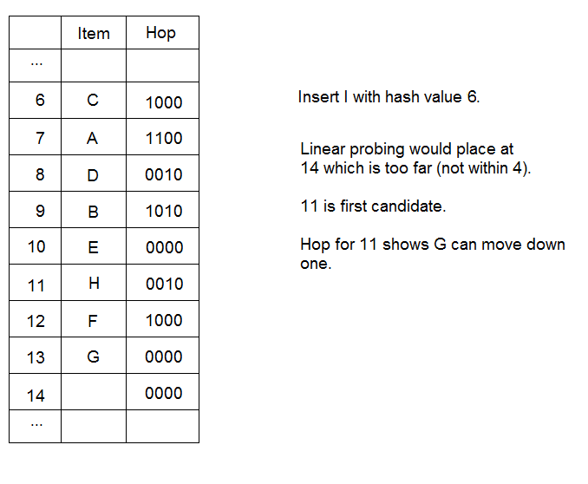

Slide 49
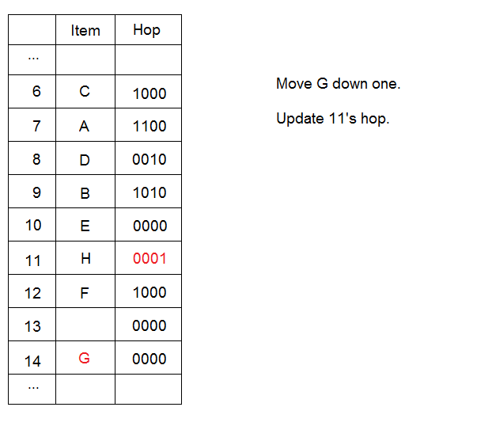

Slide 50
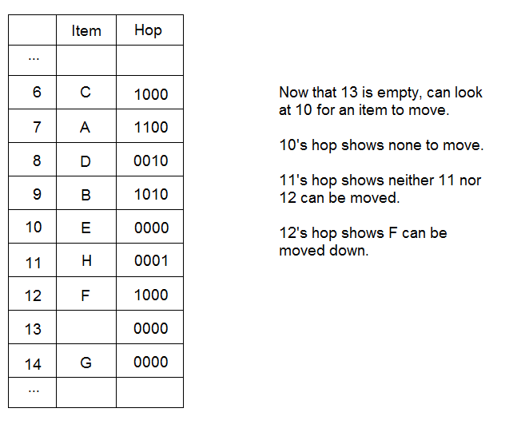

Slide 51
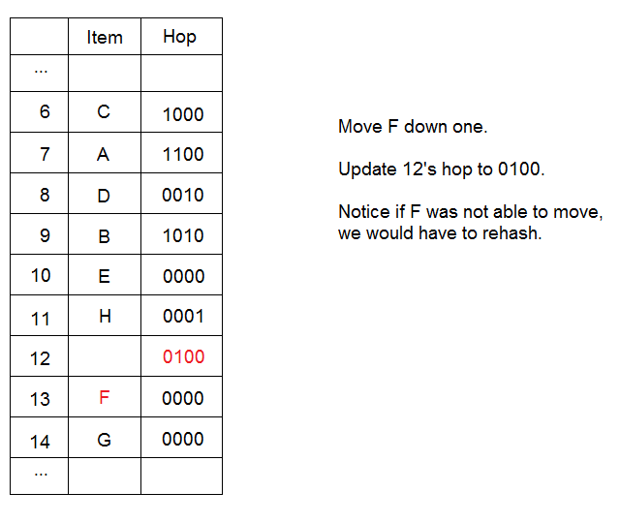

Slide 52
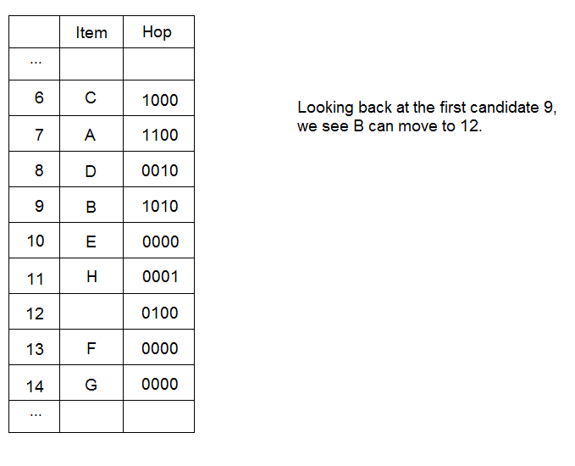

Slide 53
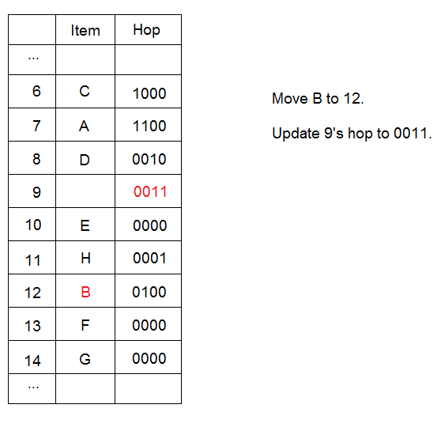

Slide 54
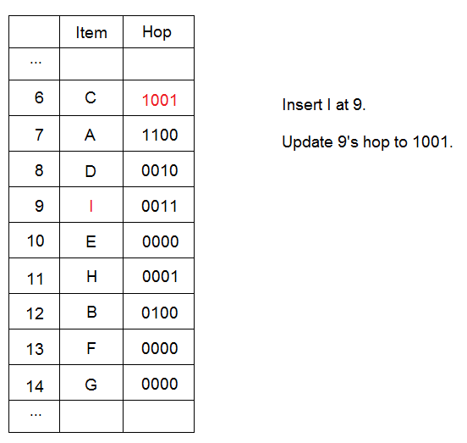

Slide 55
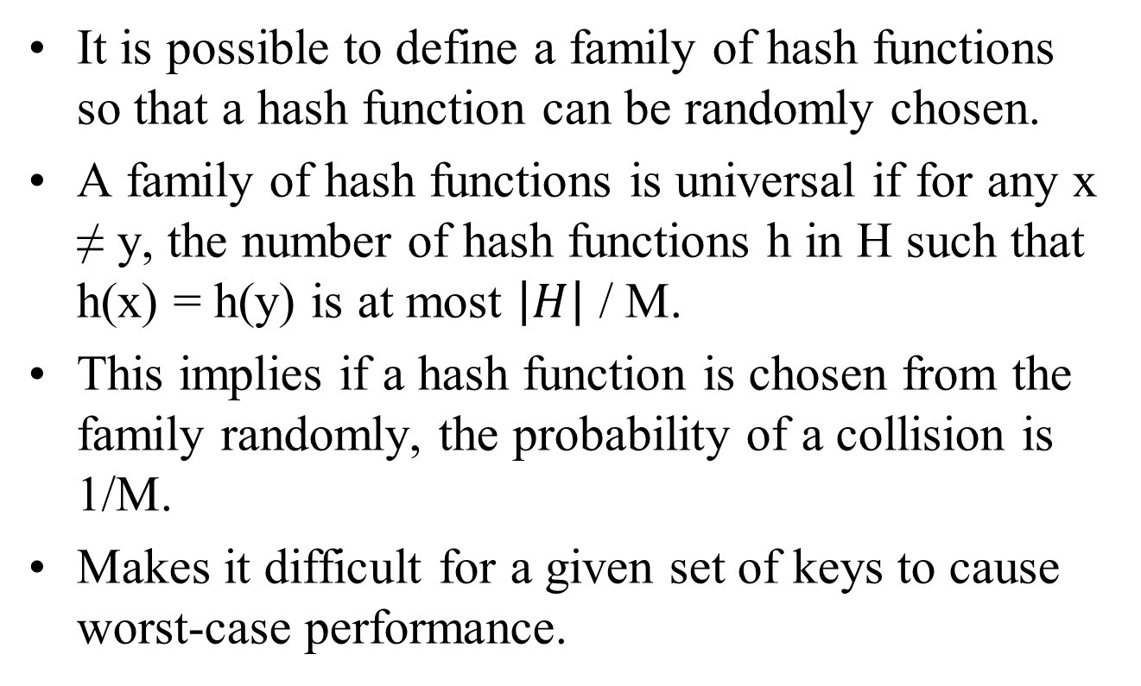
Universal Hashing
It is possible to define a family of hash functions so that a hash function can be randomly chosen.
A family of hash functions is universal if for any x ≠ y, the number of hash functions h in H such that h(x) = h(y) is at most $\left|H\right|$ / M.
This implies if a hash function is chosen from the family randomly, the probability of a collision is 1/M.
Makes it difficult for a given set of keys to cause worst-case performance.

Slide 56
Extendible Hashing
Another way to deal with a growing hash table is extendible hashing.
The idea is similar to a B-tree with a height that is always 1.
The root level is called a directory whose entries point to the leaves.
As the table grows, a leaf in the directory may be split to provide for this growth.
This may be done without affecting the other leaves.

Slide 57
Extendible Hashing
It is demonstrated here using 6-bit integers as data, with leaves holding 4 records (M=4).
D will represent the number of bits used by the directory. Thus it has 2^{D} entries.
d_{L} represents the number of leading bits the entries in a leaf have in common.

Slide 58
00 01 10 11
(2)
000100
001000
001010
001011
(2)
010100
011000
(2)
100000
101000
101100
101110
(2)
111000
111001
Insert 100100, causes directory split and leaf split:
000 001 010 011 100 101 110 111
(2)
000100
001000
001010
001011
(2)
010100
011000
(3)
100000
100100
(3)
101000
101100
101110
(2)
111000
111001

Slide 59
000 001 010 011 100 101 110 111
(2)
000100
001000
001010
001011
(2)
010100
011000
(3)
100000
100100
(3)
101000
101100
101110
(2)
111000
111001
Insert 000000, causes leaf split:
000 001 010 011 100 101 110 111
(3)
000000
000100
(3)
001000
001010
001011
(2)
010100
011000
(3)
100000
100100
(3)
101000
101100
101110
(2)
111000
111001

Slide 60
00 01 10 11
(2)
000100
001000
001010
001011
(2)
010100
011000
(2)
100000
101000
101100
101110
(2)
111000
111001
Insert 111010, 111011, 111100 requires two splits:
0000 0001 0010 0011 0100 0101 0110 0111 1000 1001 1010 1011 1100 1101 1110 1111
(2)
000100
001000
001010
001011
(2)
010100
011000
(2)
100000
101000
101100
101110
(3)
(4)
111000
111001
111010
111011
(4)
111100

Slide 61
Java Hash Tables
Hash implementations of Set and Map are the classes HashSet and HashMap.
These require the “equals” and “hashCode” methods to be defined on the hashed objects.

Slide 62
Applications of Hashing
Hash tables are often used where quick access is needed.
Compilers use hash tables to manage the symbol table.
Online spell-checkers may use a hash table to check for words in a dictionary.

Slide 63
Author’s Code
SeparateChainingHashTable.java
Implementation for separate chaining
QuadraticProbingHashTable.java
Implementation for quadratic probing hash table

Slide 64
End of Slides

