Slide 1
Coder’s House Real Time Podcast Application
By-
Praveen Kumar Chandra
CSE - A
Roll No. – 13075
University Roll No. - 1823010060

Slide 2
Introduction
This is a Real Time web based application for Podcast developed for community of Software developers, where users can listen or share their opinions on particular topic such as AI is Future, What’s new in Machine Learning etc.
Podcast basically means Listening to an audio content, it can be related to education, sports, Technology etc.
Podcast Application for developers, here they can listen about various established or new upcoming technology to excel their knowledge.
This is also beneficial for students as for them they can directly listen to senior developers their career guidance, roadmaps and resolve their doubts.

Slide 3
Why
2020 And 2021 is tough for us as People have spent most of their time in their house. People had to adapt new way living to keep moving forward like work from home, online interview and many more people start spending their time on smart phones scrolling on social media, between all these a new trend of listening podcast takes place more people start listening to podcast to excel their knowledge. This is why I choose to develop a real time web based podcast application for coders or software engineers as my major project.

Slide 4
Features
1.Registration/Login
o Registration is done using either phone number or email address.
o User can login using OTP.
o OTP will be sent on phone number or email address.
o User can logout using logout button.
2. User Profile
o User can create their profile by adding Username and Profile Picture
o User have user profile page, any authenticated user can visit this page and follow that user.
o Users have follower and following count on the profile page.

Slide 5
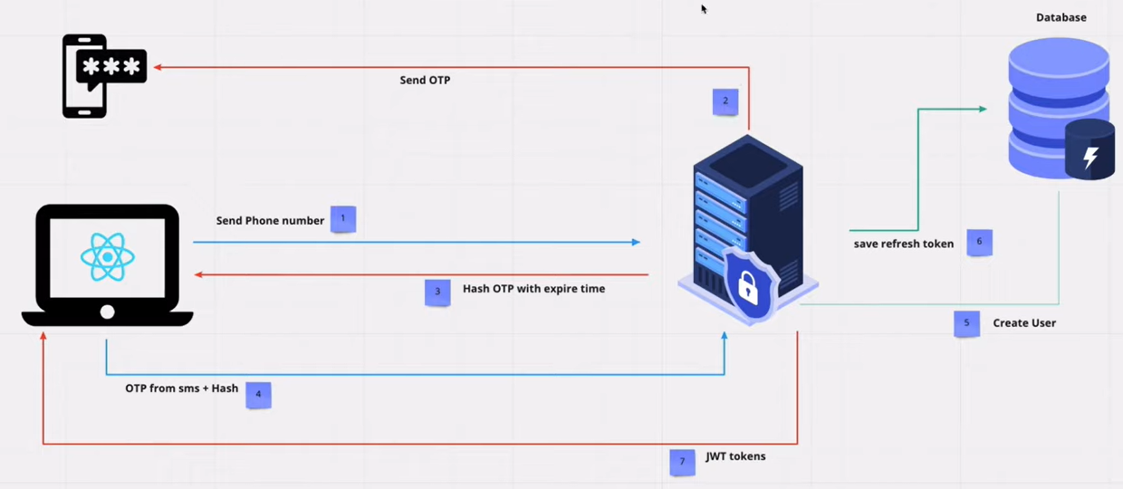
Authentication Work Flow

Slide 6
3. RoomS
o Authenticated User can see list of available public rooms
o User can filter rooms using search box
o User can join existing room or create a new room
o Creator of the room can add other users as speakers
o Rooms Are of Two types :
Public Room
Any Authenticated user can see this and can join that room.
Private Room
This is the closed room and can be joined only through the link.

Slide 7
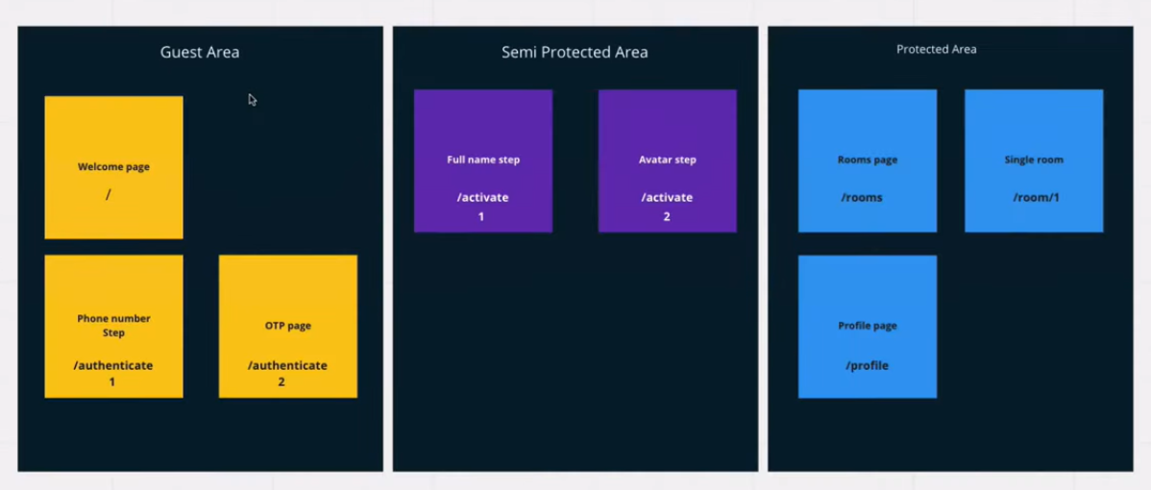
Routes

Slide 8
4. ROom
o Room will have 2 types of users
Speakers :
People who give podcast (they can mute/unmute themselves)
Listeners :
People who listen podcast (their mic is muted by default)
o Any User can leave the room
o Speaker can choose their mic from available devices.
o Creator of the room can delete the room.

Slide 9
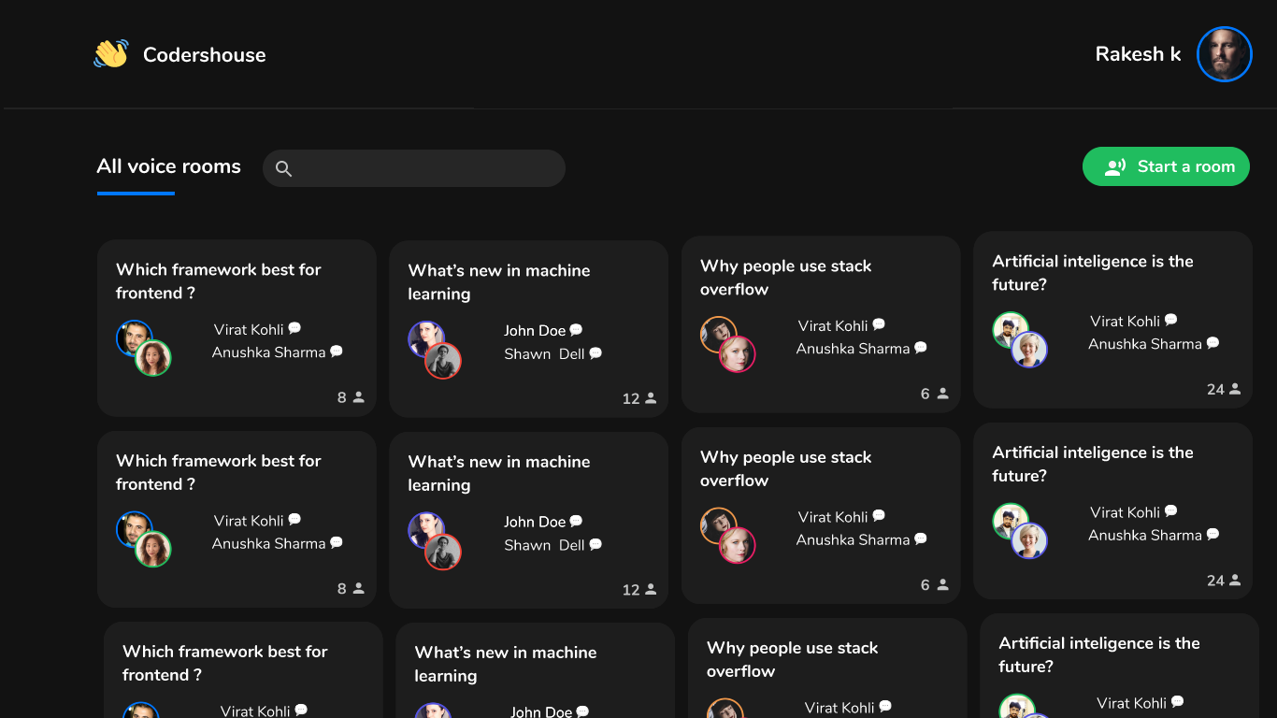
UI SKELETON

Slide 10
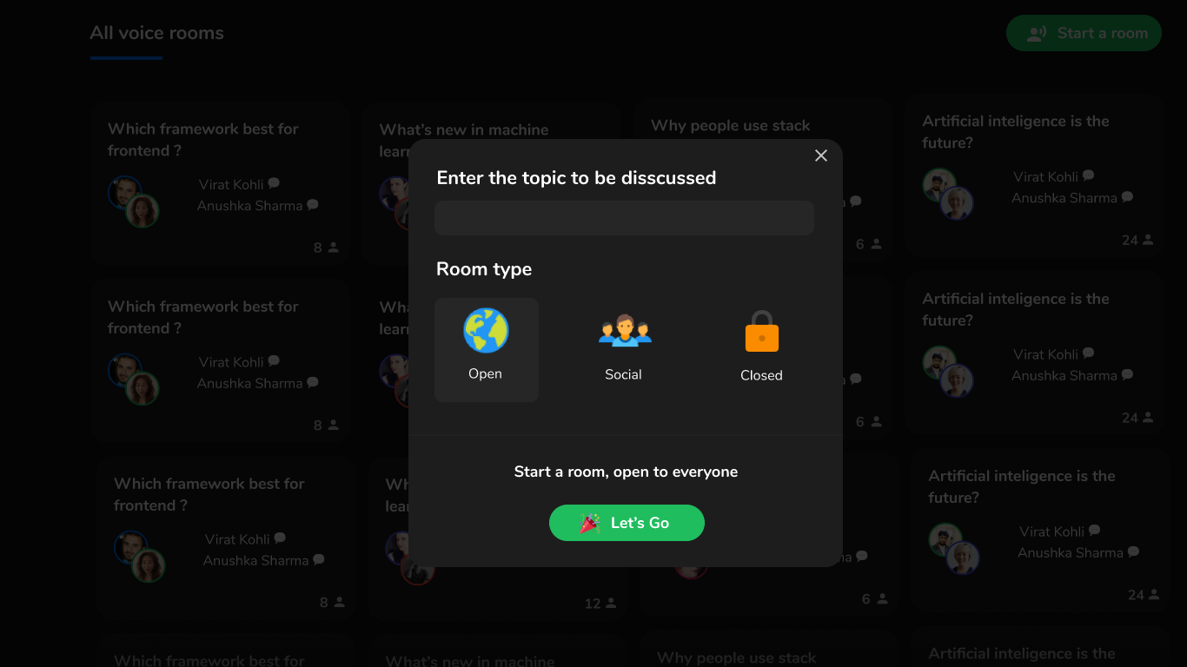

Slide 11
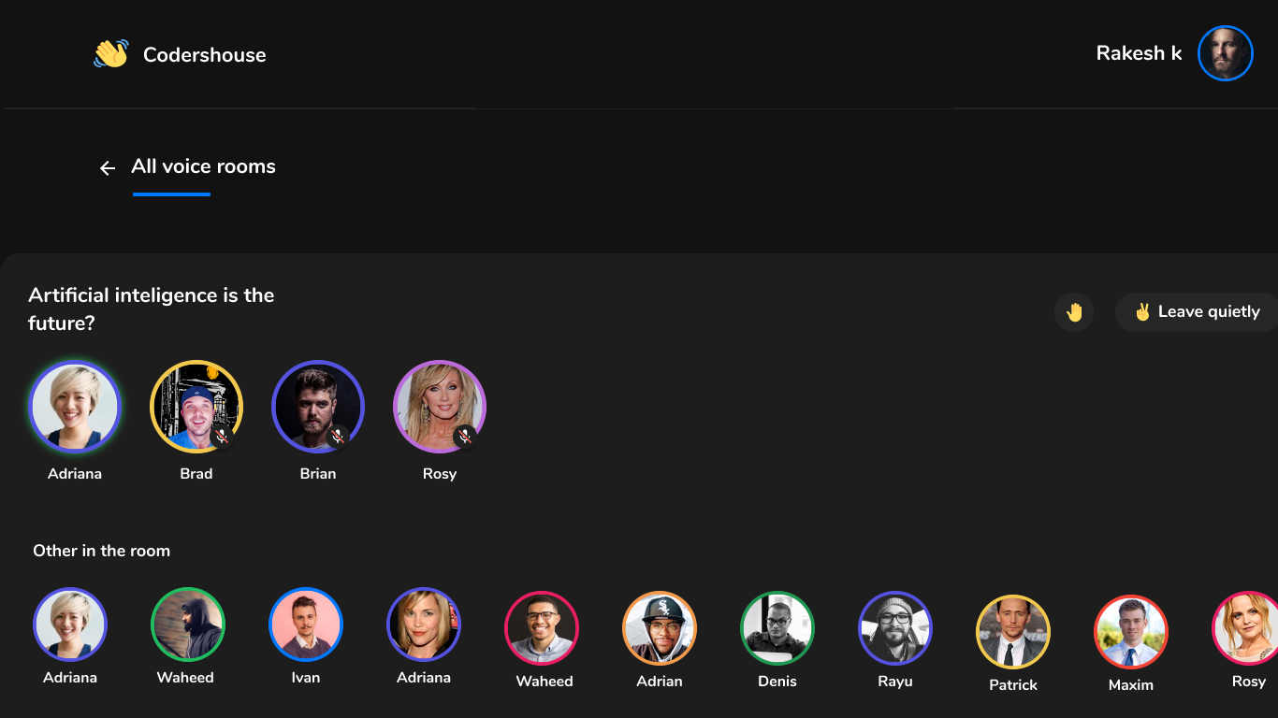

Slide 12
TECHNOLOGY USED
1.Frontend :
HTML
CSS
ReactJS : used for developing various components
React Router : used for navigation through different components and for protected routes
Redux : used for state management
Axios : used for state management

Slide 13
2. Backend :
Nodejs
Expressjs
Json Web tokens (Jwt) for Authentication
Real Time Communication
Web Sockets (socket io) :
Used for signaling establishing real time connection.
WebRTC :
Used for establishing Peer to peer connection so that different browsers can transfer voice stream in real time.

Slide 14
3. Database
MongoDB : NoSql Database, Stores data in JSON format.
4. Git/Github : used for version controlling.
5. Docker : used for containerizing the application so that it may run on different hardware.

Slide 15
Business Model and Scalability
For Newly Entered Student of tier-3 colleges, We can arrange Sessions with the employees of Good Tech Companies, So that they can guide the beginner level student for their career, and Resolve their doubts.
Secondly, we can take commission from colleges and pay the speakers after taking our share out.

Slide 16
FUTURE UPGRADATION
Text Messaging
Video Session
Screen Sharing
Store Session Recording
Download Audio session

Slide 17
ThankYOu

