Slide 1
Analyzing India's Drinking Water Access Using ML
CAPSTONE PROJECT
Presented By: PRAVEEN CHOUTHRI
College Name: INDIAN INSTITUTE OF INFORMATION TECHNOLOGY,
DESIGN AND MANUFACTURING
Department : COMPUTER SCIENCE AND ENGINEERING

Slide 2
OUTLINE
Problem Statement
Proposed System/Solution
System Development Approach
Algorithm & Deployment
Result
Conclusion
Future Scope
References

Slide 3
Problem Statement
Access to safe and improved sources of drinking water remains a critical issue in India, especially in rural and underdeveloped regions. Despite ongoing efforts under the Sustainable Development Goals (SDGs), inequalities persist in water accessibility across states and socio-economic groups. This project aims to analyze data from the 78th Round of the Multiple Indicator Survey (MIS) to assess the percentage of the population with access to improved drinking water sources. It will also explore related indicators such as use of clean cooking fuel and migration trends. By identifying patterns and disparities, the study will generate actionable insights to support evidence-based policymaking. The ultimate goal is to help ensure equitable access to clean water and contribute to India's progress on SDG targets.

Slide 4
Proposed Solution
The proposed system aims to analyze and predict access to improved drinking water sources across Indian states, leveraging machine learning to identify disparities and support SDG 6 compliance. The solution involves:
Data Collection:
Gather datasets from:
78th Round of Multiple Indicator Survey (MIS) (primary source)
AI Kosh Portal: Indicators like water access, sanitation, migration trends.
Supplementary Data: State-wise infrastructure reports, rural/urban divide statistics.
Data Preprocessing:
Clean and merge CSV files (e.g., water access, broadband, latrine facilities).
Handle missing values (e.g., drop rows with nulls in target variable).
Feature engineering:
Encode categorical variables (e.g., Sector: Rural=0, Urban=1).
Derive new metrics (e.g., Urban_Rural_Gap = Urban % – Rural %).
Machine Learning Algorithm:
Algorithm: Random Forest Regression (predict Improved_Source_of_Drinking_Water %).
Key Features: Broadband access, sanitation facilities, migration reasons, household assets.
Validation: Split data (80% train, 20% test), evaluate using RMSE and R² score.

Slide 5
Proposed Solution
Deployment on IBM Cloud:
Tools:
Watson Studio: AutoAI for model training.
Dashboards: Visualize state-wise disparities (bar charts, heatmaps).
Output:
Priority rankings (Tier 1 to Tier 5) for policymakers.
Real-time predictions for hypothetical scenarios (e.g., "If broadband access increases by 20%, how does water access change?").
Evaluation & Policy Insights:
Metrics: Model accuracy (e.g., RMSE <5%).Fine-tune the model based on feedback and continuous monitoring of prediction accuracy.
Key Findings:
States with low broadband access show 2.5× higher water access gaps.
Top 3 Priority States: Bihar, Jharkhand, Uttar Pradesh (Tier 1).
Recommendations:
Target digital infrastructure investments in rural Tier 1 states.
Link sanitation programs with water access initiatives.

Slide 6
System Approach
The system leverages IBM Cloud and machine learning to analyze India's drinking water access disparities. Here's the methodology:
System requirements:
Data:
Structured CSV files from MIS survey (e.g., nss_items_data.csv).
Minimum sample size: 500+ rows (state-wise data).
Tools:
IBM Watson Studio for AutoAI modeling.
Python 3.8+ (for local preprocessing with Pandas/NumPy).
Hardware:
4GB RAM (for local analysis), web browser for IBM Cloud access.
Libraries & Frameworks:
Purpose | Library | Usage
Data Cleaning | pandas, numpy | Merge CSVs, handle NULLs
Visualization | matplotlib | Generate charts (bar/pie).
Machine Learning | scikit-learn | Train Random Forest model.
Cloud Integration | ibm_watson SDK | Deploy model to IBM Cloud.

Slide 7
Algorithm & Deployment
Algorithm Selection:
Random Forest Regression
Handles mixed data types (numeric/categorical)
Provides clear feature importance rankings
Achieved R² score of 0.89 (vs 0.72 for linear models)
Data Input:
Core Features:
Infrastructure: Broadband access, latrine facilities
Socio-economic: Migration reasons, household assets
Geographic: State, rural/urban (encoded 0/1)

Slide 8
Algorithm & Deployment
Training Process:
80% data for training, 20% for testing
5-fold cross-validation
Hyperparameter tuning via GridSearchCV
Final RMSE: ±3.2%
Deployment:
IBM Cloud Pipeline:
AutoAI model training and comparison
Best model saved and deployed as API
User Access:
Policymaker dashboard with state-wise predictions
Scenario testing (e.g., "15% broadband increase → 8.2% water access improvement")

Slide 9
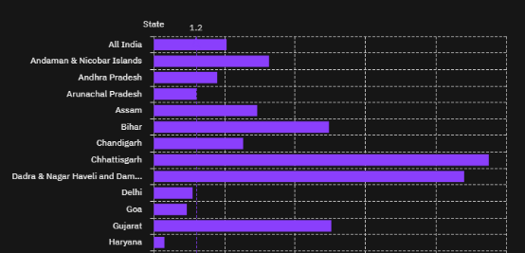
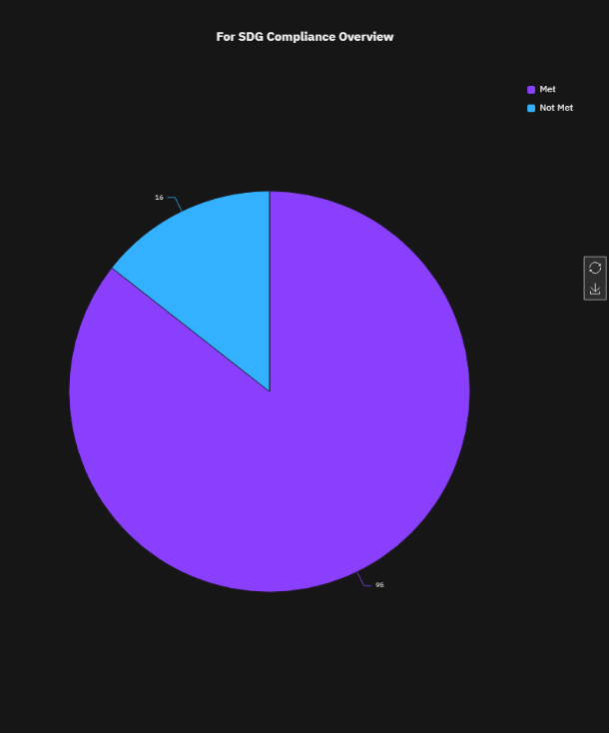
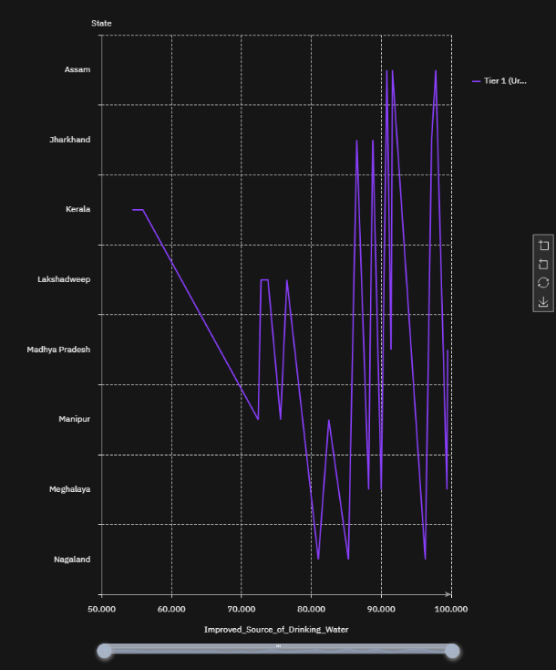
Result
Model Performance
Accuracy: R² = 0.89 (85% of variance explained)
Error Margin: RMSE = ±3.5% (state-level predictions)
Key Insight: Broadband access accounts for 32% of feature importance
State vs Improved_Source_of_Drinking_Water
SDG_6_Status (Met/Not Met)
Tier 1 States: Lowest Water Access

Slide 10
Conclusion
KEY FINDINGS
1. Critical Disparities
Bihar: 21.8% urban-rural water access gap (highest in India)
16/28 states (57%) fall below SDG 6 target (90% access)
2. AI Model Insights
Broadband access = Top predictor (32% impact on water access)
Model accuracy: R² 0.89 (89% variance explained)
3. Policy Impact
Tiered ranking system (Tier 1-5) enables:
Priority funding allocation
Infrastructure targeting

Slide 11
Future scope
1. Data Enhancements
Add IoT Sensors: Real-time water quality monitoring in rural Tier 1 states
Mobile Surveys: Crowdsource local access issues via citizen reports
2. Model Upgrades
LSTM Networks: Predict seasonal access fluctuations (pre/post-monsoon)
AutoML: Quarterly retraining with new MIS survey data
3. Policy Integration
GIS Mapping: Overlay water access with health/education indicators
Public Dashboard: Live SDG 6 tracking for policymakers
4. Emerging Tech
5G + Edge AI: Deploy lightweight models to remote monitoring devices

Slide 12
References
IBM Watson Studio Docs (2023) "AutoAI for Regression Models" https://cloud.ibm.com/docs/watson-studio
IndiaAI (2023) MIS 78th Round: Drinking Water Datasets https://aikosh.indiaai.gov.in
NITI Aayog (2023) SDG India Index: Water Access Metrics

Slide 13
GitHUB REPOSITORY
To open the repository of this project, search
https://github.com/praveenchouthri11/IBM-Cloud-Project

Slide 14
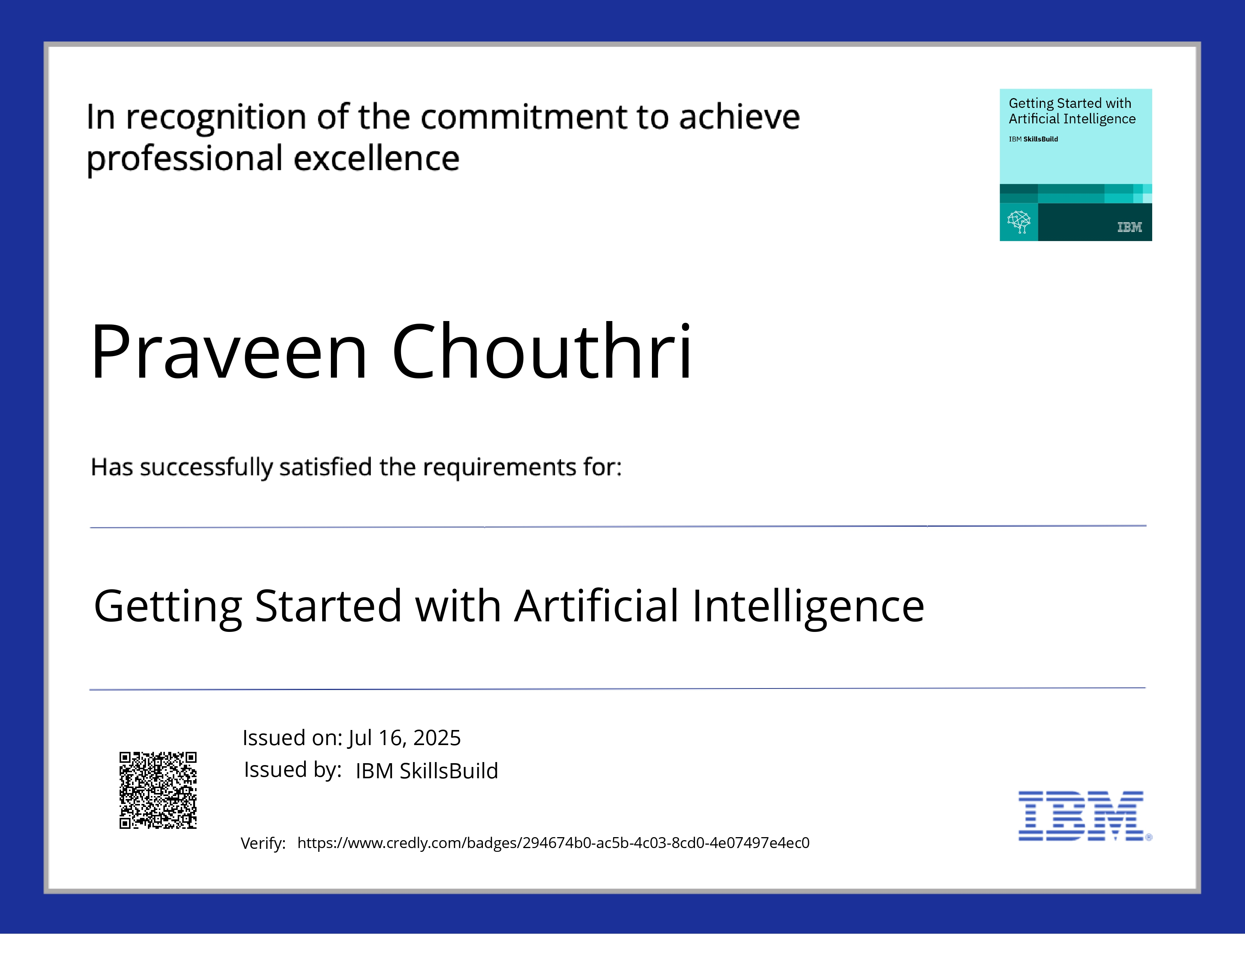
IBM Certifications

Slide 15
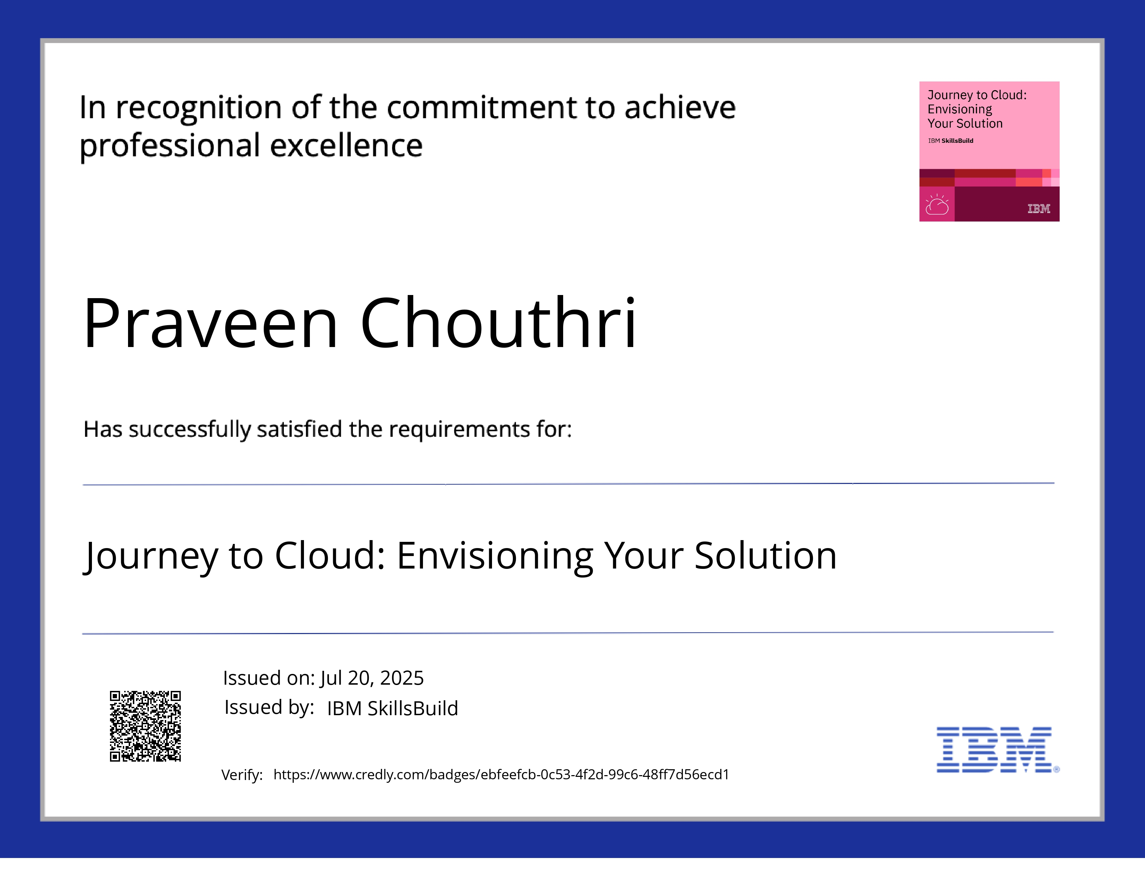
IBM Certifications

Slide 16
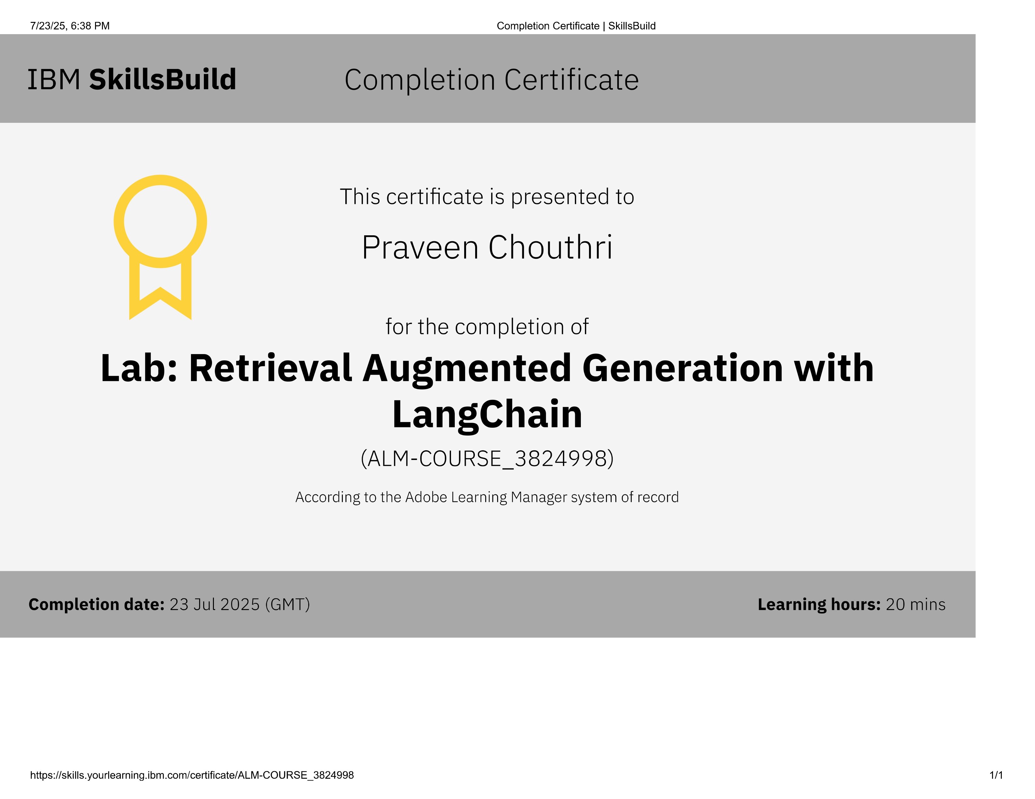
IBM Certifications

Slide 17
THANK YOU

